Slide 1
Documentation Slides
MUSC + BF Navitoclax Study

Slide 2
Data Summary
Tumor Origin
Genetic Features
Type | COSMIC | CTD
Blood | 58 | 143
Lung | 87 | 127
Breast | 34 | 36
CNS | 27 | 42
Skin | 30 | 50
Other | 174 | 359
Total | 410 | 757
Type | COSMIC | CTD
Gene Expression | 16,062 | 16,062
CNV | 20,416 | 20,416
SNP (>=3 cases) | 311 | 857
Total | 36,789 | 37,335
Navitoclax Sensitivity
Response | COSMIC | CTD
Sensitive | 78 (19%) | 117 (15.5%)
Not Sensitive | 332 (81%) | 640 (84.5%)
Total | 410 | 757

Slide 3
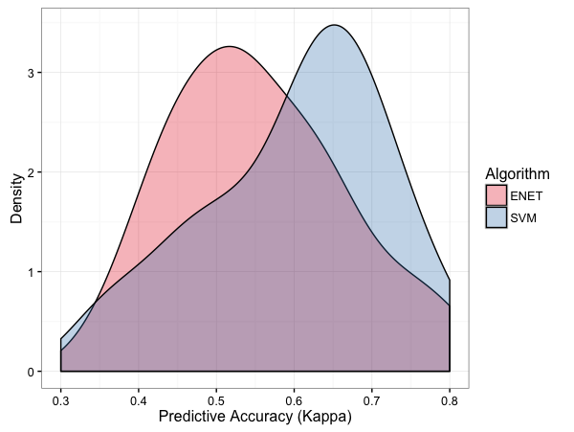
Training Process
Raw Data
Level 1 Resampling
(3x 10-fold CV)
Level 1 Resampling
(3x 10-fold CV)
…
Feature Selection + Preprocessing (Fold 1)
Feature Selection / Preprocessing (Fold 30)
Level 2 Resampling
(5-fold CV)
Level 2 Resampling
(5-fold CV)
Error Distribution Built for
Models Across Resamples
…
Parameter
Optimization (Fold 1)
Parameter
Optimization (Fold 5)
Parameter Selection + Retraining
Prediction Error Estimation

Slide 4
ML Models Applied
Elastic Net Regression (with and without sample weighting)
SVM (Radial Kernel)
kNN
Random Forest
GBM
Partial Least Squares
Multivariate Adaptive Regression Splines (MARS)
eXtreme Gradient Boosting
Shrinkage Discriminant Analysis (LDA with James-Stein type shrinkage) (R package)
Shrunken Centroids Regularized Discriminant Analysis (R package)
Predictive Analysis for Microarrays
Ensemble Models
Averaging Model – includes RF, SVM, Elastic Net,
GLM Model – Stacked ensemble of same as above, with GLM as stacking learner

Slide 5
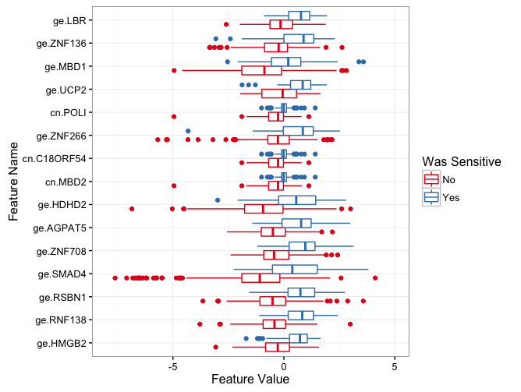
Top Features
Frequency of Feature
Selections (in resampling)
Feature Values by Navitoclax Sensitivity
Feature | Frequency
ge.HMGB2 | 30
ge.RNF138 | 30
ge.RSBN1 | 30
ge.SMAD4 | 30
ge.ZNF708 | 30
ge.AGPAT5 | 28
ge.HDHD2 | 28
cn.MBD2 | 27
cn.C18ORF54 | 26
ge.ZNF266 | 26
cn.POLI | 25
ge.UCP2 | 22
ge.MBD1 | 21
ge.ZNF136 | 21
ge.LBR | 18
cn.WDR7 | 14
ge.ABHD18 | 13
ge.CXXC1 | 12
ge.ZNF292 | 12
ge.ME2 | 11
ge.CXCR4 | 10

Slide 6
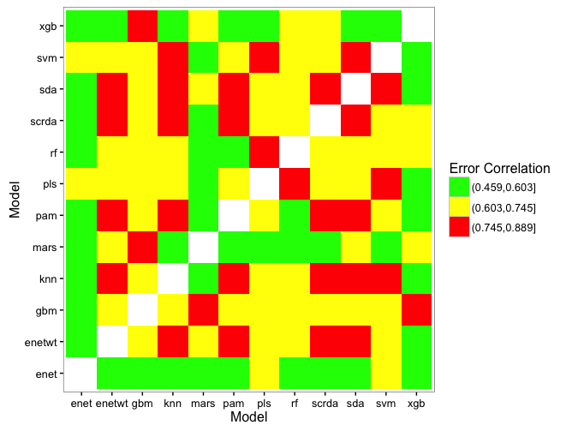
Ensemble Selection
Kappa Correlation Between Models
(across 30 folds)
SVM, SCRDA, and RF chosen due to relatively high performance and mid-range correlation in accuracy

Slide 7
Accuracy vs # Features (COSMIC)

Slide 8
Accuracy vs # Features (CTD)

