Slide 1

How Open Source Software Empowers Skiers
to Make Better Decisions on Where and When to Ski
April 19, 2013
Eric Fahsl
@WhereShouldISki @ericfahsl
http://ericfahsl.com

Slide 2
Agenda
Introduction / Objective
WhereShouldISki by the numbers
Technology Selection
Algorithms
Live Demo
Summary Statistics
Future Steps
Questions

Slide 3
Introduction / Objective
Problem statement How can I use multiple weather data sources to help decide when and where to go ski?
Algorithm Creation Desired more than just “inches of new snow”
Multiple Ratings What if there is no new snow, will it be a nice day out? How is the snow quality?
Faceted Search Framework Tell me what it’s like in the areas near me for all days in one view

Slide 4
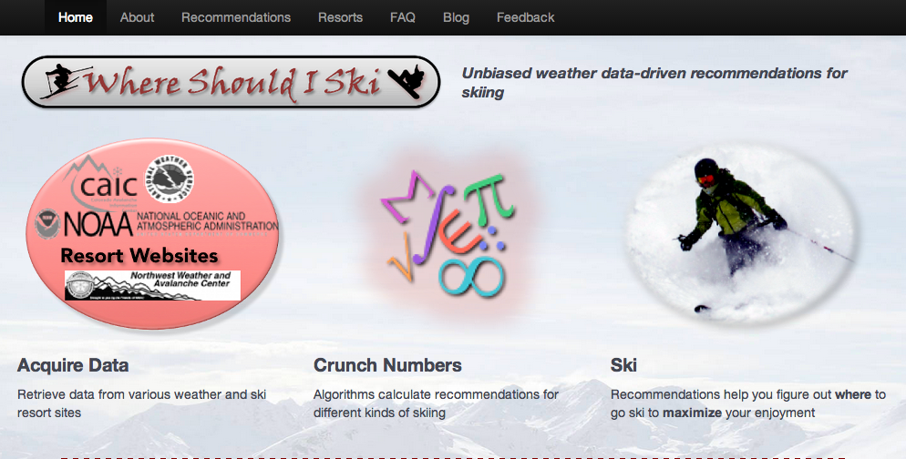
Demo
http://whereshouldiski.com

Slide 5
By the Numbers

Slide 6











Technology Selection
Presentation
Calculated Data (Ratings)
Data Collection
Infrastructure

Slide 7

Architecture – Current State
End Users
400 users per hour PEAK
10 http requests per user
=1.11 req / second
Source Data
m1.medium
Data Collector (Python Scripts, Cron)
Data Parser (Python Scripts, Cron)
Site
(Joomla – LAMP, jQuery)
Source Data
Site DB (MySQL)
Source Data
Elastic
Search
50*4 sources, 15 queries / day
1.5kb / query
=4500KB / day
=~800MB / half year
Raw Data Store (MySQL)
Computed Data (CouchDB)
50 new documents per day, 1.5kb per document
=75KB / day
=13MB / half year

Slide 8
Technology Selection
Infrastructure
Amazon Elastic Cloud Compute (EC2) Versatility and ease of new server creation. Pay for what you use.
Ubuntu Solid, reliable OS, numerous built-in tools, existing AMIs for easy use with EC2, built-in LAMP installer

Slide 9
Technology Selection
Data Collection
Python Excellent support for web service calls, numerous examples and documentation available – read from anywhere and write to anywhere
MySQL Reliable, ease-of-use, supports “everything”, built-in support with Ubuntu OS
Cron Scheduling queries to weather sources and execute logic for ratings, built-in support with Ubuntu

Slide 10
Technology Selection
Calculated Data (Ratings)
CouchDB Stores ratings per resort per day. Easy RESTful interface to add/update/delete JSON documents. Futon UI utility for QA and data inspection.
Elastic Search Scalable search framework with support for CouchDB. FAST! Facets provide searchability on categorical, numerical, and geographical data elements. JSON support for easy parsing and web support.

Slide 11
Technology Selection
Presentation
PHP For dynamic generation of content. Builds ElasticSearch queries for searches, parses, and generates HTML for resort recommendations
jQuery AJAX calls and search faceting
Joomla Page template and format creation, easy updates to static content
Bootstrap Included with Joomla template, for responsive layout and mobile support

Slide 12
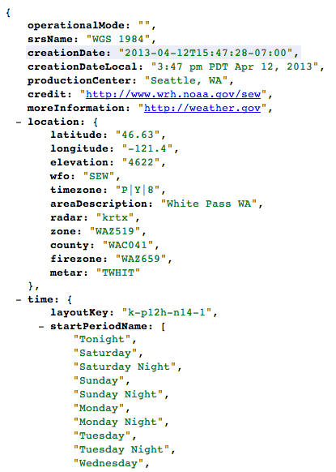
Data Collection
National Weather Service
Sample URL (JSON):
http://forecast.weather.gov/MapClick.php?unit=0&lg=english&FcstType=json&lat=46.638&lon=-121.390
Provides:
7 days of forecasts
Two forecasts per day (day/night)
Text summary
Estimated inches / Pct of precipitation
High/Low temps

Slide 13
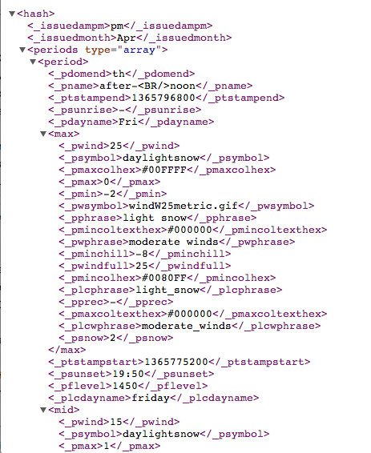
Data Collection – Snow-Forecast.com
Snow-Forecast.com
Sample URL (XML):
http://www.snow-forecast.com/resorts/White-Pass/feed.xml
Provides:
Six days of forecasts
Three forecasts per day (AM/PM/Night)
Text summary
Estimated inches / Pct of precipitation
High/Low temps
Freezing Level

Slide 14
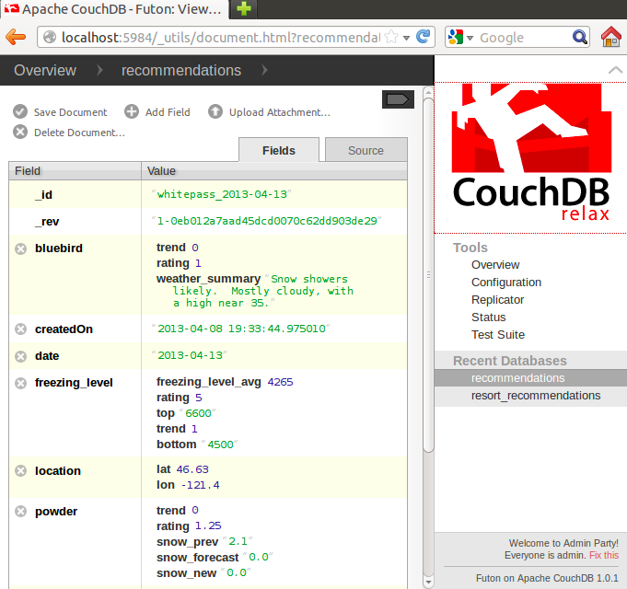
Data Collection - Storage
Rating Document Creation
For each resort and for each date:
Read weather data from MySQL DB for relevant resort and date
Create recommendation document
Calculate each rating (bluebird, powder, freezing level) and store in document
Add/Update the document to CouchDB: curl -X PUT " + COUCH_DB_URL + "/" + docId + " -H 'Content-Type: application/json' -d " + "'" + json.dumps(reccomendationDocument) + "'"

Slide 15
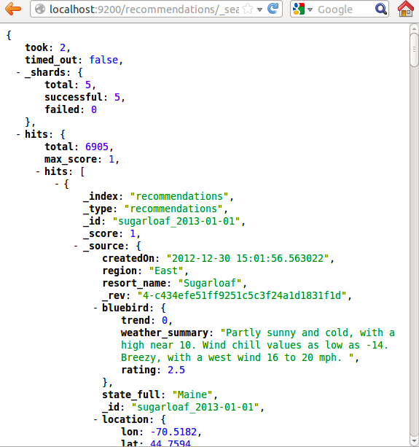
Data Collection - Search
Elastic Search Queries
For each resort and for each date:
Read weather data from MySQL DB for relevant resort and date
Create recommendation document
Calculate each rating (bluebird, powder, freezing level) and store in document
Add/Update the document to CouchDB: curl -X PUT " + COUCH_DB_URL + "/" + docId + " -H 'Content-Type: application/json' -d " + "'" + json.dumps(reccomendationDocument) + "'"

Slide 16
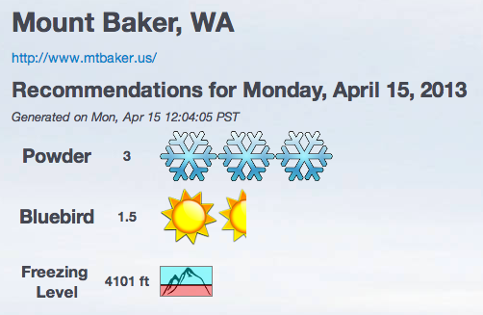
Algorithms
Output Score of 1 - 5 Common to most rating system. Easy to understand and grasp
Linear Models Simple doesn’t mean bad
Multiple Ratings Provide the full story on the mountain
Powder
Bluebird
Freezing Level

Slide 17

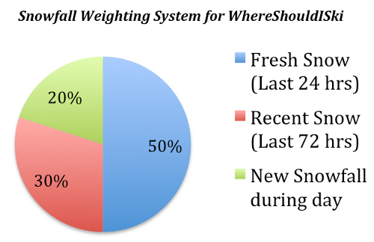


Algorithms
Powder
The important one!
Convert projected inches of snow to rating 1-5 on linear scale (eg 6.25” snow = 3.5)
Consider three factors each scored independently:
Fresh snow from the past 24 hrs
Recent snow from the past 72 hrs
New snow projected during the day
Experiment, adjust, and field test (ski) these models to create weighting
Snow (in) | Rating
0-2 | 1
2-5 | 2
5 - 7.5 | 3
7.5 - 10 | 4
10+ | 5

Slide 18
Algorithms
Bluebird
“How nice of a day will it be” or “Should I bring the camera?”
Keywords on weather summary data points to determine rating
Freezing Level
“Is it going to rain?”
Helps determine snow quality
Rating scale:
5: Freezing level below mountain bottom
1: Freezing level above mountain peak
1.25 – 4.75: Percentage of mountain (linearly) above the freezing level
Weather Summary (examples) | Rating
"Sunny", "Clear" | 5
"Mostly Sunny","Mostly Clear", "some clouds" | 4
"Partly Cloudy","Partly Sunny" | 3
"Mostly Cloudy", "Increasing Clouds", "light snow" | 2
(everything else) | 1

Slide 19
Summary Statistics
So after (nearly) a full season of weather forecasts, what do we know?

Slide 20
Future Steps
So after (nearly) a full season of weather forecasts, what do we know?

Slide 21
Questions?

