Slide 1
A trusted data platform for Singapore’s EV charging network
MODULE 2 · EXECUTIVE PRESENTATION
From the LTA DataMall API to a tested BigQuery warehouse and clear insights
Team 4 · 15 Oct 2026
Notes:
(about 20 seconds) Good morning everyone. We are [team names]. Over the next ten minutes we will show how we turned a live feed of Singapore's EV charging points into a tested, trustworthy data platform in BigQuery, and what that data already tells us. I will start with why this matters, then how we built it, how we know the data is correct, and what we found. Timing guide: introduction 1.5 minutes, summary and value 1.5, architecture and schema 2, quality 1, insights 3, scale, risks and close 1.5.

Slide 2
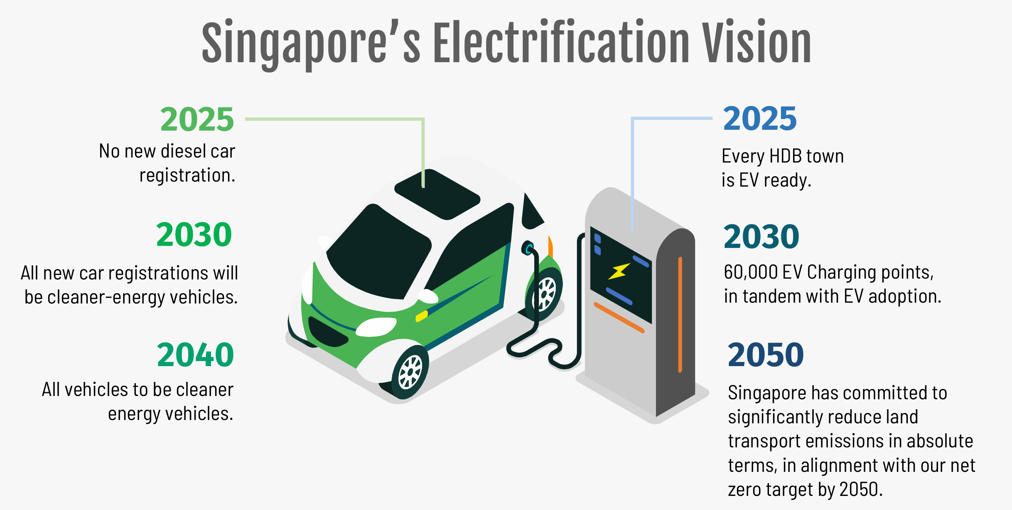
2
Notes:
(about 30 seconds) Singapore has set clear national targets. No new diesel cars from 2025, every HDB town EV ready by 2025, all new car registrations cleaner-energy by 2030, and 60,000 charging points by 2030, all in line with net zero land transport emissions by 2050. The point to land is that this is a build-out on a deadline, and a build-out needs data to plan where charging points go and to check that they work. Our project is the data side of that.

Slide 3
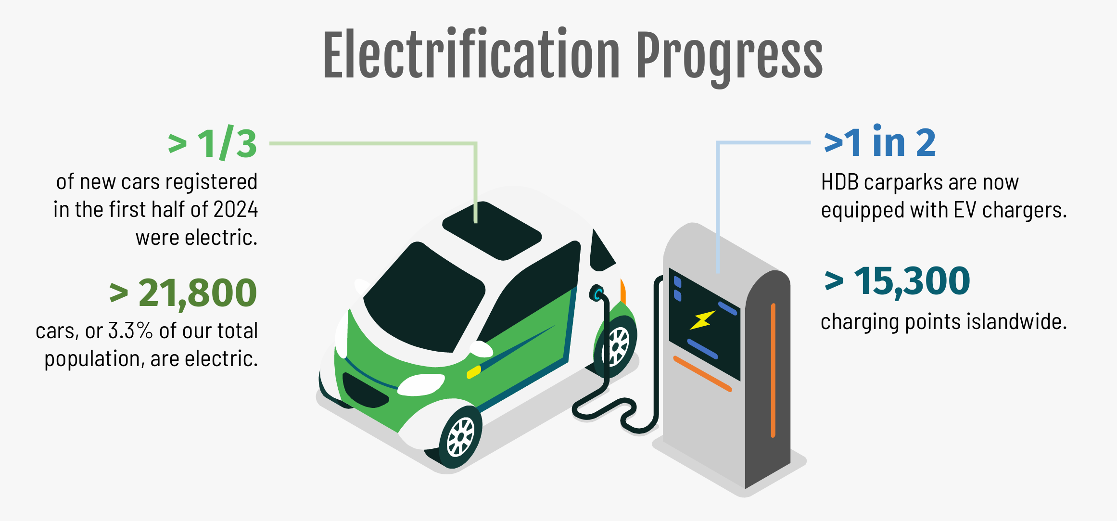
3
Notes:
(about 30 seconds) Here is where things stood in 2024. More than a third of new cars registered in the first half of that year were electric, over 21,800 electric cars are on the road, more than half of HDB carparks have EV charging points, and over 15,300 charging points exist islandwide. Demand is rising quickly. These are national figures from 2024, so they will differ from our snapshot, which is dated 13 October 2026 and counts what the LTA API currently publishes. So the question becomes: who has a trusted, up-to-date view of the charging network? That is the gap we fill.

Slide 4
From a live snapshot to a source people can trust
EXECUTIVE SUMMARY
Problem
Solution
Why it matters
The DataMall EV API returns the current state of every charging point. Without history and checks, nobody can see how the network grows or trust the numbers.
A daily pipeline loads each snapshot into BigQuery, models it as a star schema with dbt, and tests it with 58 automated checks.
One trusted source for coverage, charging speed, price and availability across 11,684 charging points and 29 operators.
EV charging data platform
4
Notes:
(about 45 seconds) In one line: we turned a live snapshot into a source people can trust. The problem is that the DataMall API only returns the current state of every charging point. There is no history, and no checks, so nobody can see how the network grows or trust the numbers. Our solution is a daily pipeline that loads each snapshot into BigQuery, models it as a star schema with dbt, and tests it with 58 automated checks. The result is one trusted source for coverage, charging speed, price and availability across 11,684 charging points and 29 operators, from our 13 October load. The history table already holds eight loads.

Slide 5
Four questions the platform answers
BUSINESS VALUE
Who runs the network?
How fast can drivers charge?
What does it cost?
Is a charging point free?
Points per operator and region, so planners see gaps and concentration.
The mix of AC and fast DC charging points by region.
Price per kWh by operator, and which operators publish no price.
Availability by point, and how it changes between daily loads.
Each answer is a query on tested tables, replacing manual downloads and spreadsheet checks. [Add the team’s estimate of time saved if you have one.]
EV charging data platform
5
Notes:
(about 40 seconds) The platform is built around four questions people actually ask. Who runs the network, which helps planners see gaps and concentration. How fast can drivers charge, meaning the mix of AC and fast DC charging points by region. What does it cost, including which operators publish no price at all. And is a charging point free, with availability by point and how it moves between daily loads. Each answer is a query on tested tables, instead of manual downloads and spreadsheet checks. These map to real decisions: where to site new charging points, which operators to partner with, and how reliable availability is.

Slide 6
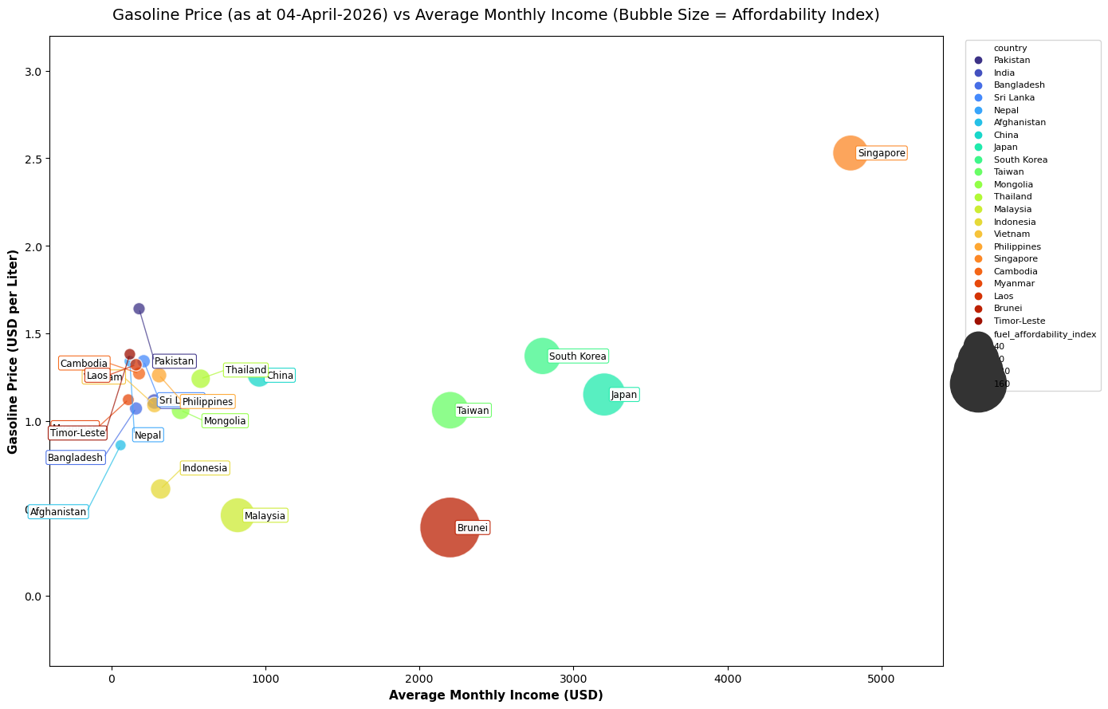
External data puts charging in context
BUSINESS CONTEXT
Fuel prices
Asia fuel prices from Kaggle show what drivers pay for petrol, the benchmark for EV charging costs. Singapore has the highest average monthly income, gasoline price and fuel affordability index
EV charging data platform
6
Reference: https://www.kaggle.com/datasets/zkskhurram/world-vs-asia-fuel-prices/data
Notes:
- From the diagram, Singapore has the highest average monthly income, gasoline price and fuel affordability index.
This led to next slide, the car COE supply and forecast EV and non-EV registrations from 2026 to 2030.
(The source files and VS Code are in our GitHub repository)

Slide 7
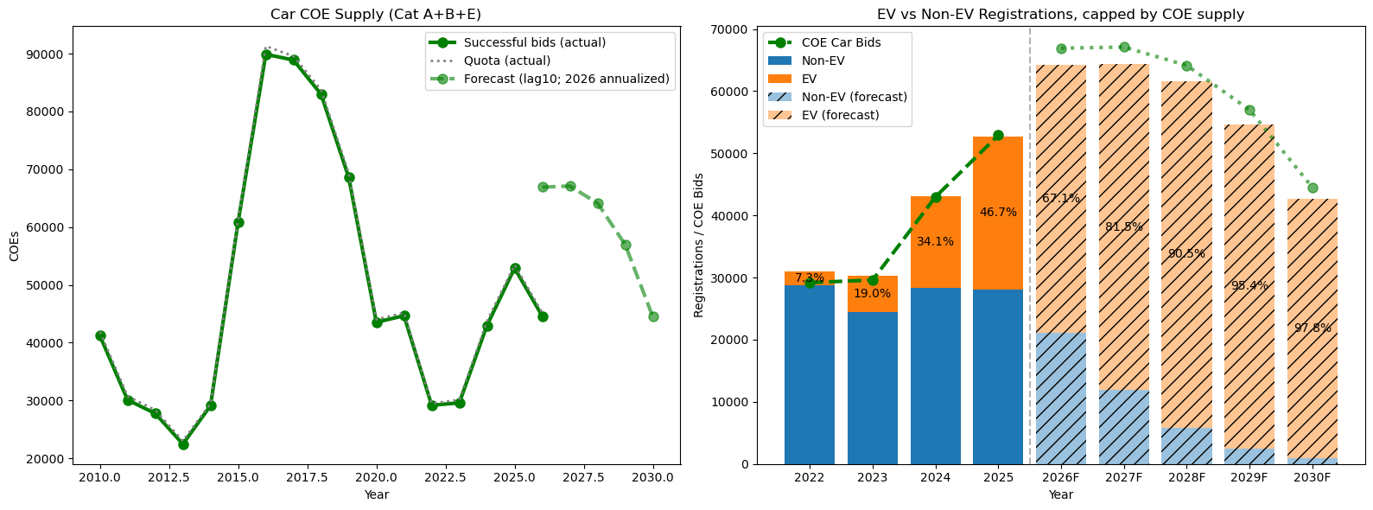
BUSINESS CONTEXT (Cont’d)
External data puts charging in context
Reference: https://datamall.lta.gov.sg, “COE bidding results” & “Monthly New Registration of Cars by Make”
Notes:
We combine Cat A, B and E into general car COE supply. At the peak of 90k in 2016, it reduce to 45k in 2026.
To predict future car COE supply, we use a linear regression model with a 10-year lag (this model uses 10 years old historical data to calculate a line of best fit for future), which accounts for the 10-year COE expiration period.
Forecast 2026/2027 should remain at around 66k. The new EV car registration expects to consist 82% in 2027 and increase to 98% in 2030.
This led us to research on the EV charging operator and EV market in Singapore.
(The source files and VS Code are in our GitHub repository)

Slide 8













Data flows through four layers
TECHNICAL OVERVIEW
1 · Source
2 · Raw
3 · Staging
4 · Analytics
5 · Use
DataMall API
ev_raw
ev_staging
ev_analytics
Notebooks
Daily batch of every charging point
Every load kept as ingested
dbt cleans and types the data
Star schema and summaries
BigQuery Python client and pandas
Extract
Load
Transform
Quality gate
Great Expectations checks every layer (58 tests on 9 tables), plus dbt tests and a Pandas and Polars cross-check.
Orchestration
Cloud Scheduler triggers a Cloud Run job daily at 09:30. Dagster on Docker runs the full pipeline manually.
EV charging data platform
7
Notes:
- The source is the LTA DataMall API, which gives a daily batch of every charging point.
- A Python script loads it into the raw layer in BigQuery, and every load is kept exactly as ingested. dbt then cleans and types the data in staging, and builds the analytics layer. Place historical snapshot at ev_charging history.
- VS Code analytics scripts sit on top, using the BigQuery Python client and pandas.
- Great Expectations checks every layer, with 58 tests on 9 tables, alongside dbt tests and a Pandas and Polars cross-check of regional counts. In production.
Cloud Scheduler triggers a Cloud Run job daily at 09:30 Singapore time, which runs ingestion and dbt. The API key is held in Google Secret Manager.
Dagster inside Docker runs the full pipeline, including the Python analytics, on demand.

Slide 9

A star schema keeps queries simple
SCHEMA DESIGN
Dimension
Fact
Summaries
dim_ev_charger
fct_ev_charging_points
3 report tables
One row per charging point: operator, location, plug and power. 11,684 rows.
Status, price and timestamps per point for the latest load, joined on ev_cp_id.
- By region (ev_charging_summary)
- By operator (ev_operator_pricing)
- By operator and region (ev_operator_by_region_analysis)
Descriptive attributes sit once in the dimension and fast-changing status and price sit in the fact table, so analysts run small joins. Every load is also kept in a raw history table (92,880 rows) for trend analysis.
EV charging data platform
8
Notes:
- We used a star schema. In the middle is the fact table, fct_ev_charging_points, with status, price and timestamps for each point in the latest load.
It joins on the charging point ID to the dimension, dim_ev_charger, which holds one row per charging point with operator, location, plug and power, 11,684 rows.
On the right are three report tables, by region, by operator, and by operator and region.
Why this design: analytical questions are mostly one fact table joined to one descriptive table, which BigQuery runs efficiently, and descriptive attributes are stored once.
Summaries are precomputed so dashboards stay fast. Every load is also kept in a raw history table of 92,880 rows for trend analysis.
One honest limitation: the fact table holds only the latest load, and history lives in that raw table.

Slide 10
Every layer is tested before anyone uses it
DATA QUALITY
58
✓
Keys are unique and no fact row is orphaned
✓
Values, formats and ranges are valid
automated checks on 9 tables
Row counts agree between layers, and Pandas and Polars agree on regional counts
✓
207 points (1.8%) publish no price
An upstream data gap, not a pipeline error. Price averages exclude them.
EV charging data platform
9
Notes:
- We run 58 automated checks using Great Expectations across 9 tables, covering every layer.
- They check that keys are unique and no fact row is orphaned, that values, formats and ranges are valid, that row counts agree between layers, and that Pandas and Polars agree on regional counts.
- The checks also surfaced a real finding. So, 207 points, 1.8 percent, publish no price. That is an upstream data gap, not a pipeline error, so our price averages exclude them.
- The script returns a pass or fail exit code, which allows us to stop the data from loading if the data failed the tests.

Slide 11
Four operators run 81% of charging points
INSIGHT
SP Mobility
2,836
Charge+
2,652
ComfortDelGro Engie
2,077
Shell
1,874
Strides YTL
1,124
Other 24 operators
1,121
Charging points per operator, latest load, 11,684 in total. The next two slides add speed, regional and planning findings.
EV charging data platform
10
Notes:
First insight: the network is concentrated.
Four operators, SP Mobility, Charge+, ComfortDelGro Engie and Shell, run 9,439 of the 11,684 charging points, which is 81 percent.
The other 25 operators share the rest. For the business this means a few operators set the experience for most drivers, so partnership, pricing and reliability decisions with those four have an outsized effect.

Slide 12
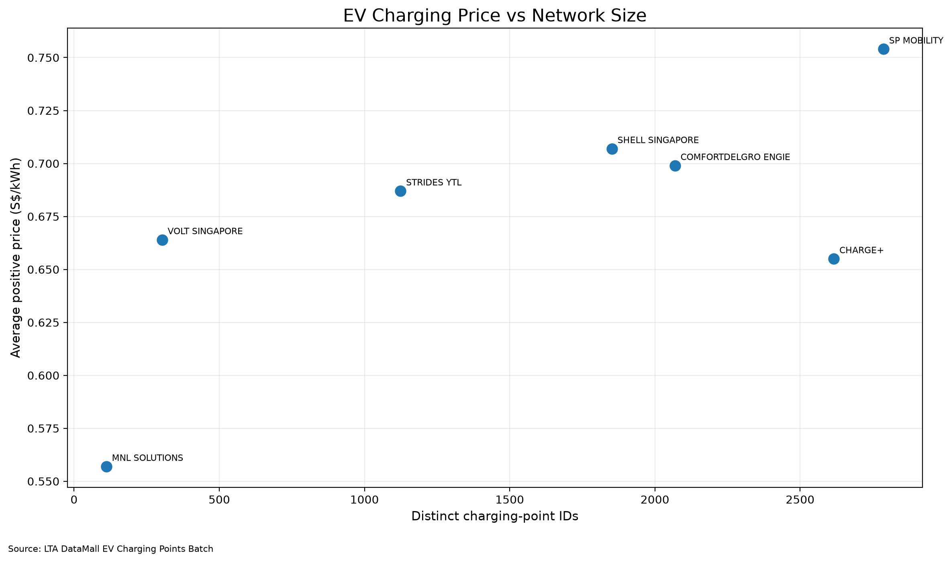
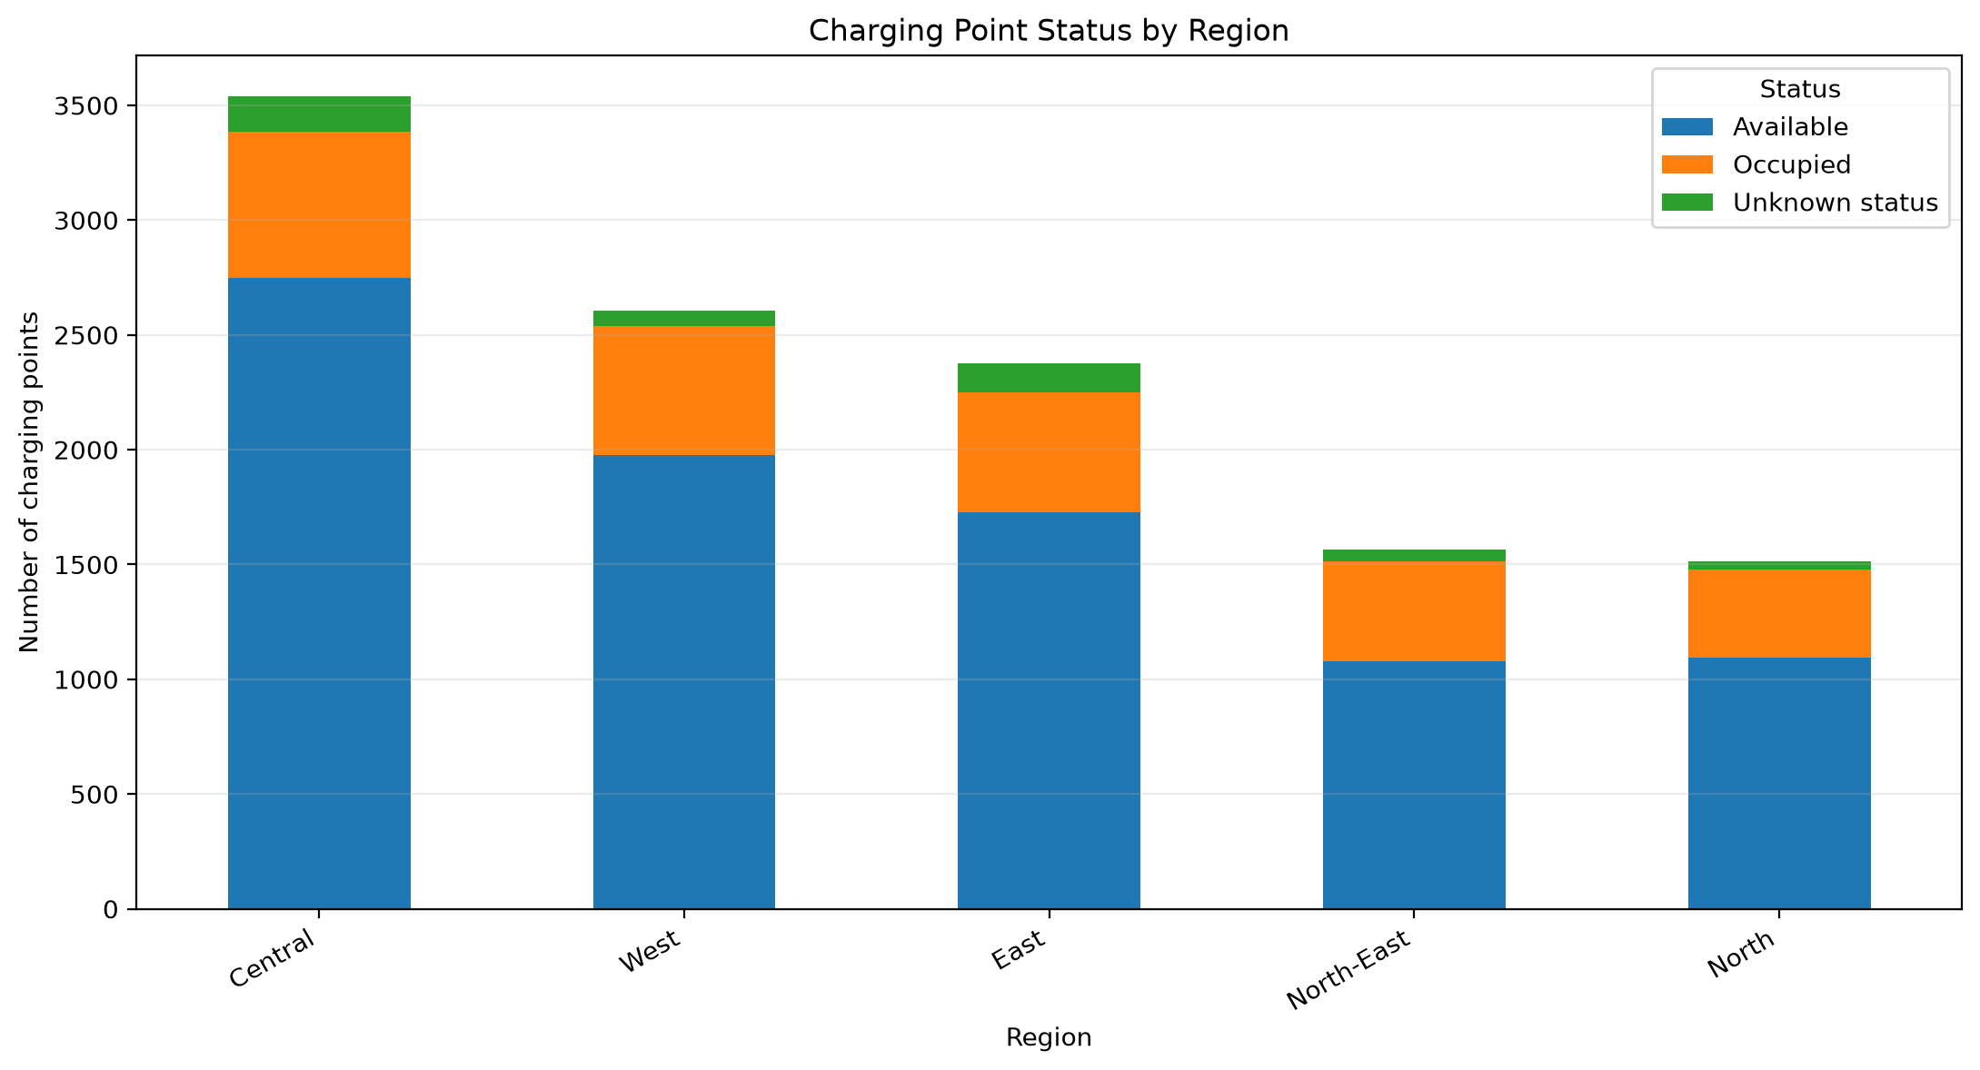
Price, speed and availability by operator and region
INSIGHT
Larger networks do not charge more: Charge+ is among the biggest and cheaper than SP Mobility. 74% of points were available, and Central has the fastest charging points at 30 kW on average.
EV charging data platform
11
Notes:
Two more views from our analytics outputs. On the left, price against network size for the seven operators with enough priced points. Larger networks do not necessarily charge more: Charge+ is among the biggest and is cheaper than SP Mobility.
On the right, availability by region. About 74 percent of points were available, and Central has the fastest charging points at about 30 kW on average.

Slide 13
From Islandwide Charging Data to HDB Carparks
Linking EV charging points to residential carparks using location and address evidence
1
Close by
✓
Strong match
The charging point is within 50 metres of the HDB carpark.
Within 50 m and the address matches
2
Same address
!
Nearby — needs verification
Addresses are tidied so that “BLK 186 BISHAN ST 13” matches “186 BISHAN STREET 13” and block range “184–187”.
Within 50 m but the address does not match
✕
No nearby match
No qualifying charging-point association identified
2,273
628
2,895
HDB carparks across 32 planning areas
carparks with a strong match
charging points matched to carparks
EV charging data platform
14
Notes:
Earlier: SG EV charging network in terms of operators, pricing, charging speed and overall availability.
Residential parking -- impt setting for EV charging, so examine the network from an HDB perspective.
Matched LTA charging points to HDB carparks using 2 criteria: 1. proximity within 50 metres and
2. matching addresses after standardisation, including block ranges.
Of 2,273 HDB carparks, 628 had strong matches, involving 2,895 charging points.
These are likely associations, not independently verified installations. A carpark without a strong match may still have chargers.

Slide 14
High Charging Availability, Yet Accessibility Concerns Remain
INSIGHT
Charging locations with at least one available charging point during observed intervals
HDB-matched
Unmatched*
Islandwide
91.9%
90.4%
90.7%
* Unmatched refers to charging locations without a strong HDB carpark association. Some may still be located at HDB carparks.
Availability exceeded 90% in every group over one week of LTA observations
86% of points are AC, which suits overnight stays but not quick top-ups
Potential barriers include location, charging speed, blocked bays and operator apps; these were not directly measured
EV charging data platform
12
Notes:
Compare availability with the wider network. (prior HDB-assoc locations)
At least one charging point was available approximately 92% of the time at HDB-matched locations, compared with about 90% for unmatched locations and 91% islandwide.
These figures are higher than the earlier 74% because we're now measuring availability by location, rather than by individual charging point.
But availability doesn't necessarily mean convenience. Charging speed, location and access restrictions may still affect drivers, although our data doesn't establish which factors cause difficulties.

Slide 15
Charging Usage Varies Across Residential Areas
INSIGHT
Highest observed occupancy
High occupancy, broader matched coverage
Future development consideration
Punggol
Pasir Ris
Tengah
47.5%
37%
22.1%
Observed occupancy
Observed occupancy
Observed occupancy
HDB carparks successfully matched
HDB carparks successfully matched
HDB carparks successfully matched
8 of 102
25 of 65
1 of 20
Key takeaway: Observed occupancy differs among matched charging points, while future housing development may affect charging needs
HDB-matched charging points only; one-week observations. Estimated overall occupancy: 25%.
Occupied includes charging, reserved and blocked.
EV charging data platform
13
Notes:
Compare how frequently charging points were occupied across selected residential areas
Punggol - highest occupancy (48%), while Pasir Ris ranked third, based on charging points matched to HDB carparks.
However, our matching method identified charging points at only 8 of Punggol's 102 carparks, compared with 25 of 65 in Pasir Ris. So these results represent the matched subset, not necessarily all HDB chargers in those areas.
Tengah recorded lower occupancy at 22%, but its ongoing residential development may change future charging needs.

Slide 16
What could go wrong, and what covers it
RISKS
Risk | Impact | Mitigation
A daily load is partial or missing | Gaps in history | Load size is checked against normal
Source adds new values | Models break | Allowed-value checks fail fast
Missing prices at some operators | Biased price view | Averages exclude unpriced points
EV charging data platform
17
Notes:
Three main risks and what covers each.
A partial or missing daily load would leave gaps in history, so we check load size against normal.
If the source adds new values, our allowed-value checks fail fast instead of letting bad data through.
Missing prices at some operators could bias the price view, so our averages exclude unpriced points. If I had to pick one to remember, it is the missing prices: 207 points, 1.8 percent, publish no price.

Slide 17
High Observed Availability, but Location and Future Demand Still Matter
WHAT THE INSIGHTS TELL US
1
Four operators run 81% of charging points
A few operators shape the experience for most drivers, so partnerships and pricing with them matter most.
2
Bigger networks do not charge more, and speed varies by region
Drivers can compare price and speed by operator and region, not just by brand size.
3
Over 90% of locations had an available charging point during the week
Existing charging locations generally had at least one available charging point during the observation period.
4
Charging usage varies geographically; future housing may change demand
Future infrastructure planning should consider local charging patterns, geographic accessibility and anticipated residential growth.
EV charging data platform
15
Notes:
(about 45 seconds) Pulling the insights together. One: the network is concentrated, with four operators running 81 percent of the 11,684 charging points, so a few partnerships reach most drivers. Two: bigger does not mean pricier. Charge+ is among the biggest and cheaper than SP Mobility, and charging speed differs by region, with Central fastest at about 30 kilowatts on average. Three: Our historical analysis also found that charging locations were generally available during the observation week.
Four: However, high availability does not necessarily mean convenient access or sufficient capacity for future demand.
The key takeaway is that infrastructure planning should consider not just current availability, but also geographic accessibility, charging speed and anticipated residential growth.
Given our limited observation period and geographic matching constraints, these findings provide preliminary planning insights rather than definitive recommendations on where new chargers should be installed.

Slide 18
A tested, automated source of truth for EV charging data
SUMMARY
Daily loads into a star schema on BigQuery
58 checks guard quality across every layer
Insights are ready for planners, operators and drivers
Questions?
18
Notes:
(about 20 seconds) To wrap up: we built a tested, automated source of truth for EV charging data. Daily loads go into a star schema on BigQuery, 58 checks guard quality across every layer, and the insights are ready for planners, operators and drivers. Thank you. We are happy to take questions. Likely ones: why BigQuery and dbt, slide 7. Why a star schema, slide 8. How do you know the data is correct, slide 9. What happens if a load fails, slides 16 and 17. Why does the fact table hold only the latest load, slide 8. How would you add real-time data: the API is polled daily today, so we would move to more frequent loads into the same raw table.

