Slide 1
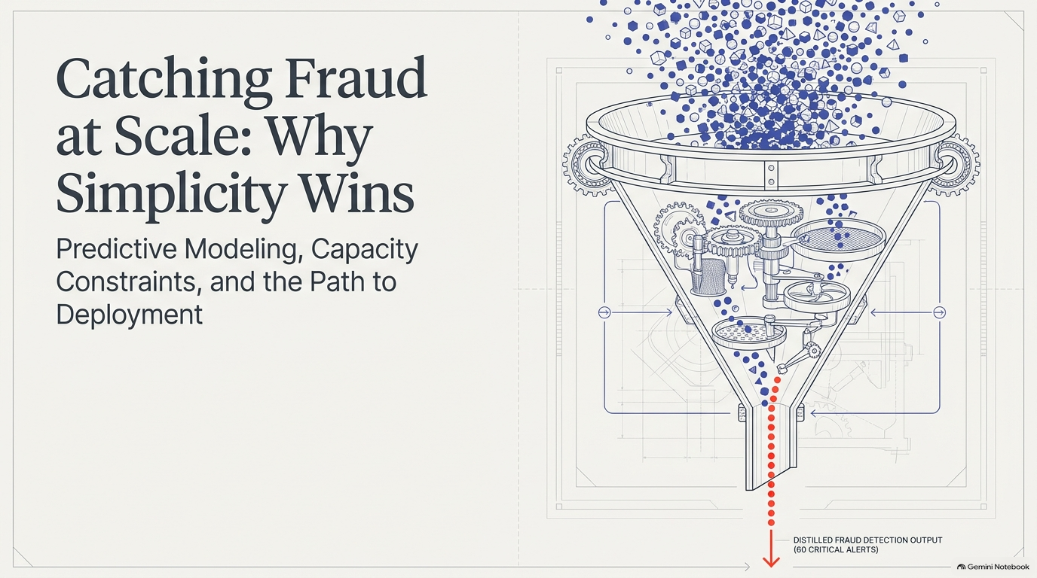

Slide 2
Index of Contents
Executive Summary
The Problem and Operational Constraints
The 98.3% Accuracy Trap
EDA First Look
Build the Zero-Leakage Pipeline
The Threshold Tradeoff
Logistic Regression (LR) Model – the Baseline Standard
Random Forest (RF) and Radient Boosting (RB) Models
Comparison of LR, RF and RB models
Priority Ranking of Key Features (KPI)
The ROI Analysis
12. Recommendation and Deployment Architecture
13. Rollout & A/B Testing Plan

Slide 3
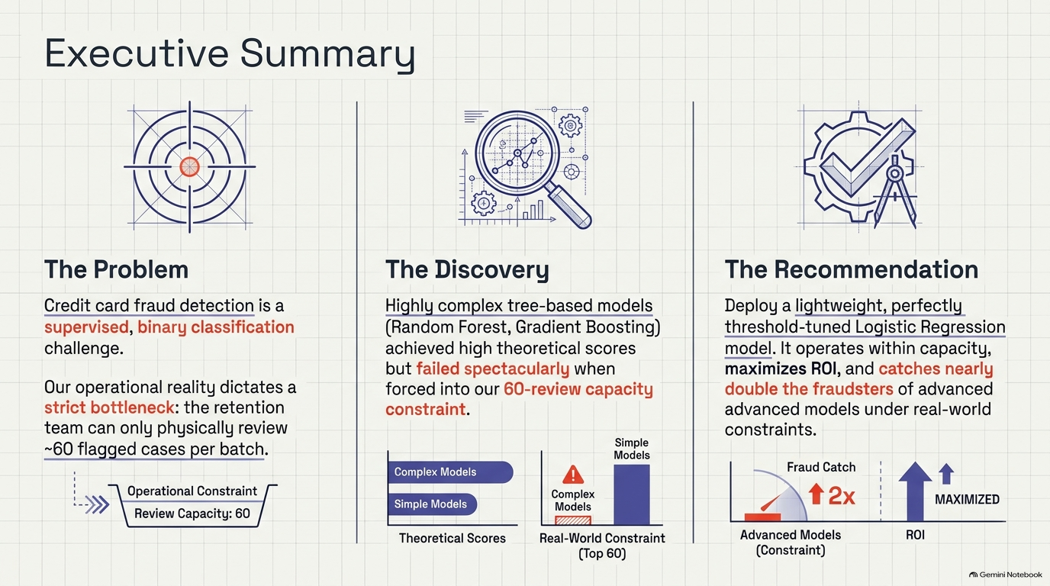

Slide 4
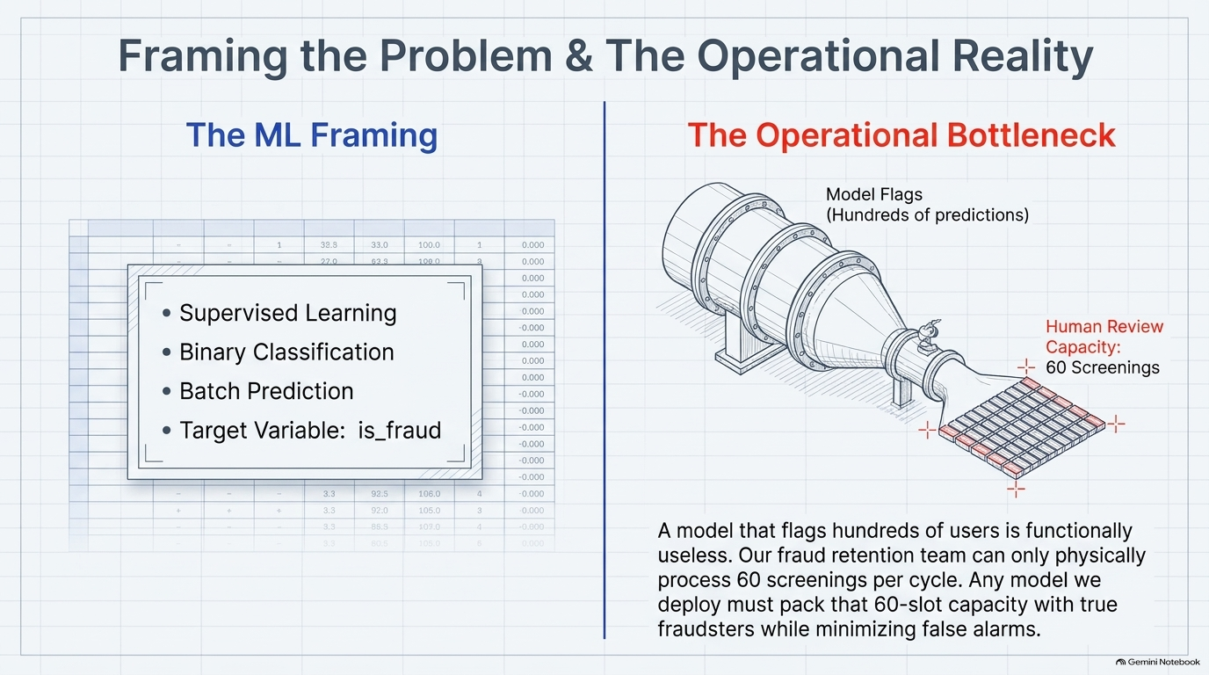
Kaggle - Credit Card Fraud Detection 2026

Slide 5
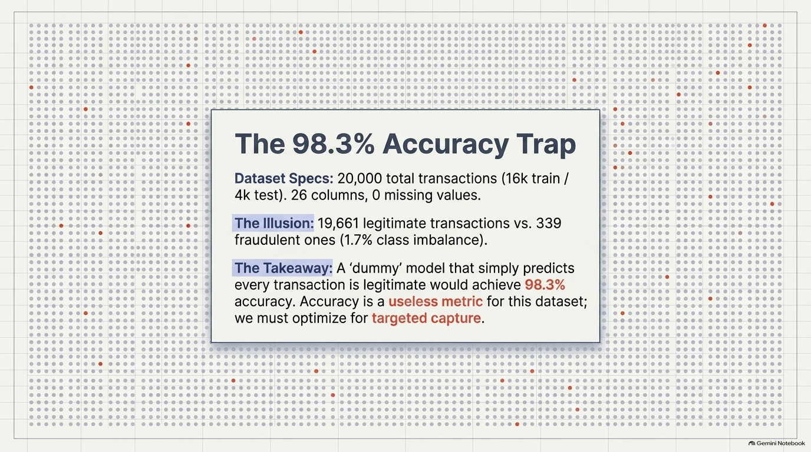

Slide 6
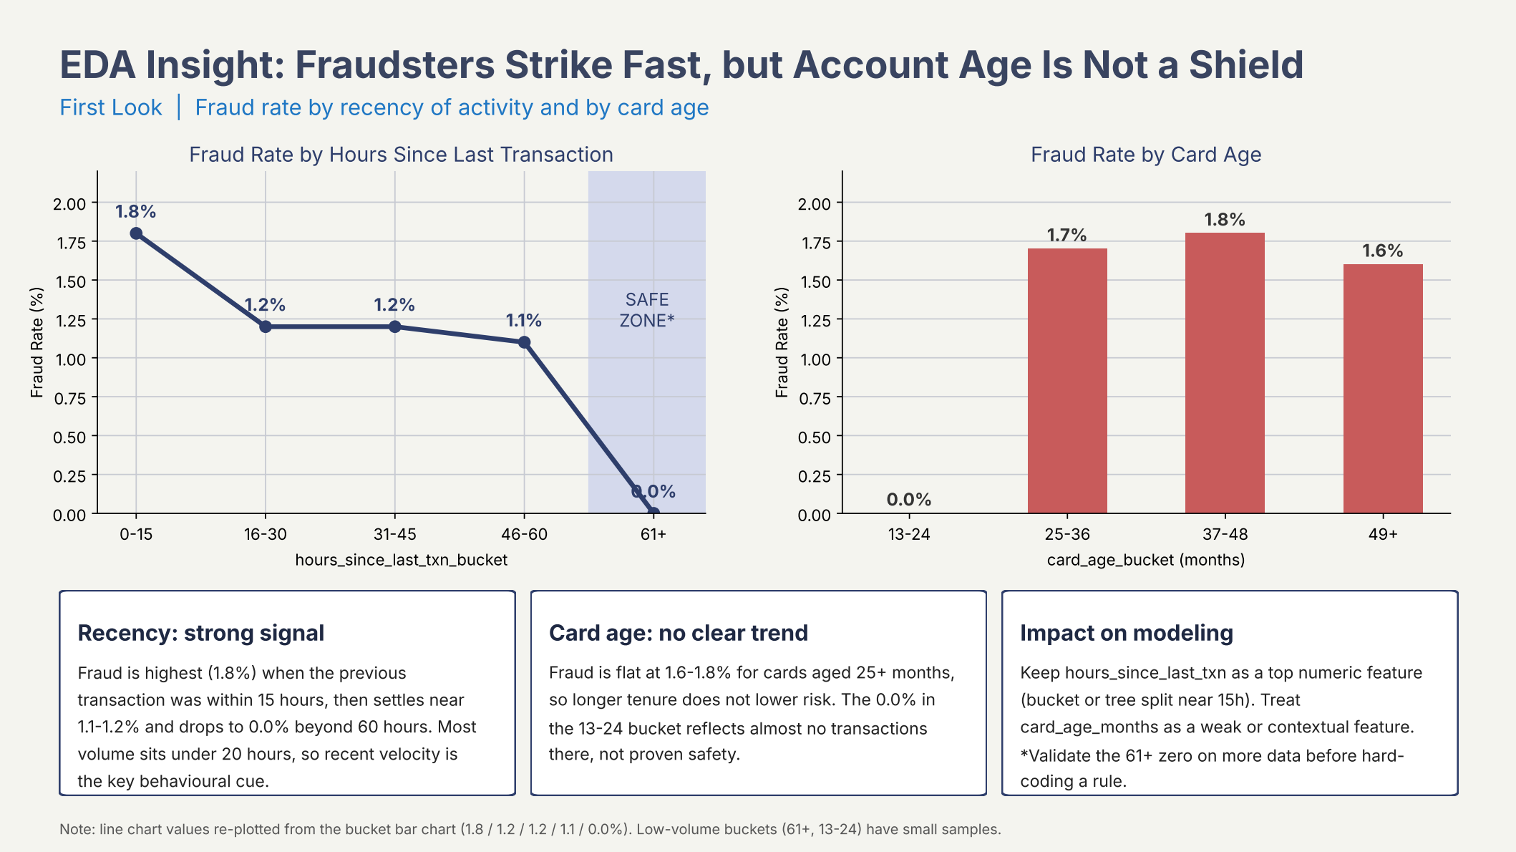
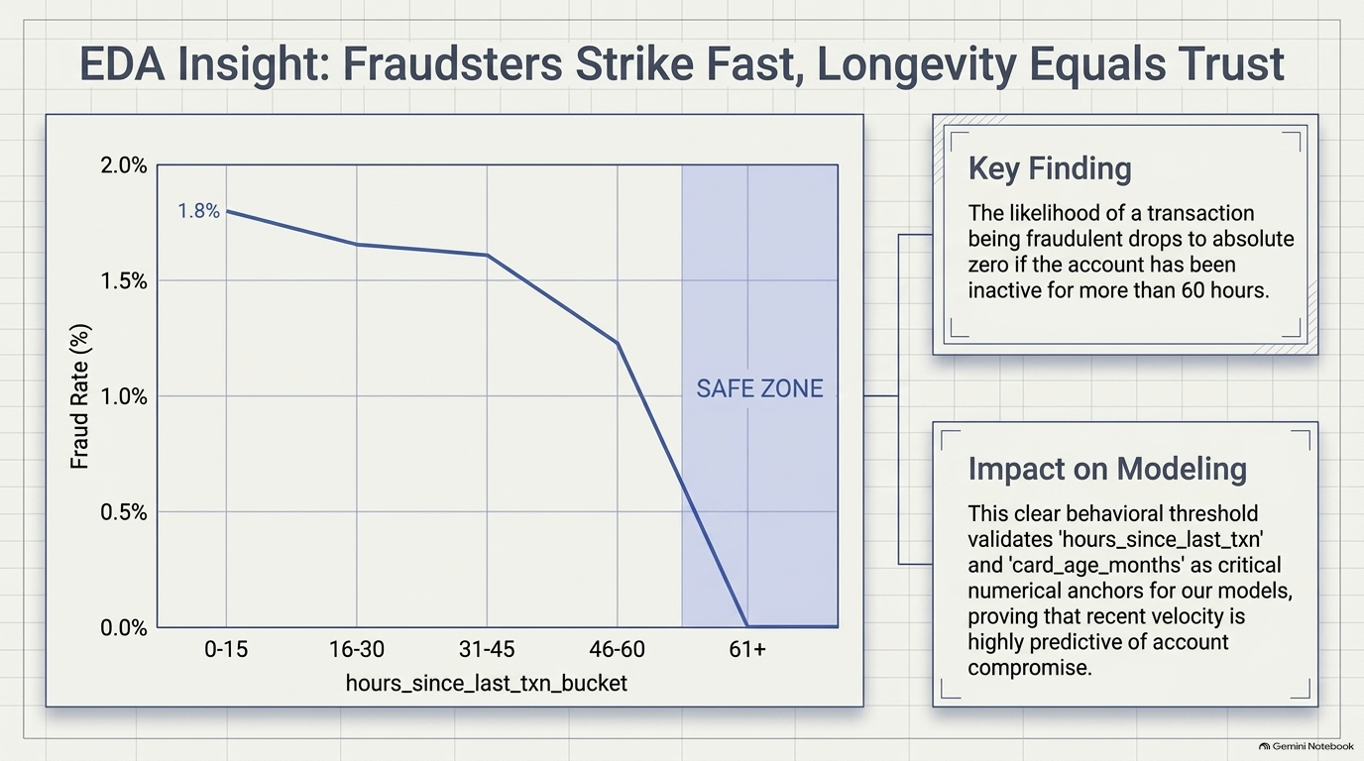
(First Look)

Slide 7
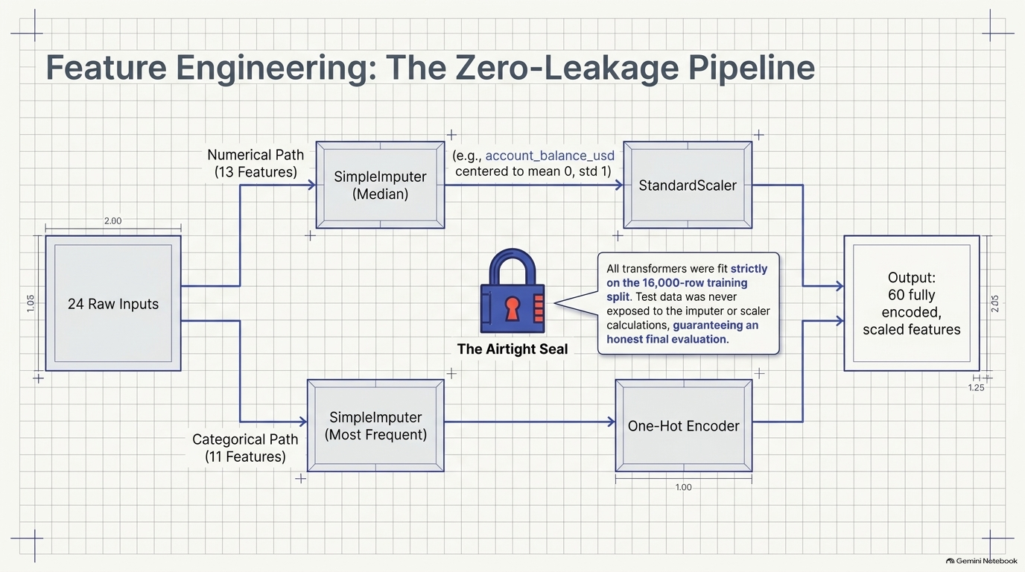

Slide 8
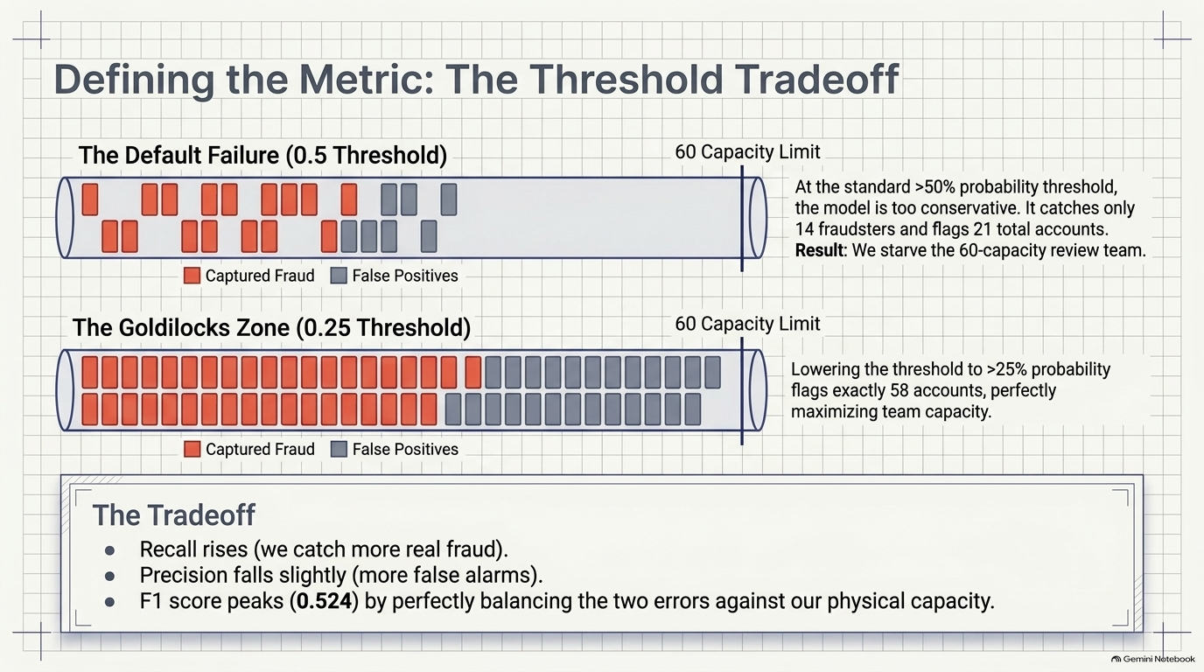

Slide 9
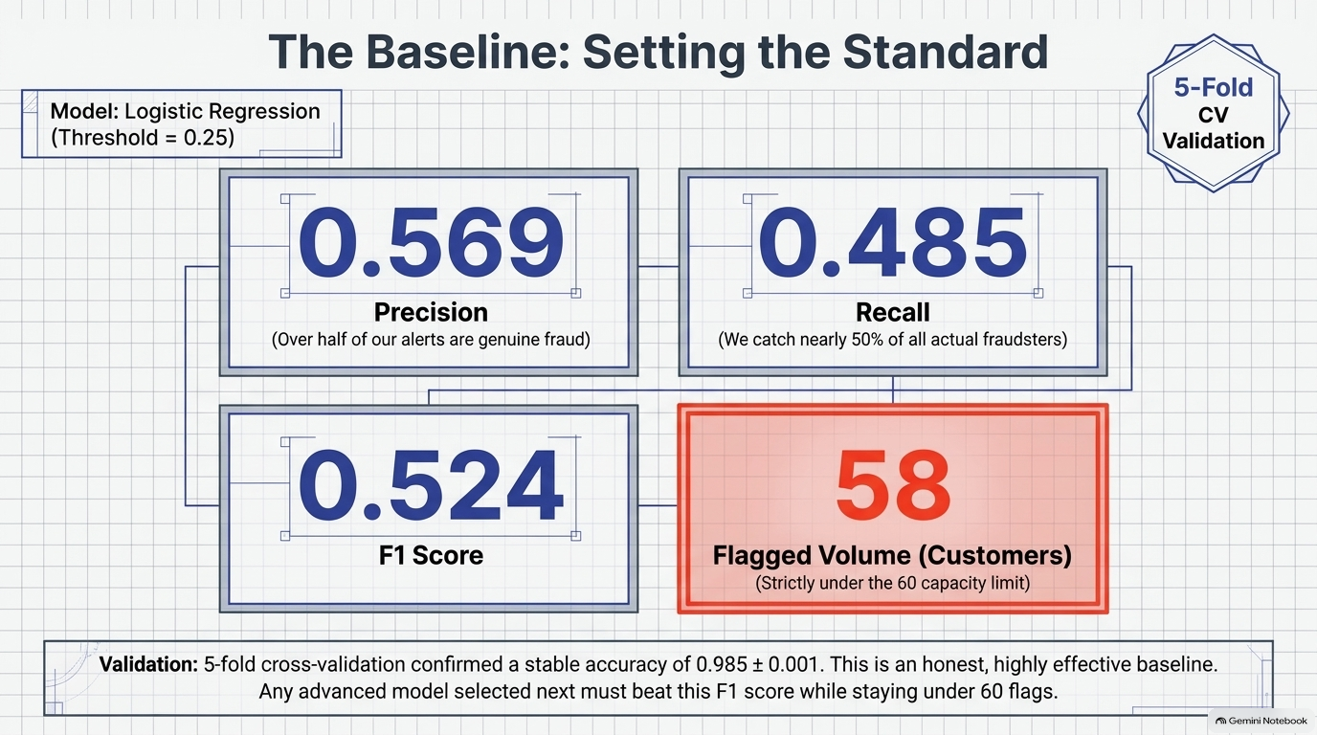

Slide 10
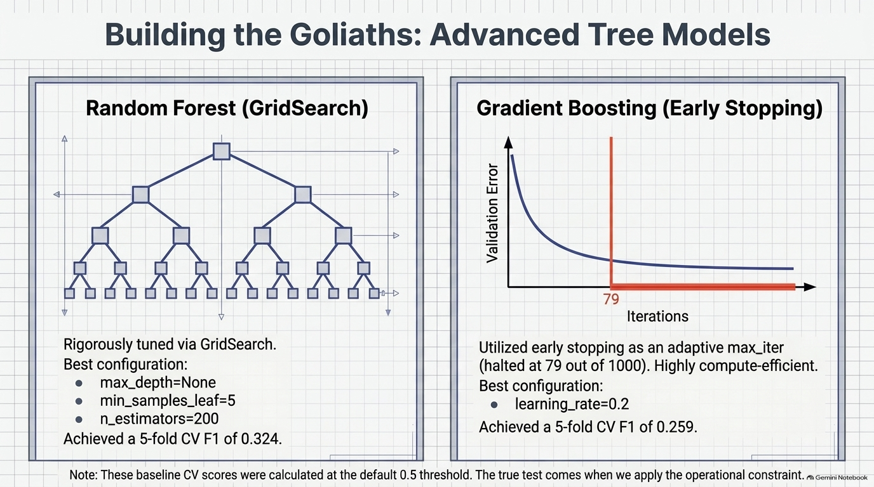

Slide 11
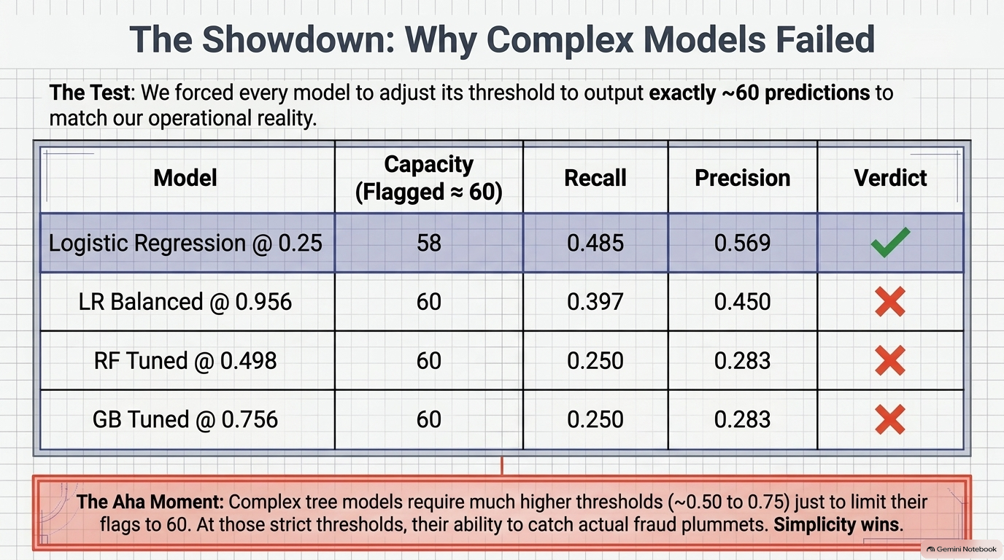

Slide 12
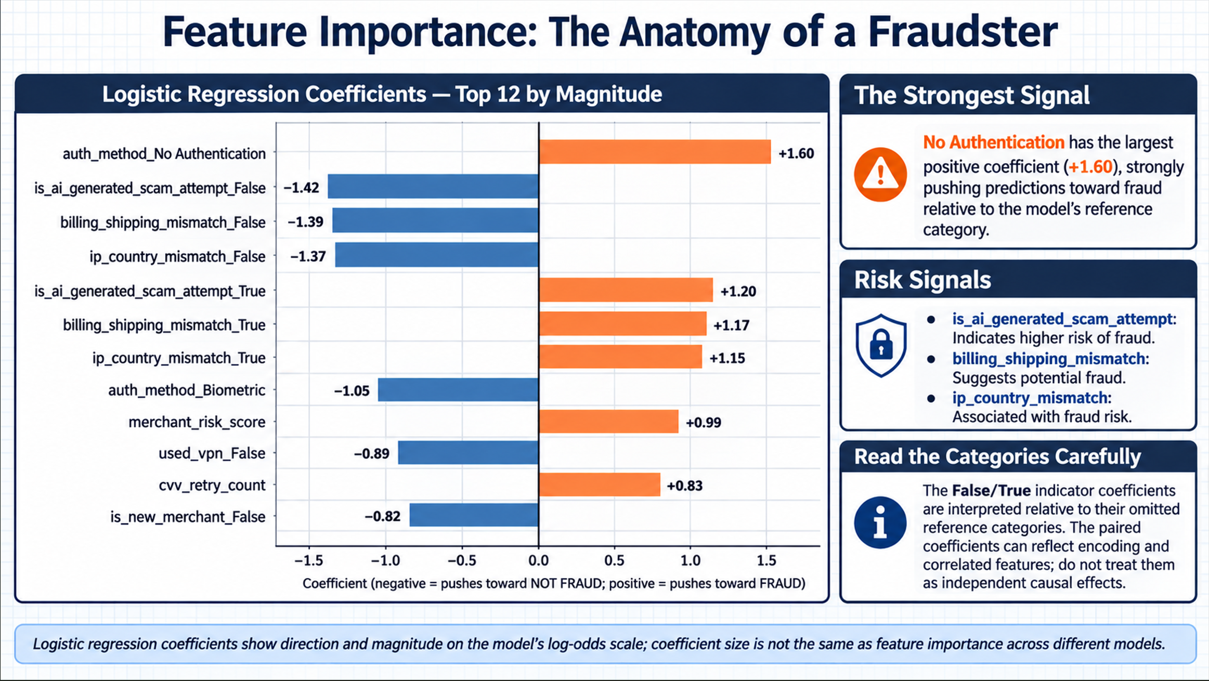
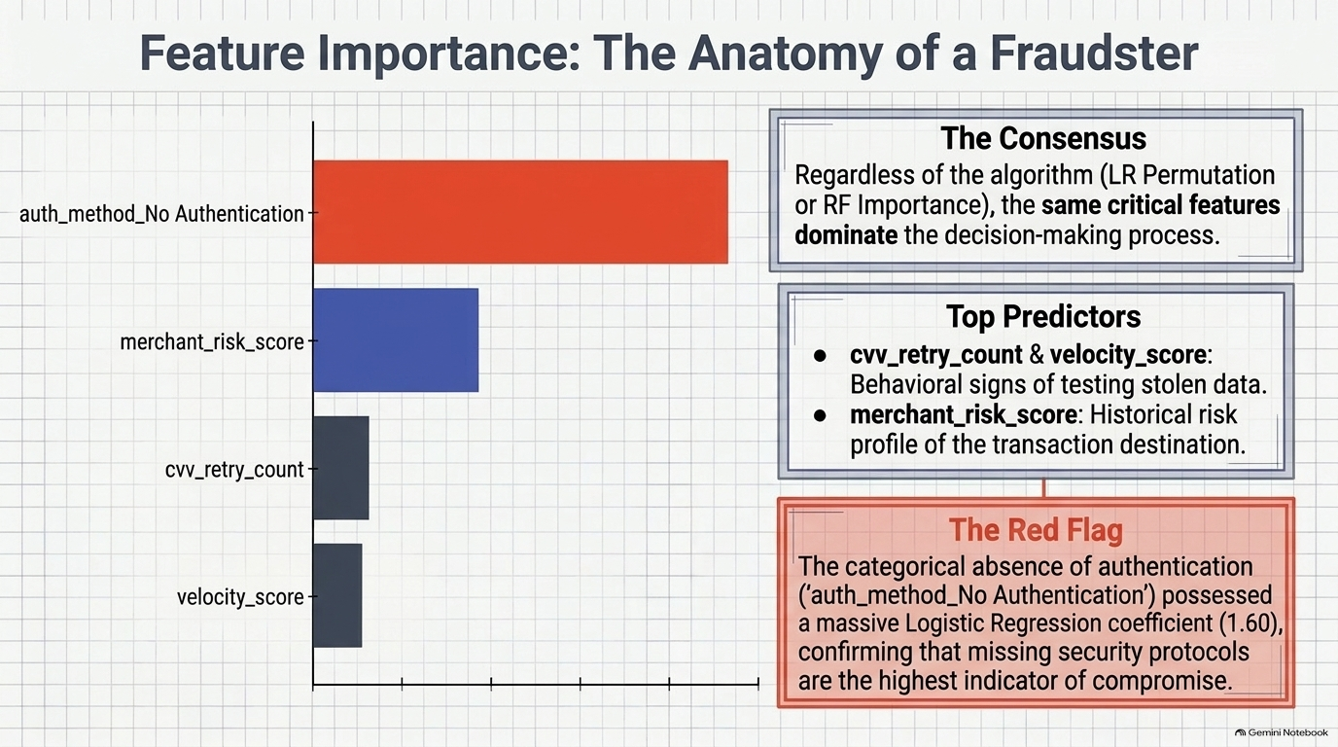
(KPI)

Slide 13
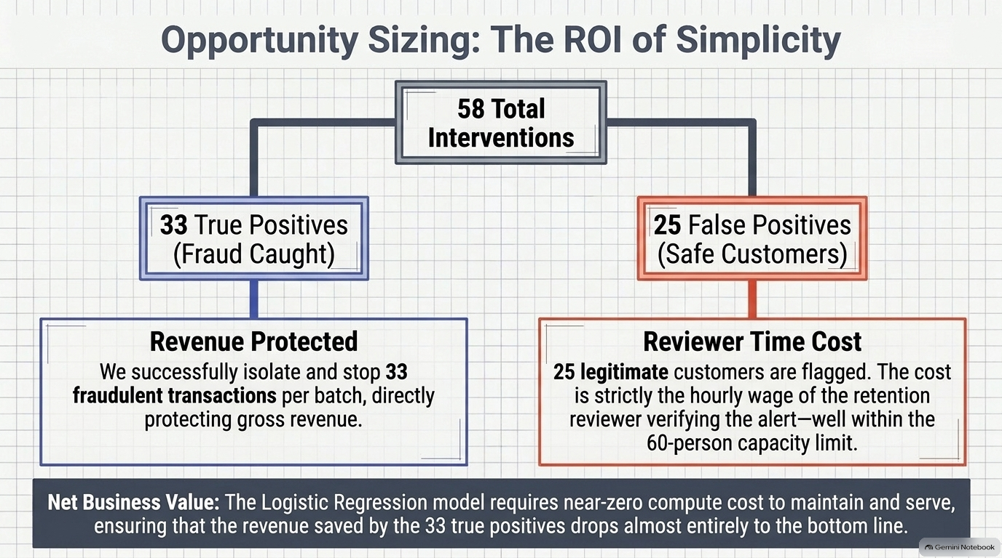

Slide 14
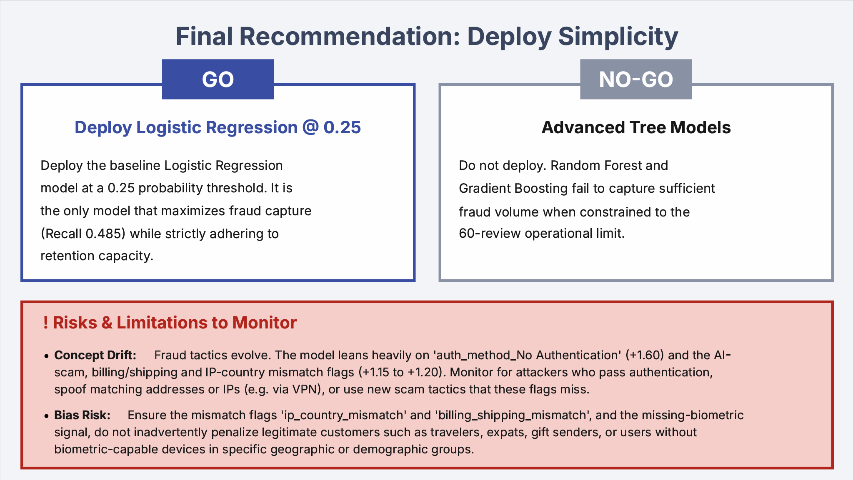
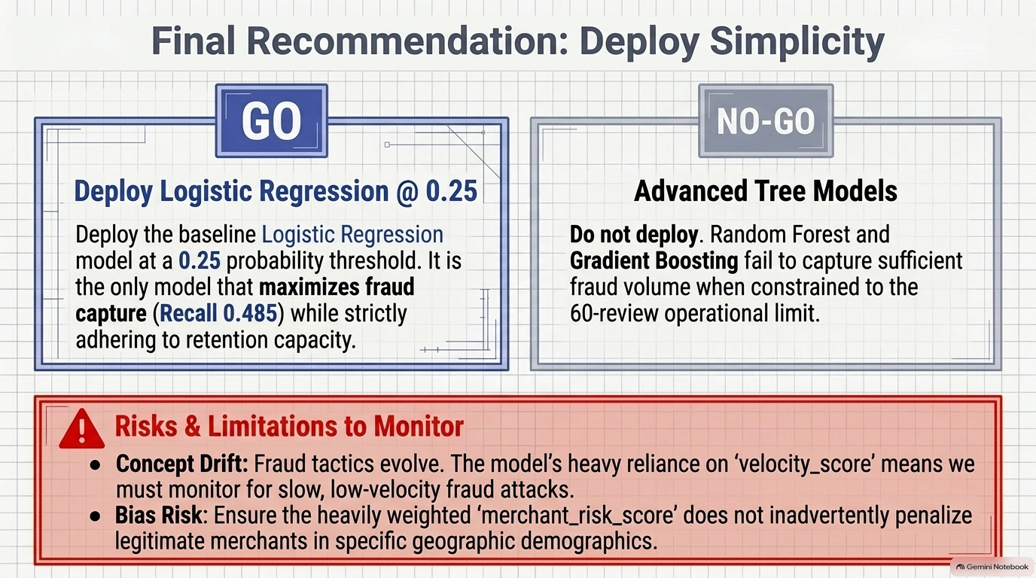

Slide 15
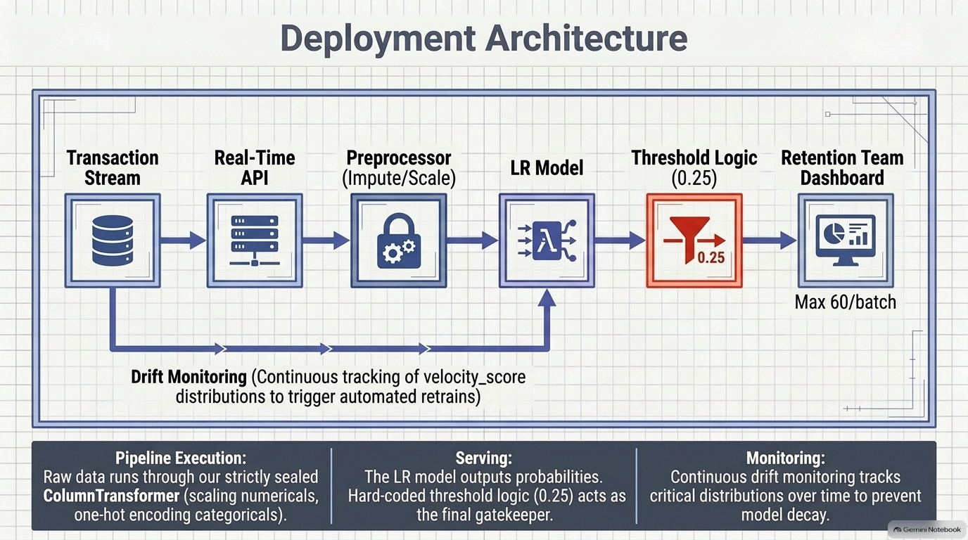
KPIs

Slide 16


