Slide 1


Slide 2


Roter Faden
Datensätze
Verbindung
Analyse

Slide 3
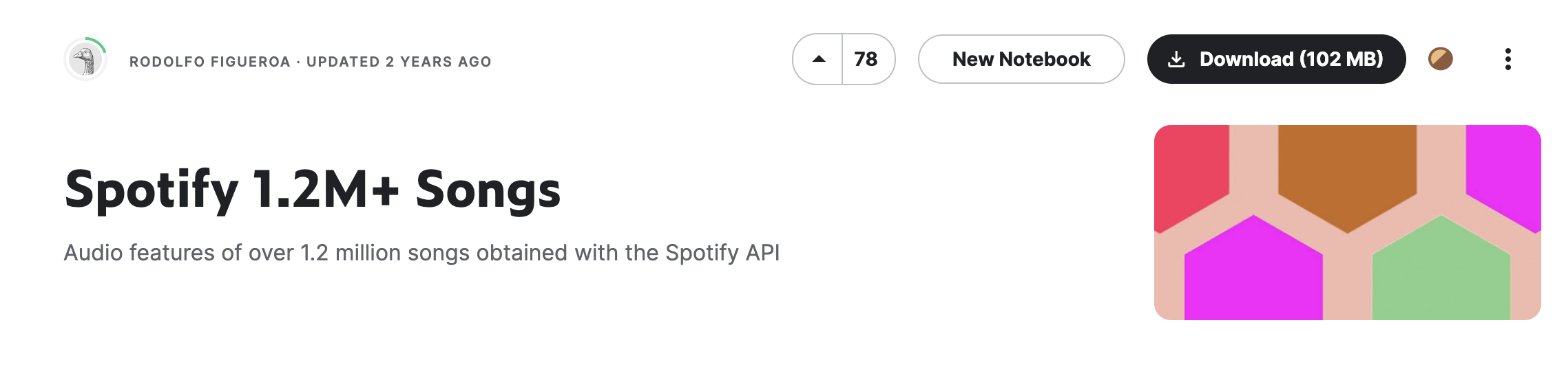
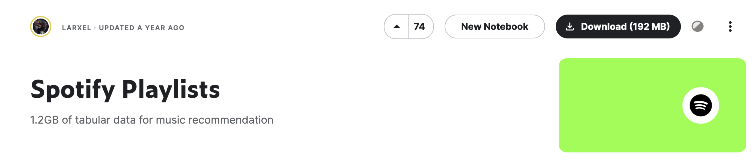
Datensätze
Notes:
Ziel: Verbindung Song-Eigenschaften mit Playlists

Slide 4
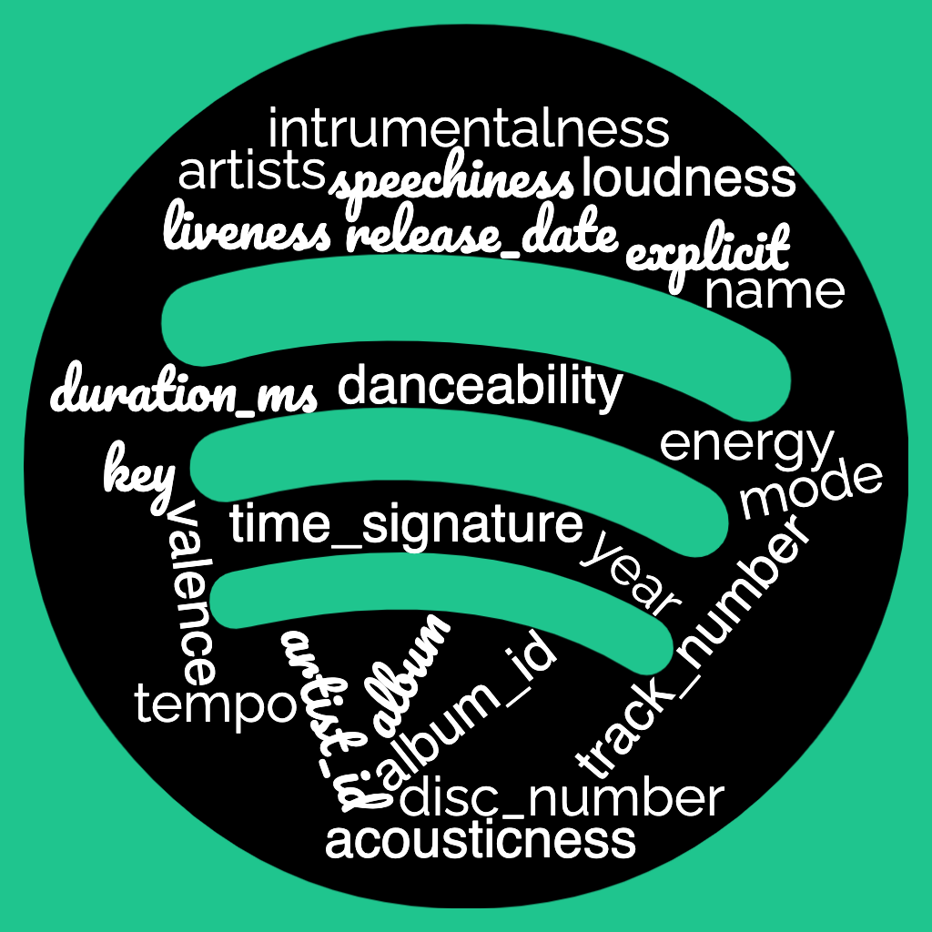
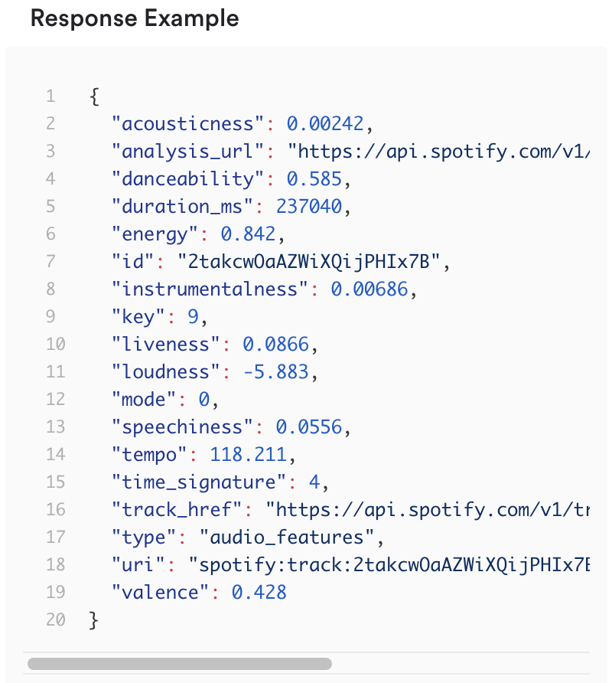
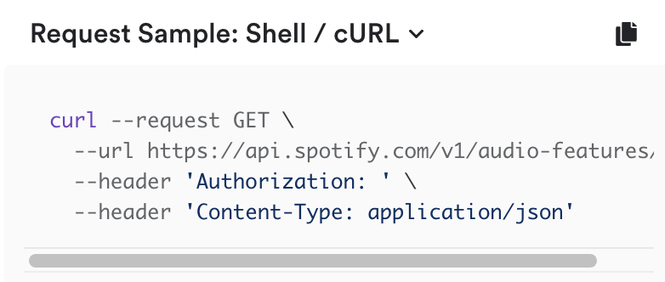
Spotify 1.2M+ Songs
generiert mittels offizieller Spotify API
Notes:
https://www.kaggle.com/datasets/rodolfofigueroa/spotify-12m-songs
https://www.kaggle.com/datasets/andrewmvd/spotify-playlists?select=spotify_dataset.csv

Slide 5
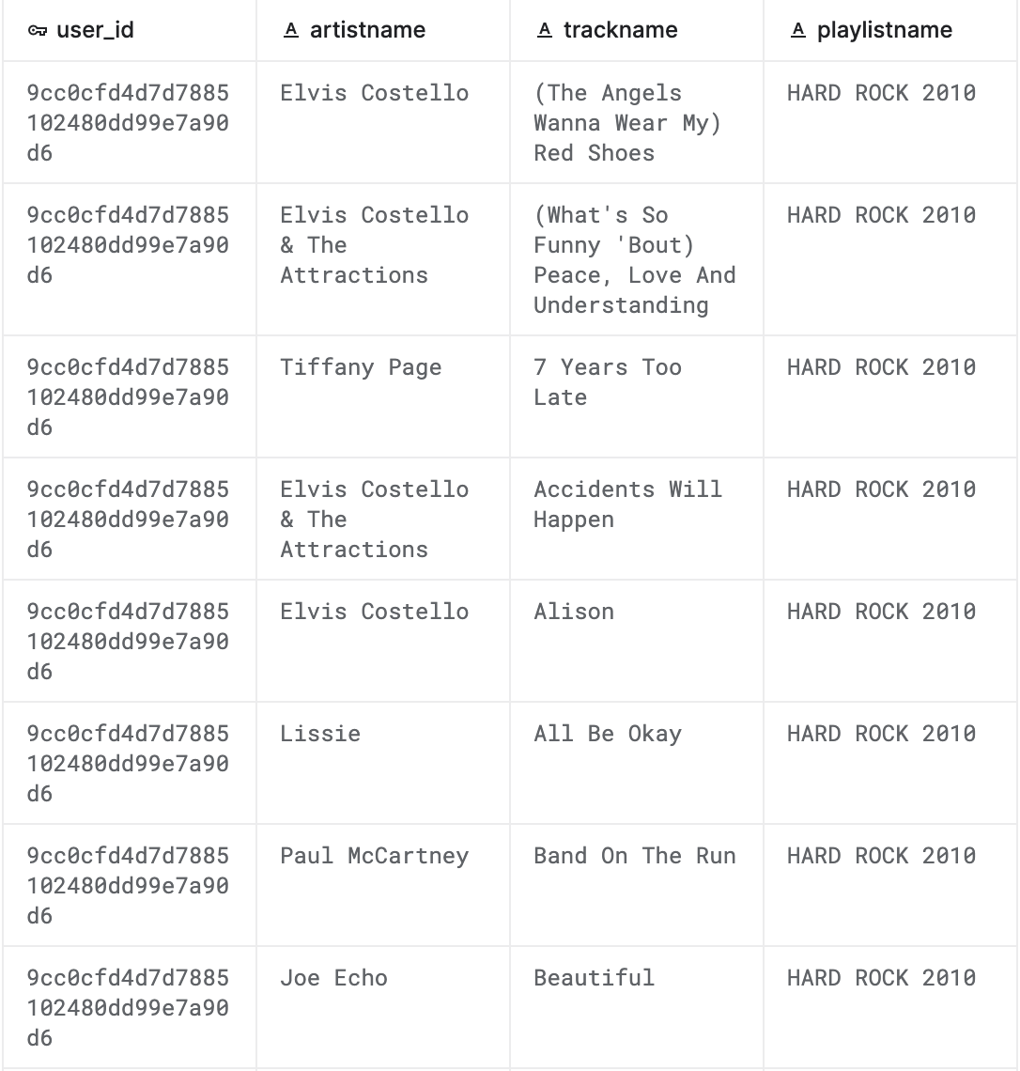
Spotify Playlists
Zahlen:
162k playlists
16k user
2M tracks

Slide 6
Verbindung der Datensätze
1.2M Songs
Playlists
id | name | artists | …
a | Flash mich | ['Mark Forster’] | …
b | Mine (feat. Drake) | ['Beyoncé’, 'Drake'] | …
user_id | artistname | trackname | playlistname
u1 | Beyoncé | Mine (feat. Drake) | December ’13
u2 | Beyoncé | Mine (feat. Drake) | Rap and R&B
u2 | Beyoncé | Mine (feat. Drake) | Top albums of 2013
u3 | Mark Forster | Flash mich | Top 100
u3 | Mark Forster | Flash mich | Random Stuff
id | name | artists | …
a | Flash mich | Mark Forster | …
b | Mine (feat. Drake) | Beyoncé | …
b | Mine (feat. Drake) | Drake | …

Slide 7
id | name | artists | …
a | Flash mich | Mark Forster | …
b | Mine (feat. Drake) | Beyoncé | …
b | Mine (feat. Drake) | Drake | …
user_id | artistname | trackname | playlistname
u1 | Beyoncé | Mine (feat. Drake) | December ’13
u2 | Beyoncé | Mine (feat. Drake) | Rap and R&B
u2 | Beyoncé | Mine (feat. Drake) | Top albums of 2013
u3 | Mark Forster | Flash mich | Top 100
u3 | Mark Forster | Flash mich | Random Stuff
artist | name | user_id | id | playlistname | ...
Beyoncé | Mine (feat. Drake) | u1 | b | December ’13 | ...
Beyoncé | Mine (feat. Drake) | u2 | b | Rap and R&B | ...
Beyoncé | Mine (feat. Drake) | u2 | b | Top albums of 2013 | ...
Mark Forster | Flash mich | u3 | a | Top 100 | ...
Mark Forster | Flash mich | u3 | a | Random Stuff | ...

Slide 8
Datenverlust
Anzahl an Songs pro Datensatz
Problem:
2.009.677
842.686
Verbindung über Artisten
Playlist Datensatz
Song Datensatz
Elvis Costello
Elvis Costello & The Attractions
Paul McCartney & Eric Clapton
Tom Petty And The Heartbreakers
Scott Bradlee feat. Dave Koz
147.280

Slide 9
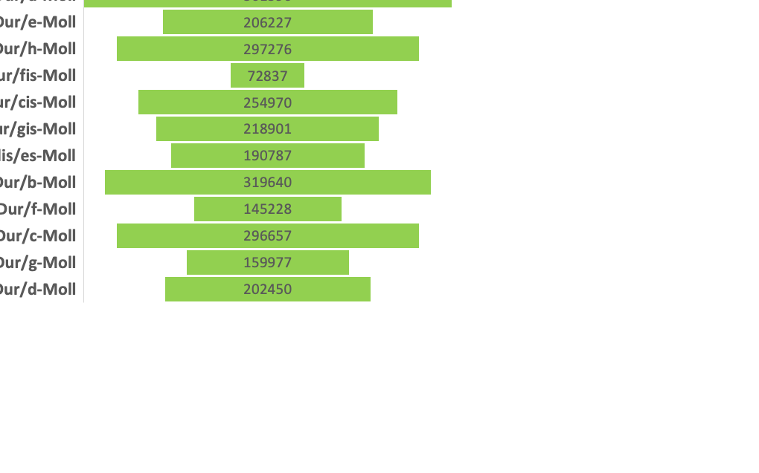
Daten zu Songs
4 min 6 sek

Slide 10
Beliebtheit von Artisten
total = 19732
Notes:
Was bedeutet beliebt?
Beyoncé in jeder 6. Playlist

Slide 11
Eigenschaften beliebter Artisten
Notes:
statistiken durchschnittssong der top 100 beliebtesten künstler verglichen mit den durchschnittssong des durchschnittsartisten
durchschnitt und stdev skaliert min/max
attribute niedrigere werte, geringere standardabweichung

Slide 12
Artisten mit den meisten Songs

Slide 13
Beliebtheit von Songs
Notes:
Creep in jeder 12 Playlist zu finden

Slide 14
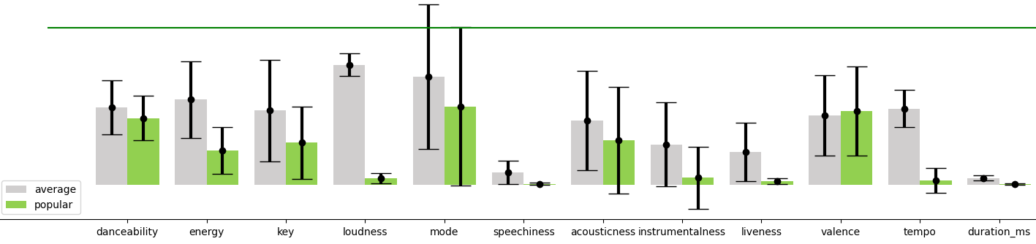
Eigenschaften beliebter Songs

Slide 15
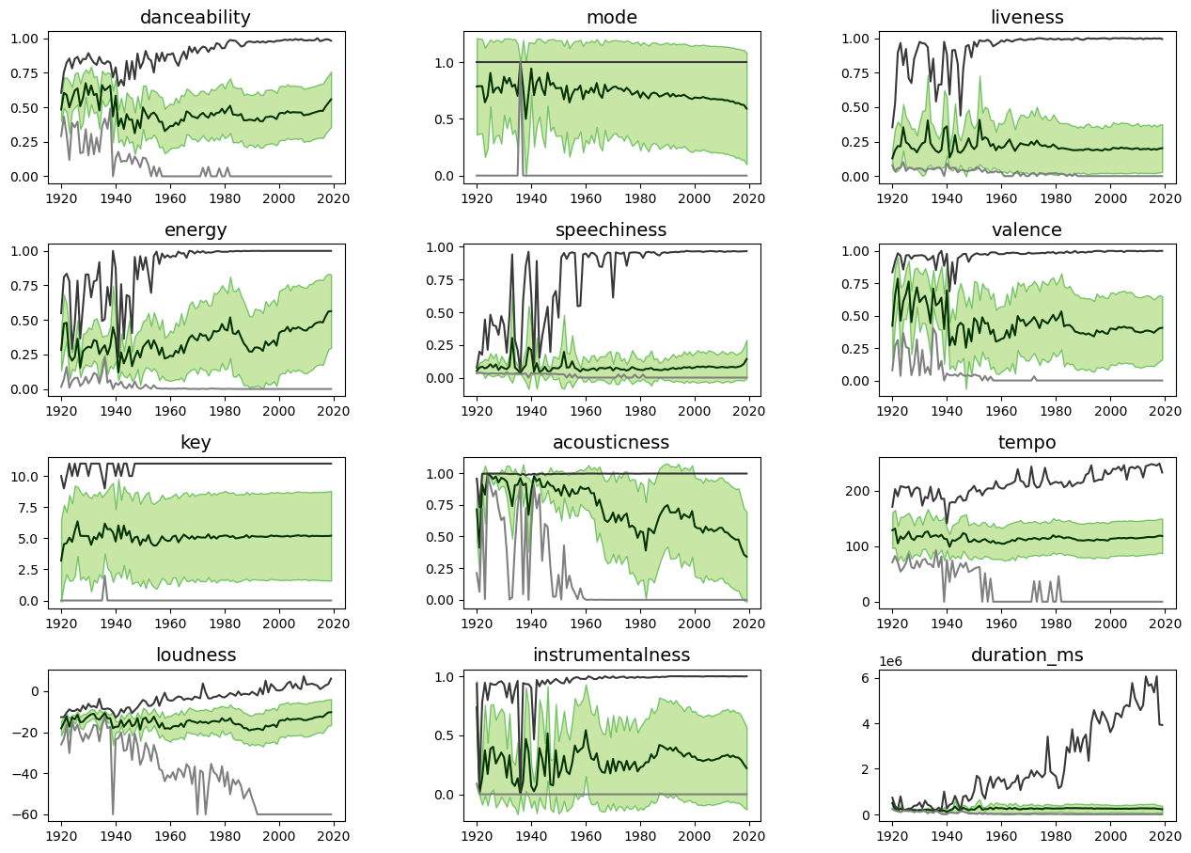
Songs im Laufe der Zeit

Slide 17
id - Spotify track ID
name - Track title
album - Album title
album_id - Spotify album ID
artists - List of artist names
artist_ids - List of Spotify artist IDs
track_number - Track number
disc_number - Disc number
explicit - Whether the song is explicit or not
danceability - How suitable a track is for dancing
energy - How intense and active a track is
key - Overall key of the track

Slide 18
loudness - Overall loudness of the track, in decibels (dB)
mode - Whether the track is in major mode (1) or minor (0)
speechiness - Proportion of spoken words in the track
acousticness - Confidence measure of whether a track is acoustic
instrumentalness - Proportion of instrumental parts in a track
liveness - Detects live audience in a track. Represents the probability that a track was performed live
valence - Measures how positive a track sounds, from 1 (extremely positive) to 0 (extremely negative)
tempo - Overall tempo of a track, in beats per minute (BPM)
duration_ms - Duration of a track, in milliseconds (ms)
time_signature - Overall time signature of a track
year - Release date of a track
release_date - Full release date of a track, usually in YYYY-MM-DD format

