Slide 1


Slide 2


Roter Faden
Datensätze
Verbindung
Analyse

Slide 3
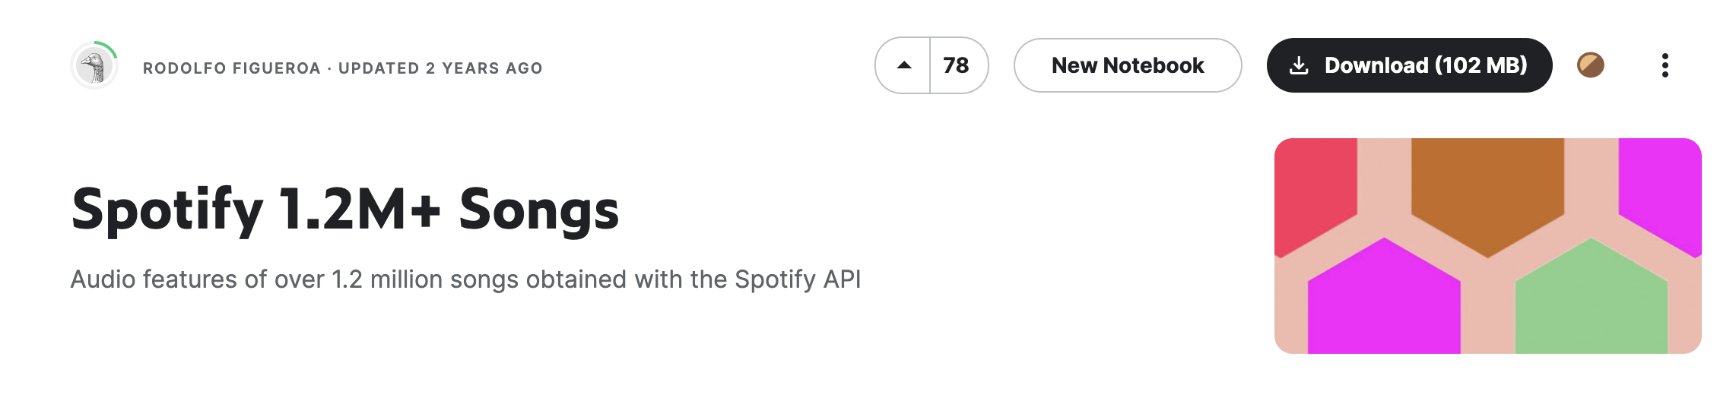
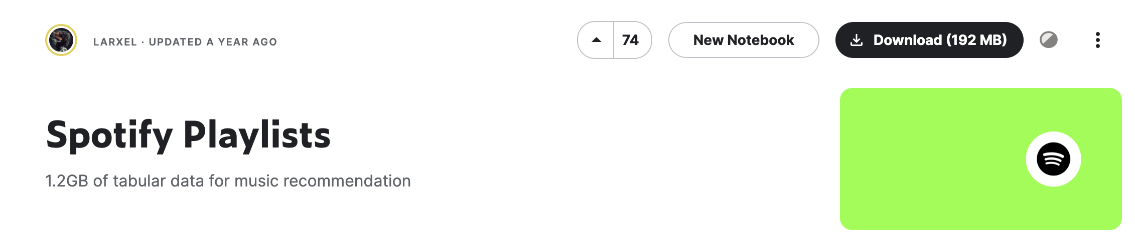
Datasets

Slide 4
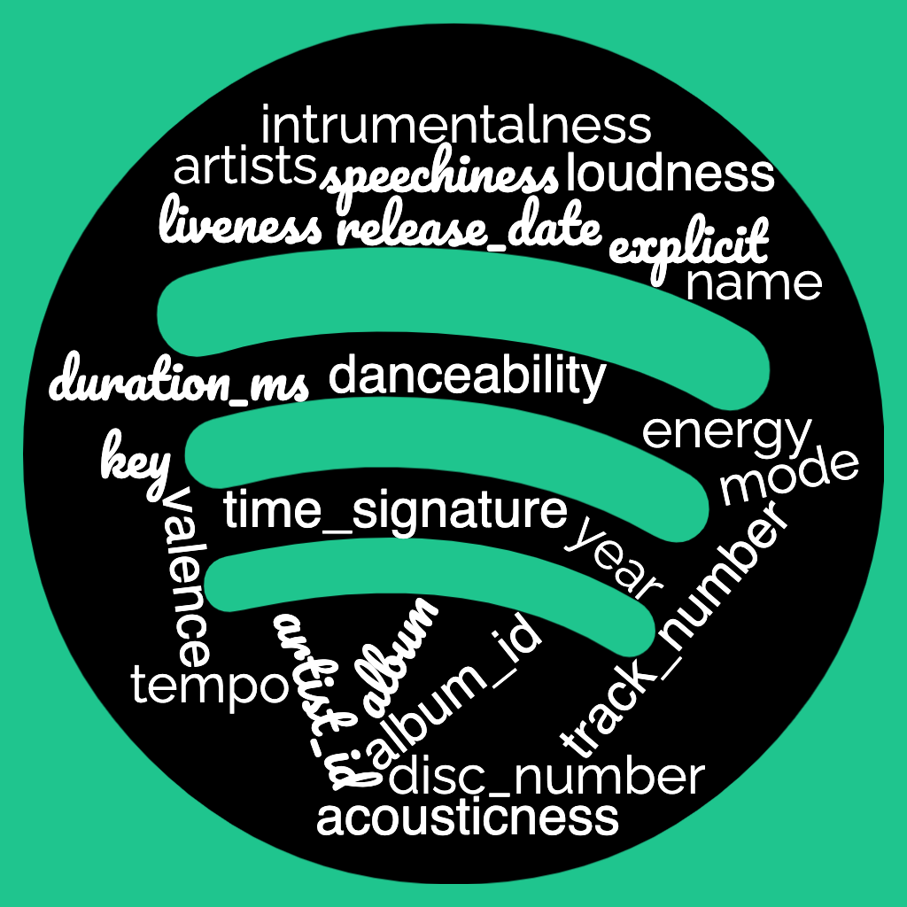
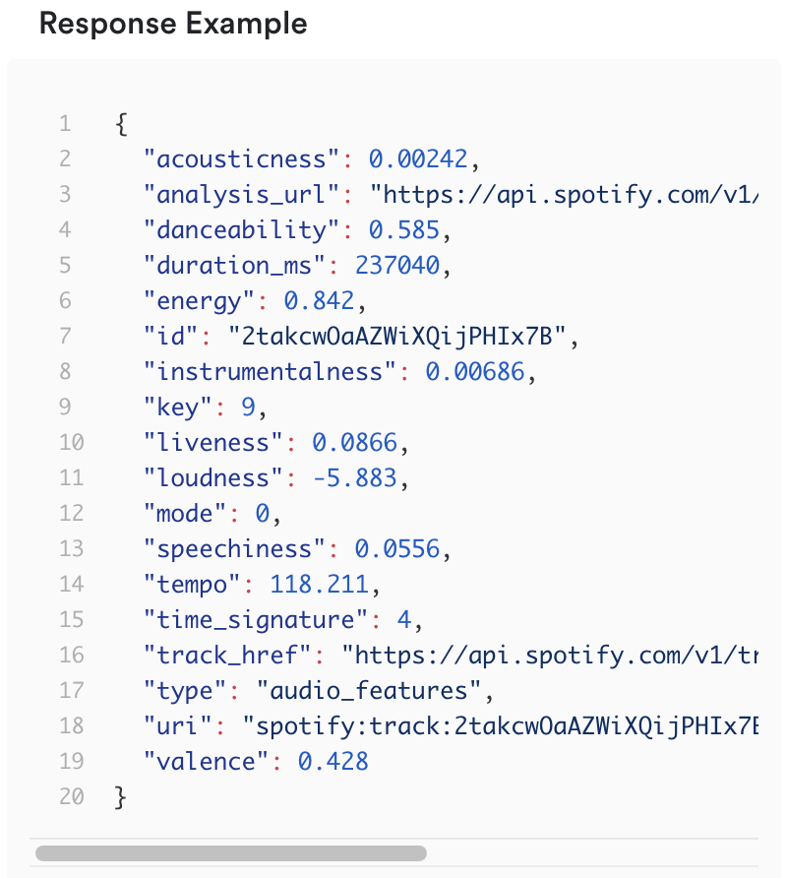
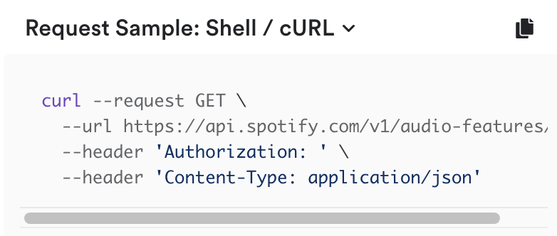
Spotify 1.2M+ Songs
generated by official Spotify API

Slide 5
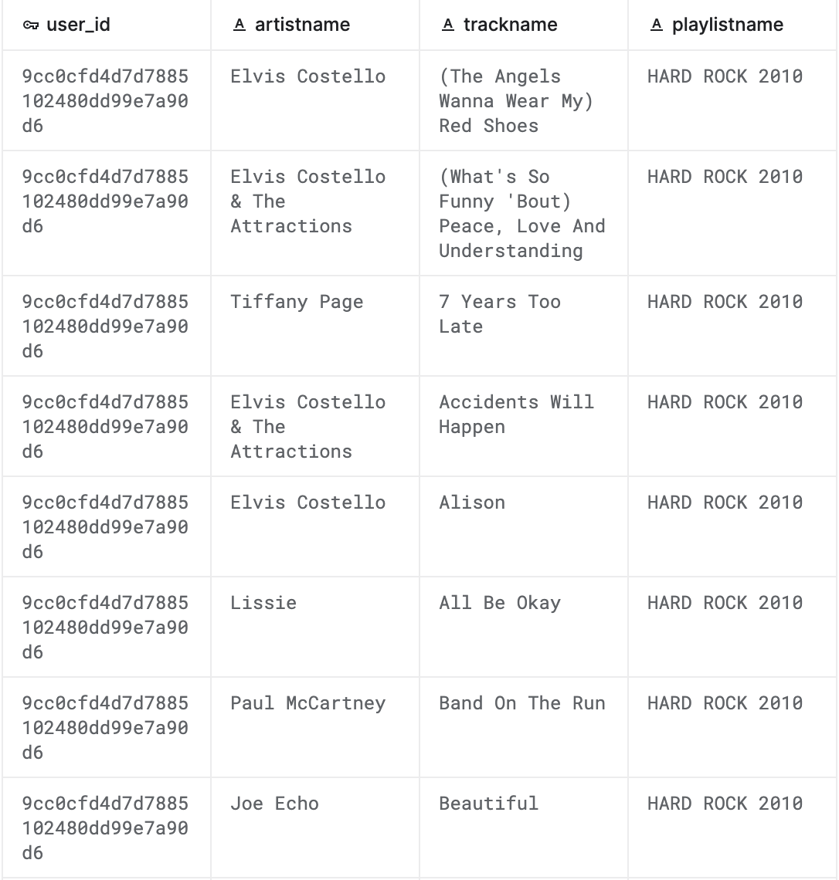
Spotify Playlists
162k playlists
16k user
2M tracks

Slide 6
Datensätze

Slide 7
Spotify 1.2M+ Songs
generated by official Spotify API

Slide 8
Spotify Playlists
162k playlists
16k user
2M tracks

Slide 9
Connection of Datasets
1.2M Songs
Playlists
id | name | artists | …
a | Flash mich | ['Mark Forster’] | …
b | Mine (feat. Drake) | ['Beyoncé’, 'Drake'] | …
user_id | artistname | trackname | playlistname
u1 | Beyoncé | Mine (feat. Drake) | December ’13
u2 | Beyoncé | Mine (feat. Drake) | Rap and R&B
u2 | Beyoncé | Mine (feat. Drake) | Top albums of 2013
u3 | Mark Forster | Flash mich | Top 100
u3 | Mark Forster | Flash mich | Random Stuff
id | name | artists | …
a | Flash mich | Mark Forster | …
b | Mine (feat. Drake) | Beyoncé | …
b | Mine (feat. Drake) | Drake | …

Slide 10
id | name | artists | …
a | Flash mich | Mark Forster | …
b | Mine (feat. Drake) | Beyoncé | …
b | Mine (feat. Drake) | Drake | …
user_id | artistname | trackname | playlistname
u1 | Beyoncé | Mine (feat. Drake) | December ’13
u2 | Beyoncé | Mine (feat. Drake) | Rap and R&B
u2 | Beyoncé | Mine (feat. Drake) | Top albums of 2013
u3 | Mark Forster | Flash mich | Top 100
u3 | Mark Forster | Flash mich | Random Stuff
artist | name | user_id | id | playlistname | ...
Beyoncé | Mine (feat. Drake) | u1 | b | December ’13 | ...
Beyoncé | Mine (feat. Drake) | u2 | b | Rap and R&B | ...
Beyoncé | Mine (feat. Drake) | u2 | b | Top albums of 2013 | ...
Mark Forster | Flash mich | u3 | a | Top 100 | ...
Mark Forster | Flash mich | u3 | a | Random Stuff | ...

Slide 11
Was ist durch merge verloren gegangen

Slide 12
Beliebtheit von Artisten
total = 19732
Notes:
Was bedeutet beliebt?
Beyoncé in jeder 6. Playlist

Slide 13
Warum beliebt?

Slide 14
Artisten mit den meisten Songs

Slide 15
Beliebtheit von Songs
Notes:
Creep in jeder 12 Playlist zu finden

Slide 16
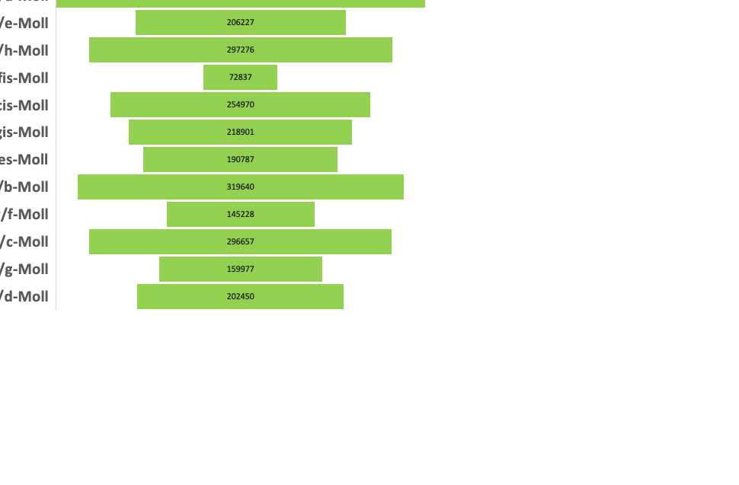
Daten zu Songs
4 min 6 sek

Slide 17
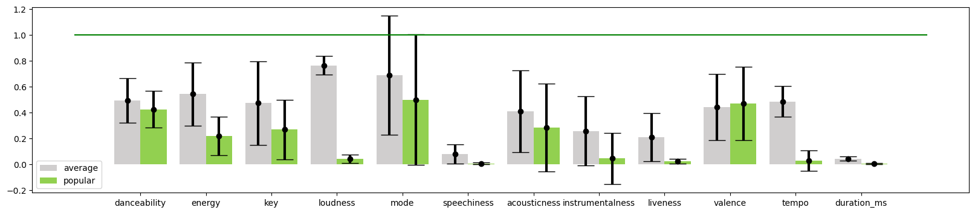
Eigenschaften von beliebten Songs

Slide 18
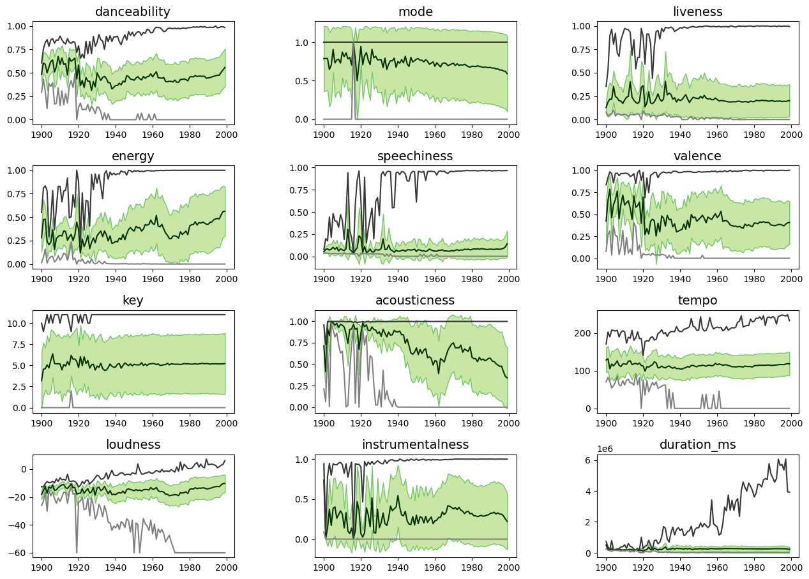
Songs im Laufe der Zeit

