Slide 1

Towards Evaluation of NIDSs in Adversarial Setting
Mohammad J. Hashemi, Greg Cusack, Eric Keller
University of Colorado Boulder
Notes:
Hi everyone my name is Mohammad Hashemi and today I wanna talk about how we can evaluate network intrusion detection systems in an adversarial setting and this work is done by me Greg Cusack and Eric Keller all from the university of Colorado Boulder

Slide 2
Network attacks are growing
Every year there is a growth in network attack complexity and scale
Wide range of impact
High monetary cost for exploited businesses
Wide-scale power outage
Billions of dollars are invested to build better tools to detect network intrusions.
Network Intrusion Detection Systems (NIDS) as a defense
Signature-based
Anomaly-based
Notes:
No text here
A graph to show network attack are growing. (symantec)

Slide 3
Network Intrusion Detection Systems
Signature-based NIDSs
Are based on known signatures
Known sequence of bytes
Fixed access patterns
Can’t detect zero-day attacks
Anomaly-based NIDSs
ML-based
Detect anomalies by measuring deviation from normal traffic
Can detect zero-day attacks
Packet-based
Kitsune [Mirsky et al. ’18] (75 citations)
Flow-based
DAGMM [Zong et al. ’18] (105 citations)
BiGAN-based [Zenati et al. ‘18] (81 citations)
Notes:
Question are they vulnerable top adversarial examples
ml-based and neural net based

Slide 4


Neural networks are vulnerable to adversarial examples
$$argmin_{δ} {\left|\left|δ\right|\right|}_{p}s.t. \left(x+δ\right)∈{\left[0,1\right]}^{m} and F\left(x+δ\right)= y_{target}$$
Gas mask
Difference magnified by 10x
French bulldog
Notes:
No animations

Slide 5
Adversarial Examples in Other Domains
Adversarial examples can be created in the physical world.
To fool face recognition systems
To fool autonomous vehicles
They can be crafted against speech-to-text systems.
They can be crafted against malware detectors.
Crafting adversarial example for each of these domains introduce its own problems.

Slide 6
Challenges of Adversarial Example attack against NIDSs

Slide 7

Image
Network Traffic
Pixel values can be modified freely.
Changing some of the features extracted from the network traffic can break down the communication.
Too much delay between packets
Adding extra bytes at the end of a packet to change its length
0
255

Slide 8
Image
Network Traffic
Pixels can be changed independently of each other.
Some features depend on each other.
Flow duration
Packets
Average IAT = Flow duration / (Packet counts – 1)
+4
-6
No dependency

Slide 9
Image
Network Traffic
All pixels can be modified to fool an image classifier.
Features extracted from victim’s packets can’t be changed.
No control over Victim Packets

Slide 10
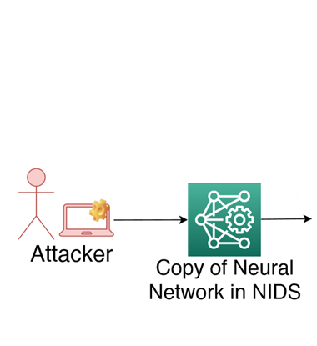
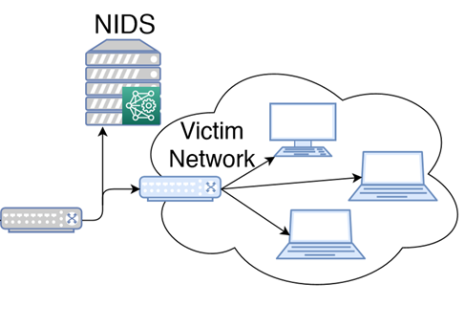
Threat Model
1
3
2

Slide 11
Legitimate Packet Transformations
Constraints
Transformations
Changing the delay between packets
Carry out original malicious intent
Splitting a packet
Not break underlying network protocols
Injecting fake packets
Notes:
Maybe no arrow

Slide 12
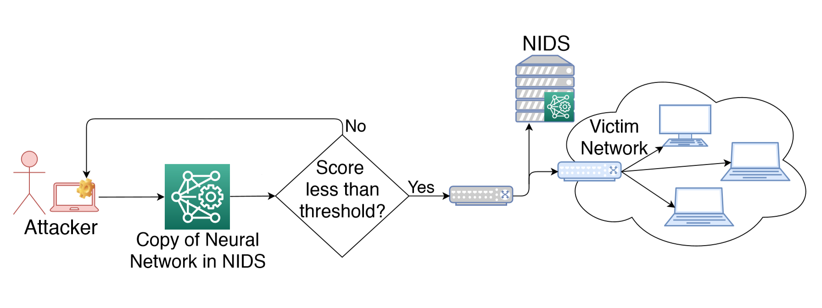
Attack in a Nutshell
3
4
1
2

Slide 13

Adversarial Examples for Packet-based NIDSs
If packet is sent from the attacker
find the minimum extra delay that can bring the anomaly score bellow a given threshold.
Does Binary search in the range between 0 and $t_{max}$.
Converts a large packet to multiple smaller packets.
Checkpoints the current state of the local copy.
Randomly split the packet into two r and L-r packets.
If the first portion could fool the local copy repeat the procedure for the remaining L-r bytes
Otherwise restore the state of local copy and choose a different r and repeat.
Try Delay
Try Split

Slide 14
Adversarial Examples for Packet-based NIDSs
If packet is sent from the victim
Sends a fake packet before a given victim’s packet.
Checkpoints the current sate of the local copy.
Sends a packet with a random length.
If the scores of the fake packet and the victim’s packet are less than threshold send them.
Otherwise restore the state of the local copy and send a packet with a different length.
For a given attack if this procedure failed multiple times we run it less frequently.
Try Inject

Slide 15
Adversarial Examples for Flow-based NIDSs
Flow features can be categorized into the 4 groups
Features extracted from victim’s packets and should not be changed.
Total length of backward packets
Minimum length of backward packets
Features that can be changed independently by using legitimate transformations.
Total forward packets
Total number of push flags in forward direction
Maximum IAT in forward direction
Features that their values depend on the 2nd group and can be calculated by a set of them.
Flow IAT can be calculated by the help of flow duration and total number of packets.
Features that can’t be recalculated based on independent features and a sequence of packets affect their values.
Standard deviation of packet lengths in forward direction
Notes:
Too much text
Animations
Say what is backward packet
Take adversarial loss out

Slide 16
Adversarial Examples for Flow-based NIDSs
Mask 1
Mask2
Mask3
0
0
0
0
1
1
1
1
0
0
0
0
0
0
0
0
Group 1
Group 2
Group 3
Group 4
0
0
0
0
1
1
1
1
0
0
0
0
1
1
0
0
Group 1
Group 2
Group 3
Group 4
0
0
0
0
1
1
1
1
0
0
0
0
1
1
1
1
Group 1
Group 2
Group 3
Group 4
$$Adversarial Loss=F(x+δ⨀mask_{i})$$
Recalculate group 3 features after each step of GD
Alg. threshold
NIDS threshold

Slide 17
Evaluation

Slide 18
Dataset
We used CICIDS2017 dataset (194 citations).
Contains network traces of 12 network attacks.
FTP-Patator
SSH-Patator
DoS attacks
Botnet
Port Scan
etc.
Suitable for both packet-based and flow-based NIDSs.
Contains PCAP files
Contains aggregated features extracted from the whole flows.

Slide 19
Dataset
The data is collected over a 5-day work week.
Mon. contains only benign traffic
Train set
Tue. – Fri contain both benign and malicious traffic
Test set
55 million packets (2.8 million flows)
10.33% of packets are labeled as malicious.
24.22% of flows are labeled as malicious.
Notes:
Maybe the first bullet point should be taken out

Slide 20
Evaluation Metric
True Positive Rate (TPR)
Ratio of malicious traffic that is detected to all of the malicious traffic.
False Positive Rate (FPR)
Ratio of benign traffic that is considered malicious to all of the benign traffic.
We set the threshold of each NIDS in a way to keep their FPR at 0.1 and we report their TPR in different settings.

Slide 21
Average Detection Rate Across All Attacks
Notes:
Convert it to a graph

Slide 22
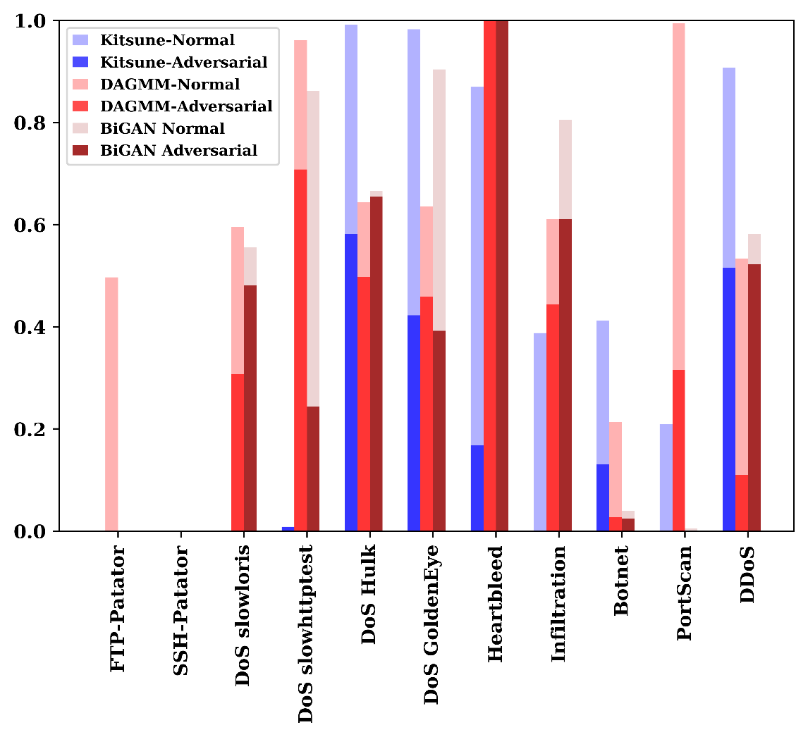
68% drop
TPR
70% drop
Notes:
Label y axis
Make star on graph
Update drop rate
Highlight from this graph

Slide 23
Future Works
Current NIDSs behave deterministically.
If adversary Fools the local copy it guarantees to fool the victim’s NIDS as well.
The adversary can’t directly query the victim’s NIDS.
Build a stochastic NIDS.
For flow-based NIDSs we measured their lower-bound of robustness.
Good for comparing different NIDSs against each other
For finding exact level of robustness we want to build a tool to modify the packets in each flow to match the extracted features with the adversarial features.

Slide 24
Conclusion
How to evaluate NIDSs in an adversarial setting.
With the help of legitimate transformations.
Not breaking the underlying protocols.
Can drop detection rates by up to
70% for packet-based NIDSs
68% for flow-based NIDSs

Slide 25
Questions?

