Slide 1


Breaking the Trust Dependence on Third Party Processes for Reconfigurable Secure Hardware
Aimee Coughlin, Greg Cusack, Jack Wampler, Eric Keller, Eric Wustrow

Slide 2

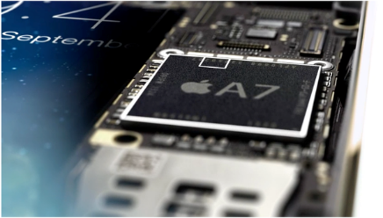
What is secure hardware?
Hardware that protects against other parts of the system
Implemented such that you can trust its functionality
Useful for defending against untrusted software
Can defend against some kinds of physical threats

Slide 3

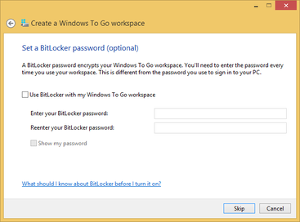
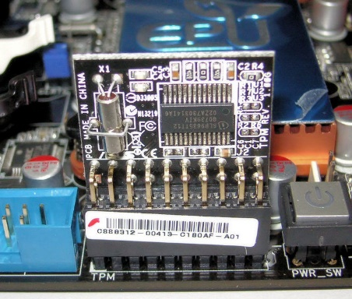
Trusted Platform Modules
Secure coprocessor that provides cryptographic functions and key storage
Most popularly used for disk encryption

Slide 4
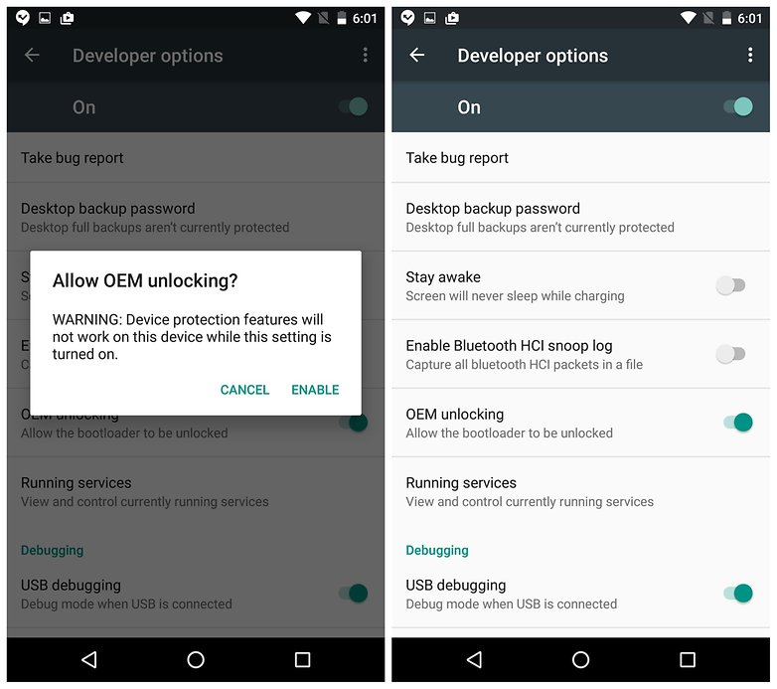
Secure Boot
Ensures that only trusted system software can boot by checking the signature of the software before it boots

Slide 5


Trusted Execution Environments
App 1
App 2
Isolated App
Operating System
CPU
TEE
Isolated Memory
Memory

Slide 6
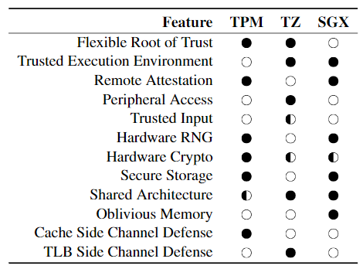
Problem: Only Manufacturers Make Decisions
What features to include
When and if patches are available

Slide 7
What if Developers Could Make These Decisions?
Application
define
Operating System
Processor
Secure Hardware

Slide 8
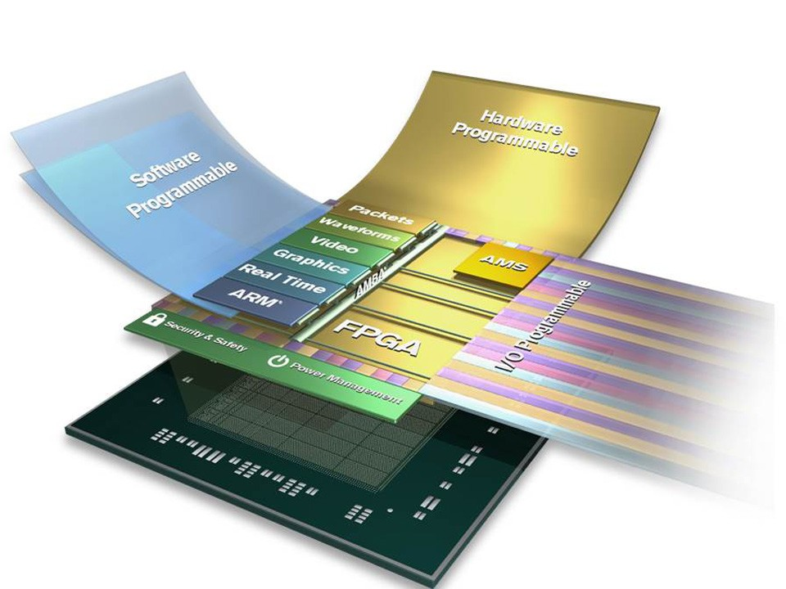
Enter FPGAs
Leverage programmability of FPGAs to enable reconfigurable secure hardware
Expose programmability to developers

Slide 9
The Downside of Programmability
Immutable nature of silicon is a basis for the guarantees of secure hardware
Programmability compromises security properties
Desired Config
Secure HW Function
FPGA

Slide 10
The Downside of Programmability
Attacker
Immutable nature of silicon is a basis for the guarantees of secure hardware
Programmability compromises security properties
Desired Config
Attacker’s Function
FPGA

Slide 11

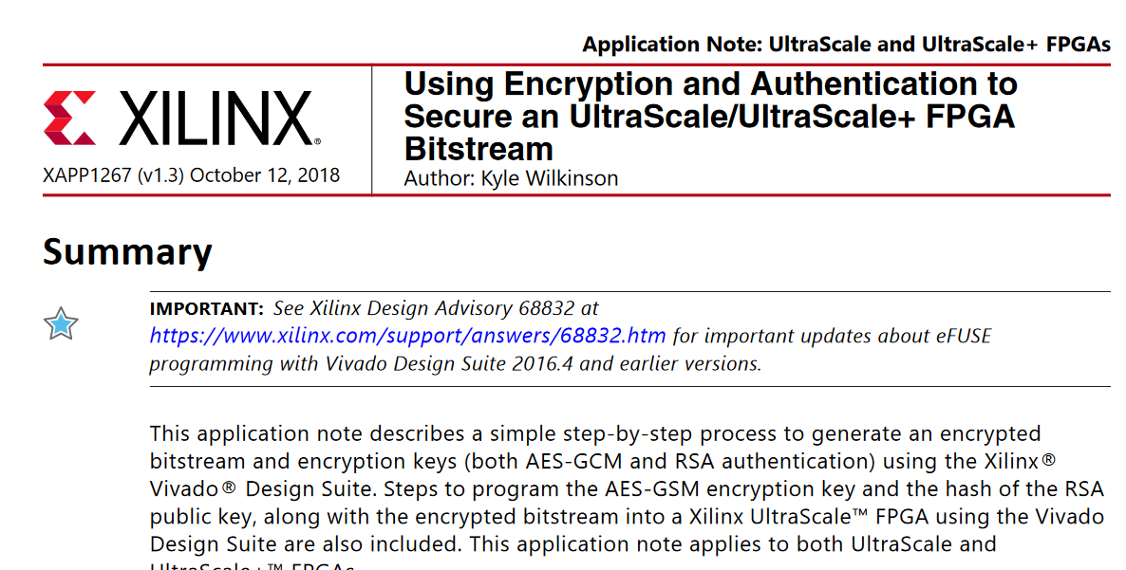
Bitstream Protection (widely available)
Desired Config
Encrypt Bitstream
Decrypt bitstream
Secure HW Function
FPGA

Slide 12
Bitstream Protection – can’t attack the device
Attacker
Desired Config
Encrypt Bitstream
Decrypt bitstream
Secure HW Function
FPGA

Slide 13
Bitstream Protection – CAN attack the process
Attacker
Desired Config
Encrypt Bitstream
Encrypt Bitstream
Decrypt bitstream
Insecure HW Function
FPGA

Slide 14
Breaking the Trust Dependence on Third Party Processes for Reconfigurable Secure Hardware

Slide 15
High-level Idea
Self-provisioning
Key creation and maintenance is internal to device
Policy-controlled update system
Decrypt bitstream
Secure HW Function
Update
System
Desired Config
FPGA

Slide 16
Defining some Roles
FPGA Manufacturer
System Manufacturer
System Provisioner <= loads an initial FPGA configuration
Application Developer <= loads secure hardware configuration
User <= operates the device
(roles may be overlap)

Slide 17
Self-provisioning
Start with empty device
self
Provision
config
Secure Storage
Secure Boot
Initial
config
FPGA

Slide 18
Self-provisioning
Start with empty device
self
Provision
config
Secure Storage
Secure Boot
Initial
config
Can only be read by specific hardware
FPGA

Slide 19
Self-provisioning
Start with empty device
self
Provision
config
Secure Storage
Secure Boot
Initial
config
Stores a public key
the device will only load an image generated with the corresponding key
FPGA

Slide 20
Self-provisioning (1) – Generate Key Pair
Special self-provisioning config used by system provisioner
self
Provision
config
Secure Storage
Secure Boot
self
Provision
system
(1) Generate a key pair
(2) Store the secret key in secure storage.
(3) Program the public key to the secure boot system on the device.
Initial
config
FPGA

Slide 21
Self-provisioning (1) – Generate Key Pair
Special self-provisioning config used by system provisioner
self
Provision
config
Secure Storage
Secure Boot
self
Provision
system
(1) Generate a key pair
(2) Store the secret key in secure storage.
(3) Program the public key to the secure boot system on the device.
(4) Sign/encrypt the initial FPGA configuration with secret key.
Initial
config
Initial
Config
(Signed)
FPGA

Slide 22
Self-provisioning (2) – Load Initial Config
Only this specific configuration can be loaded onto the FPGA (next power cycle)
Secure Storage
Secure Boot
Initial
Config
(Signed)
Update
System
(w/ INITIAL policy)
Initial policy could include a one-time use key
FPGA

Slide 23
Loading Secure HW App (1) – verify policy
The user initiates the loading of a new config
Secure Storage
Secure Boot
Initial
Config
(Signed)
(1) Receive an update.
(2) Verify that the update conforms to the update security policy.
Update
System
(w/ INITIAL policy)
Desired
Secure HW App
FPGA

Slide 24
Loading Secure HW App (1) – verify policy
The user initiates the loading of a new config
Secure Storage
Secure Boot
Initial
Config
(Signed)
(1) Receive an update.
(2) Verify that the update conforms to the update security policy.
(3) Use secret key to sign/encrypt the update
(using embedded encryption hw)
Update
System
(w/ INITIAL policy)
Desired
Secure HW App
Desired
Secure HW App
(signed)
FPGA

Slide 25
Loading Secure HW App (2) – Load Desired Config
The secure HW App is then loaded
Secure Storage
Secure Boot
Secure HW App
Update
System
(w/ NEW policy)
Desired
Secure HW App
(signed)
FPGA

Slide 26
Update Policies: Implemented by the loaded config
Flexibility to use a variety of means to protect the update (including multiple-factors)
User inputs, key maintained by trusted dev, key maintained by user, etc.
Flexibility to implement a variety of policies
Trust once (initially unprotected)
One time key (protected by shared key)
2 factor (signed by trusted dev and user input PIN)
No updates allowed

Slide 27

Implementation
Self-provisioning, secure update, secure storage on Xilinx Zynq Ultrascale+
Application: TEE (like SGX but with custom root of trust)
Remote client
ARM CPU
Remote Attestation
Server endpoint
Enclave driver
Enclave libraries
FPGA Fabric
Enclave
Logic
Secure RNG
ECDSA
Enclave
Loader /
Verifier
config
Isolated Execution Environment

Slide 28

SDK for the TEE
Enclave library
User created
Enclave Applications:
SHA512
Password manager
Just copy-in / copy-out
Contact Matcher (like Signal)
libenc.h
interface.json
libenc.c
arm.c
enclave.c
SDK
Selected Option
SW Enc
HW enc
ARM binary
HW config w/ MicroBlaze and executable
HLS Generated HW config

Slide 29
Conclusion
Main Take Away:
We don’t need to trust the system provisioner to maintain keys
Our system
protects the most important key (self-provisioning)
provides flexibility to determine how updates happen (policy)

Slide 30
Thank you
Eric.Keller@Colorado.edu

