Slide 1

Resource Management in Cloud Computing Using Machine Learning: A Survey
Sepideh Goodarzy, Maziyar Nazari, Richard Han, Eric Keller, Eric Rozner
University of Colorado Boulder

Slide 2











Slide 3
Cloud Providers Objective and Priorities
Maximizing Resource Efficiency
Minimizing Job Completion time
Minimizing Delay
Maximizing SLAs
Minimizing User’s Cost
Saving Energy
…
Resource Management

Slide 4
Resource Utilization
Less resource slack, more resource efficiency
More computing power, less delay, more SLA
CPU Limit

Slide 5
How Have Researchers Targeted This Problem?
Heuristics
Knowledge Beforehand
Algorithms
Too General
Machine Learning
Dynamic, Workload-Specific, Does not Need Knowledge Beforehand

Slide 6
Research Works Targeting Resource Management
Supervised Learning
Unsupervised Learning
Reinforcement Learning

Slide 7
Machine Learning Models
Supervised
Training Data = Feature Values + Known Label
Unsupervised
Reinforcement Learning
No Label in Training Data
Agents Finds the best sequence of actions in an environment to to maximize the notion of cumulative reward

Slide 8
Reinforcement Learning
Instant gain is not important!
Good For Decision Making!

Slide 9

Supervised Learning
Towards energy-aware scheduling in data centers using machine learning
Performance evaluation of a green scheduling algorithm for energy savings in cloud computing

Slide 10
Maximize SLA while optimizing energy consumption
Two main Techniques:
Turn off idle Machines
Consolidate tasks
J. L. Berral, ́I. Goiri, R. Nou, F. Julia`, J. Guitart, R. Gavalda`, and J. Torres, “Towards energy-aware scheduling in data centers using machine learning,” in Proceedings of the 1st International Conference on energy-Efficient Computing and Networking, 2010

Slide 11
Recent CPU% Usage
Predicted Current CPU% Usage
Predicted Power consumption
LR
M5P
Dynamic Backfilling
Predicted SLA
Notes:
Greedy ??
Identical Machines!
Heavy Backfilling!
Only CPU?
60s booting time ?

Slide 12

What happens if the load increases? 60 seconds booting time is not efficient!

Slide 13
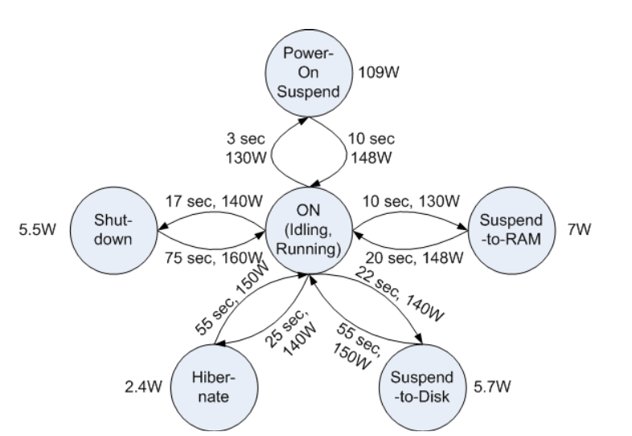
Consider Different On/Off States
Feedforward NN
Recent Workload
Current Workload
Turn on/off VM
T. V. T. Duy, Y. Sato, and Y. Inoguchi, “Performance evaluation of a green scheduling algorithm for energy savings in cloud computing,” in 2010 IEEE international symposium on parallel & distributed processing, workshops and Phd forum (IPDPSW).
Notes:
Their best result is when they keep 20% servers on more than what they have predicted

Slide 14

Still solving single dimension bin packing problem with not optimum algorithms!

Slide 15
Unsupervised Learning
Dejavu: accelerating resource allocation in virtualized environments

Slide 16
Deja Vu
Cluster workload based on their signatures (simple k-means)
Compute the required resource for each cluster with linear search
map workloads to available resources
N. Vasic ́, D. Novakovic ́, S. Miucˇin, D. Kostic ́, and R. Bianchini, “Dejavu: accelerating resource allocation in virtualized environments,” in Proceedings of the seventeenth international conference on Architectural Support for Programming Languages and Operating Systems, 2012

Slide 17
Same config for all the workloads in the same cluster even though they have different feature!

Slide 18
Reinforcement Learning
Resource management with deep reinforcement learning
Multi-objective workflow scheduling with deep-q-network-based multi-agent reinforcement learning

Slide 19
what about considering multiple resources (CPU, Memory, Network, etc) in problem space?

Slide 20
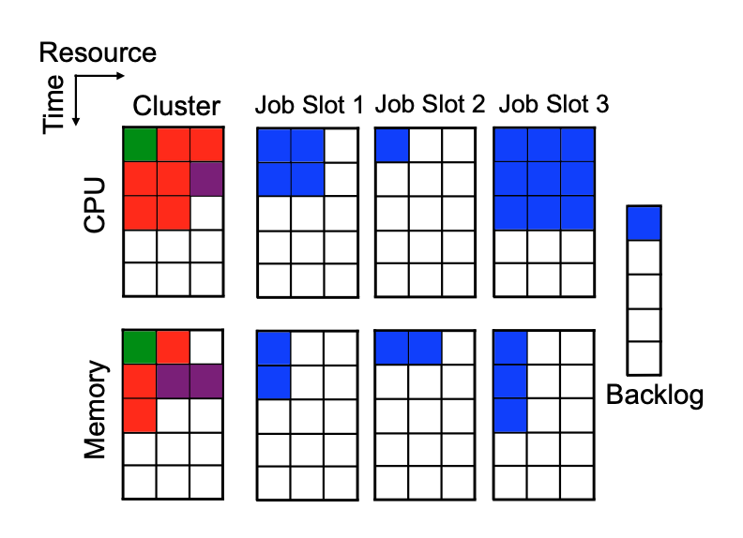
d resource type in the problem space (memory, cpu, etc)
State space: The current re-source allocation, the resource profiles of the first M jobs waiting to be scheduled, #jobs stored in the backlog
Action space: scheduling jobs
A single Dynamic objective!
Jobs can’t be preempted!
H. Mao, M. Alizadeh, I. Menache, and S. Kandula, “Resource management with deep reinforcement learning,” in Proceedings of the 15th ACM Workshop on Hot Topics in Networks, 2016

Slide 21
How about multiple dynamic conflicting objectives ?

Slide 22
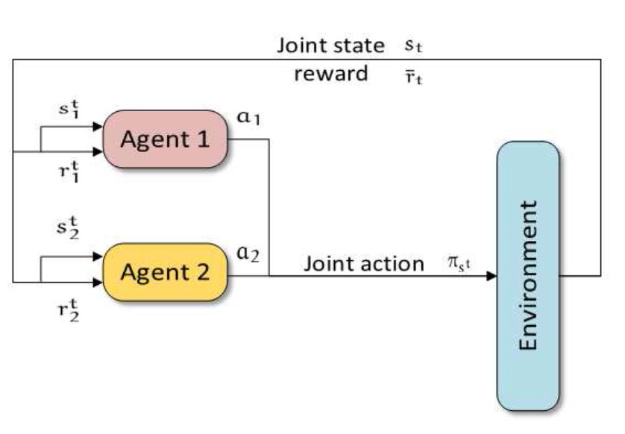
Multi-objective Workflow Scheduling with Deep-Q- network-based Multi-agent Reinforcement Learning
Decentralized deep-Q-network in Multi-agent RL setting
Minimizing make-span time and user’s cost optimization
Considered Job Dependency DAGs!
Y. Wang, H. Liu, W. Zheng, Y. Xia, Y. Li, P. Chen, K. Guo, and H. Xie, “Multi-objective workflow scheduling with deep-q-network-based multi-agent reinforcement learning,” IEEE Access, vol. 7, 2019.

Slide 23
Future Work
Supervised | Unsupervised | RL
Can be used hybrid with RL to estimate the resource usage profile of jobs | Can be used hybrid with RL for handling adversarial changes | Online RL (Meta learning)
 |  | Unknown resource usage profile before hand (POMDP)
 |  | Preemptable Jobs ( Multi agent)
 |  | More than two objectives
 |  | Drastic changes (Adversarial RL)

Slide 24

Thank you
Email: Sepideh.Goodarzy@Colorado.edu

Slide 25
Questions?

Slide 26
References are available in the Paper!

