Slide 1
Virtualizing the Data Plane Through Source Code Merging
Eric Keller, Evan Green
Princeton University
PRESTO 2008
8/22/08

Slide 2
Zooming In On a Virtual Router
Custom functionality
  Custom user environment on each node (for controlling virtual router)
  Specify single node’s packet handling
Isolated from others sharing same node
  Allocated share of resources (e.g. CPU, memory, bandwidth)
  Protected from faults in others (e.g. another virtual router crashing)
Highest performance possible
User Control Environment
Config/Query interface
From
devices
A1
A2
A3
To
devices
A4
A5
Notes:
The user experience is that they have their own user space environment where they can submit a graph to be loaded, can run applications (like routing software)
This graph is their source code. And it’s shown as a graph, but it’s just meant to mean their custom functionality.

Slide 3
General Virtualization
Isolation: Namespace, Resource, Performance
Full/Para Virtualization
  Separate operating system
  By emulating underlying hardware
  Each OS has own network stack
Container Virtualization
  Separate data structures
  By modifying kernel
  Shared network stack, each container can configure
Notes:
Resource Isolation – controlling access to resources such as devices, memory, disk
Performance Isolation – performance of one VM should not affect performance of another VM (e.g. a VM gets to run 10% of the time)
Namespace Isolation
In full virtualization – can create own kernel modules, but performance is limited.
In container virtualization – individual VEs can’t load own kernel modules.

Slide 4
Packet Processing Configurability
Goal: run custom code for packet processing
Requires: isolation
  Namespace, resource, performance
Could run each instance of custom code in a VM
  Isolation provided by virtual machine
Lighter weight solution
  Provide appearance of multiple instances
  While, still providing isolation
Click as platform for this lightweight solution

Slide 5
Click Background: Overview
Software architecture for building configurable routers
  Widely used – commercially and in research
  Easy to use, flexible, high performance
Routers assembled from packet processing modules (Elements)
  Simple and Complex
Processing specified as directed graph
Includes a scheduler
  Schedules tasks (a series of elements)
FromDevice(eth0)
Counter
Discard

Slide 6
Lightweight Virtualization
Source Code Merging: Combine graphs
  Each virtual router specifies custom graph
  Can target hardware or software
Add extra packet processing (e.g. mux/demux)
  Needed to direct packets to the correct graph
Add resource accounting
Graph 1
combine
Master
graph
Graph 2
Master Graph
Graph 1
Input
port
Output
port
Graph 2

Slide 7
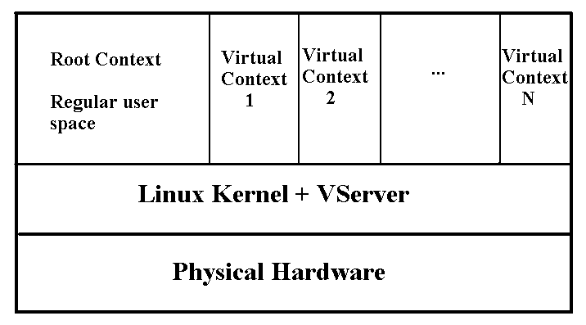
Prototype Implementation:
Linux-VServer + Click + NetFPGA (future)
Coordinating Process
Install/
Query
Install/
Query
Install/
Query
Click
Click on NetFPGA

Slide 8
Resource Accounting with VServer
Purpose of Resource Accounting
  Provides performance isolation between virtual routers
VServer’s Token Bucket Extension to Linux Scheduler
  Controls eligibility of processes/threads to run
Integration with Click
  Unified accounting for packet processing and control
  Each Click configuration assigned to a thread
  Each thread associated with a VServer context
  ~10% overhead of 10 virtual routers vs unshared node

Slide 9
Isolation Properties
Performance Isolation
  Associate each graph with virtual container
  Assume library of “safe” elements that execute within a bounded amount of time
Namespace Isolation
  Coordinating process statically renames
Resource Isolation
  Memory: assume library of “safe” elements that do not access memory outside of element
  Devices: Coordinating process adds mux/demuxing elements
Next: examine relaxing to allow custom elements

Slide 10
Problem 1: Unyielding Threads
Linux kernel threads are cooperative (i.e. must yield)
  Token scheduler controls when eligible to start
Single long task can have short term disruptions
  Affecting delay and jitter on other virtual networks
Token bucket does not go negative
  Long term, a virtual network can get more than its share
Tokens added (rate A)
Size of Bucket (S)
Min tokens to exec (M)
Tokens consumed
(1 per scheduler tick)
Notes:
Length of burst meant to be controlled by S, how long to put on hold is M.

Slide 11
Problem 1: Unyielding Threads (soln.)
Determine graph’s execution time
  Standard N port router example - ~ 5400 cycles (1.8us)
  RadixIPLookup (167k entries) - ~1000 cycles
Option 1: Break up graph
Option 2: Execute inside of container
elem1
elem2
elem3
elem1
elem2
To
User
From
Kern
elem3
Notes:
execution time is estimate due to cache issues (when in doubt…)
If an element takes too long (and is known) that can go into a container and really have no effect since its processing time dominates the overhead of kernel/user

Slide 12
Problem 2: Custom Elements in C++
Elements have access to global state
  Kernel state/functions
  Click global state
Could… (and we did)
  Pre-compile in user mode
  Pre-compile with restricted header files
Not perfect:
  With C++, you can manipulate pointers
Instead, custom elements are unknown (“unsafe”)
  For absolute safety, execute in container

Slide 13
Future Work
Safety
  Modify source code to add checks (e.g. CCured)
  Run-time monitoring
  Explore alternative tradeoff points
Add support for specialized devices (FPGAs)
  Click to FPGA
  Partitioning graph across FPGA and Software
  Specification of elements
    Language to target either HW or SW

Slide 14
Conclusion
Goal: Enable custom data planes per virtual network
Built prototype system for virtual Click in kernel
  Merging Click graphs of different virtual routers
  Adding elements to mux/demux packet to correct graph
  Unified resource accounting with Linux-VServer
Discussed issues of safety
  Performance Isolation: Unyielding threads
  Resource Isolation: Pointers
Using source code
  Enables a lightweight virtualization mechanism
  Opens up compile time solutions to safety

Slide 15
Questions

