Slide 1

Virtual ROuters On the Move (VROOM):
Live Router Migration as a Network-Management Primitive
Yi Wang, Eric Keller, Brian Biskeborn,
Kobus van der Merwe, Jennifer Rexford

Slide 2
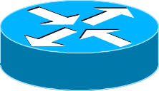
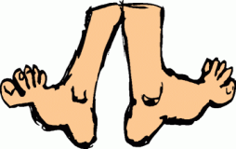
Virtual ROuters On the Move (VROOM)
Key idea
  Routers should be free to roam around
Useful for many different applications
  Simplify network maintenance
  Simplify service deployment and evolution
  Reduce power consumption
  …
Feasible in practice
  No performance impact on data traffic
  No visible impact on control-plane protocols
Notes:
The key idea of VROOM is that routers should be free to roam around, instead of being permanently attached to a specific piece of hardware.
In this talk, I’ll first show that VROOM is useful for many different network management applications, such as simplifying network maintenance, simplifying service deployment and evolution. In fact, it can also save us power.
I will then show through our prototype implementation and evaluation that VROOM is actually feasible in practice, with no performance impact on data traffic and no visible impact on routing protocols.

Slide 3
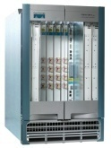
The Two Notions of “Router”
The IP-layer logical functionality, and the physical equipment
Logical
(IP layer)
Physical
Notes:
Here is the basic idea of VROOM: virtual router instances running on top of physical routers form the logical topology of a network.
The physical routers only provide shared hardware resource and the necessary virtualization support. It is the virtual routers that run routing protocols and forward actual traffic.

Slide 4
The Tight Coupling of Physical & Logical
Root of many network-management challenges (and “point solutions”)
Logical
(IP layer)
Physical
Notes:
They are basically the same thing in people’s mind. When we think of a node in a topology, we also have the physical box in our mind, and vice versa.

Slide 5
VROOM: Breaking the Coupling
Re-mapping the logical node to another physical node
VROOM enables this re-mapping of logical to physical through virtual router migration.
Logical
(IP layer)
Physical
Notes:
The mapping can change, maintaining the IP layer logical topology and configuration intact.
Each virtual router has its own routing protocol instances and its own forwarding tables. A physical router can support multiple virtual router instances through virtualization.

Slide 6
Case 1: Planned Maintenance
NO reconfiguration of VRs, NO reconvergence
VR-1
A
B

Slide 7

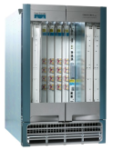
Case 1: Planned Maintenance
NO reconfiguration of VRs, NO reconvergence
A
VR-1
B

Slide 8
Case 1: Planned Maintenance
NO reconfiguration of VRs, NO reconvergence
A
VR-1
B

Slide 9


Case 2: Service Deployment & Evolution
Move a (logical) router to more powerful hardware
Notes:
In ISPs, as a service grows, it may need to be moved to a more powerful router. Today, this process usually involves certain period of downtime.

Slide 10
Case 2: Service Deployment & Evolution
VROOM guarantees seamless service to existing customers during the migration

Slide 11
Case 3: Power Savings
$ Hundreds of millions/year of electricity bills

Slide 12
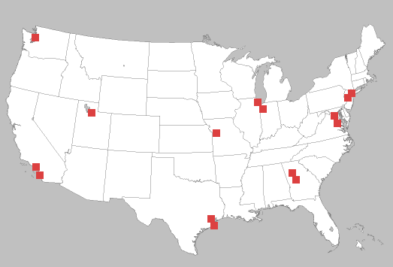


Case 3: Power Savings
Contract and expand the physical network according to the traffic volume

Slide 13
Case 3: Power Savings
Contract and expand the physical network according to the traffic volume

Slide 14
Case 3: Power Savings
Contract and expand the physical network according to the traffic volume

Slide 15
Virtual Router Migration: the Challenges
Migrate an entire virtual router instance
  All control plane & data plane processes / states

Slide 16
Virtual Router Migration: the Challenges
Migrate an entire virtual router instance
Minimize disruption
  Data plane: millions of packets/second on a 10Gbps link
  Control plane: less strict (with routing message retrans.)

Slide 17
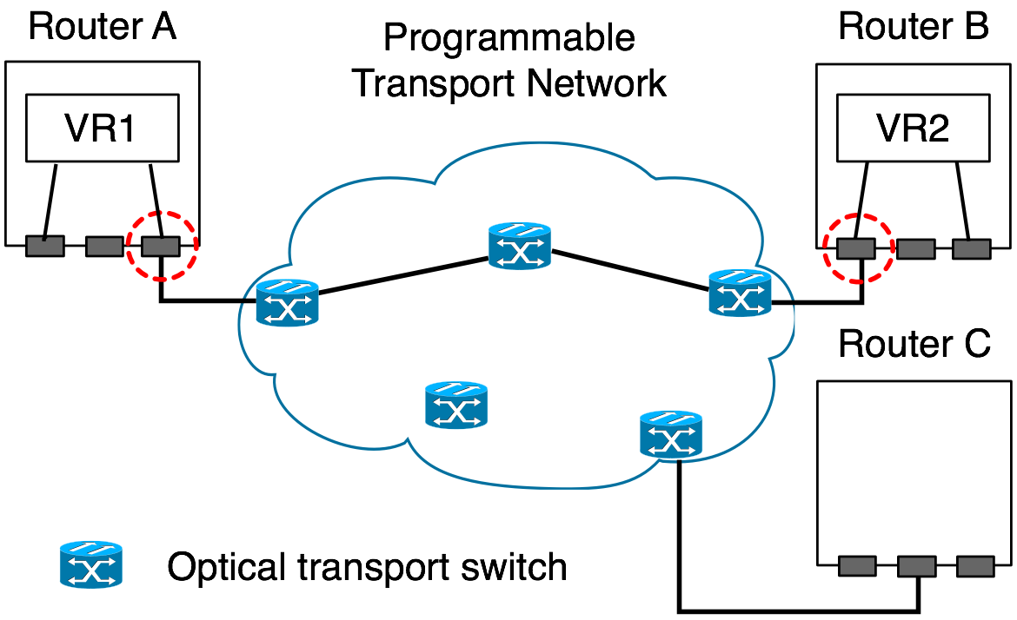
Virtual Router Migration: the Challenges
Migrating an entire virtual router instance
Minimize disruption
Link migration
Notes:
We need to migrate all the links associated with the virtual router as well. To do this in a seamless fashion, we leverage the fact that in ISPs a point-to-point link at the IP layer is usually a multi-hop path in the underlying transport network. The advances of the transport network now offer the capability to dynamically setup a new optical path and switch the old path to the new path virtually instantaneously. This allows us to realize link migration by configuring the optical transport networks.

Slide 18
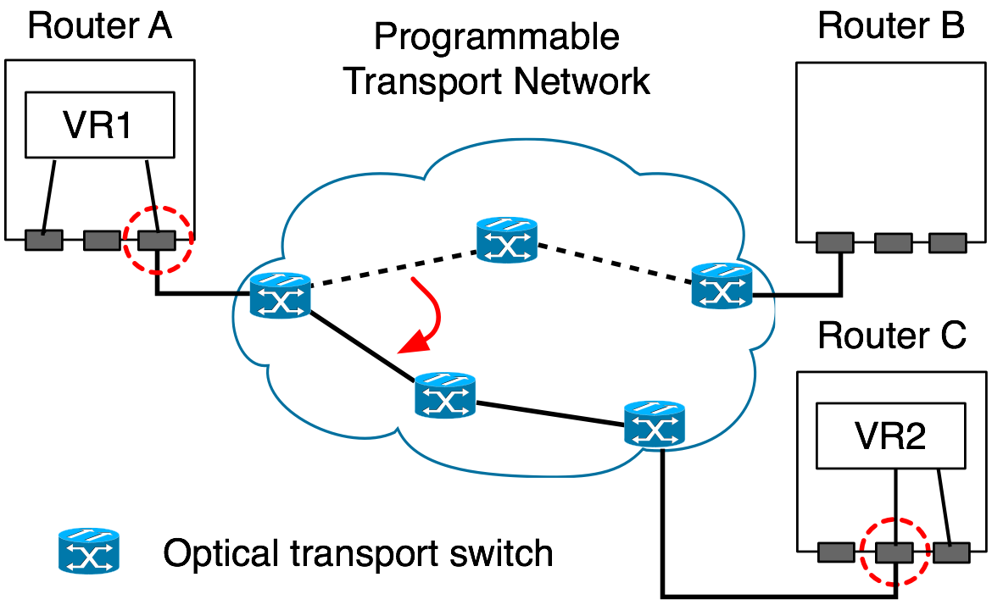
Virtual Router Migration: the Challenges
Migrating an entire virtual router instance
Minimize disruption
Link migration

Slide 19
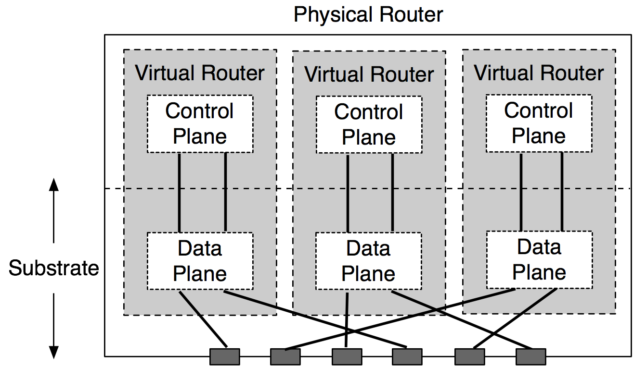
VROOM Architecture
Data-Plane Hypervisor
Dynamic Interface Binding

Slide 20
VROOM’s Migration Process
Key idea: separate the migration of control and data planes
Migrate the control plane
Clone the data plane
Migrate the links

Slide 21
Control-Plane Migration
Leverage virtual server migration techniques
Router image
  Binaries, configuration files, etc.

Slide 22
Control-Plane Migration
Leverage virtual migration techniques
Router image
Memory
  1st stage: iterative pre-copy
  2nd stage: stall-and-copy (when the control plane is “frozen”)
Notes:
During the first iteration, all pages are transferred from A to B. Subsequent iterations copy only those pages dirtied during the previous transfer phase.

Slide 23
Control-Plane Migration
Leverage virtual server migration techniques
Router image
Memory
CP
Physical router A
DP
Physical router B

Slide 24
Data-Plane Cloning
Clone the data plane by repopulation
  Enable migration across different data planes
  Eliminate synchronization issue of control & data planes
Physical router A
DP-old
CP
Physical router B
DP-new
DP-new

Slide 25
Remote Control Plane
Data-plane cloning takes time
  Installing 250k routes takes over 20 seconds*
The control & old data planes need to be kept “online”
Solution: redirect routing messages through tunnels
Physical router A
DP-old
CP
Physical router B
DP-new
*: P. Francios, et. al., Achieving sub-second IGP convergence in large IP networks,
ACM SIGCOMM CCR, no. 3, 2005.

Slide 26
Remote Control Plane
Data-plane cloning takes time
  Installing 250k routes takes over 20 seconds*
The control & old data planes need to be kept “online”
Solution: redirect routing messages through tunnels
Physical router A
DP-old
CP
Physical router B
DP-new
*: P. Francios, et. al., Achieving sub-second IGP convergence in large IP networks,
ACM SIGCOMM CCR, no. 3, 2005.

Slide 27
Remote Control Plane
Data-plane cloning takes time
  Installing 250k routes takes over 20 seconds*
The control & old data planes need to be kept “online”
Solution: redirect routing messages through tunnels
Physical router A
DP-old
CP
Physical router B
DP-new
*: P. Francios, et. al., Achieving sub-second IGP convergence in large IP networks,
ACM SIGCOMM CCR, no. 3, 2005.

Slide 28
Double Data Planes
At the end of data-plane cloning, both data planes are ready to forward traffic
DP-old
CP
DP-new

Slide 29
Asynchronous Link Migration
With the double data planes, links can be migrated independently
A
DP-old
B
CP
DP-new
Notes:
The double data planes simplify link migration because they enable the links to be migrated independently. For example, in this simple example, to migrate the links, we can first set up the links from the new physical nodes to the two adjacent nodes. We can then migrate the traffic in each direction separately.

Slide 30
Prototype Implementation
Control plane: OpenVZ + Quagga
Data plane: two prototypes
  Software-based data plane (SD): Linux kernel
  Hardware-based data plane (HD): NetFPGA
Why two prototypes?
  To validate the data-plane hypervisor design (e.g., migration between SD and HD)

Slide 31
Evaluation
Performance of individual migration steps
Impact on data traffic
Impact on routing protocols
Experiments on Emulab

Slide 32
Evaluation
Performance of individual migration steps
Impact on data traffic
Impact on routing protocols
Experiments on Emulab

Slide 33
Impact on Data Traffic
The diamond testbed
n1
VR
n0
n3
n2

Slide 34
Impact on Data Traffic
SD router w/ separate migration bandwidth
  Slight delay increase due to CPU contention
HD router w/ separate migration bandwidth
  No delay increase or packet loss

Slide 35
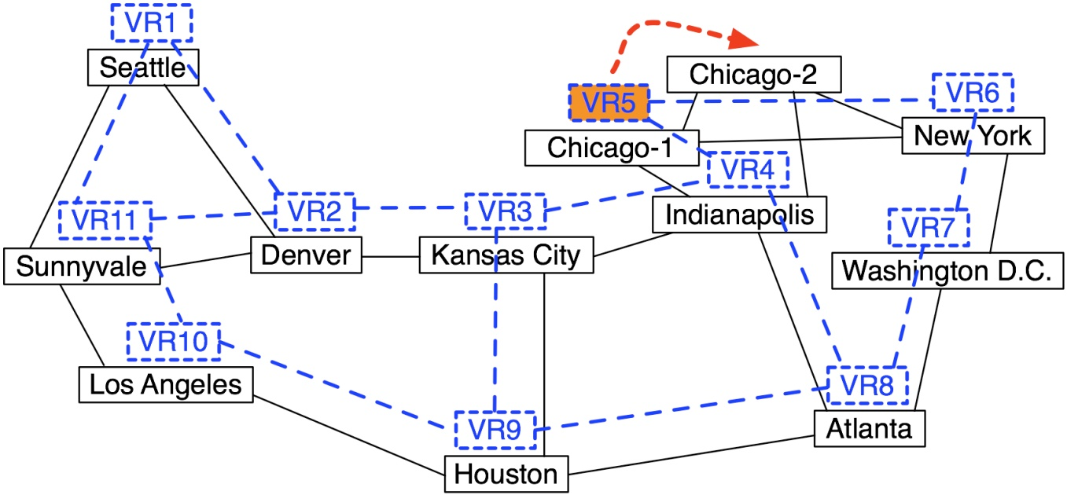
Impact on Routing Protocols
The Abilene-topology testbed

Slide 36
Core Router Migration: OSPF Only
Introduce LSA by flapping link VR2-VR3
  Miss at most one LSA
  Get retransmission 5 seconds later (the default LSA retransmission timer)
  Can use smaller LSA retransmission-interval (e.g., 1 second)

Slide 37
Edge Router Migration: OSPF + BGP
Average control-plane downtime: 3.56 seconds
  Performance lower bound
OSPF and BGP adjacencies stay up
Default timer values
  OSPF hello interval: 10 seconds
  BGP keep-alive interval: 60 seconds

Slide 38
Where To Migrate
Physical constraints
  Latency
    E.g, NYC to Washington D.C.: 2 msec
  Link capacity
    Enough remaining capacity for extra traffic
  Platform compatibility
    Routers from different vendors
  Router capability
    E.g., number of access control lists (ACLs) supported
The constraints simplify the placement problem

Slide 39
Conclusions & Future Work
VROOM: a useful network-management primitive
  Separate tight coupling between physical and logical
  Simplify network management, enable new applications
  No data-plane and control-plane disruption
Future work
  Migration scheduling as an optimization problem
  Other applications of router migration
    Handle unplanned failures
    Traffic engineering

