Slide 1
Better by a HAIR:
Hardware-Amenable Internet Routing
Brent Mochizuki
University of Illinois at Urbana-Champaign
Joint work with:
Firat Kiyak (Illinois)
Eric Keller (Princeton)
Matthew Caesar (Illinois)

Slide 2
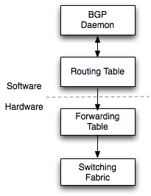
Router Design Today
Control Plane
  Maintains routing table
  Implemented in software
Data Plane
  Forwards packets
  Implemented in hardware

Slide 3
Routing Faces Scaling Challenges
Routers are experiencing scaling challenges
  The Internet is still growing
  New protocols and IPv6 require larger address spaces
  Large bursts of updates occur when links go down or come back up

Slide 4
Some Workarounds
Use timers (MRAI) to mask instability
  Slows convergence leading to longer instances of black holes and routing loops
Use flap damping to disallow less stable routes
  Harms availability, leading to black holes
Limit which routes are advertised
  Places constraints on policies

Slide 5
Our Approach
Routing is conventionally done in software
Hardware has clear performance benefits
  Specialized circuits would allow routing to be done more quickly
  Hardware is inherently parallel
We investigate using the extreme design point of an all-hardware router
  Target is FPGA (reprogrammable hardware)

Slide 6
Implementing BGP in Hardware
A full-hardware router can speed up BGP processing, however:
  It seems that BGP was designed to be processed in software
  The protocol makes it difficult to process in hardware
    Our design is very complex
    Slow processing speed

Slide 7
Implementing BGP in Hardware
Why is it complex to implement BGP in hardware?
What parts of the design would perform poorly?
Can we design a new protocol with the functionality of BGP without these problems?

Slide 8
Sources of Complexity in BGP
No total ordering of routes
  Computing the best route
    Must compare each advertised route
  BGP allows the MED attribute
    Every route must be considered when choosing the best route (instead of the advertised route and the previously-best route)
Route 1
Route 2
Route 3

Slide 9
Sources of Complexity in BGP
2. IP Prefix Addressing
  Translating an IP prefix to a physical memory address in the routing table (RIB) is difficult to implement
  Trie lookup structure
    Not a regular structure
    Requires extra memory
IP Lookup
RIB
Memory
Address
… … … …

Slide 10
Sources of Complexity in BGP (cont.)
3. Long and variable length fields
  Variable length fields add processing complexity
    Parser states are not predictable since
      Depends on the length of variable-length fields
      Depends on the presence of optional fields
    Tradeoff between design complexity and performance

Slide 11
HAIR: Hardware-Amenable Internet Routing
1. Provides for a total ordering of routes
2. Simplifies route lookup by using virtual addressing instead of IP addresses
3. Uses shorter, fixed-length fields

Slide 12
HAIR – Total ordering of routes
HAIR avoids the MED ordering problem
The best route can be chosen by comparing only the newly advertised and previously-best routes
BGP
HAIR
New Route
New Route
Best Route
Best Route
Best Route
Route 3
Best Route
Route 3
Route 4
Route 4
Route 5
Route 5

Slide 13
HAIR – Destination Address
HAIR operates on a virtual address space
  Each destination network is enumerated with a unique fixed identifier on a global scale
  This identifier is used to directly index into the RIB
BGP
HAIR
IP Lookup
Destination IP: 12.0.0.0/24
1
1
Virtual
Address
RIB
RIB
Memory
Address
0
… … … …
… … … …

Slide 14
HAIR – Fixed and Shorter Length Fields
Requiring fixed length fields allows a very simple parsing design
  The parser state is predictable
  This makes processing speeds predictable as well
BGP
HAIR
Amt Parsed < Length
clk
…
clk
clk
Parse
clk
Parse0
ParseN
clk
Length
END
END

Slide 15
HAIR – Path Attribute Labels
Policy decides which route is best by comparing path attributes
Each router will only see a relatively small number of unique sets of path attributes
We use labels to enumerate each of these sets
Attributes:
Origin = 1 (EGP)
LocalPref = 50
…
Label Table
Label: 001

Slide 16
HAIR – Path Attribute Labels
Each set of labels is defined locally
Label translation performed at each router to avoid collisions and fragmentation of the label space
Inbound Label
Label Table
Outbound Label

Slide 17
HAIR – Path Attribute Labels
Since there is a total ordering of routes, each label can be ranked by routing preference
Computing the best route is as easy as comparing ranks

Slide 18
Advertisement in BGP
BGP Update
Advertise: 12.1.1.0/24
Attributes:
Origin = 1 (EGP)
LocalPref = 50
…
IP Lookup
Memory
Address
Route
Info
Best Route Logic
RIB
…
… … … …
New Route

Slide 19
Label Advertisement in HAIR
Label Packet Generator
Label Mapping
Label Packet
Label Table
Outbound Label
Label Update
Inbound Label
Label
Translation
HAIR Label Update
Label: 002
Attributes:
Origin = exterior
LocalPref = 50
…

Slide 20
Route Advertisement in HAIR
Label Translation
Outbound Label Rank
Inbound Label
Virtual
Address
Route Info.
RIB
New Route
HAIR Route Update
Advertise: 3128
Label: 002

Slide 21
Analysis - Methodology
Ran update traces on 3 designs:
    Quagga open-source software router
        3GHz CPU
    Hardware implementation of BGP processor
        125MHz NetFPGA target
    Hardware implementation of HAIR processor
        125MHz NetFPGA target

Slide 22
Analysis – Performance Metrics
Compare throughput
  High throughput handles bursts well
Compare delay
  Low delay means faster convergence

Slide 23
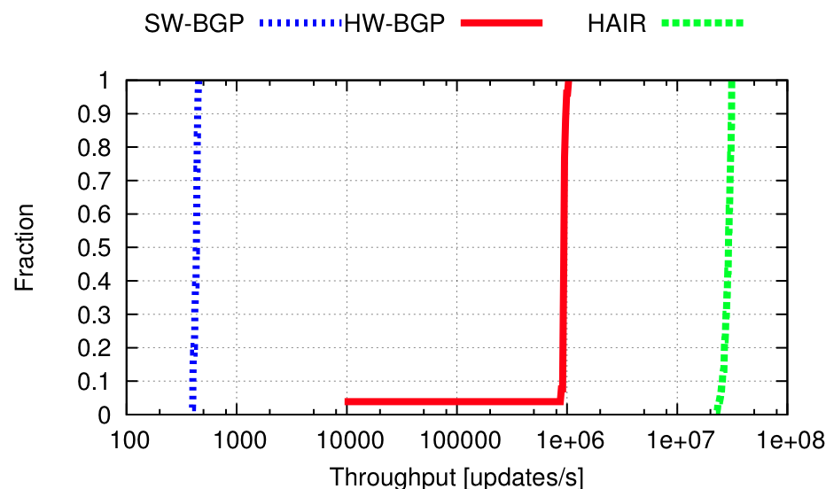

Analysis - Throughput
BGP in Hardware increases throughput by up to 3 orders of magnitude.
HAIR increases throughput by 1 more order of magnitude.

Slide 24
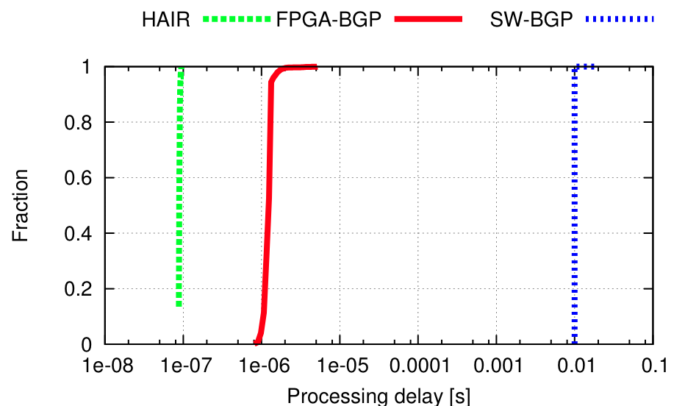

Analysis - Delay
BGP in Hardware reduces delay by 4 orders of magnitude
HAIR reduces delay by 1 more

Slide 25
Analysis
Throughput higher and delay lower for hardware designs
  Due to lack of OS, increased parallelization, and direct access to memory
Performance is even better for HAIR
  Our changes to the protocol not only make it easier to implement, but also improve performance

Slide 26
Conclusions
We challenge the assumption that routing protocols must be processed in software
BGP in hardware is difficult to implement
We propose HAIR, a hardware-amenable protocol with similar functionality to BGP
    Allows for simple and high-performing hardware designs
Future Work: Determining optimal division of labor between hardware and software in router design, examining other protocols

