Slide 1
Virtually Eliminating Router Bugs
CoNEXT’09
Minlan Yu
Princeton University
http://verb.cs.princeton.edu
Joint work with Eric Keller (Princeton), Matt Caesar (UIUC),
Jennifer Rexford (Princeton)
Notes:
- before the news items, maybe stay a few words about routers running complex softwarewhich, like any complex software, can have bugs. often with disastrous effects... rightnow you jump a bit abruptly into the news items.

Slide 2
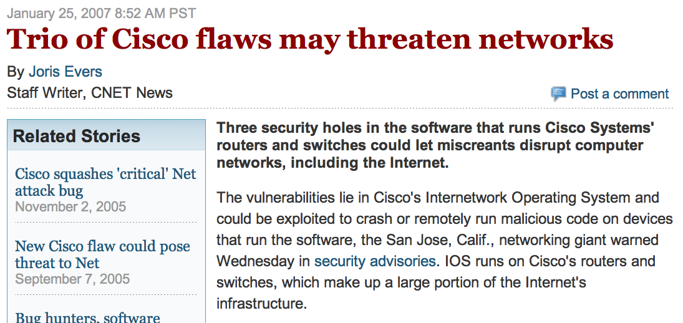
Router Bugs in the News

Slide 3
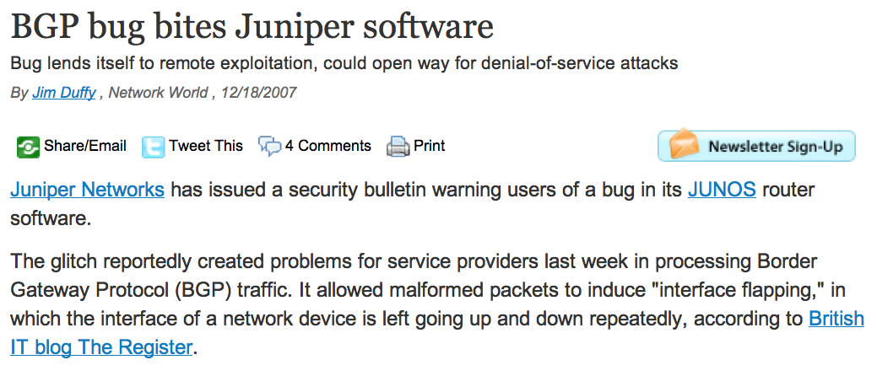
Router Bugs in the News

Slide 4
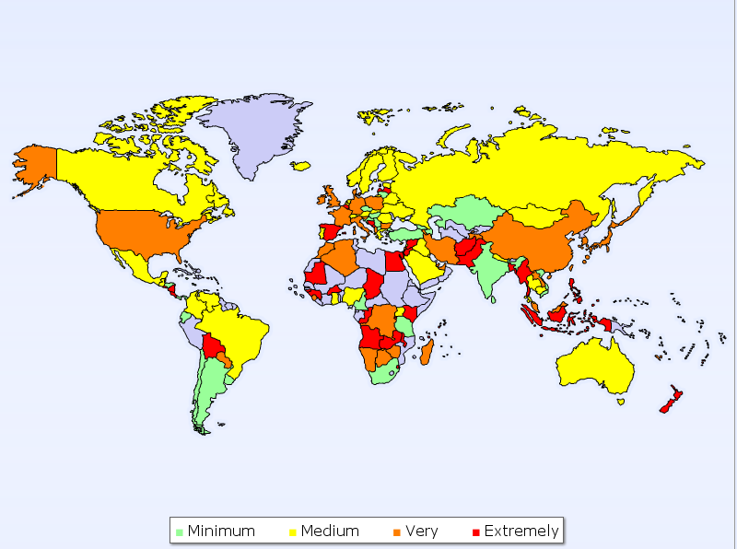
Example of Router Bugs
1 misconfiguration tickled 2 bugs (2 vendors)
  Real bugs on Feb 16, 2009
  Huge increase in the global rate of updates
  10x increase in global instability for an hour
AS path
Prepending
After: len > 255
Misconfiguration:
as-path prepend 47868
Did not
filter
AS47878
prepended
252 times
AS29113
Notification
MikroTik bug:
no-range check
Cisco bug:
Long AS paths
Global Instability by Country
Notes:
Announced a single prefix to a single provider
Stress real event
Source: Renesys

Slide 5

Router Bugs
Router bugs are a serious problem
  Routers are getting more complicated
    Quagga 220K lines, XORP 826K lines
  Vendors are allowing third-party software
  Other outages are becoming less common
Router bugs are hard to detect and fix
  Byzantine failures don’t simply crash the router
  Violate protocol, can cause cascading outages
  Often discovered after serious outage
How to detect bugs and stop their effects before they spread?
Notes:
Cisco XX lines,
outers are getting complex, with xorp and quagga having hundreds of thousands of lines, and the problem is even worse for real commercial routers, which have millions of lines”

Slide 6


Avoiding Bugs via Diversity
Run multiple, diverse routing instances
  Use voting to select majority result
  Software and Data Diversity (SDD) ensures correctness
    E.g., XORP and Quagga, different update timing
  Similar approach applied in other fields
  But new challenges and opportunities in routing
Vote
Notes:
OS, real-time software for fault tolerance
Totoally different
make sure to say that this is not a new idea, but that routing introduces new challenges and opportunities.
where performance is mission-critical
What is specific to router bugs?
Challenges and opportunities
Why does diversity work?
Studies in XORP and Quagga bugazilla database

Slide 7
SDD Challenges in Routers
Making replication transparent
  Interoperate with existing routers
  Duplicate network state to routing instances
  Present a common configuration interface
Handling transient, real-time nature of routers
  React quickly to network events
    E.g., buggy behaviors, link failures
  But not over-react to transient inconsistency
Routing Instance I
A
B
C
Routing Instance II
B
A
C
time
Notes:
stress that during convergence the routers may disagree -- explain why, as folks not familiar with routing may not understand why this kind of behavior is acceptable, or even normal.
I think the point here is not just that the router should react quickly to buggy behavior, but also that our techniques should not prevent the router from reacting quickly to other events. For example, using majority voting also slows down the reaction time of the router to non-buggy events (e.g. link failures).

Slide 8
SDD Opportunities in Routers
Easy to vote on standardized output
  Control plane: IETF-standardized routing protocols
  Data plane: forwarding-table entries
Easy to recover from errors via bootstrap
  Routing has limited dependency on history
  Don’t need much information to bootstrap instance
Diversity is effective in avoiding router bugs
  Based on our studies on router bugs and code

Slide 9
Outline
Exploiting software and data diversity (SDD)
  Effective in avoiding bugs
  Enough hardware resources to support diversity
Bug-tolerant router (BTR) architecture
  Make replication transparent with low overhead
  React quickly and handle transient inconsistency
Prototype and evaluation
  Small, trusted code base
  Low processing overhead
Notes:
We implement our approach.We found our technique can be implemented with few lines of code, making it amenable to a trusted or verifiable implementation.We assume it's a small, and threfore trusted code base

Slide 10
Outline
Exploiting software and data diversity (SDD)
  Effective in avoiding bugs
  Enough hardware resources to support diversity
Bug-tolerant router (BTR) architecture
  Make replication transparent with low overhead
  React quickly and handle transient inconsistency
Prototype and evaluation
  Small, trusted code base
  Low processing overhead
Notes:
Bug-tolerant router (BTR) architecture
How to make it transparent to peers?
How to vote on the output?
Exploiting data and software diversity (SDD)
Is it easy to implement diversity in routers?
Can router bugs be eliminated by diversity?
Prototype and evaluation
What is the overhead of BTR?
Any effect on routing convergence?

Slide 11
Why Diversity Works?
Enough diversity in routers
  Software: Quagga, XORP, BIRD
  Protocols: OSPF and IS-IS
  Environment: timing, ordering, memory
Enough resources for diversity
  Extra processor blades for hardware reliability
  Multi-core processors, separate route servers
Effective in avoiding bugs
Notes:
Router bugs may be correlated
- slide 18: on the hardware reliability, can stress that today commercial routers already run multiple software instances (of same exact software, config, etc.), so we merely suggest that these extra instances be (i) diversified and (ii) contribute to voting, rather than just acting as stand-by.

Slide 12
Evaluate Diversity Effect
Most bugs can be avoided by diversity
  Reproduce and avoid real bugs
  .. in XORP and Quagga bugzilla database
Diversity on execution environment
Diversity Mechanism | Avoid bugs in database
Timing/Order of Messages | 39%
Configuration | 25%
Timing/Order of Connections | 12%
Combining all execution diversity | 88%
Notes:
These can be used together
Characterize them all and … Verify some of them….

Slide 13
Effect of Software Diversity
Sanity check on implementation diversity
  Picked 10 bugs from XORP, 10 bugs from Quagga
  None were present in the other implementation
Static code analysis on version diversity
  Overlap decreases quickly between versions
    75% of bugs in Quagga 0.99.1 are fixed in Quagga 0.99.9
    30% of bugs in Quagga 0.99.9 are newly introduced
Vendors can also achieve software diversity
  Different code versions, different code trains
  Code from acquired companies, open-source
Notes:
We want to run the new version, but old version to avoid 30%
acquisitions of other companies, use of open-source software;;;; they may also be skeptical that the bugs seen in XORP and Quagga are representative of Cisco/Juniper bugs. not sure what to say about that, except that when we talk with vendors they generally agree.
Mention vendors can also diversify execution enviroment (memory layout, connection set-up order, etc.) even for a single software variant
“Vendors can also...”, so up to this point, all your results were not for vendors? who were they for? Orally when you say this point, maybe you could mention that both operators and vendors can use these techniques (ie you don't require explicit vendor approval to use these techniques... do you want to mention that somewhere explicitly?)
“open source” -- when you mention this, you could also point out that this might not be far-fetched, many vendors already incorporate BSD code
Static code analysis is the analysis of computer software that is performed without actually executing programs built from that software (analysis performed on executing programs is known as dynamic analysis). In most cases the analysis is performed on some version of the source code and in the other cases some form of the object code. The term is usually applied to the analysis performed by an automated tool, with human analysis being called program understanding, program comprehension or code review.

Slide 14
Outline
Exploiting software and data diversity (SDD)
  Effective in avoiding bugs
  Enough hardware resources to support diversity
Bug-tolerant router (BTR) architecture
  Make replication transparent with low overhead
  React quickly and handle transient inconsistency
Prototype and evaluation
  Small, trusted code base
  Low processing overhead
Notes:
Showed SDD works

Slide 15
Bug-tolerant Router Architecture
Protocol
daemon
Protocol
daemon
Protocol
daemon
Routing
table
Routing
table
Routing
table
Hypervisor
REPLICA
MANAGER
FIB
VOTER
UPDATE
VOTER
Interface 1
Forwarding table (FIB)
Iinterface 2

Slide 16
Replicating Incoming Routing Messages
Protocol
daemon
Protocol
daemon
Protocol
daemon
Routing
table
Routing
table
Routing
table
Update
Hypervisor
12.0.0.0/8
REPLICA
MANAGER
FIB
VOTER
UPDATE
VOTER
Interface 1
Forwarding table (FIB)
Iinterface 2
No need for protocol parsing – operates at socket level

Slide 17
Voting: Updates to Forwarding Table
Protocol
daemon
Protocol
daemon
Protocol
daemon
Routing
table
Routing
table
Routing
table
Update
Hypervisor
12.0.0.0/8
REPLICA
MANAGER
FIB
VOTER
UPDATE
VOTER
Interface 1
Forwarding table (FIB)
Iinterface 2
12.0.0.0/8 → IF 2
Transparent by intercepting calls to “Netlink”
Notes:
Netlink is the kernel side of the socket simplemnetation

Slide 18
Voting: Control-Plane Messages
Protocol
daemon
Protocol
daemon
Protocol
daemon
Routing
table
Routing
table
Routing
table
Hypervisor
Update
12.0.0.0/8
REPLICA
MANAGER
FIB
VOTER
UPDATE
VOTER
Interface 1
Forwarding table (FIB)
Iinterface 2
12.0.0.0/8 → IF 2
Transparent by intercepting socket system calls

Slide 19
Simple Voting Mechanisms
Tolerate transient periods of disagreement
  Different replicas can have different outputs
  … during routing-protocol convergence
Several different voting mechanisms
  Master-slave: speeding reaction time
  Continuous majority: handling transience
master
Routing Instance I
A
B
C
Routing Instance II
B
A
C
Routing Instance III
A
C
time
Notes:
tens of sec

Slide 20
Simple Voting Mechanisms
Tolerate transient periods of disagreement
  Different replicas can have different outputs
  … during routing-protocol convergence
Several different voting mechanisms
  Master-slave: speeding reaction time
  Continuous majority: handling transience
Continuous majority
A
C
Routing Instance I
A
B
B
C
C
Routing Instance II
B
B
A
A
C
C
A
A
C
Routing Instance III
C
time
Notes:
Other algorithms in the paper ….
tens of sec

Slide 21
Simple Voting and Recovery
Recovery
  Hiding replica failure from neighboring routers
  Hypervisor kills faulty instance, invokes new one
Small, trusted software component
  No parsing, treats data as opaque strings
  Just 514 lines of code in voter implementation
Notes:
Stress 514 lines

Slide 22
Outline
Exploiting software and data diversity (SDD)
  Effective in avoiding bugs
  Enough hardware resources to support diversity
Bug-tolerant router (BTR) architecture
  Make replication transparent with low overhead
  React quickly and handle transient inconsistency
Prototype and evaluation
  Small, trusted code base
  Low processing overhead
Notes:
Bug-tolerant router (BTR) architecture
How to make it transparent to peers?
How to vote on the output?
Exploiting data and software diversity (SDD)
Is it easy to implement diversity in routers?
Can router bugs be eliminated by diversity?
Prototype and evaluation
What is the overhead of BTR?
Any effect on routing convergence?

Slide 23
Prototype
Prototype implementation
  No modification of routing software
  Simple, trusted hypervisor
  Built on Linux with XORP and Quagga
Evaluation environment
  Evaluated in 3GHz Intel Xeon
  BGP trace from Route Views on March, 2007
Evaluation metric
  Voting delay and fault rate of different voting algo.
  Delay of hypervisor

Slide 24
Effectiveness of Voting
Setup
  3 XORP and 3 Quagga routing instances
  Inject bugs of realistic frequency and duration
Voting algorithm | Avg voting delay (sec) | Fault rate
Single router | - | 0.066%
Master-slave | 0.02 | 0.0006%
Continuous-majority | 0.035 | 0.00001%
Notes:
with duration of 600
seconds, and interarrival time of 1.2 million seconds

Slide 25
Small Overhead
Small increase on FIB pass through time
  Time between receiving an update to FIB changes
  Delay overhead of just hypervisor is 0.1% (0.06sec)
  Delay overhead of 5 routing instances is 4.6%
Little effect on network-wide convergence
  ISP networks from Rocketfuel, and cliques
  Found no significant change in convergence (beyond the pass through time)
Notes:
slide 20: do you think that 0.06 number would increase with the size of the FIB transfer? I.e. I think one case people are concerned about is when there's a link failure and you need to simultaneously update 200k entries in your FIB. Would it still be 0.06 overhead then? Say, it might, actually, right? Since if you have multicore then the bottleneck would still be bandwidth to the FIB. Anyway that would be neat if that's the case, and maybe you could be prepared in case someone asks that...
(and when you say clique, also mention why you're looking at cliques, because they represent a worst case for convergence

Slide 26
Conclusion
Seriousness of routing software bugs
  Cause outages, misbehaviors, vulnerabilities
  Violate protocol semantics, so not handled by traditional failure detection and recovery
Software and data diversity (SDD)
  Effective, has reasonable overhead
Design and prototype of bug-tolerant router
  Works with Quagga and XORP software
  Low overhead, and small trusted code base

Slide 27
More information at
http://verb.cs.princeton.edu
Thanks!
Questions?

