Slide 1

Building Asynchronous Circuits With JBits
Eric Keller
eric.keller@xilinx.com
FPL 2001
FPL2001

Slide 2


JBits Background
A Java API to configure Xilinx FPGA bitstreams
Provides complete design control
  Routing
  CLB configuration
Supports run-time reconfiguration
Allows for tools to built upon it
Example low-level configuration call:
jbits.set(row, col, S1F1.S1F1, S1F1.SINGLE_EAST0)

Slide 3
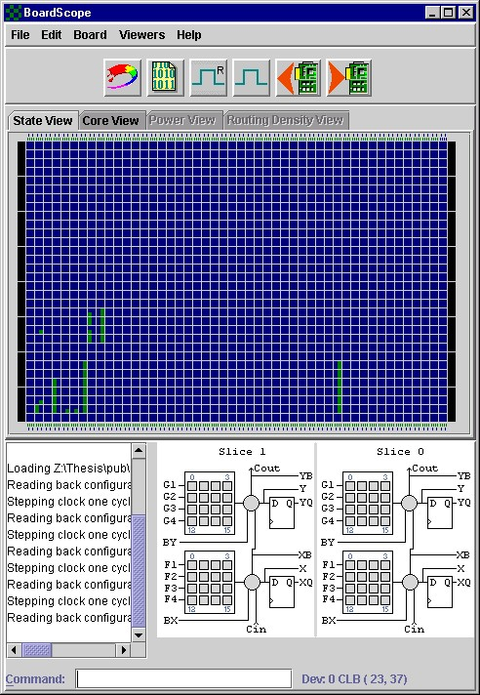
The JBits Environment
RTP Core
Library
User
Code
JBits
API
JRoute
API
Remote
Hardware
BoardScope
Debugger
TCP/IP
XHWIF
FPGA
Hardware
Device
Simulator
FPGA

Slide 4
Asynchronous Advantages
Modularity
Low power
Average-case performance
No clock distribution
Adapt to environmental conditions

Slide 5
Why use JBits?
Complete control over circuit
Have some fixed routes and others auto-routed
  Can pre-route modules to meet any delay constraint
Use templates to add delay to a net
Clean HDL for dual-rail cores
Combine asynchronous design and RTR

Slide 6
Null Convention Logic
Developed by Theseus, Inc.
Four-phase signaling, dual-rail communication
Delay Insensitive (almost)
  Occurs in very few situations
  Easily analyzable
M-of-N gates
  Output goes high when M of the N inputs go high
  Output goes low when all N inputs go low
  Symbolized by
M

Slide 7
NCL Full Adder Stage
A single
dual-rail
net
* Red lines represent high state
A_0
A_1
2
3
Sum_0
B_0
B_1
Cin_0
2
3
Sum_1
Cin_1
Cout_1
Cout_0
Values of dual-rail net
A_0
A_1
val
red
red
n/a
red
black
0
black
red
1
2 of 3 gate takes up 1 Virtex LUT
3 of 5 gate takes up 2 Virtex LUTs
black
black
null

Slide 8
NCL Register
A_0
2
A_1
NCL
CIRCUIT
2
B_0
2
B_1
2
Low requests NULL
High requests DATA
2
from_next
to_prev
Implement 4-phase signaling
  Receive NULL➔Request DATA➔Rec. DATA➔Req. NULL

Slide 9
RTPCore Overview
inputA
4
+
4
output
inputB
4
cout
cin
Bus inputA = new Bus(“inputA”, this, DATA_WIDTH);
Bus inputB = new Bus(“inputB”, this, DATA_WIDTH);
Bus output = new Bus(“output”, this, DATA_WIDTH);
Net cin = new Net(“carryIn”, this);
Net cout = new Net(“carryOut”, this);
Adder adder = new Adder(“adder”, inputA, inputB, cin, output, cout);
addChild(adder, Place.LOWER_LEFT);
adder.implement();

Slide 10
RTPCore Modifications
No support for Dual-Rail Signals
  Added DualRailBus and DualRailNet.
  Cores to convert between dual and single rail.
  JRoute support for dual rail signals
DualRailBus inputA = new DualRailBus(“inputA”, this, DATA_WIDTH);
DualRailBus inputB = new DualRailBus(“inputB”, this, DATA_WIDTH);
DualRailBus output = new DualRailBus(“output”, this, DATA_WIDTH);
DualRailNet cin = new DualRailNet(“carryIn”, this);
DualRailNet cout = new DualRailNet(“carryOut”, this);
NCLAdd adder = new NCLAdd(“add”, inputA, inputB, cin, output, cout);
addChild(adder, Place.LOWER_LEFT);
adder.implement();

Slide 11
Dual-Rail Full Adder
DualRailBus
inputA
+
4
4
DualRailBus
output
DualRailBus
inputB
4
DualRailNet
cin
DualRailNet
cout
Net
DualRailNet
inputA[0]
inputA[1]
4 bit DualRailBus
inputA[2]
inputA[3]

Slide 12
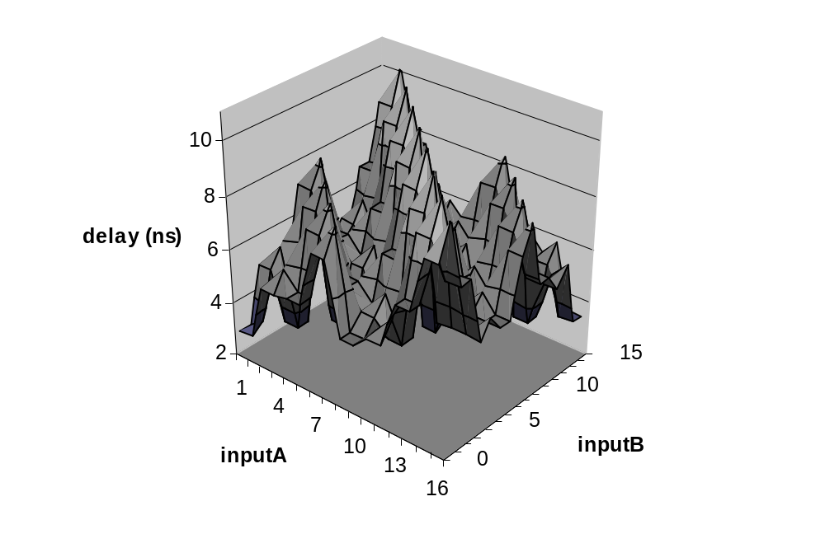
Delay Analysis - NCL Full Adder
inputA
4
+
output
inputB
4
4
Average case performance
Depends on carry propagation
  0+0 no carry ➔ lowest delay
  15+1 carry at each stage ➔ longest delay

Slide 13
Future Work
Defect Tolerance
  Work around a defect on an FPGA
  No timing analysis because of delay insensitive
  Can place modules anywhere and they work
Other methodologies
  Add support in JRoute for isochronic forks
    symmetric and asymmetric
Examine FPGAs targeted to asynchronous design

