Slide 1

Dynamic Circuit Specialization of a CORDIC Processor
Eric Keller
Nov. 7, 2000
SPIE Photonics East

Slide 2
CORDIC
COordinate Rotation DIgital Computer
Introduced in 1959 by Jack Volder.
Performs vector rotations of arbitrary angles using only shifts and adds.
An iterative algorithm
  Works by performing micro-rotations
Calculates a wide variety of functions
  sine, cosine, arc tangent, square root.

Slide 3
Modes defined by Volder
Rotation - “The coordinate components of a vector and an angle of rotation are given and the coordinate components of the original vector, after rotation through the given angle, are computed.”
Vector - “The coordinate components of a vector are given and the magnitude and angular argument of the original vector are computed.”

Slide 4
In other words...
Rotation Mode
  rotates a vector (x,y) by a given angle (z)
1
3
5
6
(x’, y’) z’=0
4
2
0
(x, y)
z

Slide 5
In other words...
Vector Mode
  rotates a vector (x,y) to the x axis while recording the angle required to make the rotation (z’)
0 (x,y)
2
z’
4
5 (x’, 0)
3
1

Slide 6
Unified Equations
x_{i+1} = x_{i} - y_{i}md_{i}2^{-i}
y_{i+1} = y_{i} + x_{i}d_{i}2 ^{-i}
z_{i+1} = z_{i} - d_{i}e_{i}
where:
d_{i} = -1 if z_{i} < 0, +1 otherwise for Rotation Mode
= +1 if y_{i} < 0, -1 otherwise for Vector Mode
e_{i} = tan ⁻¹ (2 ^{-i}) for Circular coordinate system
= tanh ⁻¹ (2 ^{-i}) for Hyperbolic coordinate system
= 2 ^{-i} for Linear coordinate system
m = 1 for Circular coordinate system
= -1 for Hyperbolic coordinate system
= 0 for Linear coordinate system

Slide 7
Derivation
Rotation transform:
x’ = x cos Φ - y sin Φ
y’ = y cos Φ + x sin Φ
rearrange:
x’ = cos Φ[x - y tan Φ ]
y’ = cos Φ[y + x tan Φ ]
restrict tan Φ = 2^{-i} :
x_{i+1} = K_{i} [ x_{i} - y_{i}d_{i}2^{-i} ]
y_{i+1} = K_{i} [ y_{i} + x_{i}d_{i}2^{-i} ]

Slide 8
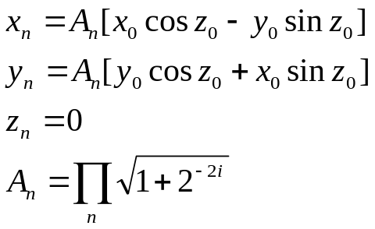
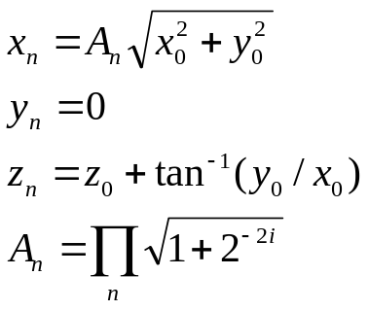
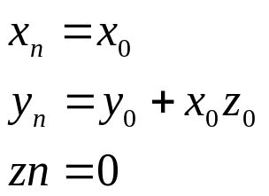
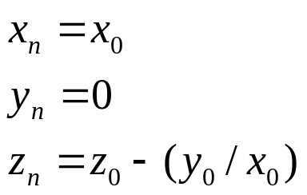
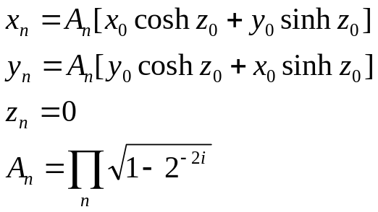
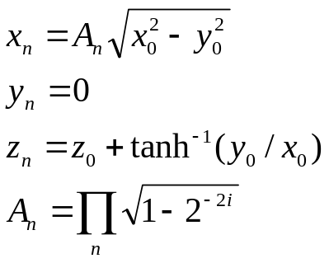
Output Equations
Circular - Rotation
Circular - Vector
Linear - Rotation
Linear - Vector
Hyperbolic - Rotation
Hyperbolic - Vector

Slide 9
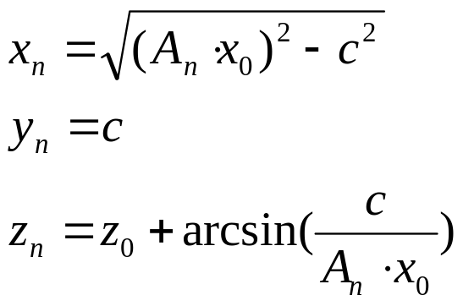
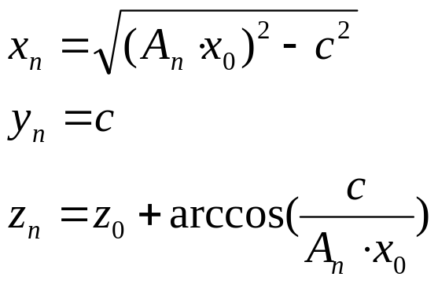
Inverse Equations
Inverse - Arcsine
Inverse - Arccosine
d_{i} =+1 if y_{i} < c, -1 otherwise
d_{i} =+1 if x_{i} < c, -1 otherwise

Slide 10
Hardware Implementation
x_{i}
x_{i+1}
>>
+/-
y_{i}
y_{i+1}
>>
+/-
z_{i}
z_{i+1}
+/-
sign_{i}

Slide 11
Virtex Add-Subtract
Subtract Controlled
Cout
B1
0 1
A1
S1
B0
0 1
A0
S0
ADD-SUBTRACT

Slide 12
JBits
A Java API providing access to resources in an FPGA bitstream
jbits.set(row, col, S0F1.S0F1, S0F1.SINGLE_SOUTH6);
Tool suite built on it (or related to it)
  VirtexDS, JRoute, BoardScope, XHWIF, etc.
Run-Time Parameterizable Cores
Allows for Run-Time Reconfiguration

Slide 13
Run-Time Reconfigurable CORDIC
Get a general purpose CORDIC processor for the price of a specialized one.
Switch between modes
  change ADDSUBTRACT control
  change where ADDSUB line comes from
Switch between coordinate systems
  change constant in z unit
  change ADDSUBTRACT control
  account for double iterations

Slide 14
Double Iterations
xalt
yalt
zalt
x
y
z
addsub
xout
yout
zout
xalt
yalt
zalt
x
y
z
addsub
xalt
yalt
zalt
x
y
z
addsub
xout
yout
zout
xout
yout
zout

Slide 15
Alternate Inputs
Cout
Alt_B0
AddSub
B0
0 1
A0
S1
Alt_A0
Cin
SingleEast[14]
SingleNorth[19]
.
S0F1
.
.

Slide 16
Summary
Use JBits for Run-Time Reconfiguration
General Purpose CORDIC processor
Performance of Specialized CORDIC

Slide 17
Questions?
Eric.Keller@xilinx.com
JBits@xilinx.com

