Slide 1
Software Decelerators
Eric Keller, Gordon Brebner and Phil James-Roxby
Xilinx Research Labs

Slide 2
Talk Outline
Background
Software Decelerators
Case Study: Finite State Machines
Results
Conclusions

Slide 3

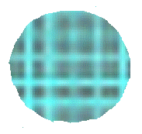
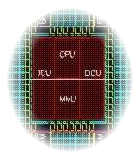
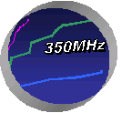


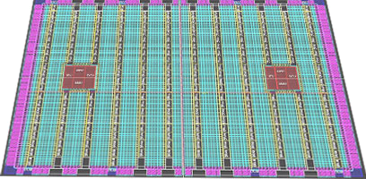
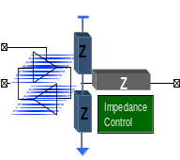

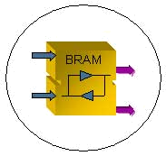
Modern Platform FPGA
Embedded DSP Functionality
High-speed Serial Transceivers
622 Mbps to 3.125 Gbps
PowerPC™ Processors 400+ MHz clock rate
Advanced FPGA Logic
18 Bit
36 Bit
18 Bit
Digitally Controlled Impedance
SelectIO™-Ultra Technology
DCM
High Performance Sync Dual-Port™ RAM
Digital Clock Management

Slide 4
Hardware Accelerator
Processor-Centric
Algorithms executed on processor
  key functions performed by hardware
Goal: Increase overall performance
JPEG2000
Mem
Processor
DWT
RCT
Tier 1 Coder

Slide 5
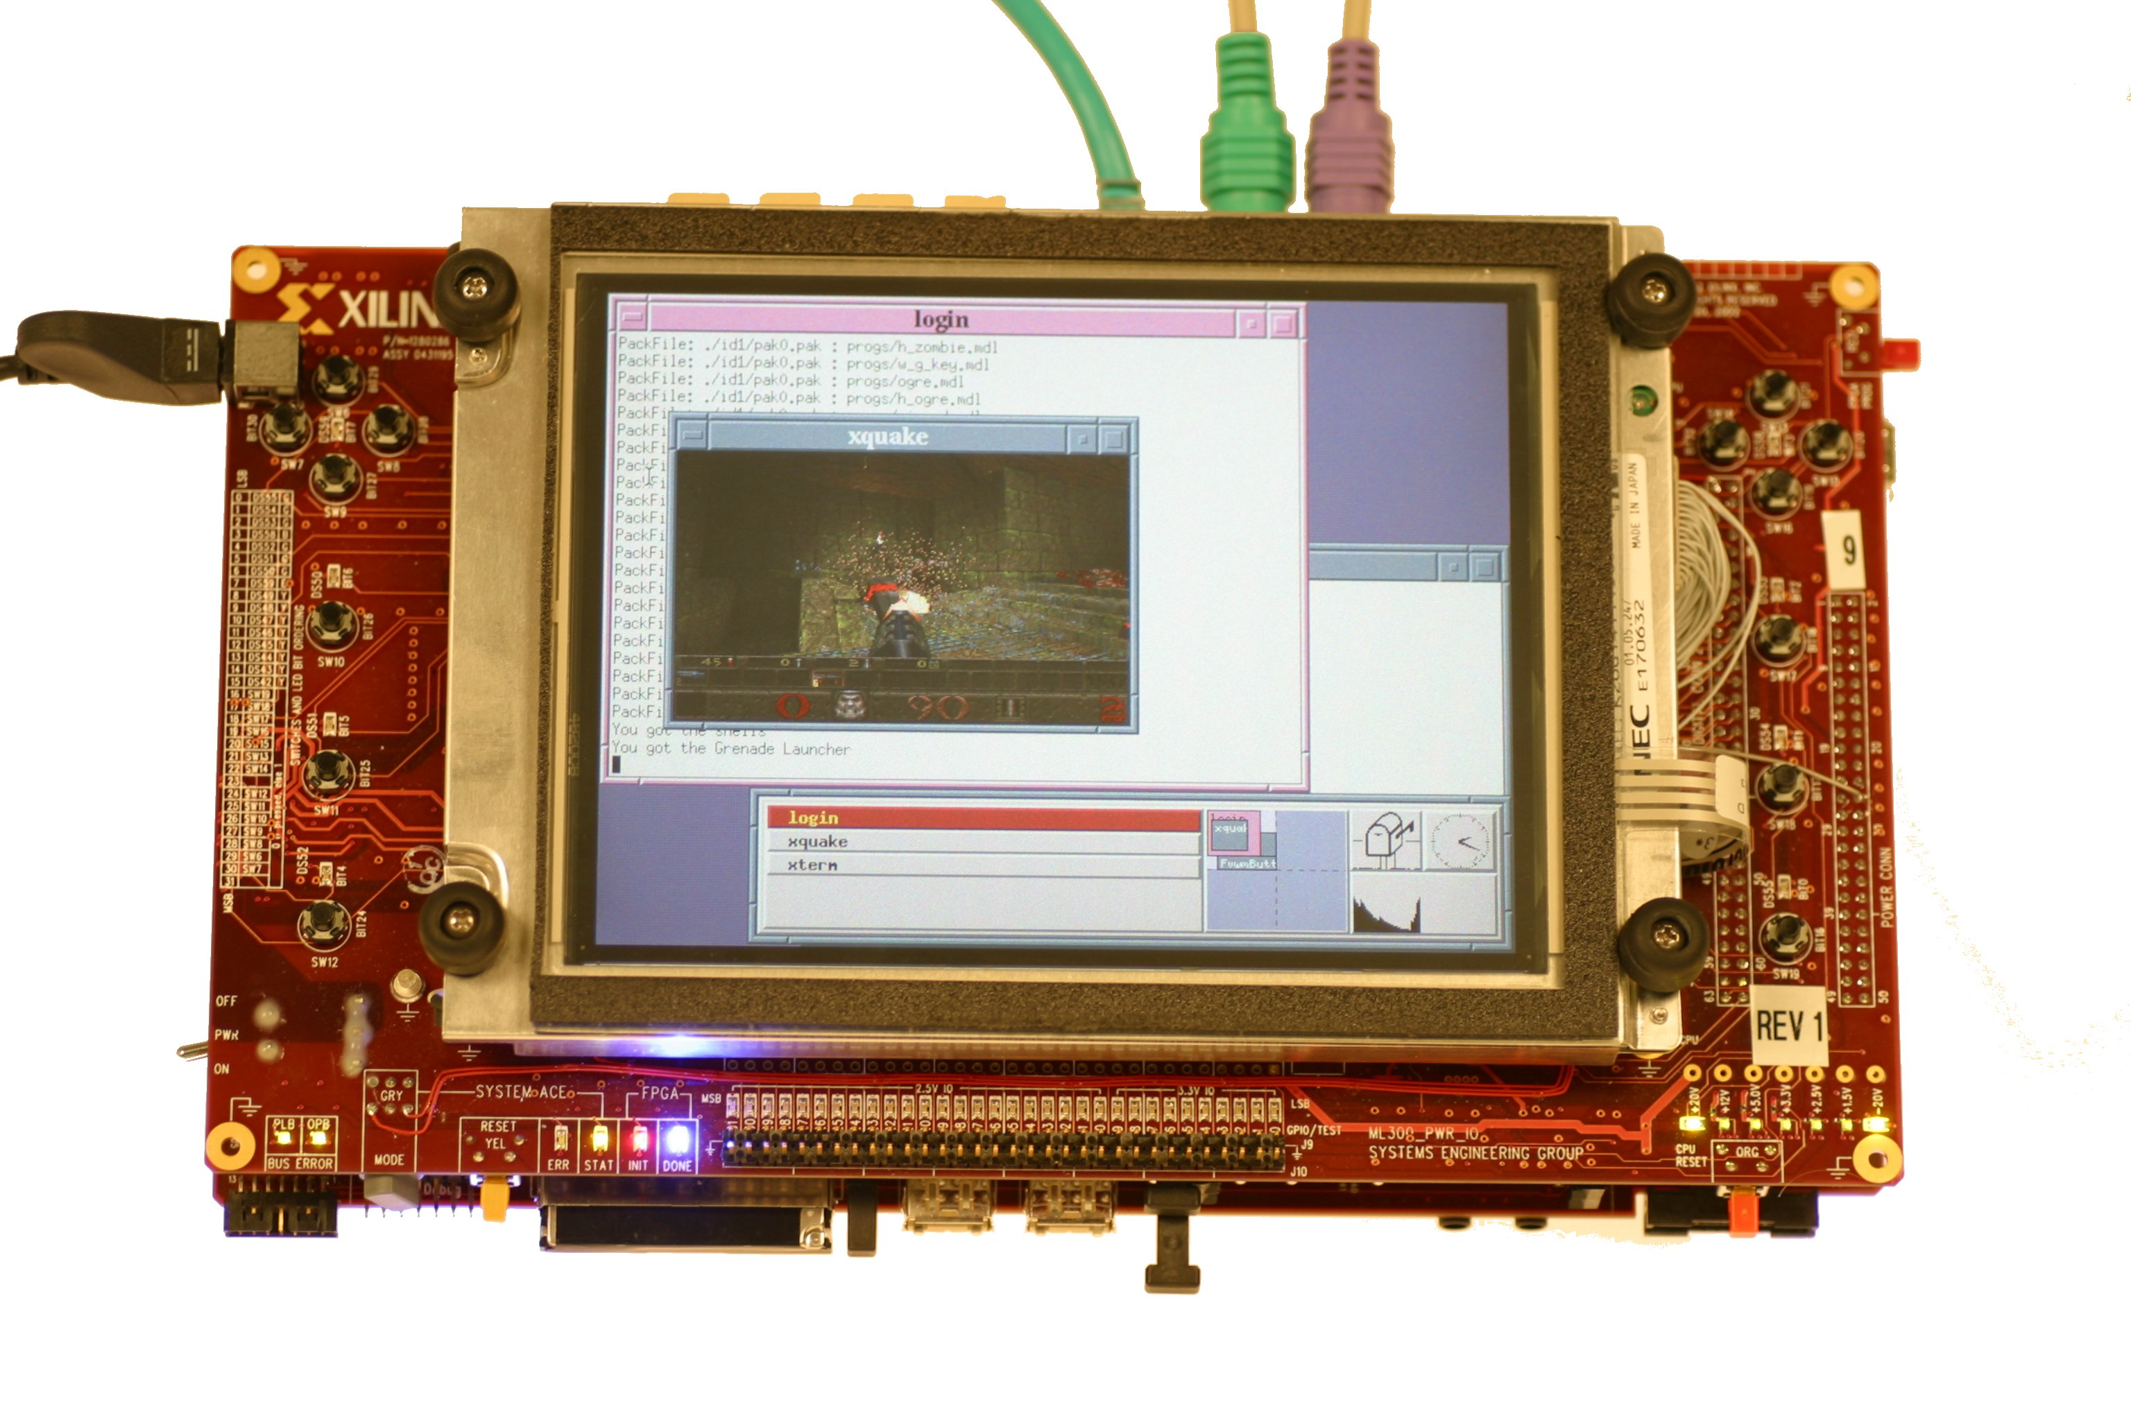
Motherboard On A Chip
Processor running an operating system
Common board peripherals on FPGA
  Ethernet MAC
  SVGA controller

Slide 6
Logic-centric viewpoint
Consistent with an interface-centric view that is appropriate for reactive systems - highly relevant for future ambient intelligence/ubiquitous computing
Processors have no special status in systems, and indeed play only a secondary role as ‘function units’
Explicit ‘hardware-software co-design’ becomes lesser issue - certainly no top-level partitioning
Hardware accelerators of processor-centric model are inverted and replaced by ‘software decelerators’

Slide 7
Software Decelerators
Algorithms are executed in logic
  Processor executes software to perform one or more services for programmable logic
&
PPC
+
*
+
outputs
inputs

Slide 8
Motivation
Emergence of platform FPGAs
To increase overall system quality
  by making use of services provided by processor
Ease of designing a complex function
Offload non time-critical logic
  to achieve a better partition (e.g. saving area)
Offload corner cases
  e.g. in MIR IPv4 packets handled in logic, IPv6 handled in processor

Slide 9
Goals
Overall area consumed by software decelerator should not be greater than logic counterpart
Interfacing logic should consume minimal logic
Interface should shield logic from processor
  and vice versa
Provide timing and resource usage information
Implementation neutral method to capture design

Slide 10
Example: finite state machines
Implement a general class of sequential functions that are recognizable in digital designs
Processor determines next state and state outputs to meet schedule determined by logic-based system
  possibility to support multiple state machines
Hardware
platform
FSM
decelerator
generator
Graphical
Representation
Textual
Representation
Software
Timing
report

Slide 11
Design Entry
Graphical front end
  e.g. StateCAD
Textual intermediate representation
  XML to support many design entry methods
Define interface
Define state
<variables>
<variable name=“op” dir=“in” width=“4”/>
</variables>
<state name=“stateADD”>
<eqns> <eqn lhs=“out0” rhs=“in1+in2/> </eqns>
<transitions> <tran next=“state1”/> </transitions>
</state>

Slide 12
Logic-Processor Interface
Rest of system doesn’t see processor signals
Choice of interface
  PowerPC’s native busses: PLB, OCM, DCR
With only two nodes, optimizations are possible
  interface logic always being addressed
  No need for arbiter
PowerPC

Slide 13
Clocking
Polling/Interrupt on external clock
  processing time for state must be less than clock period
  processor uses polling to detect clock edges
  clock edge causes an interrupt
Software Generated
  processor generates clock pulse using a memory mapped circuit
  allows different states to take different processing time

Slide 14
Software Design
General case is complex requiring timing analysis
Assembly code generation
  each state has same structure (clock/reset, equations, transitions)
Execute out of cache
  predictable memory accesses
Accurate timing generation
  count the exact number of cycles it will take for each state and transition

Slide 15
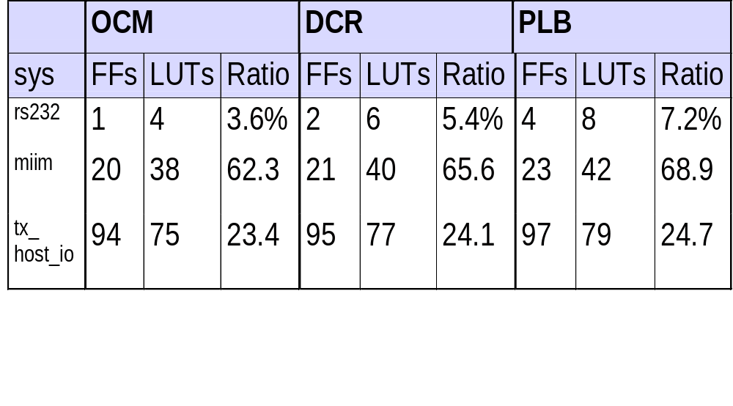
Results: Resource Usage
*Ratio is the area of the decelerator as a percentage of area consumed by a logic implementation

Slide 16
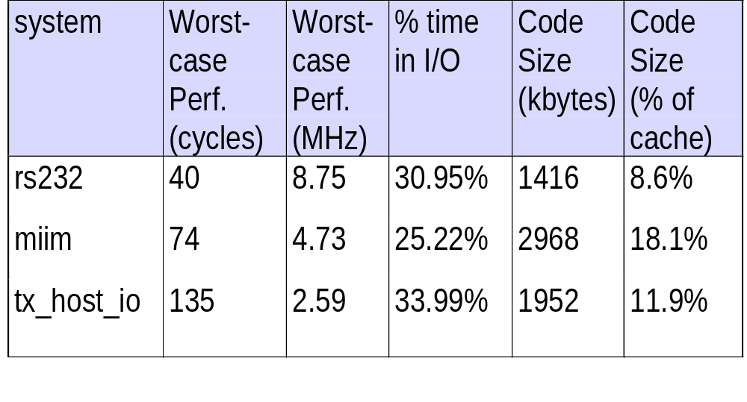
Results: Performance

Slide 17
Conclusions
Software decelerators
  through example of FSM based design methodology
  extendable to other functions
  can provide an increased overall system quality
Methodology applicable to subset of designs
  achievable speeds vary with characteristics of FSM
I/O takes a lot of processing time

Slide 18
Future Work
Further study implications of logic centric model
Automatic selection and synthesis of logic-processor interfaces
Characteristics of hard/soft processors
  e.g. I/O takes large percentage of time
FSM based architectural components
Domain-specific high-level design entry and tools

