Slide 1
Gene Matching Using JBits
Steven A. Guccione
Eric Keller

Slide 2

String Matching
At least nine independent discoveries of the dynamic programming algorithm for minimum edit distance published in the early 1970s
Useful for many types of problems (speech recognition, typography, geology, etc …)
Renewed interest with the beginning of the Human Genome Project in 1990

Slide 3
Gene Matching
Four character alphabet from four bases in DNA sequences: adenine (A), thymine (T), cytosine (C), and guanine (G)
Matching in presence of character insertions and deletions required
Matching of protein sequences also of interest
Several matching algorithms currently in use
3 billion bases in the human genome

Slide 4
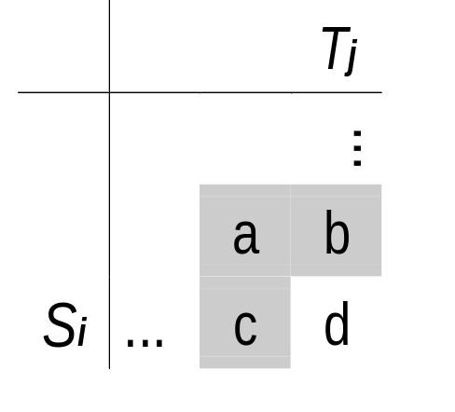
Smith-Waterman Algorithm
Optimal edit distance calculation
Position independent
O(nm) complexity
a
if Si = Tj
a + sub
if Si <> Tj
d = min
b + ins
c + del

Slide 5
A Smith-Watermann Example
Compare strings T=“mail” and S=“male”
Set substitution cost = 2, insert / delete costs = 1
Perform calculations starting at (T0, S0)
Final edit distance at (Tn, Sm) = 2
O(n*m) operations

Slide 6
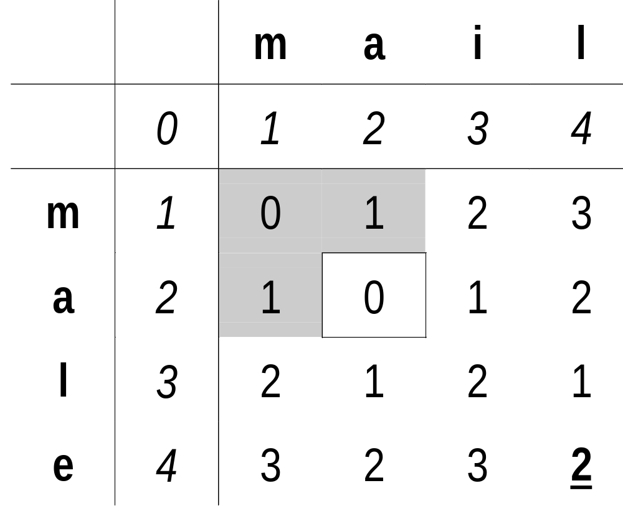
A Smith-Watermann Example

Slide 7
Exploiting Parallelism
Recurrence dependencies limit parallelism
Parallelizing along diagonals possible
Can use N processing units
Requires time proportional to M

Slide 8
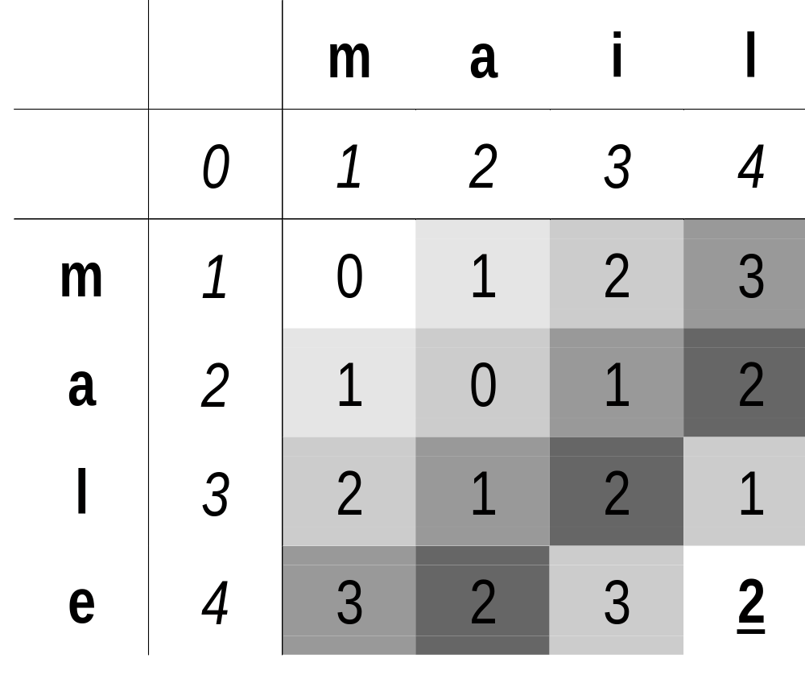
Parallelism Along Diagonals

Slide 9
A JBits Implementation
JBits permits rapid configurable circuit implementation
Easily parameterized circuit elements
Good for highly repetitive structures
Portable across devices of different sizes
Permits dense circuit implementation

Slide 10
Logic Implementation
Si
Tj
=
2
+
a
min
d
b
+
1
min
c
+
1
a
if Si = Tj
a + 2
if Si <> Tj
d = min
b + 1
= 4LUT pair
c + 1

Slide 11
Implementation Details
Sj string values can be folded into circuit
Addition constants also folded in
Total logic circuit uses six four-input Look-Up Tables (4LUTs)
Further optimizations possible

Slide 12
The Parameterizable Circuit
Tin
Tout
Tj
Din
a
d
Dout
c
b
INITin
INITout

Slide 13
Datapath Width
Output values change by 0, +1 or +2 (Lipton and Lopresti)
Two bits are enough to represent calculations
Datapath width independent of string length
Final edit distance easily derived from string of two-bit values using a counter
  Initialize counter to string length
  if (d_{t+1} = d_{t} +1) count up, else count down

Slide 14
Further Optimizations
d always equals a or (a+2)
  d0 is always the same as a0
b and c always equals a+1 or a-1
  only most significant bit of each is necessary
Function becomes a wide or
  Design can be mapped to carry chain logic
Final optimized circuit uses six flip-flops, five 4LUTs and carry chain logic
Uses three LUT-FF pair “slices”

Slide 15
Further Circuit Optimizations
dout
t0out
t1out
t0in
<>
t1in
s0
0 1
s1
1
din
a+1=
b=c
0 1
1
0
0 1
0
INITin
INITout

Slide 16
The Array
GCAGTTGCA...
counter
Data in
In T out
In T out
In T out
In D out
In D out
In D out
in INIT out
in INIT out
in INIT out

Slide 17
RTR Advantages
No flip-flops needed to store string
No time spent loading string
Simpler IO / interfacing
Smaller circuits
Faster circuits
Lower power

Slide 18
RTR vs. Static Design
Splash II (VHDL): 33.33 LUT/FF pairs per processing unit
JBits: 6 LUT/FF pairs per processing unit
No time required to pre-load match string
Data and circuit loaded via configuration bus
Result read back via configuration bus
No IOBs or special interfacing required

Slide 19
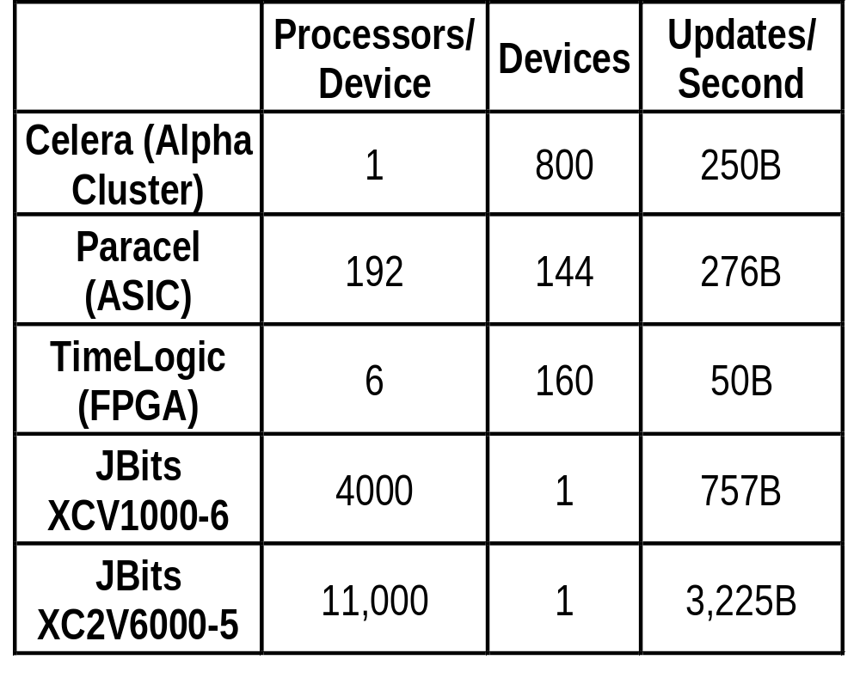
Comparisons
Notes:
V1000 = 64 x 96 CLBs x 4 LUT/FF pairs per CLB = 24,576 LUT/FF pairs
at 6 LUT/FF pairs per PE = 4096 PEs
approx. 4000 PEs at 188 MHz = 752,000B matches / second
2V6000 = 96 x 88 CLBs x 8 LUT/FF pairs per CLB = 67,584 LUT/FF pairs
at 6 LUT/FF pair per PE = 11,264 PEs
approx 11,000 PEs at 266 MHz = 2,926,000 matches / second

Slide 20
Conclusions
Modern FPGAs provide fast, efficient gene matching implementations
A single FPGA can replace hundreds of high-end compute servers
Run-time reconfiguration (RTR) provides speed, density, power and interfacing advantages

