Slide 1
Java Debug Hardware Modules
Using JBits
by
Jonathan Ballagh
Eric Keller
Peter Athanas
Reconfigurable Architectures Workshop 2001

Slide 2
Overview
Motivation
JBits Overview
Virtex Device Simulator
Simulator Stimulus
Hardware Modeling
RAM Model Example
Test Bench Design
Advantages/Disadvantages
Future Work/Conclusions

Slide 3

Motivation
Want to safely test RTR designs
Traditional simulators lack RTR support
Provide more flexibility than traditional simulators
“Black box” nature of the configuration bitstream
Design to bitstream translation is error prone
Did we get what we wanted?
FPGA

Slide 4
JBits
A Java API to configure Xilinx FPGA bitstream
Provides complete design control
  Routing
  CLB configuration
Supports run-time reconfiguration
Allows for tools to be built upon it
Example low-level configuration call:
jBits.Set(row, col, S1F1.S1F1, S1F1.SINGLE_EAST0)

Slide 5
The JBits Environment
RTP Core
Library
User
Code
JBits
API
JRoute
API
BoardScope
Debugger
XHWIF
TCP/IP
Device
Simulator

Slide 6
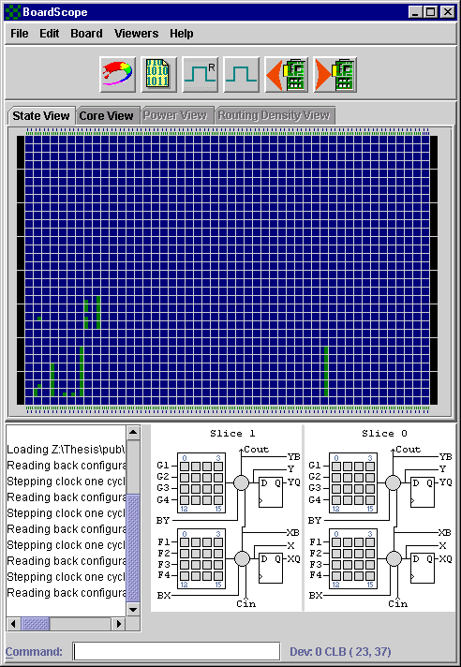
Virtex Device Simulator
Java based simulator for Virtex devices
Models the FPGA hardware
  Interconnected flip-flops and 4-input LUTs
Determines state information of Virtex FPGA
Allows “safe” validation of designs
FPGA

Slide 7
Virtex Device Simulator
Supports simulation of RTR designs
No mechanism for generating external I/O
The problem:
- How do we do test bench design?

Slide 8
Simulator Stimulus
Manage I/O in a separate process
SimulatorClient connects to VirtexDS server
Internal FPGA states travel over TCP/IP connection
VirtexDS
FPGA
Simulator
Server
Internal FPGA Signals
TCP/IP Connection
Simulator
Client

Slide 9
Simulator Stimulus
Signals are probed and stimulated through JBits Pin resources
Example JBits Pin declaration:
Pin reg_pin = new Pin(pin.CLB, 4, 9, CenterWires.S0_XQ);
Row Column
CLB, IOB, BRAM, or DLL
JBits Resource

Slide 10
Simulator Stimulus - Functions
Pins are read using readPinValue (Pin)
Vectors are read using readVector(Pin[] IOPins)
Pins are written using setPinValue(Pin, int)
Vectors are written using writeVector(int val, Pin[] IOPins)
Method waitForStep() waits for simulator clock to be stepped

Slide 11
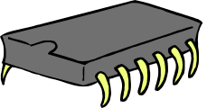
Hardware Modeling
Models extend SimulatorClient class
Devices are modeled using behavioral Java code
Examples:
Limited only by the resources available to the “host” machine
Memory
Processor
Control Signal Manipulation

Slide 12
Model Operation
Generic model operation:
Initialization
Read Pin Values
from Simulator
Determine Next
State
File I/O
Write Pin Values
to Simulator
Wait for Clock
Step

Slide 13
Example: RAM
public class RAMClient extends SimulatorClient {
/* class member fields */
private int[] RAMContents; /* array storing memory values */
private Pin[] addrPins; /* RAM address pins */
private Pin[] dataPins; /* RAM data I/O pins */
private Pin RWPin; /* RAM read/write pin */
private Pin CEPin; /* RAM chip enable pin */
/**
* Creates an instance of the RAMClient
*
* @param _addrPins - collection of RAM addr pins
* @param _dataPins - collection of RAM data pins
* @param _RWPin - RAM read/write pin
* @param _CEPin - RAM chip enable pin
* @param _RAMContents - RAM memory values
*
*/
public RAMClient(Pin[] _addrPins, Pin[] _dataPins, Pin _RWPin, Pin _CEPin,
int[] _RAMContents) {
...

Slide 14
Example: RAM
while (stepCount < maxSteps) {
/* obtain RAM address */
address = readVector(addrPins);
/* check CEPin status */
if (readValue(CEPin) == 0) { /* active low */
/* check the r/w status */
if (readValue(RWPin) == 0) /* write */
RAMContents[address] = readVector(dataPins);
else /* read */
writeVector(RAMContents[address], dataPins);
} /* end if */
/* wait for VirtexDS to be stepped */
waitForStep();
stepCount++;
} /* end while */

Slide 15
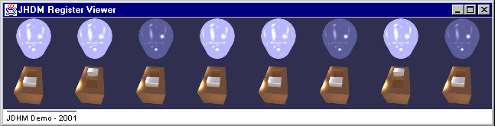
Test Bench Design
Models
VirtexDS
Vector Files
FPGA
….
….
…..
….
….
…..
….
….
…..
XHWIF
GUI(s)
BoardScope

Slide 16
Advantages
Java language easily models design
Allows hardware level simulation involving proto type hardware components
Supports RTR, unlike traditional VHDL simulators
Testbench can be designed for any Virtex bitstream
  Design tool is irrelevant

Slide 17
Disadvantages
Only supports Virtex devices
No way to view asynchronous events
Only one device simulator can be open at a time
Very “low-level”…

Slide 18
Future Work
Only 1 VirtexDS can be open at a time
Allow direct access to VirtexDS event queues, rather than with a TCP/IP connection.
Allow primitives to generate events on external models. This would allow for better timing models.
Communication between external modules
Add asynchronous event support
Use JBits User Constraints File Parser to automatically obtain Pin locations

Slide 19
Conclusions
Provides a method to model external hardware
Allows bitstream level debugging with VirtexDS
  Which means that it supports RTR
More flexible than VHDL testbenches
Graphical model representations can be designed to complement the BoardScope graphical debugger.

Slide 20
Questions?

