Slide 1
Programming a Hyper-Programmable Architectures for Networked Systems
Eric Keller and Gordon Brebner
Xilinx Research Labs, USA

Slide 2
Hyper-Programmable Architectures for Networked Systems
Gordon Brebner, Phil James-Roxby, Eric Keller, Chidamber Kulkarni
and Chris Neely
Xilinx Research Labs, USA

Slide 3
What this talk is about
Message Processing (MP) as a specific domain, addressing adaptable networked systems
The Hyper-Programmable MP (HYPMEP) environment for domain-specific harnessing of programmable logic devices
HAEC, an XML-based Level 2 API for the HYPMEP soft platform
In brief, an initial experiment with HAEC

Slide 4








Networking everywhere
“Disappearing computer”
“Ambient intelligence”
Network
Network
Network
Network
“Pervasive computing”
“Ubiquitous computing”
Networks on chip
Theories of interaction

Slide 5
Message Processing (MP)
Key future computation+communication paradigm
“Message” chosen as neutral term, encompassing “cell”, “datagram”, “data unit”, “frame”, “packet”, “segment”, “slot”, “transfer unit”, etc.
MP is ‘intermediate’ between Digital Signal Processing (DSP) and Data Processing (DP):
  Like DSP, MP seems natural PLD territory
  But, like DP, MP has more complex data types and more processing irregularity than DSP

Slide 6

Example: MP-style operations
Is this message for me?
Do I want this message?
Change the address on
this message.
Break this message into
two parts.
Retrieve this message
from my mailbox.
Queue this message up
for delivery.
Translate this message
to another language.
Validate a signature
on this message.

Slide 7
Classes of MP operations
Matching and lookup
  read-only on messages; results used for control
Simple manipulations (that can be combined)
  read/write on specific message fields
Characteristic domain-specific computations
  hook to allow complex (DSP or DP style) operations
Message marshalling
  movement, queueing and scheduling of messages

Slide 8
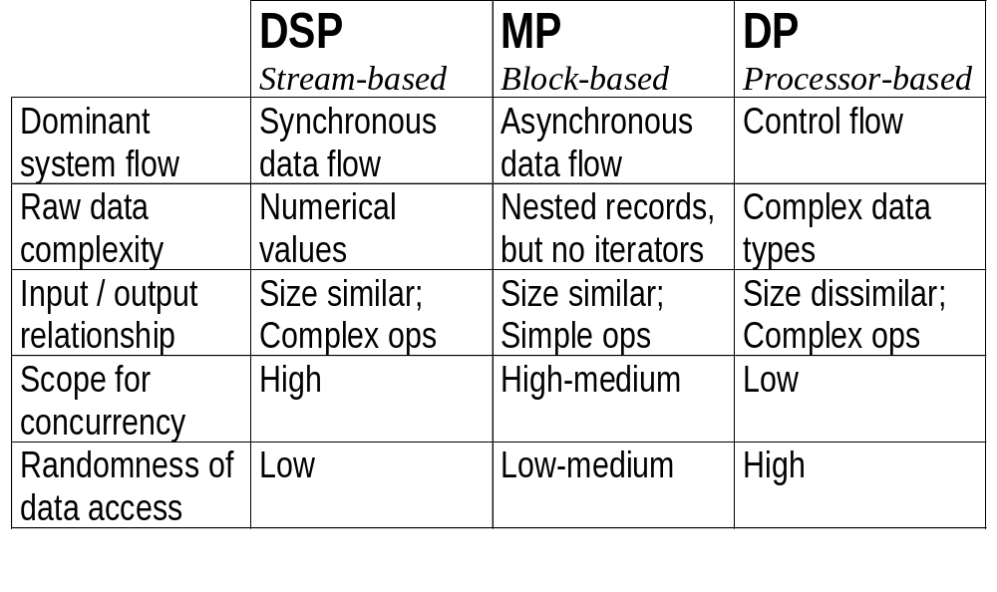
Comparison of DSP, MP and DP

Slide 9
Programmable logic
Earliest: programmable array logic (PAL) and programmable logic array (PLA) devices
  restrictions on structure of implemented logic circuitry
Then: the Field Programmable Gate Array (FPGA)
  basic device architecture has a large (up to multi-million) array of programmable logic elements interfaced to programmable interconnect elements
Now: the Platform FPGA
  a heterogeneous programmable system-on-chip device

Slide 10
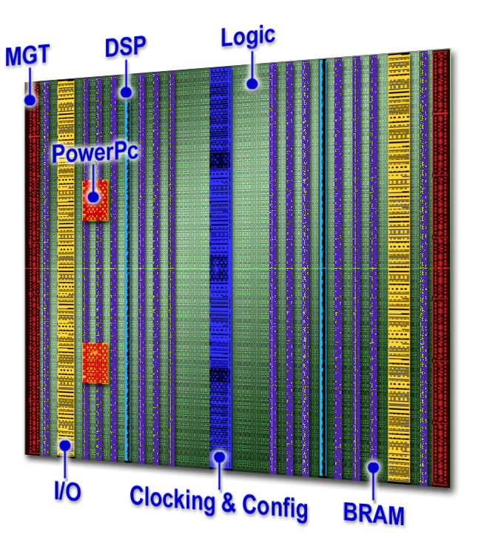
Today’s Platform FPGA
No longer just an array of programmable logic
Example shown:
Xilinx Virtex-4
(launched in September 2004)
Very important: the programmable interconnect

Slide 11
PLDs for networked systems
Vast bulk of successful present-day use:
  PLD as direct substitute for ASIC or ASSP on board
  conventional hardware (+software) design flow
Maybe map network processor to PLD instead of ASIC
Future opportunity: deliver modern PLD attributes directly to networked applications
  remove bottlenecks from traditional design flows
  implementations are still mainly a research topic

Slide 12



HYPMEP Environment
...
Design automation tools for
MP users (entry, debug, ...)
Provide concurrency,
interconnection and
programmability
API access
Hooks for
existing IP
cores and
software
HYPMEP soft platform
Exploit concurrency,
interconnection and
programmability
Efficient mapping
Programmable
logic devices

Slide 13
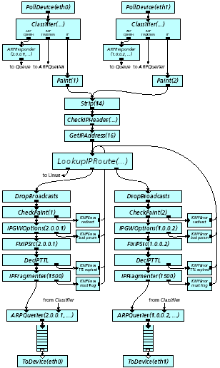
Example: design entry in Click
By Kohler et al (MIT, 2001)
Shows a standards-compliant
two-port IP packet router
Each box is an instance of a
pre-defined Click element
Packets are ‘pushed’ and
‘pulled’ through the graph
There are 16 elements
on the data forwarding path
Input
Lookup
Simple op
Queue
Output

Slide 14
HYPMEP soft platform APIs
Level of abstraction determines complexity of compiler for efficient mapping to PLD
Three levels of abstraction being investigated:
  HIC: abstracted functions and memories
  HAEC: abstracted functions; memory blocks
  HOC: explicit function and memory blocks
Backward mapping is as important as forward mapping, to preserve user abstraction level for testing, debugging and monitoring

Slide 15
Main HAEC components
Threads: lightweight concurrent message processing entities compiled to PLD implementations
Hooks: wrappers for existing functional blocks with PLD implementations
Interfaces: for moving messages into or out of the system perimeter
Memories: for storage of messages, system state or system data

Slide 16
System control flows
A control flow is associated with each individual message within the system
In simple case of message in/message out:
  begins with thread activation on arrival of message
  … thread starts one or more threads or hooks
  … threads in turn can start more threads or hooks
  … ultimately a thread handles departure of message
Based upon lightweight start/stop mechanism
Data plane - also have control plane control flows

Slide 17
Threads
Each thread is implemented as a custom finite state machine, and threads run concurrently
Concurrent instructions are associated with each each state, with dedicated implementations
Instruction set may be programmed itself - seek simple operations fitted to message processing
Instructions include memory accessing, and operations to interact with other threads

Slide 18
Example HAEC code for thread
<thread name="rx_thread">
<useinterface intname="RX" name="mygmac" port="rx"/>
<usemem intname="PUT" name="ethrecv_buf" port="put"/>
<variables>
<internal name="len" width="16"/>
<internal name="addr" width="11"/>
</variables>
<states start="startState" altstart="RX_dataValid">
<state name="startState">
<operation op="WRITE_DATA" params="PUT, RX_Data, 4"/>
<operation op="ASSIGN" params="addr, 4"/>
<transition next="writeData"/>
</state>
<state name="writeData">
<conditional>
<condition cond="EQUAL" params="RX_dataValid, 1">
<operation op="WRITE_DATA" params="PUT,RX_Data,addr"/>
<operation op="ADD" params="addr, addr, 1"/>
<transition next="writeData"/>
</condition>
<condition cond="else" params="">
<operation op="WRITE_DATA" params="PUT, addr, 0"/>
<transition next="commitPacket"/>
</condition>
</conditional>
</state>
…

Slide 19
Inter-thread communication
Have standard start/stop (and pause/resume) synchronization mechanism, seen earlier
Two direct communication mechanisms:
  lightweight direct data passing and signaling between two threads
  data channels between threads: extra functionality can reside in the channel
Indirect communication via shared memory is also possible (with care of course)

Slide 20
Hooks and blocks
Threads provide a basis for programming many common processing tasks for network protocols
Use hooks and blocks in other cases:
  algorithms without natural FSM model (e.g. encryption)
  existing implementations exist in logic or software
Hook is the interfacing wrapper for a block:
  allows activation of block by threads
  allows connection of blocks to memories

Slide 21
Interfaces and memories
Interface:
  has an internal hook-style interface to block
  has an external interface for the block
  associated threads handle message input/output
Memory
  memory blocks present one or more ports to threads
  ports are accessed by thread instructions
  used for messages, lookup tables and state

Slide 22
Mapping HYPMEP to PLDs
Must be efficient:
  system: resource usage, timing, power
  messages: throughput, latency, reliability, cost
Interface-centric system model
  as opposed to processor-centric for example
  placement and usage of interfaces, memories and their interconnection dominates the mapping
Standard tools for design-time hyper-programmability
More specialized tools for run-time reconfiguration

Slide 23
Compiling HAEC to VHDL
Each system component instantiated in HAEC is mapped to a hardware entity on the FPGA:
  threads mapped to custom hardware
  generation of signals required between threads
  hooked blocks, interfaces and memories already exist as pre-defined netlists and are stitched in
One major contribution of the compiler is the automatic generation of clock signals
  transition from software world to hardware world

Slide 24
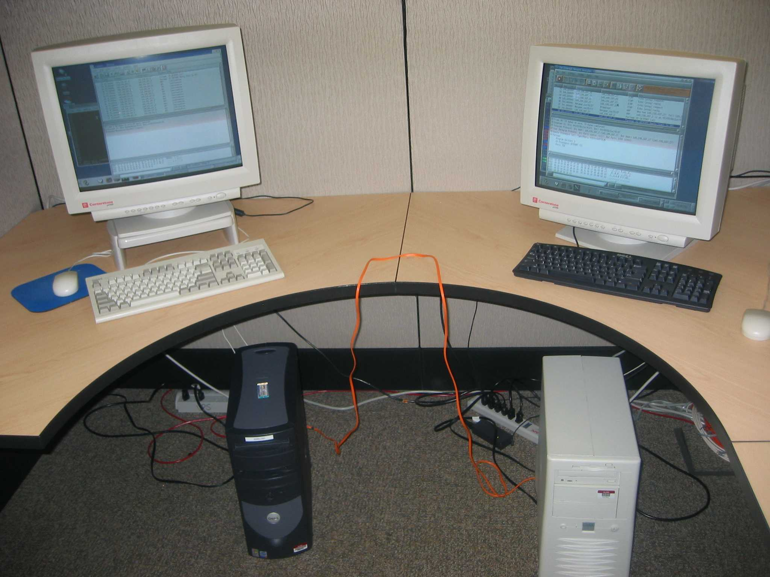
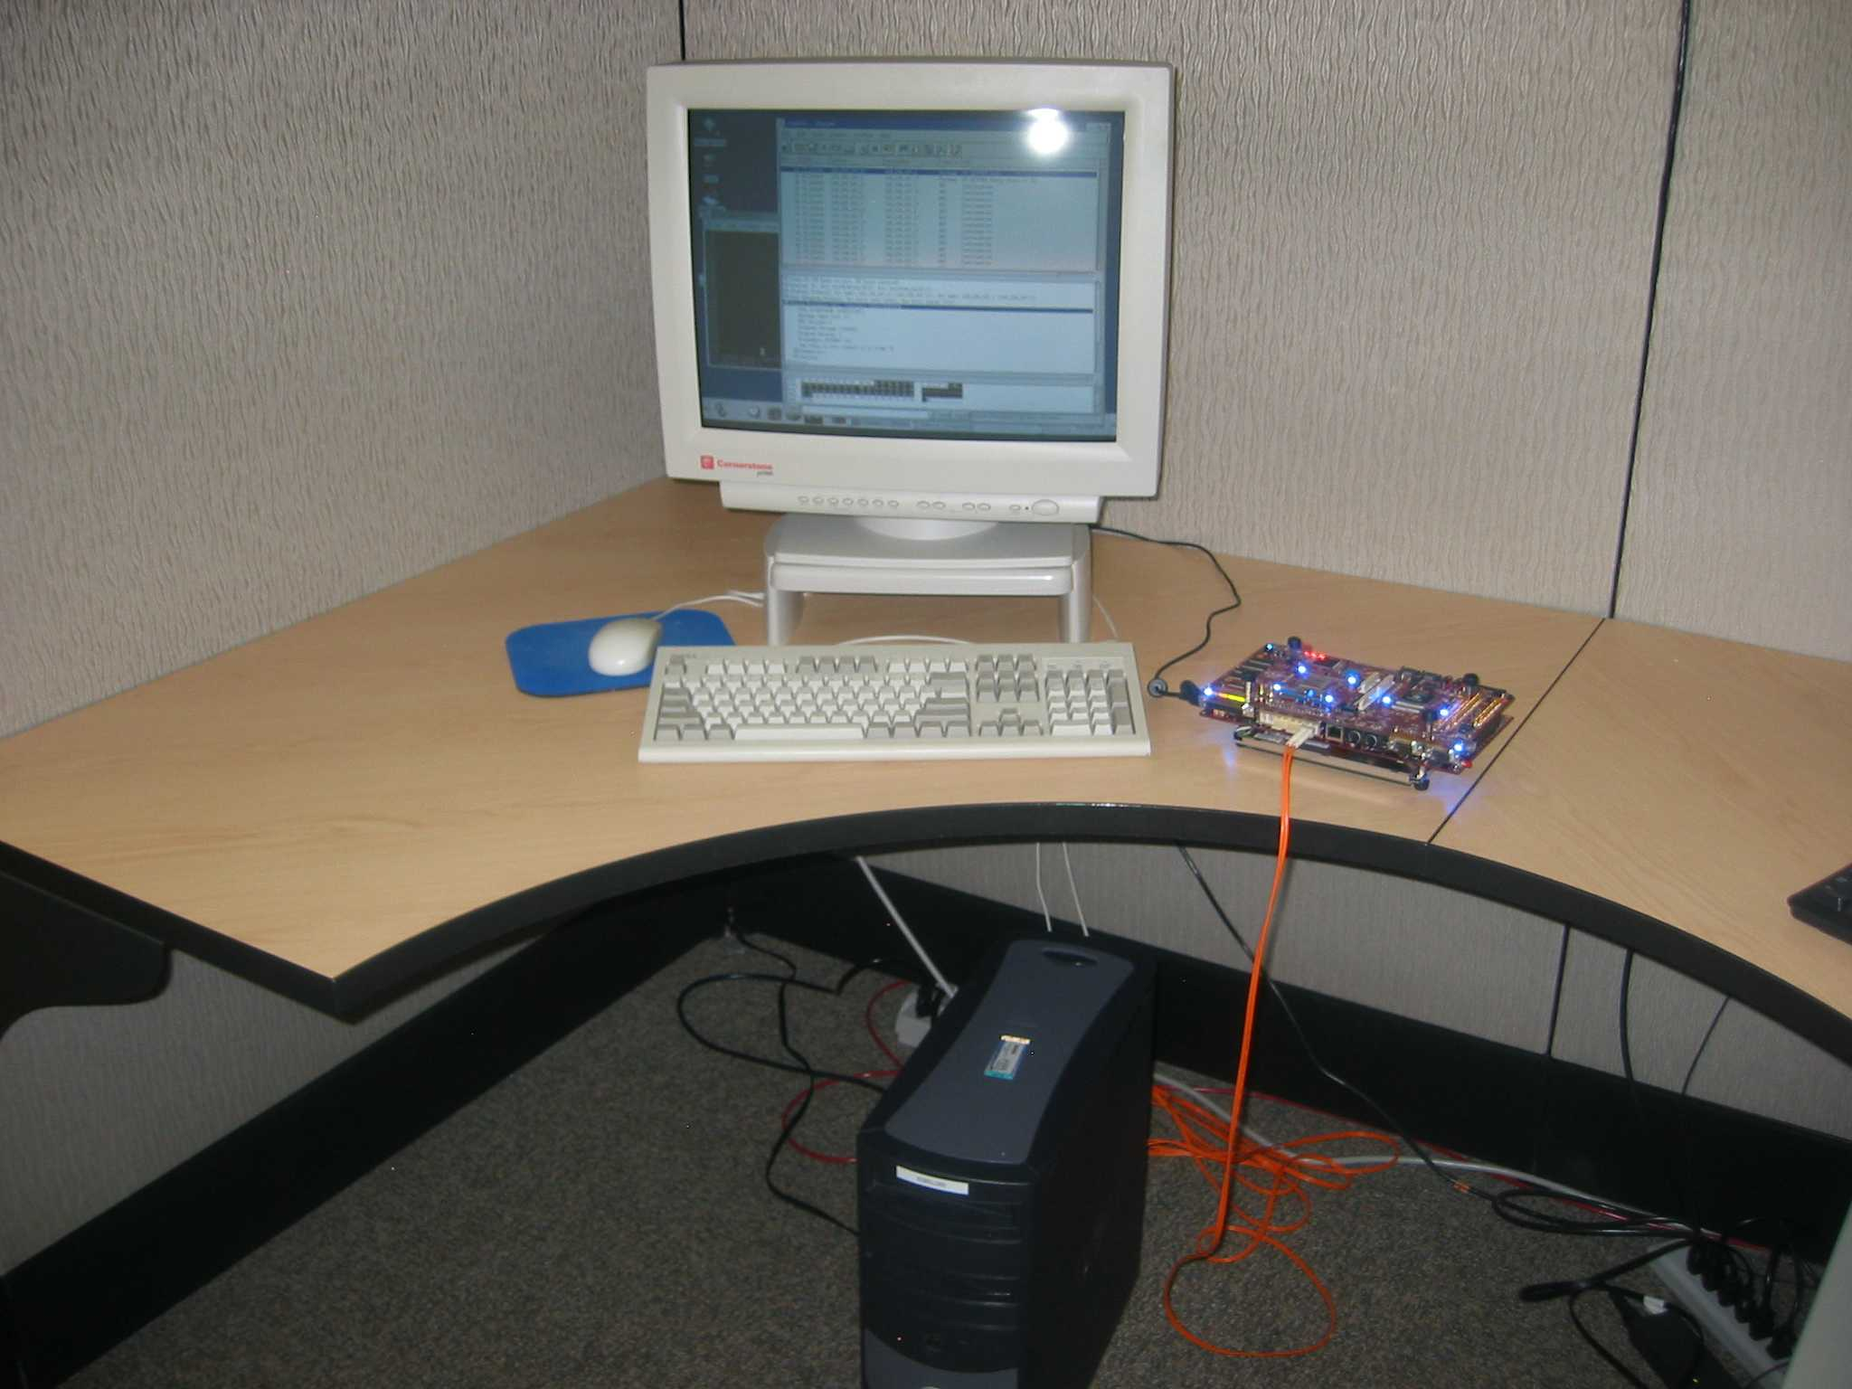
Remote Procedure Call example
RPC protocol underpins Network File System (NFS) for example
RPC over UDP over IP over Ethernet protocol stack
FPGA is acting as a genuine Internet server
End system example, as opposed to intermediate system (e.g. bridge, router)
Before:
use a
2 GHz
Linux PC
After:
use a
small
FPGA
(Xilinx
XC2VP7)

Slide 25
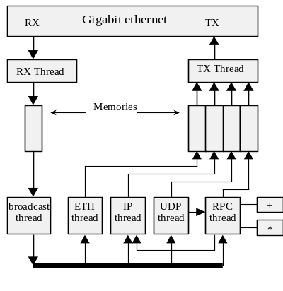
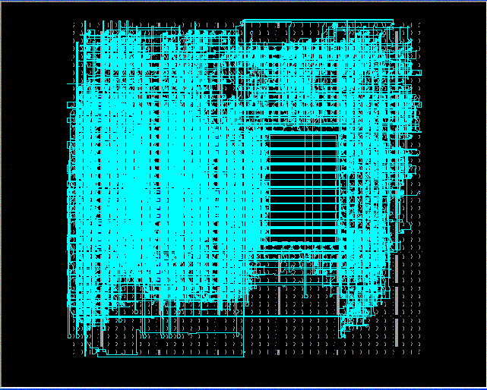
RPC design results
Operates at 1 Gb line rate
Per-RPC protocol latency is 2.16 μs
  7.5X over Linux on 2 GHz P4
  10X attainable with small mods
2600 logic slices and 5 block RAMs
  Ethernet core is half the slices
869 lines of XML-based description ...
… compiled to 2950 lines of VHDL
Design and implementation time:
  TWO PERSON-WEEKS

Slide 26
Conclusions and future plans
Illustration of how PLDs can have primary roles in adaptable networked systems
First generation of HYPMEP implemented
Validated by various gigabit rate experiments
Now exploring embedded networking applications
Longer-term strategy is to, in tandem:
  break down traditional hardware/software boundaries
  break down data plane/control plane boundaries

Slide 27
The End

