Slide 1
JRoute: A Run-Time Routing API for FPGAs
®
by Eric Keller
JRoute RAW2000 5/1/00

Slide 2
What is JRoute?
JRoute is a Java API for performing routing of FPGAs at run-time
Uses JBits calls to set the routing
Supports Xilinx Virtex™ devices

Slide 3
Review of JBits
A Java API to configure Xilinx FPGA bitstream
Provides complete design control
  Routing
  CLB Configuration
Supports Run-Time Reconfiguration
jBits.set(row, col, S1F1.S1F1, S1F1.SINGLE_EAST0)

Slide 4
The JBits Environment
RTP Core
Library
JBits
API
User
Code
JRoute
API
BoardScope
Debugger
XHWIF
TCP/IP
Device
Simulator

Slide 5
Why do we need JRoute?
JBits only provides manual routing
JRoute facilitates the use of run-time relocatable and parameterizable cores
JRoute provides automated routing support

Slide 6
Virtex Routing Overview
To adjacent
GRM
To adjacent
To adjacent
GRM
GRM
GRM
To adjacent
GRM
Direct connection
CLB
Direct connection
to adjacent CLB
to adjacent CLB

Slide 7
JRoute Features
Various Levels of Control
Support for Cores
Avoids Contention
Unrouter
Debugging Features
Plug-in Different Algorithms

Slide 8
Various Levels of Control
Individual Connection
Specify Path (defined as list of resources)
Specify Template (defined as list of directions)
Source to Sink
Source to Multiple Sinks
Multiple Sources to an equal number of Sinks

Slide 9
Greedy Algorithms
Target Designs - structured and regular
Global followed by Detailed inefficient
RTR - Global undefined

Slide 10
Single Source - Single Sink
2
1
6
Point reachable
with hexes
18
18
12

Slide 11
Support for Cores
Hierarchical designs
Define a Port
  no need to know which pins to connect to
  no need to connect to each input
Same calls to router with Ports (as with Pins)
Routes when it can

Slide 12
Port Example
(W+X) * (Y+ Z)
from another AdderCore
n
A
n
A
n
n
n
B
out
B
out
n
clk
reset
clk
reset
AdderCore
MultiplyCore
    /* get the outputs from the adder */
    Port[] source = adder.getPortOut( );
    /* get the B input ports from the multiplier */
    Port[] sink = multiplier.getPortB( );
    /* connect the output from the adder to the input B of the multiplier */
    jroute.route(source, sink);

Slide 13
Hierarchical Cores
Core 3
Core 1
Core 2
X
A
O1
C
O2
Z
Y
B
Logic
Logic

Slide 14
Avoids Contention
Virtex devices have bi-directional lines
Uses an interface ResourceFactory to keep track of resource usage
  Has calls such as addConnection() and removeConnection()
Doesn’t allow user to use a resource already in use
Checks if a wire is on before tries to use it

Slide 15
Unrouter
Releases resources that are no longer needed
Forward or reverse direction
In forward, specify source
In reverse, specify sink
Uses ResourceFactory
Ports or Pins

Slide 16
Reverse Unroute
Source
Sink
jroute.reverseUnroute (sink);

Slide 17
Reverse Unroute
Source
Sink
removed this wire
jroute.reverseUnroute (sink);

Slide 18
Reverse Unroute
Source
Sink
removed this wire
jroute.reverseUnroute (sink);

Slide 19
Reverse Unroute
Source
Sink
jroute.reverseUnroute (sink);

Slide 20
Debugging Features
Methods trace() and reverseTrace()
Specify a source pin and trace() returns the entire netlist to all sinks
Specify a sink pin and reverseTrace returns the part of the netlist leading to the sink
Uses ResourceFactory to determine connections
Can get info about any wire (ie on/off, drives, driven by).

Slide 21
Plug-in Different Algorithms
Interface for each routing call
  fanout, point to point, etc.
Implement the interface
call setInterface method
  jroute.setFanoutRouterInterface(myfan);
All code that calls jroute.route(src,sink[]) now uses myfan instead of the default

Slide 22
Results: Example Execution Time
Number of Routes: 3975
  JBits calls: 351 ms => 11.3 k r/s
  JRoute Low-Level: 1051 ms => 3.8 k r/s
  JRoute Path: 951 ms => 4.2 k r/s
  JRoute Template: 1071 ms => 3.7 k r/s
  JRoute Point to Point: 1643 ms => 2.4 k r/s
  JRoute Fanout: 2754 ms => 1.5 k r/s
Pentium III 450 MHz

Slide 23
Future Work
Only knows about connections made through router
No support for IOBs or Block Ram (which JBits doesn’t support yet)

Slide 24
Questions?

Slide 25
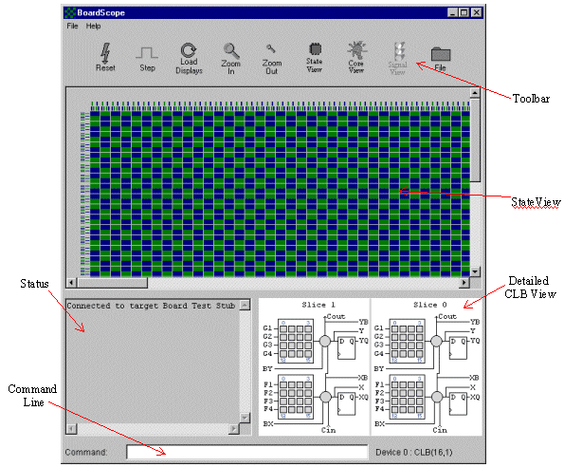
BoardScope Main Display
Notes:
4

Slide 26
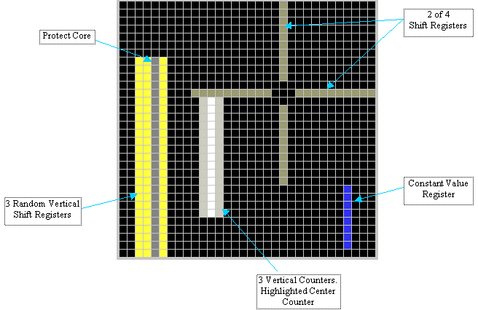
BoardScope RTP Core Display

