Slide 1
A self-reconfiguring platform
Brandon Blodget ,Philip James-Roxby, Eric Keller, Scott McMillan, Prasanna Sundararajan

Slide 2
Outline
Overview
Self reconfiguration
Motivation
External and internal configuration access ports
Reconfiguration details
Hardware architecture
Software architecture
Performance
Current Work

Slide 3
Overview
Self Reconfiguring Platform (SRP)
Intelligent control of reconfiguration via an embedded processor
  PowerPC or MicroBlaze
C based protocol stack
API presents virtual FPGA abstraction of random access reconfiguration
General purpose tool

Slide 4
Self-reconfiguration
We can identify several different types of reconfiguration
  Full - reconfigure all resources
  Partial - reconfigure subsets
  Dynamic - reconfigure subsets, other subsets operate normally
  Self-reconfiguration - reconfigure subsets while other subsets operate normally and one subset controls reconfiguration

Slide 5
Motivation
The motivation for the SRP is
  Integrated support for RTR
  No need to provide external support for partial reconfiguration
  Fast reconfiguration
  Bitstream Manipulation
  Low overhead
  Ease of use
  Novel applications (High Density Crossbars, FPGA OS)

Slide 6
ICAP
ICAP is the Internal Configuration Access Port for Virtex II and Virtex II Pro devices
It is a functional subset of SelectMap and is accessible internally via a user design
It allows the user design to control device reconfiguration at run-time
It becomes available after initial (externally controlled) configuration is complete

Slide 7
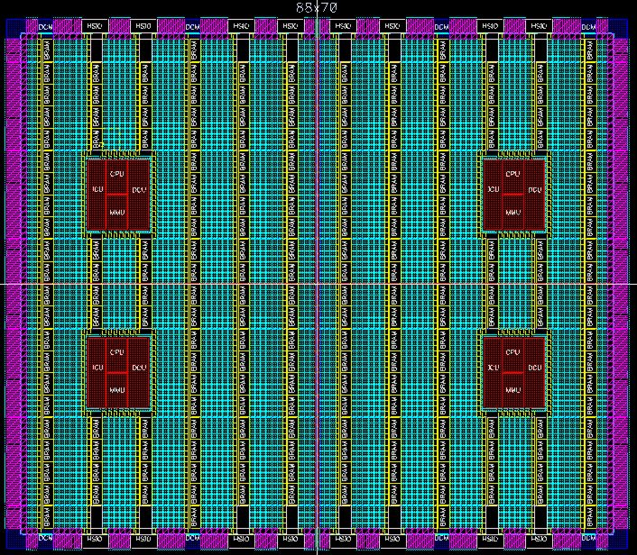
SelectMap & ICAP
SelectMAP
ICAP

Slide 8
SelectMAP versus ICAP
SelectMAP
ICAP
D[0:7]
I[0:7]
O[0:7]
DONE
INIT
BUSY
BUSY
CS
CE
WRITE
WRITE
PROGRAM
CCLCK
CCLCK
M2 M1 M0

Slide 9
Virtex II Configuration Arch
Virtex II [PRO] Device is column reconfigurable
Each CLB column takes up 1 major frame
Each CLB major frame takes up 22 minor frames
1 minor frame is the smallest grain of reconfiguration
Pad frame required
Smallest reconfig packet -> Header + Data Frame +Pad Frame

Slide 10
Frame Sizes

Slide 11
SRP Methodology
Embedded Processor controlling reconfiguration via the ICAP
Read - Modify - Write
Benefits
  No external configuration cache required
  Reconfigure partial columns
Disadvantages
  Slower. Must do a read first.
  SRL16s and LUT RAMs can cause problems.

Slide 12
SRP Hardware
FPGA
Configuration
Memory
ICAP
Registers
Size
Offset
RNC
Done
PowerPC
Or
MicroBlaze
Control
Logic
Dual-port
Block
RAM
CoreConnect OPB

Slide 13
Software stack
Application Code
XPART
Level 3
Hardware
Independent
ICAP API
Level 2
Hardware
Dependent
Device Drivers
Emulated ICAP
Device Drivers
Level 1
ICAP Controller
Level 0
Embedded Microprocessor
External (Window/Unix)

Slide 14
Definitions
XPART – Xilinx Partial Reconfiguration Toolkit
  Bitstream resource abstraction
  Relocatable module functionality
ICAP API
  An abstraction layer that allows XPART to be platform independent

Slide 15
ICAP API
setDevice() – Specifies the target device. Can be any Virtex II or Virtex II Pro part
storageBufferWrite() – Writes data to the BRAM
storageBufferRead() – Reads data from BRAM
deviceRead() – Reads specified number of bytes from the device to the BRAM
deviceWrite() – Writes specified number of bytes from BRAM to the device

Slide 16
ICAP API cntd
deviceReadFrame() – Reads one or more frames from device to BRAM
deviceWriteFrame() – Writes one or more frames from BRAM to device
setConfiguration() – Writes configuration to device from any address location
getConfiguration() – Reads device configuration and stores it at specified address location

Slide 17
XPART
getCLBBits() – Reads back the state of a selected CLB resource.
setCLBBits() – Reconfigures the state of a selected CLB resource
copyCLBModule() – Given a bounding box, the module is copied to a new location on the device
setCLBModule() – Places the module at a particular location on the device

Slide 18
Performance
System 1 - CPU @ 50MHZ, OPB @ 50MHZ
System 2 - CPU @ 300MHZ, OPB @ 100MHZ

Slide 19
Conclusions
Presented an intelligent subsystem for self-reconfiguration of Xilinx Virtex II and Virtex II Pro FPGAs (ICAP API)
Created the abstraction of an FPGA architecture with randomly accessible configuration memory (XPART)
Demonstrated the high performance of the platform

Slide 20
Current & Future Work
Complete emulated ICAP Device Drivers
Use SRP as a controller for a reconfigurable crossbar
Build an SRP Linux driver for the ML300 platform.
Research relocatable module functionality

Slide 21
Thank You

Slide 22
Simple example
  #include <XPART.h>
  #include <LUT.h> /* Bitstream resource library for LUTs */
  int main(int argc, char *args[])
  {
  char* value;
  int error, i, row, col, slice;
  setDevice(XC2VP7); // Set the device type

Slide 23
Example continued
  /* Initialize FLUT in SLICE_X0Y4 to all ones */
  col = SLICEX_COL(0);
  row = SLICEY_ROW(4);
  slice = SLICEXY_SLICE(0,4);
  for (i=0; i<16; i++) value[i]=1;
  error = setCLBBits(row, col, LUT.RES[slice][LE_F_LUT], value, 16);
  return error;
  } /* end main() */

Slide 24
CopyModule() functionality
fromY1
fromY2
toY1
fromX1
fromX2
toX1

Slide 25
Lightweight ICAP interface
FPGA
Configuration
Memory
ICAP
MicroBlaze
32-bit memory-
mapped
Register
ICAP_IN: Bits 0-7
CE: Bit 8
WRITE: Bit 9
CCLK: Bit 10
ICAP_OUT: Bits 16-23
Busy: Bit 24
BRAM
Scratch
pad
CoreConnect OPB
Open Peripheral Bus

