Slide 1


A Run-Time Reconfigurable 2D Discrete Wavelet Transform using JBits
Eric Keller
Jonathan Ballagh
Peter Athanas

Slide 2
Topics
Motivation
DWT Background
Design Overview
Interfacing
Results
Future Work/Conclusions

Slide 3
Motivation
Previous ASIC/FPGA DWT implementations were static
  Wavelet coefficients are fixed
Certain wavelets are more effective for different applications
Currently, JPEG2000 uses a “lossy” and “loss-less” wavelet
  Will eventually allow for more wavelets
Software provides a great deal of flexibility, but is too slow
ASICs are fast, but are limited in terms of parameterization
Implementation
Medium
Wavelet Selection
Motorala StarCore DWT
SFT/DSP
YES
TI TMS320C62x DWT
SFT/DSP
YES
AD ADV601 Codec
ASIC
NO
AD JPEG2000 Chip
ASIC
NO
Benkrid et al DWT
FPGA
SORT OF

Slide 4
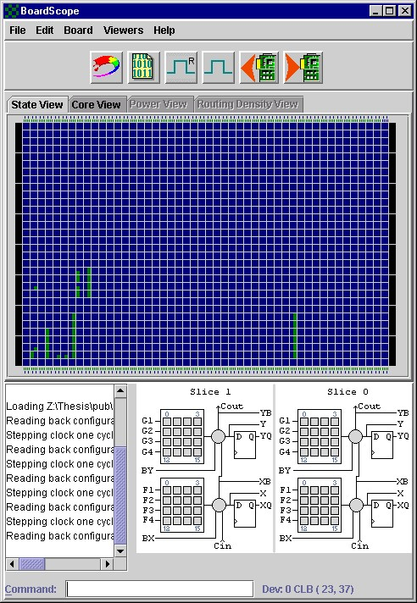
The JBits Environment
RTP Core
Library
User
Code
JBits
API
JRoute
API
Remote
Hardware
BoardScope
Debugger
TCP/IP
XHWIF
FPGA
Hardware
FPGA
Device
Simulator

Slide 5
The 2-D DWT
Multiresolutional decomposition of a signal
Represents the signal in the time-scale domain
More efficient than the DCT
  Used in JPEG2000
Low-pass filter extracts average coefficients
High-pass filter extracts detail coefficients
TRANSFORM OUTPUT
ROWS
Low/Low
Output
Low/High
Output
Low-Pass
Output
High-Pass
Output
COLS
High/Low
Output
High/High
Output
LL
L
LPF y
2
LPF x
2
HL
IMAGE
HPF y
2
H
LH
LPF y
2
HPF x
2
HPF y
2
HH

Slide 6
Core Hierarchy
ShiftRegister
Comparator
LUT4
Address
Generators
Constant
Register
MUX2_1
Counter
MUX2_1
DWT2D
AdderTree
Register
KCM
MUX2_1
DistributedROM
FIRFilter
16x1ROM
Adder
AdderTree
Register
Register

Slide 7
DWT2D Core
Fully parameterizable
  Filter length and coefficients
  Image height and width
  Coefficient precision
Based on the folded-architecture
Filter bank latency is balanced with registers
MUX cores select filter input source, filter output, memory addresses and data
OUTPUT
INPUT
MEMORY 1
MEMORY 2
MUX
MUX
MEMORY ADDRRESS GENERATOR 1
MEMORY ADDRESS GENERATOR 2
MUX
HP FIR FILTER
MUX
LP FIR FILTER
Z⁻¹

Slide 8
Address Generators
Separate input and output address generators cores
Zero-padding on edges
Generates addresses for SRAM memories
Difficult without behavioral synthesis
Same circuitry is used to perform row and column scans
  Output address generator reverses row and column address values
512
512
256
256
512
512
LEVEL 1 ROWS
LEVEL 1 COLUMNS
LEVEL 2 ROWS
256
128
128
256
128
128
LEVEL 2 COLUMNS
LEVEL 3 ROWS
LEVEL 3 COLUMNS

Slide 9
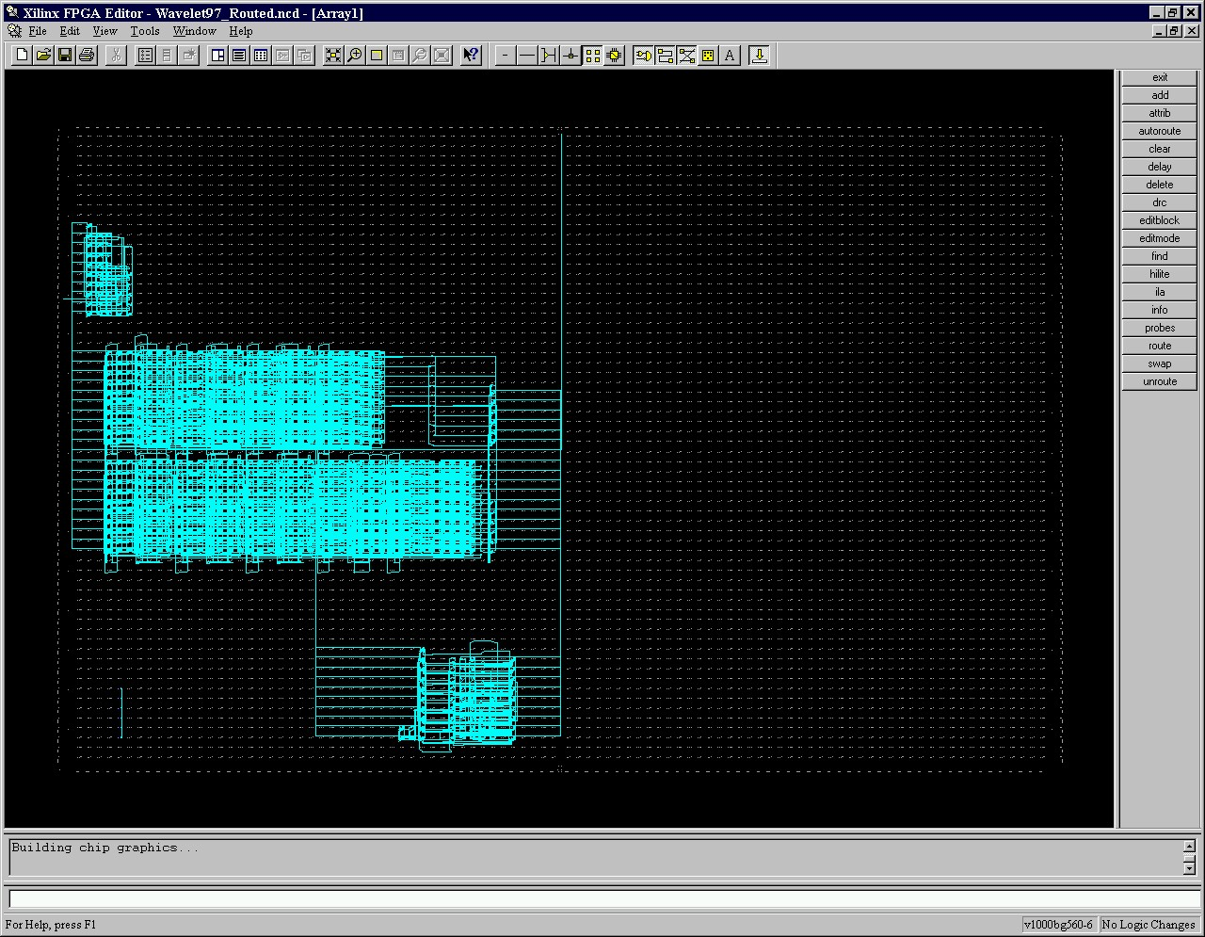
DWT2D NCD View
Generated using XDL RTP core output
Features a 9/7-tap 12-bit filter-bank configuration
Address generators are located near their respective SRAM IOBs
IOB interfacing is not shown

Slide 10
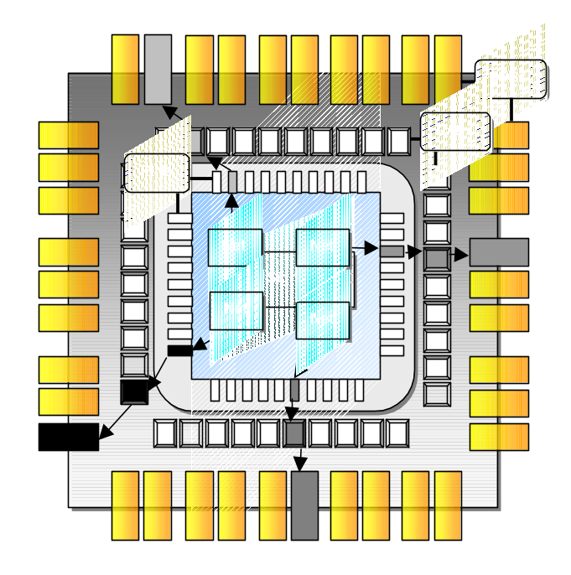
Interfacing
DWT2D requires two external SRAMs
Slaac1V X2 XCV1000 was the target FPGA
JBits RTR I/O classes were used for core interfacing
  Provide automated IOB configuration/interfacing using a RTR core interface
  Eliminated reliance on external tool flows
Created SRAM RTP core to abstract SRAM hardware

Slide 11
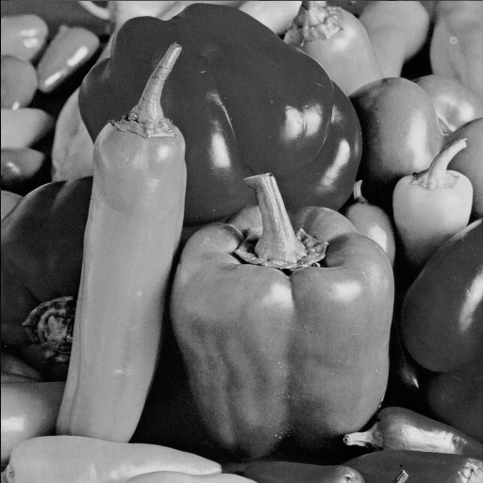
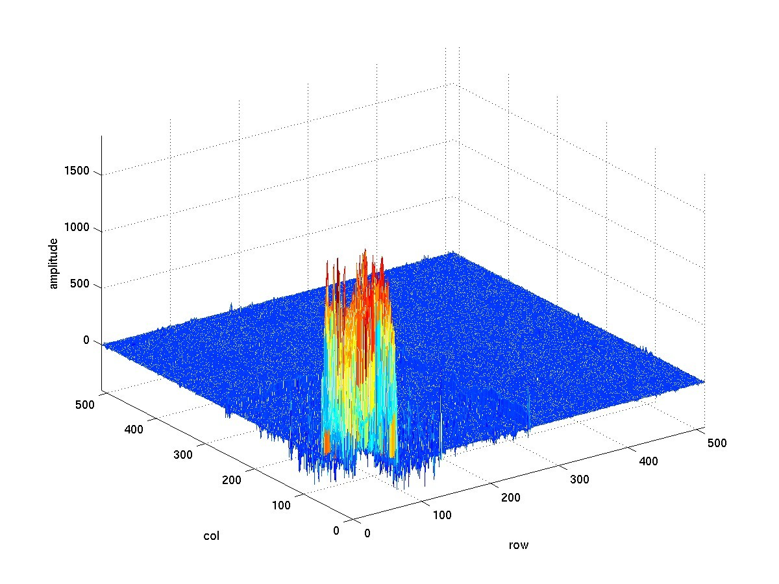
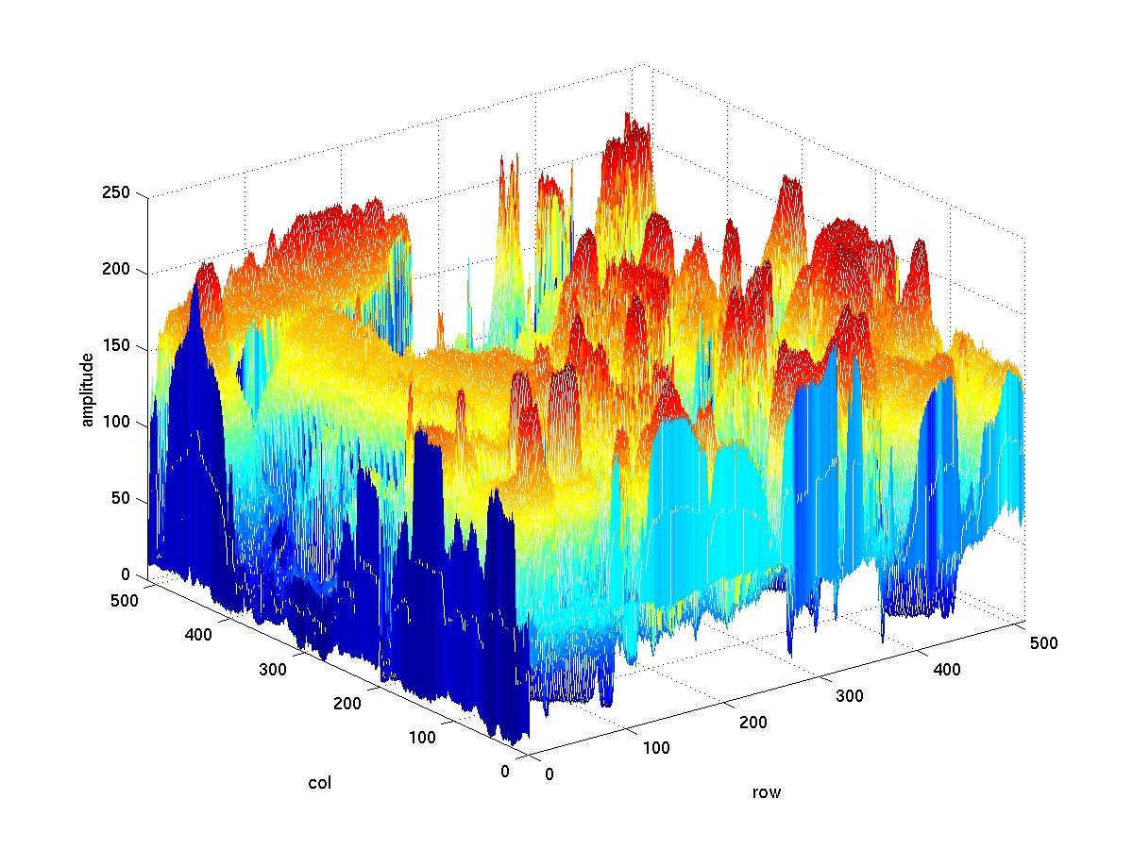
Results – Transform Output
PEPPERS.BMP
UNTRANSFORMED PIXEL INTENSITIES
TRANSFORMED COEFFICIENT OUTPUT
3-Levels of Decomposition
Daubechies’s N=3 Orthogonal Wavelet Filters

Slide 12
Results – DWT2D Performance
Filters
Frequency (MHz)
JBits to Bitstream (sec)*
Filter Configuration (sec)*
CLBs
5/3
84.154
12.978
2.524
450
2/2
84.154
11.909
1.242
280
9/7
84.154
15.642
5.258
770
6/6
84.154
13.910
3.575
600
Benkrid et al
DWT2D
TMS320C62x (200 MHz)
StarCore (300 MHz)
Period (msec)
3.50
6.23
15.8
27.2
Timing results were computed on 1 GHz Pentium III with 1 GB of RAM running Windows2000

Slide 13
Results – FIR Filter Performance
8-BIT
12-BIT
16-BIT
Taps
Freq. (MHz)
CLBs
Freq. (MHz)
CLBs
Freq. (MHz)
CLBs
2
186.71
40
176.44
80
167.67
108
3
177.34
64
172.98
120
166.83
168
5
172.06
104
164.88
210
153.35
276
6
166.81
120
157.36
240
152.86
324
7
171.67
144
151.76
280
145.90
384
9
166.42
192
147.51
370
136.95
504

Slide 14
Results - Partial Reconfiguration
Reconfiguration times are still too lengthy!
In most cases, only the filters are dynamic
Use existing DWT2D bitstream
  Leave FIR filter circuitry in place
  Use constant-folding to modify LUTs
Use JRTR to keep track of bitstream changes
  Write only modified portion of bitstream

Slide 15
Results – Partial Reconfiguration
9/9
6/6
5/5
3/3
Filter Reconfiguration
0.122 sec
0.120 sec
0.121 sec
0.120 sec
Partial Bitstream Write
0.071 sec
0.060 sec
0.050 sec
0.040 sec
Partial Bitstream Size
72,234 bytes
48,185 bytes
40,169 bytes
24,137 bytes
Full XCV1000 bitstream size is ~ 766K bytes

Slide 16
Future Work
Use a more efficient architecture (non-folded)
  Recursive Pyramid Algorithm
    Uses a systolic-parallel architecture
    Transform period of N² cycles/level
    Requires less memory
Use on-chip BRAM to store intermediate results
Reduce critical path delay
  Bring DWT speed up to filter speeds
Add row-extension support
  Symmetric reflection
Integrate core into a compression system
  Add quantizer and entropy encoder cores

Slide 17
Conclusions
Designed a RTR/RTP 2-D DWT core using JBits
  Also created several smaller cores for the DWT core library
  FIR Filter / Adder Tree / KCM / Adder / Comparator
No reliance on traditional vendor tools
  Generated completely from a XCV1000 NULL bitstream
Implemented an RTR I/O interfacing methodology
  Used RTR I/O classes to connect the DWT2D core to the Slaac1V SRAMs
Showed that reasonable DWT2D reconfiguration times are achievable with partial reconfiguration

