Slide 1
An FPGA Wire Database for Run-Time Routers
Eric Keller
Scott McMillan

Slide 2
Requirements
Low-Memory Overhead
  For embedded system limitations
Low-Level
  Control of individual wires
Incremental
  Add and remove nets at run-time

Slide 3
Background
JBits is a Java API providing access to resources in a Xilinx FPGA bitstream
  ie LUT, routing PIPs, etc.
Support run-time reconfiguration
Tools built upon it
  JRoute (run-time router), VirtexDS (simulator), BoardScope (debugger), etc.

Slide 4
Definitions
Pin - a single point of a physical wire
  includes tile row, tile col, wire ID
Wire - a single point of a physical wire representing any location on device
  tile specific but not coordinate specific
  class with functionality for connectivity
  includes wire ID - an int representing the wire
Segment - an entire physical wire
  includes multiple Pins

Slide 5
Intra-Tile Routing Graph
Xilinx FPGAs are organized in tiles
  ie CLB, BRAM, IOB
Within a tile there is connectivity information about each routing resource
A
B
A
A
A
B
A
A
A
B
A
A

Slide 6
Intra-Tile Routing Graph
Methods to get source and sink and make connection (in the Wire class)
Wire getSink(int i) - gets the ith possible sink
Wire getSource(int i) - gets the ith possible source
void connectSource(int i, int row, int col) - connects the ith source to this wire. The row and col are needed because the Wire object provides intra-tile connectivity for any tile of the same type.

Slide 7
Advantages of
Intra-Tile Routing Graph
Store connectivity only once for each tile type
  not once for every tile on device
  XCV1000 has CLB array of 64x96
    CLB routing graph duplicated 6,144 times in flat graph
Device independent
Only loads wires that get accessed
  ie in implementation of Smith-Watermann algorithm only 1,136 out of 2,424 wires to be instantiated

Slide 8
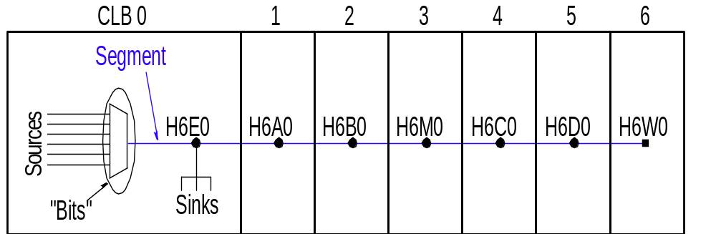
Inter-Tile Routing Graph
Method to get a Segment
  getSegment(int row, int col)
  Segment is a physical wire that spans multiple tiles
  Dependent on location

Slide 9
Inter-Tile Routing Graph
Only need to have Segments in memory that are being used
Can cache segments to improve performance
Storage is small since software builds up segments
  instead of having device specific flat routing graphs.

Slide 10
Example Code
// Prints every pin on segment and all sinks of that pin
Wire wire = com.xilinx.JBits.Virtex.Bits.Wires.Center.E0.getWire();
Segment seg = wire.getSegment(row, col);
for (i=0;i<seg.numPins();i++) {
Pin p = get(i);
System.out.println(“Pin: “ + p);
w = lookup.getWire(p); // gets the tile specific version of the wire
for (int j=0; j<w.numSinks(); j++) {
sink = w.getSink(j);
System.out.println(“ sink: “ + sink);
}
}

Slide 11
Negatives
Extra Processing Cycles

Slide 12
Defect Testing
Problem: Isolate defective wires on FPGA
Requires ability to specify individual wires
  Route to from an output to a wire then from that wire to an input
  Route using a fully specified net (ie every wire in the net is specified by the user)
  The Wire database supports both

Slide 13
Defect Tolerance
Problem: After isolating fault, need to be able to route around it
Each wire has a unique ID.
Associate a tile coordinate with the wire and a run-time router can keep a list of wires to avoid
JRoute has a method accessable to user to mark an individual wire

Slide 14
Reconfigurable CAM
CAM stands for Content Addressable Memory
  give it the content and it will give you the address
  used in routers
Use JRoute to modify the priority encoder
  Incrementally add/remove nets
Order in B determines priority
  reroute nets from the match unit to the priority encoder to change priority
match
unit
priority
encoder

Slide 15
Debugging
Observe internal signals by instrumenting design with extra logic
  Internal Logic Analyzer
With run-time routing a user can modify which nets are being observed

Slide 16
RTP Cores
Run-Time Parameterizable Cores
  modify design at run time using high level cores
Need to be able to connect/unconnect cores
Run-time routing performs the dynamic modification of the connectivity

Slide 17
Partial Reconfiguration
Problem: Need the ability to swap in/out modules
Possible Solutions
  Static router avoids routing through area, and keeps all routes for the module in that area
  Use a dynamic router to route module, which avoids any routes that went through the area
  Static router doesn’t avoid routing through area.
    Static router of module will avoid the existing routes
    Needs low level control to tell router wires to avoid

Slide 18
Future Work
Detailed analysis of memory usage
Port to other programming language
  C is more memory efficient than Java
Analyze benefit of applying the wire database to static routers
  Do current routing algorithms not map well to our database?

Slide 19
Conclusions
Run-Time routing enables many applications
  low-level control
  incrementally add/remove nets
  efficient memory usage for embedded applications
A wire database written in Java uses an object oriented approach to the routing graph
  Segments are built at run-time

