Slide 1


LinuxFP: Transparently Accelerating Linux Networking
Marcelo Abranches*, Erika Hunhoff*, Rohan Eswara*, Oliver Michel⁺, Eric Keller*
*University of Colorado Boulder ⁺Princeton
ICDCS 2024
Jersey City, New Jersey USA

Slide 2
Software Based Packet Processing

Slide 3


Software Based Packet Processing
Ecosystem of services, tools, applications
Networking API
Platform
Enabling Technology

Slide 4
Software Based Packet Processing
Networking API
Platform
Enabling Technology

Slide 5
Software Based Packet Processing
Ecosystem of services, tools, applications
Networking API
Platform
Enabling Technology

Slide 6
Software Based Packet Processing Examples
Ecosystem of services, tools, applications
Networking API
Platform
Enabling Technology

Slide 7
Software Based Packet Processing Examples
Ecosystem of services, tools, applications
Networking API
Platform
Enabling Technology
Data Center Load Balancing

Slide 8
Software Based Packet Processing Examples
Ecosystem of services, tools, applications
Networking API
Platform
Enabling Technology
Cloud Overlay Networks

Slide 9
Software Based Packet Processing Examples
Ecosystem of services, tools, applications
Networking API
Platform
Virtual Networking Between Containers
Enabling Technology

Slide 10


Software Based Packet Processing in Linux
FRR
iproute2
Kubernetes CNI Plugins
Ansible
Docker
brctl
netlink
Ecosystem of services, tools, applications
Networking API
Platform
Enabling Technology

Slide 11
Fast Software Based Packet Processing
Ecosystem of services, tools, applications
Networking API
Platform
Enabling Technology

Slide 12
Fast Software Based Packet Processing
Ecosystem of services, tools, applications
Linux | In-Kernel, network stack bypass | Kernel Bypass
Linux Networking Stack | eBPF/XDP (eXpress Data Path) | DPDK (Dataplane Development Kit
Robust | Specific | Specific
Networking API
Platform
Enabling Technology

Slide 13
Fast Software Based Packet Processing
Ecosystem of services, tools, applications
Linux | In-Kernel, network stack bypass | Kernel Bypass
Linux Networking Stack | eBPF/XDP (eXpress Data Path) [0] | DPDK (Dataplane Development Kit
Robust | Specific | Specific
Networking API
Platform
Enabling Technology
[0] THøiland-Jørgensen, et. al. The eXpress Data Path: Fast programmable packet processing in the operating system kernel. In ACM CoNEXT, 2018.
[1] DPDK Project. Data plane development kit, 2022. Retrieved June 13, 2022, from https://www.dpdk.org.

Slide 14
Fast Software Based Packet Processing
Ecosystem of services, tools, applications
Linux | In-Kernel, network stack bypass | Kernel Bypass
Linux Networking Stack | eBPF/XDP (eXpress Data Path) [0] | DPDK (Dataplane Development Kit [1]
Robust | Specific | Specific
Networking API
Platform
Enabling Technology
[0] THøiland-Jørgensen, et. al. The eXpress Data Path: Fast programmable packet processing in the operating system kernel. In ACM CoNEXT, 2018.
[1] DPDK Project. Data plane development kit, 2022. Retrieved June 13, 2022, from https://www.dpdk.org.

Slide 15
Fast Software Based Packet Processing
Ecosystem of services, tools, applications
Networking API
Platform
Enabling Technology

Slide 16
Fast Software Based Packet Processing
Ecosystem of services, tools, applications
Linux | Polycube | Vector Packet Processing (VPP)
Linux Networking Stack | eBPF | DPDK
Robust, familiar programming model | Limited by available network functions, custom API | Manual programming model
Networking API
Platform
Enabling Technology

Slide 17
Fast Software Based Packet Processing
Ecosystem of services, tools, applications
Linux | Polycube [0] | Vector Packet Processing (VPP)
Linux Networking Stack | eBPF | DPDK
Robust, familiar programming model | Limited by available network functions, custom API | Manual programming model
Networking API
Platform
Enabling Technology
[0] Miano, et. al. A Framework for eBPF-Based Network Functions in an Era of Microservices. IEEE TNSM, 18(1), 2021.
[1] FD.io: The worlds’ secure networking dataplane, 2023. Retrieved October 20, 2023, https://fd.io.

Slide 18
Fast Software Based Packet Processing
Ecosystem of services, tools, applications
Linux | Polycube [0] | Vector Packet Processing (VPP) [1]
Linux Networking Stack | eBPF | DPDK
Robust, familiar programming model | Limited by available network functions, custom API | Manual programming model, custom API
Networking API
Platform
Enabling Technology
[0] Miano, et. al. A Framework for eBPF-Based Network Functions in an Era of Microservices. IEEE TNSM, 18(1), 2021.
[1] FD.io: The worlds’ secure networking dataplane, 2023. Retrieved October 20, 2023, https://fd.io.

Slide 19
Fast Software Based Packet Processing
Ecosystem of services, tools, applications
Existing Linux networking ecosystem
Networking API
AND
Platform
Accelerated packet processing
Enabling Technology

Slide 20
LinuxFP (Linux Fast Path)
Transparently enables accelerated packet processing while:
  Maintaining compatibility with the Linux networking API
  Maintaining access to the breadth of the Linux networking stack

Slide 21
LinuxFP Design
Dual processing pipelines
  Slow Path: Linux networking stack
  Fast Path: eBPF/XDP
Use Linux kernel networking state for both paths to maintain consistency
Modular design with newFast Path Module abstraction
Dynamic and automatic installation of FPMs, as-needed

Slide 22
LinuxFP Design
Dual processing pipelines
  Slow Path: Linux networking stack
  Fast Path: eBPF/XDP
Use Linux kernel networking state for both paths to maintain consistency
Modular design with newFast Path Module abstraction
Dynamic and automatic installation of FPMs, as-needed

Slide 23
LinuxFP Design
Dual processing pipelines
  Slow Path: Linux networking stack
  Fast Path: eBPF/XDP
Use Linux kernel networking state for both paths to maintain consistency
Modular design with new Fast Path Module (FPM) abstraction
Dynamic and automatic installation of FPMs, as-needed

Slide 24
LinuxFP Design
Dual processing pipelines
  Slow Path: Linux networking stack
  Fast Path: eBPF/XDP
Use Linux kernel networking state for both paths to maintain consistency
Modular design with newFast Path Module abstraction
Dynamic and automatic installation of FPMs, as-needed

Slide 25
Linux
Ecosystem of services, tools, applications
Linux Networking API
Linux Kernel
Linux Networking Stack
Network

Slide 26
LinuxFP
Ecosystem of services, tools, applications
Linux Networking API
Linux Kernel
Linux Networking Stack
LinuxFP Fast Path
Network

Slide 27
LinuxFP
Ecosystem of services, tools, applications
Linux Networking API
Linux Kernel
Linux Networking Stack
LinuxFP Fast Path
Network
FPM = Fast Path Module
FPM
FPM
FPM

Slide 28
LinuxFP
Ecosystem of services, tools, applications
Linux Networking API
Linux Kernel
Linux Networking Stack
Hand Off
LinuxFP Fast Path
Network
FPM
FPM
FPM

Slide 29
LinuxFP
Ecosystem of services, tools, applications
Linux Networking API
Linux Kernel
Linux Networking Stack
Hand Off
Read/Write
LinuxFP Fast Path
Network
FPM
FPM
FPM

Slide 30
LinuxFP
Ecosystem of services, tools, applications
Linux Networking API
Linux Kernel
Linux Networking Stack
Helper functions exist in the kernel
Hand Off
Read/Write
LinuxFP Fast Path
Network
FPM
FPM
FPM
Notes:
Helper function example: access forwarding information base (FIB)
Ipt is iptables

Slide 31
LinuxFP
Ecosystem of services, tools, applications
Linux Networking API
Linux Kernel
Linux Networking Stack
Helper functions exist in the kernel
Hand Off
Read/Write
LinuxFP Fast Path
Example:
bpf_fib_lookup()
Network
FPM
FPM
FPM
Notes:
Helper function example: access forwarding information base (FIB)
Ipt is iptables

Slide 32
LinuxFP
Ecosystem of services, tools, applications
Linux Networking API
Linux Kernel
Linux Networking Stack
Helper functions exist in the kernel*
Hand Off
Read/Write
LinuxFP Fast Path
Example:
bpf_fib_lookup()
Network
FPM
FPM
FPM
*New Example:
bpf_ipt_lookup()
Notes:
Helper function example: access forwarding information base (FIB)
Ipt is iptables

Slide 33
LinuxFP
Ecosystem of services, tools, applications
LinuxFP Controller
Linux Networking API
Linux Kernel
Linux Networking Stack
Hand Off
Read/Write
LinuxFP Fast Path
Network
FPM
FPM
FPM

Slide 34
LinuxFP
How to Accelerate
Ecosystem of services, tools, applications
LinuxFP Controller
Linux Networking API
Linux Kernel
Linux Networking Stack
Hand Off
Read/Write
LinuxFP Fast Path
Network
FPM
FPM
FPM

Slide 35
LinuxFP
What to Accelerate
Ecosystem of services, tools, applications
LinuxFP Controller
Linux Networking API
Linux Kernel
Linux Networking Stack
Hand Off
Read/Write
LinuxFP Fast Path
Network
FPM
FPM
FPM

Slide 36

LinuxFP
# This is my virtual router setup script
sudo ip a add 10.0.1.1/24 dev ens1f0np0
sudo ip a add 10.0.2.1/24 dev ens1f1np1
sudo ip l set up dev ens1f0np0
sudo ip l set up dev ens1f1np1
What to Accelerate
LinuxFP Controller
Linux Networking API
Linux Kernel
Linux Networking Stack
Hand Off
Read/Write
LinuxFP Fast Path
Network
FPM
FPM
FPM

Slide 37

LinuxFP
# This is my virtual router setup script
sudo ip a add 10.0.1.1/24 dev ens1f0np0
sudo ip a add 10.0.2.1/24 dev ens1f1np1
sudo ip l set up dev ens1f0np0
sudo ip l set up dev ens1f1np1
What to Accelerate
LinuxFP Controller
Linux Networking API
Linux Kernel
Linux Networking Stack
Hand Off
Read/Write
LinuxFP Fast Path
Network
FPM
FPM
FPM

Slide 38

LinuxFP
# This is my virtual router setup script
sudo ip a add 10.0.1.1/24 dev ens1f0np0
sudo ip a add 10.0.2.1/24 dev ens1f1np1
sudo ip l set up dev ens1f0np0
sudo ip l set up dev ens1f1np1
What to Accelerate
LinuxFP Controller
Introspect
Linux Networking API
Linux Kernel
Linux Networking Stack
Hand Off
Read/Write
LinuxFP Fast Path
Network
FPM
FPM
FPM

Slide 39
LinuxFP
# This is my virtual router setup script
sudo ip a add 10.0.1.1/24 dev ens1f0np0
sudo ip a add 10.0.2.1/24 dev ens1f1np1
sudo ip l set up dev ens1f0np0
sudo ip l set up dev ens1f1np1
What to Accelerate
LinuxFP Controller
Introspect
Linux Networking API
Linux Kernel
Linux Networking Stack
Assemble Fast Path
Hand Off
Read/Write
LinuxFP Fast Path
Network
FPM
FPM
FPM

Slide 40
LinuxFP
# This is my virtual router setup script
sudo ip a add 10.0.1.1/24 dev ens1f0np0
sudo ip a add 10.0.2.1/24 dev ens1f1np1
sudo ip l set up dev ens1f0np0
sudo ip l set up dev ens1f1np1
What to Accelerate
LinuxFP Controller
Introspect
Linux Networking API
Linux Kernel
Linux Networking Stack
Assemble Fast Path
Hand Off
Read/Write
LinuxFP Fast Path
Network
FPM
FPM
FPM

Slide 41
LinuxFP Controller
Formulate Processing Graph
Compose + Synthesize
Compile
Deploy
Introspect
Service Inspector
  netlink
Topology Manager
  Maintain processing order
  JSON graph, specific config
Fast Path Synthesizer
  Select FMP module template
  Parameterize using config
Compatibility Manager
Fast Path Deployer
  Generate eBPF bytecode
  Attach to TC (traffic control) or XDP hooks

Slide 42
LinuxFP Controller
Formulate Processing Graph
Compose + Synthesize
Compile
Deploy
Introspect
Service Inspector
  netlink
Topology Manager
  Maintain processing order
  JSON graph, specific config
Fast Path Synthesizer
  Select FMP module template
  Parameterize using config
Compatibility Manager
Fast Path Deployer
  Generate eBPF bytecode
  Attach to TC (traffic control) or XDP hooks

Slide 43
LinuxFP Controller
Formulate Processing Graph
Compose + Synthesize
Compile
Deploy
Introspect
Service Inspector
  netlink
Topology Manager
  Maintain processing order
  JSON graph, specific config
Fast Path Synthesizer
  Select FMP module template
  Parameterize using config
Compatibility Manager
Fast Path Deployer
  Generate eBPF bytecode
  Attach to TC (traffic control) or XDP hooks

Slide 44
LinuxFP Controller
Formulate Processing Graph
Compose + Synthesize
Compile
Deploy
Introspect
Service Inspector
  netlink
Topology Manager
  Maintain processing order
  JSON graph, specific config
Fast Path Synthesizer
  Select FPM template
  Parameterize using config
Compatibility Manager
Fast Path Deployer
  Generate eBPF bytecode
  Attach to TC (traffic control) or XDP hooks

Slide 45
LinuxFP Controller
Formulate Processing Graph
Compose + Synthesize
Compile
Deploy
Introspect
Service Inspector
  netlink
Topology Manager
  Maintain processing order
  JSON graph, specific config
Fast Path Synthesizer
  Select FPM template
  Parameterize using config
Compatibility Manager
Fast Path Deployer
  Generate eBPF bytecode
  Attach to TC (traffic control) or XDP hooks

Slide 46
What to accelerate?
Fast path: narrow, common case
Slow path: wide, exceptional case

Slide 47
What to accelerate for forwarding?

Slide 48
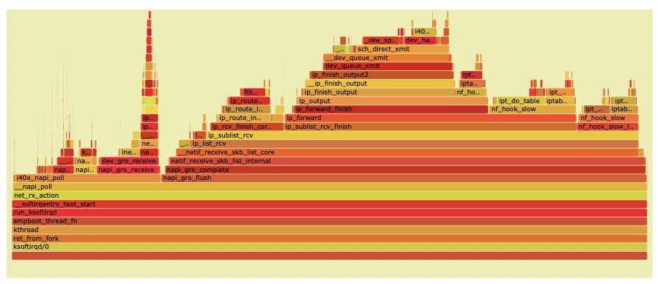
What to accelerate for forwarding?
Depth
Of
Call
Stack
Trace Call Stacks

Slide 49

What to accelerate for forwarding?
Depth
Of
Call
Stack
Trace Call Stacks

Slide 50
What to accelerate for forwarding?
Depth
Of
Call
Stack
Trace Call Stacks

Slide 51
Forwarding in LinuxFP
Fast Path
Parsing
Rewriting
Forwarding information base (FIB) lookup
Forwarding
Slow Path
ARP handling
IP (de)fragmentation

Slide 52
LinuxFP Evaluation
Enable fast packet processing
Virtual Network Functions: Virtual Router
Virtual Network Functions: Virtual Gateway
Maintain compatibility with the Linux networking API
Pod-to-Pod Networking with Kubernetes and Flannel

Slide 53
LinuxFP Evaluation
Enable fast packet processing
Virtual Network Function: Router
Maintain compatibility with the Linux networking API
Pod-to-Pod Networking with Kubernetes and Flannel

Slide 54

Linux
VPP (Vector Packet Processor)
  Built on enabling technology of DPDK (kernel bypass)
  Configured through custom CLI or custom API
  Dedicated core(s), batching of packets
Polycube
  Built on eBPF
  Runs in Linux kernel
  Fixed dataplane configured with custom CLI
Virtual Network Functions: Baselines

Slide 55
Linux
Polycube [0]
  Built on eBPF
  Runs in Linux kernel
  Fixed dataplane configured with custom CLI
VPP (Vector Packet Processor)
  Built on enabling technology of DPDK (kernel bypass)
  Configured through custom CLI or custom API
  Dedicated core(s), batching of packets
Virtual Network Functions: Baselines
[0] Miano, et. al. A Framework for eBPF-Based Network Functions in an Era of Microservices. IEEE TNSM, 18(1), 2021.
[1] FD.io: The Worlds’ Secure Networking Dataplane, 2023. Retrieved October 20, 2023, https://fd.io.

Slide 56
Linux
Polycube [0]
  Built on eBPF
  Runs in Linux kernel
  Fixed dataplane configured with custom CLI
VPP [1] (Vector Packet Processor)
  Built on enabling technology of DPDK (kernel bypass)
  Configured through custom CLI or custom API
  Dedicated core(s), batching of packets
Virtual Network Functions: Baselines
[0] Miano, et. al. A Framework for eBPF-Based Network Functions in an Era of Microservices. IEEE TNSM, 18(1), 2021.
[1] FD.io: The Worlds’ Secure Networking Dataplane, 2023. Retrieved October 20, 2023, https://fd.io.

Slide 57
Linux
Polycube [0]
  Built on eBPF
  Runs in Linux kernel
  Fixed dataplane configured with custom CLI
VPP [1] (Vector Packet Processor)
  Built on enabling technology of DPDK (kernel bypass)
  Configured through custom CLI or custom API
  Dedicated core(s), batching of packets
Virtual Network Functions: Baselines
[0] Miano, et. al. A Framework for eBPF-Based Network Functions in an Era of Microservices. IEEE TNSM, 18(1), 2021.
[1] FD.io: The Worlds’ Secure Networking Dataplane, 2023. Retrieved October 20, 2023, https://fd.io.

Slide 58
Linux
Polycube [0]
  Built on eBPF
  Runs in Linux kernel
  Fixed dataplane configured with custom CLI
VPP [1] (Vector Packet Processor)
  Built on enabling technology of DPDK (kernel bypass)
  Configured through custom CLI or custom API
  Dedicated core(s), batching of packets
Virtual Network Functions: Baselines
[0] Miano, et. al. A Framework for eBPF-Based Network Functions in an Era of Microservices. IEEE TNSM, 18(1), 2021.
[1] FD.io: The Worlds’ Secure Networking Dataplane, 2023. Retrieved October 20, 2023, https://fd.io.

Slide 59


Virtual Network Functions: Virtual Router
Experimental Setup
Test Device: Virtual Router
Source
Sink

Slide 60
Virtual Network Functions: Virtual Router
Experimental Setup
Test Device: Virtual Router
-- 50 Prefixes with iproute2
Source
Sink
DPDK Pktgen

Slide 61
Virtual Network Functions: Virtual Router
Throughput: Number of Cores

Slide 62
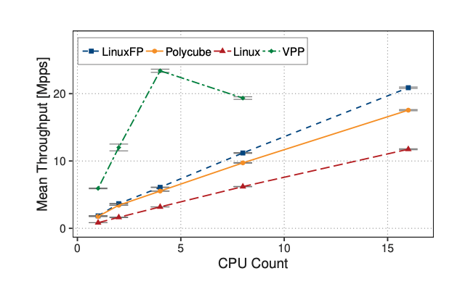
Virtual Network Functions: Virtual Router
Throughput: Number of Cores

Slide 63
Virtual Network Functions: Virtual Router
Throughput: Number of Cores
LinuxFP nearly doubles throughput compared to Linux

Slide 64
Virtual Network Functions: Virtual Router
Throughput: Number of Cores
Comparable to Polycube, but LinuxFP keeps Linux API

Slide 65
Virtual Network Functions: Virtual Router
Throughput: Number of Cores
Comparable to Polycube, but LinuxFP keeps Linux API
Implementation differences explored in paper

Slide 66
Virtual Network Functions: Virtual Router
Throughput: Number of Cores
Vector processing (batching), Dedicated cores

Slide 67
Virtual Network Functions: Virtual Router
Single Core Throughput: Packet Size

Slide 68
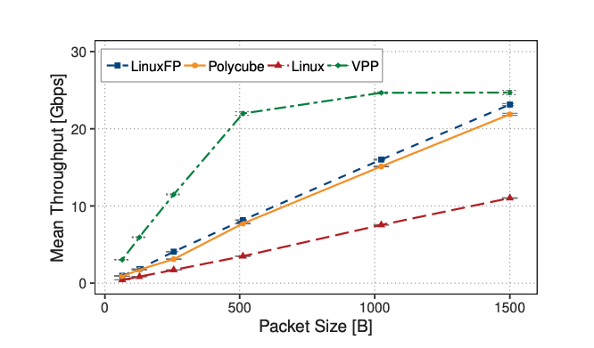
Virtual Network Functions: Virtual Router
Single Core Throughput: Packet Size

Slide 69
Virtual Network Functions: Virtual Router
Single Core Throughput: Packet Size

Slide 70
Virtual Network Functions: Virtual Router
Single Core Throughput: Packet Size

Slide 71
Virtual Network Functions: Virtual Router
Single Core Latency
Experimental Setup
Test Device: Virtual Router
-- 50 Prefixes with iproute2
Source
Sink
128 netperf sessions

Slide 72
Virtual Network Functions: Virtual Router
Single Core Latency
System | Average | 99th Percentile | Standard Deviation
Linux | 326.872 μS | 512.378 μS | 109.265 μS
Polycube | 145.792 μS | 269.772 μS | 60.204 μS
VPP | 85.604 μS | 182.265 μS | 32.011 μS
LinuxFP | 151.675 μS | 279.407 μS | 76.798 μS
Notes:
Microsecond

Slide 73
Virtual Network Functions: Virtual Router
Single Core Latency
System | Average | 99th Percentile | Standard Deviation
Linux | 326.872 μS | 512.378 μS | 109.265 μS
Polycube | 145.792 μS | 269.772 μS | 60.204 μS
VPP | 85.604 μS | 182.265 μS | 32.011 μS
LinuxFP | 151.675 μS | 279.407 μS | 76.798 μS
Less than half of average latency of Linux
Notes:
Microsecond

Slide 74
LinuxFP Evaluation
Enable fast packet processing
Virtual Network Functions: Router
Maintain compatibility with the Linux networking API
Pod-to-Pod Networking with Kubernetes and Flannel

Slide 75
LinuxFP Evaluation
Enable fast packet processing
Virtual Network Functions: Router and Gateway
Maintain compatibility with the Linux networking API
Pod-to-Pod Networking with Kubernetes and Flannel

Slide 76
Experimental
Setup
Host 0
Linux
Host 1
Host 2
Linux
Linux

Slide 77
Experimental
Setup: Kubernetes
Host 0
Kubernetes Primary
Linux
Host 1
Host 2
Pod
App
Kubernetes Secondary
Kubernetes Secondary
Flannel (CNI Plugins)
Flannel (CNI Plugins)
Linux
Linux

Slide 78
Experimental
Setup: Pod-to-Pod
Host 0
Kubernetes Primary
Linux
Host 1
Host 2
Pod
Pod
App
App
Kubernetes Secondary
Kubernetes Secondary
Flannel (CNI Plugins)
Flannel (CNI Plugins)
Linux
Linux

Slide 79
Experimental
Setup: Pod-to-Pod
Host 0
Kubernetes Primary
Linux
Host 1
Host 2
Pod
Pod
App
App
Kubernetes Secondary
Kubernetes Secondary
Flannel (CNI Plugins)
Flannel (CNI Plugins)
Linux
Linux

Slide 80
Experimental
Setup: Pairs of Pods
Host 0
Kubernetes Primary
Linux
Host 1
Host 2
Pod
Pod
Netserver
Netperf
Kubernetes Secondary
Kubernetes Secondary
Flannel (CNI Plugins)
Flannel (CNI Plugins)
Linux
Linux

Slide 81
Experimental
Setup: LinuxFP
Host 0
Kubernetes Primary
Linux
Host 1
Host 2
Pod
Pod
LinuxFP Controller
Netserver
Netperf
LinuxFP Controller
Kubernetes Secondary
Kubernetes Secondary
Flannel (CNI Plugins)
Flannel (CNI Plugins)
LinuxFP
LinuxFP

Slide 82
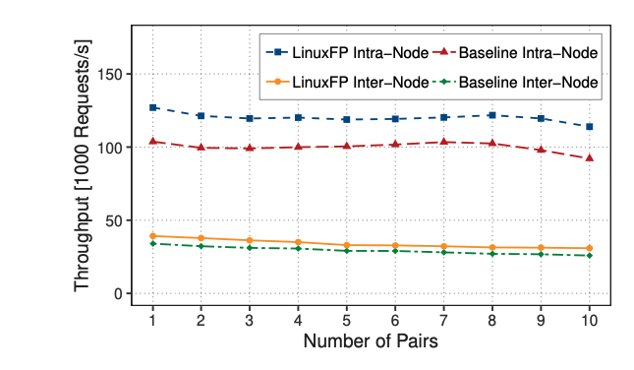
Kubernetes Pod-to-Pod
Throughput: Pairs of Pods

Slide 83
Kubernetes Pod-to-Pod
Throughput: Pairs of Pods
120% (intra) of Linux tput
116% (inter) of Linux tput

Slide 84
LinuxFP
Transparently enables accelerated packet processing while:
  Maintaining compatibility with the Linux networking API
  Maintaining access to the breadth of the Linux networking stack

Slide 85

Questions?
Erika Hunhoff (erika.hunhoff@colorado.edu)
Thank you!
Marcelo Abranches
Rohan Eswara
Oliver Michel
Eric Keller
LinuxFP is available at: github.com/mcabranches/tna
BPF Kernel Helper functions available at: github.com/mcabranches/linux
ICDCS 2024
Jersey City, New Jersey USA

