Slide 1
Programming Abstractions for AMD XNDATM NPUs
Low level of abstraction
High level of abstraction
IRON
Efficiency
Expressivity
Extensibility

Slide 2
Agenda
Background
  AMD XDNATM NPUs
  IRON
Extensions to IRON
  Example program
Evaluation
Future Work

Slide 3
Agenda
Background
  AMD XDNATM NPUs
  IRON
Extensions to IRON
  Example program
Evaluation
Future Work

Slide 4
Background on AMD XNDATM NPUs

Slide 5
Background on AMD XNDATM NPUs
AIE Tile
AIE Tile
AIE Tile
Processor Core
Processor Core
…
Processor Core
L1
DMA
L1
DMA
L1
DMA
The Neural Processing Unit (NPU)
…
AIE Tile
AIE Tile
AIE Tile
Processor Core
Processor Core
…
Processor Core
L1
DMA
L1
DMA
L1
DMA
…
…
…
…
…
…
…
AIE Tile
AIE Tile
AIE Tile
Processor Core
Processor Core
…
Processor Core
L1
DMA
L1
DMA
L1
DMA
…
Memory Tile
Memory Tile
Memory Tile
L2
L2
…
L2
DMA
DMA
DMA
…
Shim Tile
Shim Tile
…
Shim Tile
DMA
DMA
DMA
L3: External Memory

Slide 6
Background on AMD XNDATM NPUs
AI Engine
(AIE) array
Compute Tiles
Memory
(Mem) Tiles
Shim Tiles
AIE Tile
AIE Tile
AIE Tile
Processor Core
Processor Core
…
Processor Core
L1
DMA
L1
DMA
L1
DMA
…
AIE Tile
AIE Tile
AIE Tile
Processor Core
Processor Core
…
Processor Core
L1
DMA
L1
DMA
L1
DMA
…
…
…
…
…
…
…
AIE Tile
AIE Tile
AIE Tile
Processor Core
Processor Core
…
Processor Core
L1
DMA
L1
DMA
L1
DMA
…
Memory Tile
Memory Tile
Memory Tile
L2
L2
…
L2
DMA
DMA
DMA
…
Shim Tile
Shim Tile
…
Shim Tile
DMA
DMA
DMA
L3: External Memory

Slide 7
Background on AMD XNDATM NPUs
AIE Tile
AIE Tile
AIE Tile
Processor Core
Processor Core
…
Processor Core
L1
DMA
L1
DMA
L1
DMA
Spatially distributed compute and memory
Multi-level memory hierarchy
Explicitly scheduled, decoupled data movement
…
AIE Tile
AIE Tile
AIE Tile
Processor Core
Processor Core
…
Processor Core
L1
DMA
L1
DMA
L1
DMA
…
…
…
…
…
…
…
AIE Tile
AIE Tile
AIE Tile
Processor Core
Processor Core
…
Processor Core
L1
DMA
L1
DMA
L1
DMA
…
Memory Tile
Memory Tile
Memory Tile
L2
L2
…
L2
DMA
DMA
DMA
…
Shim Tile
Shim Tile
…
Shim Tile
DMA
DMA
DMA
L3: External Memory

Slide 8
Background on AMD XNDATM NPUs
AIE Tile
AIE Tile
AIE Tile
Processor Core
Processor Core
…
Processor Core
L1
DMA
L1
DMA
L1
DMA
Spatially distributed compute and memory
Multi-level memory hierarchy
Explicitly scheduled, decoupled data movement
…
AIE Tile
AIE Tile
AIE Tile
Processor Core
Processor Core
…
Processor Core
L1
DMA
L1
DMA
L1
DMA
…
…
…
…
…
…
…
AIE Tile
AIE Tile
AIE Tile
Processor Core
Processor Core
…
Processor Core
L1
DMA
L1
DMA
L1
DMA
…
Memory Tile
Memory Tile
Memory Tile
L2
L2
…
L2
DMA
DMA
DMA
…
Shim Tile
Shim Tile
…
Shim Tile
DMA
DMA
DMA
L3: External Memory

Slide 9
Background on AMD XNDATM NPUs
AIE Tile
AIE Tile
AIE Tile
Processor Core
Processor Core
…
Processor Core
L1
DMA
L1
DMA
L1
DMA
Spatially distributed compute and memory
Multi-level memory hierarchy
Explicitly scheduled data movement
…
AIE Tile
AIE Tile
AIE Tile
Processor Core
Processor Core
…
Processor Core
L1
DMA
L1
DMA
L1
DMA
…
…
…
…
…
…
…
AIE Tile
AIE Tile
AIE Tile
Processor Core
Processor Core
…
Processor Core
L1
DMA
L1
DMA
L1
DMA
…
Memory Tile
Memory Tile
Memory Tile
L2
L2
…
L2
DMA
DMA
DMA
…
Shim Tile
Shim Tile
…
Shim Tile
DMA
DMA
DMA
L3: External Memory

Slide 10
Background on AMD XNDATM NPUs
AIE Tile
AIE Tile
AIE Tile
Processor Core
Processor Core
…
Processor Core
L1
DMA
L1
DMA
L1
DMA
Spatially distributed compute and memory
Multi-level memory hierarchy
Explicitly scheduled data movement
…
AIE Tile
AIE Tile
AIE Tile
Processor Core
Processor Core
…
Processor Core
L1
DMA
L1
DMA
L1
DMA
…
…
…
…
…
…
…
AIE Tile
AIE Tile
AIE Tile
Processor Core
Processor Core
…
Processor Core
L1
DMA
L1
DMA
L1
DMA
…
Memory Tile
Memory Tile
Memory Tile
L2
L2
…
L2
DMA
DMA
DMA
Data Movement Accelerators (DMA)
…
Shim Tile
Shim Tile
…
Shim Tile
DMA
DMA
DMA
L3: External Memory

Slide 11
An NPU design needs…
Synchronization
Dataflow
Runtime operations

Slide 12
An NPU design needs…
Low level of abstraction
High level of abstraction
Synchronization
Dataflow
Runtime operations

Slide 13
An NPU design needs…
Low level of abstraction
High level of abstraction
IRON
Synchronization
Dataflow
Runtime operations
Exercise hardware features
Performance engineers
Research & education

Slide 14




IRON: Open-source toolkit for AMD XDNATM NPUs
Many details out of scope but described in paper or IRON programming guide.
MLIR-AIE dialect
Python API
Example Programs
Programming Guide

Slide 15

IRON Example: Matrix Scalar Add
https://github.com/Xilinx/mlir-aie/tree/main/programming_examples/basic/matrix_scalar_add
Matrix
(Tensor)
In Data Movement
+N
Element-wise scalar addition
Tile
(Sub-tensor)
Out Data Movement

Slide 16
with mlir_mod_ctx() as ctx:
@device(AIEDevice.npu1_1col)
def device_body():
mty = np.ndarray[(MH, MW), np.dtype[np.int32]]
tty = np.ndarray[(TH, TW), np.dtype[np.int32]]
shm0 = tile(0, 0)
aie2 = tile(0, 2)
fi = object_fifo("in", shm0, aie2, 2, tty)
fo = object_fifo("out", aie2, shm0, 2, tty)
@core(aie2)
def core_body():
for _ in range_(sys.maxsize):
a = fi.acquire(ObjectFifoPort.Consume, 1)
b = fo.acquire(ObjectFifoPort.Produce, 1)
for i in range_(TH):
for j in range_(TW):
b[i, j] = a[i, j] + 1
fi.release(ObjectFifoPort.Consume, 1)
fo.release(ObjectFifoPort.Produce, 1)
@runtime_sequence(mty, mty)
def sequence(dati, dato):
in_task = shim_dma_single_bd_task(fi, dati,
sizes=[1, 1, TH, TW],
strides=[0, 0, MW, 1])
out_task = shim_dma_single_bd_task(fo, dato,
sizes=[1, 1, TH, TW],
strides=[0, 0, MW, 1],
issue_token=True)
dma_start_task(in_task, out_task)
dma_await_task(out_task)
dma_free_task(in_task)
print(ctx.module)

Slide 17
with mlir_mod_ctx() as ctx:
@device(AIEDevice.npu1_1col)
def device_body():
mty = np.ndarray[(MH, MW), np.dtype[np.int32]]
tty = np.ndarray[(TH, TW), np.dtype[np.int32]]
shm0 = tile(0, 0)
aie2 = tile(0, 2)
fi = object_fifo("in", shm0, aie2, 2, tty)
fo = object_fifo("out", aie2, shm0, 2, tty)
@core(aie2)
def core_body():
for _ in range_(sys.maxsize):
a = fi.acquire(ObjectFifoPort.Consume, 1)
b = fo.acquire(ObjectFifoPort.Produce, 1)
for i in range_(TH):
for j in range_(TW):
b[i, j] = a[i, j] + 1
fi.release(ObjectFifoPort.Consume, 1)
fo.release(ObjectFifoPort.Produce, 1)
@runtime_sequence(mty, mty)
def sequence(dati, dato):
in_task = shim_dma_single_bd_task(fi, dati,
sizes=[1, 1, TH, TW],
strides=[0, 0, MW, 1])
out_task = shim_dma_single_bd_task(fo, dato,
sizes=[1, 1, TH, TW],
strides=[0, 0, MW, 1],
issue_token=True)
dma_start_task(in_task, out_task)
dma_await_task(out_task)
dma_free_task(in_task)
print(ctx.module)
Types and Resources

Slide 18
with mlir_mod_ctx() as ctx:
@device(AIEDevice.npu1_1col)
def device_body():
mty = np.ndarray[(MH, MW), np.dtype[np.int32]]
tty = np.ndarray[(TH, TW), np.dtype[np.int32]]
shm0 = tile(0, 0)
aie2 = tile(0, 2)
fi = object_fifo("in", shm0, aie2, 2, tty)
fo = object_fifo("out", aie2, shm0, 2, tty)
@core(aie2)
def core_body():
for _ in range_(sys.maxsize):
a = fi.acquire(ObjectFifoPort.Consume, 1)
b = fo.acquire(ObjectFifoPort.Produce, 1)
for i in range_(TH):
for j in range_(TW):
b[i, j] = a[i, j] + 1
fi.release(ObjectFifoPort.Consume, 1)
fo.release(ObjectFifoPort.Produce, 1)
@runtime_sequence(mty, mty)
def sequence(dati, dato):
in_task = shim_dma_single_bd_task(fi, dati,
sizes=[1, 1, TH, TW],
strides=[0, 0, MW, 1])
out_task = shim_dma_single_bd_task(fo, dato,
sizes=[1, 1, TH, TW],
strides=[0, 0, MW, 1],
issue_token=True)
dma_start_task(in_task, out_task)
dma_await_task(out_task)
dma_free_task(in_task)
print(ctx.module)
Dataflow with ObjectFIFOs
Name, Source, Dest., Depth, Type

Slide 19
with mlir_mod_ctx() as ctx:
@device(AIEDevice.npu1_1col)
def device_body():
mty = np.ndarray[(MH, MW), np.dtype[np.int32]]
tty = np.ndarray[(TH, TW), np.dtype[np.int32]]
shm0 = tile(0, 0)
aie2 = tile(0, 2)
fi = object_fifo("in", shm0, aie2, 2, tty)
fo = object_fifo("out", aie2, shm0, 2, tty)
@core(aie2)
def core_body():
for _ in range_(sys.maxsize):
a = fi.acquire(ObjectFifoPort.Consume, 1)
b = fo.acquire(ObjectFifoPort.Produce, 1)
for i in range_(TH):
for j in range_(TW):
b[i, j] = a[i, j] + 1
fi.release(ObjectFifoPort.Consume, 1)
fo.release(ObjectFifoPort.Produce, 1)
@runtime_sequence(mty, mty)
def sequence(dati, dato):
in_task = shim_dma_single_bd_task(fi, dati,
sizes=[1, 1, TH, TW],
strides=[0, 0, MW, 1])
out_task = shim_dma_single_bd_task(fo, dato,
sizes=[1, 1, TH, TW],
strides=[0, 0, MW, 1],
issue_token=True)
dma_start_task(in_task, out_task)
dma_await_task(out_task)
dma_free_task(in_task)
print(ctx.module)
Per-AIE core program
Dataflow + Kernel

Slide 20
with mlir_mod_ctx() as ctx:
@device(AIEDevice.npu1_1col)
def device_body():
mty = np.ndarray[(MH, MW), np.dtype[np.int32]]
tty = np.ndarray[(TH, TW), np.dtype[np.int32]]
shm0 = tile(0, 0)
aie2 = tile(0, 2)
fi = object_fifo("in", shm0, aie2, 2, tty)
fo = object_fifo("out", aie2, shm0, 2, tty)
@core(aie2)
def core_body():
for _ in range_(sys.maxsize):
a = fi.acquire(ObjectFifoPort.Consume, 1)
b = fo.acquire(ObjectFifoPort.Produce, 1)
for i in range_(TH):
for j in range_(TW):
b[i, j] = a[i, j] + 1
fi.release(ObjectFifoPort.Consume, 1)
fo.release(ObjectFifoPort.Produce, 1)
@runtime_sequence(mty, mty)
def sequence(dati, dato):
in_task = shim_dma_single_bd_task(fi, dati,
sizes=[1, 1, TH, TW],
strides=[0, 0, MW, 1])
out_task = shim_dma_single_bd_task(fo, dato,
sizes=[1, 1, TH, TW],
strides=[0, 0, MW, 1],
issue_token=True)
dma_start_task(in_task, out_task)
dma_await_task(out_task)
dma_free_task(in_task)
print(ctx.module)
Input data
Output data

Slide 21
with mlir_mod_ctx() as ctx:
@device(AIEDevice.npu1_1col)
def device_body():
mty = np.ndarray[(MH, MW), np.dtype[np.int32]]
tty = np.ndarray[(TH, TW), np.dtype[np.int32]]
shm0 = tile(0, 0)
aie2 = tile(0, 2)
fi = object_fifo("in", shm0, aie2, 2, tty)
fo = object_fifo("out", aie2, shm0, 2, tty)
@core(aie2)
def core_body():
for _ in range_(sys.maxsize):
a = fi.acquire(ObjectFifoPort.Consume, 1)
b = fo.acquire(ObjectFifoPort.Produce, 1)
for i in range_(TH):
for j in range_(TW):
b[i, j] = a[i, j] + 1
fi.release(ObjectFifoPort.Consume, 1)
fo.release(ObjectFifoPort.Produce, 1)
@runtime_sequence(mty, mty)
def sequence(dati, dato):
in_task = shim_dma_single_bd_task(fi, dati,
sizes=[1, 1, TH, TW],
strides=[0, 0, MW, 1])
out_task = shim_dma_single_bd_task(fo, dato,
sizes=[1, 1, TH, TW],
strides=[0, 0, MW, 1],
issue_token=True)
dma_start_task(in_task, out_task)
dma_await_task(out_task)
dma_free_task(in_task)
print(ctx.module)
Tile Width (TW)
Tile
Height
(TH)
Tile
(Sub-tensor)
Matrix
Height
(MH)
Matrix Width (MW)

Slide 22
Recall, an NPU design needs…
Synchronization
Dataflow
Runtime operations
with mlir_mod_ctx() as ctx:
@device(AIEDevice.npu1_1col)
def device_body():
mty = np.ndarray[(MH, MW), np.dtype[np.int32]]
tty = np.ndarray[(TH, TW), np.dtype[np.int32]]
shm0 = tile(0, 0)
aie2 = tile(0, 2)
fi = object_fifo("in", shm0, aie2, 2, tty)
fo = object_fifo("out", aie2, shm0, 2, tty)
@core(aie2)
def core_body():
for _ in range_(sys.maxsize):
a = fi.acquire(ObjectFifoPort.Consume, 1)
b = fo.acquire(ObjectFifoPort.Produce, 1)
for i in range_(TH):
for j in range_(TW):
b[i, j] = a[i, j] + 1
fi.release(ObjectFifoPort.Consume, 1)
fo.release(ObjectFifoPort.Produce, 1)
@runtime_sequence(mty, mty)
def sequence(dati, dato):
in_task = shim_dma_single_bd_task(fi, dati,
sizes=[1, 1, TH, TW],
strides=[0, 0, MW, 1])
out_task = shim_dma_single_bd_task(fo, dato,
sizes=[1, 1, TH, TW],
strides=[0, 0, MW, 1],
issue_token=True)
dma_start_task(in_task, out_task)
dma_await_task(out_task)
dma_free_task(in_task)
print(ctx.module)

Slide 23
Recall, an NPU design needs…
Synchronization
Dataflow
Runtime operations
with mlir_mod_ctx() as ctx:
@device(AIEDevice.npu1_1col)
def device_body():
mty = np.ndarray[(MH, MW), np.dtype[np.int32]]
tty = np.ndarray[(TH, TW), np.dtype[np.int32]]
shm0 = tile(0, 0)
aie2 = tile(0, 2)
fi = object_fifo("in", shm0, aie2, 2, tty)
fo = object_fifo("out", aie2, shm0, 2, tty)
@core(aie2)
def core_body():
for _ in range_(sys.maxsize):
a = fi.acquire(ObjectFifoPort.Consume, 1)
b = fo.acquire(ObjectFifoPort.Produce, 1)
for i in range_(TH):
for j in range_(TW):
b[i, j] = a[i, j] + 1
fi.release(ObjectFifoPort.Consume, 1)
fo.release(ObjectFifoPort.Produce, 1)
@runtime_sequence(mty, mty)
def sequence(dati, dato):
in_task = shim_dma_single_bd_task(fi, dati,
sizes=[1, 1, TH, TW],
strides=[0, 0, MW, 1])
out_task = shim_dma_single_bd_task(fo, dato,
sizes=[1, 1, TH, TW],
strides=[0, 0, MW, 1],
issue_token=True)
dma_start_task(in_task, out_task)
dma_await_task(out_task)
dma_free_task(in_task)
print(ctx.module)

Slide 24
with mlir_mod_ctx() as ctx:
@device(AIEDevice.npu1_1col)
def device_body():
mty = np.ndarray[(MH, MW), np.dtype[np.int32]]
tty = np.ndarray[(TH, TW), np.dtype[np.int32]]
shm0 = tile(0, 0)
aie2 = tile(0, 2)
fi = object_fifo("in", shm0, aie2, 2, tty)
fo = object_fifo("out", aie2, shm0, 2, tty)
@core(aie2)
def core_body():
for _ in range_(sys.maxsize):
a = fi.acquire(ObjectFifoPort.Consume, 1)
b = fo.acquire(ObjectFifoPort.Produce, 1)
for i in range_(TH):
for j in range_(TW):
b[i, j] = a[i, j] + 1
fi.release(ObjectFifoPort.Consume, 1)
fo.release(ObjectFifoPort.Produce, 1)
@runtime_sequence(mty, mty)
def sequence(dati, dato):
in_task = shim_dma_single_bd_task(fi, dati,
sizes=[1, 1, TH, TW],
strides=[0, 0, MW, 1])
out_task = shim_dma_single_bd_task(fo, dato,
sizes=[1, 1, TH, TW],
strides=[0, 0, MW, 1],
issue_token=True)
dma_start_task(in_task, out_task)
dma_await_task(out_task)
dma_free_task(in_task)
print(ctx.module)
Efficiency
Read, write, modify designs
Only provide detail in areas of interest
Expressivity
Do not compromise on designer’s explicit control of hardware
Extensibility
Custom tooling, reusable logic

Slide 25
with mlir_mod_ctx() as ctx:
@device(AIEDevice.npu1_1col)
def device_body():
mty = np.ndarray[(MH, MW), np.dtype[np.int32]]
tty = np.ndarray[(TH, TW), np.dtype[np.int32]]
shm0 = tile(0, 0)
aie2 = tile(0, 2)
fi = object_fifo("in", shm0, aie2, 2, tty)
fo = object_fifo("out", aie2, shm0, 2, tty)
@core(aie2)
def core_body():
for _ in range_(sys.maxsize):
a = fi.acquire(ObjectFifoPort.Consume, 1)
b = fo.acquire(ObjectFifoPort.Produce, 1)
for i in range_(TH):
for j in range_(TW):
b[i, j] = a[i, j] + 1
fi.release(ObjectFifoPort.Consume, 1)
fo.release(ObjectFifoPort.Produce, 1)
@runtime_sequence(mty, mty)
def sequence(dati, dato):
in_task = shim_dma_single_bd_task(fi, dati,
sizes=[1, 1, TH, TW],
strides=[0, 0, MW, 1])
out_task = shim_dma_single_bd_task(fo, dato,
sizes=[1, 1, TH, TW],
strides=[0, 0, MW, 1],
issue_token=True)
dma_start_task(in_task, out_task)
dma_await_task(out_task)
dma_free_task(in_task)
print(ctx.module)
Efficiency
Read, write, modify designs
Only provide detail in areas of interest
Expressivity
Do not compromise on designer’s explicit control of hardware
Extensibility
Custom tooling, reusable logic

Slide 26
with mlir_mod_ctx() as ctx:
@device(AIEDevice.npu1_1col)
def device_body():
mty = np.ndarray[(MH, MW), np.dtype[np.int32]]
tty = np.ndarray[(TH, TW), np.dtype[np.int32]]
shm0 = tile(0, 0)
aie2 = tile(0, 2)
fi = object_fifo("in", shm0, aie2, 2, tty)
fo = object_fifo("out", aie2, shm0, 2, tty)
@core(aie2)
def core_body():
for _ in range_(sys.maxsize):
a = fi.acquire(ObjectFifoPort.Consume, 1)
b = fo.acquire(ObjectFifoPort.Produce, 1)
for i in range_(TH):
for j in range_(TW):
b[i, j] = a[i, j] + 1
fi.release(ObjectFifoPort.Consume, 1)
fo.release(ObjectFifoPort.Produce, 1)
@runtime_sequence(mty, mty)
def sequence(dati, dato):
in_task = shim_dma_single_bd_task(fi, dati,
sizes=[1, 1, TH, TW],
strides=[0, 0, MW, 1])
out_task = shim_dma_single_bd_task(fo, dato,
sizes=[1, 1, TH, TW],
strides=[0, 0, MW, 1],
issue_token=True)
dma_start_task(in_task, out_task)
dma_await_task(out_task)
dma_free_task(in_task)
print(ctx.module)
Efficiency
Read, write, modify designs
Only provide detail in areas of interest
Expressivity
Do not compromise on designer’s explicit control of hardware
Extensibility
Custom tooling, reusable logic

Slide 27
with mlir_mod_ctx() as ctx:
@device(AIEDevice.npu1_1col)
def device_body():
mty = np.ndarray[(MH, MW), np.dtype[np.int32]]
tty = np.ndarray[(TH, TW), np.dtype[np.int32]]
shm0 = tile(0, 0)
aie2 = tile(0, 2)
fi = object_fifo("in", shm0, aie2, 2, tty)
fo = object_fifo("out", aie2, shm0, 2, tty)
@core(aie2)
def core_body():
for _ in range_(sys.maxsize):
a = fi.acquire(ObjectFifoPort.Consume, 1)
b = fo.acquire(ObjectFifoPort.Produce, 1)
for i in range_(TH):
for j in range_(TW):
b[i, j] = a[i, j] + 1
fi.release(ObjectFifoPort.Consume, 1)
fo.release(ObjectFifoPort.Produce, 1)
@runtime_sequence(mty, mty)
def sequence(dati, dato):
in_task = shim_dma_single_bd_task(fi, dati,
sizes=[1, 1, TH, TW],
strides=[0, 0, MW, 1])
out_task = shim_dma_single_bd_task(fo, dato,
sizes=[1, 1, TH, TW],
strides=[0, 0, MW, 1],
issue_token=True)
dma_start_task(in_task, out_task)
dma_await_task(out_task)
dma_free_task(in_task)
print(ctx.module)
Efficiency
Read, write, modify designs
Only provide detail in areas of interest
Expressivity
Do not compromise on designer’s explicit control of hardware
Extensibility
Custom tooling, reusable logic

Slide 28
Agenda
Background
  AMD XDNATM NPUs
  IRON
Extensions to IRON
  Example program
Evaluation
Future Work

Slide 29
Extensions to IRON
Key Technique:
  Distance from MLIR
Enables:
  Refined constructs
  Defaults and extensions

Slide 30
Distance from MLIR
fi = object_fifo("in", shm0, aie2, 2, tty)
MLIR Python Bindings
MLIR

Slide 31
Distance from MLIR
ObjectFifo(tty)
Extensions to IRON
resolve()
fi = object_fifo("in", shm0, aie2, 2, tty)
MLIR Python Bindings
MLIR

Slide 32
Refined Constructs
Program
Worker
Runtime
ObjectFIFO

Slide 33
Refined Constructs
With Extensions
mty = np.ndarray[(MH, MW), np.dtype[np.int32]]
tty = np.ndarray[(TH, TW), np.dtype[np.int32]]
fi = ObjectFifo(tty)
fo = ObjectFifo(tty)
def core_fn(of_in, of_out):
a = of_in.acquire(1)
b = of_out.acquire(1)
for i in range_(TH):
for j in range_(TW):
b[i, j] = a[i, j] + 1
of_in.release(1)
of_out.release(1)
my_worker = Worker(core_fn,
fn_args=[fi.cons(), fo.prod()])
tap = TensorTiler2D.simple_tiler(
(MH, MW), (TH, TW))[0]
rt = Runtime()
with rt.sequence(mty, mty) as (dati, dato):
rt.start(my_worker)
rt.fill(fi.prod(), dati, tap)
rt.drain(fo.cons(), dato, tap, wait=True)
print(Program(NPU1Col1(),rt).resolve_program(
SequentialPlacer()))
Program
Worker
Runtime
ObjectFIFO

Slide 34
Refined Constructs
mty = np.ndarray[(MH, MW), np.dtype[np.int32]]
tty = np.ndarray[(TH, TW), np.dtype[np.int32]]
fi = ObjectFifo(tty)
fo = ObjectFifo(tty)
def core_fn(of_in, of_out):
a = of_in.acquire(1)
b = of_out.acquire(1)
for i in range_(TH):
for j in range_(TW):
b[i, j] = a[i, j] + 1
of_in.release(1)
of_out.release(1)
my_worker = Worker(core_fn,
fn_args=[fi.cons(), fo.prod()])
tap = TensorTiler2D.simple_tiler(
(MH, MW), (TH, TW))[0]
rt = Runtime()
with rt.sequence(mty, mty) as (dati, dato):
rt.start(my_worker)
rt.fill(fi.prod(), dati, tap)
rt.drain(fo.cons(), dato, tap, wait=True)
print(Program(NPU1Col1(),rt).resolve_program(
SequentialPlacer()))
Program
Worker
Runtime
ObjectFIFO

Slide 35
Refined Constructs
mty = np.ndarray[(MH, MW), np.dtype[np.int32]]
tty = np.ndarray[(TH, TW), np.dtype[np.int32]]
fi = ObjectFifo(tty)
fo = ObjectFifo(tty)
def core_fn(of_in, of_out):
a = of_in.acquire(1)
b = of_out.acquire(1)
for i in range_(TH):
for j in range_(TW):
b[i, j] = a[i, j] + 1
of_in.release(1)
of_out.release(1)
my_worker = Worker(core_fn,
fn_args=[fi.cons(), fo.prod()])
tap = TensorTiler2D.simple_tiler(
(MH, MW), (TH, TW))[0]
rt = Runtime()
with rt.sequence(mty, mty) as (dati, dato):
rt.start(my_worker)
rt.fill(fi.prod(), dati, tap)
rt.drain(fo.cons(), dato, tap, wait=True)
print(Program(NPU1Col1(),rt).resolve_program(
SequentialPlacer()))
Program
Worker
Runtime
ObjectFIFO

Slide 36
Refined Constructs
mty = np.ndarray[(MH, MW), np.dtype[np.int32]]
tty = np.ndarray[(TH, TW), np.dtype[np.int32]]
fi = ObjectFifo(tty)
fo = ObjectFifo(tty)
def core_fn(of_in, of_out):
a = of_in.acquire(1)
b = of_out.acquire(1)
for i in range_(TH):
for j in range_(TW):
b[i, j] = a[i, j] + 1
of_in.release(1)
of_out.release(1)
my_worker = Worker(core_fn,
fn_args=[fi.cons(), fo.prod()])
tap = TensorTiler2D.simple_tiler(
(MH, MW), (TH, TW))[0]
rt = Runtime()
with rt.sequence(mty, mty) as (dati, dato):
rt.start(my_worker)
rt.fill(fi.prod(), dati, tap)
rt.drain(fo.cons(), dato, tap, wait=True)
print(Program(NPU1Col1(),rt).resolve_program(
SequentialPlacer()))
Program
Worker
Runtime
ObjectFIFO

Slide 37
Refined Constructs
mty = np.ndarray[(MH, MW), np.dtype[np.int32]]
tty = np.ndarray[(TH, TW), np.dtype[np.int32]]
fi = ObjectFifo(tty)
fo = ObjectFifo(tty)
def core_fn(of_in, of_out):
a = of_in.acquire(1)
b = of_out.acquire(1)
for i in range_(TH):
for j in range_(TW):
b[i, j] = a[i, j] + 1
of_in.release(1)
of_out.release(1)
my_worker = Worker(core_fn,
fn_args=[fi.cons(), fo.prod()])
tap = TensorTiler2D.simple_tiler(
(MH, MW), (TH, TW))[0]
rt = Runtime()
with rt.sequence(mty, mty) as (dati, dato):
rt.start(my_worker)
rt.fill(fi.prod(), dati, tap)
rt.drain(fo.cons(), dato, tap, wait=True)
print(Program(NPU1Col1(),rt).resolve_program(
SequentialPlacer()))
Program
Worker
Runtime
ObjectFIFO

Slide 38
Extensibility
Placement
On-the-fly Data Transformations

Slide 39
Extensibility
mty = np.ndarray[(MH, MW), np.dtype[np.int32]]
tty = np.ndarray[(TH, TW), np.dtype[np.int32]]
fi = ObjectFifo(tty)
fo = ObjectFifo(tty)
def core_fn(of_in, of_out):
a = of_in.acquire(1)
b = of_out.acquire(1)
for i in range_(TH):
for j in range_(TW):
b[i, j] = a[i, j] + 1
of_in.release(1)
of_out.release(1)
my_worker = Worker(core_fn,
fn_args=[fi.cons(), fo.prod()])
tap = TensorTiler2D.simple_tiler(
(MH, MW), (TH, TW))[0]
rt = Runtime()
with rt.sequence(mty, mty) as (dati, dato):
rt.start(my_worker)
rt.fill(fi.prod(), dati, tap)
rt.drain(fo.cons(), dato, tap, wait=True)
print(Program(NPU1Col1(),rt).resolve_program(
SequentialPlacer()))
Placement
On-the-fly Data Transformations

Slide 40
Extensibility
mty = np.ndarray[(MH, MW), np.dtype[np.int32]]
tty = np.ndarray[(TH, TW), np.dtype[np.int32]]
fi = ObjectFifo(tty)
fo = ObjectFifo(tty)
def core_fn(of_in, of_out):
a = of_in.acquire(1)
b = of_out.acquire(1)
for i in range_(TH):
for j in range_(TW):
b[i, j] = a[i, j] + 1
of_in.release(1)
of_out.release(1)
my_worker = Worker(core_fn,
fn_args=[fi.cons(), fo.prod()])
tap = TensorTiler2D.simple_tiler(
(MH, MW), (TH, TW))[0]
rt = Runtime()
with rt.sequence(mty, mty) as (dati, dato):
rt.start(my_worker)
rt.fill(fi.prod(), dati, tap)
rt.drain(fo.cons(), dato, tap, wait=True)
print(Program(NPU1Col1(),rt).resolve_program(
SequentialPlacer()))
Placement
On-the-fly Data Transformations
  tap: Tensor Access Pattern
  tas: Tensor Access Sequence
More information in paper!

Slide 41
Agenda
Background
  AMD XDNATM NPUs
  IRON
Extensions to IRON
  Example program
Evaluation
Future Work

Slide 42
27 Sample designs
Evaluation Goals: Efficiency, Expressivity, Extensibility
Imperfect metrics, but representative of trends
See paper for more details

Slide 43
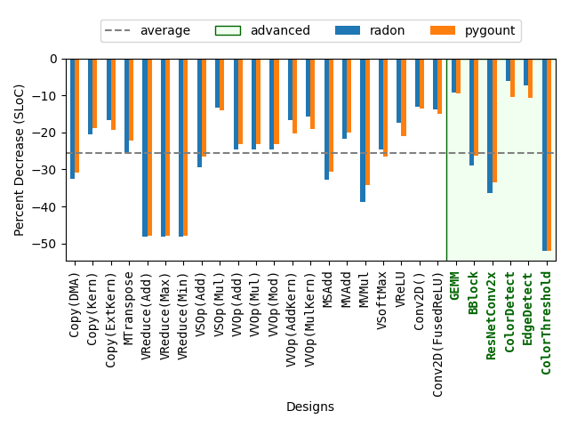
Designer Efficiency – Decrease in single lines of code (SLOC)

Slide 44
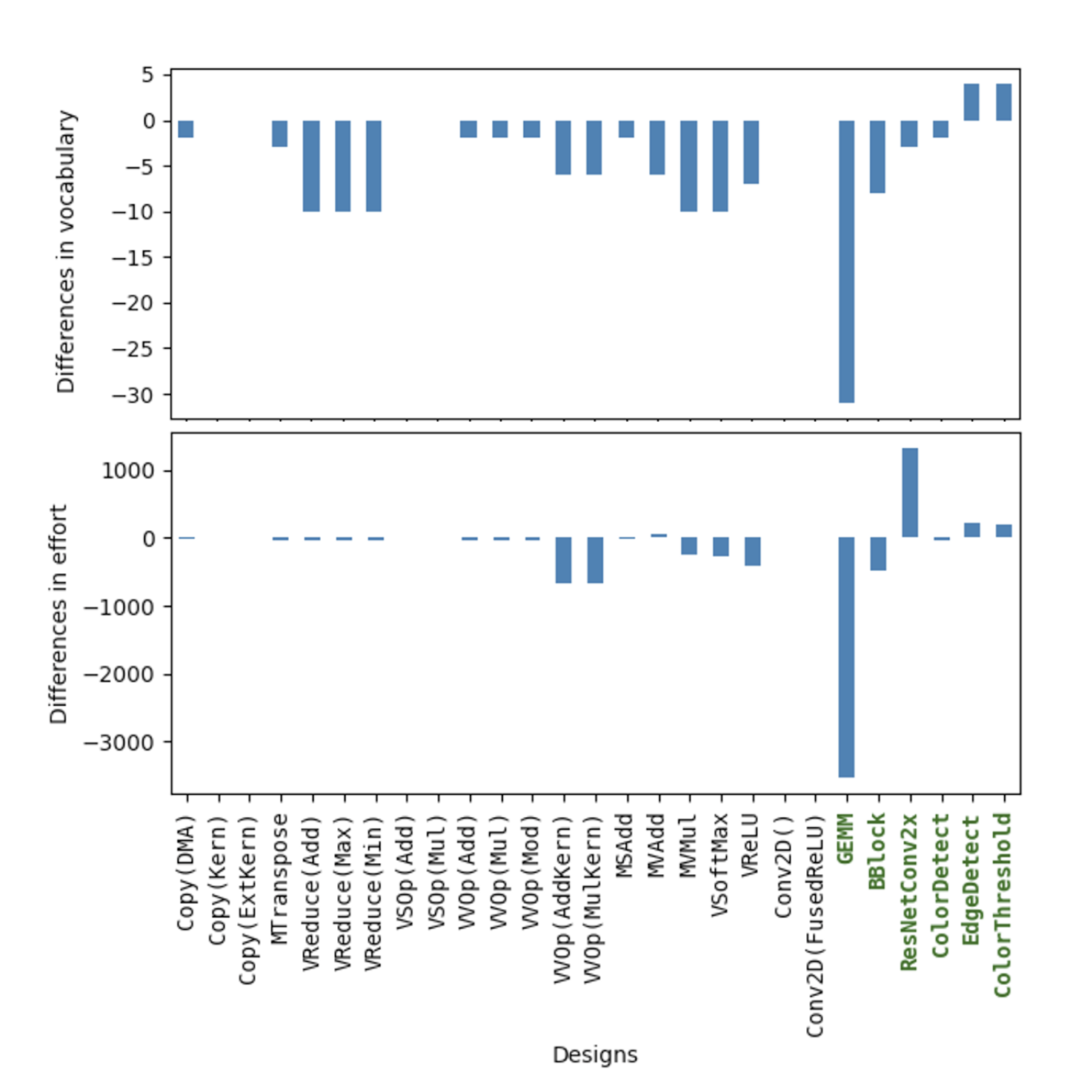
Designer Efficiency –
Decreases in Halstead vocabulary (top) and effort (bottom)

Slide 45
SequentialPlacer
mty = np.ndarray[(MH, MW), np.dtype[np.int32]]
tty = np.ndarray[(TH, TW), np.dtype[np.int32]]
fi = ObjectFifo(tty)
fo = ObjectFifo(tty)
def core_fn(of_in, of_out):
a = of_in.acquire(1)
b = of_out.acquire(1)
for i in range_(TH):
for j in range_(TW):
b[i, j] = a[i, j] + 1
of_in.release(1)
of_out.release(1)
my_worker = Worker(core_fn,
fn_args=[fi.cons(), fo.prod()])
tap = TensorTiler2D.simple_tiler(
(MH, MW), (TH, TW))[0]
rt = Runtime()
with rt.sequence(mty, mty) as (dati, dato):
rt.start(my_worker)
rt.fill(fi.prod(), dati, tap)
rt.drain(fo.cons(), dato, tap, wait=True)
print(Program(NPU1Col1(),rt).resolve_program(
SequentialPlacer()))
24/27 examples

Slide 46
TensorTiler2D
mty = np.ndarray[(MH, MW), np.dtype[np.int32]]
tty = np.ndarray[(TH, TW), np.dtype[np.int32]]
fi = ObjectFifo(tty)
fo = ObjectFifo(tty)
def core_fn(of_in, of_out):
a = of_in.acquire(1)
b = of_out.acquire(1)
for i in range_(TH):
for j in range_(TW):
b[i, j] = a[i, j] + 1
of_in.release(1)
of_out.release(1)
my_worker = Worker(core_fn,
fn_args=[fi.cons(), fo.prod()])
tap = TensorTiler2D.simple_tiler(
(MH, MW), (TH, TW))[0]
rt = Runtime()
with rt.sequence(mty, mty) as (dati, dato):
rt.start(my_worker)
rt.fill(fi.prod(), dati, tap)
rt.drain(fo.cons(), dato, tap, wait=True)
print(Program(NPU1Col1(),rt).resolve_program(
SequentialPlacer()))
5 designs

Slide 47
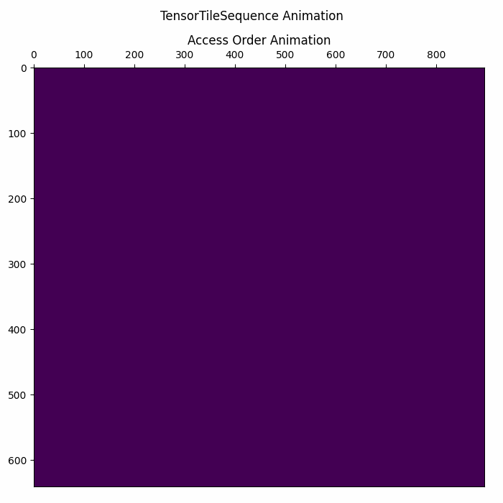


Matrix Multiplication Visualization of Runtime DMA Ops
https://github.com/Xilinx/mlir-aie/blob/main/programming_examples/basic/matrix_multiplication/whole_array/mat_mul_whole_array_visualization.ipynb
A Runtime DMA Pattern
B Runtime DMA Pattern
C Runtime DMA Pattern
Note: Timing between animations is not coordinated

Slide 48
Agenda
Background
  AMD XDNATM NPUs
  IRON
Extensions to IRON
  Example program
Evaluation
Future Work

Slide 49
Future Work
Extend further
Currently integrated and available!
Improvements:
1) Debugging, tracing
2) Data visualizations
3) …
Enable related works
ObjectFIFO analysis
Analyze similarities to other platforms
Support advanced designs

Slide 50


Questions?
IRON (MLIR-AIE): https://github.com/Xilinx/mlir-aie
MLIR-AIE & IRON are a project many have contributed to: Thank you!

Slide 51
Efficiency, Expressivity, and Extensibility in a
Close-to-Metal NPU Programming Interface
Erika Hunhoff‡†, Joseph Melber∗, Kristof Denolf∗, Andra Bisca∗, Samuel Bayliss∗, Stephen Neuendorffer∗, Jeff Fifield∗, Jack Lo∗, Pranathi Vasireddy∗, Phil James-Roxby∗, Eric Keller†
∗AMD †University of Colorado at Boulder ‡Work performed at AMD

Slide 52
with mlir_mod_ctx() as ctx:
@device(AIEDevice.npu1_1col)
def device_body():
mty = np.ndarray[(MH, MW), np.dtype[np.int32]]
tty = np.ndarray[(TH, TW), np.dtype[np.int32]]
shm0 = tile(0, 0)
aie2 = tile(0, 2)
fi = object_fifo("in", shm0, aie2, 2, tty)
fo = object_fifo("out", aie2, shm0, 2, tty)
@core(aie2)
def core_body():
for _ in range_(sys.maxsize):
a = fi.acquire(ObjectFifoPort.Consume, 1)
b = fo.acquire(ObjectFifoPort.Produce, 1)
for i in range_(TH):
for j in range_(TW):
b[i, j] = a[i, j] + 1
fi.release(ObjectFifoPort.Consume, 1)
fo.release(ObjectFifoPort.Produce, 1)
@runtime_sequence(mty, mty)
def sequence(dati, dato):
in_task = shim_dma_single_bd_task(fi, dati,
sizes=[1, 1, TH, TW],
strides=[0, 0, MW, 1])
out_task = shim_dma_single_bd_task(fo, dato,
sizes=[1, 1, TH, TW],
strides=[0, 0, MW, 1],
issue_token=True)
dma_start_task(in_task, out_task)
dma_await_task(out_task)
dma_free_task(in_task)
print(ctx.module)
Target device

Slide 53
with mlir_mod_ctx() as ctx:
@device(AIEDevice.npu1_1col)
def device_body():
mty = np.ndarray[(MH, MW), np.dtype[np.int32]]
tty = np.ndarray[(TH, TW), np.dtype[np.int32]]
shm0 = tile(0, 0)
aie2 = tile(0, 2)
fi = object_fifo("in", shm0, aie2, 2, tty)
fo = object_fifo("out", aie2, shm0, 2, tty)
@core(aie2)
def core_body():
for _ in range_(sys.maxsize):
a = fi.acquire(ObjectFifoPort.Consume, 1)
b = fo.acquire(ObjectFifoPort.Produce, 1)
for i in range_(TH):
for j in range_(TW):
b[i, j] = a[i, j] + 1
fi.release(ObjectFifoPort.Consume, 1)
fo.release(ObjectFifoPort.Produce, 1)
@runtime_sequence(mty, mty)
def sequence(dati, dato):
in_task = shim_dma_single_bd_task(fi, dati,
sizes=[1, 1, TH, TW],
strides=[0, 0, MW, 1])
out_task = shim_dma_single_bd_task(fo, dato,
sizes=[1, 1, TH, TW],
strides=[0, 0, MW, 1],
issue_token=True)
dma_start_task(in_task, out_task)
dma_await_task(out_task)
dma_free_task(in_task)
print(ctx.module)

Slide 54
Goals
Efficiency
Read, write, modify designs
Only provide detail in areas of interest
Expressivity
Do not compromise on designer’s explicit control of hardware
Extensibility
Custom tooling, reusable logic

Slide 55
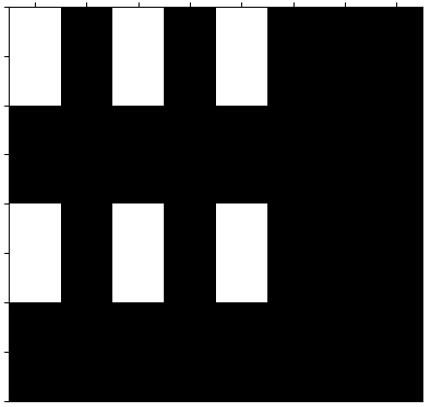
Tensor Access Pattern Tools: TensorTiler2D
from aie.helpers.taplib import TensorTiler2D
taps = TensorTiler2D.step_tiler(
(4, 8),
(1, 1),
tile_group_repeats=[2, 3],
tile_group_steps=[2, 2],
allow_partial=True)
x3
Step 2
1x1
1x1
1x1
Step 2
x2
1x1
1x1
1x1

Slide 56
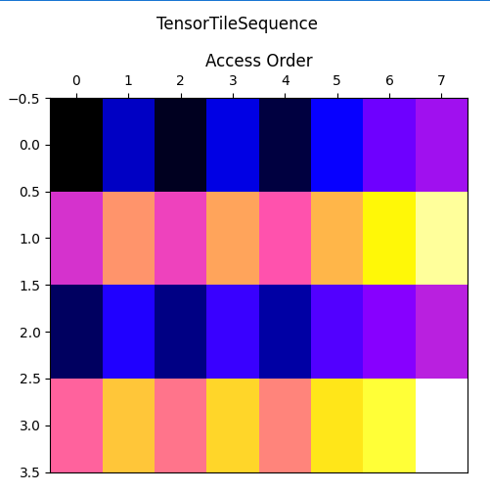
Tensor Access Pattern Tools: TensorTiler2D
from aie.helpers.taplib import TensorTiler2D
taps = TensorTiler2D.step_tiler(
(4, 8),
(1, 1),
tile_group_repeats=[2, 3],
tile_group_steps=[2, 2],
allow_partial=True)
taps.visualize()

Slide 57
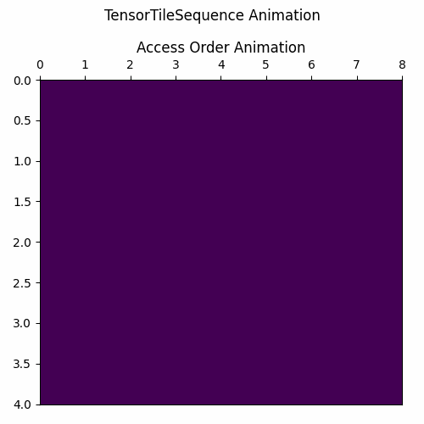
Tensor Access Pattern Tools: TensorTiler2D
from aie.helpers.taplib import TensorTiler2D
taps = TensorTiler2D.step_tiler(
(4, 8),
(1, 1),
tile_group_repeats=[2, 3],
tile_group_steps=[2, 2],
allow_partial=True)
anim = taps.animate()
# View in notebook
HTML(anim.to_jshtml())
# Save to file
anim.save("myfile.gif")

