Slide 1

EL2 Authorized Reset application
Date (2026.03.20)

Slide 2
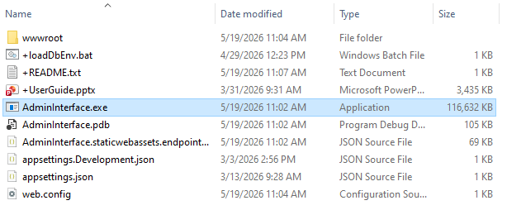
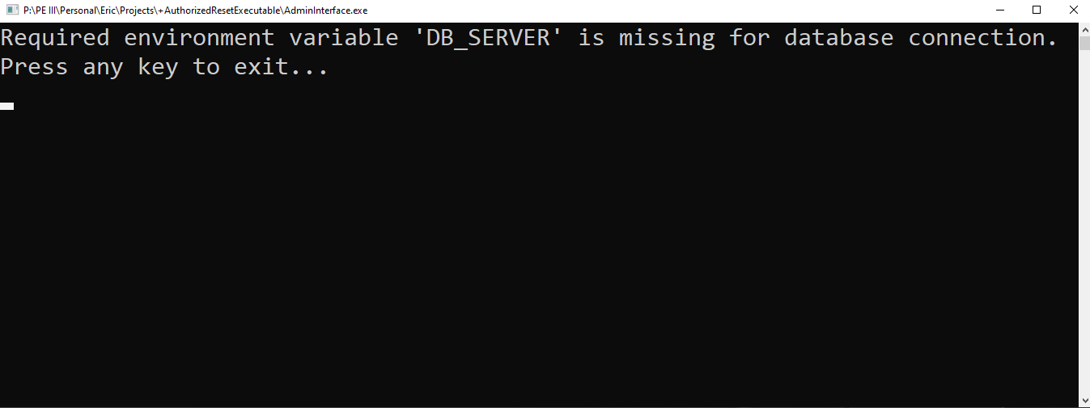
Running the program
The folder with the program resides at the path P:/PE III/Personal/Eric/Projects/+AuthorizedResetExecutable as of 2026-06-02. It should look something like this. Files without a ‘+’ are for the program and should not be touched.
Before you run the .exe, make sure to run +loadDbEnv.bat (or just loadDbEnv if you hide file extensions) first, otherwise you’ll just see the following:

Slide 3
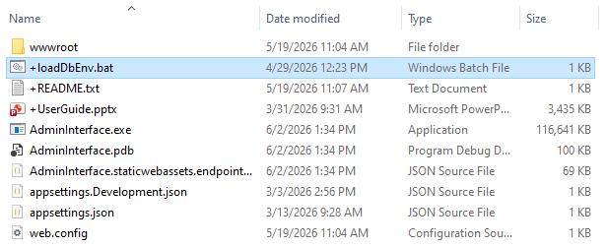
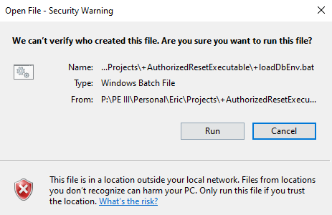
The .bat file
The .bat file loads a few environment variables to so the database credentials can be stored outside the app. Because it automatically executes commands and doesn’t live on your computer’s hard drive, it’s flagged as malicious even if you’ve run it before. By default, double clicking this will execute its contents straight from the terminal. If you want to see what it’s doing, you’re welcome to open it in a text editor by right-clicking, then selecting edit (although you will still need to confirm the security dialog). Doing so will not execute the commands.
What you’ll see if you run straight from the P drive
When you run the .bat file, you’ll see a terminal window pop up briefly, then disappear. That means the file has run and you’re ready to run the actual program.

Slide 4
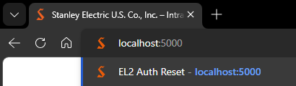
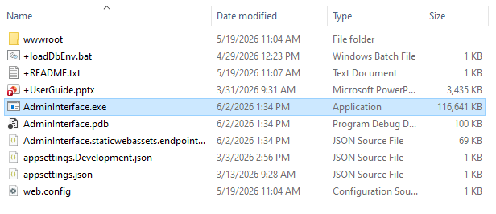
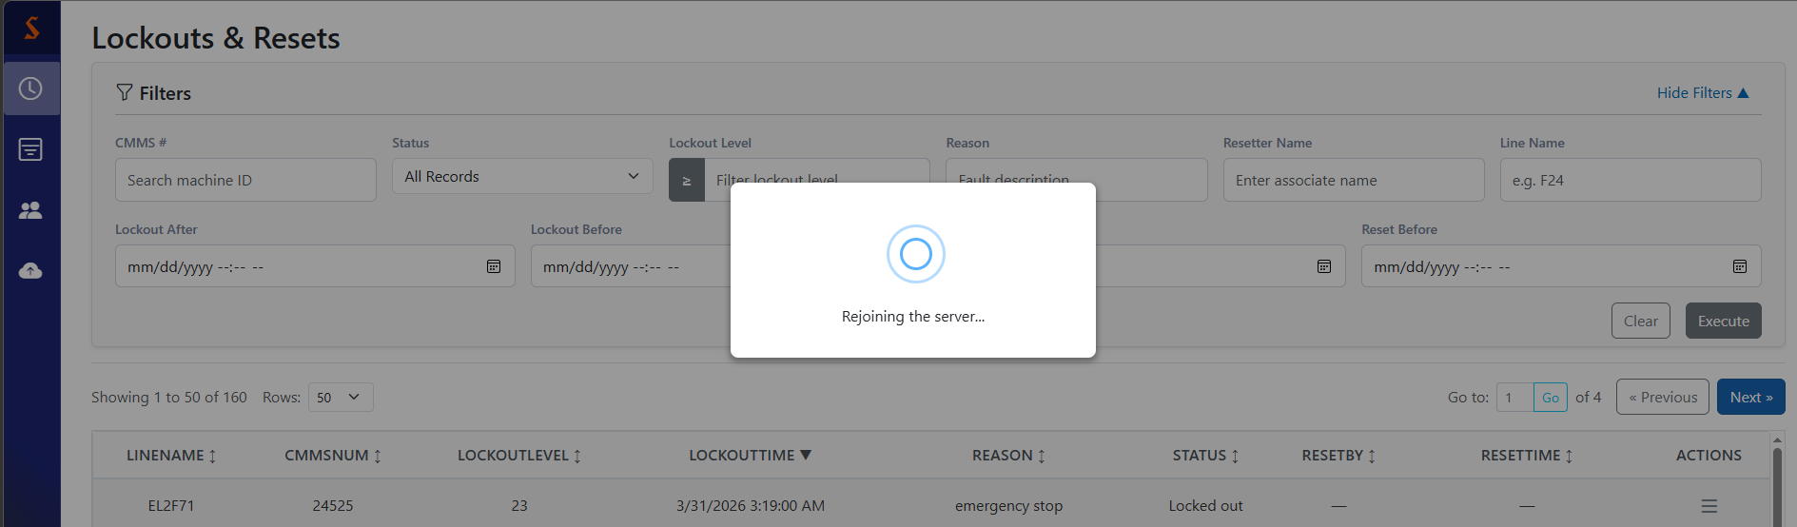
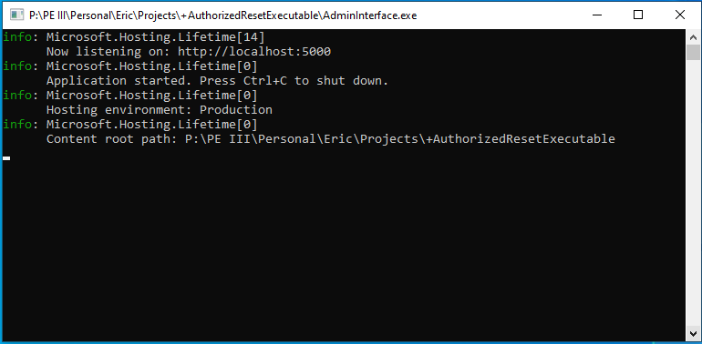
The .exe file
This app is hosted locally, so there’s not a website to go to (in the traditional sense). Open any browser and type in the address from the second line of the terminal output. I’m 99% sure it’s stable at localhost:5000, but it will always match whatever you see in the terminal created by the .exe.
Once you’ve run the .bat file, you’re ready to go. Double clicking the .exe file will show the security dialog (because it’s an executable), but after you confirm, it should show something like this:
Side note: the app’s lifespan is tied to the terminal, not the browser. Thus, it doesn’t care when you close the tab, go to a different site, or even close the browser entirely. The only way to end it is to go back to the terminal and either close it or press Ctrl+C as it indicates. Once the app closes, all tabs currently viewing it will try to reconnect a couple times before giving up.

Slide 5
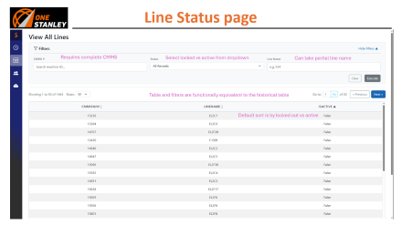
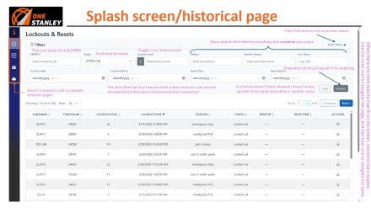
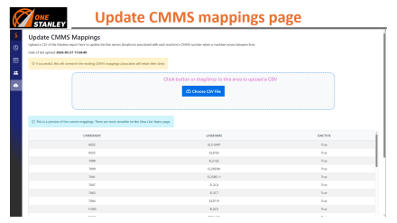
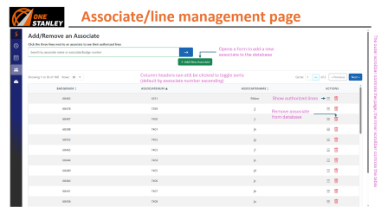
Table of Contents
If you’re just browsing, start here
If you’re an admin, you’ll be interested in this one

Slide 6
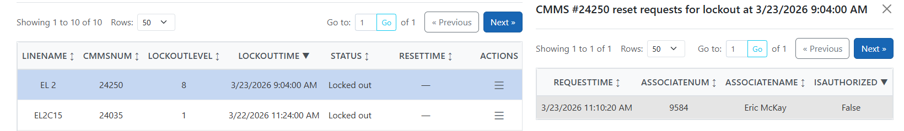
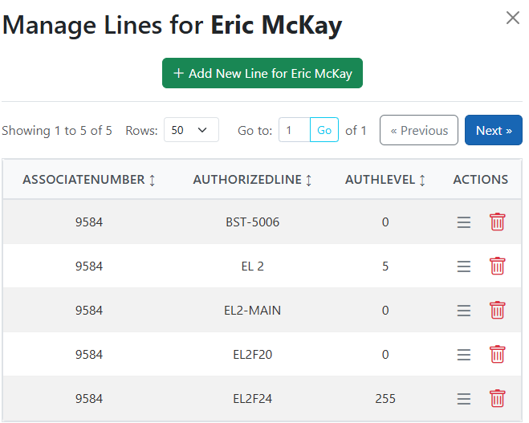



Explaining lockout level
The list of current lockouts
The list of attempted resets for this lockout
My authorized lines
In this scenario, a machine on the base EL 2 line was awaiting a reset with lockout level 8. I’m authorized to reset the base EL 2 line, but my reset request was denied because my auth level on that line is only 5.
When an associate is authorized for a line, their authority for that line is described by a number 0-255 (but usually 0-25). This is their “auth level”.
Lockout level is determined at the time of lockout. It corresponds to the rank of the defect. Lockout level 0 means anyone authorized on the line can reset.
To release a lockout, the associate performing the reset must have an auth level greater than or equal to the lockout level. Insufficient auth level is treated the same as not being authorized on the line at all.

Slide 7
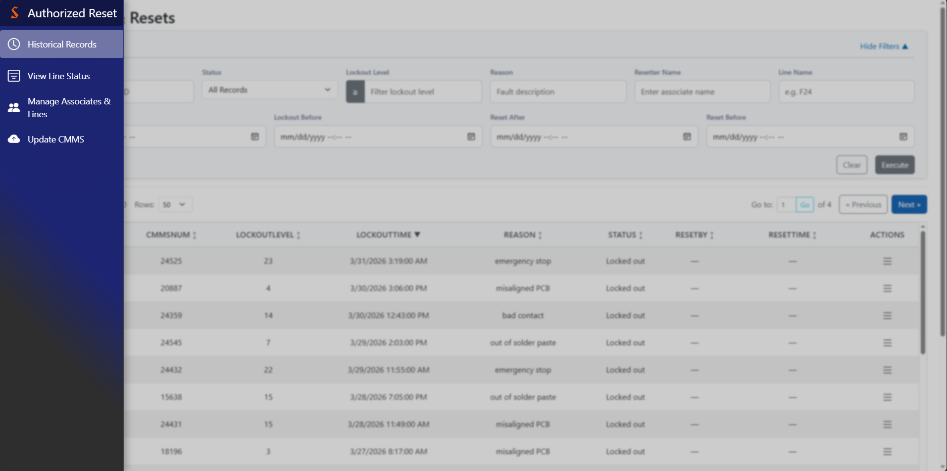
Navigation bar
Detection window
When hovering over the left side of the screen, the content dims and blurs to draw attention to the navbar overlay

Slide 8
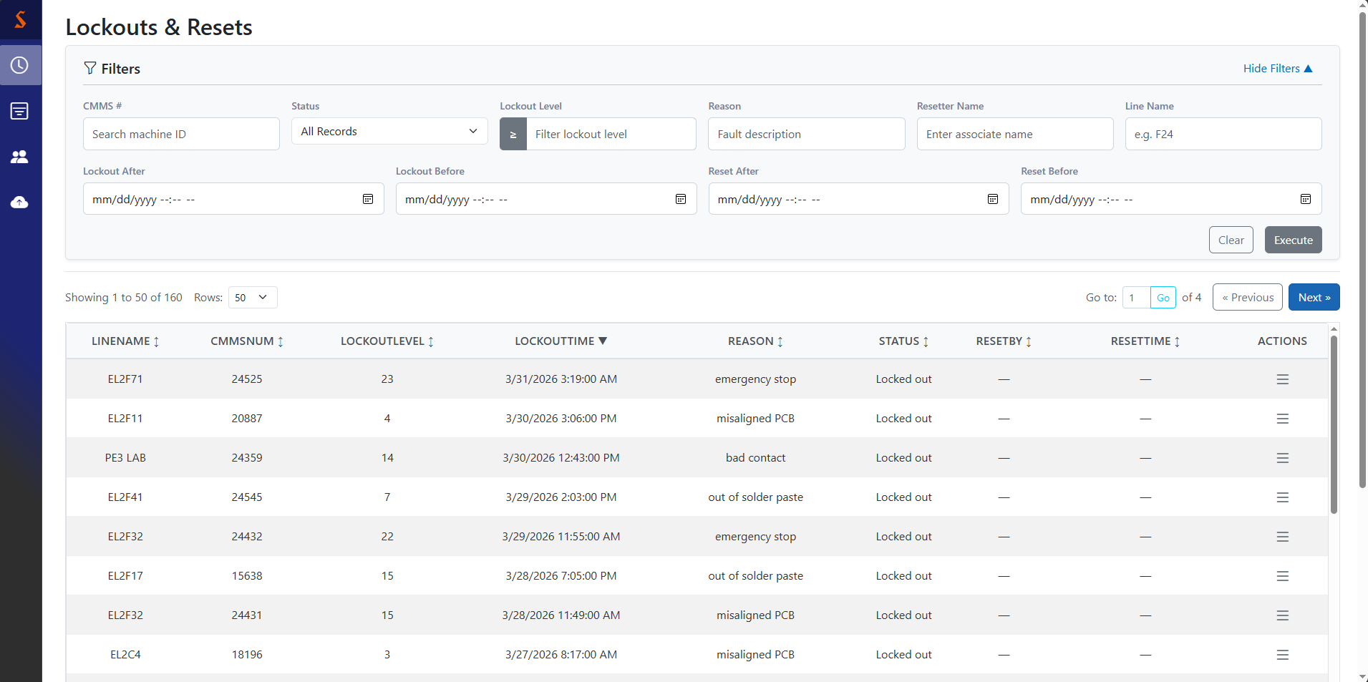
Splash screen/historical page
Hide the filters to free up screen space
These search their field for everything that contains your input
When there are more results than fit on the screen, two scroll bars appear.
Use the outer one to navigate the page, and the inner one to navigate the table
This one needs the full CMMS
Locked vs released
Toggle > vs < lockout level
Gray when clicking it wouldn’t do anything
Hover to expand, click to navigate between pages
The date filters (all four) require both a date and time. Just provide the start/end of the day to include/exclude it as desired
If a lockout hasn’t been released, it won’t show up when filtering by reset date or resetter name

Slide 9
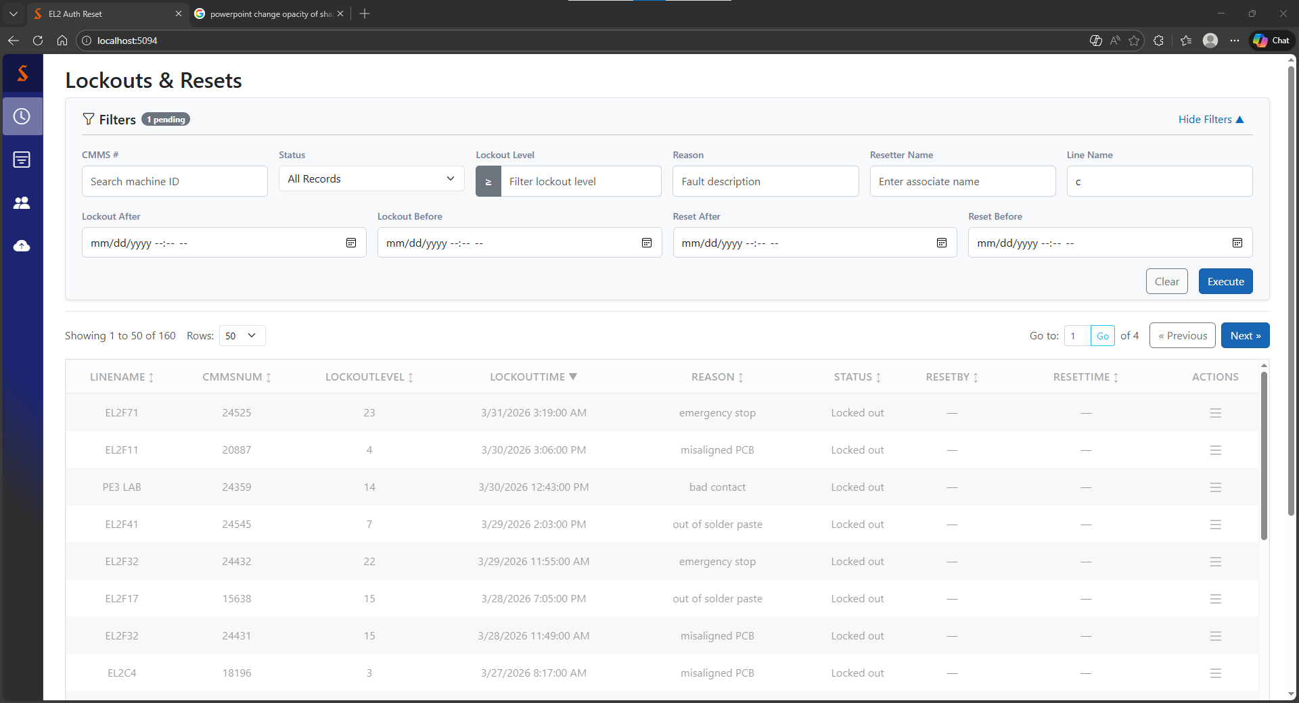
Using the filters
To remind you to search
Blue when ready to be pressed
12 AM to include day, 11:59 PM to exclude (same as reset after)
11:59 PM to include day, 12 AM to exclude (same as reset before)
Press clear to reset all filters and go back to the full table or execute to run a search with the current filters.
The table becomes faded if you haven’t executed the search yet to remind you that it’s waiting for you to do so. You can’t interact when it’s like this.

Slide 10
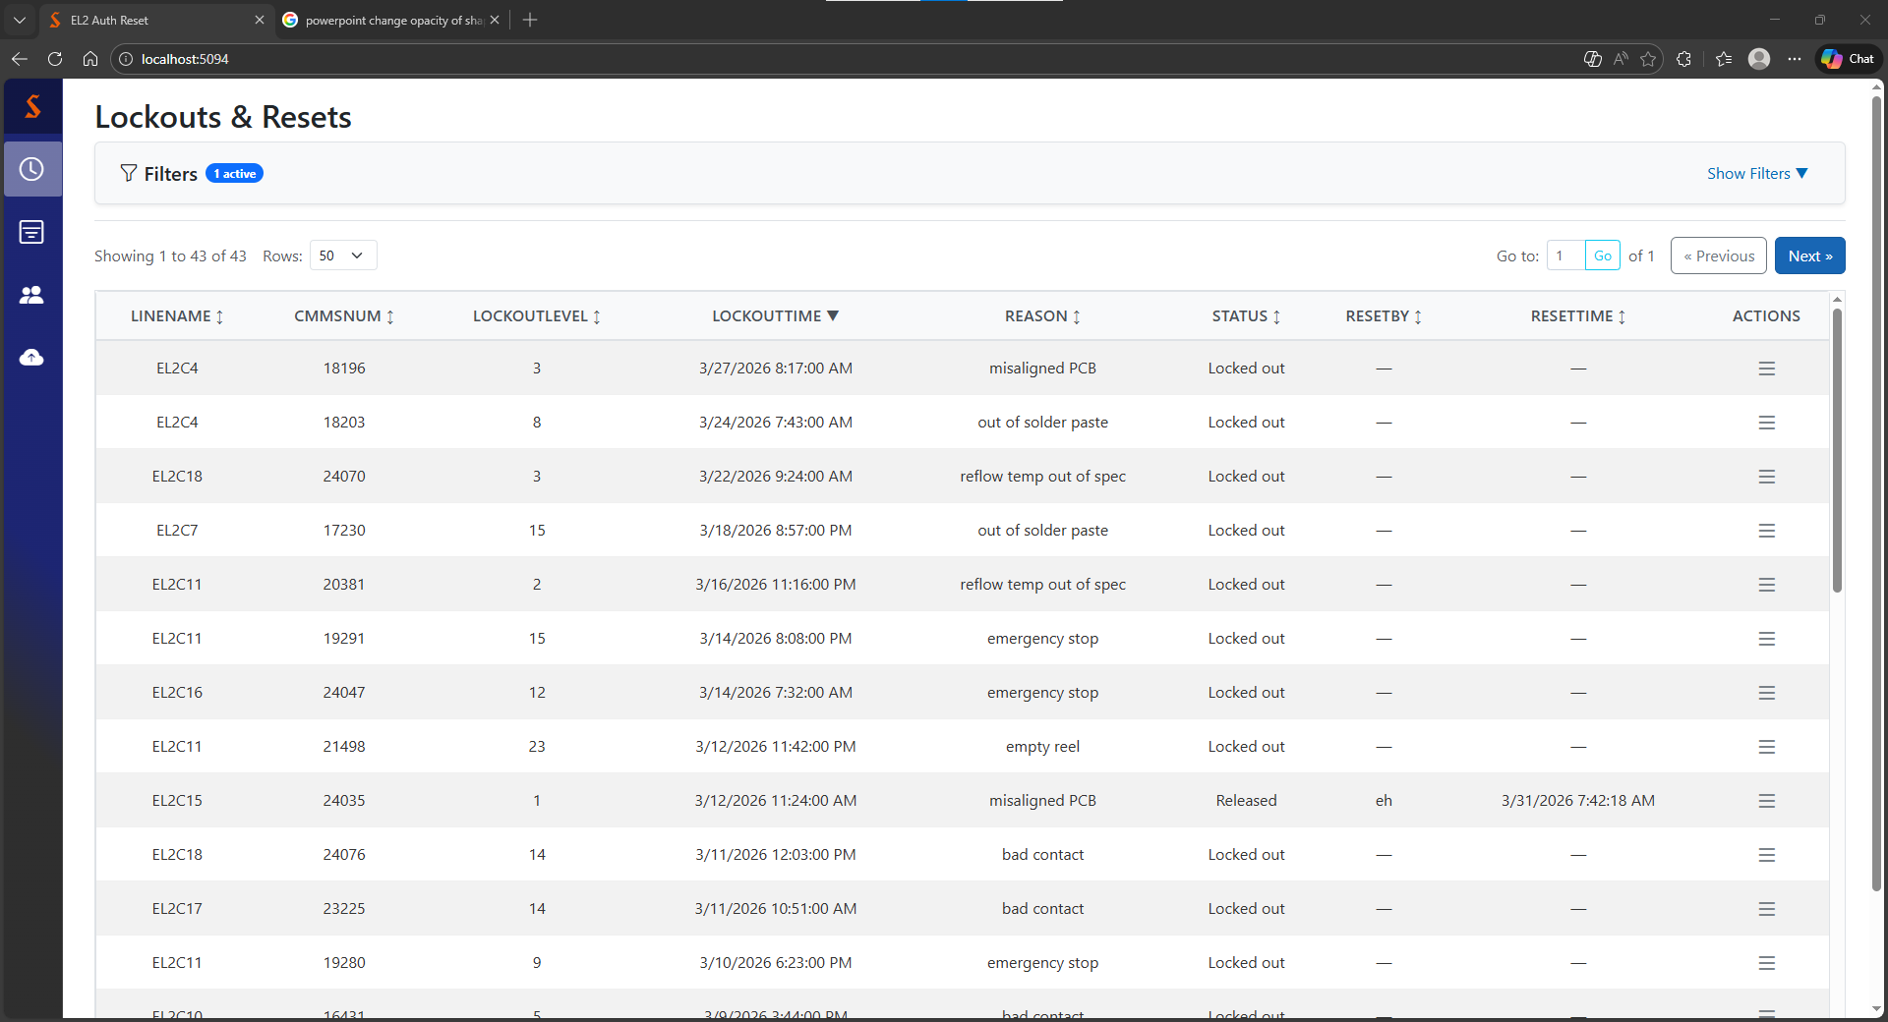
Using the table
Sorting assumes you only want to see entries where that value exists. For example, sorting by reset time here would hide all entries except the ones reset by ‘b’ and ‘eh’, then apply the sort
Auto-collapses on search
To remind you this is a filtered table
The results you’re seeing now
Results per page
Click any column header to cycle through sort directions for that attribute. You can only sort by one column at once, and the default sort is by most recent lockout time.
Jump to a specific page

Slide 11
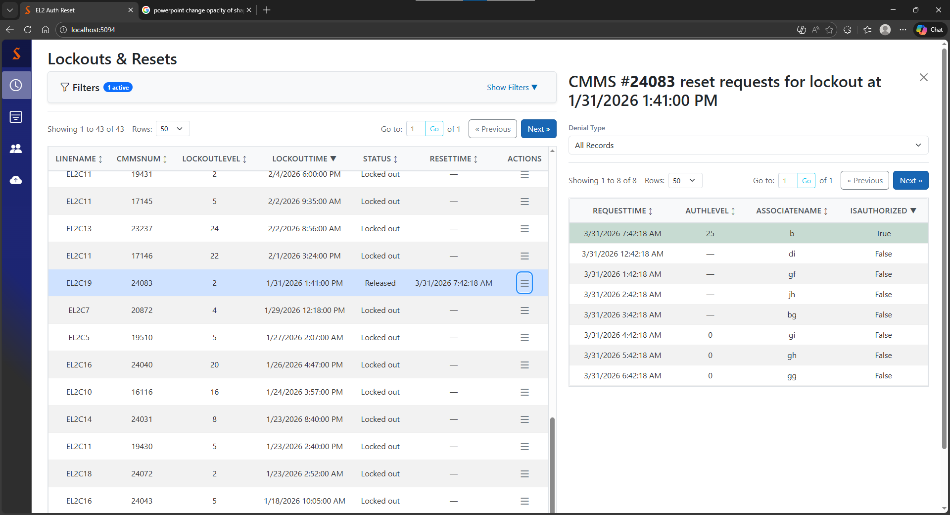
Historical: the ‘expand’ button
Clicking the three lines next to an entry will highlight the row in blue and open a split screen of all attempted resets for that lockout.
If the lockout has a paired reset, it’s highlighted in green and at the top (default sort is by auth state)
Can filter denied requests by insufficient auth level or no privileges on target line
If a lockout has been released, the successful reset is always at the top

Slide 12
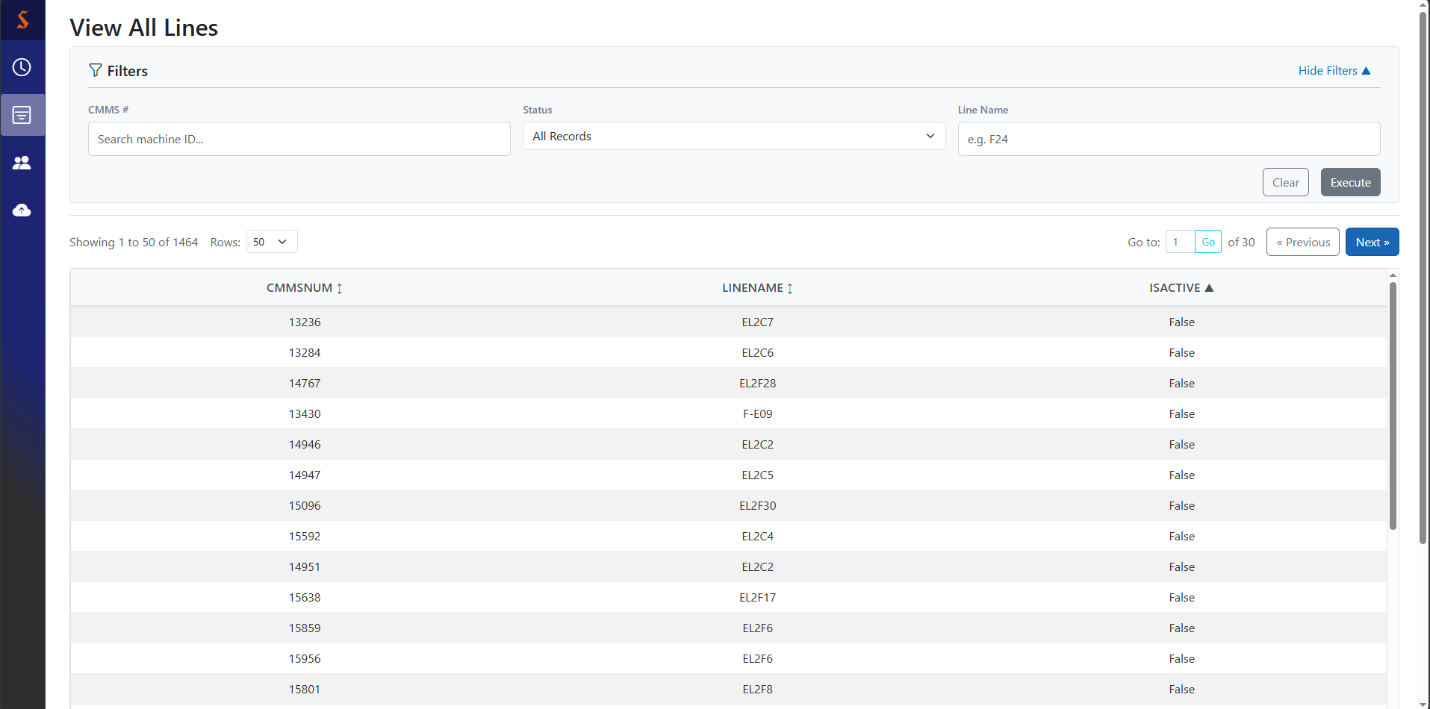
Line Status page
Requires complete CMMS
Select locked vs active from dropdown
Can take partial line name
Table and filters are functionally equivalent to the historical table
Default sort is by locked out vs active

Slide 13
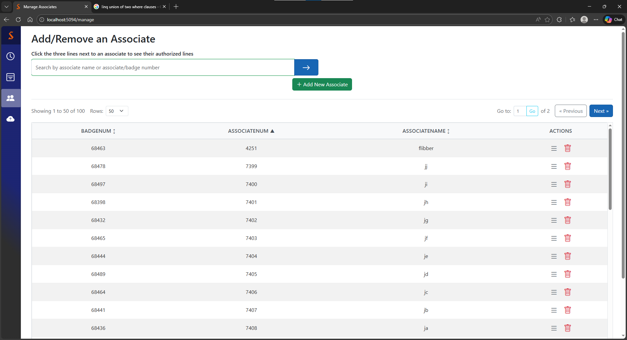
Associate/line management page
The outer scrollbar controls the page, the inner scrollbar controls the table
Opens a form to add a new associate to the database
Column headers can still be clicked to toggle sorts (default by associate number ascending)
Show authorized lines
Remove associate from database

Slide 14
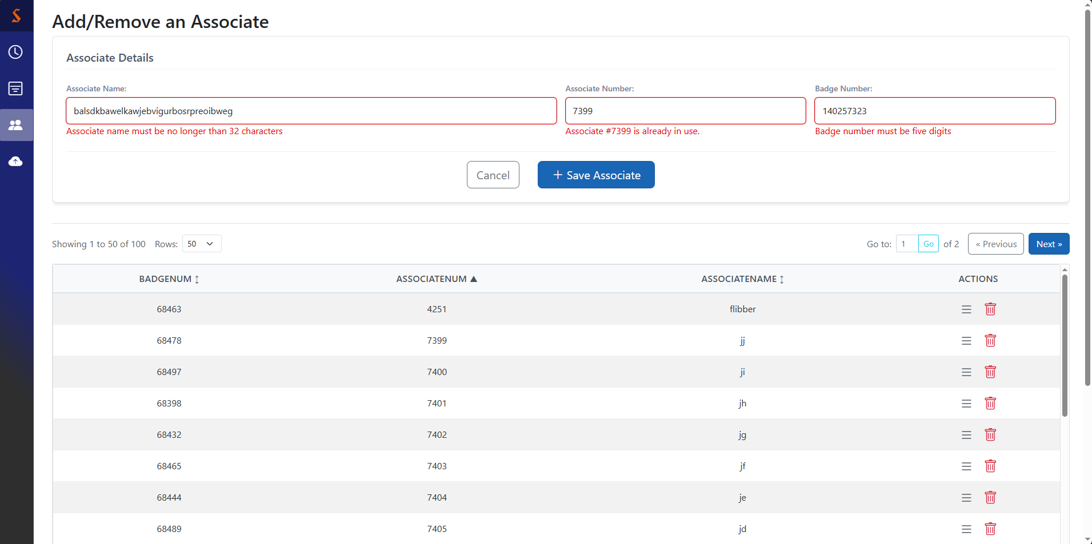
Associate addition
Associates can share names, but not associate/badge numbers. If you want to reuse an associate/badge number not currently in circulation, remove the old associate from the database first and you won’t have problems.
These validators trigger immediately when you click away or try to submit. To remove them, fix their problem, then click away/submit again.
See the next page for what a successful addition looks like.
Clear & close
Save (& clear) & close

Slide 15
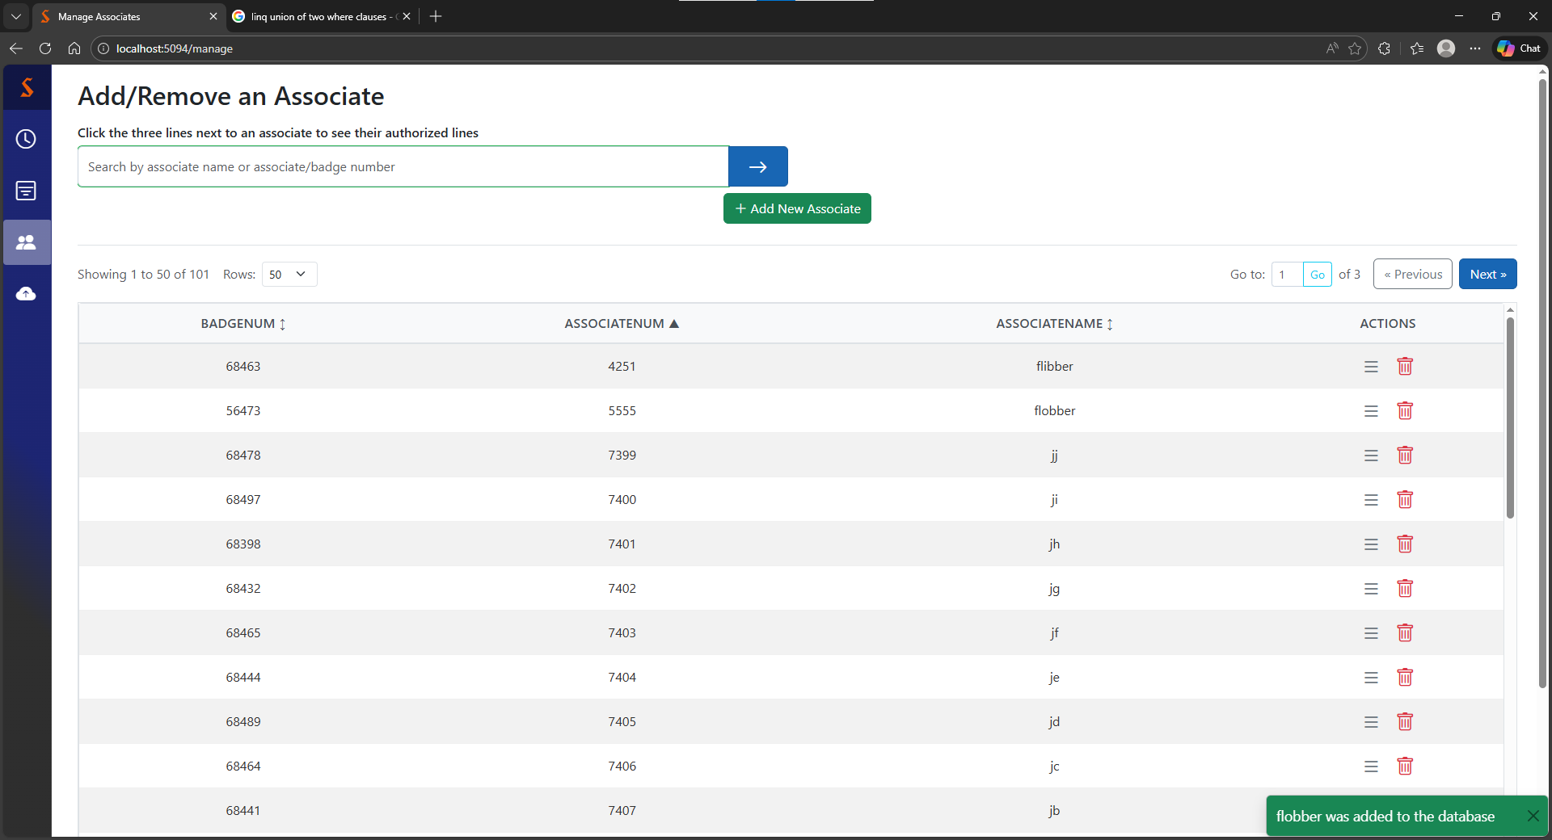
Successful associate addition
Fun fact: the message that briefly appears on success is called a toast
As a rule of thumb, if the app doesn’t yell at you and the form closes, it worked. But in case you’re not convinced, you’ll see a little message telling you it worked.

Slide 16
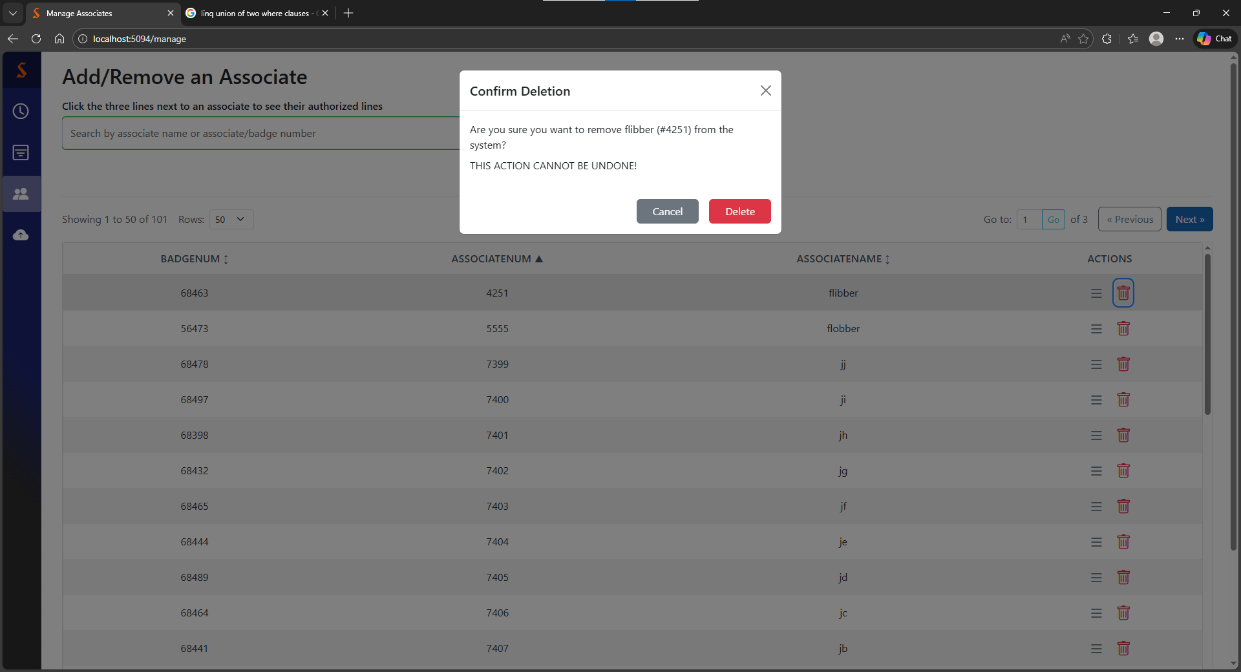
Associate removal
Also cancel
Removes associate
Cancel deletion
This is what you see when you press the trash can for an associate

Slide 17
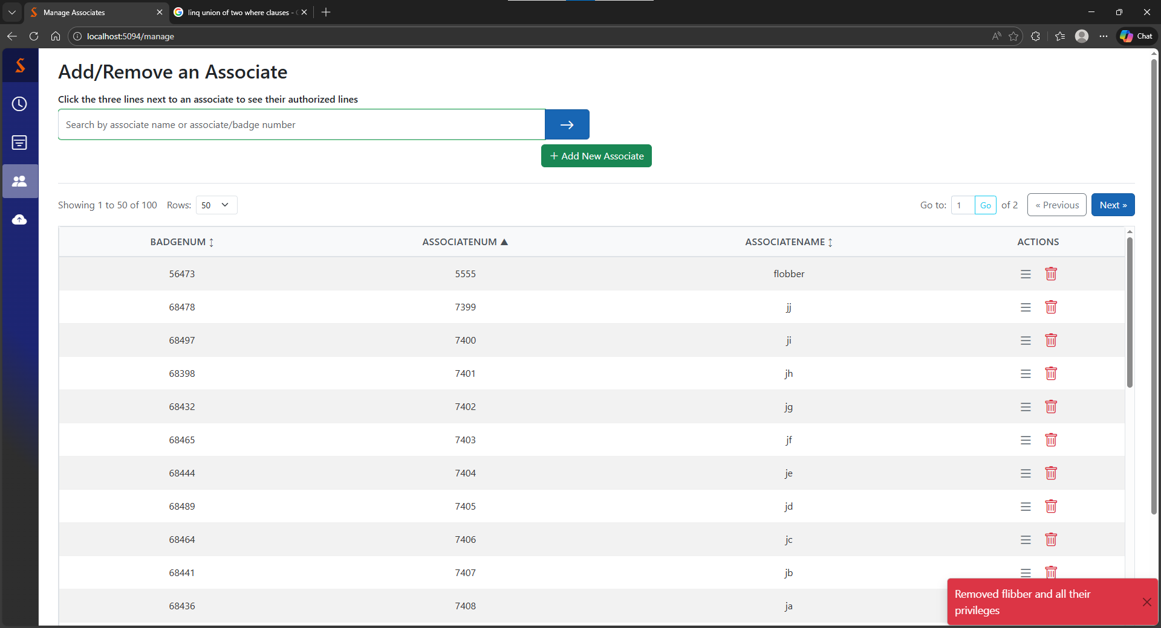
Successful associate removal
You can be sure the deletion worked if you see this toast

Slide 18
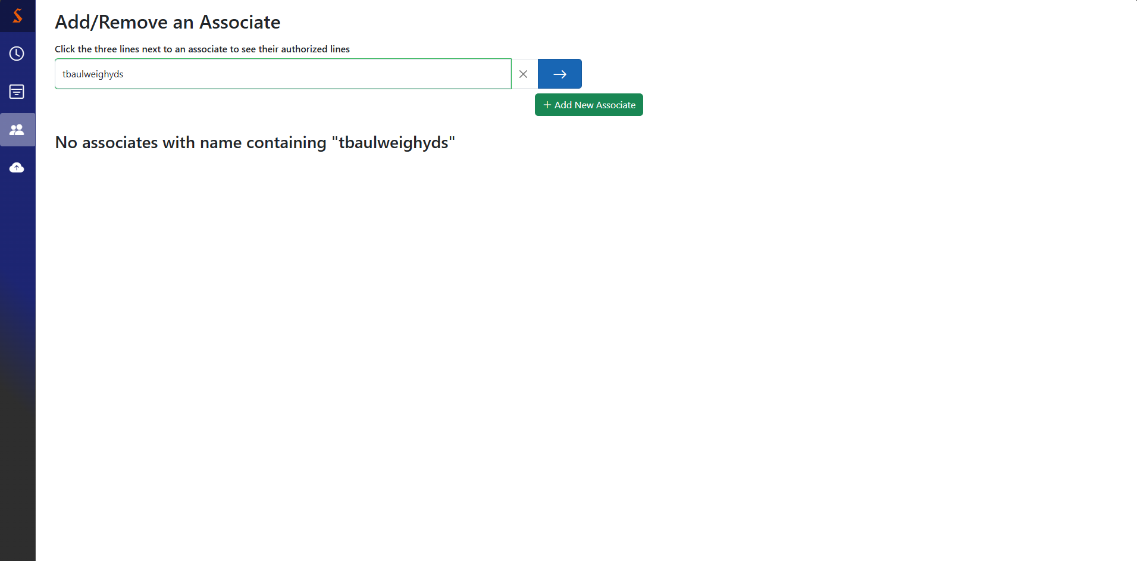
Empty search
If you made it here, try a different search, or hit the X button in the search bar to clear it and show the full table. The back button will not do the same thing.

Slide 19
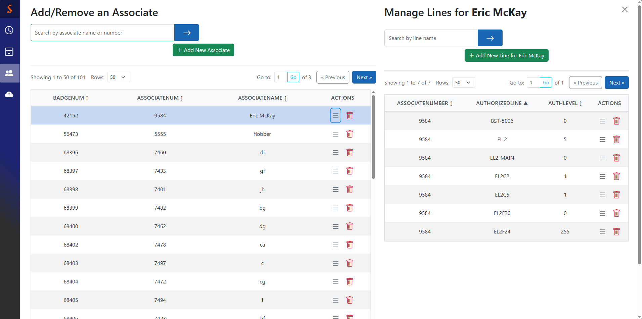
Line management
Close split screen
Pressing the three lines next to an associate opens a split screen view showing their authorized lines on the right
Open the form to authorize a new line
Pressing the expand button highlights the target associate’s row
Close split screen
Open the form to modify privileges for an existing line
Revoke privileges for this line (delete dialog)

Slide 20
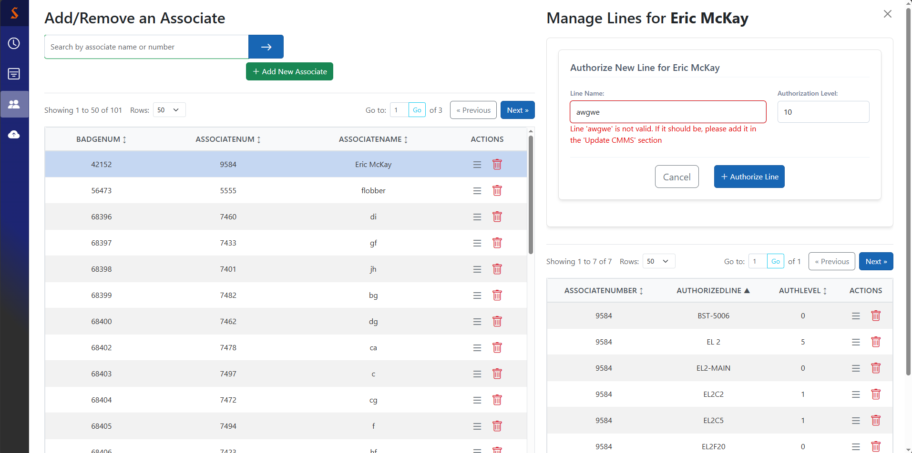
Line addition
The highest lockout level releasable by this associate
Clamped to valid values
There’s a dropdown that provides only
valid lines

Slide 21
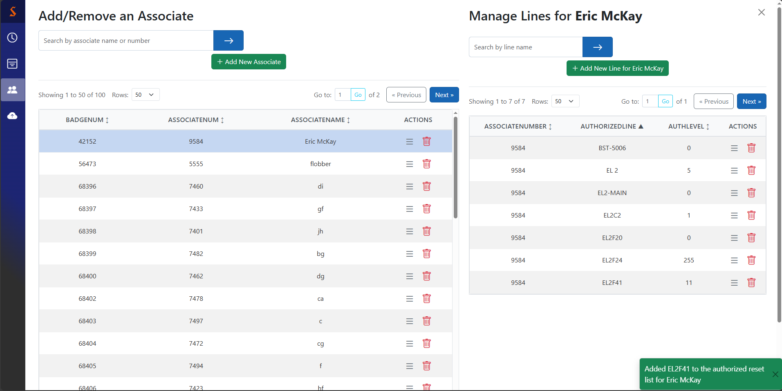
Successful line addition
This toast lets you know the new line authorization was successful, even if it’s off screen

Slide 22
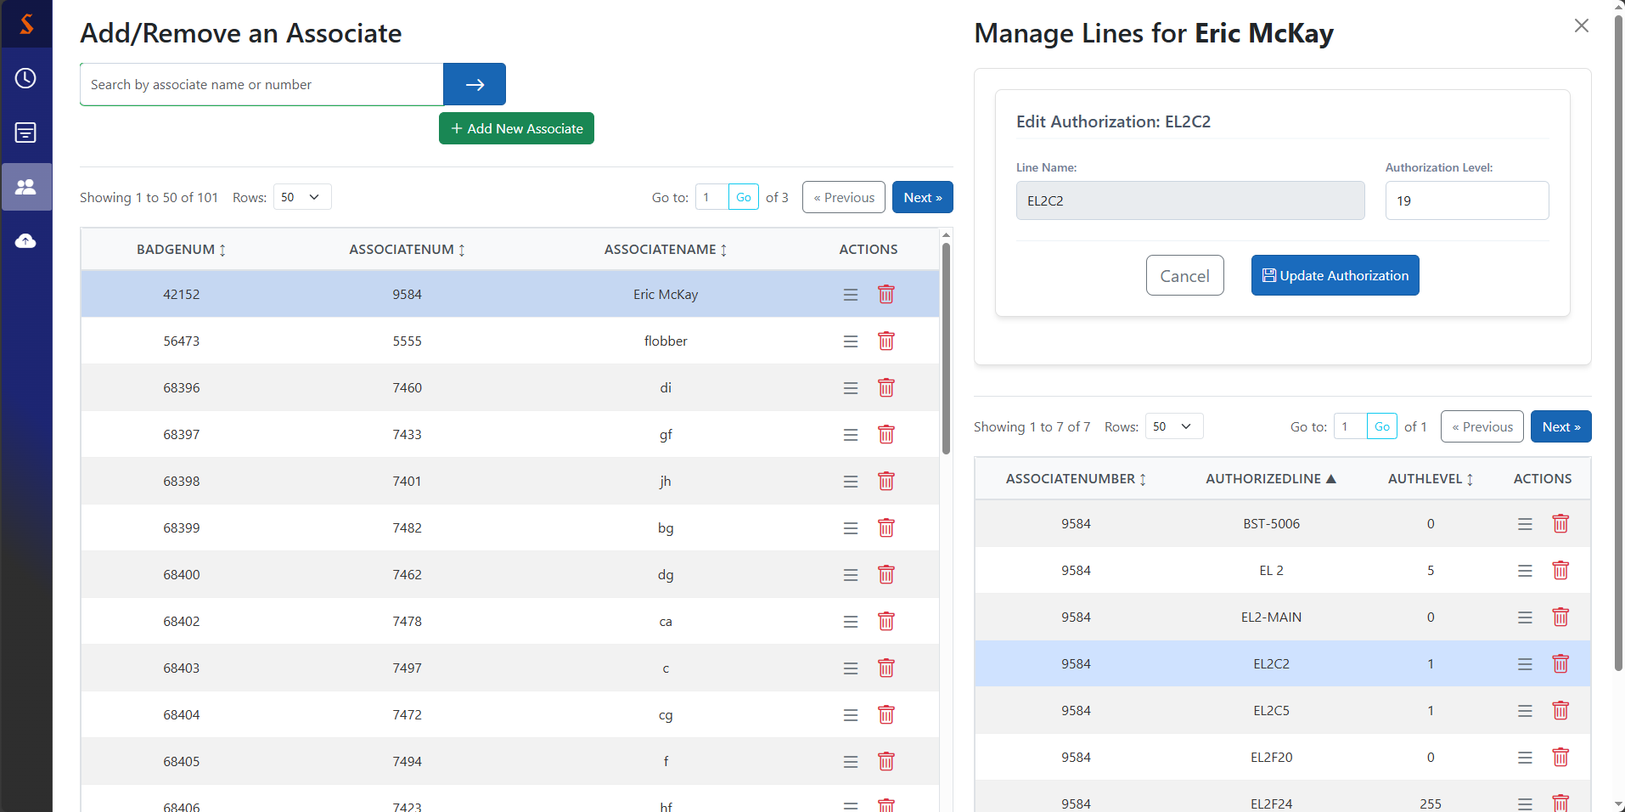
Line update
Can’t change line name, but can edit auth level
Pressing the expand button highlights the target row

Slide 23
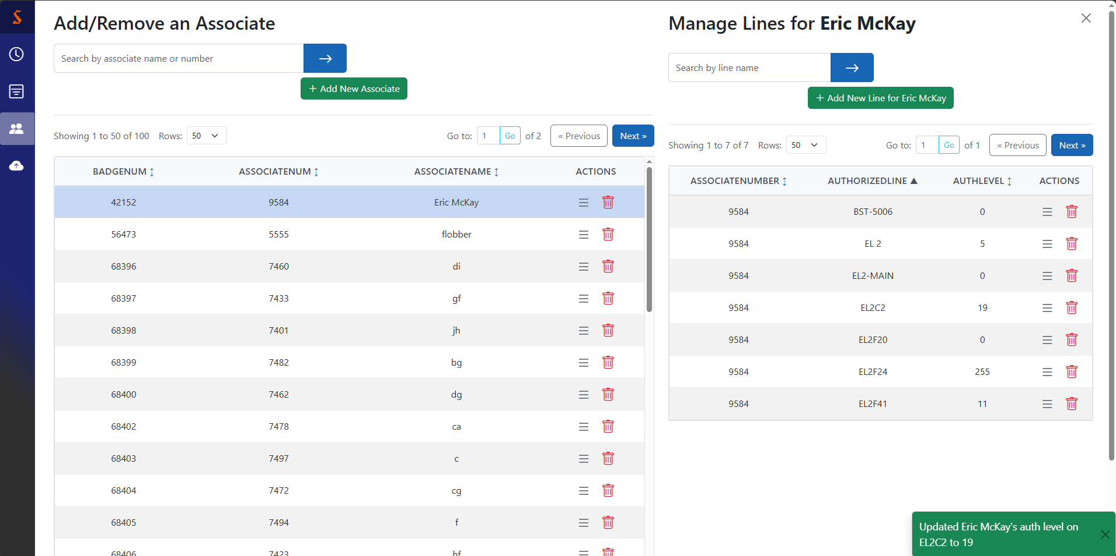
Successful line update
This toast lets you know the auth level change was successful, even if the line is off screen

Slide 24
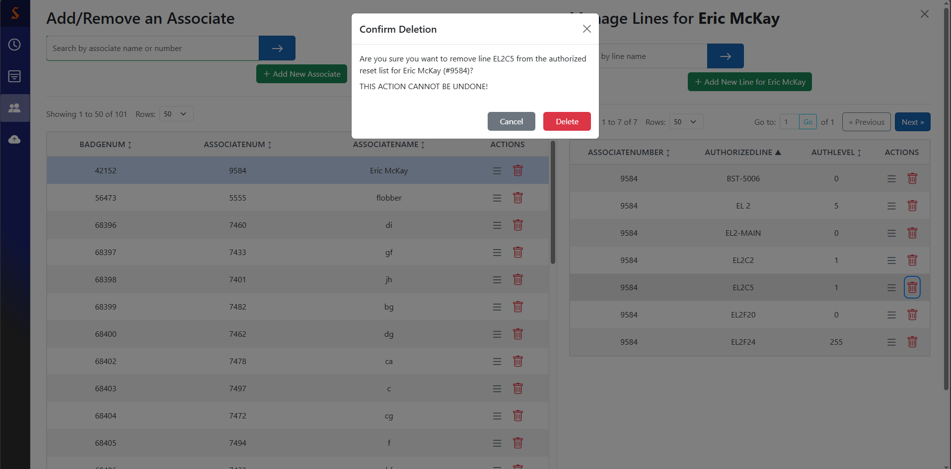
Line removal
Also cancel
Removes line from associate
Cancel deletion
This is what you see when you press the trash can for an associate’s line

Slide 25
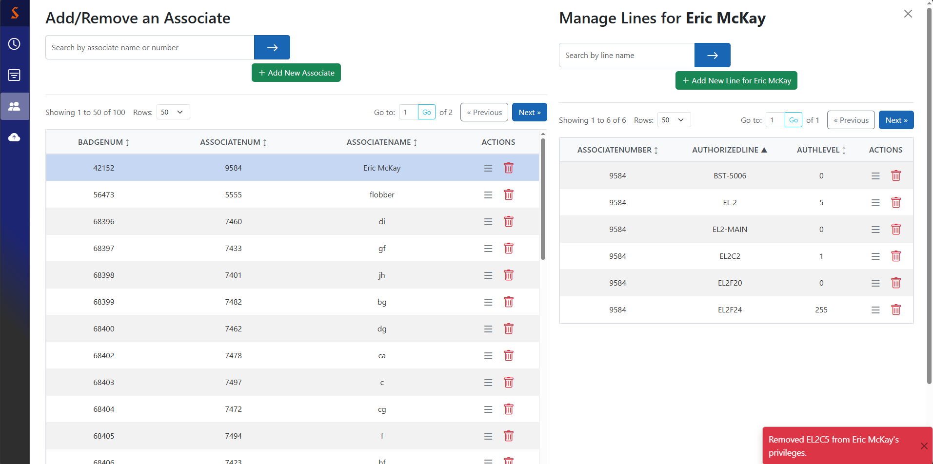
Successful line removal
Notably, this only revokes this associate’s reset privileges for this line. It does not delete the line.
You can be sure the deletion worked if you see this toast

Slide 26
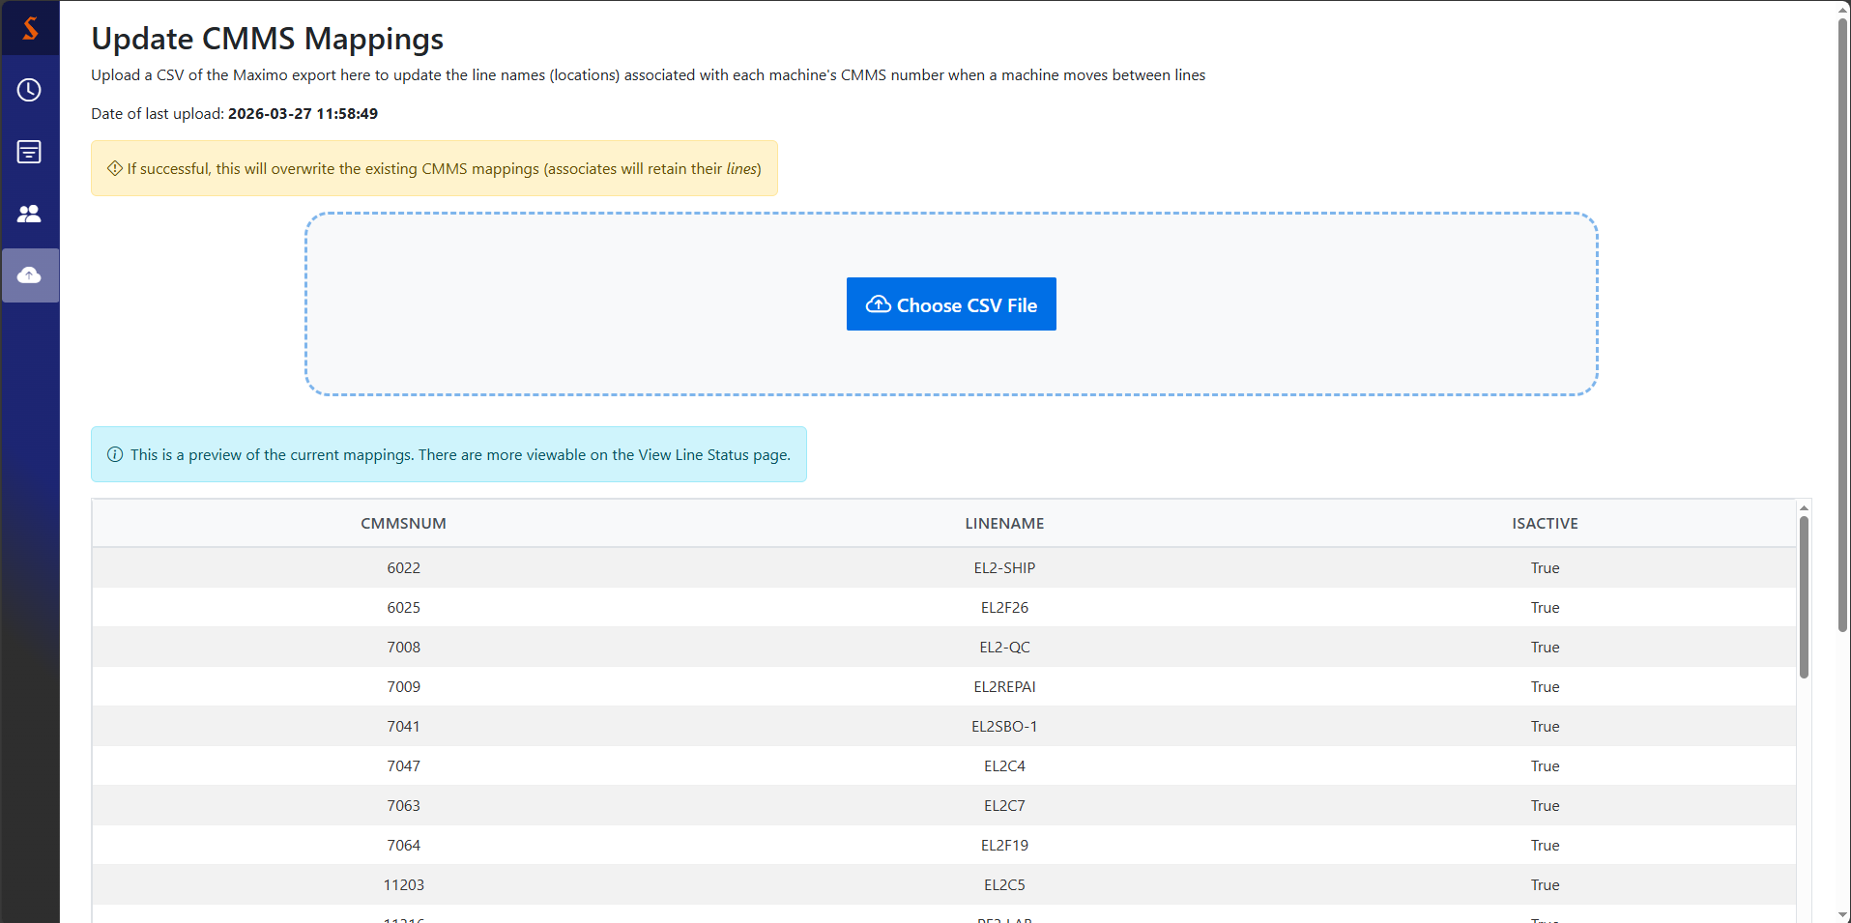
Update CMMS mappings page
Click button or drag/drop to this area to upload a CSV

Slide 27
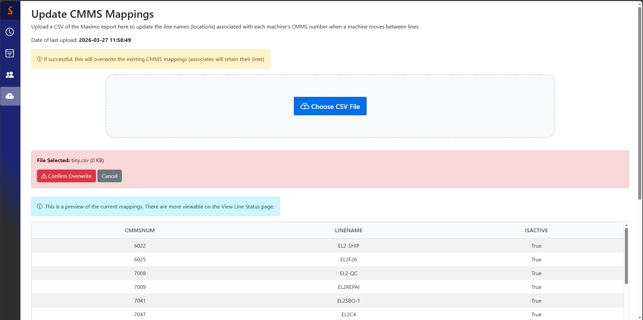
CSV upload confirmation
Either file upload method gives you this confirmation

Slide 28
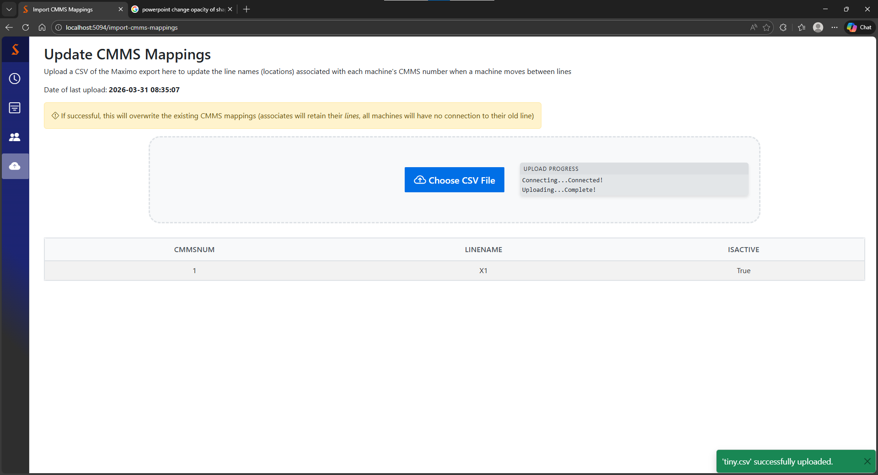
CSV upload progress updates
As long as the CSV you upload is in the Maximo format, you shouldn’t have any problems
After a successful upload, you’ll see this message.
If you upload a non-CSV or a CSV where the columns aren’t what the reader expects, you haven’t affected the database, but the little gray update box will be…troubled. Just refresh & try another file and all will be well.

