Slide 1

Foolproof Sample Management application
Date (2026.06.02)

Slide 2
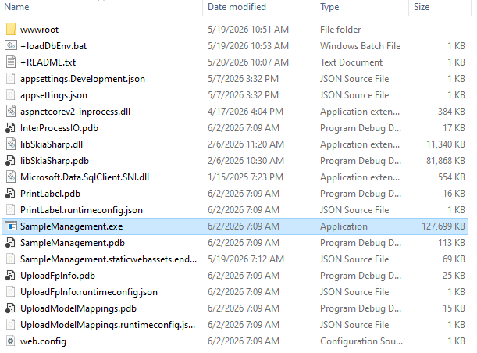
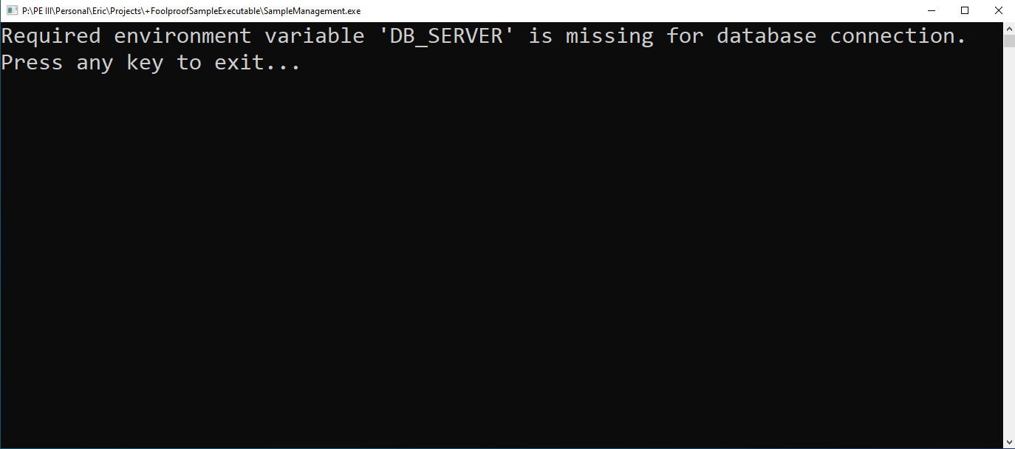
Running the program
The folder with the program resides at the path P:/PE III/Personal/Eric/Projects/+FoolproofSampleExecutable as of 2026-06-02. It should look something like this. Files without a ‘+’ are for the program and should not be touched.
Before you run the .exe, make sure to run +loadDbEnv.bat (or just loadDbEnv if you hide file extensions) first, otherwise you’ll just see the following:

Slide 3
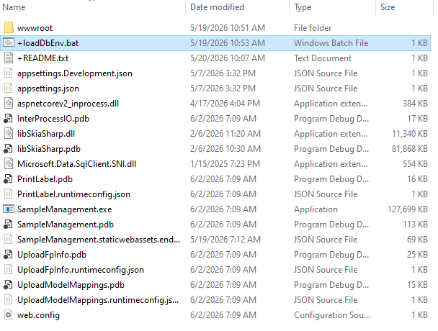
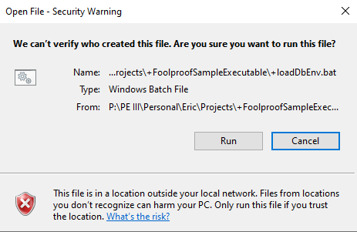
The .bat file
The .bat file loads a few environment variables to offload database credentials from the app. Because it automatically executes commands and doesn’t live on your computer’s hard drive, it’s flagged as malicious even if you’ve run it before. By default, double clicking this will execute its contents straight from the terminal. If you want to see what it’s doing, you’re welcome to open it in a text editor by right-clicking, then selecting edit (although you will still need to confirm the security dialog). Doing so will not execute the commands.
What you’ll see if you run straight from the P drive
When you run the .bat file, you’ll see a terminal window pop up briefly, then disappear. That means the file has run and you’re ready to run the actual program.

Slide 4
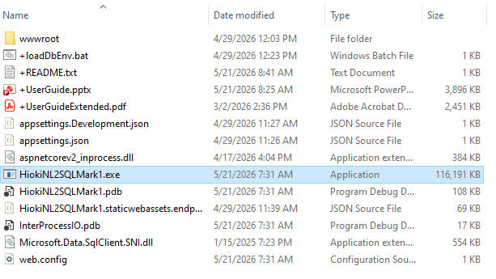
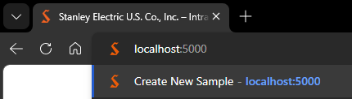
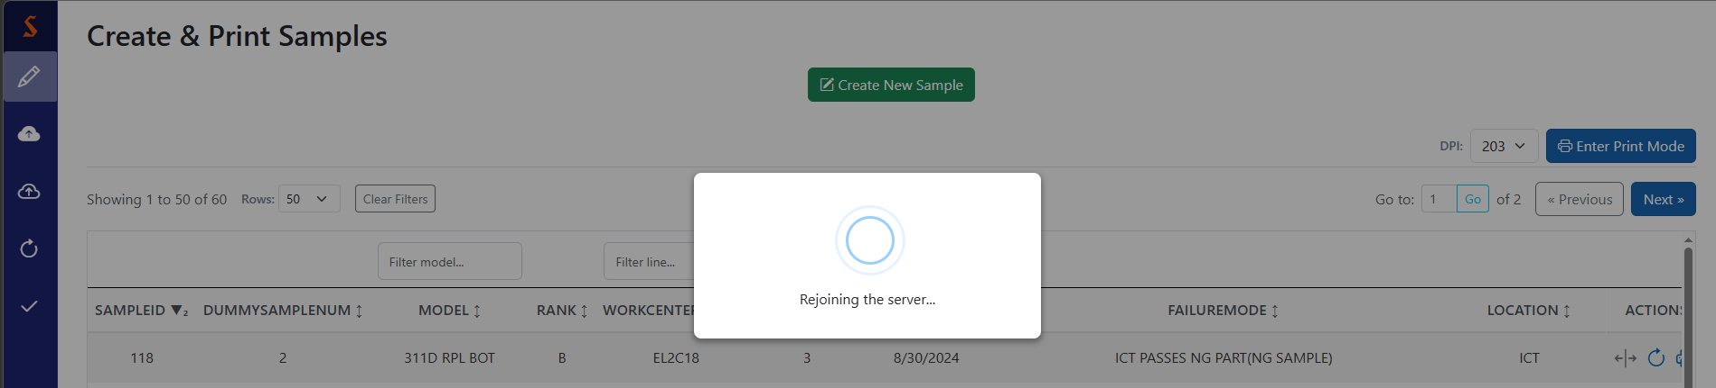
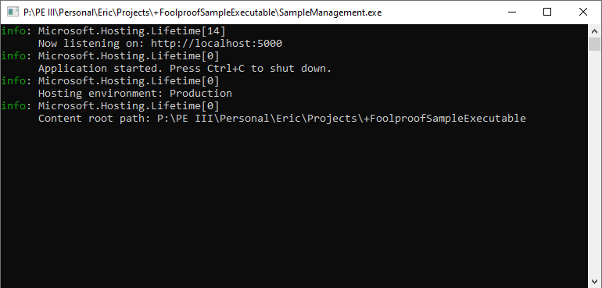
The .exe file
This app is hosted locally, so there’s not a website to go to (in the traditional sense). Open any browser and type in the address from the second line of the terminal output. I’m 99% sure it’s stable at localhost:5000, but it will always match whatever you see in the terminal created by the .exe.
Once you’ve run the .bat file, you’re ready to go. Double clicking the .exe file will show the security dialog (because it’s an executable), but after you confirm, it should show something like this:
Side note: the app’s lifespan is tied to the terminal, not the browser. Thus, it doesn’t care when you close the tab, go to a different site, or even close the browser entirely. The only way to end it is to go back to the terminal and either close it or press Ctrl+C as it indicates. Once the app closes, all tabs currently viewing it will try to reconnect a couple times before giving up.

Slide 5
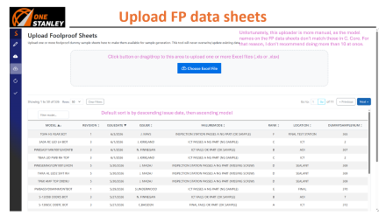
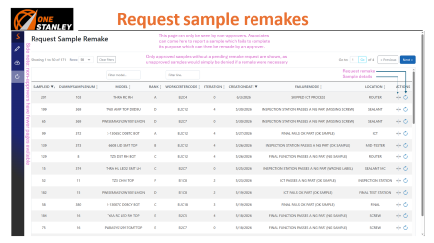
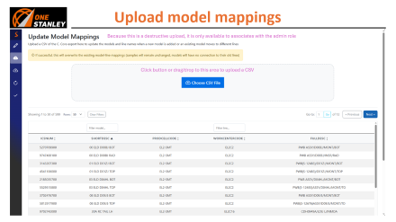
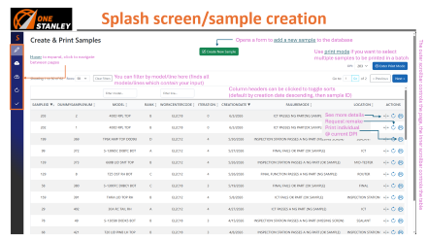
Table of Contents
If you’re just browsing, start here
If you’re an admin, you’ll be interested in this one

Slide 6
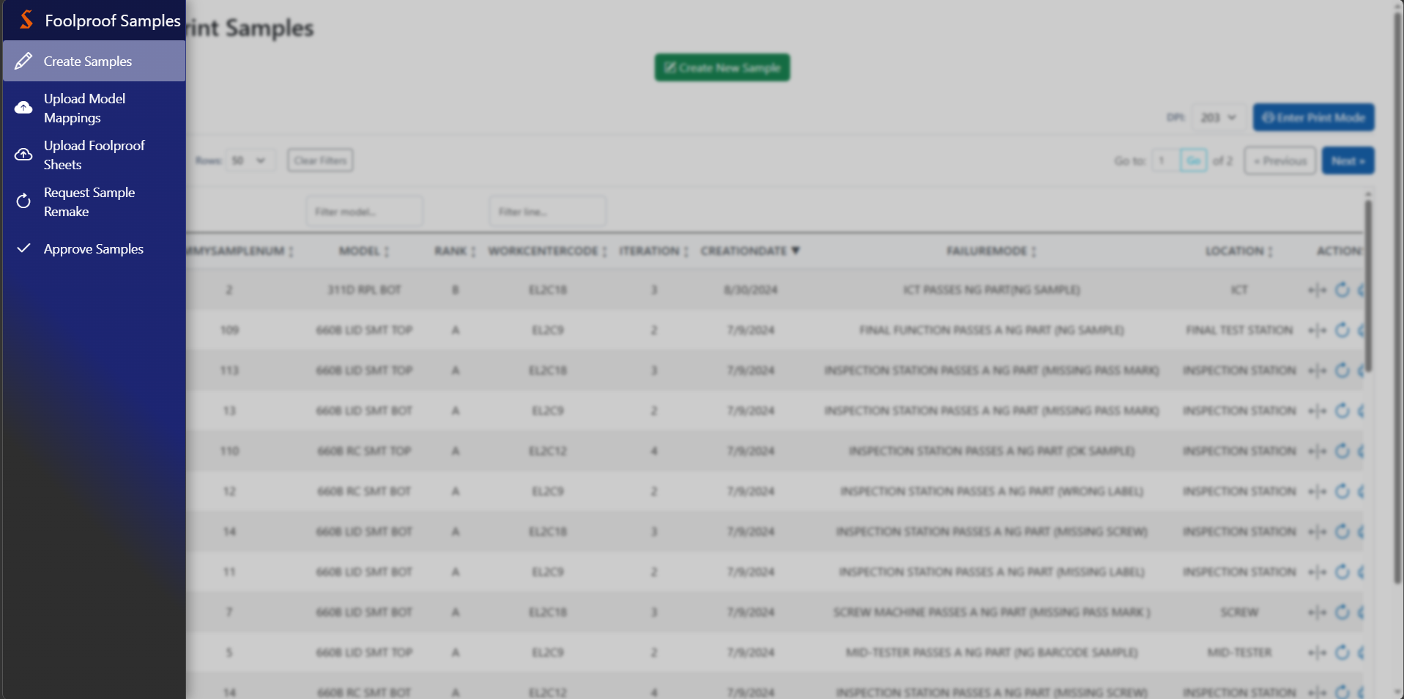
Navigation bar
When hovering over the left side of the screen, the content dims and blurs to draw attention to the navbar overlay
Detection window

Slide 7
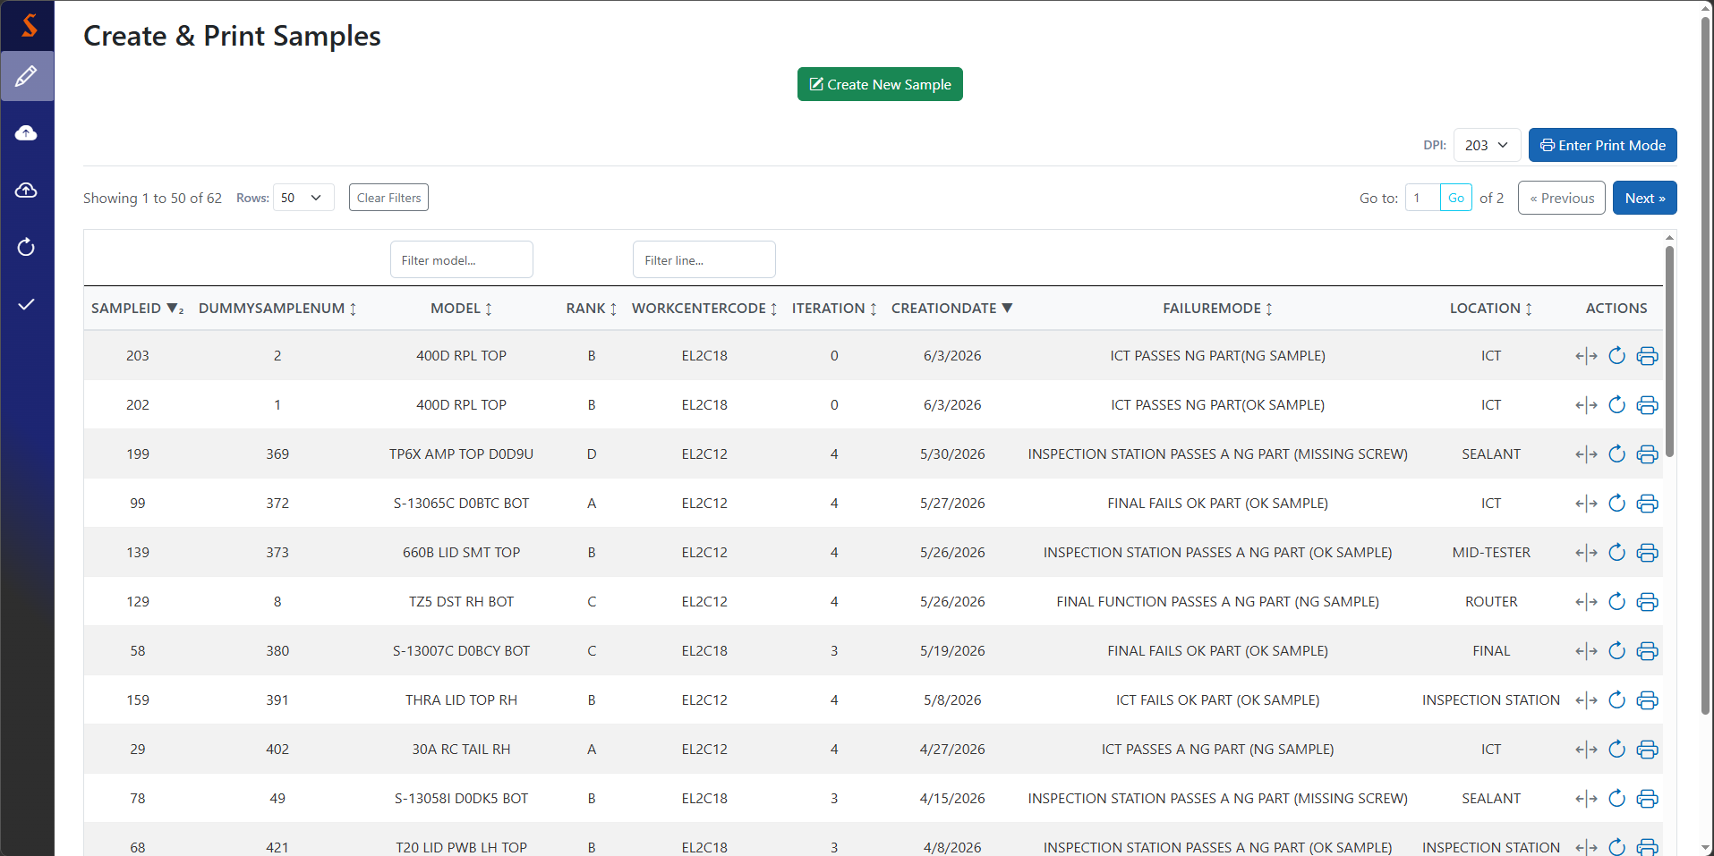
Splash screen/sample creation
Opens a form to add a new sample to the database
The outer scrollbar controls the page, the inner scrollbar controls the table
Use print mode if you want to select multiple samples to be printed in a batch
Hover to expand, click to navigate between pages
You can filter by model/line here (finds all models/lines which contain your input)
Column headers can be clicked to toggle sorts (default by creation date descending, then sample ID)
See more details
Request remake
Print individual
@ current DPI

Slide 8
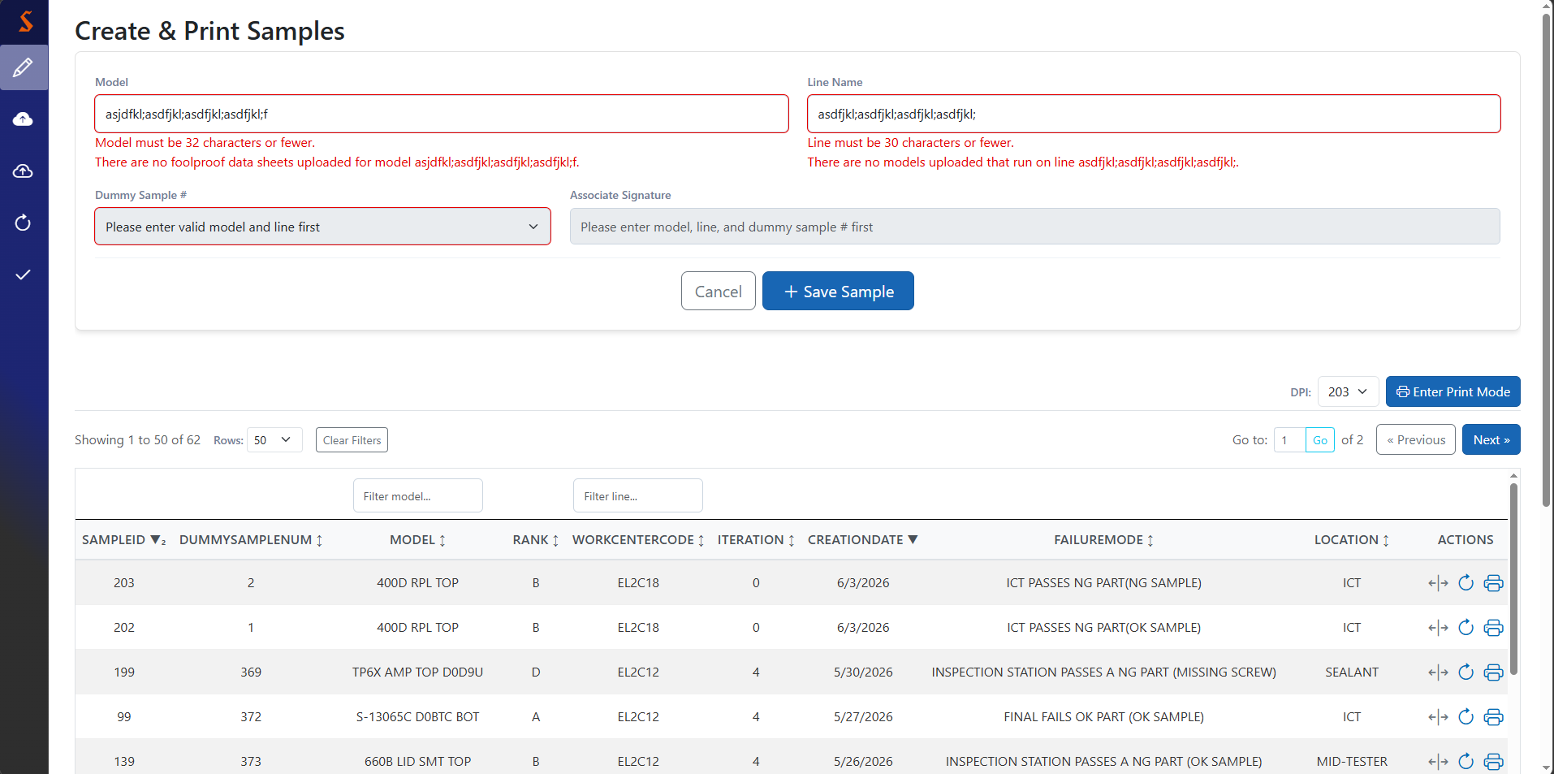
Sample creation
These validators trigger immediately when you click away or try to submit. To remove them, fix their problem, then click away/submit again.
Dummy sample # and associate signature fields remain disabled until a good model-line pair is provided
Clear & close
Save (keep model/line info) & close

Slide 9
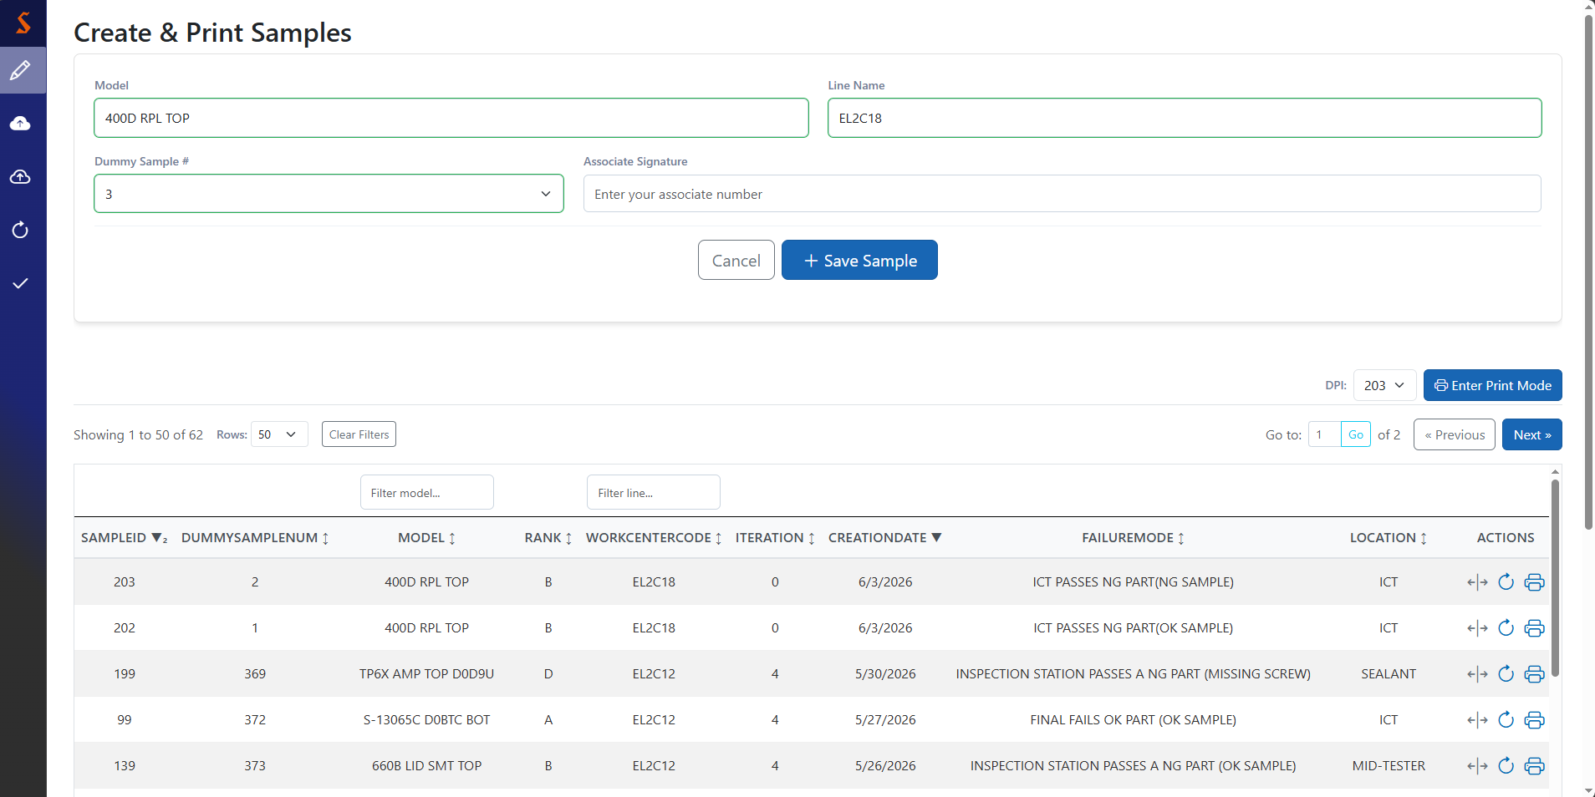
Sample creation
These validators trigger immediately when you click away or try to submit. To remove them, fix their problem, then click away/submit again.
Dummy sample # dropdown populates with dummy sample numbers from the FP data sheet(s) for this model
See the next page for what a successful addition looks like.
Clear & close
Save (keep model/line info) & close

Slide 10
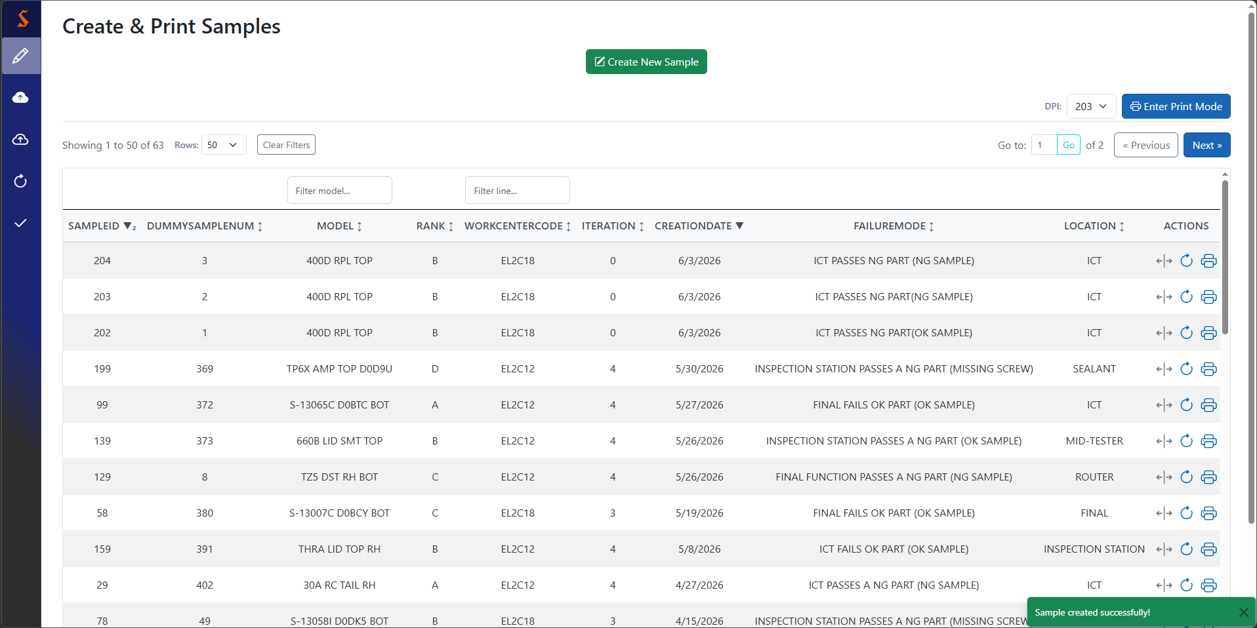
Successful sample creation
Fun fact: the message that briefly appears on success is called a toast
As a rule of thumb, if the app doesn’t yell at you and the form closes, it worked. But in case you’re not convinced, you’ll see a little message telling you it worked.

Slide 11
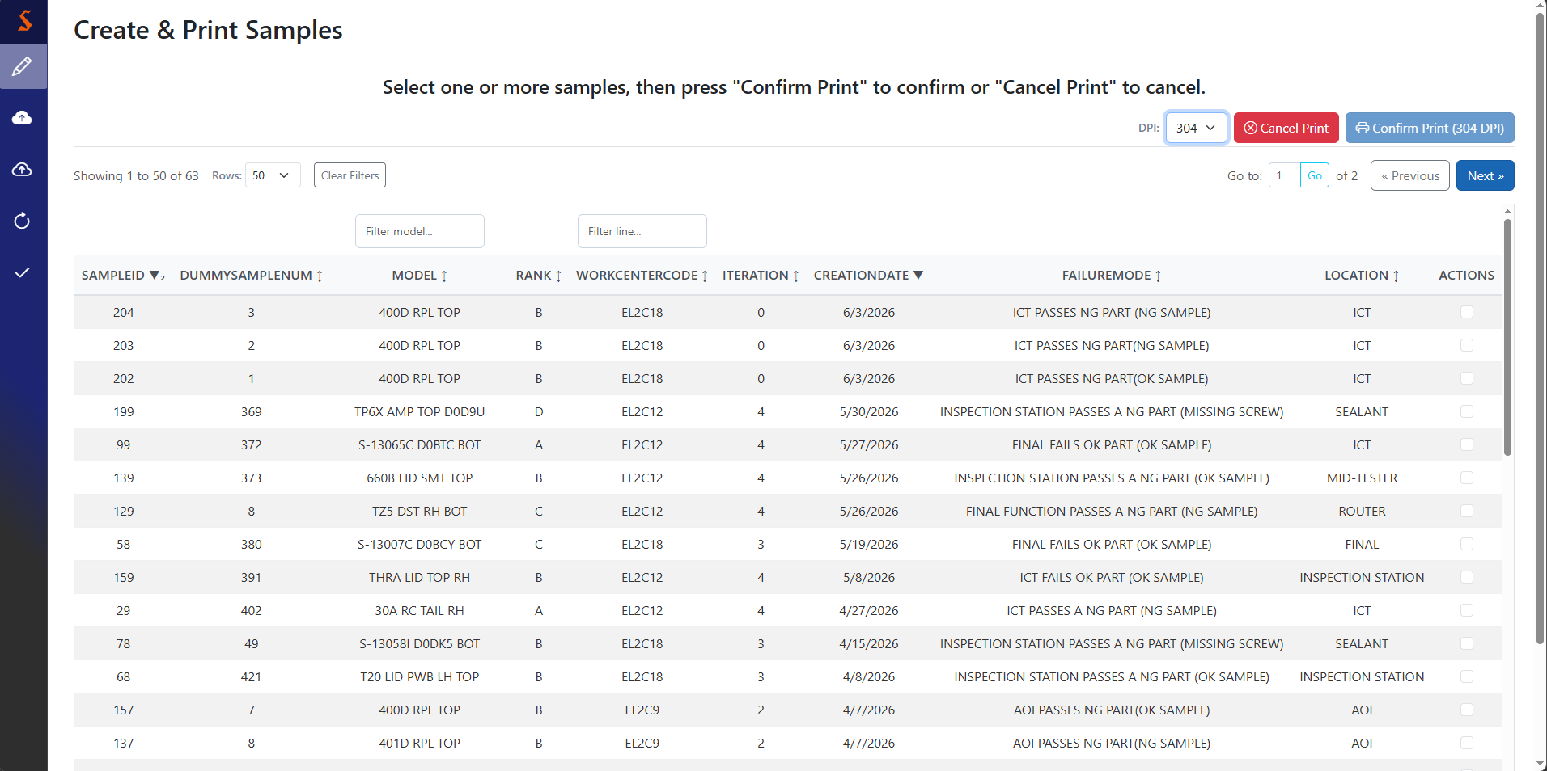
Print mode
This is what you see when you press the “Enter Print Mode” button in the upper right
Send batch to printer
Exit print mode
Change print DPI
(can set default in config)
Note that already-approved samples are hidden, so they may not be re-printed

Slide 12
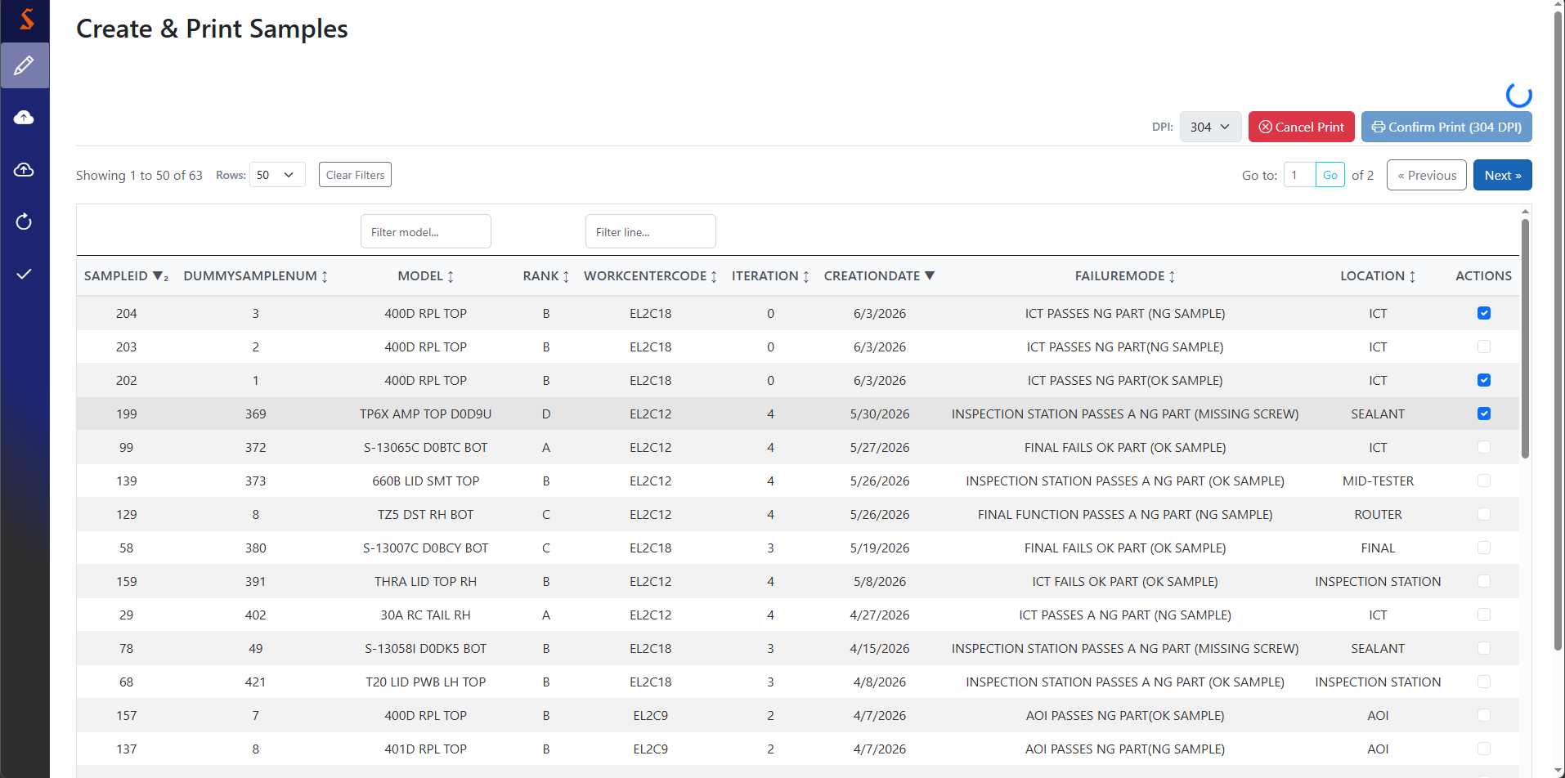
During a print
When you press “Confirm Print”, you’ll get this loading spinner
You can press “Cancel Print” at any time to terminate the print job and return to the print staging screen

Slide 13
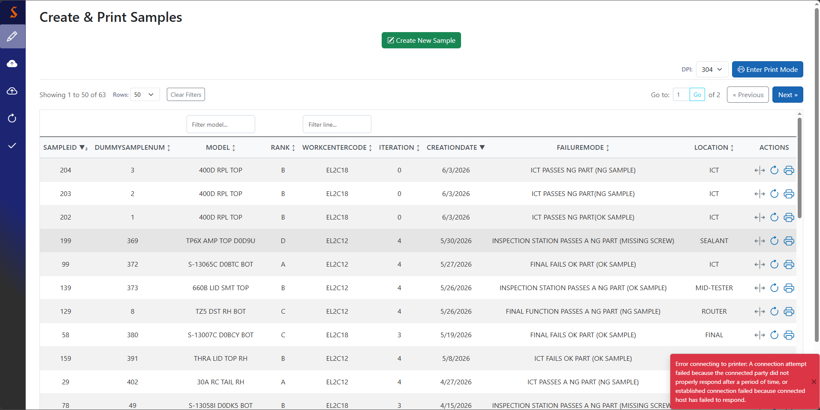
Failed print
There’s a couple reasons a print might fail, but the most common one is that the computer simply can’t find the printer. Make sure the environment variable in the .bat file has the right IP address, and you’re on the same network as the printer.

Slide 14
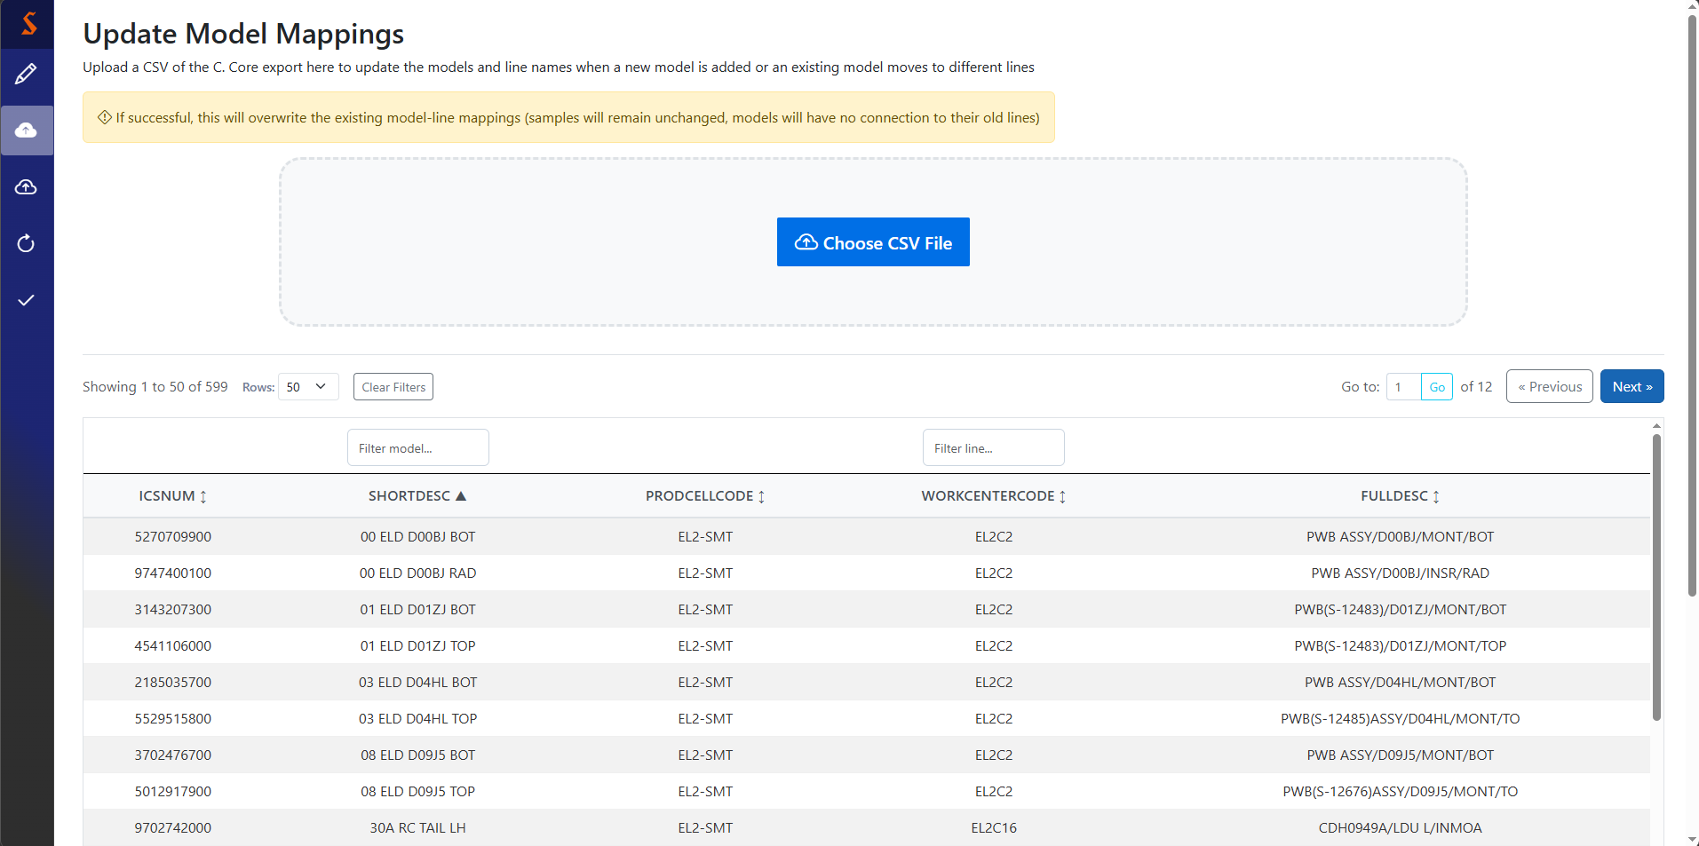
Upload model mappings
Because this is a destructive upload, it is only available to associates with the admin role
Click button or drag/drop to this area to upload a CSV

Slide 15
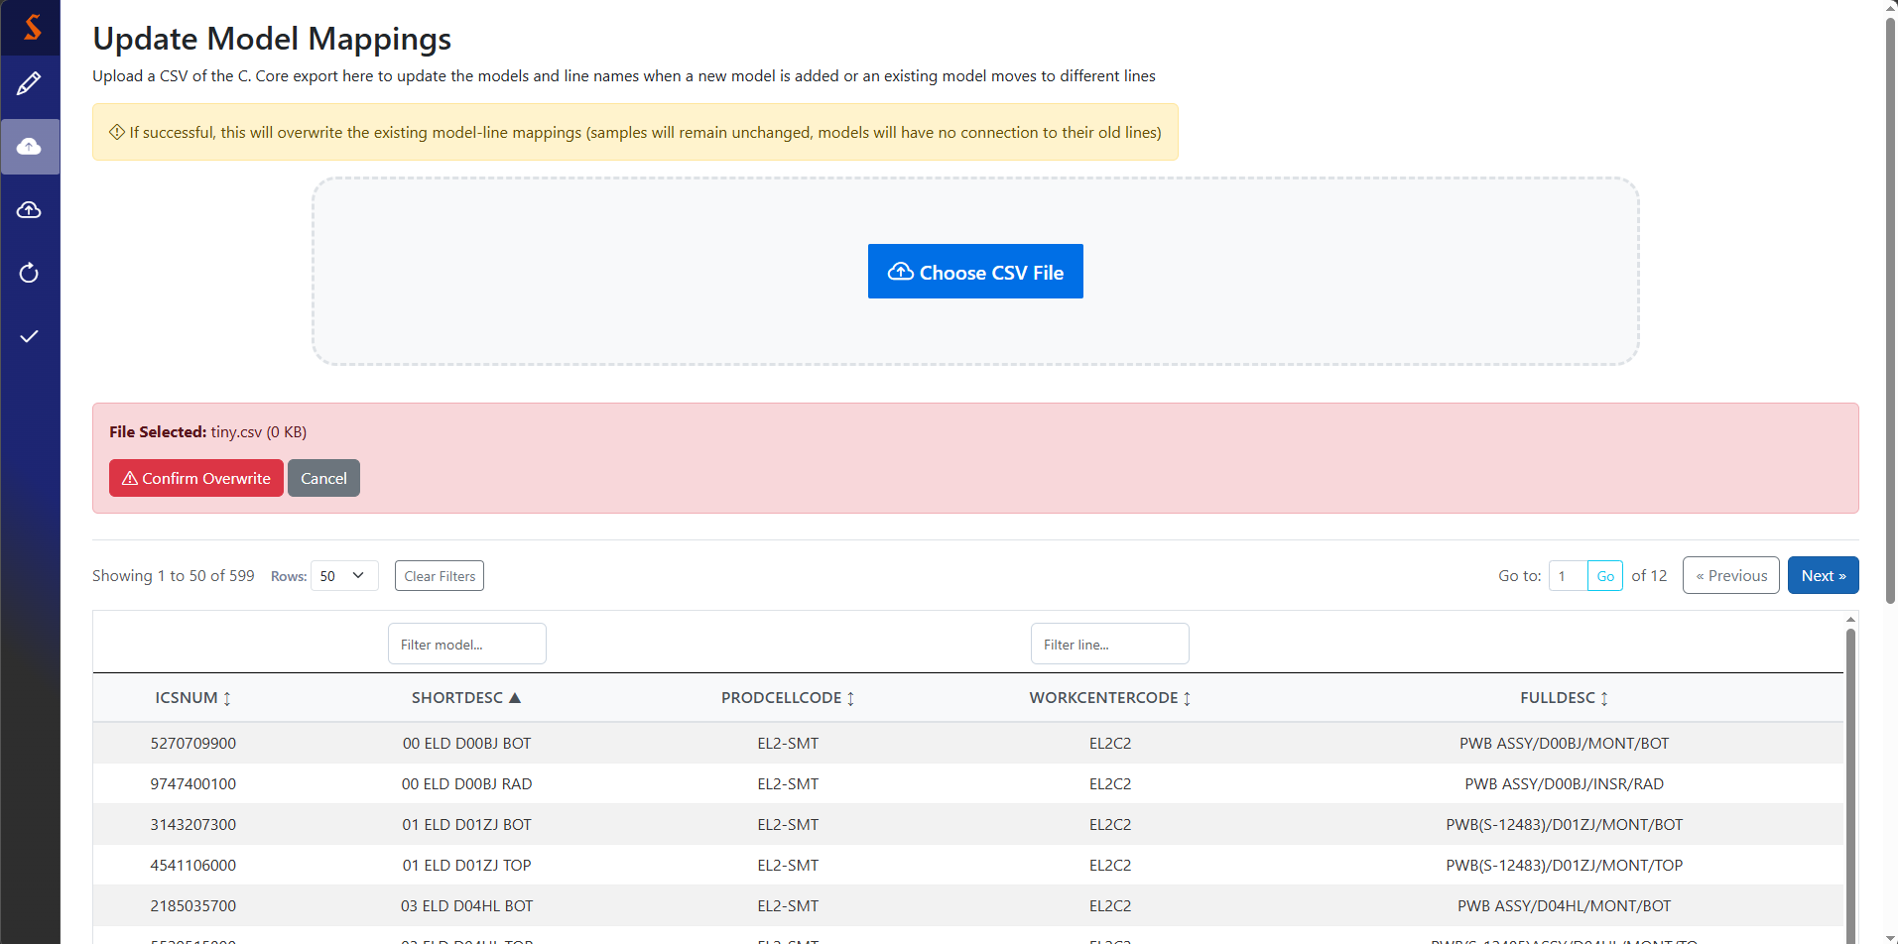
CSV upload confirmation
Either file upload method gives you this confirmation

Slide 16
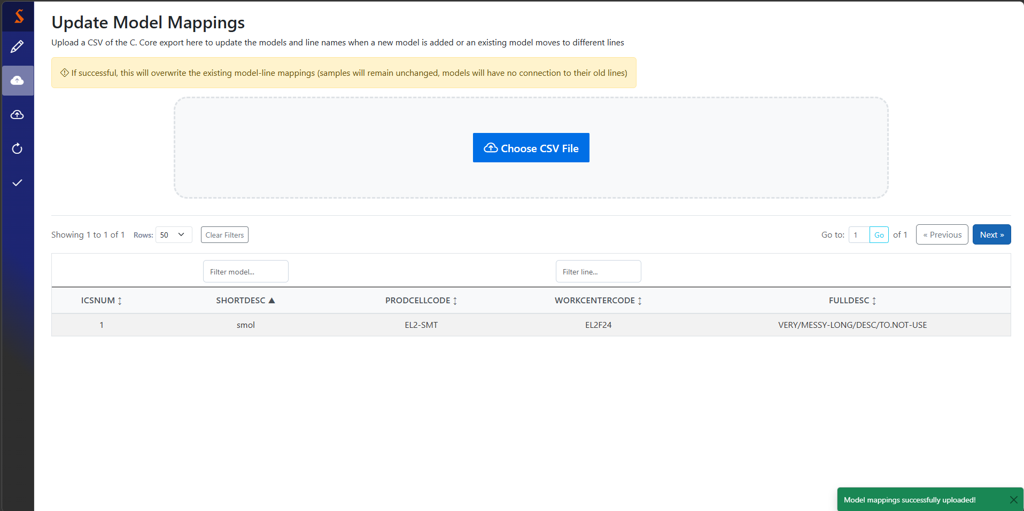
CSV upload progress updates
As long as the CSV you upload is in the C.Core format, you shouldn’t have any problems
After a successful upload, you’ll see this message.

Slide 17
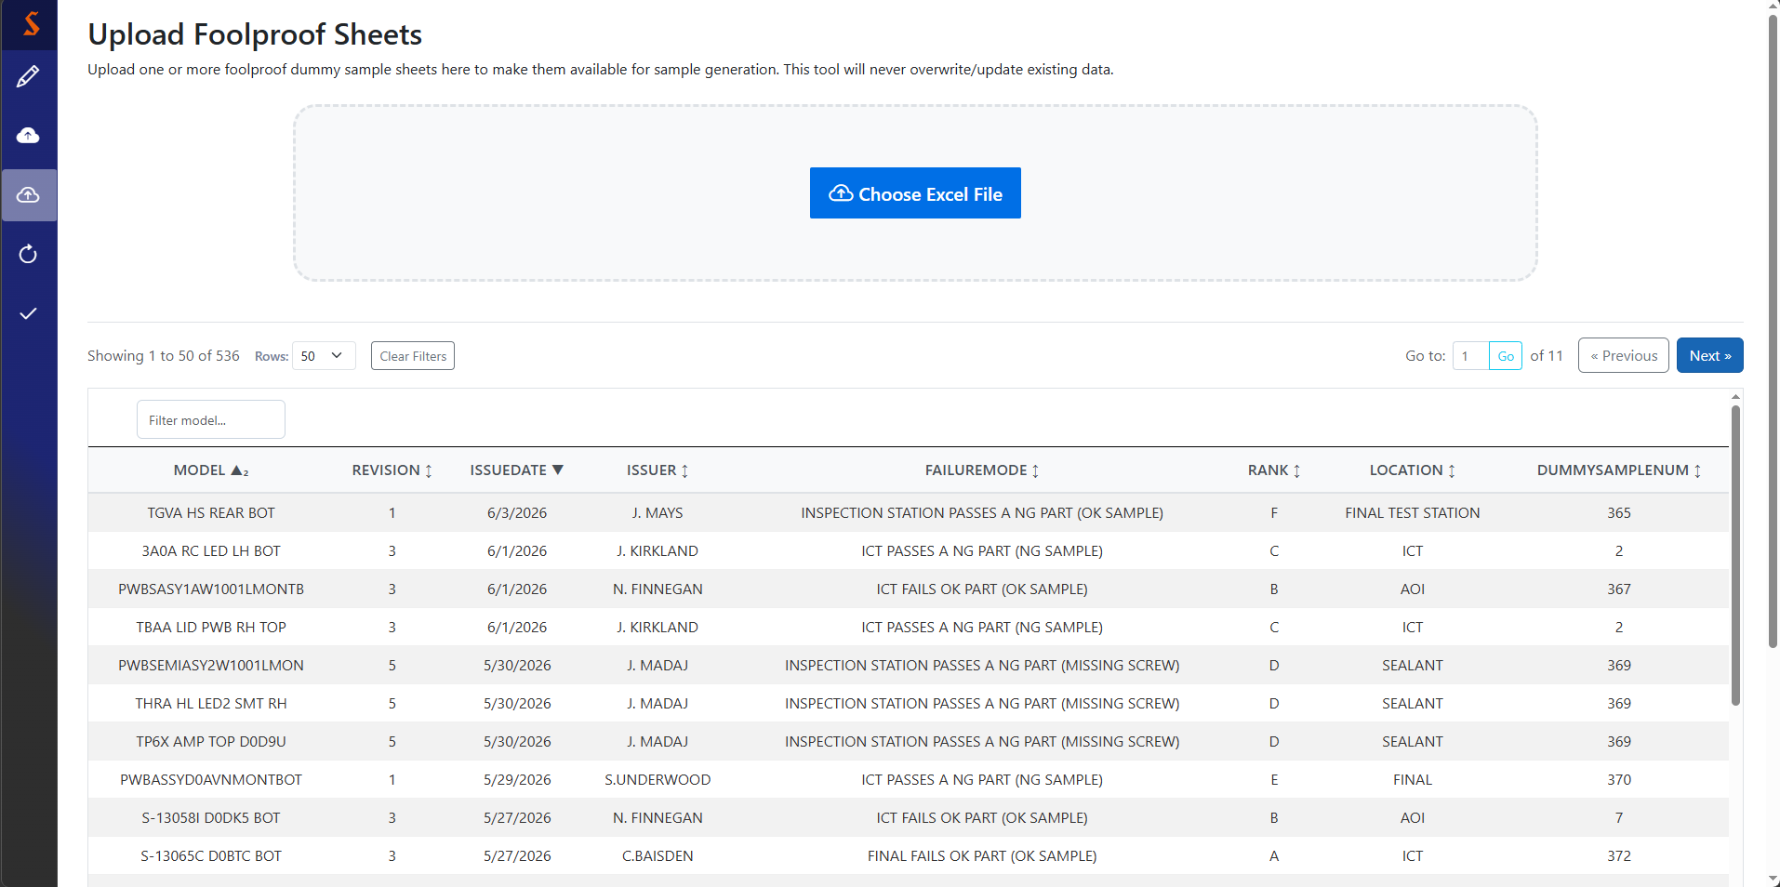
Upload FP data sheets
Unfortunately, this uploader is more manual, as the model names on the FP data sheets don’t match those in C. Core. For that reason, I don’t recommend doing more than 10 at once.
Click button or drag/drop to this area to upload one or more Excel files (.xls or .xlsx)
Default sort is by descending issue date, then ascending model

Slide 18
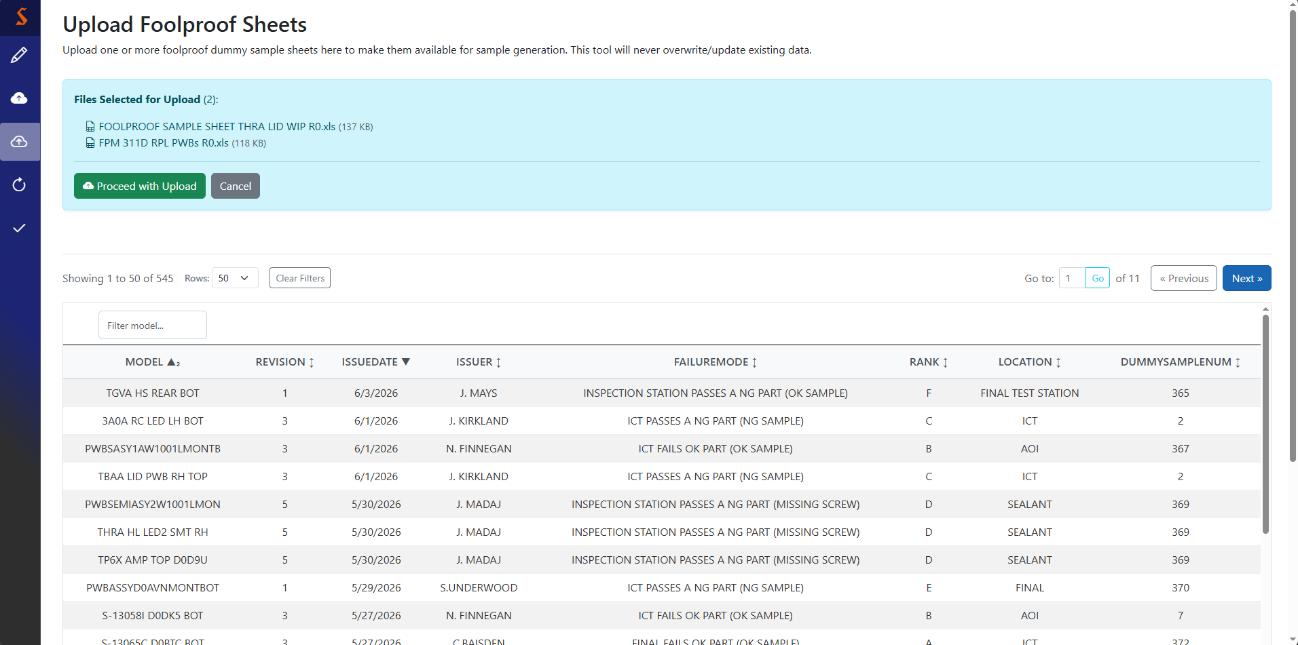
Confirm file selection
Selecting your file(s) will get you here. Double-check they all look good, then hit proceed with upload.

Slide 19
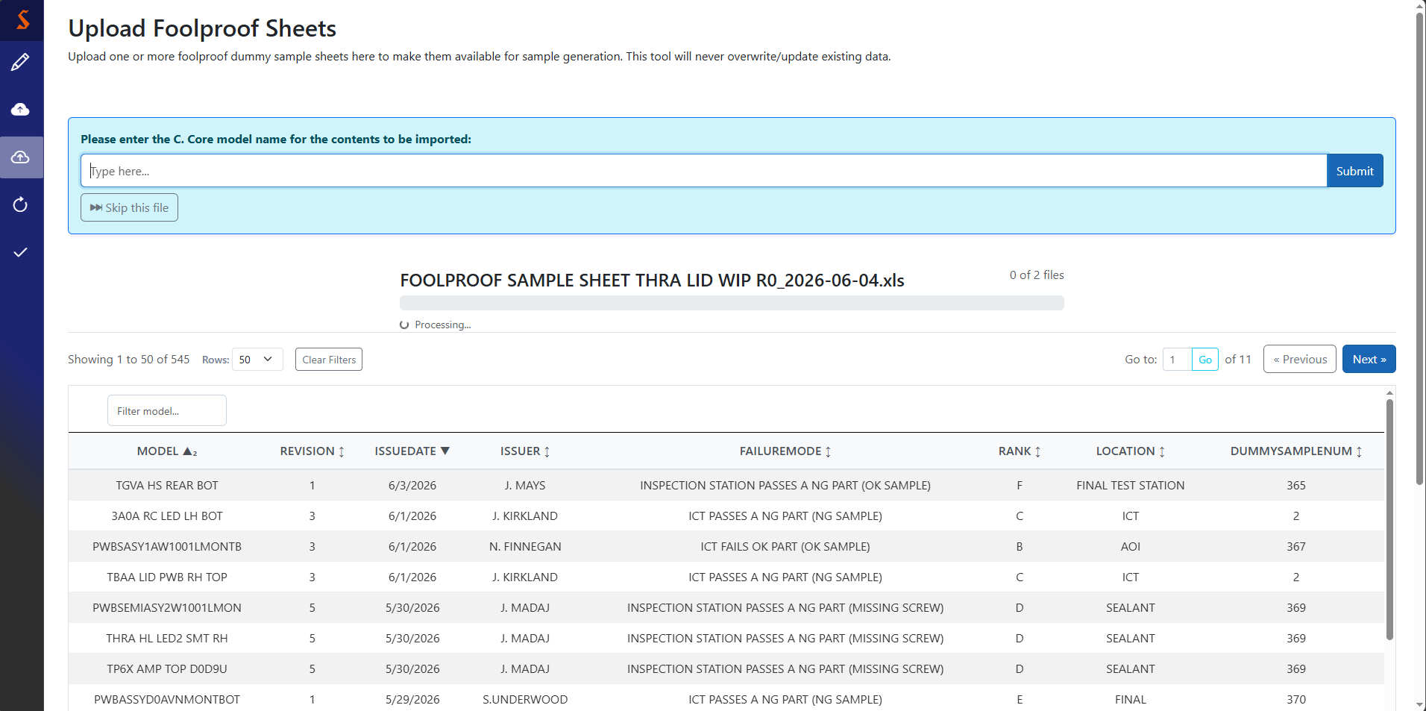
Specify model name
Each file has two parts: model identification, then column filter.
As you type, you’ll see your available options. Make sure to pick one, or you’ll have to do it again.
If you realize you don’t want this file, just hit skip.

Slide 20
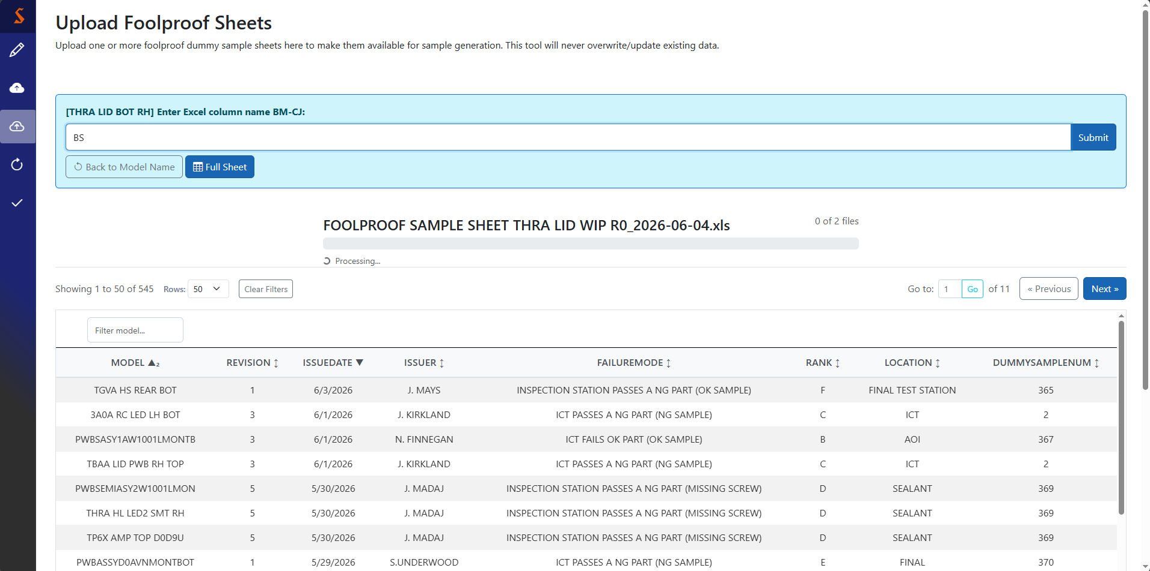
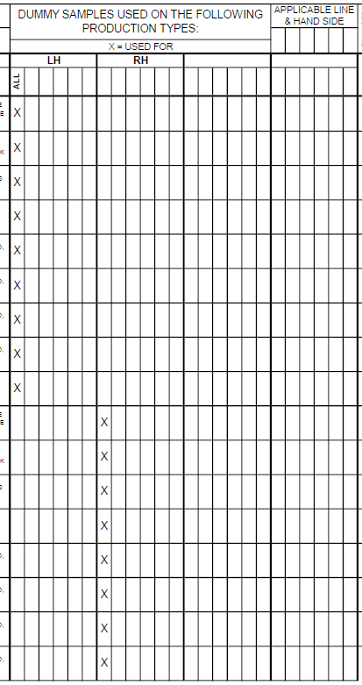
Apply column filter
If your file has multiple variants of a base model (e.g., LH-RH, RPL-DRIVER), enter the Excel column name that marks the subtype for your selected model name.
If you realize you picked the wrong model, hit back to model name.
If you don’t want a filter, hit full sheet.
This particular model has a left-hand and right-hand subtype. In the sheet, the RH subtype is marked in Excel column BS, and the LH subtype is marked in Excel column BM

Slide 21
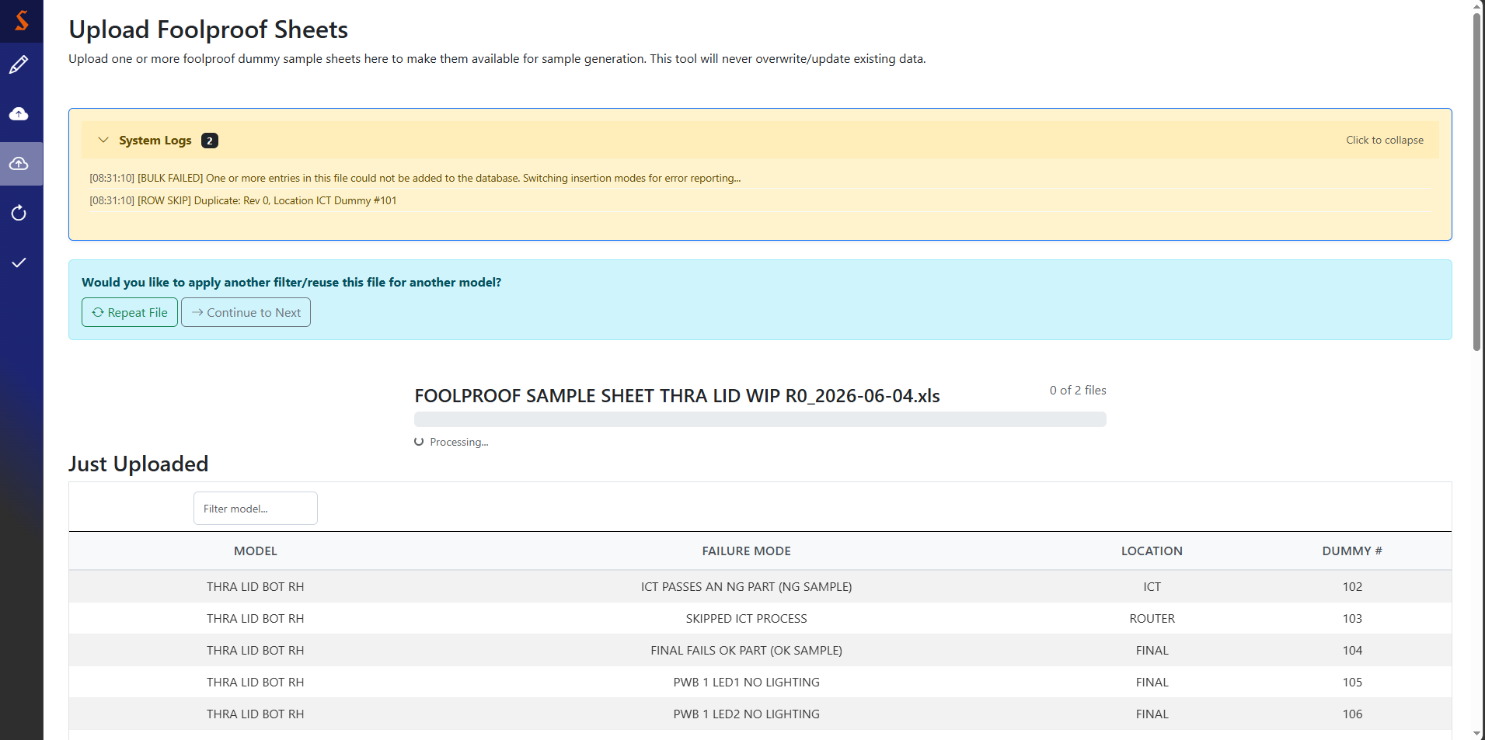
Single-row duplicate
For this subtype, one of the rows was already in the table, so the system informs you that row was skipped in this upload.
Since there’s another subtype in this file, we’ll select Repeat File.
If you apply a column filter, you’ll be asked if you want to do another.
Hit repeat file to pick another model and column,
or continue to next to finish this file
After each subtype, you’ll see a review table of what was just uploaded. Note how the entry that it claims was skipped above (dummy sample 101) is absent.

Slide 22
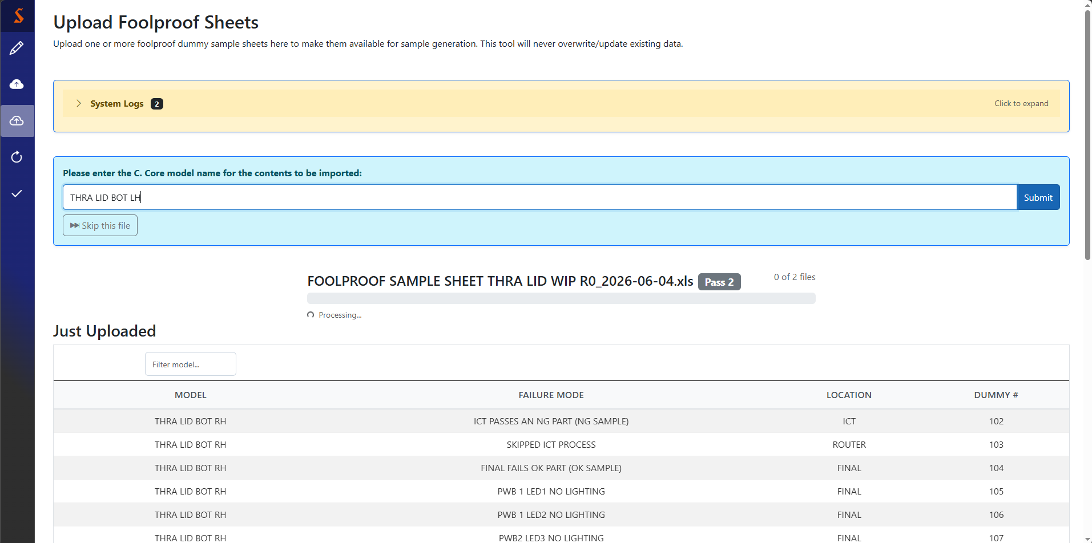
Repeating for a different subtype
When you repeat a file for a different subtype, you’ll see the ‘pass number’ next to the file name.

Slide 23
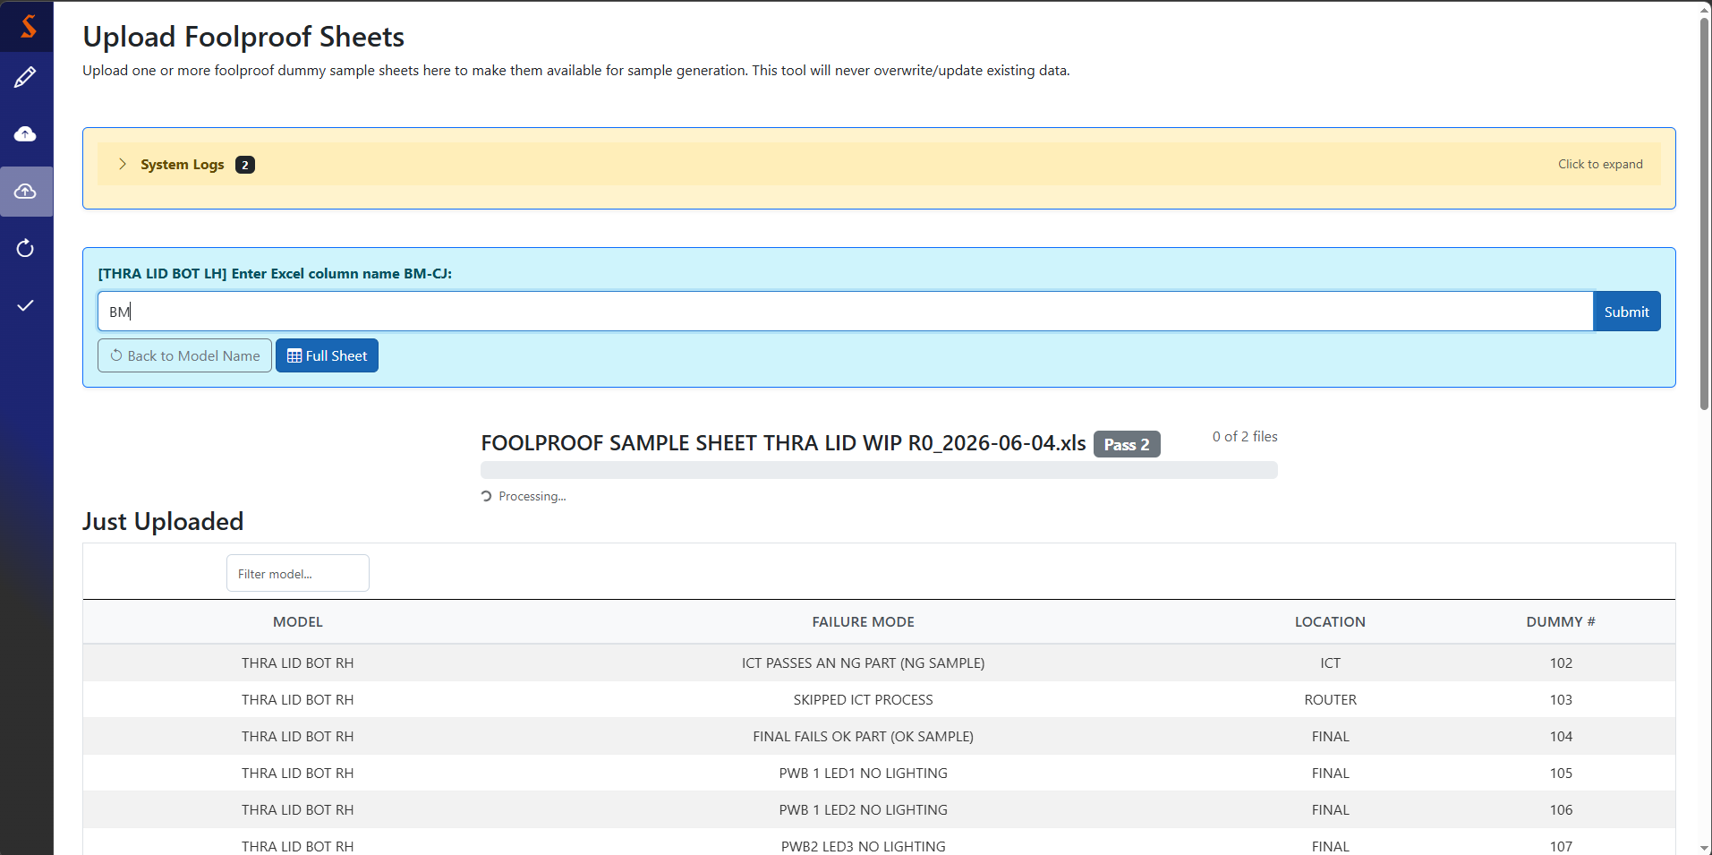
Repeating for a different subtype (cont.)
Recall that the LH subtype is marked in Excel column BM

Slide 24
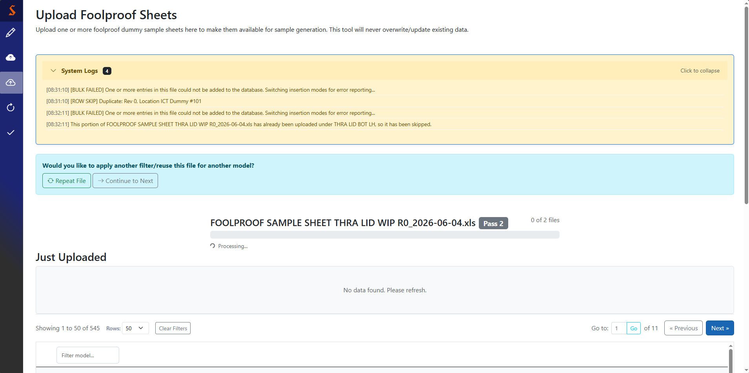
Full-subtype/file duplicate
Based on this output, we can understand that the uploader tried to add the rows marked in BM, but every row had already been uploaded (so adding it again would be duplicate).
We’ve handled all subtypes in this file, so we’ll select Continue to Next
The empty review table reinforces this conclusion

Slide 25
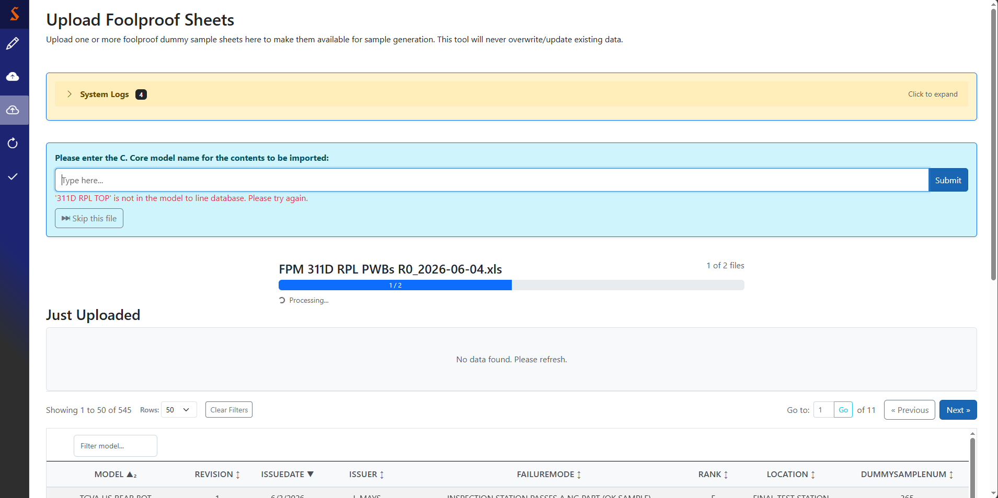
More files
This is what it looks like when the system gets a model name that it can’t find in the model-to-line database. If it should exist, use the model mapping uploader for a new C. Core import.
Now we’ve started the next file, the progress bar updates

Slide 26
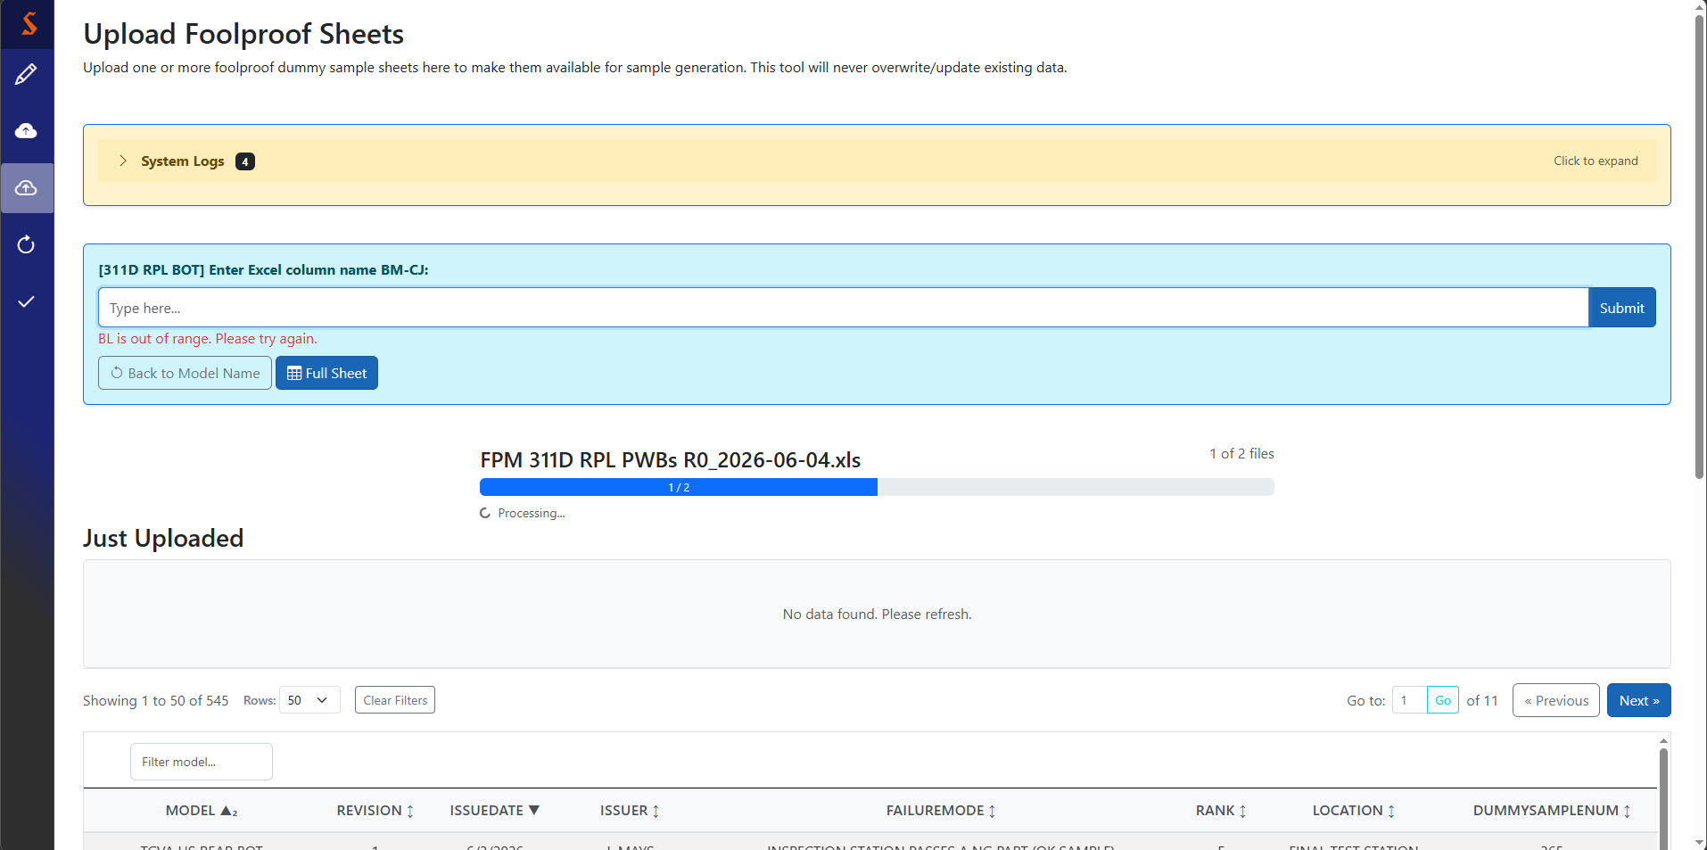
More files (cont.)
This is what it looks like when the system gets a column filter outside of the range that is marked for subtypes
We’ll select full sheet because this data sheet does not have subtypes. This also skips the ‘Repeat file?’ prompt

Slide 27
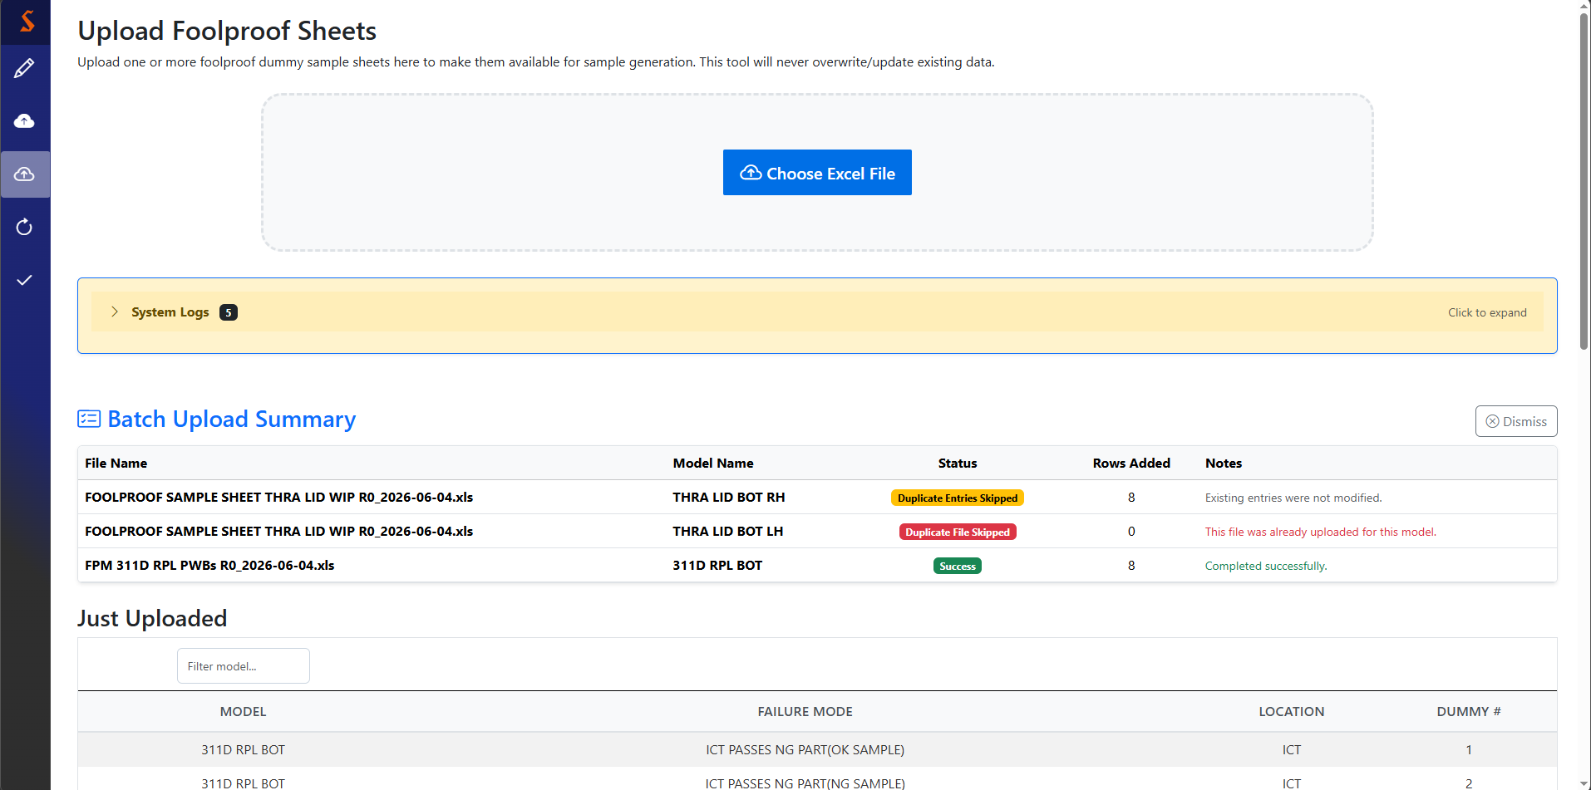
FP data sheet upload summary
After processing all files, you’ll get a by-model upload summary. The most interesting information is the status and rows added, which will tell you how much of your batch uploaded successfully.
Use the dismiss button to show the full FP data sheet table and clear the upload summary

Slide 28
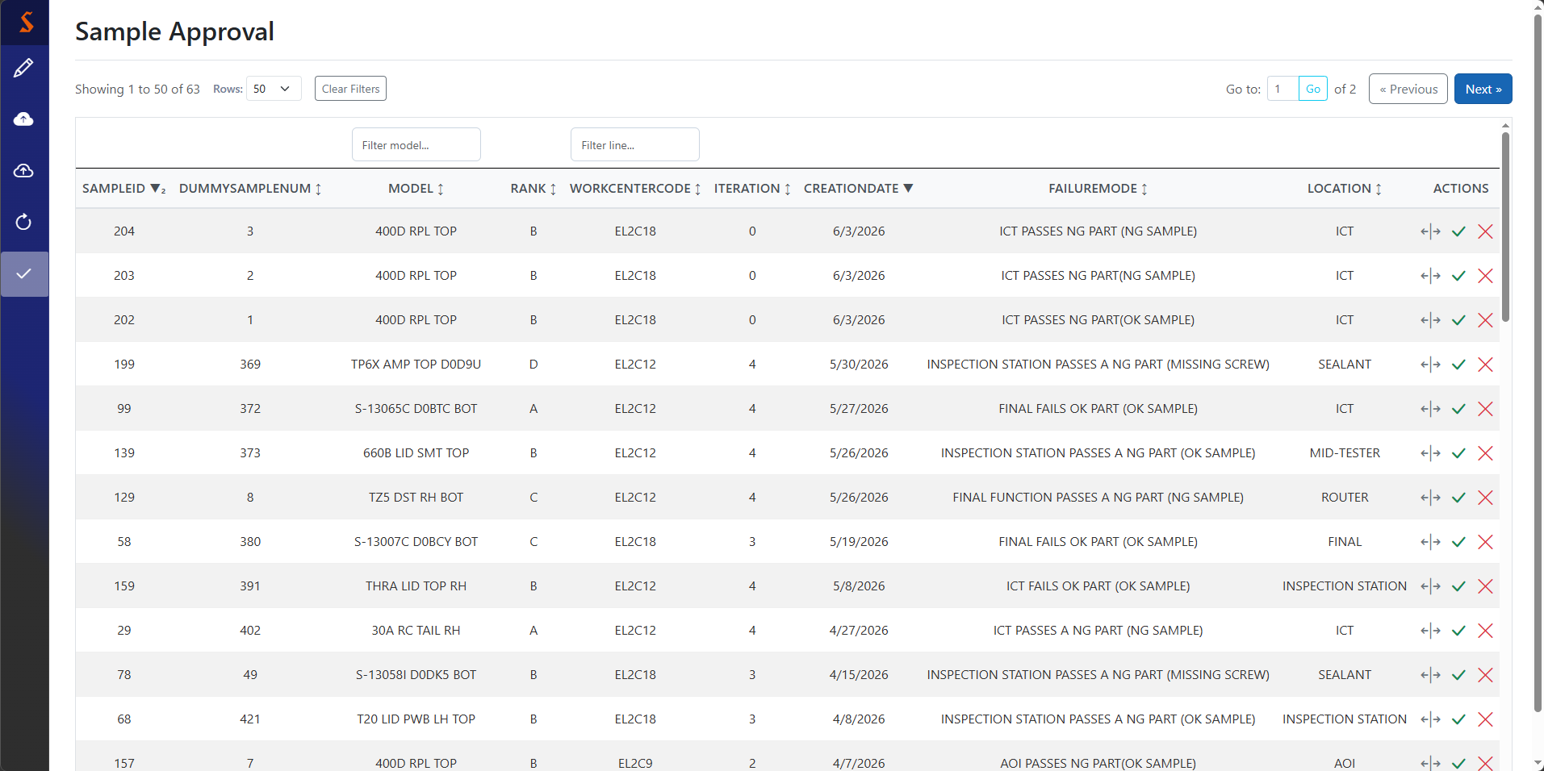
Approve samples
As the role name suggests, this is an approver-only page. All new samples get sent here before being officially activated. The intended flow is for the approver to sign the physical label, then come here and approve it for recording purposes.
Deny sample
Approve sample
See details

Slide 29
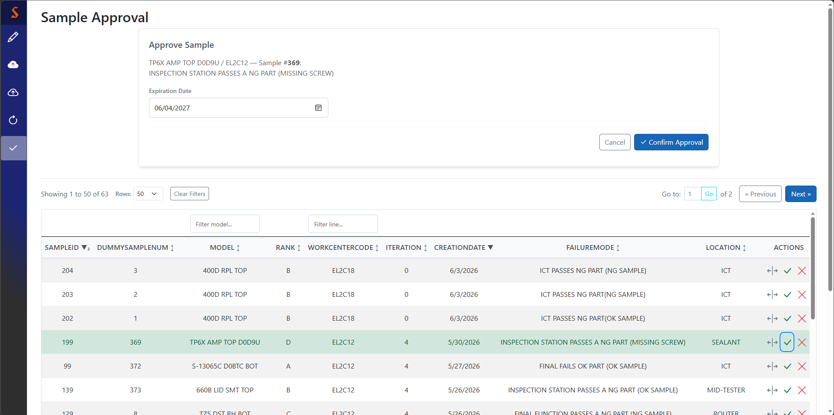
Picking an expiration date
Use date picker to select audit-compliant expiry date (defaults to one year)
Disabled until expiration date is provided

Slide 30
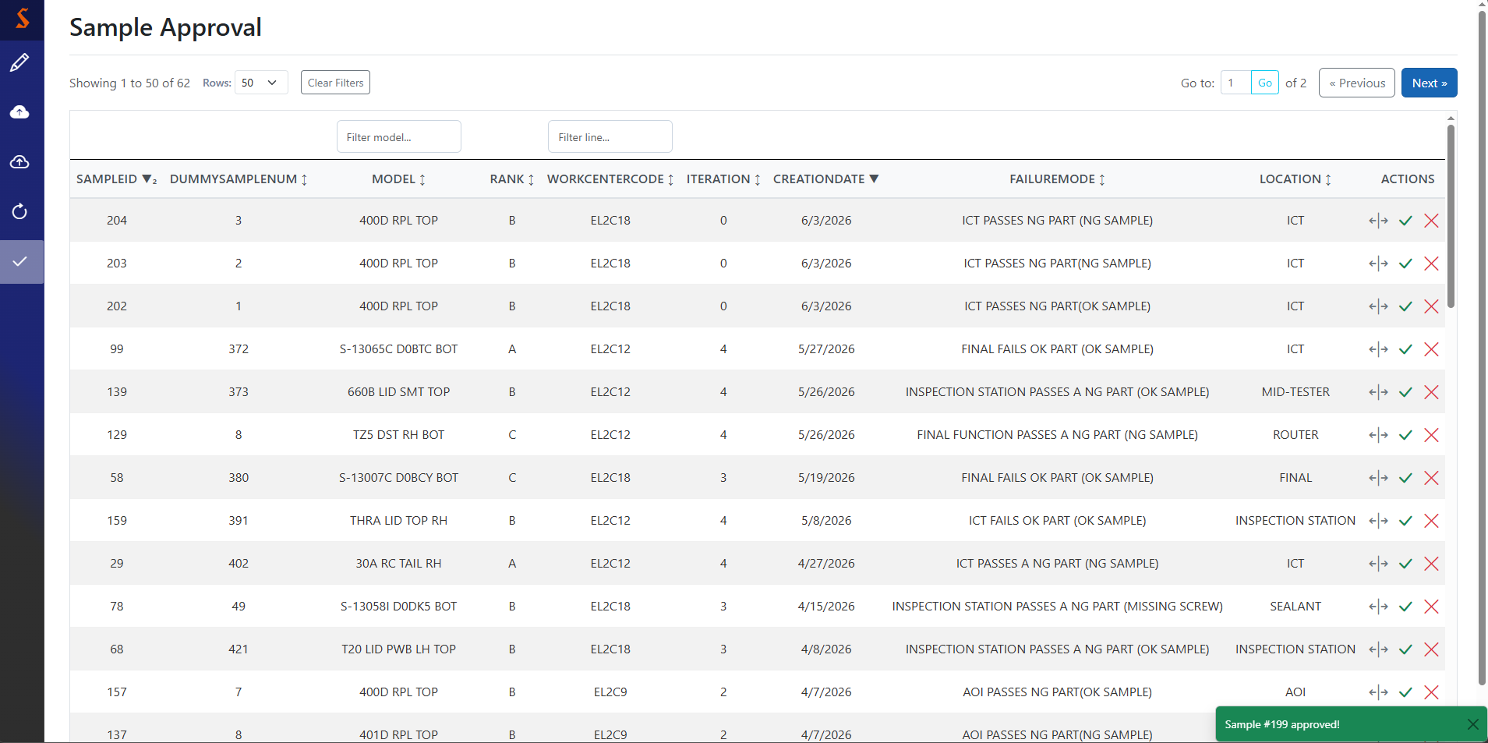
Successful sample approval
Confirming approval activates this sample, deactivates the last revision, hides it from this screen and shows the success toast.

Slide 31
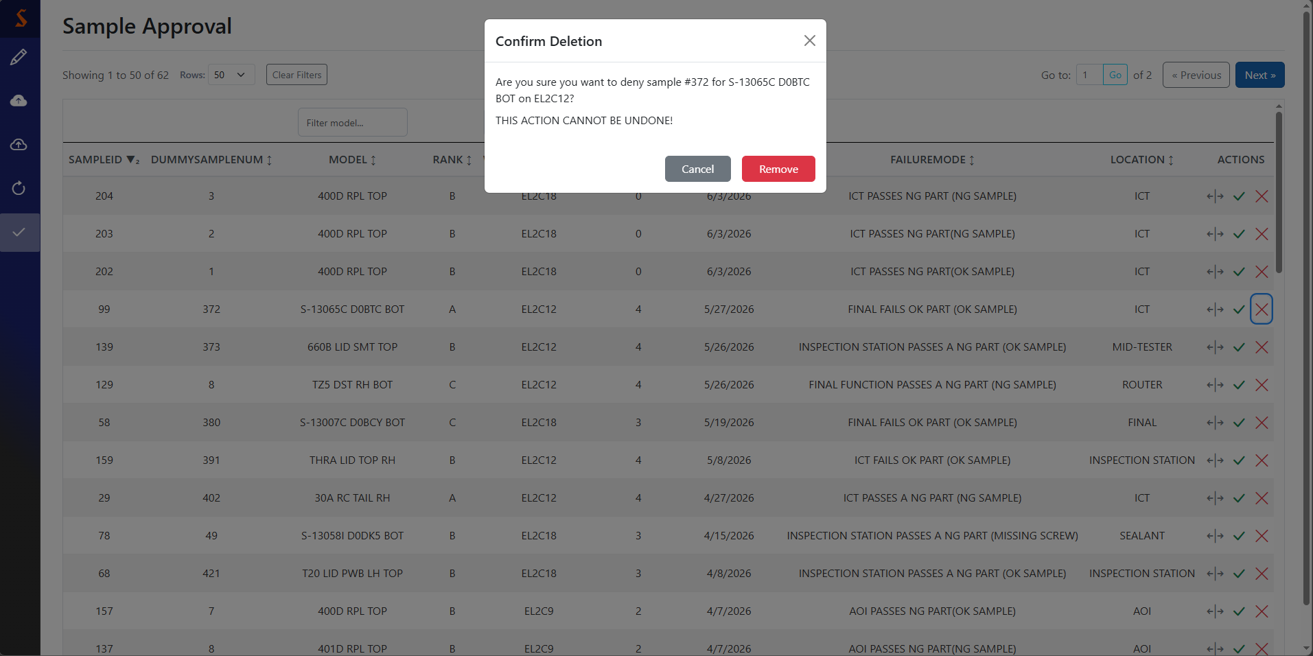
Line update
Can’t change line name, but can edit auth level
Press cancel to take no action, or remove to deny the sample
Pressing the expand button highlights the target row

Slide 32

Successful line removal
Successful removal shows the success toast and hides it from this page

Slide 33
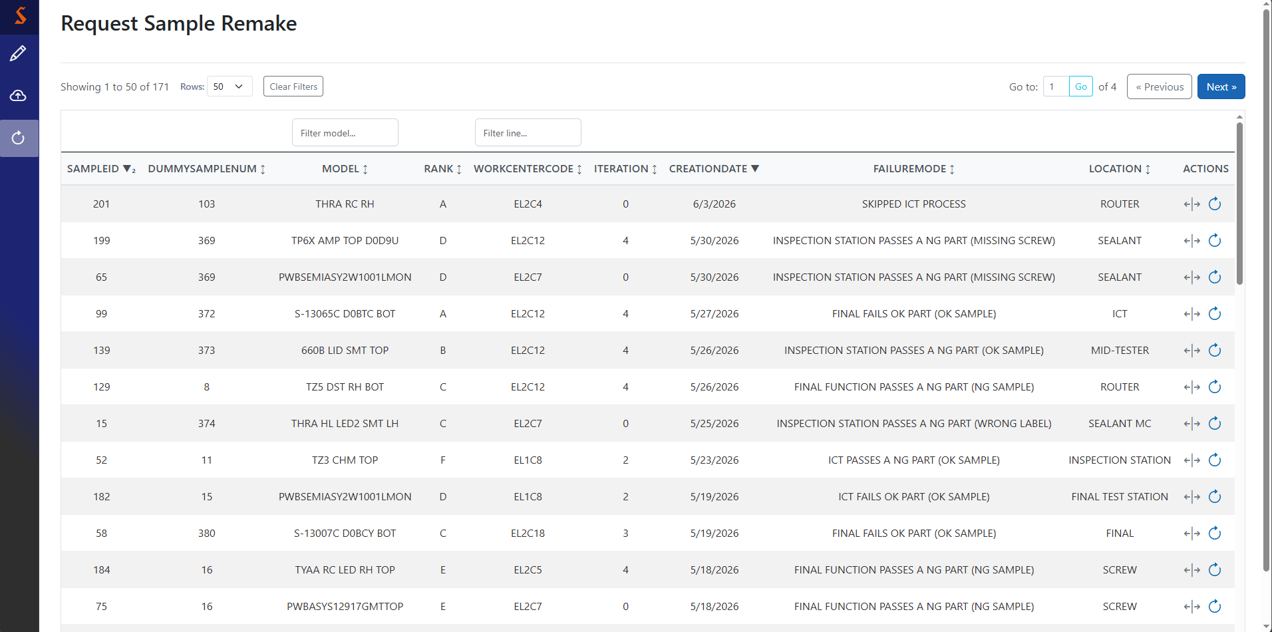
Request sample remakes
This page can only be seen by non-approvers. Associates can come here to report a sample which fails to complete its purpose, which can then be remade by an approver.
Side note: non-approvers have fewer pages available
Only approved samples without a pending remake request are shown, as unapproved samples would simply be denied if a remake were necessary
Request remake
Sample details

Slide 34
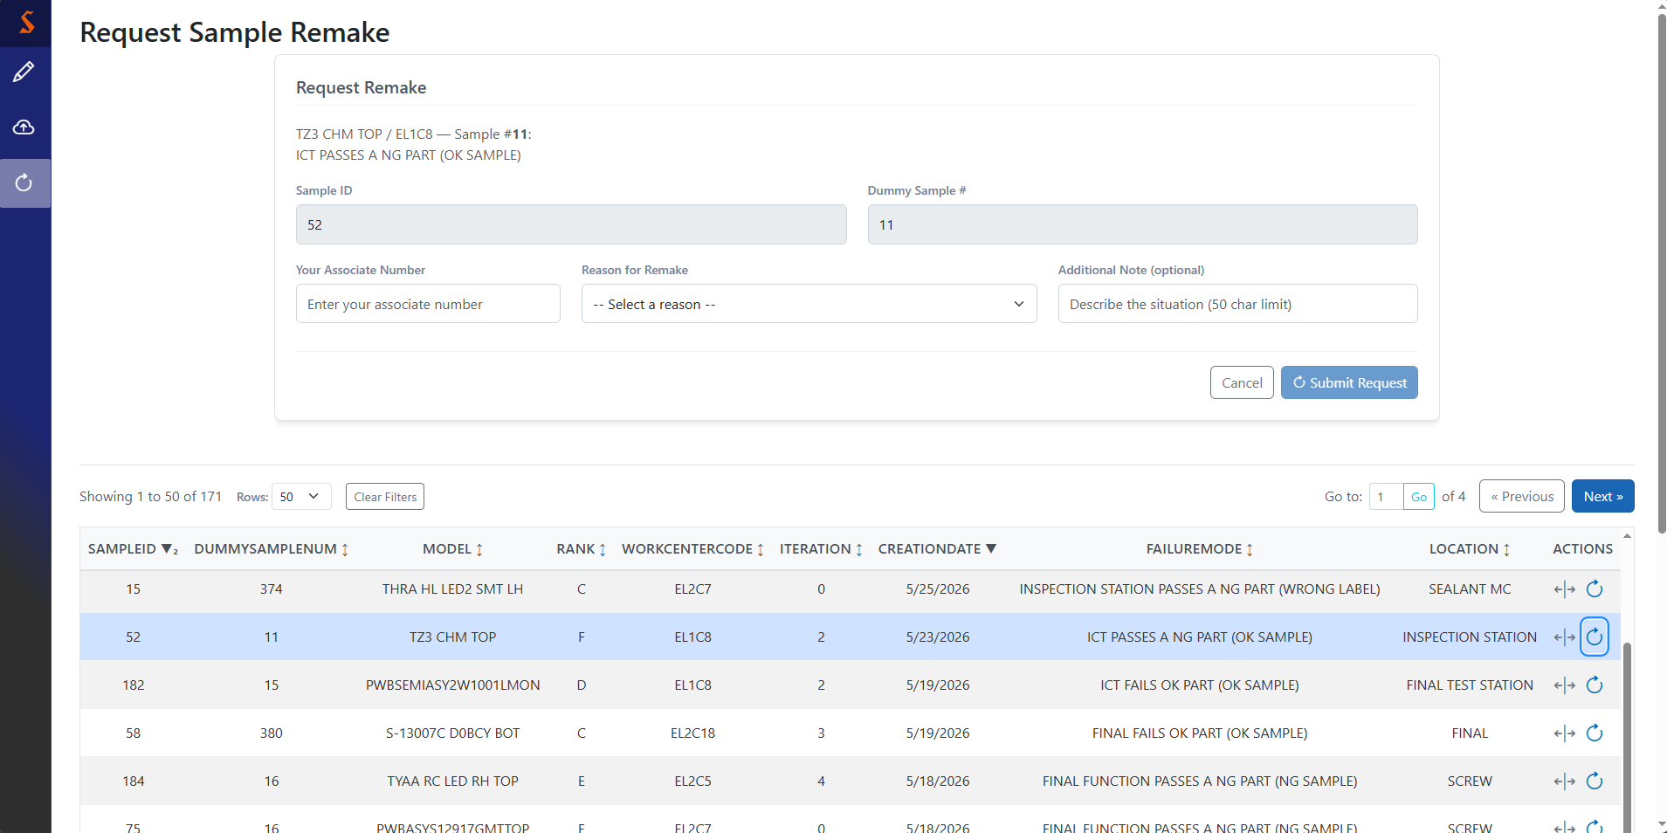
Remake request form
Pressing the request remake button opens this form
For traceability
Pick the most accurate reason from the dropdown
Provide context as desired
Grayed out until associate number & sample reason are provided
Errors for this form are rare, but they’ll appear here

Slide 35
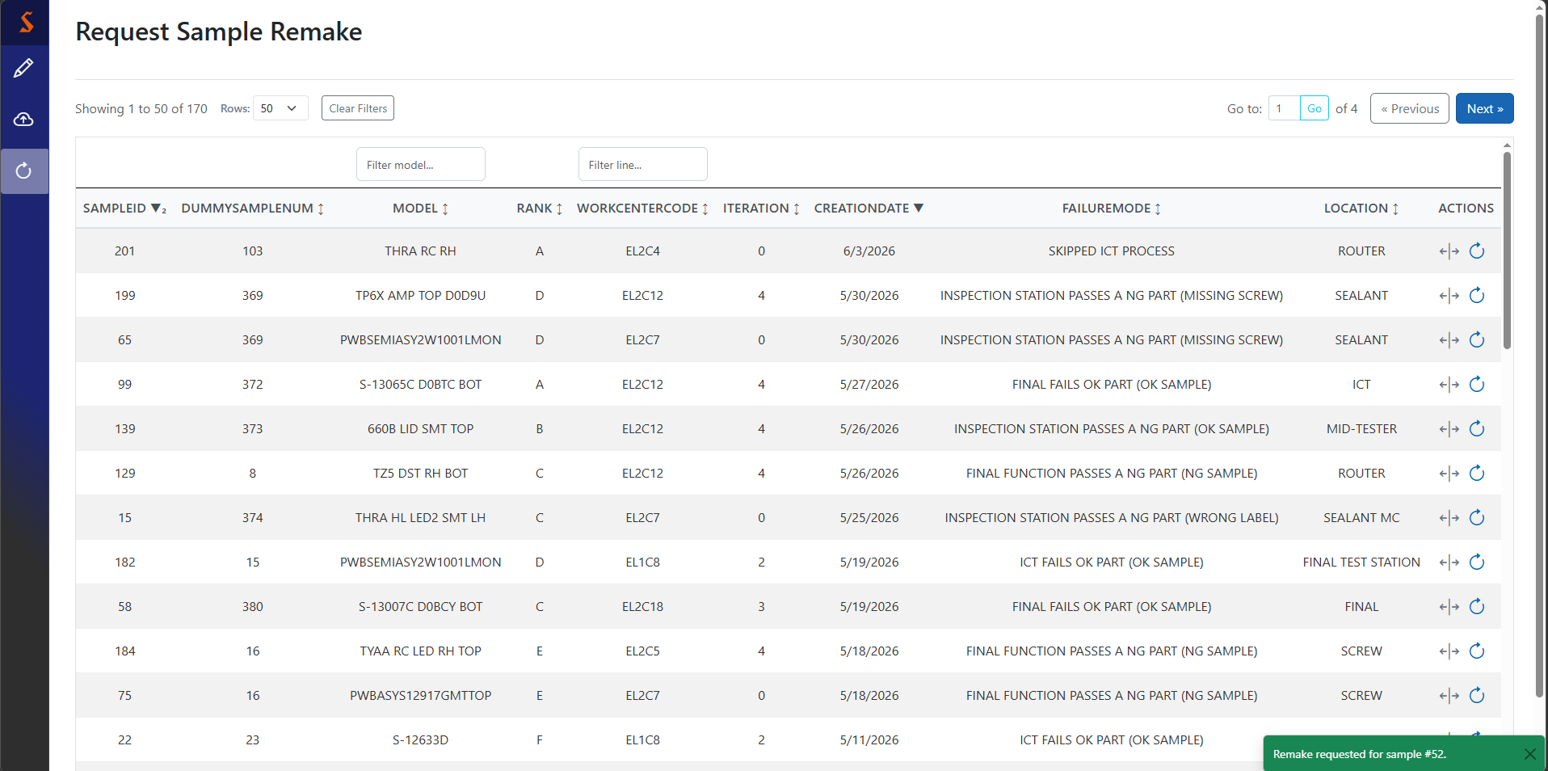
Successful remake request
A successful remake request will hide the target sample, because it now has a pending remake request
Upon successful request, there will be a toast

Slide 36
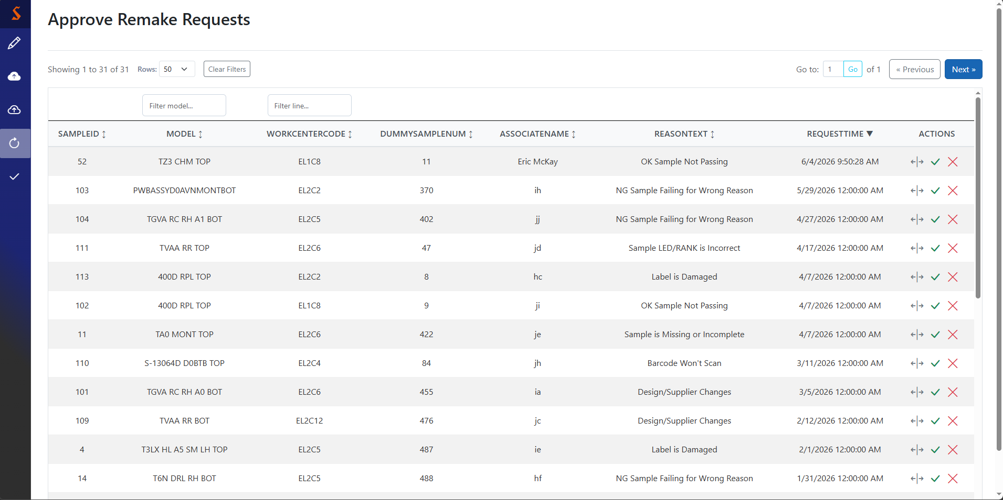
Approve sample remakes
This is an approver-only page. The only samples shown here are those with a pending remake request
Deny remake
Approve remake
See details

Slide 37
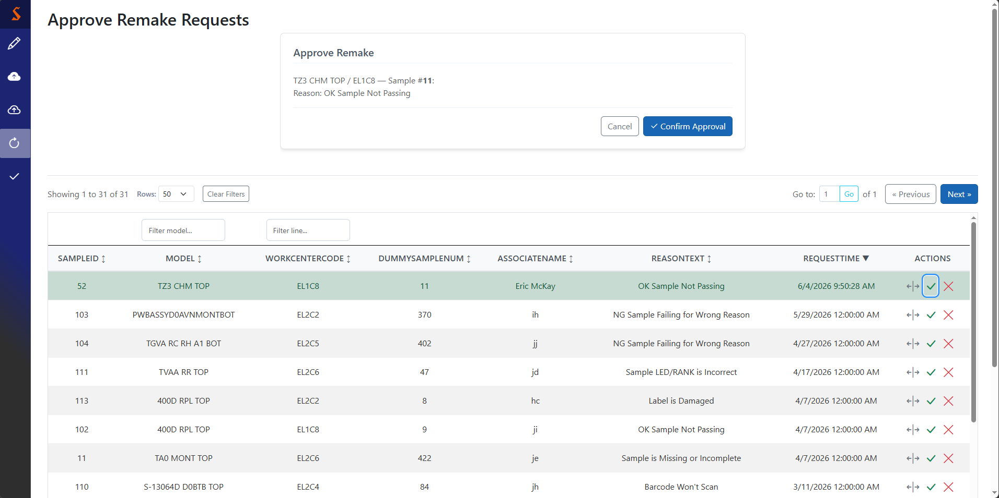
Approving a remake
Pressing the approve button for a sample opens this confirmation card
Important: this does not actually create a new sample, it just takes the current one out of circulation. The new sample should be created using the Create Sample page

Slide 38
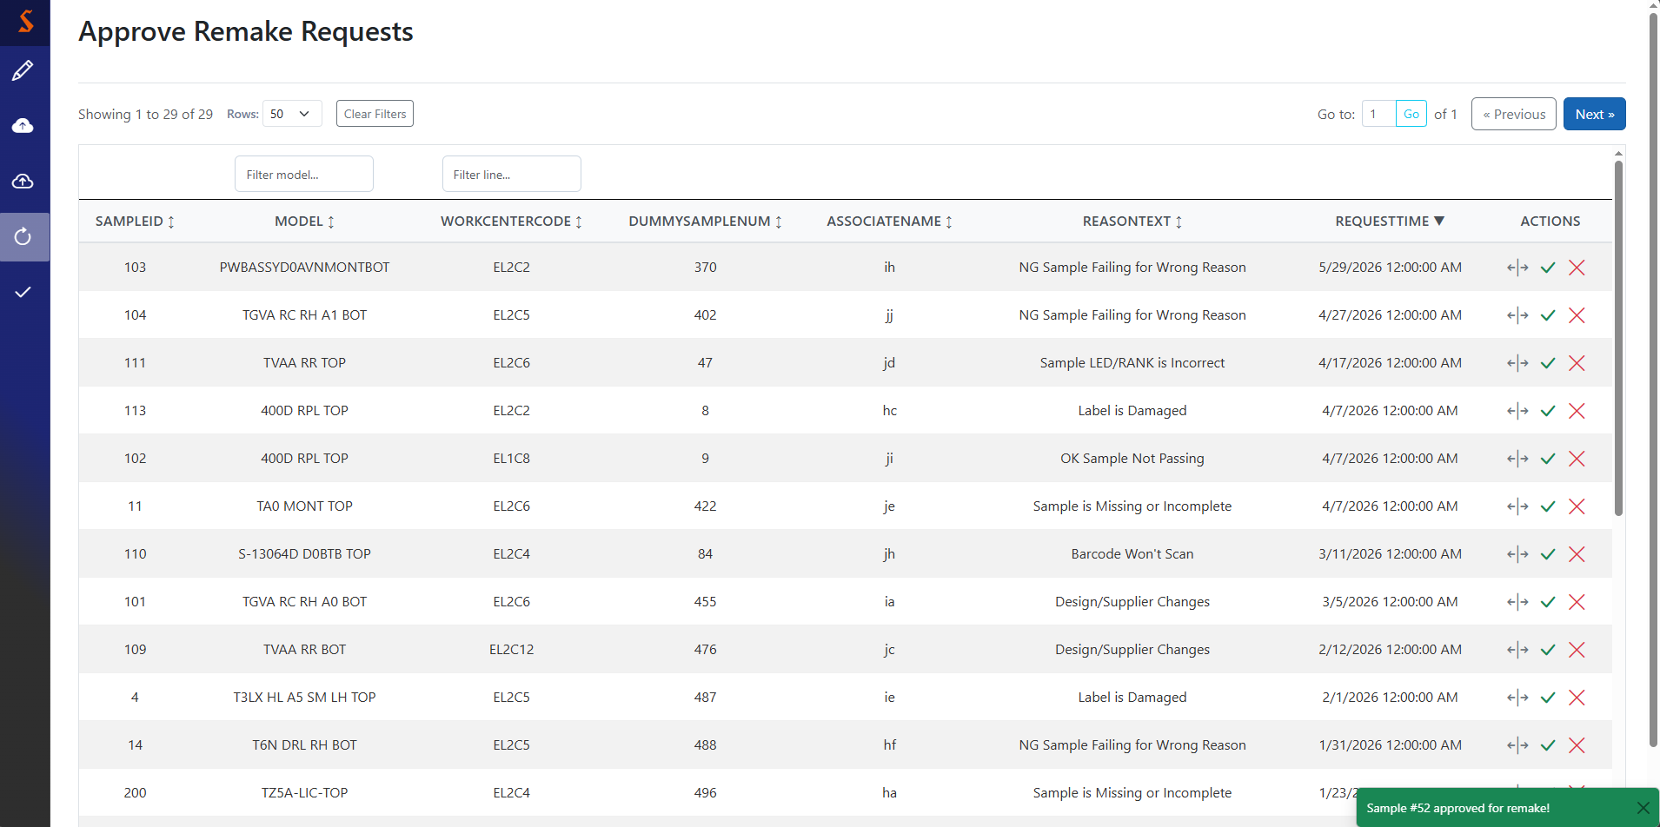
Successful remake approval
Confirming approval hides it from this screen and shows the success toast.
I will reiterate, this does not actually create a new sample, it just takes the current one out of circulation. The new sample should be created using the Create Sample page

Slide 39
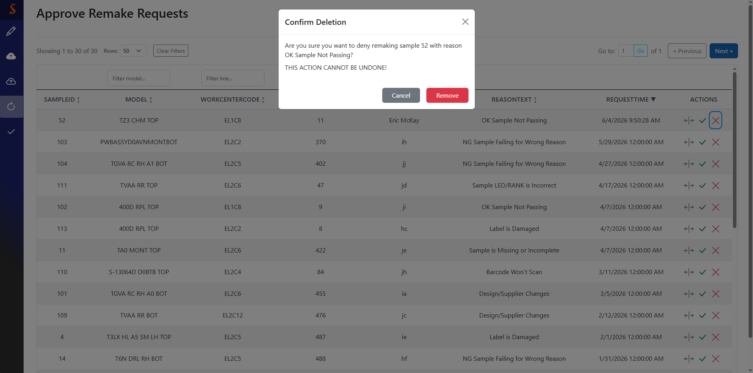
Denying a remake
Press cancel to take no action, or remove to deny the remake

Slide 40

Successful remake denial
Denying a remake will hide it from the page and show the success toast.

