Slide 1

Hioki ICT Database search application
Date (2026.02.26)

Slide 2
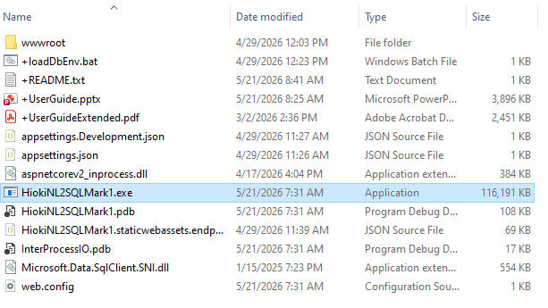
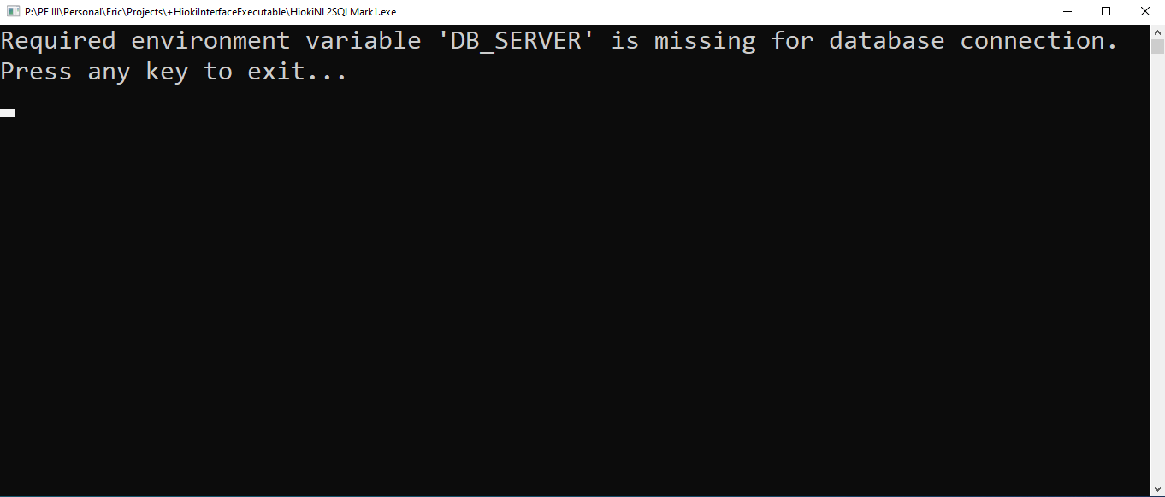
Running the program
The folder with the program resides at the path P:/PE III/Personal/Eric/Projects/+HiokiInterfaceExecutable as of 2026-05-21. It should look something like this. Files without a ‘+’ are for the program and should not be touched.
Before you run the .exe, make sure to run +loadDbEnv.bat (or just loadDbEnv if you hide file extensions) first, otherwise you’ll just see the following:

Slide 3
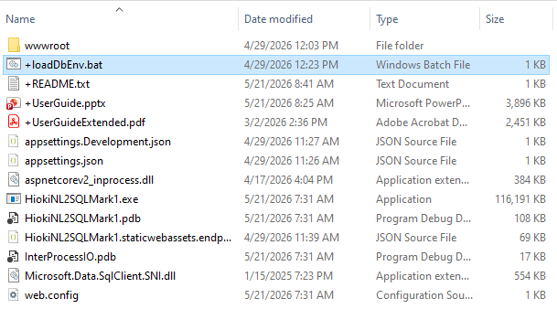
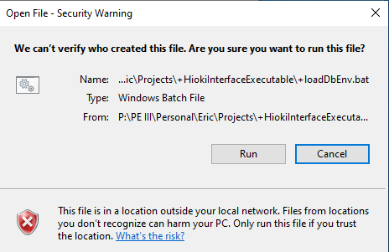
The .bat file
The .bat file loads a few environment variables to offload database credentials from the app. Because it automatically executes commands and doesn’t live on your computer’s hard drive, it’s flagged as malicious even if you’ve run it before. By default, double clicking this will execute its contents straight from the terminal. If you want to see what it’s doing, you’re welcome to open it in a text editor by right-clicking, then selecting edit (although you will still need to confirm the security dialog). Doing so will not execute the commands.
What you’ll see if you run straight from the P drive
When you run the .bat file, you’ll see a terminal window pop up briefly, then disappear. That means the file has run and you’re ready to run the actual program.

Slide 4
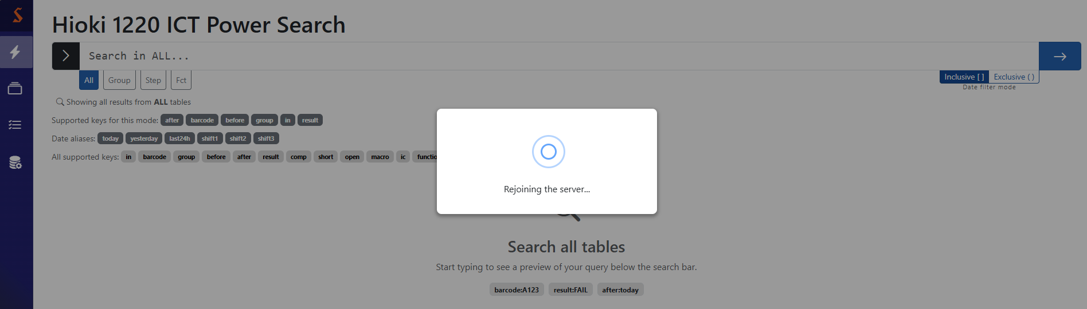
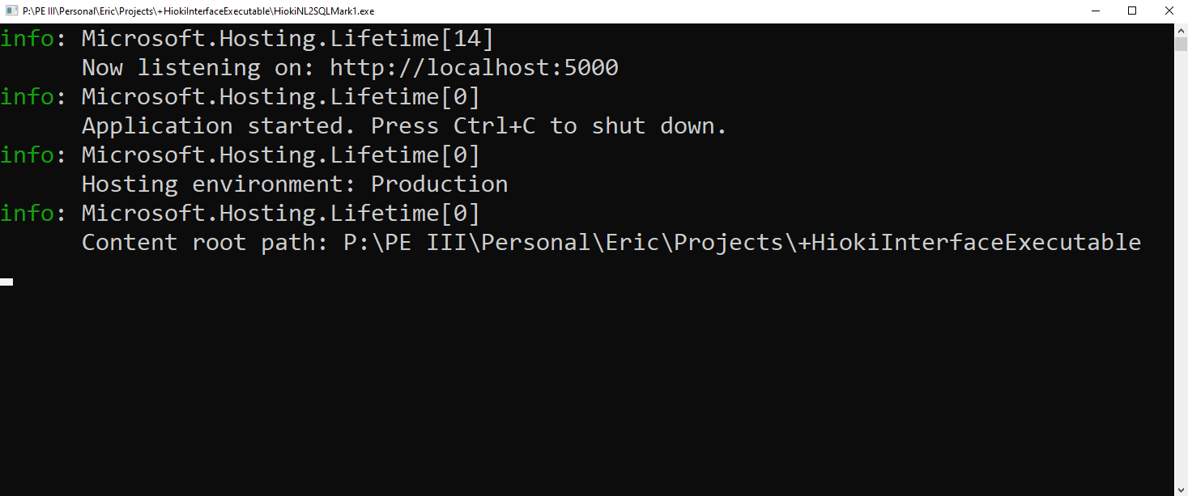
The .exe file
This app is hosted locally, so there’s not a website to go to (in the traditional sense). Open any browser and type in the address from the second line of the terminal output. I’m 99% sure it’s stable at localhost:5000, but it will always match whatever you see in the terminal created by the .exe.
Once you’ve run the .bat file, you’re ready to go. Double clicking the .exe file will show the security dialog (because it’s an executable), but after you confirm, it should show something like this:
Side note: the app’s lifespan is tied to the terminal, not the browser. Thus, it doesn’t care when you close the tab, go to a different site, or even close the browser entirely. The only way to end it is to go back to the terminal and either close it or press Ctrl+C as it indicates. Once the app closes, all tabs currently viewing it will try to reconnect a couple times before giving up.

Slide 5
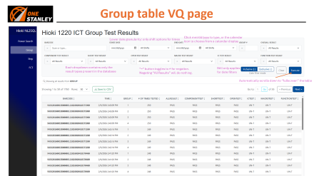
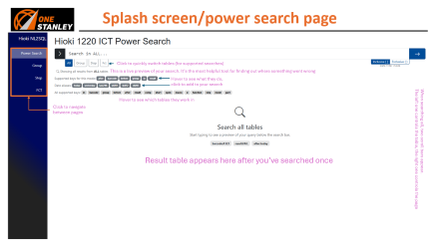
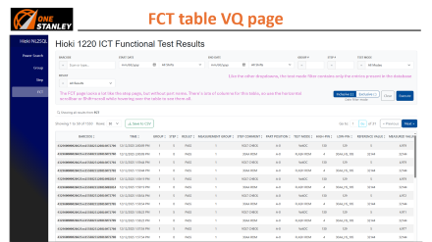
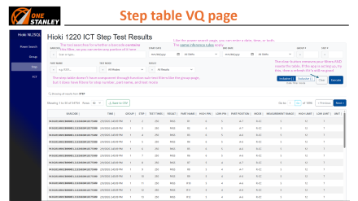
Table of Contents

Slide 6
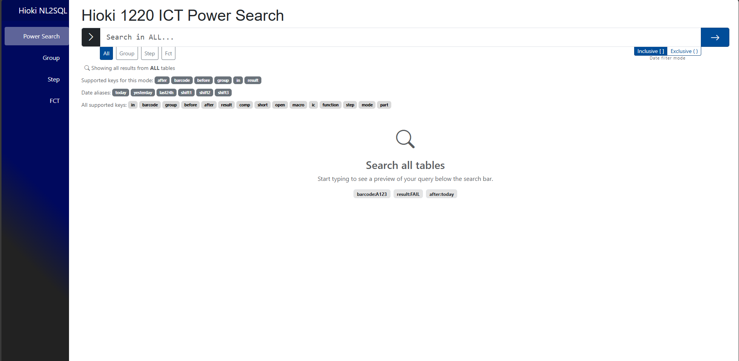
Splash screen/power search page
Click to quickly switch tables (for supported searches)
This is a live preview of your search. It’s the most helpful tool for finding out where something went wrong
Hover to see what they do, click to add to your search
When searching all, two scroll bars appear.
The left one controls the table, the right one controls the page
Hover to see which tables they work in
Click to navigate between pages
Result table appears here after you’ve searched once

Slide 7
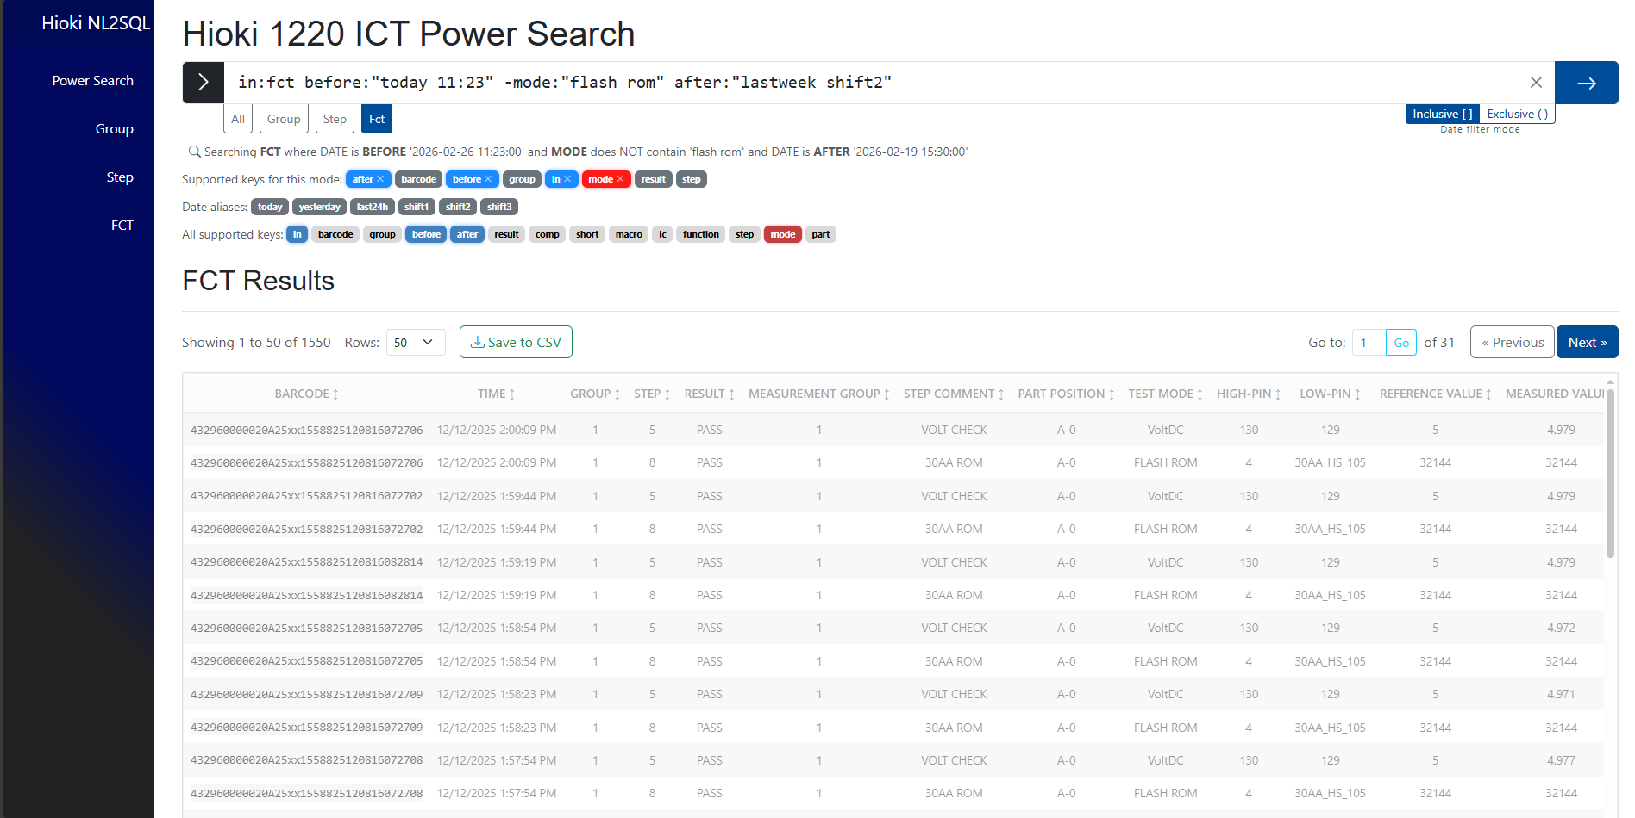
Using the search bar
Use space-separated key:value syntax. Put a hyphen at the start of any key to filter out the value.
Wrap a value in quotes if you wish to include a space or colon (including time) inside the value.
This is what the tool thinks you said. It is always right.
With these settings, the date range is from the start of 2nd shift on 2/19 to 11:23 on 2/26 (see preview)
As you type, filters will populate based on your ‘in’ tag, and change color based on presence
Gray: filter is not in search
Blue: filter is in search
Red: negative filter in search
These do not apply for date aliases
The table becomes faded if you haven’t pressed enter yet to remind you that it’s waiting for you to search. You can’t interact when it’s like this, but you can refresh if you want to go back to the search that generated this table

Slide 8
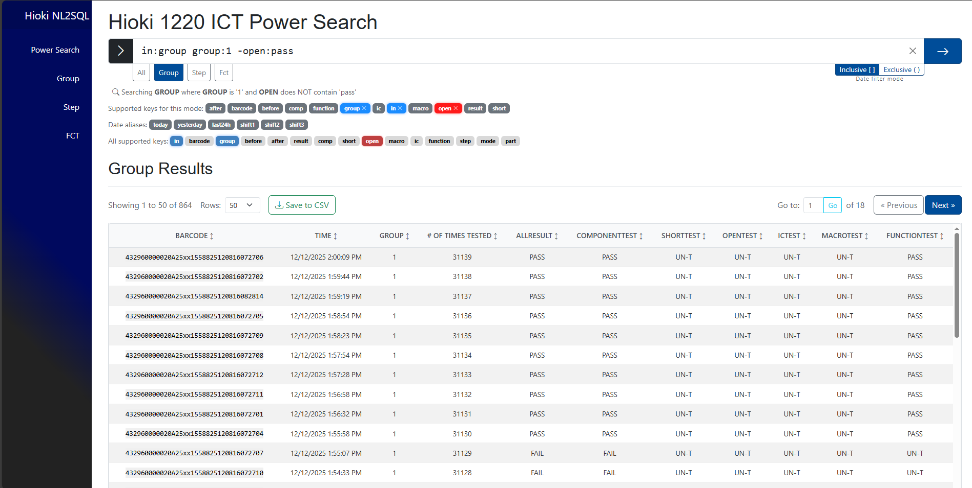
Using the table
The results you’re seeing now
Results per page
Jump to a specific page
Save the entire search’s results to a CSV file
(check your browser’s download settings)
Use this small scroll bar to navigate the table
Click any column header to cycle through sort directions for that attribute. You can only sort by one column at once, and the default sort is by most recent time.
Click any item in the barcode column to search for it across all tables

Slide 9
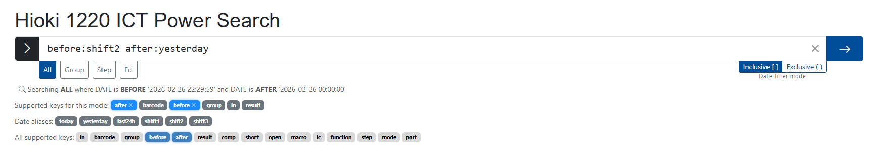
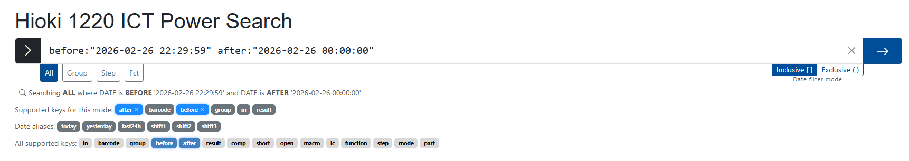
Date aliases: substitution
Executing the search will substitute date aliases with their actual values
When you click an alias, it’s added to the search. If you have a key waiting for a value, only the alias is appended. Otherwise, it assumes “after: <alias>”
If you use a shift alias without a date, the app infers that you meant the most recent time that shift ran (including the current shift)
If you use a time without a date, the app infers you meant today at that time. This MUST be in quotes, otherwise the tool cannot read it properly.
24hr time works best, but you can use AM/PM just the same IF you don’t put a space between the time and AM/PM (the tool does not understand that)
If you use a date or date alias without a time, the app infers that you meant that entire day, adjusting midnight/23:59 for after/before, respectively

Slide 10

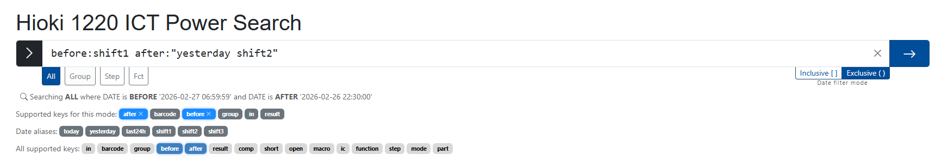
Date aliases: inclusivity
These searches are identical except for the inclusivity
These searches were performed during first shift on 2/27, so auto-detection mapped shift1 to the current shift and shift2 to yesterday’s 2nd shift
The shift3 alias was not used, but if it were, it would correspond to the 3rd shift in between (spanning 2/26 to 2/27)
This gathers all the entries between the time 2nd shift started yesterday and the time 1st shift will end today
Searching before the current shift with inclusive mode enabled is the only time the tool will search the future (to capture the entire first shift)
This gathers all the entries between the time 2nd shift ended yesterday and the time 1st shift started today

Slide 11
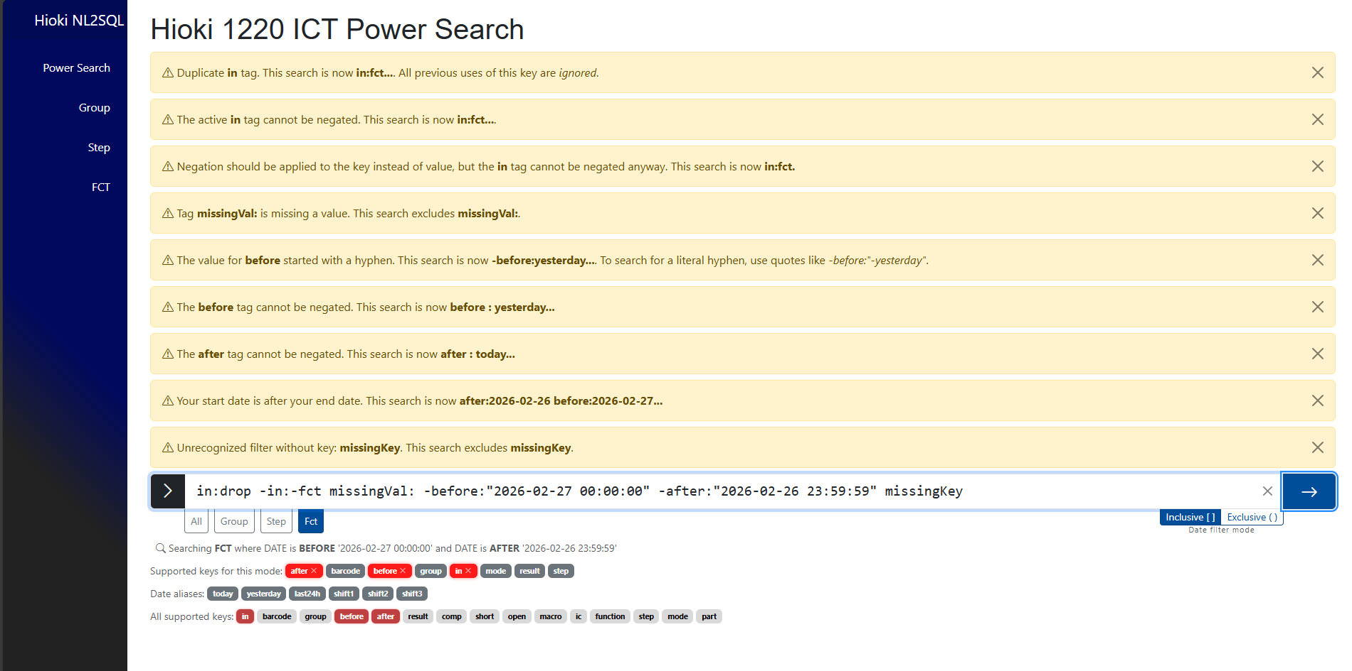
Errors: non-fatal
Hopefully, your error list won’t be this long. Errors with a yellow background are non-fatal, and the search will execute with even this many, automatically applying the changes it mentions.
If the messages are taking up too much space, you can click the X on each to dismiss them, but they’ll automatically go away on your next search
Side note: this is alias translation at work. Observe how the error messages refer to ‘today’ and ‘yesterday’
The preview still shows you what the search bar sees
This particular set of amended filters didn’t yield results, so they are not shown

Slide 12
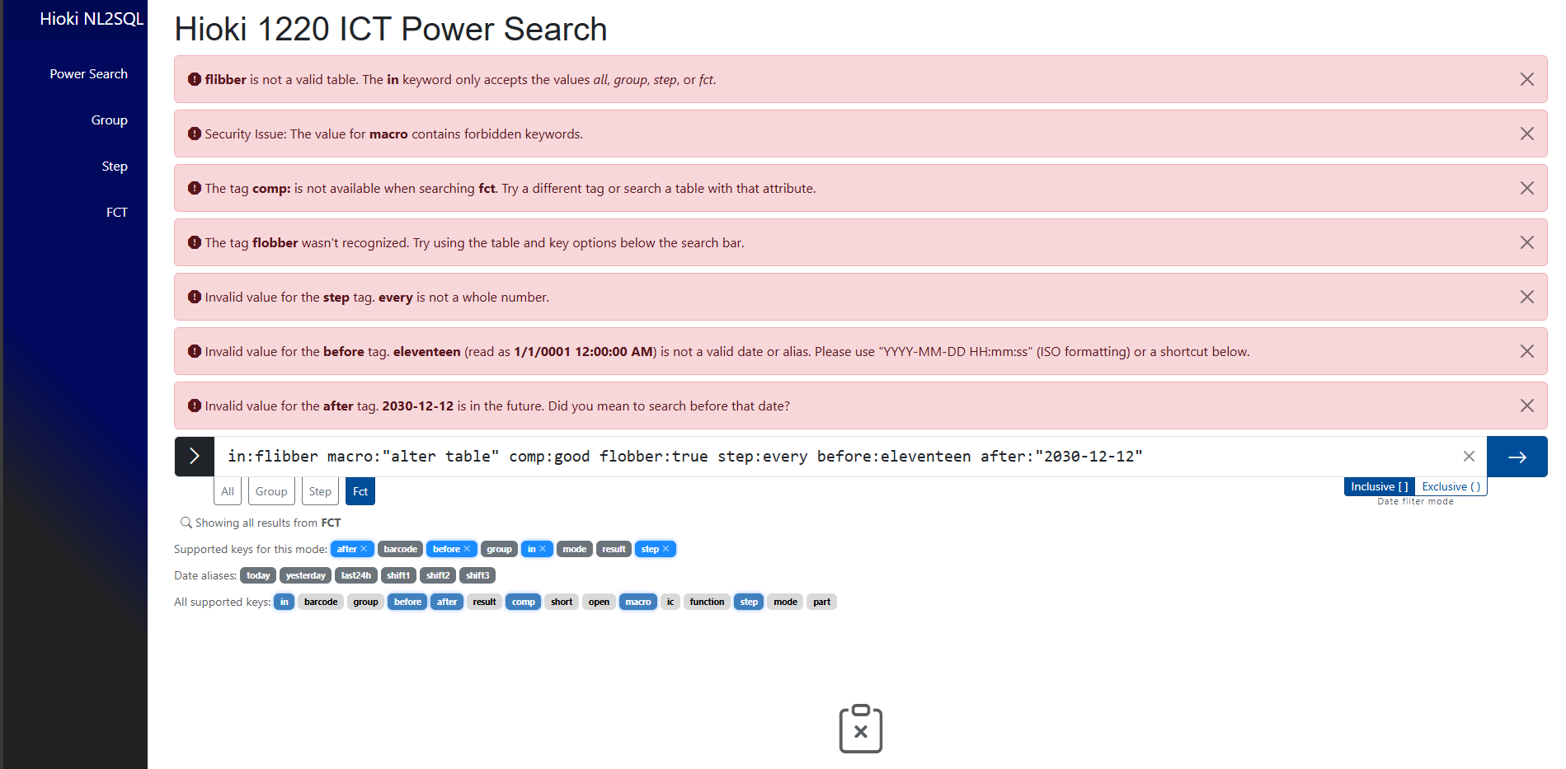
Errors: fatal
With just one red background error, your search won’t even execute. These usually mean the tool had no idea what you meant and needs your help to correct it.
We’ll discuss this symbol on the next slide

Slide 13
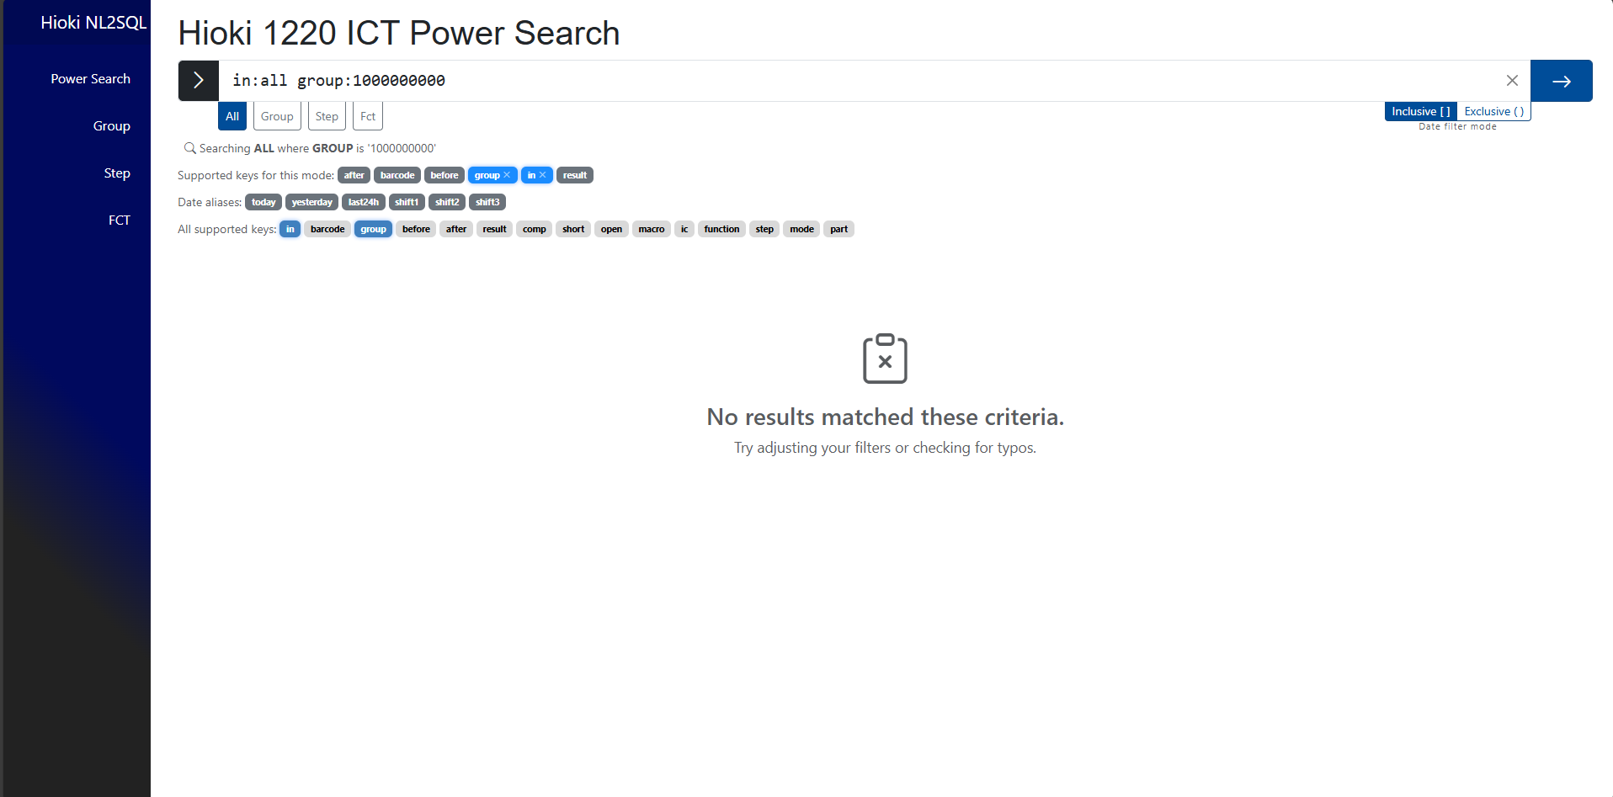
No results
There weren’t any errors in this search, but there’s no group with a number that high, so there weren’t any results. The tool can’t really help you here, so just double check the preview to make sure your search is what you really meant.

Slide 14
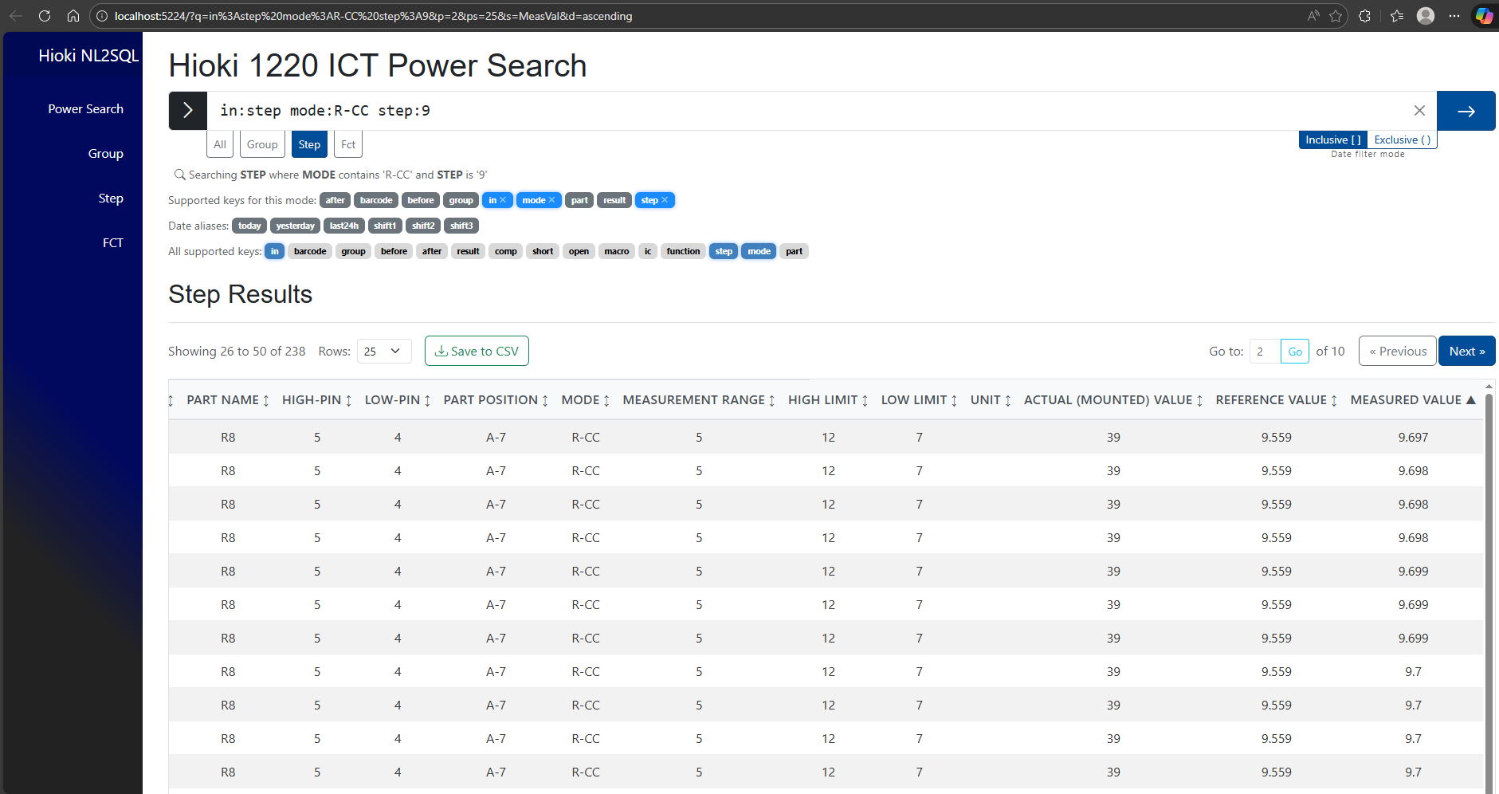
Sharing/saving a search
The URL updates on a successful search, sort, or page change, so it always matches the search that was used to get the table being displayed
Page # and size (p and ps parameter)
Filters (q parameter)
Sort column name and direction (s and d parameter)
The power search page builds a URL from your search so it can be easily shared. Simply copy the search bar and have someone else paste it after they start the program on their machine. Barring no changes in the database, this will show them the exact same results, down to the filters, sorts, and page.
This is also a good way to “bookmark” a search you like to execute from time to time

Slide 15



The visual query builder pages
The visual query builder (VQ) pages are the app’s three other pages that provide a simpler interface than the search bar at the cost of customization
They are all mostly the same, but provide different form fields depending on what filters are available for their respective tables
Table controls (i.e., sorts, pagination, save to CSV) are the same as the power search page
Because each VQ page only touches one table, it’s loaded immediately when you navigate here

Slide 16
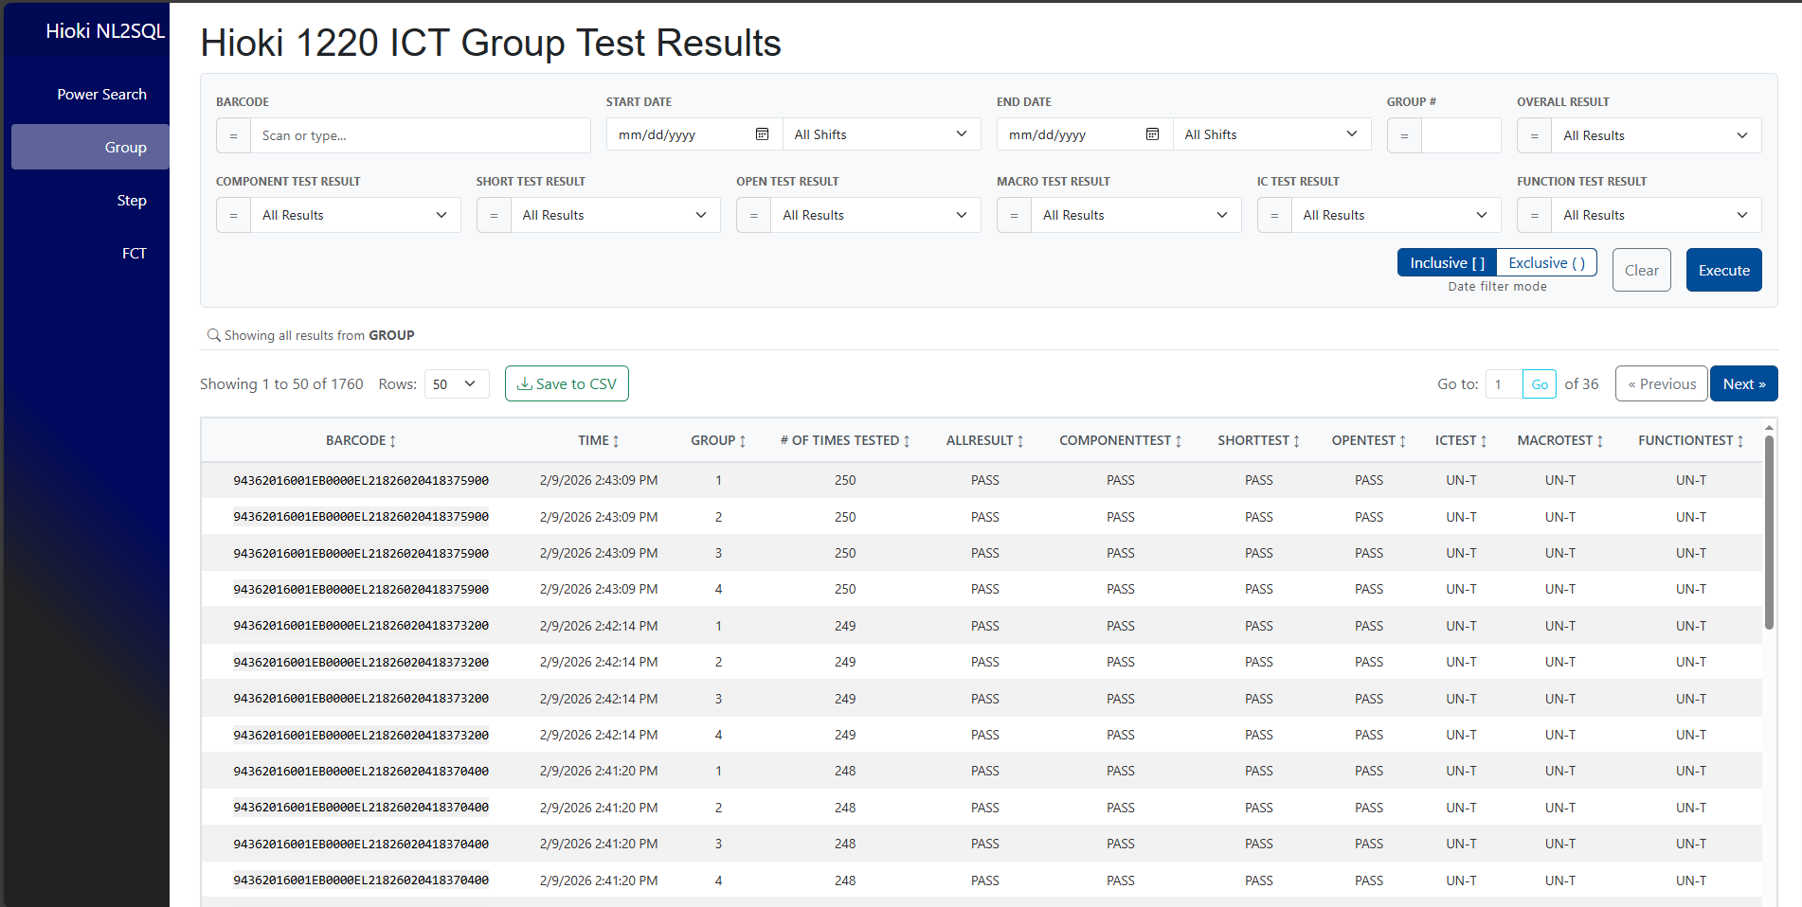
Group table VQ page
Lower date granularity: only shift options for times
Click mm/dd/yyyy to type, or the calendar icon to choose from a calendar display
Each dropdown contains only the result types present in the database
“=“ button toggles to ≠ for negation. Negating “All Results” will do nothing.
Still only applies for date filters
Automatically scrolls down to “fullscreen” the table

Slide 17
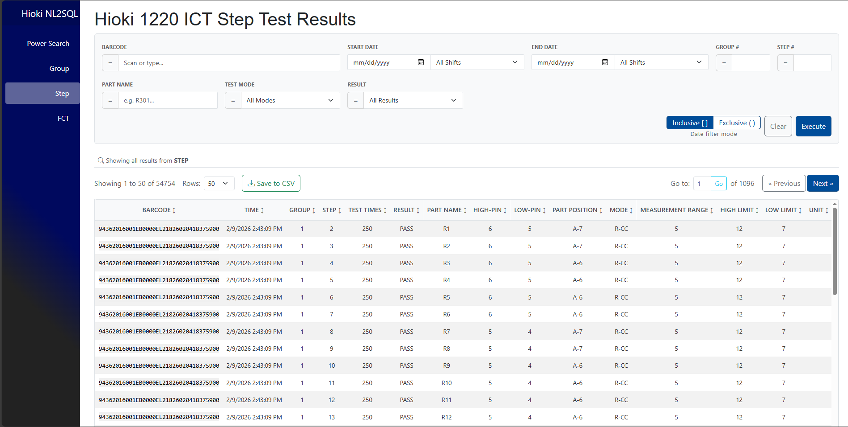
Step table VQ page
Like the power search page, you can enter a date, time, or both.
The same inference rules apply
The tool searches for whether a barcode contains this filter, so you can enter any portion of it here
The clear button removes your filters AND resets the table. If the app is acting up, try this, then a refresh if it’s still no good
The step table doesn’t have component through function sub-test filters like the group page, but it does have filters for step number, part name, and test mode

Slide 18
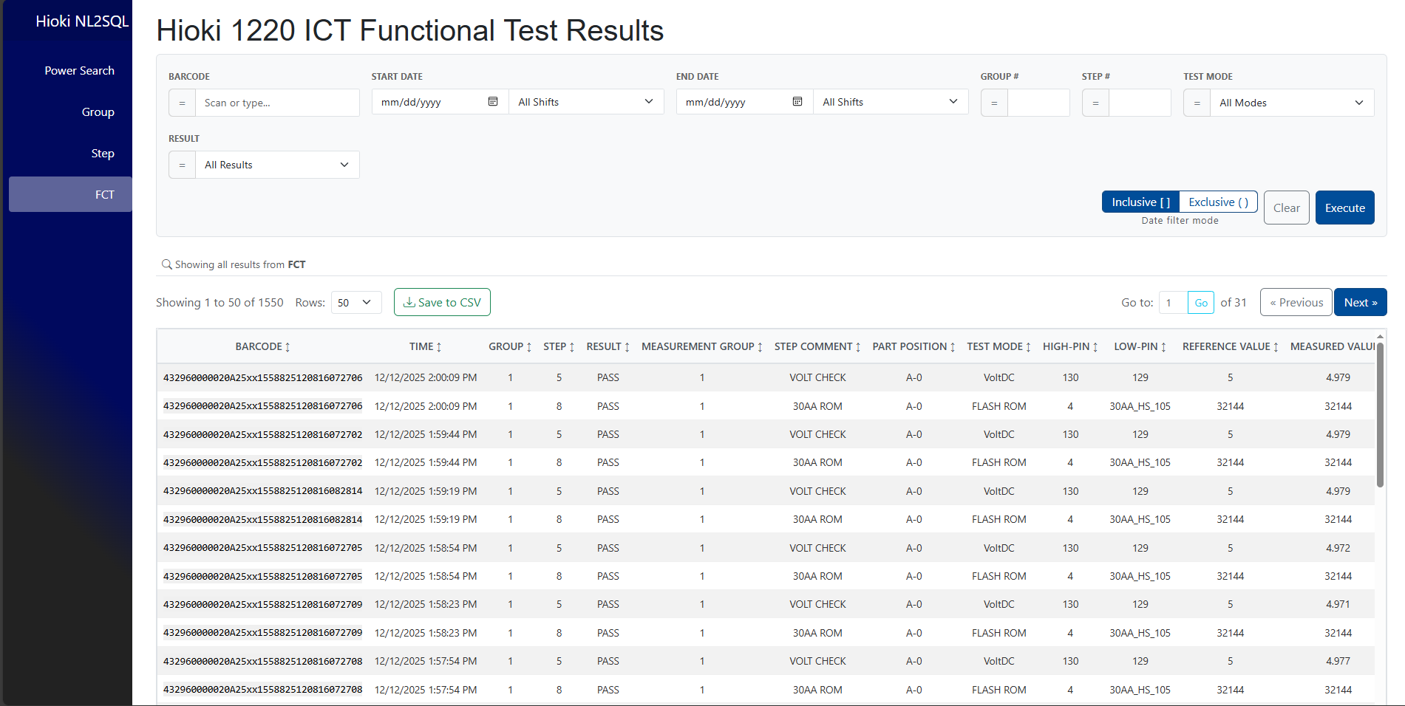
FCT table VQ page
Like the other dropdowns, the test mode filter contains only the entries present in the database
The FCT page looks a lot like the step page, but without part name. There’s lots of columns for this table, so use the horizontal scrollbar or Shift+scroll while hovering over the table to see them all.

