Slide 1
Human Capabilities
April 6, 2026 | week 2 | SWE 263P Matthew Bietz
Notes:
Some slides and content borrowed from Dr. Stacy Branham

Slide 2
Today’s Agenda
What Sets HCD Process Apart? (~30 min)
Human Capabilities & HCD + Break (~30 min + 15 min)
Design Principles + Break (~30 min + 15 min)
Activity (~30 min + 15 min)
Coming Up (~5 min)

Slide 3
The Human-Centered Design Perspective
Blame computers, not humans! Computers are new, humans are old
Our human instincts, bodies, capabilities are core to how we interact with designed artifacts
Key principles and practices of (good and bad) design undergird all design, including computing design

Slide 4
% of Software Projects that are...
On Budget
On Time
On Target
?
?
?
Standish Group Report, 2015
Notes:
I'm curious, what do you think is the approximate amount of software projects that end up on budget, on time, and on target these days?
Data source:
The Standish Group has been producing a decennial report of industrial software engineering projects since 1994. The latest report in 2015 updates us on the percentage of projects that are produced onbudget, ontime, and ontarget--meaning to the satisfaction of customers.
Anyone want to venture a guess?
Source. https://www.standishgroup.com/sample_research_files/CHAOSReport2015-Final.pdf

Slide 5
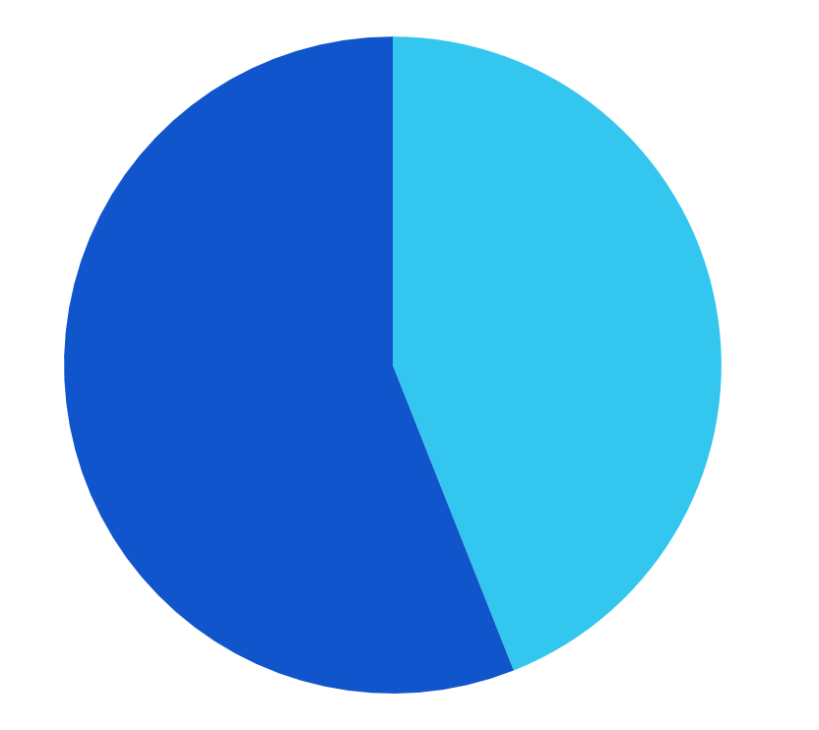
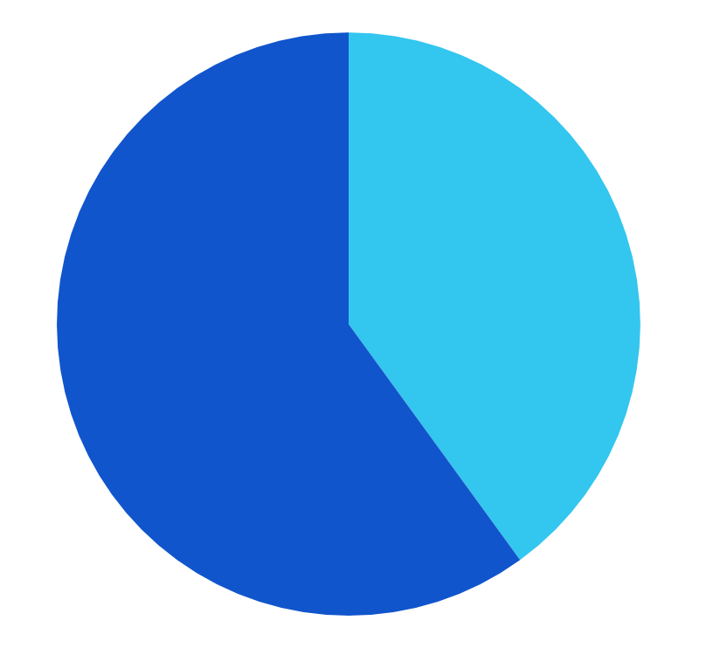
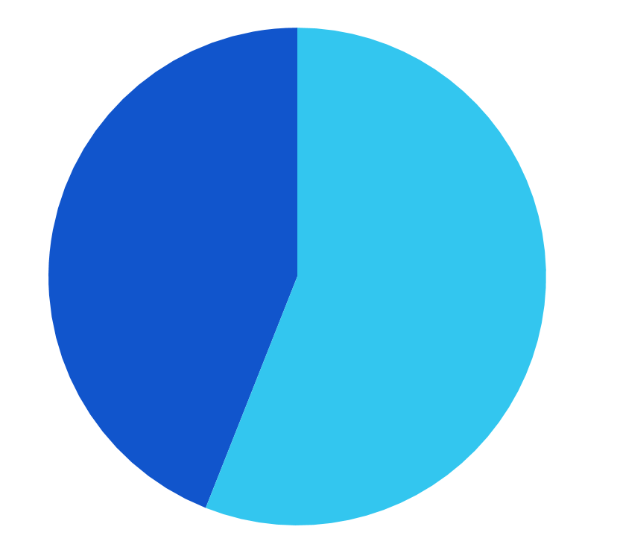
% of Software Projects that are...
On Budget
On Time
On Target
NO 56%
YES 44%
NO 60%
YES 40%
NO 44%
YES 56%
Standish Group Report, 2015
Notes:
It's actually something around 50% for each of these, which isn't as low as you might have thought.
Source. https://www.standishgroup.com/sample_research_files/CHAOSReport2015-Final.pdf

Slide 6
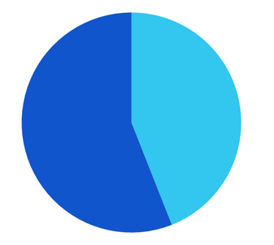
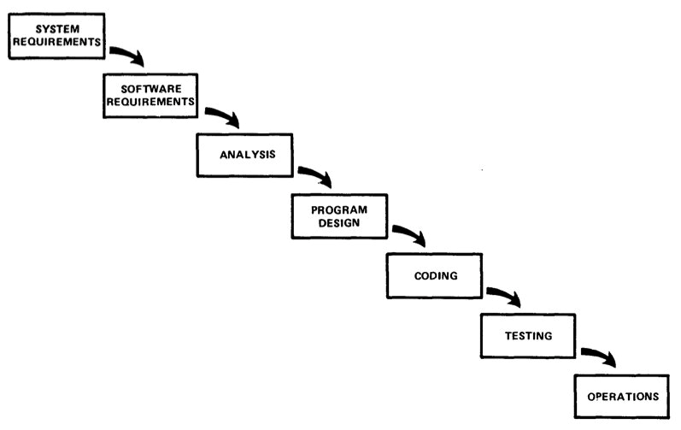
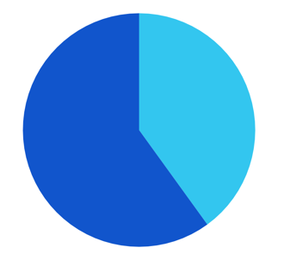
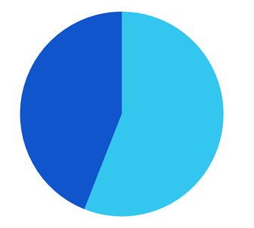
The Waterfall Model of Design
On Budget
NO 56%
YES 44%
On Time
NO 60%
YES 40%
“The results for all projects show that agile projects have almost four times the success rate as waterfall projects, and waterfall projects have three times the failure rate as agile projects.”
On Target
NO 44%
YES 56%
Notes:
Now let’s bring process back into our discussion of design as business.
The report states that agile has a much higher success rate compared to waterfall projects, and waterfall projects fail more often.
Why does the waterfall process not perform as well as agile, do you think?
In this report, scholars and the data presented suggest that waterfall doesn’t scale. You can look into this report more on your own if you’re interested.
2% budget—software quality; 15% user involvement

Slide 7
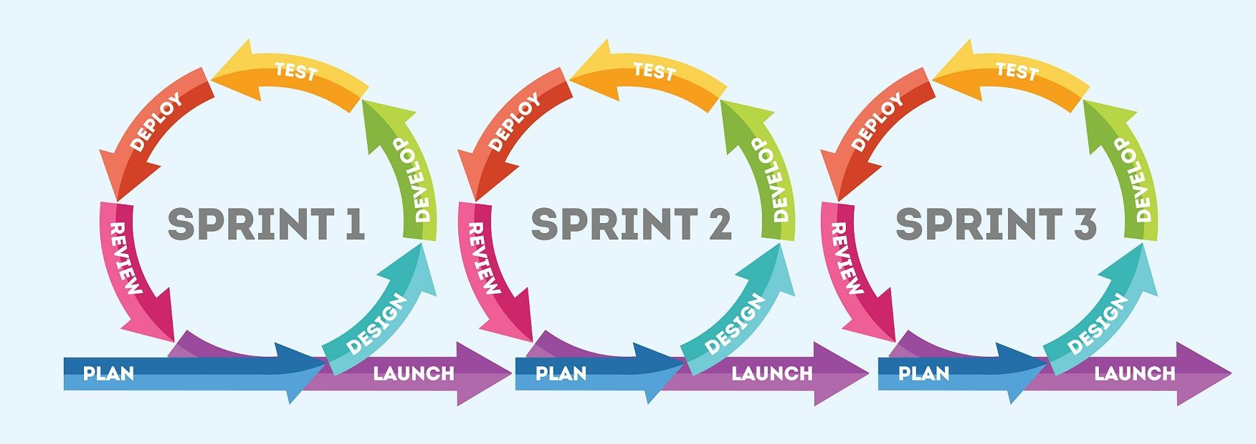
The Agile SE Process
From Is Agile Always the Best Solution

Slide 8
The HCD Process
1
Assess Needs
4
2
Test with Users
Specify Requirements
3
Successful Design
Build Prototypes

Slide 9
Matt’s View on SE & UX Process Models
Models are usefult, but…
Abstraction is not reality
SE models tend to treat “design” as a black box
UX models tend to treat “implementation” as a black box

Slide 10
Tensions Between SE / UX Approaches
Temporalities
Some UX processes don’t fit 2-week sprints
Some UX testing requires a working system
Too-frequent releases (continuous delivery) can harm UX
Interdependence
UX and software design affect each other
Different Subgoals
Implement in increments vs. holistic user experience
Software quality may mean different things
Software often requires tradeoffs (example: 2-factor authentication)

Slide 11
IDEO’s Design Process
IDEO Design Process video on YouTube

Slide 12
Qualities of HCD (in IDEO video)
Rapid prototyping – “fail often in order to succeed sooner”
Team environment – sharing, diverse perspectives
Spoke with / observed stakeholders – “real experts”
Props (baby doll, paper bags, plastic bags) + role play
Asked the stakeholders for feedback
Brainstorming Rules
No hierarchy
“Focused chaos”
Encourage wild ideas
As many ideas as possible
Defer judgment
Build on each others’ ideas

Slide 13
Today’s Agenda
What Sets HCD Process Apart? (~30 min)
Human Capabilities & HCD + Break (~30 min + 15 min)
Design Principles + Break (~30 min + 15 min)
Activity (~30 min + 15 min)
Coming Up (~5 min)

Slide 14
Designing for Human Capabilities

Slide 15
Basic HCD Principle
Basic Principle: Designs that are matched to human cognitive and physical capabilities will be easier to use and provide a better user experience.

Slide 16
Memory Experiment
Close your computers & put down your phones (just for a couple minutes)
Focus on the presentation screens

Slide 17
R T J V P

Slide 18
Recite The Letters

Slide 19
W X Y I M C P T X O P I Y Q A H E W M

Slide 20
Recite the Letters

Slide 21
Cow Dog Bird Cat Rabbit

Slide 22
List the Animals
Which set was easiest to remember?

Slide 23
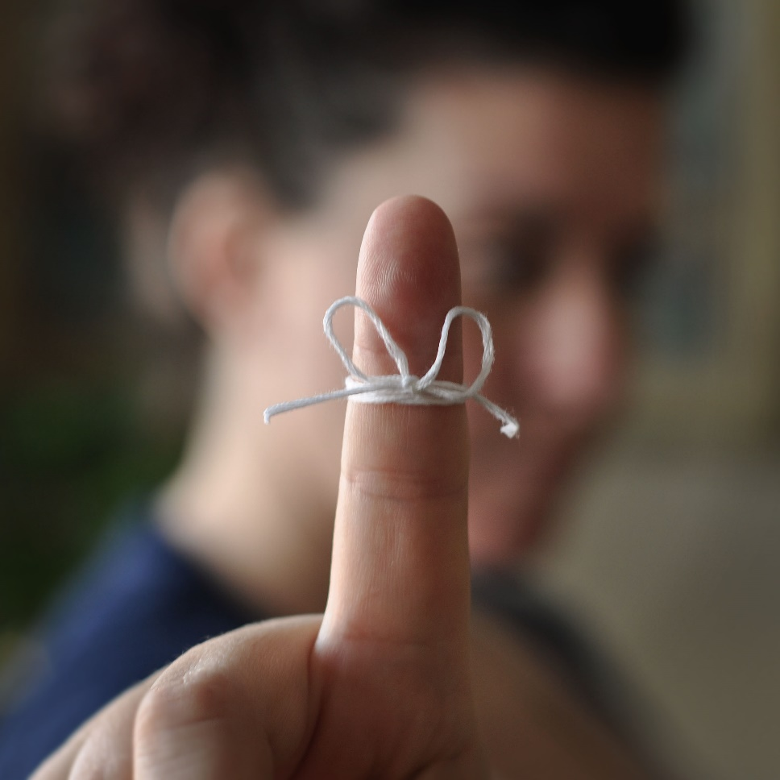
Short-Term vs. Long-Term Memory
Can’t remember things for long without practice
Can keep a limited number in short-term memory: “7 plus or minus 2” (Miller’s “magic number”)
Grouping and hierarchy
Mnemonics
“My Very Educated Mother Just Served Us Nachos”
Photo by Flood G.

Slide 24

Memory Quiz
What 2022 film won the Best Picture Oscar at the 2023 Academy Awards?
A: Everything Everywhere All at Once

Slide 25



Which is a poster for a Marvel Movie?
A
B
C

Slide 26
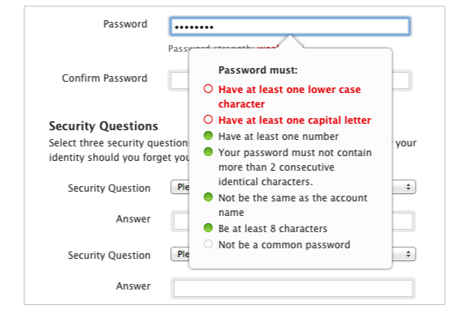
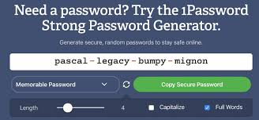
Recognition vs. Recall
Human memory and computer memory work in different ways
Humans are better at recognition
Computers are better at recall
We can use this kind of knowledge to design more intuitive systems

Slide 27
15 min break

Slide 28
Today’s Agenda
What Sets HCD Process Apart? (~30 min)
Human Capabilities & HCD + Break (~30 min + 15 min)
Design Principles + Break (~30 min + 15 min)
Activity (~30 min + 15 min)
Coming Up (~5 min)

Slide 29
Norman Doors
Norman Doors video on YouTube

Slide 30

Norman’s 6 Design Principles
Affordances
Signifiers
Constraints
Mappings
Feedback
Conceptual Model
Photo by Alfred Kenneally

Slide 31


Affordances
The user should be able to discern what actions they can take on the interface – what it affords.
a switch affords flipping
a wheel affords turning
a button affords pressing
a grip affords dragging

Slide 32
Signifiers
Good signifiers communicate what the affordances of the interface are
To visit the link, click here
Affordance: I can click it
Signifier: Blue text with underline

Slide 33
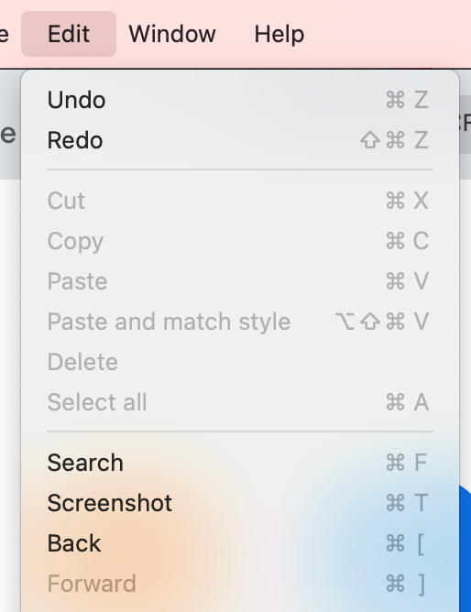
Constraints
Limiting the user’s possible actions with the system to reduce complexity and likelihood of error; constraints can be physical or digital.
Menu items that aren’t currently available are grayed out and can’t be clicked.

Slide 34
Mapping
It should be easy to predict what reaction the system will have when the user interacts with a system control.
click here
visit Canvas
✗
✓

Slide 35
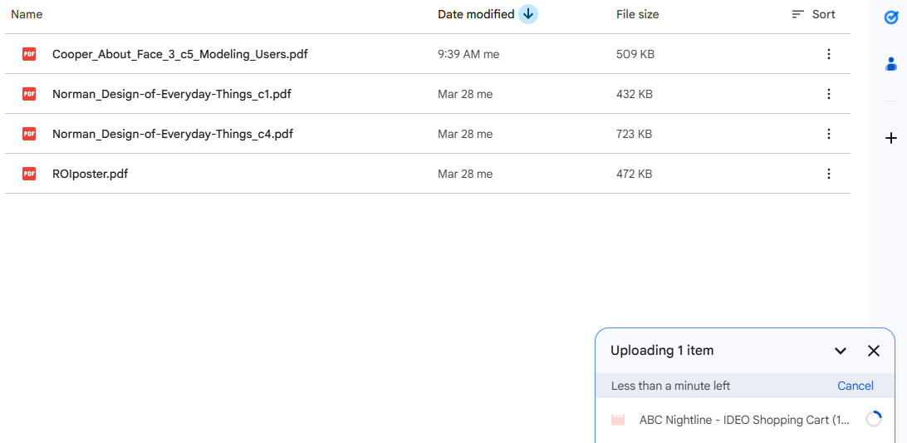
Feedback
Provide information back to users that indicates their action was registered by the system; feedback should be given for both actions and status.

Slide 36
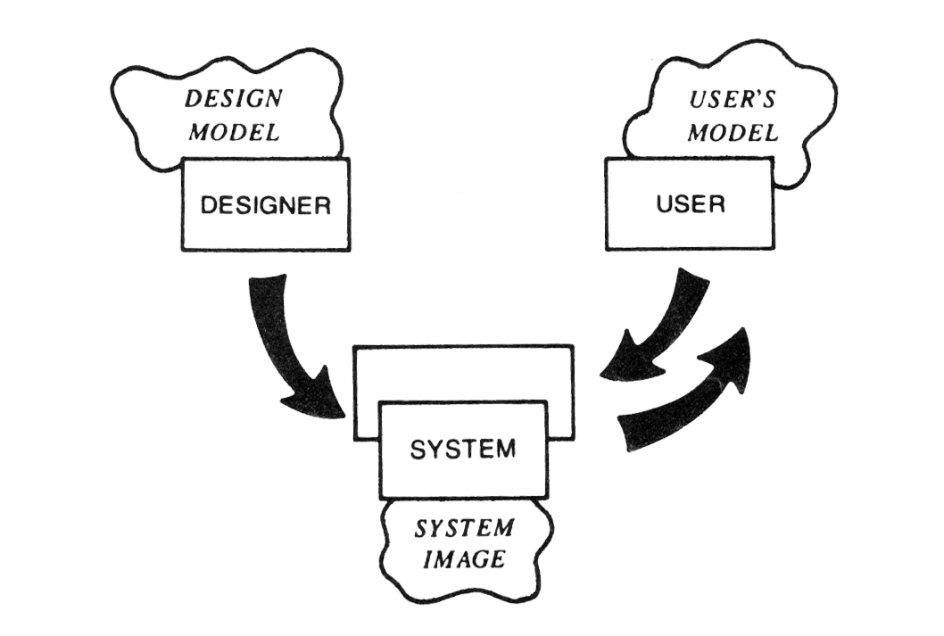
Conceptual Model
Designers have to communicate their conceptual model to the user through the interface (system image)
The user refines their mental model through interacting with the system over time

Slide 37
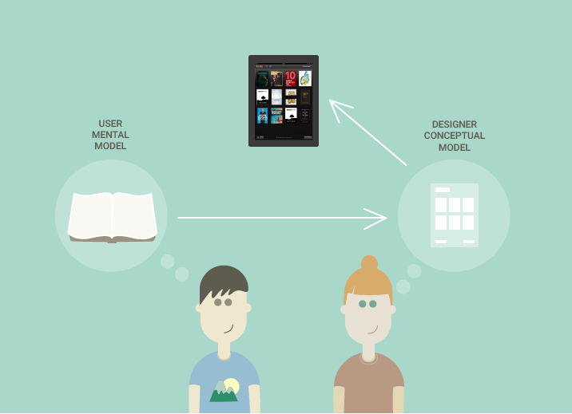
Designer’s Conceptual Model
E-BOOK READER
USER
DESIGNER
Notes:
Now, let’s say we have a designer who wants to design a digital book reading application. So she has a conceptual model that includes things like people should be able to read a book from front to back, jump ahead, put a book mark in it. She is building a model of what this book application will do.
Image borrowed from: https://mk0caiblog1h3pefaf7c.kinstacdn.com/wp-content/uploads/2016/01/recast-ai-conceptual-model-vs-mental-model.png

Slide 38
User’s Mental Model
TRADITIONAL BOOK
USER
Notes:
Now, let’s say we have a designer who wants to design a digital book reading application. So she has a conceptual model that includes things like people should be able to read a book from front to back, jump ahead, put a book mark in it. She is building a model of what this book application will do.
Image borrowed from: https://mk0caiblog1h3pefaf7c.kinstacdn.com/wp-content/uploads/2016/01/recast-ai-conceptual-model-vs-mental-model.png

Slide 39
Designers and Users have Different Models
TRADITIONAL BOOK
E-BOOK READER
✗
USER
DESIGNER
Notes:
These two people generally don’t communicate directly
Image borrowed from: https://mk0caiblog1h3pefaf7c.kinstacdn.com/wp-content/uploads/2016/01/recast-ai-conceptual-model-vs-mental-model.png

Slide 40
Designers use Metaphors to Communicate the Conceptual Model
METAPHOR
TRADITIONAL BOOK
E-BOOK READER
USER
DESIGNER
Notes:
so, the designer has to embed the conceptual model into the design, using tools like metaphors
Image borrowed from: https://mk0caiblog1h3pefaf7c.kinstacdn.com/wp-content/uploads/2016/01/recast-ai-conceptual-model-vs-mental-model.png

Slide 41
Users revise their mental model through use
GULF OF EXECUTION
GULF OF EVALUATION
METAPHOR
TRADITIONAL BOOK
E-BOOK READER
USER
DESIGNER
Notes:
the user brings their mental model to the system. With every interactional turn, in which the gulfs of execution and evaluation are bridged, the user is testing and refining their mental model.
Image borrowed from: https://mk0caiblog1h3pefaf7c.kinstacdn.com/wp-content/uploads/2016/01/recast-ai-conceptual-model-vs-mental-model.png

Slide 42

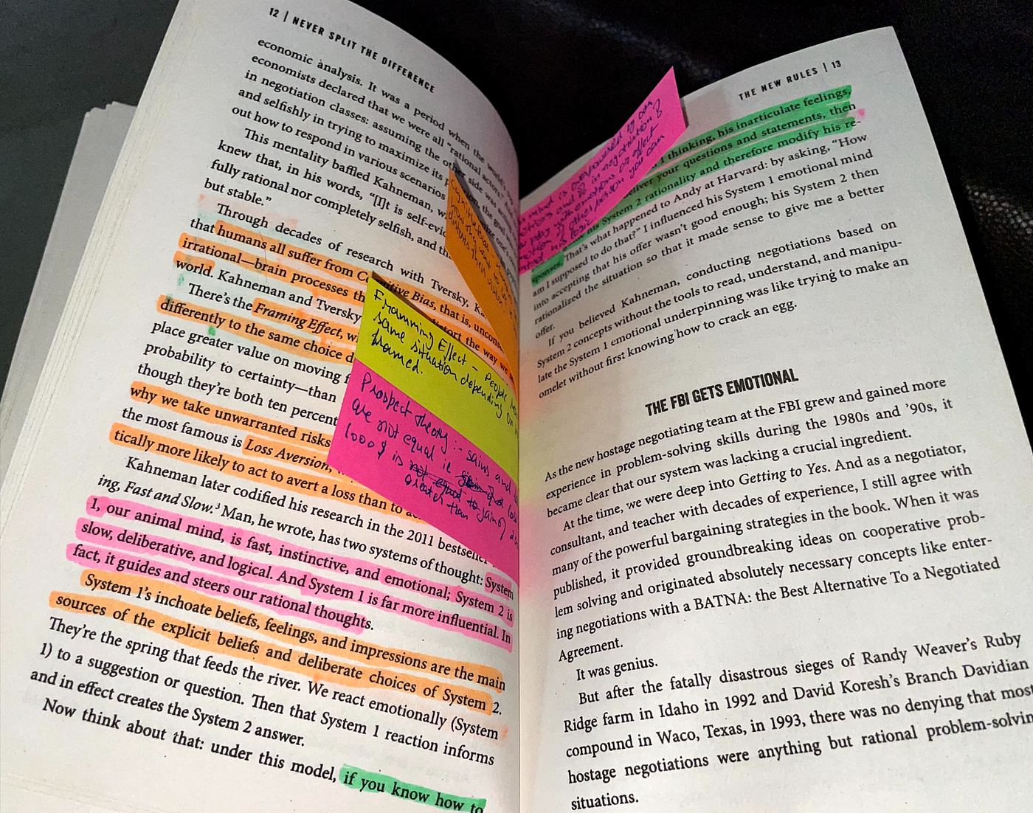
Mental Model: Books / Libraries

Slide 43
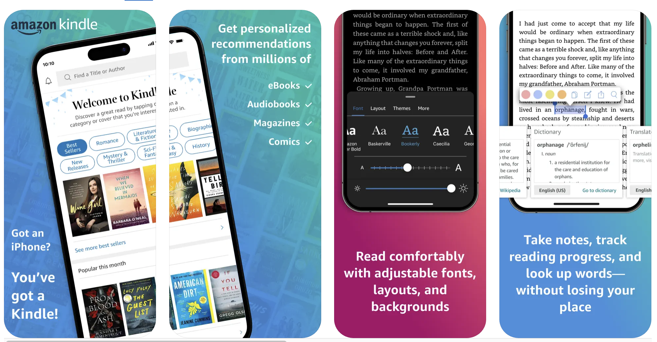
Conceptual Models: Personal Library

Slide 44
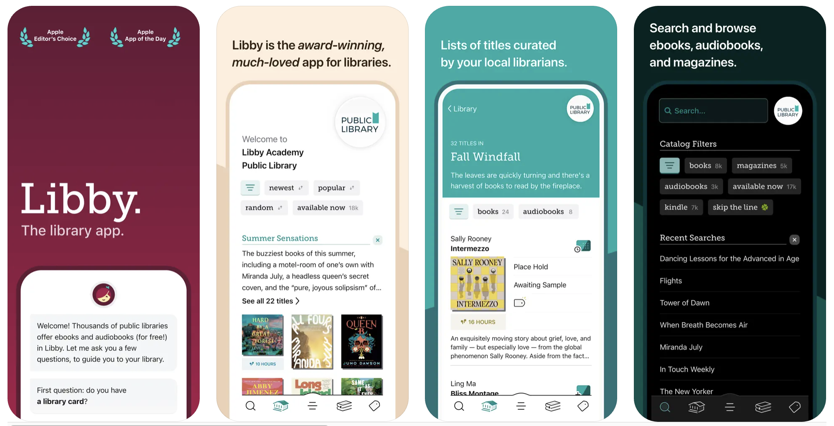
Conceptual Models: Public Library

Slide 45
Challenge of Designing for Mental Models
Mental models are adopted from prior experience with systems and technologies, e.g., “The same stimuli were grouped together in version x, so…”
Mental models are age-based, culturally situated, etc., so you have to design to multiple mental models to support more users
Your challenge as designer: determine the user’s Mental Model (but remember – “The User Is Not Like Me”)
Notes:
partially sourced from: www.cs.uvm.edu/~jbongard/2009_hci/CS228_09.ppt

Slide 46
Norman’s 6 Design Principles
Affordances: Suggest what action can be taken
Signifiers: Indicate where the actions can take place
Constraints: Limit possible actions to prevent error
Mappings: Suggest what the result of actions will be
Feedback: Indicate system status and response to input
Conceptual Model: Representation of how the system works

Slide 47
10 min break

Slide 48
Today’s Agenda
What Sets HCD Process Apart? (~30 min)
Human Capabilities & HCD + Break (~30 min + 15 min)
Design Principles + Break (~30 min + 15 min)
Activity (~30 min + 15 min)
Coming Up (~5 min)

Slide 49
In-Class Activity: Fundamental Principles
Form a group of 3-4 people
Analyze how a Google form does or does not support Norman’s design principles
Add a slide to share your findings
Links are available on the Canvas Week 2 page.

Slide 50
Assignment: “A Thing I Hate”
Identify and analyze some designed object (a physical object, a computer interface, etc.) that you personally find frustrating.
Use the ideas that we read about in Norman.
Write 400-500 words and submit by Sunday, 11:59pm.

Slide 51
This week
What were the 5 animals we recited earlier?
Complete Week 2 Deliverable A Thing I Hate
Do Week 3 readings

