Slide 1
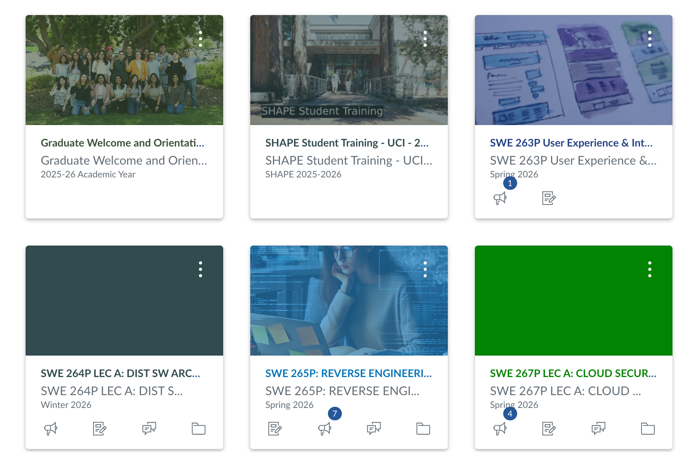
SWE 263P | Heuristic Evaluation
Canvas LMS: student workflow evaluation
A focused inspection of how Canvas supports finding assignments, deadlines, announcements, grades, and calendar items.
Evaluated workflows
Assignments, due dates, announcements, grades, calendar, and course navigation.
Evaluator: Zhenyu Song | May 30, 2026
Canvas heuristic evaluation | 01
Notes:
Introduce Canvas as the system, the student-side workflows evaluated, and the goal of the video: identify where the interface supports students well and where it creates avoidable friction.

Slide 2
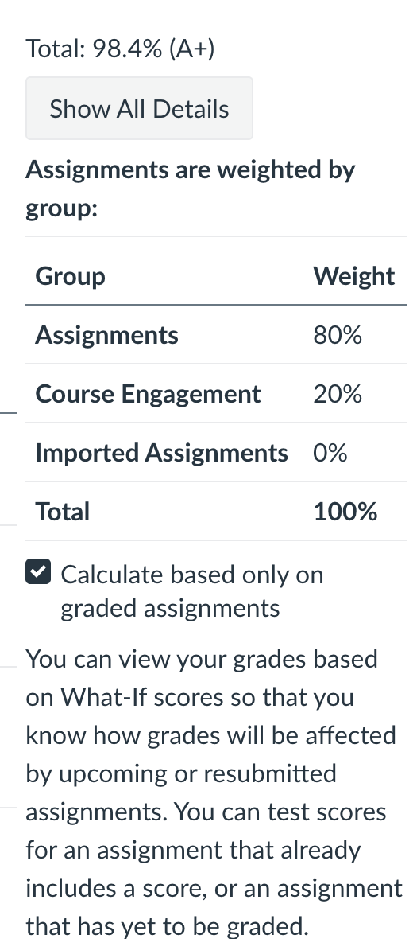
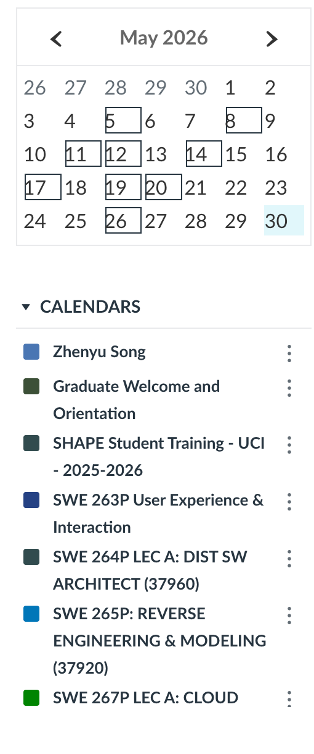
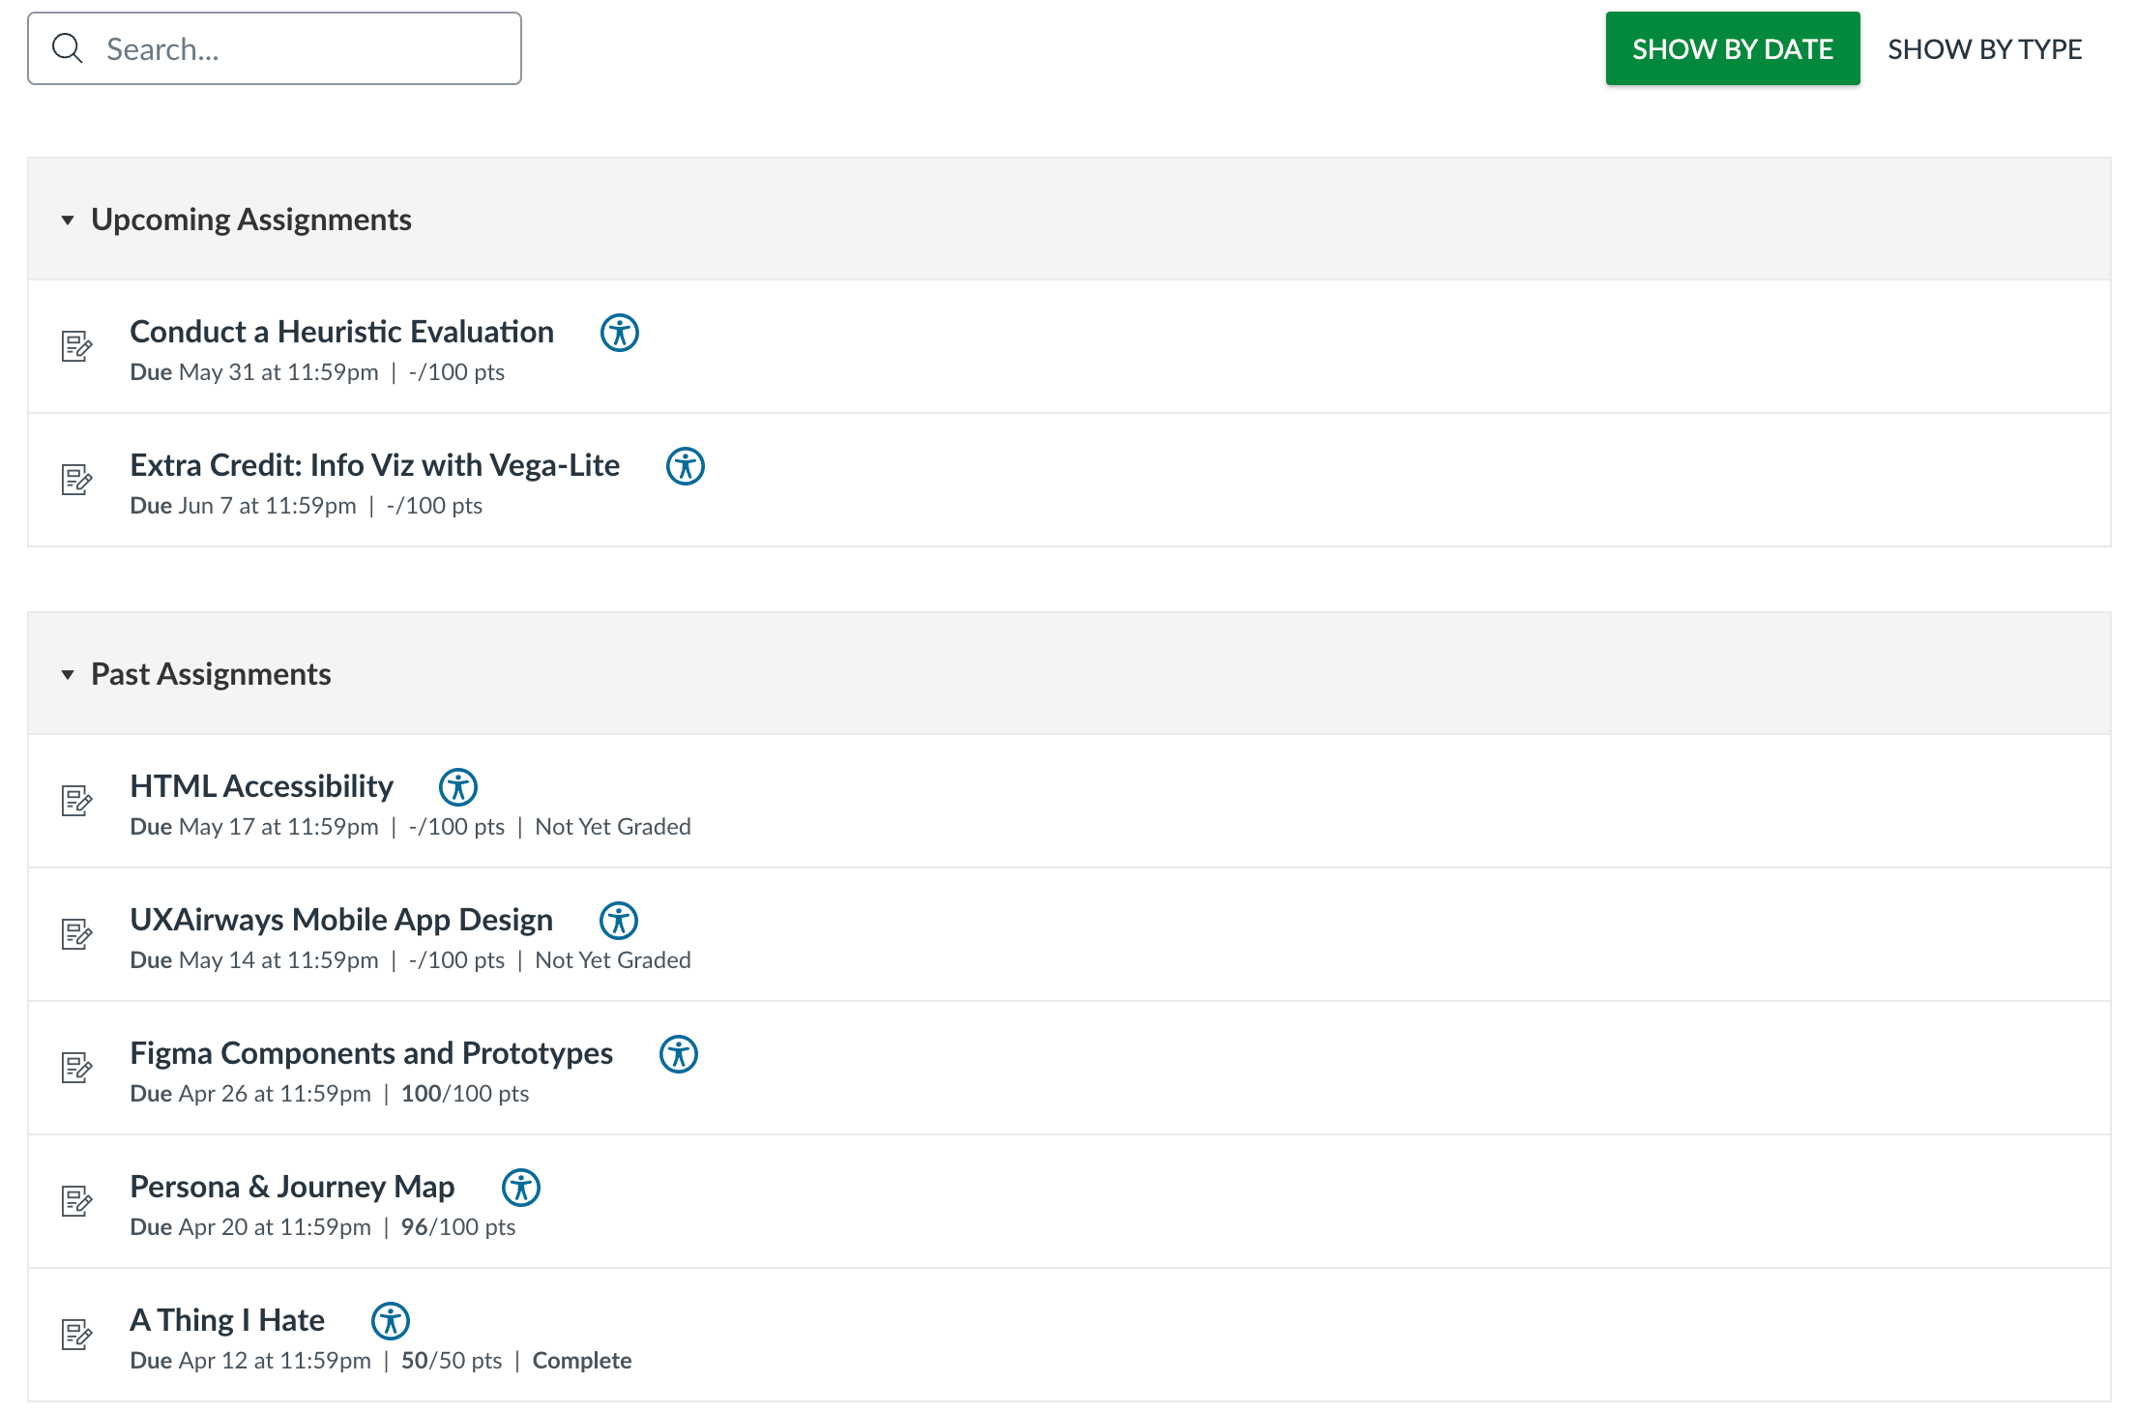
Method
Heuristic evaluation of Canvas student workflows
Scope
Inspection
Evidence
Student workflows: assignments, deadlines, announcements, grades, calendar, and course navigation.
Applied Nielsen's 10 heuristics as a lightweight usability inspection method.
Used six Canvas screenshots and the completed workbook to select the top four heuristics.
Heuristic evaluations are useful for finding visible design issues quickly, but they do not replace testing with students.
Canvas heuristic evaluation | 02
Notes:
Explain that this is a usability inspection, not a user test. The analysis applies Nielsen's heuristics to common tasks visible in the screenshots and prioritizes four issues for the video.

Slide 3
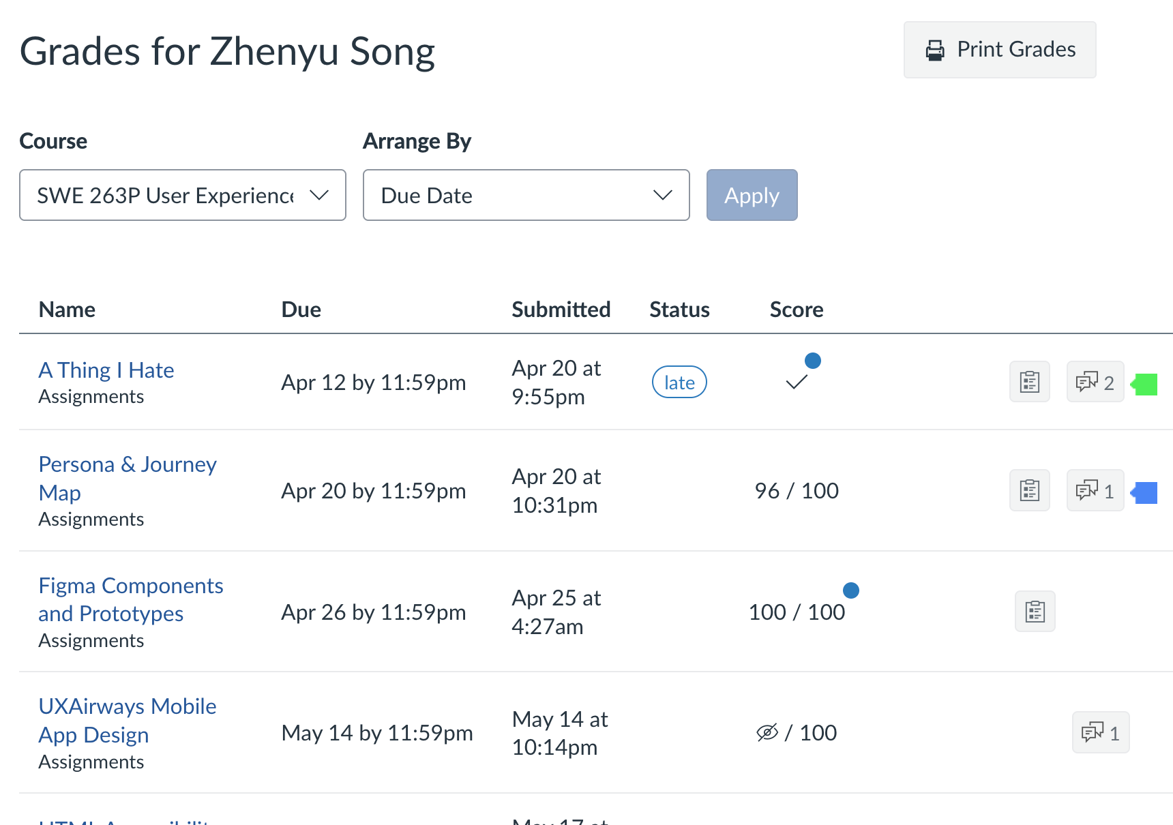
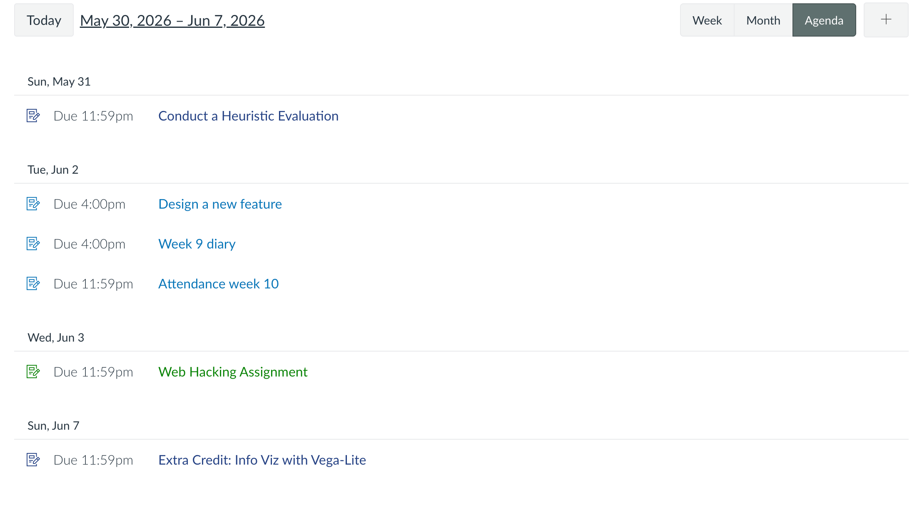
System Overview
Canvas is a hub for many parallel student tasks
Core student jobs
See what is due, find course material, read updates, interpret grades, and plan time across multiple courses.
Canvas heuristic evaluation | 03
Notes:
Briefly walk through the evidence: Dashboard, course homepage, Assignments, Grades, Announcements, and Calendar. Emphasize that the evaluation follows ordinary student tasks.

Slide 4
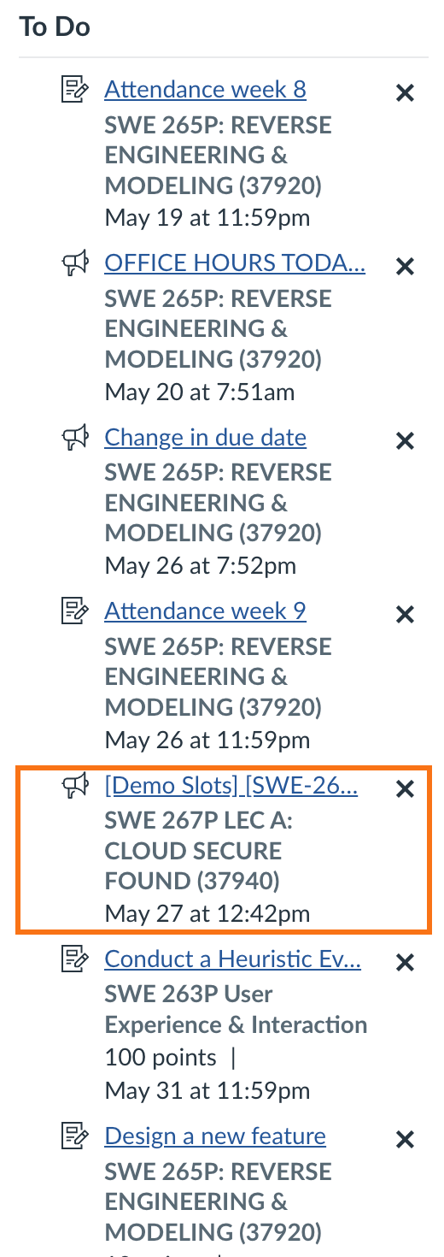
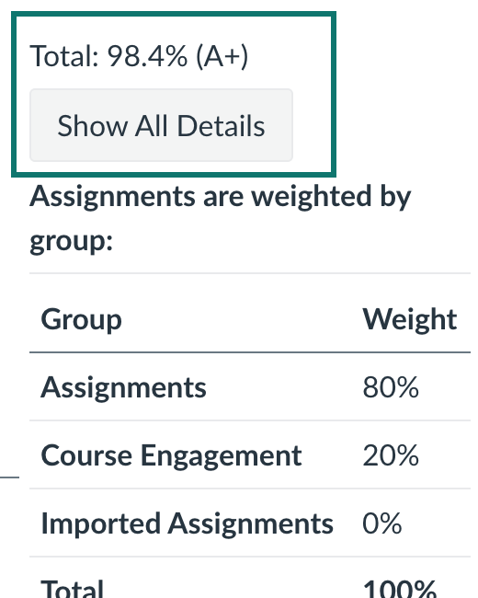
H1. Visibility of System Status
Source: Nielsen Norman Group, n.d.
The interface should keep users informed about what is happening.
Works well
Due dates, To Do items, badges, and grade totals make the system state easy to check.
Needs work
Some status details are hidden behind small icons, hidden-score symbols, and truncated item names.
Recommendation: keep the status cues, but label icon-only states and expose full high-priority item names.
Canvas heuristic evaluation | 04
Notes:
Define the heuristic, then point to the To Do list, badges, due dates, and grade sidebar as strengths. Then explain the weak spots: hidden score symbols, small comment/status icons, and truncated item names.

Slide 5
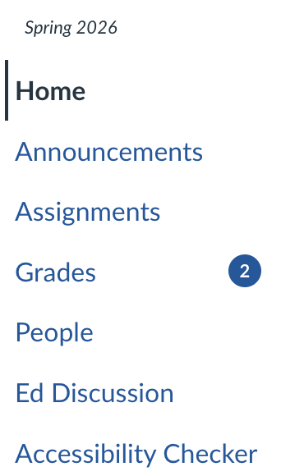
H4. Consistency and Standards
Source: Nielsen Norman Group, n.d.; Kumar, n.d.
Users should not wonder whether similar words, situations, or actions mean the same thing.
Consistent base
Global navigation, course navigation, blue links, and tables repeat across pages.
Functional gap
Similar small icons appear in different contexts without visible labels at the decision point.
Kumar's lens: Canvas is aesthetically and internally consistent, but functional consistency is weaker when icon meaning is not visible while scanning.
Canvas heuristic evaluation | 05
Notes:
Define consistency and mention Kumar's internal, external, aesthetic, and functional consistency. Canvas is internally consistent in navigation, but icon meanings are not always clear or consistent across contexts.

Slide 6
H6. Recognition Rather Than Recall
Source: Nielsen Norman Group, n.d.
Visible options reduce memory load.
Recognition support
Persistent navigation and table headers make major destinations visible.
Recall burden
Truncated course names and icon-only shortcuts ask students to remember meanings before acting.
Recommendation: reveal full names on hover/focus and add text labels or a compact legend for course-card shortcuts.
Canvas heuristic evaluation | 06
Notes:
Define the heuristic. Course navigation and table headers support recognition, but truncated names and icon-only course-card actions require students to remember meanings.

Slide 7
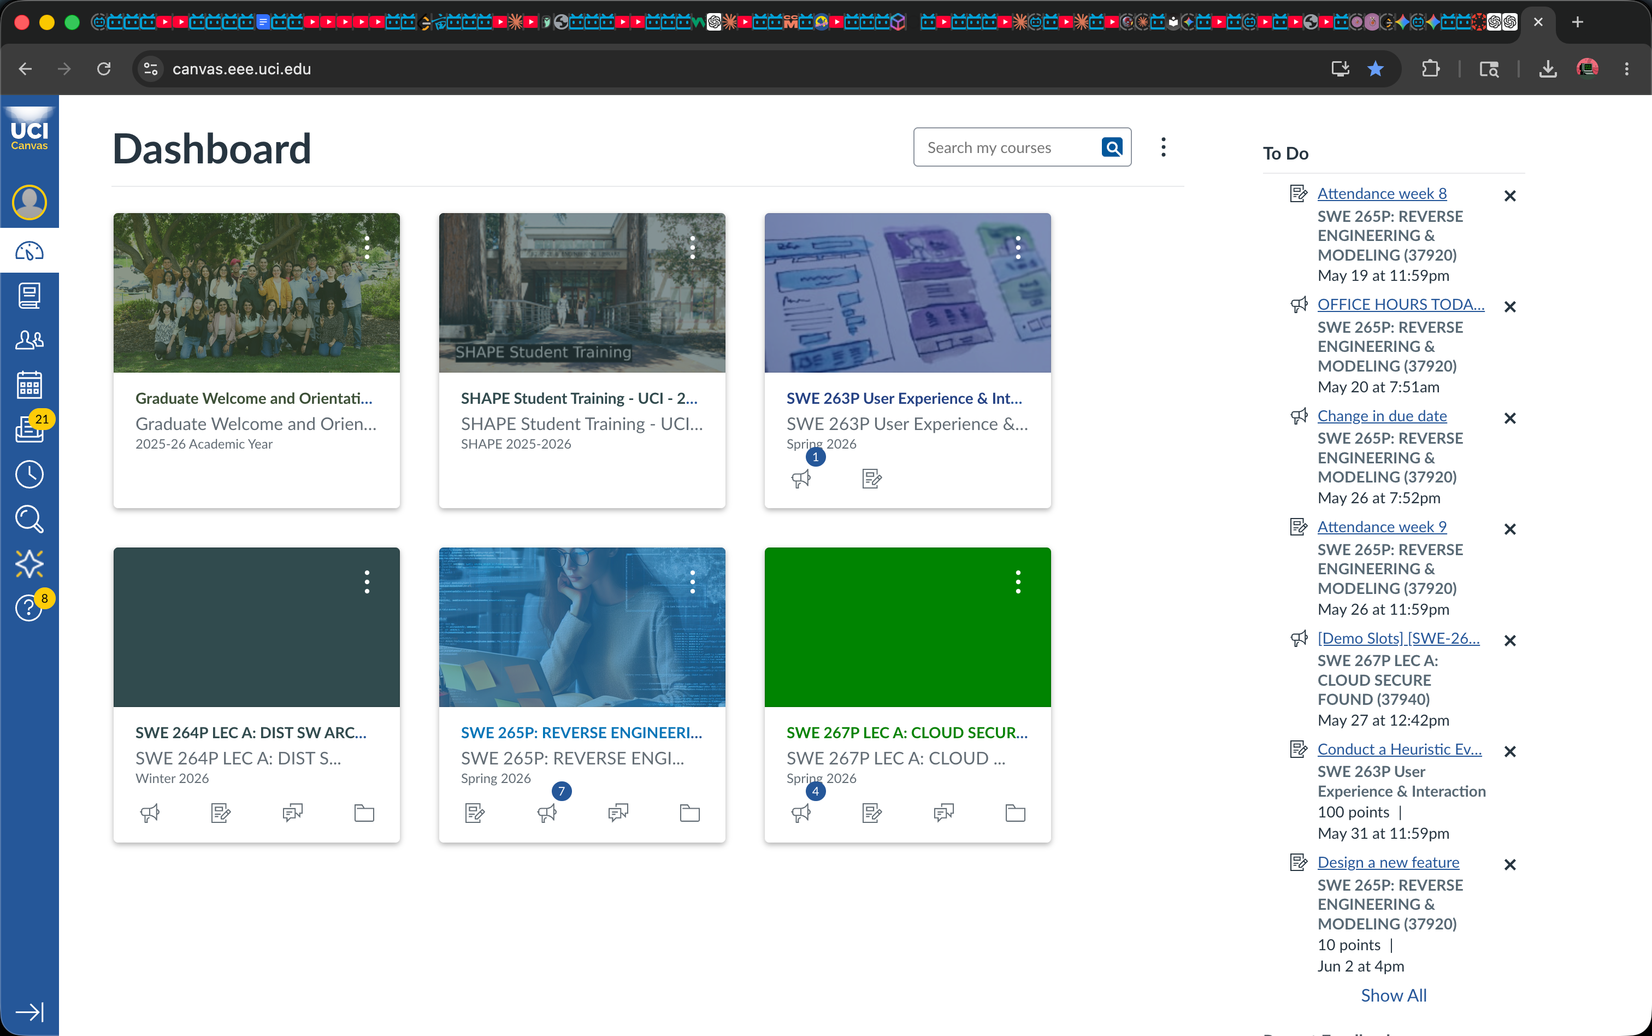
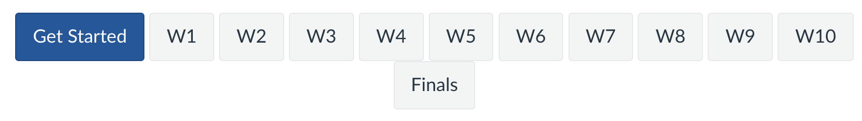
H8. Aesthetic and Minimalist Design
Source: Nielsen Norman Group, n.d.
Extra information competes with what students need most.
Problem
Recommendation
Useful information competes for attention, so students scan across cards, images, badges, utility panels, and long To Do lists.
Give urgent coursework stronger visual priority, offer a denser list view, and group secondary tools away from main content.
Canvas heuristic evaluation | 07
Notes:
Define minimalist design. The Dashboard and course home page contain useful information, but course images, icons, To Do entries, utility buttons, and side panels compete for attention.

Slide 8
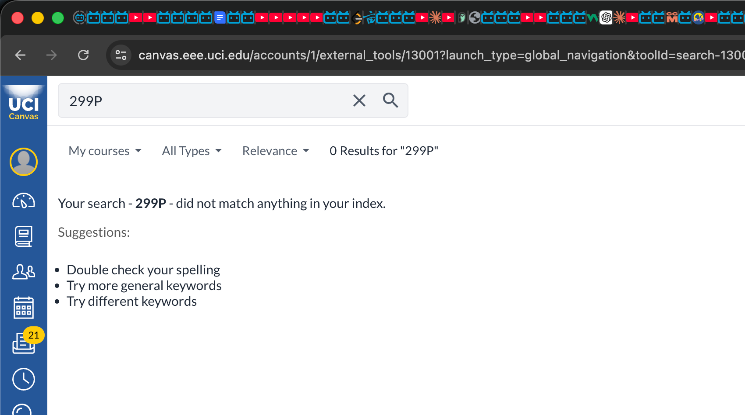
Prioritized Recommendations
Small changes could reduce repeated student effort
1. Label status icons
2. Reduce truncation
4. Add contextual help
Add visible labels or accessible tooltips for comments, hidden scores, course-card shortcuts, and unread markers.
Show full course and assignment names for high-priority items, especially in Dashboard and To Do.
Place short help beside grade weighting, hidden scores, calendar filters, and assignment status.
3. Show recovery steps
The search no-results page explains what happened and suggests next actions. Reuse this pattern for dismissed To Do items, hidden calendar events, and confusing grade states.
Priority: favor small UI changes that reduce repeated student scanning, uncertainty, and recovery effort.
Canvas heuristic evaluation | 08
Notes:
Summarize four actionable fixes: clearer labels, less truncation, recovery steps, and contextual help. Use the search no-results screenshot as an example of a useful recovery pattern.

Slide 9
Conclusion
Canvas is powerful and mostly learnable, but priority and meaning need stronger surface cues.
Strengths
Risks
Canvas makes core academic information findable through persistent navigation, To Do, due dates, search, and grade summaries.
Dense pages, truncated labels, and ambiguous icons can make students miss meaning even when the information is present.
Overall finding
Canvas works, but it should make status, meaning, and priority easier to see when students decide what to do next.
Canvas heuristic evaluation | 09
Notes:
Close with a balanced evaluation: Canvas works because core tasks are findable, but it can better show status, clarify icon meaning, and reduce Dashboard clutter.

Slide 10
References
Sources used for the evaluation criteria and presentation
• Nielsen Norman Group. (n.d.). 10 Usability Heuristics for User Interface Design. https://www.nngroup.com/articles/ten-usability-heuristics/
• Nielsen Norman Group. (n.d.). How to Conduct a Heuristic Evaluation. https://www.nngroup.com/articles/how-to-conduct-a-heuristic-evaluation/
• Baxter, K., Courage, C., & Caine, K. Understanding Your Users, Chapter 14: Evaluation Methods.
• Kumar, V. (n.d.). The four types of consistency in design.
• Canvas screenshots captured from UCI Canvas student interface, May 30, 2026.
AI-use notice
AI helped refine script wording and slide layout.
Canvas heuristic evaluation | 10
Notes:
Use this slide as the end card or include the references in the video description.

