Slide 1
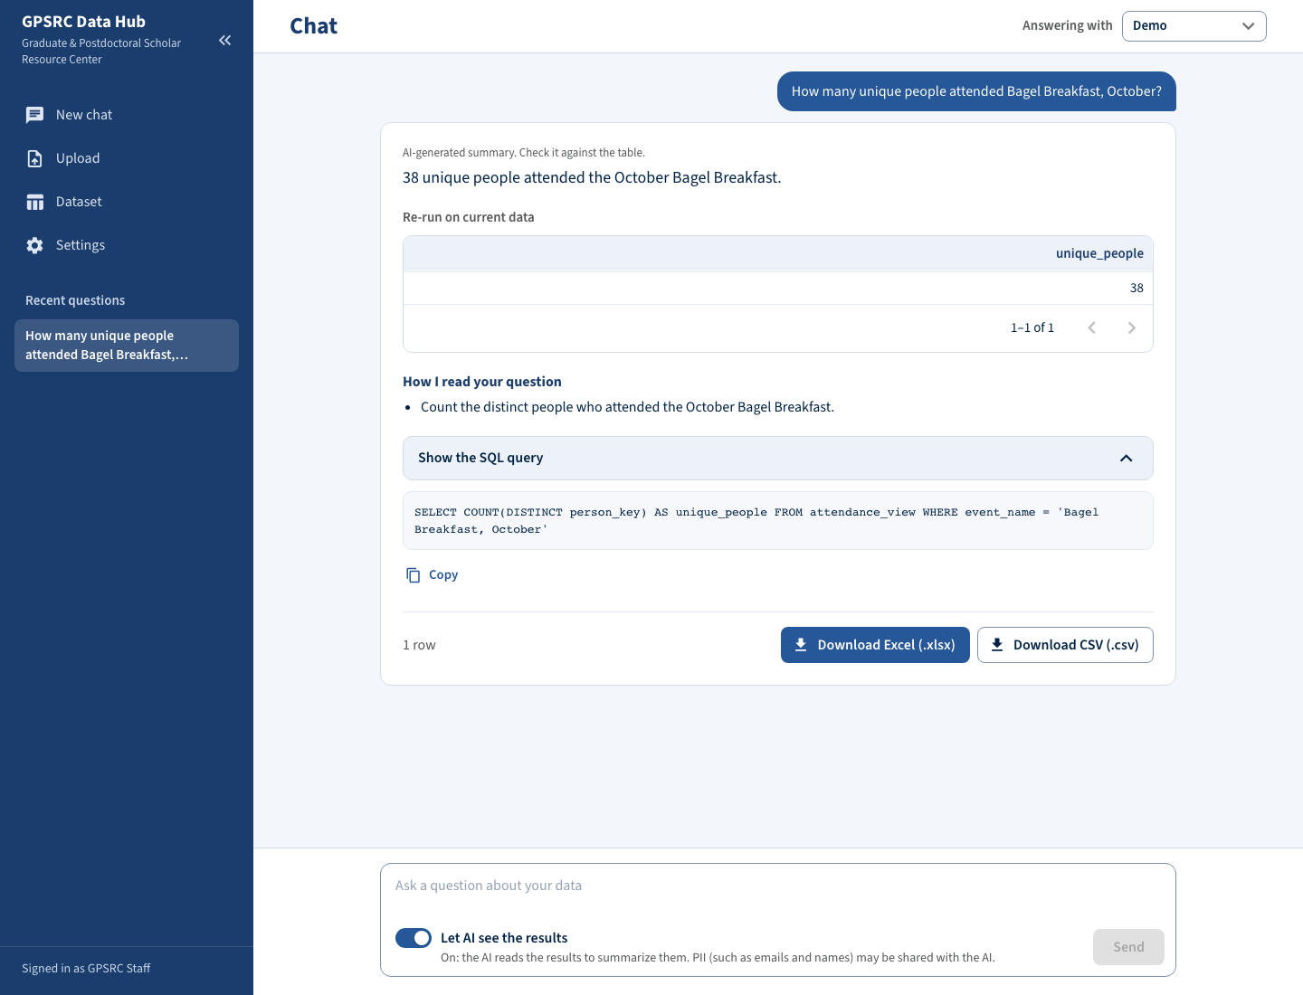
SWE 276P · MIDTERM PRESENTATION · FALL 2026
Program Registration & Attendance Data Hub
Upload each event's export. Ask questions in plain English. Download the answer as Excel.
SPONSOR
Kayleigh Anderson-Natale, PhD
Director of Postdoc and Professional Development, GPSRC, UCI Graduate Division
TEAM ZOTSYNC
Brandon Y Lau
Database / DevOps
Jennifer Sun
Frontend
Molly Tran
Backend / Data Import
Zhenyu (Eric) Song
AI / Chatbot
Notes:
Speaker: Brandon (30 seconds).
Good afternoon. We are Team ZotSync, and our project is the Program Registration and Attendance Data Hub for UCI's Graduate and Postdoctoral Scholar Resource Center, the GPSRC.
Our sponsor is Dr. Kayleigh Anderson-Natale, Director of Postdoc and Professional Development.
I'm Brandon and I handle the database and DevOps. Jennifer builds the frontend, Molly owns the backend and data import, and Eric owns the AI chatbot. Each of us will present one part today.

Slide 2



PROBLEM & OBJECTIVES
Event attendance data is scattered across spreadsheets
Today
Goal: three measurable targets
Two platforms, two formats
CampusGroups and 12twenty export different columns. 12twenty has no NetID.
Confirmed by the sponsor on October 21. Due December 4, 2026.
18 / 20
sponsor-style reporting questions answered correctly
Copied by hand
A student assistant pastes each event's list into a yearly sheet.
293 · 79
rows and unique NetIDs match the sponsor's compiled sheet, with no duplicates
Slow to answer
Unique students by school means filtering, sorting and de-duplicating in Excel.
< 1 min
from question to downloaded Excel file
2
Notes:
Speaker: Molly (1 minute).
The GPSRC runs events all year. Students register on CampusGroups or 12twenty, and the two platforms export different columns. 12twenty does not even have a NetID.
After each event a student assistant pastes the attendee list into a yearly spreadsheet. A simple question, like how many unique students from one school came this term, means filtering, sorting and removing duplicates by hand.
The sponsor's real goal is better reporting: showing leadership who the GPSRC reaches, and finding the groups it is missing.
On October 21 the sponsor confirmed three targets for December 4: the chatbot answers at least 18 of 20 reporting questions correctly; the sample files reproduce the sponsor's compiled sheet, 293 rows and 79 unique NetIDs, with no duplicates; and any question goes to an Excel file in under a minute.

Slide 3

SYSTEM OVERVIEW & DESIGN
The AI writes the SQL; the database computes the answer
One GPSRC computer · Docker Compose
Web client
React 19 · MUI
Web server
Nginx · 127.0.0.1 only
API
FastAPI · LangGraph
Database
PostgreSQL 16 · read-only chatbot role
GPSRC staff
Upload: native exports, people linked by NetID then email. Export: any answer as Excel or CSV.
AI provider
ZotGPT · OpenAI · DeepSeek
Sends the schema and the question; gets SQL back. Never needs student rows.
Every question
Question
plain English, follow-ups
Generate SQL
by the AI
Guard
sqlglot: one SELECT, one view
Execute
read-only role, 5 s limit
Answer
summary, SQL, table, Excel
Gold = safety layer. A rejected query goes back to the AI for repair, up to 3 tries.
3
Notes:
Speaker: Eric (2 minutes).
This is the architecture as built. Everything runs on one GPSRC computer in three Docker containers. Nginx serves the React app and only listens on localhost, the FastAPI application does the work, and PostgreSQL stores one growing dataset. Public cloud is excluded for privacy.
The key design choice: the AI writes SQL, and the database computes the answer. The AI receives the schema and the question, never student rows, so counts are exact and staff can read the SQL behind every answer.
The bottom row is what happens to each question. A LangGraph graph asks the AI for SQL. Then two safety layers: sqlglot accepts only one SELECT on one view, and the query runs as a read-only database role with a five-second limit. Even if the check is bypassed, that role cannot change data or read other tables. If a query is rejected, the error goes back to the AI for repair, up to three tries.
Staff manage AI models in Settings, so they can switch between ZotGPT, OpenAI and DeepSeek with no code change.

Slide 4

PROGRESS TO DATE
MVP built: all three targets met on sample data
20 / 20
benchmark questions correct (held-out set: 10 / 10)
293 · 79
rows and NetIDs match the compiled sheet; a re-upload adds nothing
4–7 s
from question to downloaded Excel file
Built Oct 20–22 with AI-assisted development
9 of 10 acceptance tests pass; login moves to Sprint 3
1,149 automated tests; 63 user stories walked
Sponsor's 14 requests checked: 13 pass, 1 gap
Chat: the answer, how the question was read, the SQL, and Excel/CSV downloads
4
Notes:
Speaker: Jennifer (2 minutes).
We built the MVP early, from October 20 to 22, using AI-assisted development with Claude Code. Each owner specified their part, reviewed the generated code and tested it. That puts us about a month ahead of the schedule in our charter.
This screenshot is the chat page. Staff type a question and get a one-line answer, a "How I read your question" note, the SQL, and buttons to download Excel or CSV. Upload, Dataset and Settings pages are done too.
On the sponsor's sample data, all three targets are met: 20 of 20 benchmark questions, plus 10 of 10 on held-out questions we wrote before tuning; the import reproduces the compiled sheet, 293 rows and 79 NetIDs, and re-uploading a file adds nothing; and a question becomes an Excel file in 4 to 7 seconds.
Nine of ten acceptance tests pass. The tenth is login, which we moved to Sprint 3. We have over 1,100 automated tests, we walked 63 user stories by hand, and we checked all 14 requests from the sponsor meeting. Thirteen passed, five of them with small caveats, and one found a gap, which Molly will cover next.

Slide 5




CHALLENGES & LESSONS LEARNED
Challenges, and how we are handling them
Privacy
Trusting AI answers
Double counting
Changing scope
Names and emails are in the data; the AI service is external.
An answer can look right and still be wrong.
A second download of an event is saved as a new event.
Scope narrowed twice; some decisions wait on the sponsor.
The AI sees the schema, not rows. Sharing results needs two switches and sponsor approval.
Every answer shows its SQL and table. The 30-question benchmark is re-run after each prompt change.
Found in the sponsor walkthrough. It is the first fix in Sprint 2.
Metrics confirmed early. Open questions are batched for the Sprint 2 demo.
LESSONS LEARNED
With AI-assisted coding, the bottleneck is verification and sponsor decisions, not code.
Walking the sponsor's real requests found a bug that over 1,100 automated tests missed.
5
Notes:
Speaker: Molly (1 minute).
Privacy: the data has student names and emails, and the AI service is outside the computer. The AI only sees the schema when it writes SQL. Letting it read query results for a summary needs two switches, and the sponsor still has to approve it.
Trust: an AI answer can look right and be wrong, so every answer shows its SQL and the table, and we re-run a 30-question benchmark after every prompt change.
Double counting: walking the sponsor's requests, we found that downloading the same event a second time and uploading it creates a second event, so its attendees are counted twice. It is our first fix in Sprint 2.
Scope: the sponsor narrowed the project twice. We got measurable targets confirmed early, and we are collecting open questions for the Sprint 2 demo.
Two lessons: with AI-assisted coding, verifying and getting decisions is now the slow part, and testing against the sponsor's real requests catches what unit tests miss.

Slide 6

NEXT STEPS & TIMELINE
Next: sponsor demo and fixes, then handoff by December 4
Sprint 0 · Done
Sep 24 – Oct 19
Sprint 1 · Now
Oct 20 – Nov 2
Sprint 2
Nov 3 – Nov 16
Sprint 3
Nov 17 – Dec 7
Sponsor meetings
MVP built and tested
Sponsor demo (week 7)
Staff login; automated CI
Scope, MOV, business case, charter
ZotGPT check; Oct 28 sponsor meeting
Fix double counting
Install at the GPSRC; staff training
Midterm; WBS
Delete chats, Downloads page, Insights button
Final demo Dec 4; Showcase Dec 7
Risks and dependencies
Sponsor approval for the AI reading query results
ZotGPT access and AI credits ($100–200 request)
Docker Desktop on the GPSRC computer (admin rights)
Real export files may differ from our synthetic samples
6
Notes:
Speaker: Brandon (1.5 minutes).
This is our updated timeline. Sprint 0 was scope and planning. Sprint 1, the current one, built the MVP; this week we check that UCI's ZotGPT service works with the Hub and meet the sponsor on October 28.
Sprint 2, November 3 to 16, starts with a demo for the sponsor in week 7. Then we fix the double counting and add three follow-up features from our MVP review: deleting chats, a Downloads page and an Insights button.
Sprint 3 adds staff login and automated CI, installs the Hub on the GPSRC computer, and trains the staff. The final demo is December 4 and the Capstone Showcase is December 7.
The main risks are outside our code: the sponsor's approval for the AI reading query results, ZotGPT access and AI credits, whether Docker can be installed on the GPSRC computer, and whether real export files match our synthetic samples.

Slide 7

CLOSING
Thank you
A working MVP, about a month ahead of plan
All three success metrics met on sample data
Privacy first: the AI writes SQL without student rows
Questions and feedback?
Team ZotSync · Brandon, Jennifer, Molly, Eric
Thank you to our sponsor, Dr. Kayleigh Anderson-Natale, and the GPSRC team for their time, sample data and feedback.
Notes:
Speaker: Jennifer (30 seconds).
To sum up: we have a working MVP about a month ahead of plan, it meets all three success metrics on the sponsor's sample data, and its design keeps student rows away from the AI when it writes queries.
Thank you to Dr. Anderson-Natale and the GPSRC team for their time, the sample data and their feedback.
We are happy to take questions and feedback.

