Slide 1
PITCH DECK
QueryForge
LIVE CONTEXT
Built in 72 hours
ClawHunt Builder Camp 2026 hackathon
Powered by Kimi K2.7
Model used in the live demo
Demo data
10K orders | 500 products | 1,000 users | 8 regions | 20 categories
Natural-language business data queries with charts on demand.
Business users ask a question, QueryForge fetches the data, and the answer appears as KPI cards, charts, or reusable dashboard views.
queryforge-production-8d6f.up.railway.app
QueryForge | ClawHunt Builder Camp 2026
1/9

Slide 2
PAIN POINT
The bottleneck is request handling, not analysis.
When business teams need answers, every clarification becomes another handoff.
Analyst queue
Business waiting loop
Same metric is requested by multiple teams in slightly different words.
Questions arrive as ad hoc requests, follow-ups, and revised definitions.
Analysts spend attention on recreating views instead of interpreting the business.
Revenue, category, channel, and customer questions come up during operating reviews.
Teams need a chart they can inspect immediately, not another request thread.
Metric definitions have to stay consistent as more people reuse the answer.
The product opportunity: make common business questions self-service while keeping analyst-defined metrics reusable.
QueryForge | ClawHunt Builder Camp 2026
2/9

Slide 3
SOLUTION
Analysts define the metric library once; business users self-serve.
QueryForge turns the analyst role from repeated report builder into metric owner.
01
02
03
Analyst setup
Business questions
Reusable answers
Define preset metrics once: revenue trend, category margin, top products, channel orders, and repeat buyer views.
Users type a natural-language question or rerun a saved metric from the library.
Charts, KPI cards, progress streaming, and self-correction keep the answer usable in front of the business.
->
->
Core capability: plain-language data access that preserves analyst-defined business meaning.
QueryForge | ClawHunt Builder Camp 2026
3/9

Slide 4
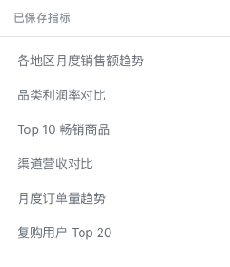
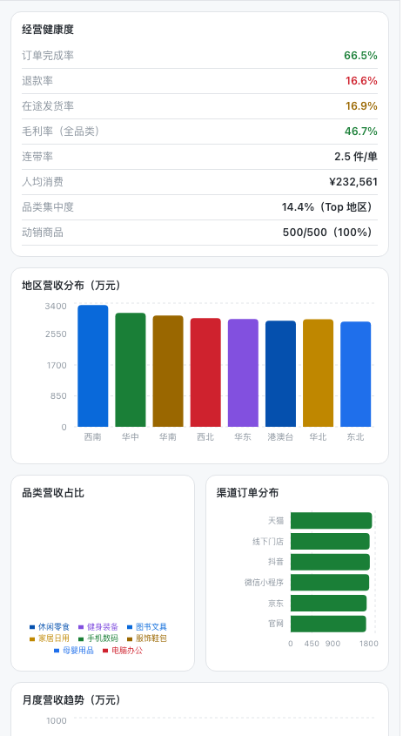
PRODUCT DEMO
The live product already combines questions, KPI cards, and dashboard panels.
Screenshots are from the deployed QueryForge demo with actual demo data.
Natural-language entry
A user types a business question and gets a charted answer.
8 KPI cards
Revenue, AOV, margin, repeat rate, completion, refund, basket, active buyers.
6 dashboard panels
Region bar, category pie, monthly trend, channel bar, top products, user segments.
Preset metric library
Analysts create reusable metrics that business users can rerun.
Dashboard remains visible while the user asks or reruns questions.
The product view is built around business application: operating health, regional performance, channel mix, product focus, and user segmentation.
QueryForge | ClawHunt Builder Camp 2026
4/9

Slide 5
DATA PROOF
Eight KPI cards are backed by the demo dataset.
The dashboard summarizes the operating view business users can reuse.
TOTAL REVENUE
AOV
MARGIN
REPEAT RATE
¥232M
¥23K
46.7%
100%
30-month demo history
Average order value
All-category average
1,000 active buyers
COMPLETION
REFUND
BASKET
ACTIVE BUYERS
66.5%
16.6%
2.5 items
1,000
6,650 completed orders
1,664 refunded orders
Average items per order
Across 20 categories
Demo data scope: 10K orders | 500 products | 1,000 users | 8 regions | 20 categories
QueryForge | ClawHunt Builder Camp 2026
5/9

Slide 6
HOW IT WORKS
Question to answer, with progress visible throughout.
The flow is designed for business users: ask, watch progress, inspect the chart, reuse the metric.
1
2
3
4
Ask
->
Stream
->
Answer
->
Reuse
Type a business question in natural language.
Progress updates show what is happening.
Data appears as charts, tables, or KPI cards.
Save useful answers into the metric library.
Self-correction loop
If a query fails, QueryForge fixes the attempt and retries so the user can stay focused on the business question.
No handoff is required for routine data questions once the metrics have been set up.
QueryForge | ClawHunt Builder Camp 2026
6/9

Slide 7
USE CASES
The demo scenarios map directly to operating questions.
Each scenario starts with a business question and ends with a reusable visual answer.
Regional performance
Category margin
How are regions contributing to revenue over time?
Which categories carry the strongest margin?
Output: region distribution and monthly trend.
Output: category comparison view.
Product focus
Customer behavior
Which products are driving the most revenue?
Which buyers and segments show repeat activity?
Output: top products table.
Output: repeat buyer and user segment views.
The same surface supports quick exploration and repeated management reporting.
QueryForge | ClawHunt Builder Camp 2026
7/9

Slide 8
WHAT'S NEXT
Move from a hackathon demo to a business-ready tool.
The roadmap extends the existing product without adding unsupported market or revenue claims.
Deployment
Harden the live environment, improve onboarding, and make the demo easier to hand off to evaluators or early users.
More data sources
Connect additional business datasets beyond the ecommerce demo while preserving the same question-to-chart experience.
Team features
Add shared metric libraries, saved views, and collaboration controls for analysts and business stakeholders.
QueryForge | ClawHunt Builder Camp 2026
8/9

Slide 9
CTA
QueryForge
Let business teams ask for data directly while analysts own the reusable metrics.
LIVE DEMO
queryforge-production-8d6f.up.railway.app
GITHUB
github.com/eric-stone-plus/queryforge
Built at ClawHunt Builder Camp 2026 in 72 hours | Kimi K2.7
QueryForge | ClawHunt Builder Camp 2026
9/9

