Slide 1
Simulating multiple vibration absorbers and their effect on the response to earthquakes
Eric Wieser and Ajinkya Bhalerao

Slide 2
Building the model

Slide 3
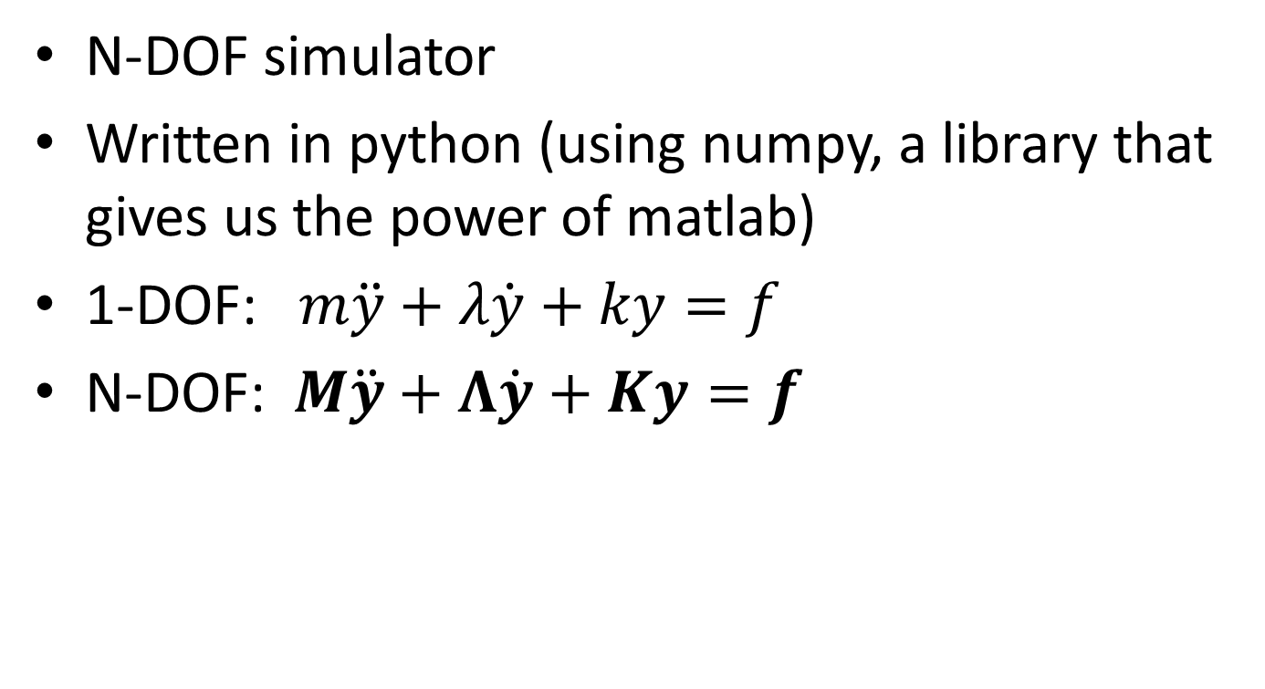
Modelling our system
N-DOF simulator
Written in python (using numpy, a library that gives us the power of matlab)
1-DOF: $m\ddot{y}+λ\dot{y}+ky=f$
N-DOF: $M\ddot{y}+Λ\dot{y}+Ky=f$

Slide 4
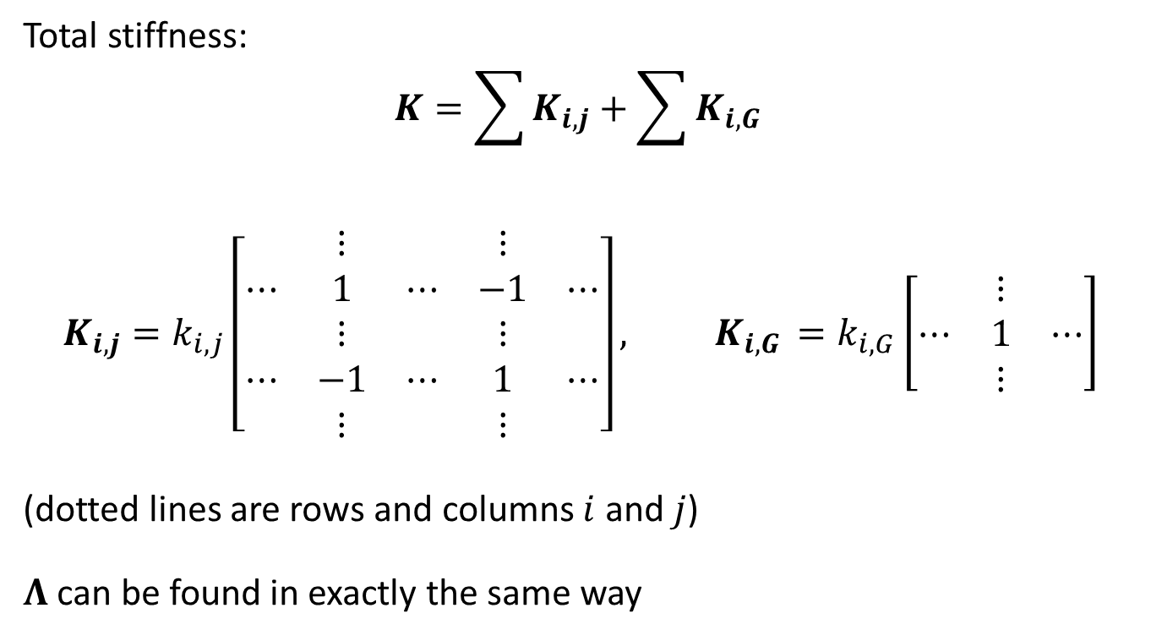
Deriving the stiffness matrix
Total stiffness:
$$K=\sum{K_{i,j}}+\sum{K_{i,G }}$$
$$K_{i,j}=k_{i,j}\left[\begin{matrix} & ⋮ & & ⋮ & \\ ⋯ & 1 & ⋯ & −1 & ⋯ \\ & ⋮ & & ⋮ & \\ ⋯ & −1 & ⋯ & 1 & ⋯ \\ & ⋮ & & ⋮ & \end{matrix}\right], K_{i,G }=k_{i,G}\left[\begin{matrix} & ⋮ & \\ ⋯ & 1 & ⋯ \\ & ⋮ & \end{matrix}\right]$$
(dotted lines are rows and columns $i$ and $j$)
$Λ$ can be found in exactly the same way

Slide 5
Time response
Verlet integrator (like in Mars lander!)
Takes external force as a function of time
Combines with M, K, and Λ to find acceleration
Works with vectors to find all displacements simultaneously

Slide 6
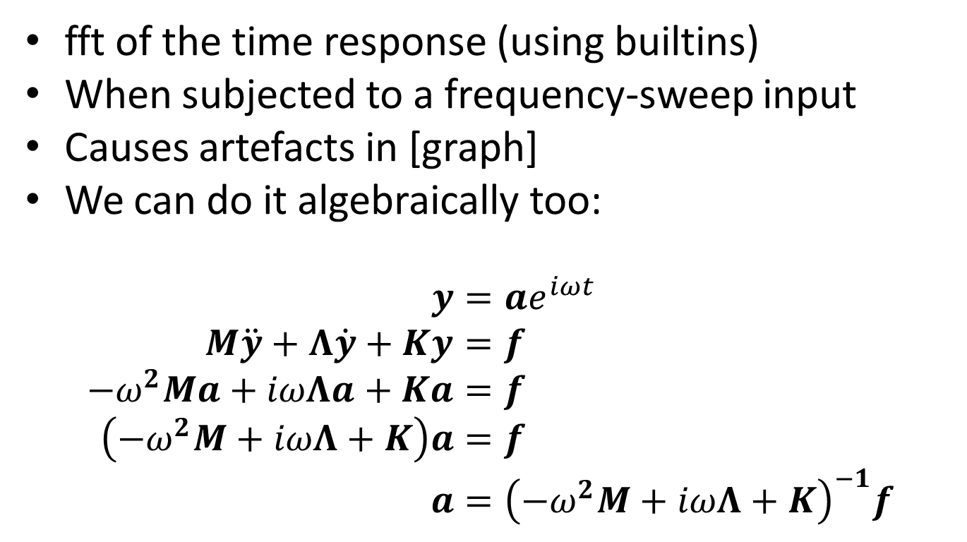
Frequency response
fft of the time response (using builtins)
When subjected to a frequency-sweep input
Causes artefacts in [graph]
We can do it algebraically too:
$$y=ae^{iωt} \\ M\ddot{y}+Λ\dot{y}+Ky=f \\ {−ω}^{2}Ma+iωΛa+Ka=f \\ \left(−ω^{2}M+iωΛ+K\right)a=f \\ a={\left(−ω^{2}M+iωΛ+K\right)}^{−1}f$$

Slide 7
Finding resonant frequencies
To a good approximation, numerically finding maxima on a frequency response is sufficient
Can also be solved by solving a quadratic equation with matrix coefficients (quadratic eigenvalue problem)

Slide 8
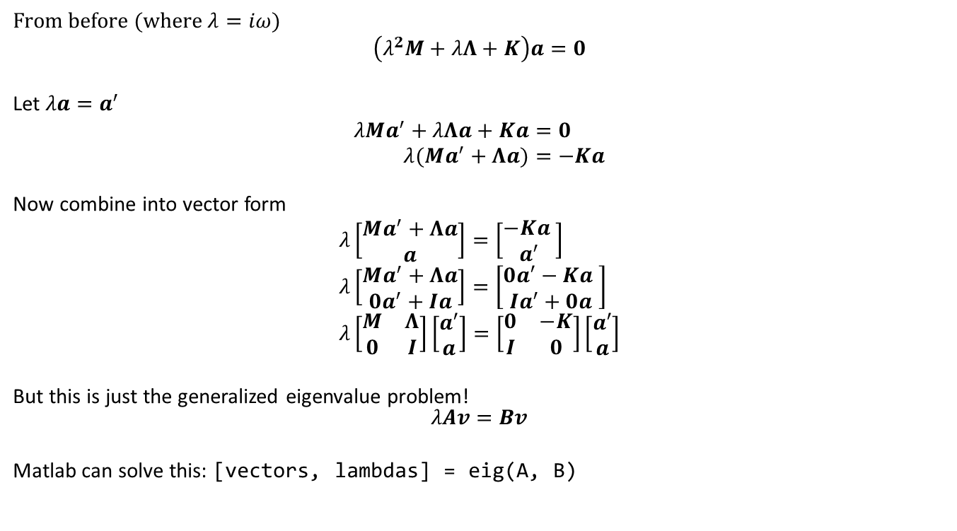
Quadratic eigenvalue problem
From before (where $λ=iω$)
$$\left(λ^{2}M+λΛ+K\right)a=0$$
Let $λa=a^{′}$
$$λMa^{′}+λΛa+Ka=0 \\ λ(Ma^{′}+Λa)=−Ka$$
Now combine into vector form
$$λ\left[\begin{matrix}Ma^{′}+Λa \\ a\end{matrix}\right]=\left[\begin{matrix}−Ka \\ a^{′}\end{matrix}\right] \\ λ\left[\begin{matrix}Ma^{′}+Λa \\ 0a^{′}+Ia\end{matrix}\right]=\left[\begin{matrix}0a′−Ka \\ Ia^{′}+0a\end{matrix}\right] \\ λ\left[\begin{matrix}M & Λ \\ 0 & I\end{matrix}\right]\left[\begin{matrix}a′ \\ a\end{matrix}\right]=\left[\begin{matrix}0 & −K \\ I & 0\end{matrix}\right]\left[\begin{matrix}a′ \\ a\end{matrix}\right]$$
But this is just the generalized eigenvalue problem! $$λAv=Bv$$
Matlab can solve this: [vectors, lambdas] = eig(A, B)

Slide 9
Testing the model

Slide 10
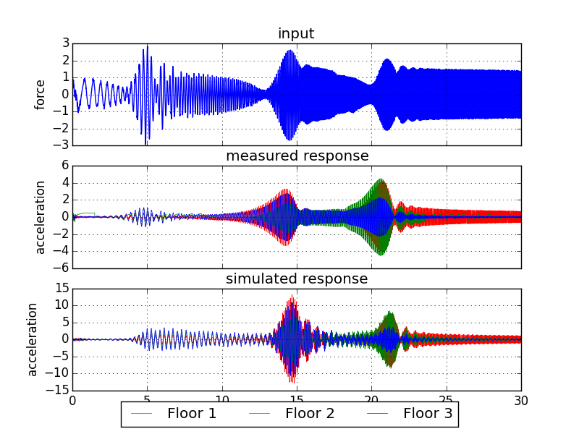
Comparison against real structure
Notes:
Couldn’t get a step response from the structure, because force and signal to transducer were not in sync
Got data from the original under a frequency sweep

Slide 11
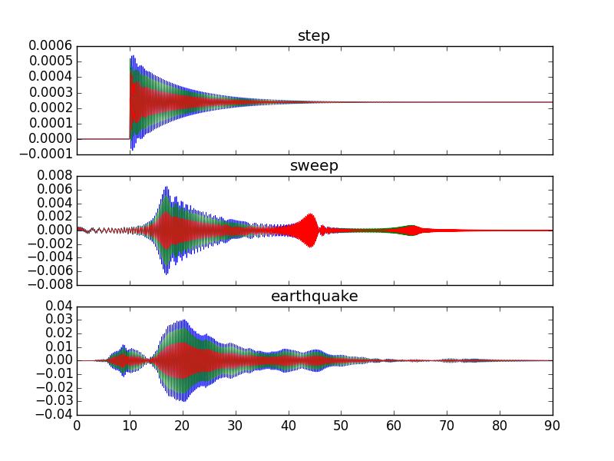
Displacement-time graphs of model

Slide 12
Adding absorbers to the model

Slide 13
Iteratively adding absorbers
Repeatedly add dampers to eliminate the maximum response
Conserve total mass of absorbers
As a result, some absorbers become less massive and therefore less effective, so are duplicated on further iterations

Slide 14
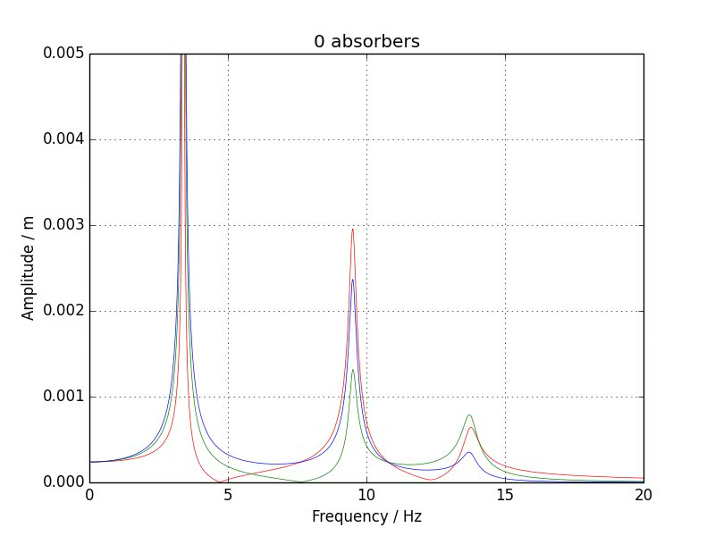
Effect of adding absorbers (video)

Slide 15
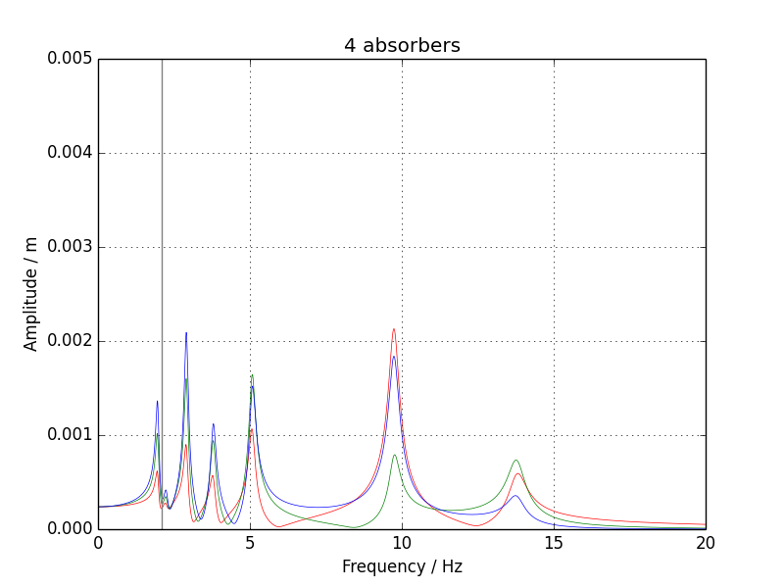
Effect of adding absorbers

Slide 16
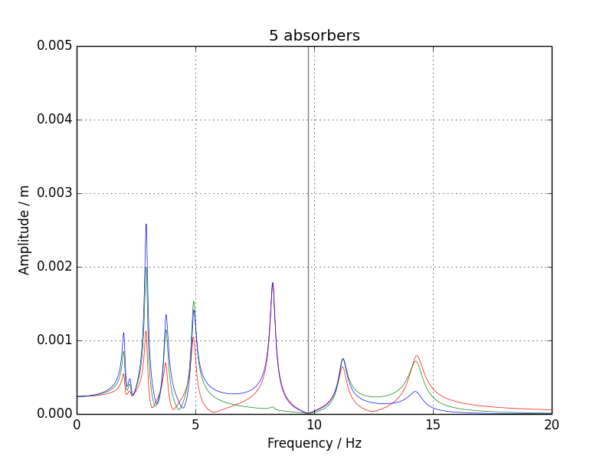
Effect of adding absorbers

Slide 17
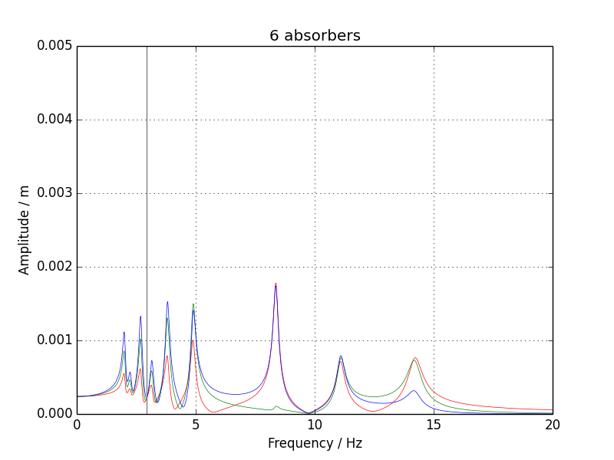
Effect of adding absorbers

Slide 18
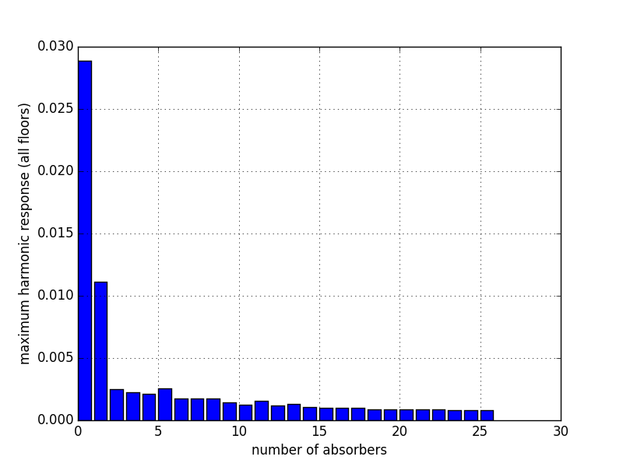
Effect of adding absorbers

Slide 19
Applying stimuli

Slide 20
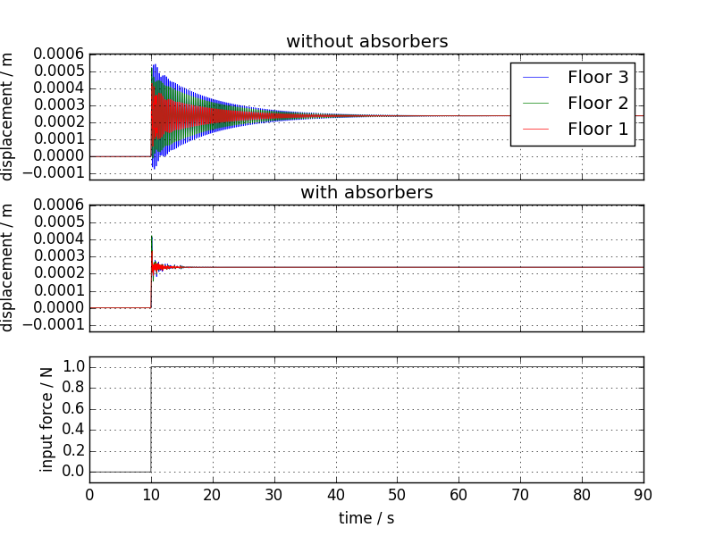
Response to step input

Slide 21
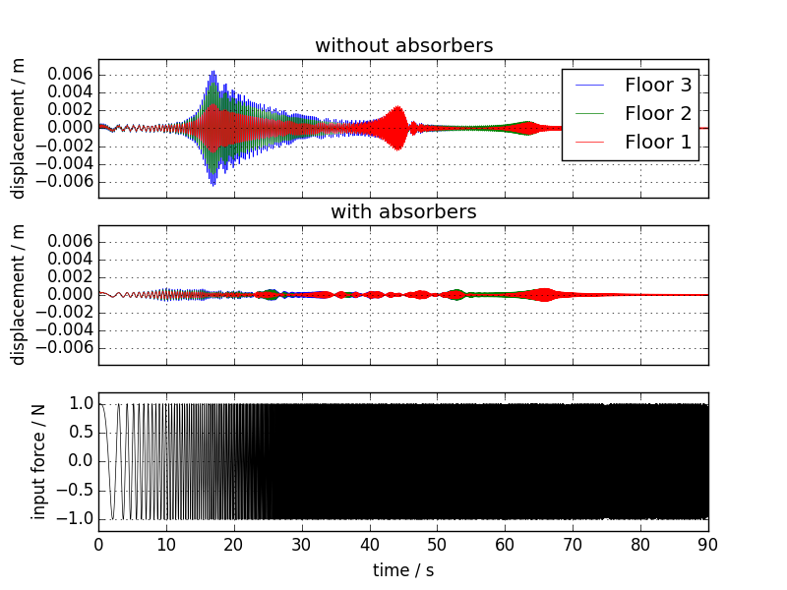
Response to frequency sweep

Slide 22
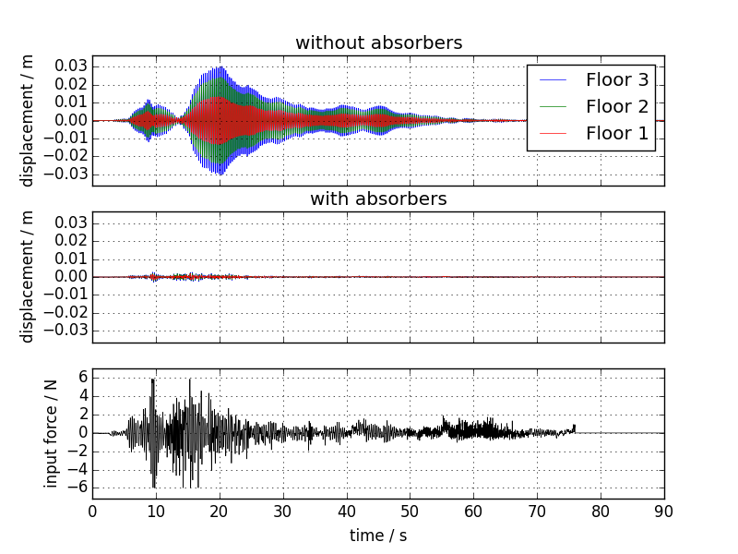
Response to earthquake

Slide 23
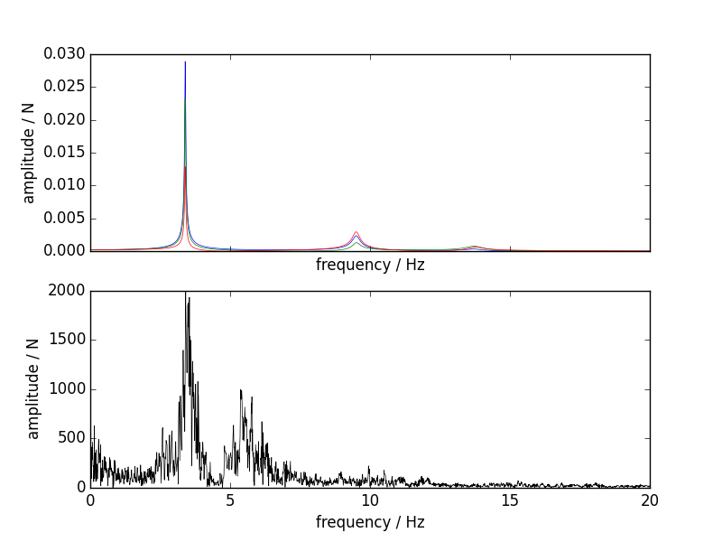
Tuning for earthquakes

Slide 24
Damping resonant peaks
Absorbers needs a damped frequency matching the frequency of the peak to eliminate
Can be derived from databook equations
[equation]
For simplicity, assume absorber damping equal to building damping

