Slide 1
Simulating multiple vibration absorbers and their effect on the response to earthquakes
Eric Wieser and Ajinkya Bhalerao

Slide 2
Designing the simulator
In python, using numpy and matplotlib
Notes:
So, our first job is to build a software model of the structure. We did this in python, using numpy for matrix algebra, and matplotlib for plotting. It’s a lot like matlab.

Slide 3
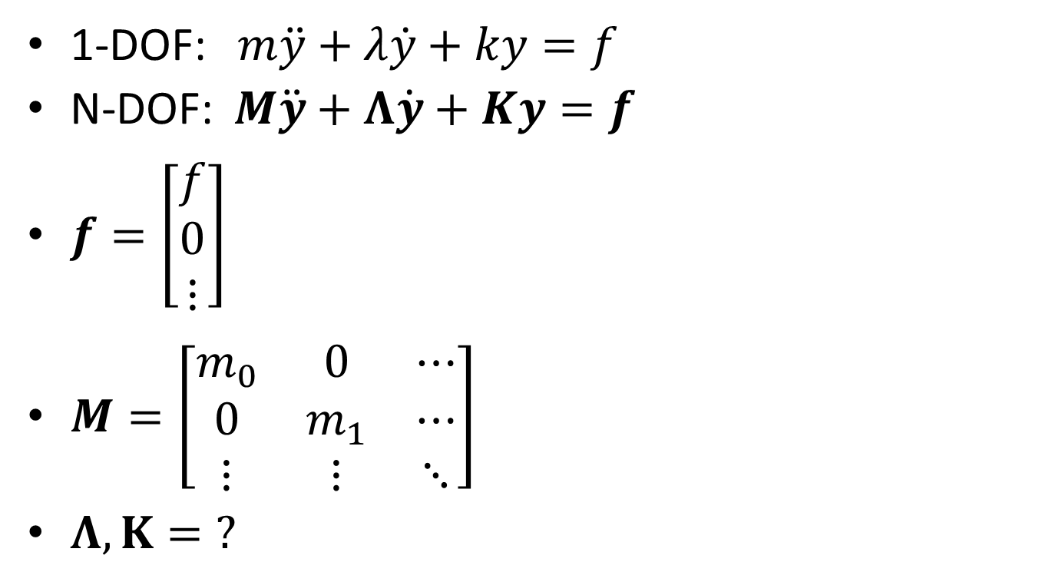
Modelling our system
1-DOF: $m\ddot{y}+λ\dot{y}+ky=f$
N-DOF: $M\ddot{y}+Λ\dot{y}+Ky=f$
$f=\left[\begin{matrix}f \\ 0 \\ ⋮\end{matrix}\right]$
$M=\left[\begin{matrix}m_{0} & 0 & ⋯ \\ 0 & m_{1} & ⋯ \\ ⋮ & ⋮ & ⋱\end{matrix}\right]$
$Λ,K=\text{?}$
Notes:
Form a system of differential equations for each body Collapse these into matrix form force is applied at only one floor, so we know the form of the force vector Generalizing the mass matrix is also easy How do we generalize the damping and stiffness matrices?

Slide 4
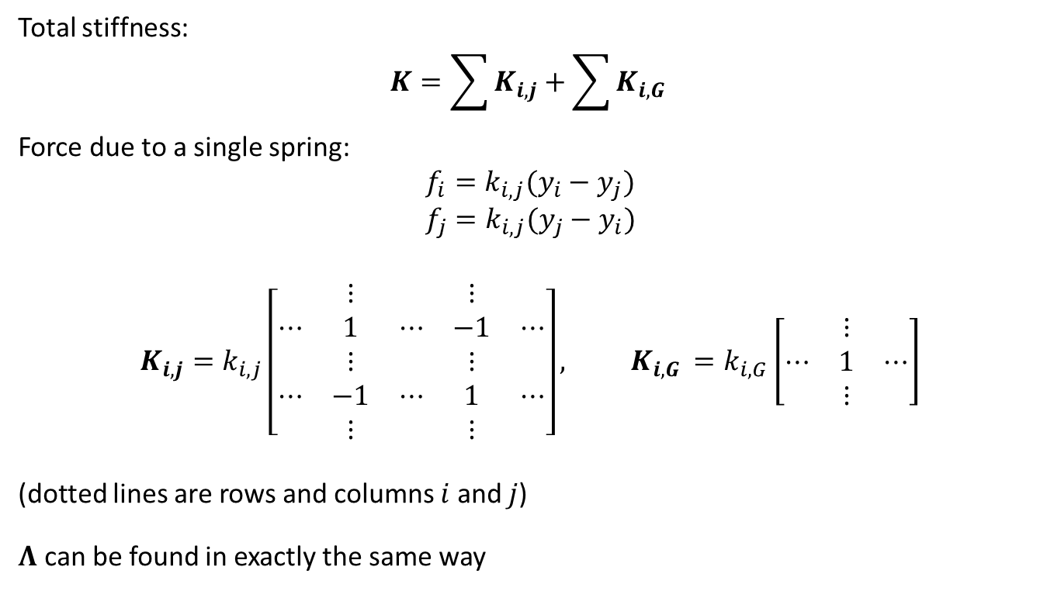
Deriving the stiffness matrix
Total stiffness:
$$K=\sum{K_{i,j}}+\sum{K_{i,G }}$$
Force due to a single spring:
$$f_{i}=k_{i,j}(y_{i}−y_{j})$$
$$f_{j}=k_{i,j}(y_{j}−y_{i})$$
$$K_{i,j}=k_{i,j}\left[\begin{matrix} & ⋮ & & ⋮ & \\ ⋯ & 1 & ⋯ & −1 & ⋯ \\ & ⋮ & & ⋮ & \\ ⋯ & −1 & ⋯ & 1 & ⋯ \\ & ⋮ & & ⋮ & \end{matrix}\right], K_{i,G }=k_{i,G}\left[\begin{matrix} & ⋮ & \\ ⋯ & 1 & ⋯ \\ & ⋮ & \end{matrix}\right]$$
(dotted lines are rows and columns $i$ and $j$)
$Λ$ can be found in exactly the same way
Notes:
Differential equations are linear So we can break the matrix into a sum of components due to each spring – either between two bodies, or between a body and a rigid support
And we can derive the stiffness matrix for a single spring by forming the equations for each end, and combining them into a matrix. The rest of the entries in the matrix are zero

Slide 5
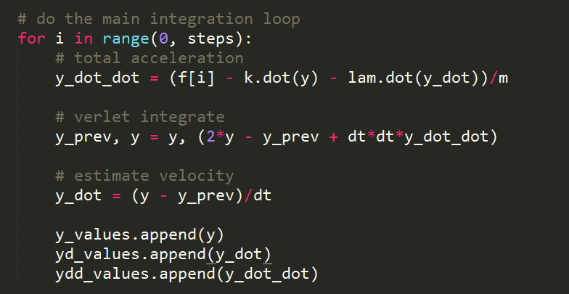
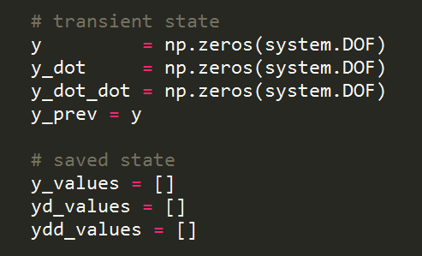
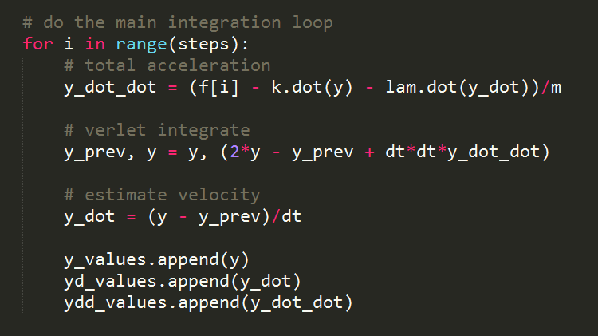
Response over time
Takes external force as a function of time
Combines with M, K, and Λ to find acceleration
Verlet integration
Notes:
Find response over time using a verlet integrator
Input is an array of external forces over time Using previous equation, rearrange to find y dot dot Use verlet integration, as in mars lander Vectors represent displacement of each floor in one axis, rather than displacement of one mars lander in each axis

Slide 6
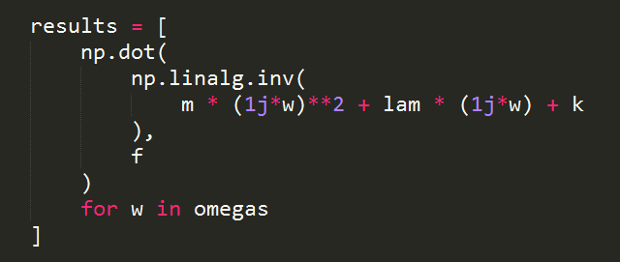
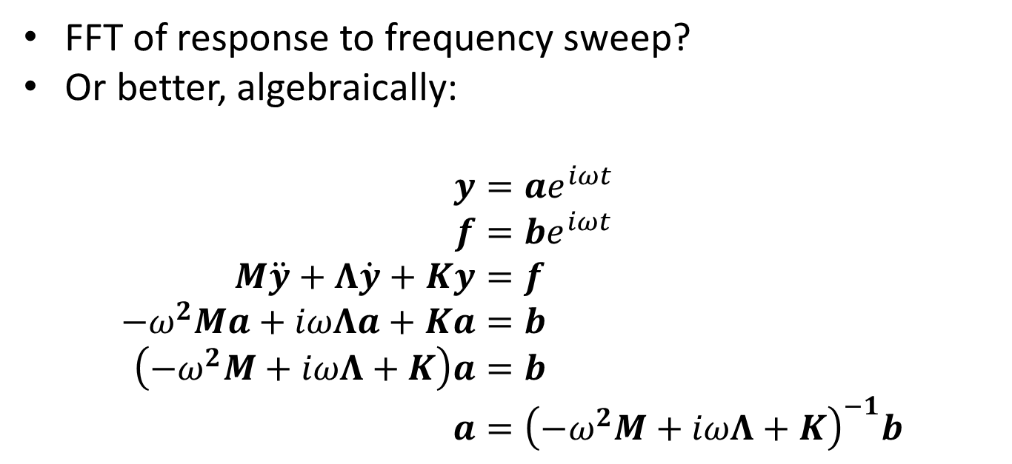
Frequency response
FFT of response to frequency sweep?
Or better, algebraically:
$$y=ae^{iωt} \\ f=be^{iωt} \\ M\ddot{y}+Λ\dot{y}+Ky=f \\ {−ω}^{2}Ma+iωΛa+Ka=b \\ \left(−ω^{2}M+iωΛ+K\right)a=b \\ a={\left(−ω^{2}M+iωΛ+K\right)}^{−1}b$$
Notes:
Easy way – use a frequency sweep signal as the input, and find the FFT of the time response
Discretization of sweep and sampling window causes “wiggles” in result Better to do this algebraically. Use a substitution as done in lectures, but keep the damping term Result is complex – take the absolute value for the amplitude of the harmonic response

Slide 7
Finding resonant frequencies
To a good approximation, numerically finding maxima on a frequency response is sufficient
Can also be solved by solving a quadratic equation with matrix coefficients
Notes:
To apply absorbers, we need to know the resonant frequencies. Easiest just to read the peaks off the frequency response graph Or we could try and do it algebraically again! Solution in lectures had no damping term

Slide 8
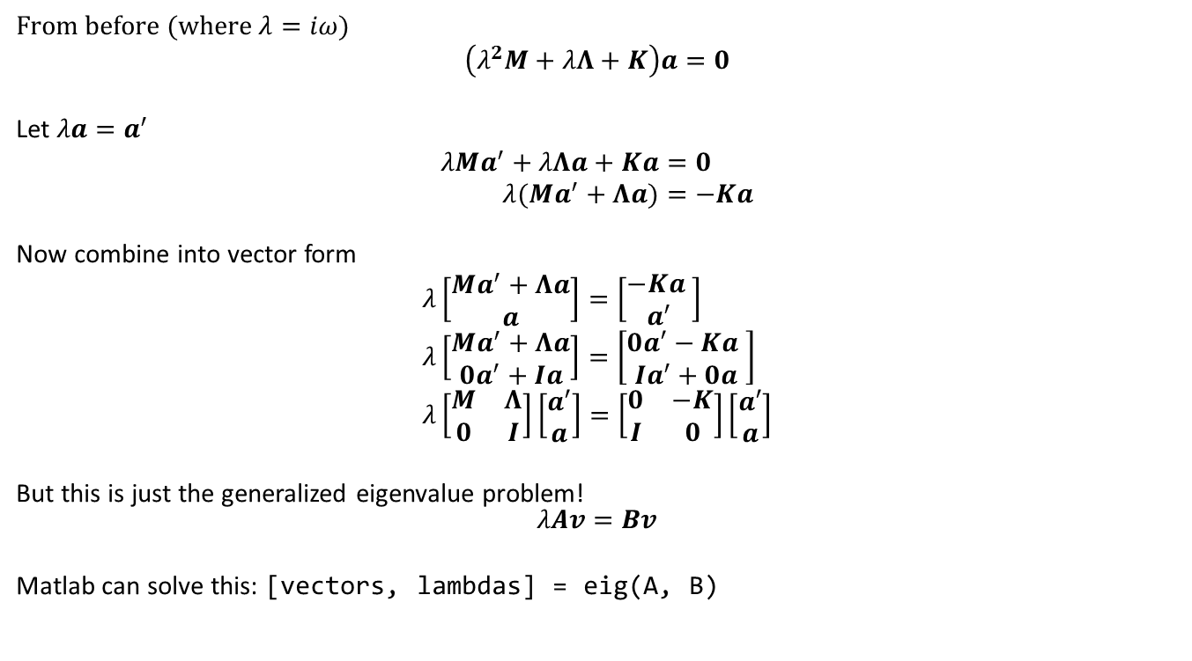
Quadratic eigenvalue problem
From before (where $λ=iω$)
$$\left(λ^{2}M+λΛ+K\right)a=0$$
Let $λa=a^{′}$
$$λMa^{′}+λΛa+Ka=0 \\ λ(Ma^{′}+Λa)=−Ka$$
Now combine into vector form
$$λ\left[\begin{matrix}Ma^{′}+Λa \\ a\end{matrix}\right]=\left[\begin{matrix}−Ka \\ a^{′}\end{matrix}\right] \\ λ\left[\begin{matrix}Ma^{′}+Λa \\ 0a^{′}+Ia\end{matrix}\right]=\left[\begin{matrix}0a′−Ka \\ Ia^{′}+0a\end{matrix}\right] \\ λ\left[\begin{matrix}M & Λ \\ 0 & I\end{matrix}\right]\left[\begin{matrix}a′ \\ a\end{matrix}\right]=\left[\begin{matrix}0 & −K \\ I & 0\end{matrix}\right]\left[\begin{matrix}a′ \\ a\end{matrix}\right]$$
But this is just the generalized eigenvalue problem! $$λAv=Bv$$
Matlab can solve this: [vectors, lambdas] = eig(A, B)
Notes:
Start off with our equation from before, substituting for clarity Introduce a substitution, removing the quadratic term Now we have two simultaneous equations, which can be written in matrix form And we end up with a standard form that numpy (or matlab) is able to solve

Slide 9
Testing the simulator
By comparison to reality and by inspection

Slide 10
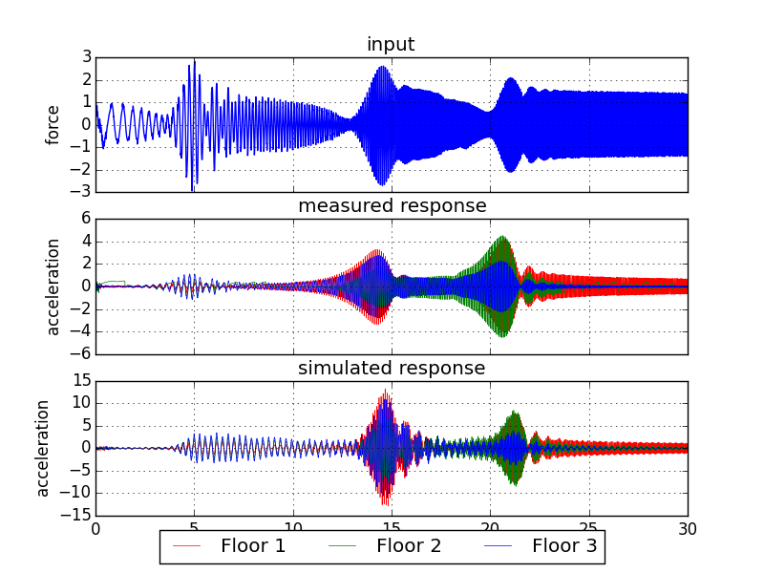
Comparison against real structure
Notes:
Couldn’t get a step response from the structure, because force and signal to transducer were not in sync
Got data from the original under a frequency sweep Resonant peaks occut in roughly the same places in both traces
Peaks are wider in measured response – suggesting more degrees of freedom, eg flexible floor or bolts No units from measurements, so not possible to compare magnitude

Slide 11
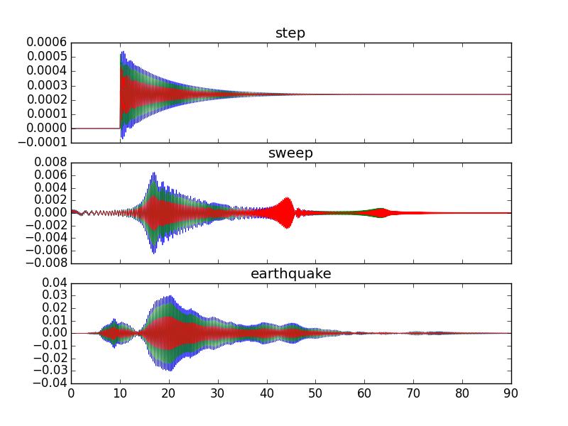
Displacement-time graphs of model
Notes:
Step decays exponentially
A frequency sweep has three high-amplitude regions corresponding to the resonant frequencies And a test of running earthquake data through the simulator, which we’ll talk about more later

Slide 12
Adding absorbers

Slide 13
Iteratively adding absorbers
Repeatedly add absorbers to eliminate the maximum response
Conserve their total mass
Some absorbers become less massive and therefore less effective, so are duplicated on further iterations

Slide 14
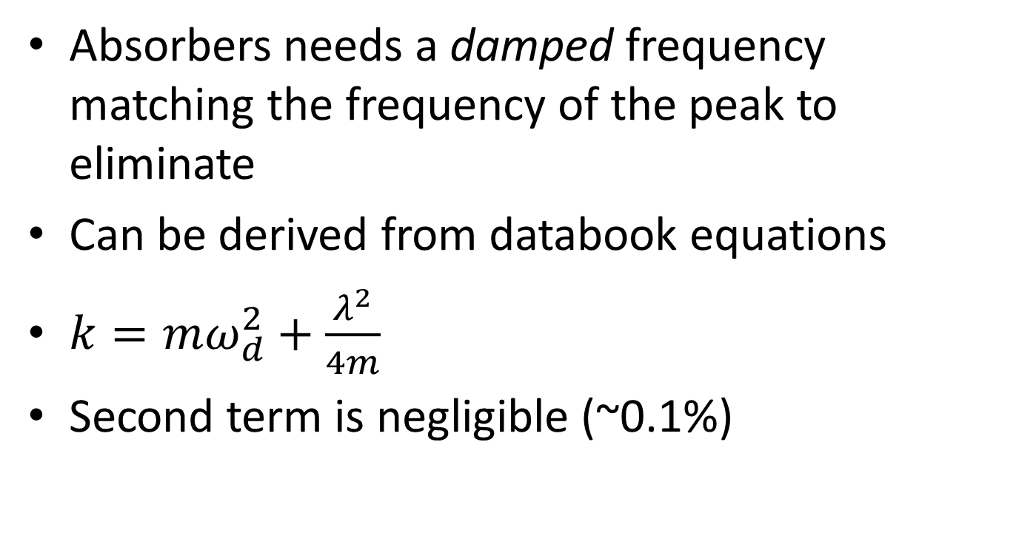
Damping resonant peaks
Absorbers needs a damped frequency matching the frequency of the peak to eliminate
Can be derived from databook equations
$k=mω_{d}^{2}+\frac{λ^{2}}{4m}$
Second term is negligible (~0.1%)

Slide 15
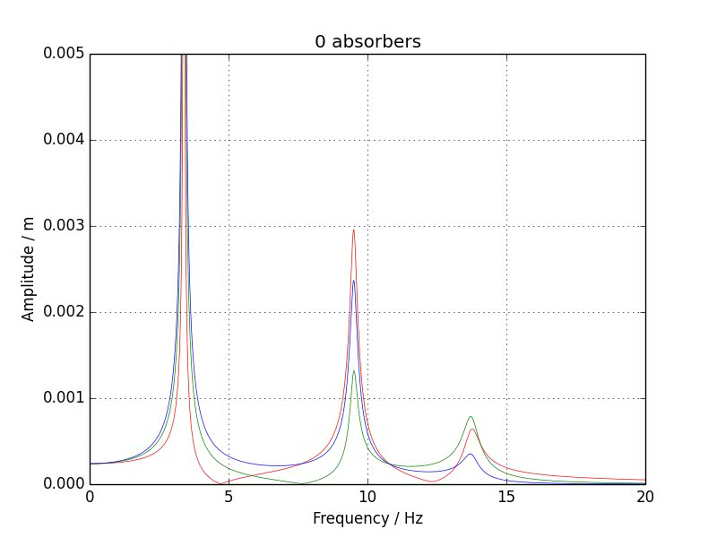
Effect of adding absorbers (video)

Slide 16
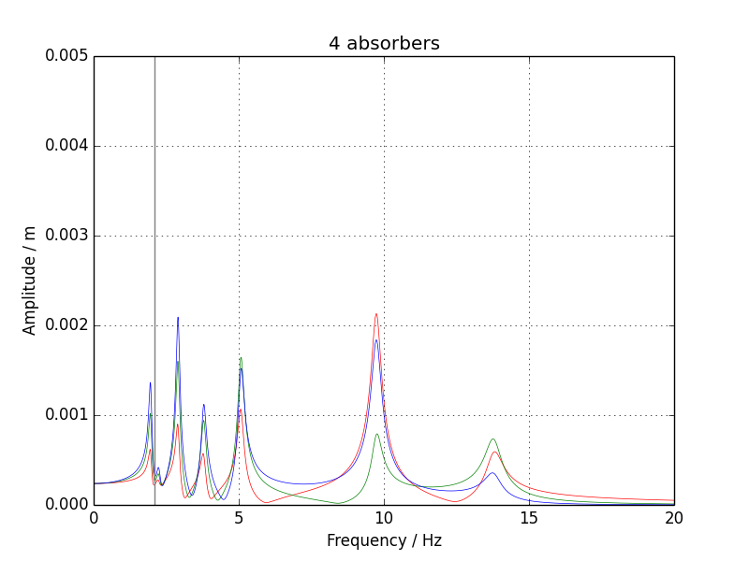
Effect of adding absorbers

Slide 17
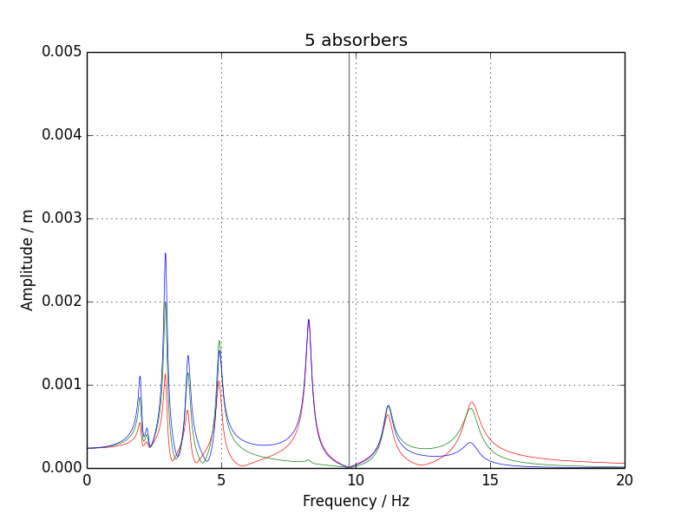
Effect of adding absorbers

Slide 18
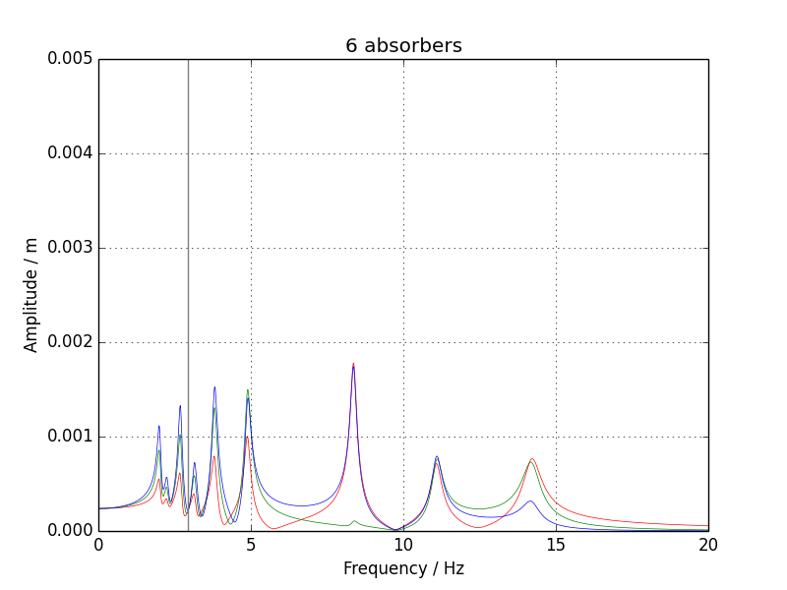
Effect of adding absorbers

Slide 19
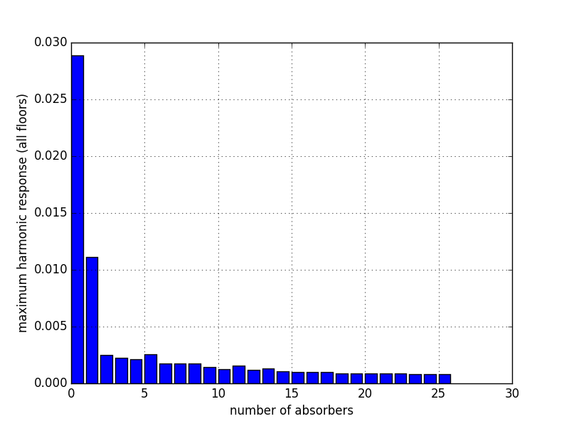
Effect of adding absorbers

Slide 20
Applying stimuli
Investigating the effectiveness of the absorbers

Slide 21
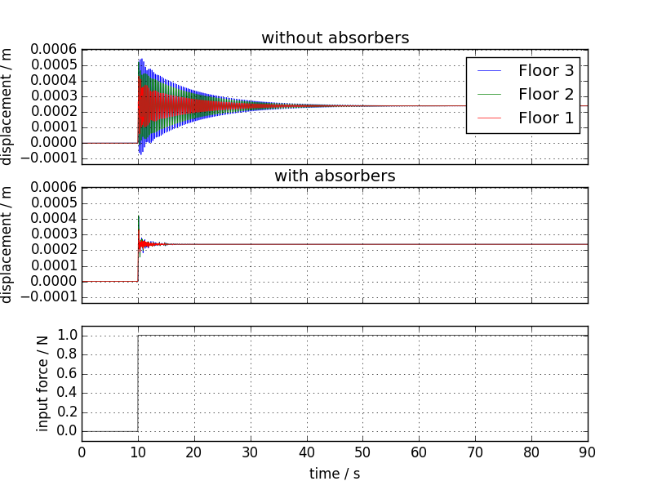
Response to step input

Slide 22
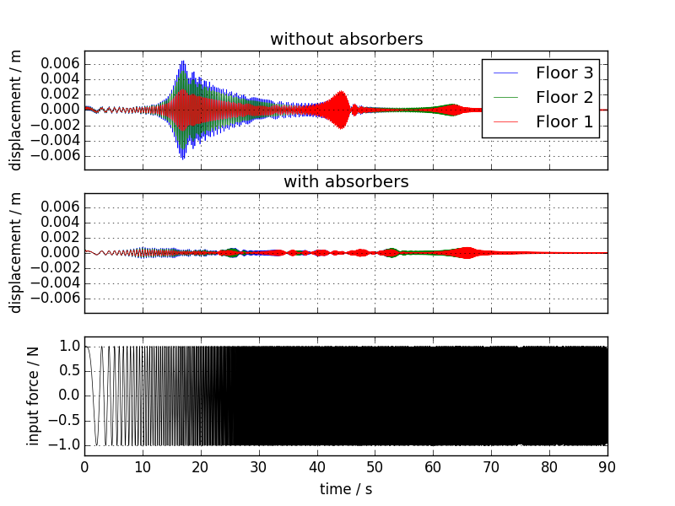
Response to frequency sweep

Slide 23
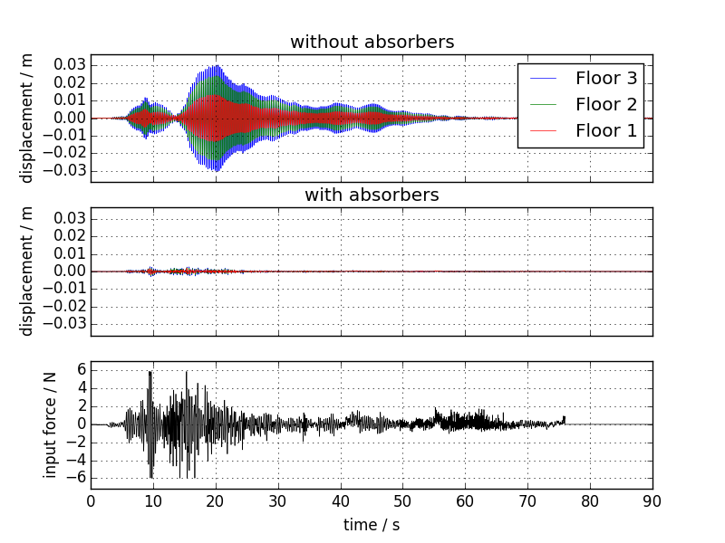
Response to earthquake

Slide 24
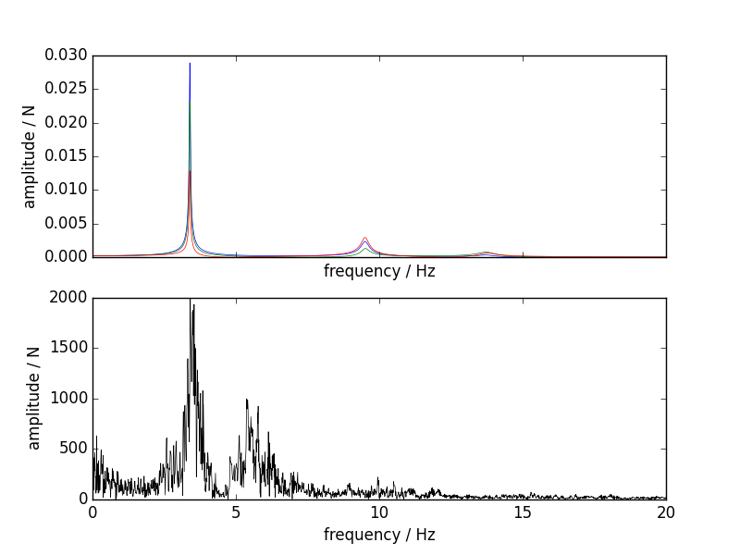
Tuning for earthquakes

Slide 25
Conclusions
Linear modelling is reasonably representative of the true behaviour of the system
Adding more absorbers gives diminishing returns
Absorbers are effective at mitigating motion due to earthquakes

