Slide 1
Simulating multiple vibration absorbers and their effect on the response to earthquakes

Slide 2
Building the model

Slide 3
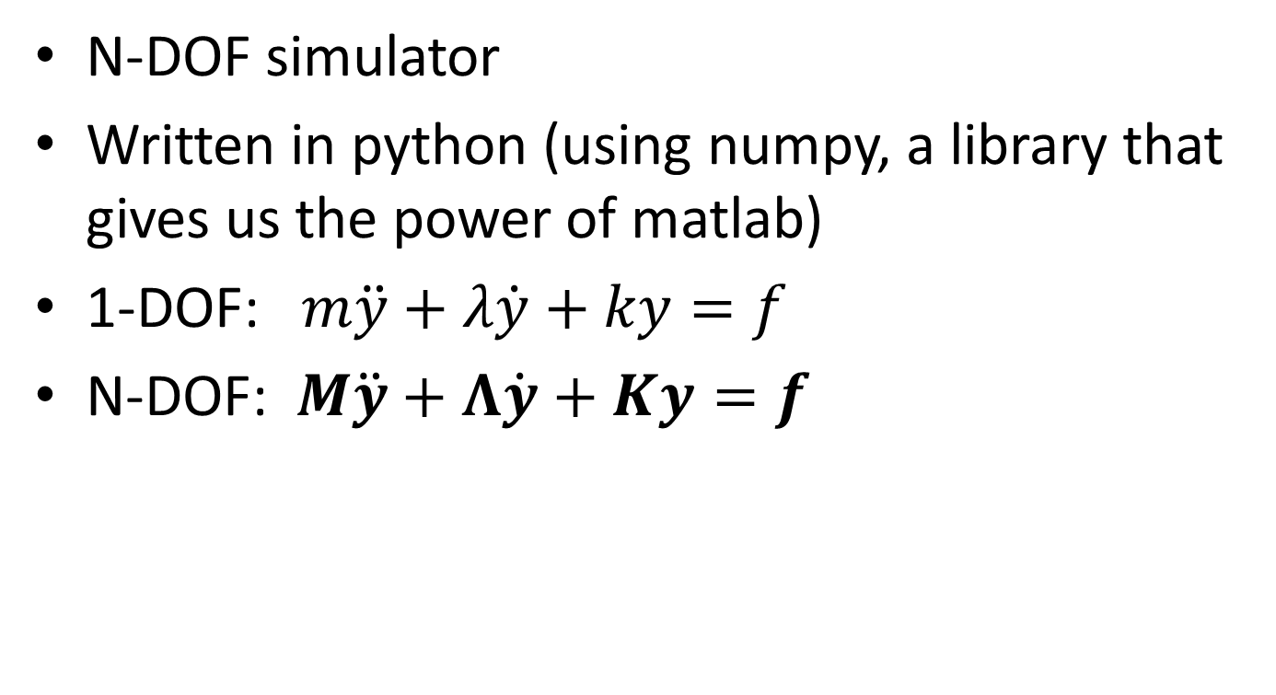
Modelling our system
N-DOF simulator
Written in python (using numpy, a library that gives us the power of matlab)
1-DOF: $m\ddot{y}+λ\dot{y}+ky=f$
N-DOF: $M\ddot{y}+Λ\dot{y}+Ky=f$

Slide 4
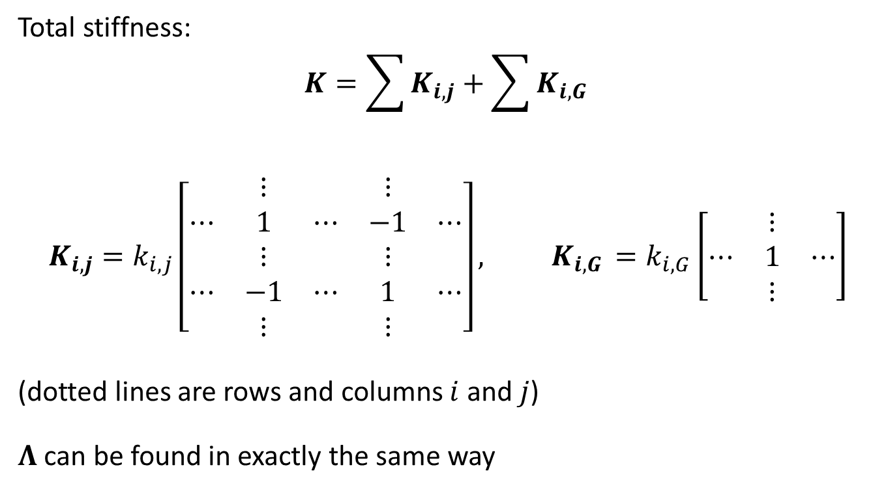
Deriving the stiffness matrix
Total stiffness:
$$K=\sum{K_{i,j}}+\sum{K_{i,G }}$$
$$K_{i,j}=k_{i,j}\left[\begin{matrix} & ⋮ & & ⋮ & \\ ⋯ & 1 & ⋯ & −1 & ⋯ \\ & ⋮ & & ⋮ & \\ ⋯ & −1 & ⋯ & 1 & ⋯ \\ & ⋮ & & ⋮ & \end{matrix}\right], K_{i,G }=k_{i,G}\left[\begin{matrix} & ⋮ & \\ ⋯ & 1 & ⋯ \\ & ⋮ & \end{matrix}\right]$$
(dotted lines are rows and columns $i$ and $j$)
$Λ$ can be found in exactly the same way

Slide 5
Time response
Verlet integrator (like in mars lander!)
Takes external force as a function of time
Combines with M, K, and Λ to find acceleration
Works with vectors to find all displacements simultaneously

Slide 6
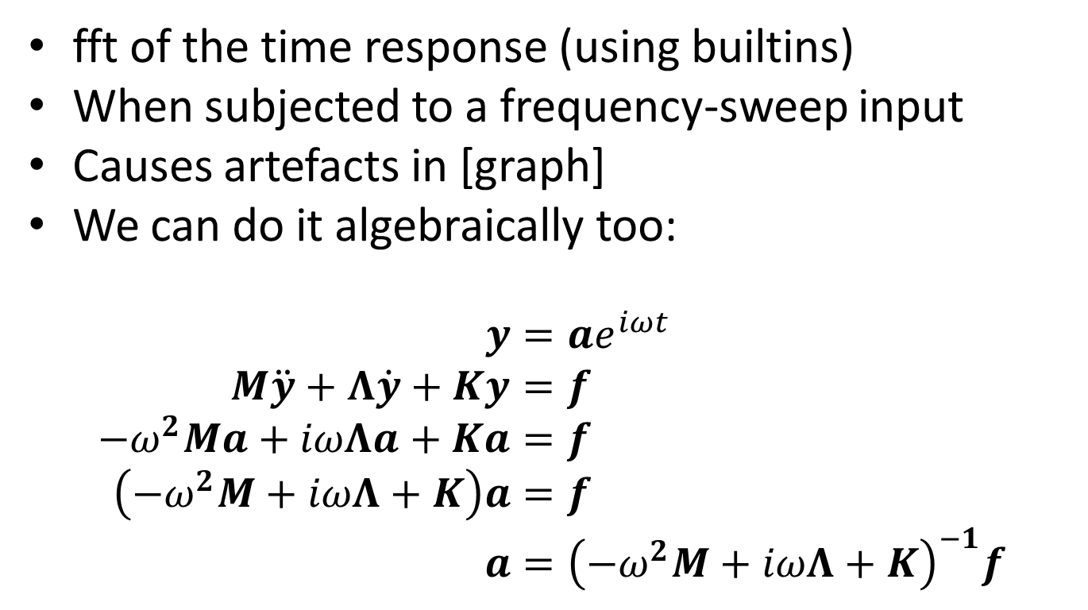
Frequency response
fft of the time response (using builtins)
When subjected to a frequency-sweep input
Causes artefacts in [graph]
We can do it algebraically too:
$$y=ae^{iωt} \\ M\ddot{y}+Λ\dot{y}+Ky=f \\ {−ω}^{2}Ma+iωΛa+Ka=f \\ \left(−ω^{2}M+iωΛ+K\right)a=f \\ a={\left(−ω^{2}M+iωΛ+K\right)}^{−1}f$$

Slide 7
Finding resonant frequencies
To a good approximation, numerically finding maxima on a frequency response is sufficient
Can also be solved by solving a quadratic equation with matrix coefficients (quadratic eigenvalue problem)

Slide 8
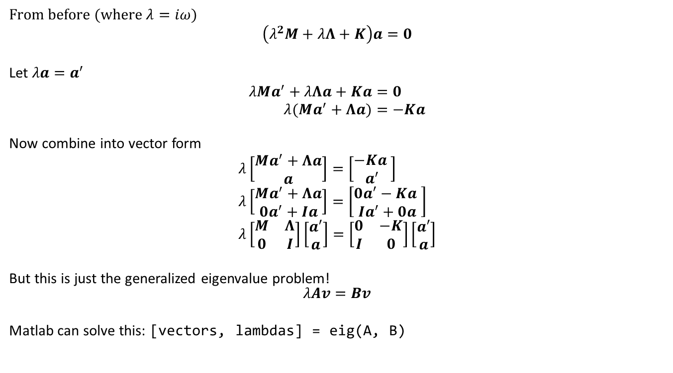
Quadratic eigenvalue problem
From before (where $λ=iω$)
$$\left(λ^{2}M+λΛ+K\right)a=0$$
Let $λa=a^{′}$
$$λMa^{′}+λΛa+Ka=0 \\ λ(Ma^{′}+Λa)=−Ka$$
Now combine into vector form
$$λ\left[\begin{matrix}Ma^{′}+Λa \\ a\end{matrix}\right]=\left[\begin{matrix}−Ka \\ a^{′}\end{matrix}\right] \\ λ\left[\begin{matrix}Ma^{′}+Λa \\ 0a^{′}+Ia\end{matrix}\right]=\left[\begin{matrix}0a′−Ka \\ Ia^{′}+0a\end{matrix}\right] \\ λ\left[\begin{matrix}M & Λ \\ 0 & I\end{matrix}\right]\left[\begin{matrix}a′ \\ a\end{matrix}\right]=\left[\begin{matrix}0 & −K \\ I & 0\end{matrix}\right]\left[\begin{matrix}a′ \\ a\end{matrix}\right]$$
But this is just the generalized eigenvalue problem! $$λAv=Bv$$
Matlab can solve this: [vectors, lambdas] = eig(A, B)

Slide 9
Testing the model

Slide 10
Comparison against real structure
Couldn’t get a step response from the structure, because force and signal to transducer were not in sync
Got data from the original under a frequency sweep

Slide 11
Adding absorbers to the model

Slide 12
Damping resonant peaks
Absorbers needs a damped frequency matching the frequency of the peak to eliminate
Can be derived from databook equations
[equation]
For simplicity, assume absorber damping equal to building damping

Slide 13
Iteratively adding absorbers
Repeatedly add dampers to eliminate the maximum response
Conserve total mass of absorbers
As a result, some absorbers become less massive and therefore less effective, so are duplicated on further iterations

Slide 14
Effect of adding absorbers
[graph/animation]

Slide 15
Effect of adding absorbers
[histogram of absorber frequency by mass]
[max amplitude (by floor) against n_abs]

Slide 16
Applying a “real” earthquake

Slide 17
Displacement / time graph

Slide 18
Tuning for earthquakes
Multiply FFT of earthquake by freq response when tuning
Result:
[graph of displacement before vs after]
[ dfft before after?]

