Slide 1
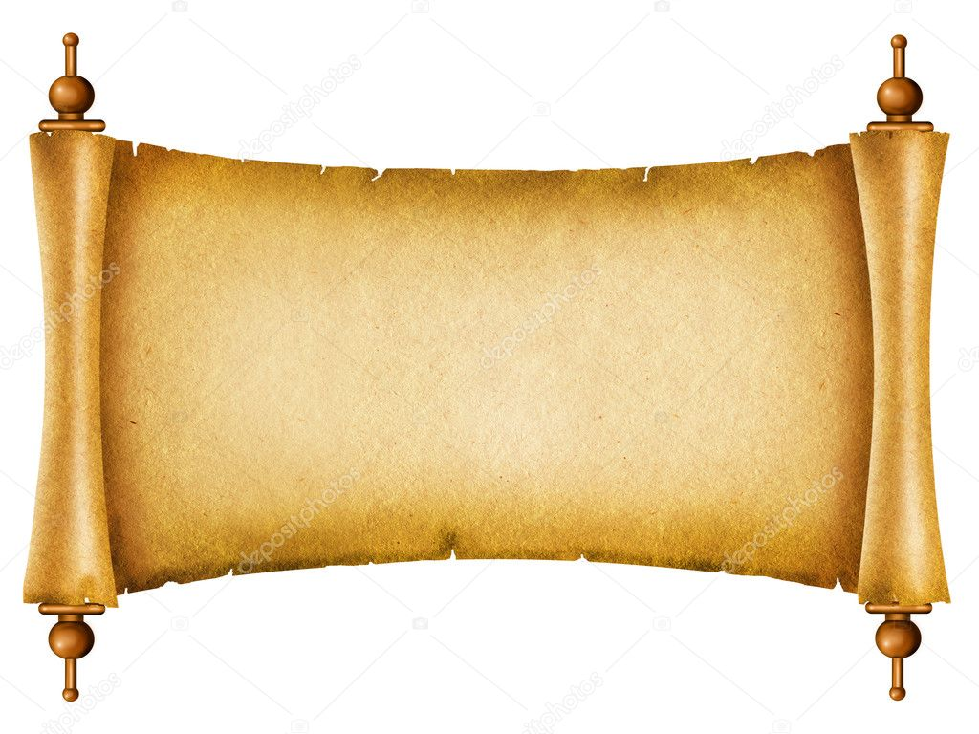
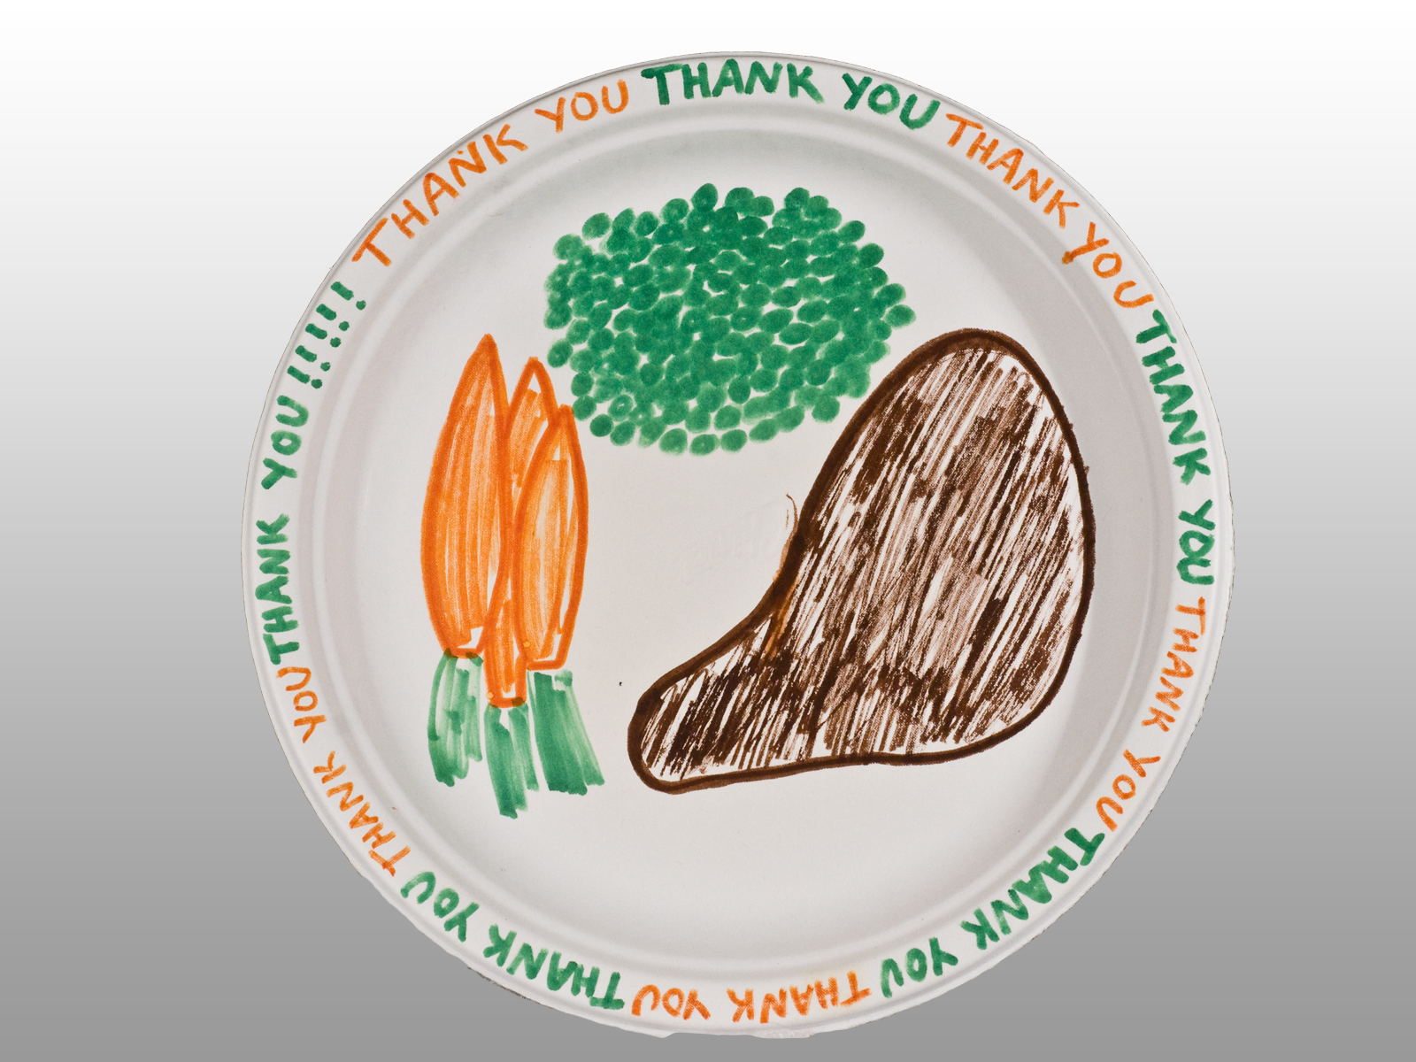
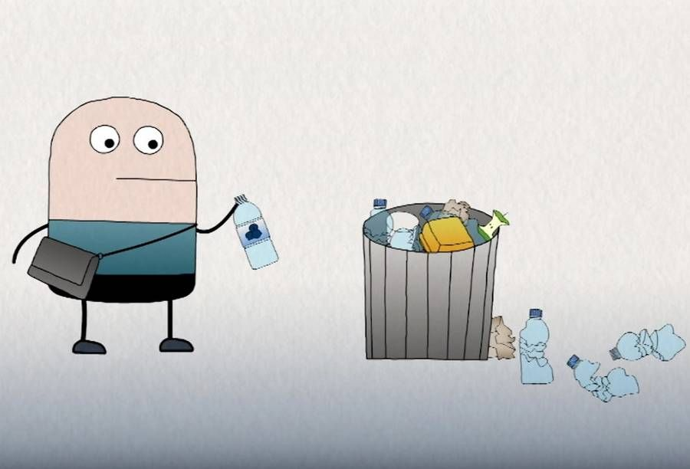
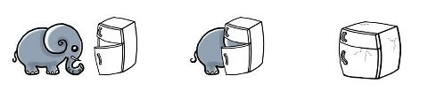
3 steps to keep the table clean
Step 1:
Take an unused paper
Step 2:
Put your food on the paper
Step 3:
Throw away the paper

