Slide 1
Deep SFM - Proprosal
Rui Zhu, You-Yi Jau
2018/11

Slide 2
Outlines
Motivation
Introduction
Traditional method
Baseline
Proposed method
References

Slide 3
Motivation
Modules are designed heuristically
Submodules are optimized individually
Can deep learning help?
Image 1: Img_1
Depth
Modules
Image 2: Img_2
Camera Pose

Slide 4
Conclusion: Keypoint-based method: Our method
Goal
Optimize the modules based on output error (keypoint reprojection error)
Self-supervised training using estimated pose and depth.
Use temporal information to adapt keypoint selector (attention map)
Fine tune
Image 1:
I_{t}
Keypoint selector (attention)
Feature descriptor
Feature Correspondence
RANSAC
Pose/ Depth
Image 2: I_{t+1}
Keypoint selector (attention)
Feature descriptor
Notes:
Optimize the modules based on output error (keypoint reprojection error)
Self-supervised training using estimated pose and depth.
fine-tune to generalize in any scenes
Use temporal information to adapt keypoint selector (attention map)
1 img → 2 img to optimize
-----
Approach
Train dense detecting mask based on the output pose.
Train descriptor based on the dense correspondence image.

Slide 5
Pipeline
Input/ Output
Modules
Image 1: Img_1
Depth
Modules
Image 2: Img_2
Camera Pose

Slide 6
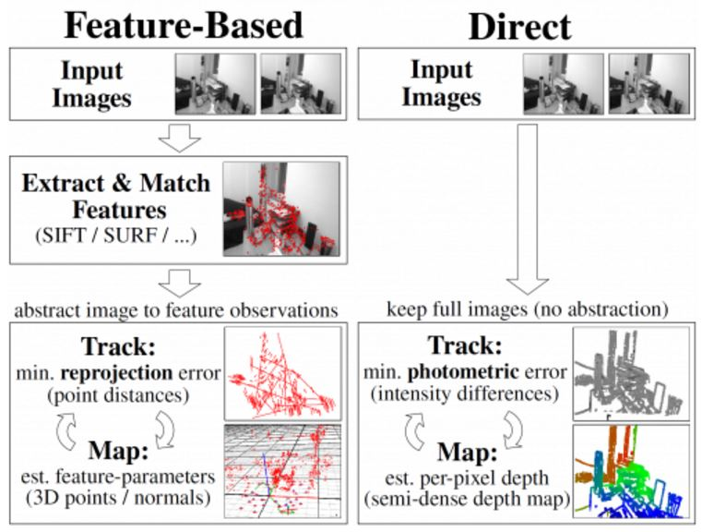
How to design “Modules” with learning?
Feature-based method
Direct Method
Medium: LSD-slam and ORB-slam2, a literature based explanation
Notes:
In feature-based method, we extract features
Minimize reprojection error
Sparse mapping
Direct method
minimize photometric error
semi-dense depth map

Slide 7
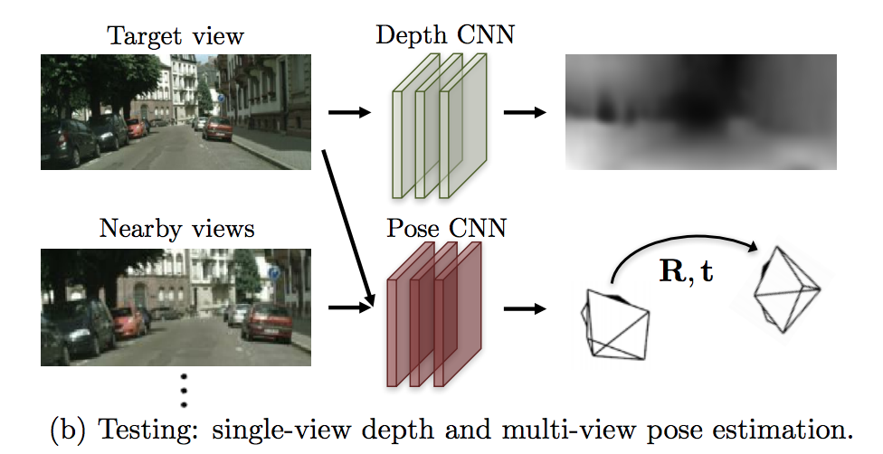
Modules: Direct method
Unsupervised learning of depth and ego-motion from video
T Zhou, M Brown, N Snavely, DG Lowe - CVPR, 2017
Notes:
Paper from Berkeley
Input, output
Unsupervised, self-supervised
Transformation, depth, warping
Limitations
Static scene
no occlusion/disocclusion between the target view and the source views
Train mask to weight pixels

Slide 8
Modules: Keypoint-based method
Input
Detection
Description
Matching
Estimation
Output
Image 1:
I_{t}
Feature Detector
Feature descriptor
Feature Correspondence
RANSAC
Pose/ Depth
Image 2: I_{t+1}
Feature Detector
Feature descriptor
Notes:
Input, output
Describe different sub modules

Slide 9
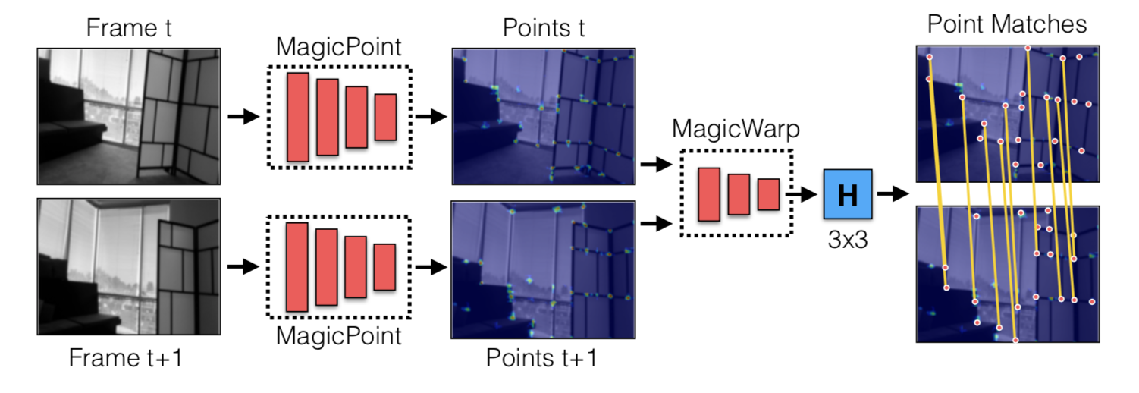
Keypoint-based method: Example
Toward Geometric Deep SLAM
D DeTone, T Malisiewicz, A Rabinovich - arXiv preprint arXiv:1707.07410, 2017
Image 1:
I_{t}
Feature Detector
Feature descriptor
Feature Correspondence
RANSAC
Pose
Image 2:
I_{t+1}
Feature Detector
Feature descriptor
Notes:
Example
Input, detector, correspondence

Slide 10
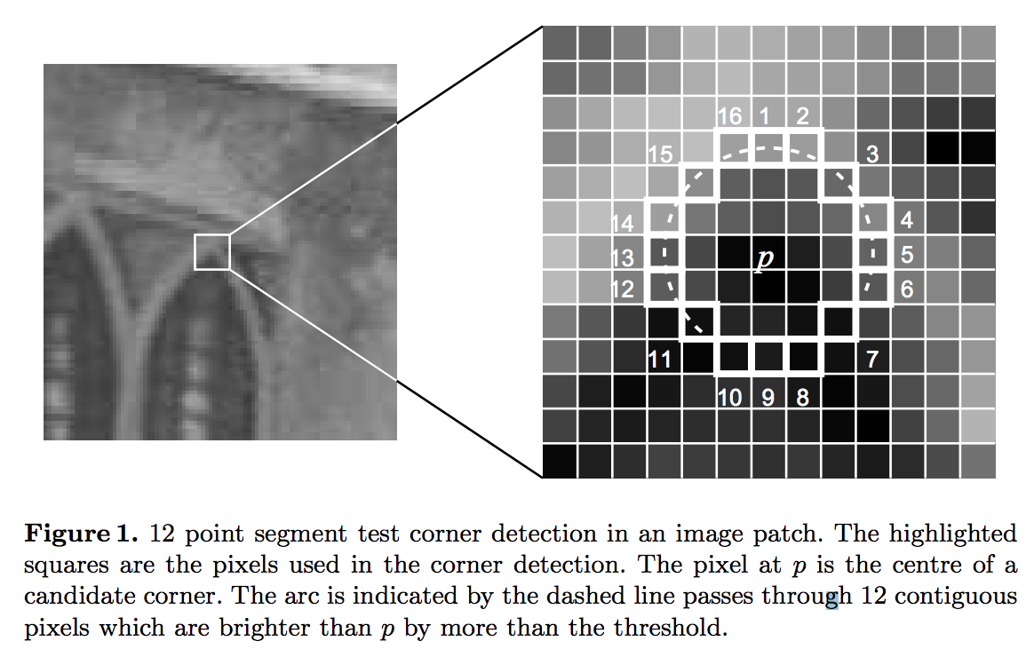
Keypoint-based method: Traditional method
Input
Detection
Description
Matching
Estimation
Output
Fast Corner Detector
E. Rosten and T. Drummond. Machine learning for high-speed corner detection. In ECCV, 2006.

Slide 11
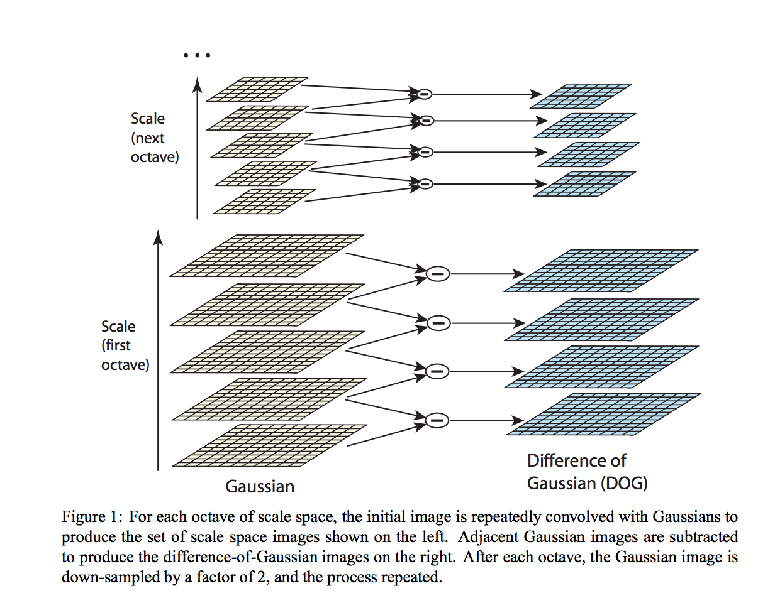
Keypoint-based method: Traditional method
Input
Detection
Description
Matching
Estimation
Output
Scale-Invariant Feature Transform (SIFT)
D. G. Lowe. Distinctive image features from scale-invariant keypoints. IJCV, 2004.
Notes:
Most famous one
Using gaussian pyramid to extract key points
robust to scale

Slide 12
Keypoint-based method: Traditional method
Input
Detection
Description
Matching
Estimation
Output
Nearest neighbor
SIFT: Euclidean distance

Slide 13
Keypoint-based method: Traditional method
Input
Detection
Description
Matching
Estimation
Output
RANSAC
Homography matrix
Motion and structure from motion in a piecewise planar environment
OD Faugeras, F Lustman - International Journal of Pattern Recognition and …, 1988
Essential Matrix
Eight-point algorithm

Slide 14
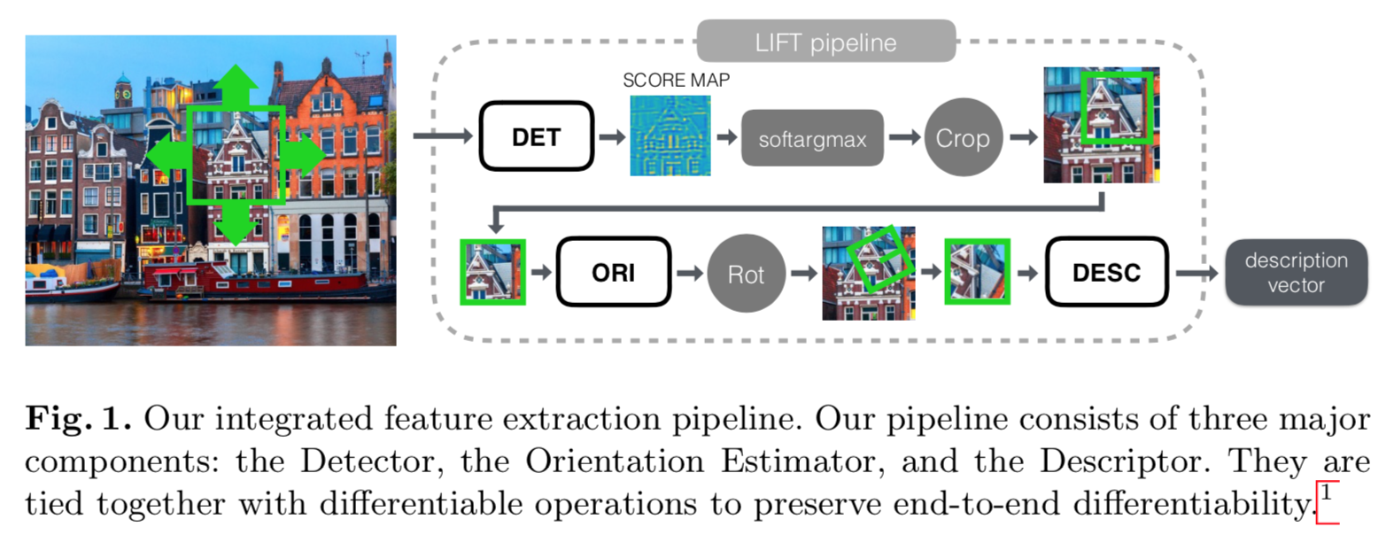
Keypoint-based method: Baseline
Input
Detection
Description
Matching
Estimation
Output
Lift: Learned Invariant Feature Transform
Imitate the pipeline of SIFT
Lift: Learned invariant feature transform KM Yi, E Trulls, V Lepetit, P Fua - European Conference on Computer Vision, 2016
Notes:
What for:
“Deep SIFT”: given image patch (points that survived SfM), pass through keypoint detector (and cropper), orientation estimator (and spatial transformer), and descriptor.
What is trained:
keypoint detector given image patch, orientation estimator, descriptor (with L2 metric)
Training data:
Natural sequences processed with SLAM

Slide 15
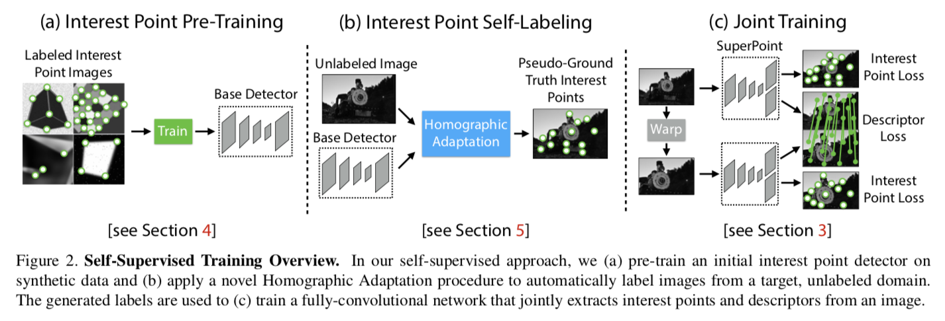
Keypoint-based method: Baseline
Input
Detection
Description
Matching
Estimation
Output
SuperPoint: Self-Supervised Interest Point Detection and Description
[PDF] SuperPoint: Self-Supervised Interest Point Detection and Description D DeTone, T Malisiewicz, A Rabinovich - arXiv preprint arXiv:1712.07629, 2017
Notes:
What for:
Image alignment with keypoint detection and correspondence (by nearest-neighbours on learned feature descriptors)
What is trained:
Keypoint detector and descriptor individually trained and supervised
Training data:
Trained on augmented synthetic images augmented with Homography Adaptation as pseudo-ground truth (homography warps here), and ground truth correspondence to supervise descriptor
Limitations:
GT key points augmented from pre-defined synthetic data
Key point detection and descriptor (correspondence) are separately supervised
No subpixel precision in detectors (as opposed to SIFT)

Slide 16
Keypoint-based method: Baseline
Input
Detection
Description
Matching
Estimation
Output
Nearest neighbor
SIFT: Euclidean distance

Slide 17
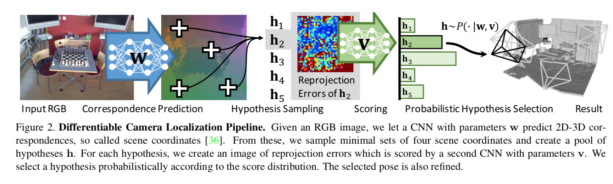
Keypoint-based method: Baseline
Input
Detection
Description
Matching
Estimation
Output
DSAC-differentiable RANSAC for camera localization
[PDF] DSAC-differentiable RANSAC for camera localization
E Brachmann, A Krull, S Nowozin, J Shotton, F Michel… - IEEE Conference on …, 2017
Notes:
What for:
Camera relocation, estimation camera pose from single RGB image, given scene map
RGB Image → noisy 2D-3D correspondences by predicting pixel-wise “scene coordinates”→ hypothesis selection with RANSAC → best hypothesis as pose
What is trained:
Scene correspondence estimation with CNN
Hypothesis scoring with CNN
Deep RANSAC by probabilistic selection with the softmaxed scores
Training data:
Natural RGB-D sequences
Resources:
https://hci.iwr.uni-heidelberg.de/vislearn/research/scene-understanding/pose-estimation/#DSAC (entire line of pose estimation works)
https://github.com/cvlab-dresden/DSAC
Limitations:
Check follow-ups https://scholar.google.com/scholar?cites=14275705625585988293&as_sdt=2005&sciodt=0,5&hl=en
Check codes to understand the pipeline

Slide 18
Keypoint-based method: Our method
Goal
Optimize the modules based on output error (keypoint reprojection error)
Self-supervised training using estimated pose and depth.
Use temporal information to adapt keypoint selector (attention map)
Fine tune
Image 1:
I_{t}
Keypoint selector (attention)
Feature descriptor
Feature Correspondence
RANSAC
Pose/ Depth
Image 2: I_{t+1}
Keypoint selector (attention)
Feature descriptor
Notes:
Optimize the modules based on output error (keypoint reprojection error)
Self-supervised training using estimated pose and depth.
fine-tune to generalize in any scenes
Use temporal information to adapt keypoint selector (attention map)
1 img → 2 img to optimize
-----
Approach
Train dense detecting mask based on the output pose.
Train descriptor based on the dense correspondence image.

Slide 19
Backup slides

Slide 20
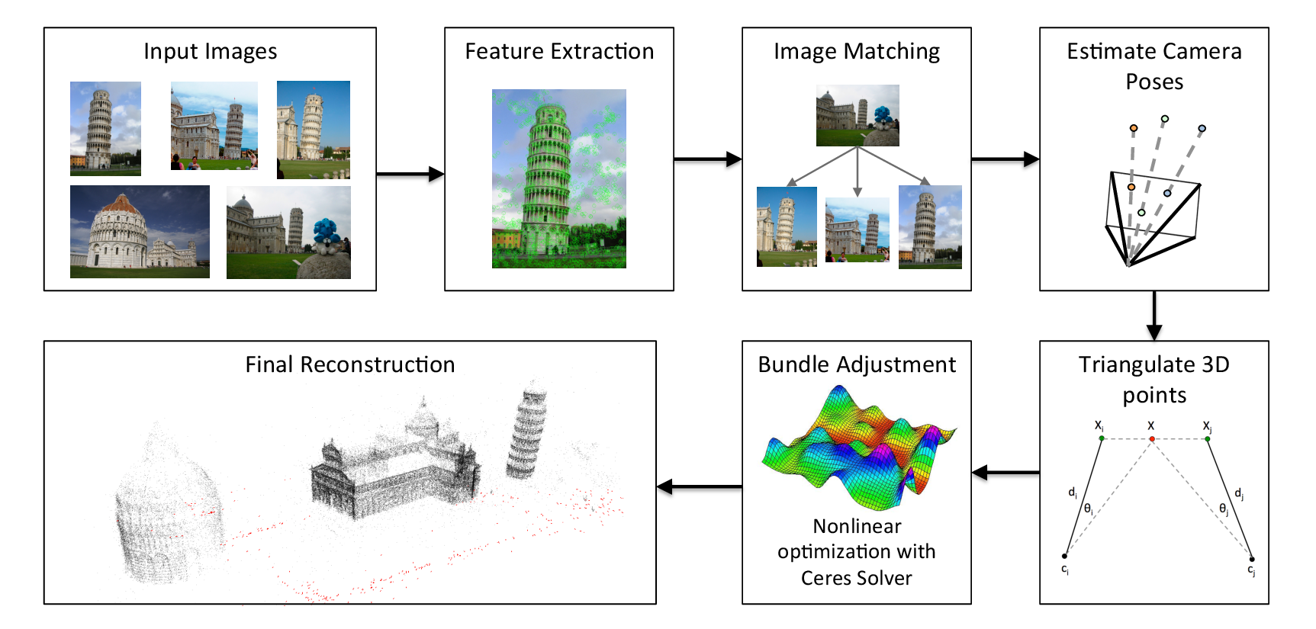
Reference Pipeline
http://www.theia-sfm.org/sfm.html

Slide 21
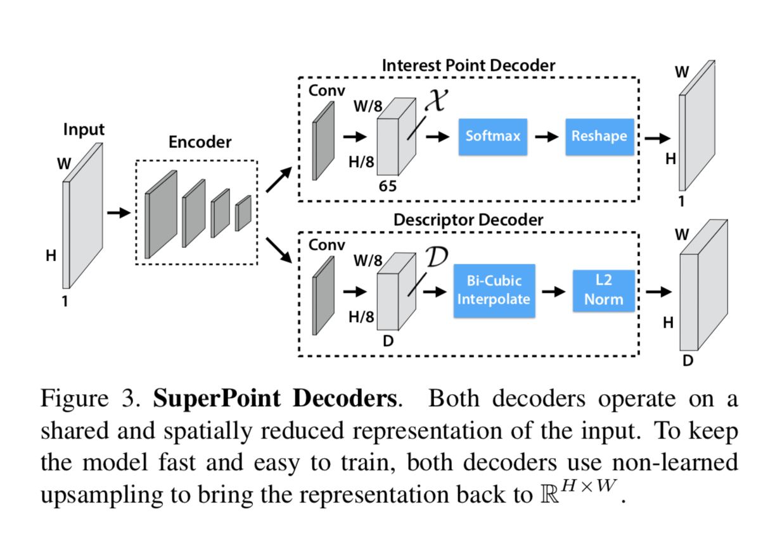
SuperPoint: Self-Supervised Interest Point Detection and Description

Slide 22
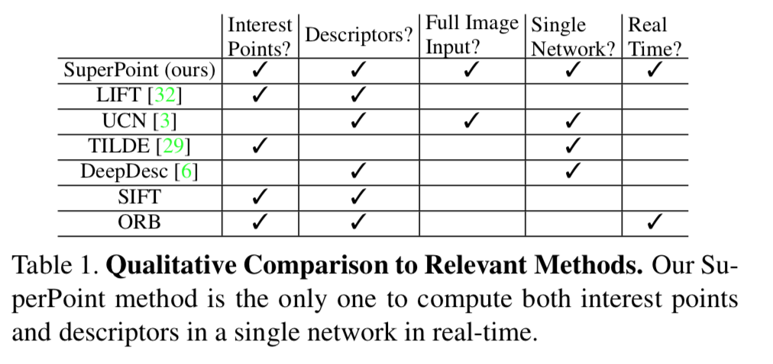
Comparison between relevant methods

