Slide 1

STOCK PREDICTION
ERIC ZHOU

Slide 2

OVERVIEW
Exploration
Statistical Approach
Technical Indicators
Other Factors
Price Forecasting
Simple LSTM
Complex LSTM
Change Prediction
SVM Direction
LSTM % Change
LSTM Direction
Further Expansion
Future Plans

Slide 3

EXPLORATION
STATISTICAL APPROACH, TECHNICAL INDICATORS, OTHER FACTORS

Slide 4
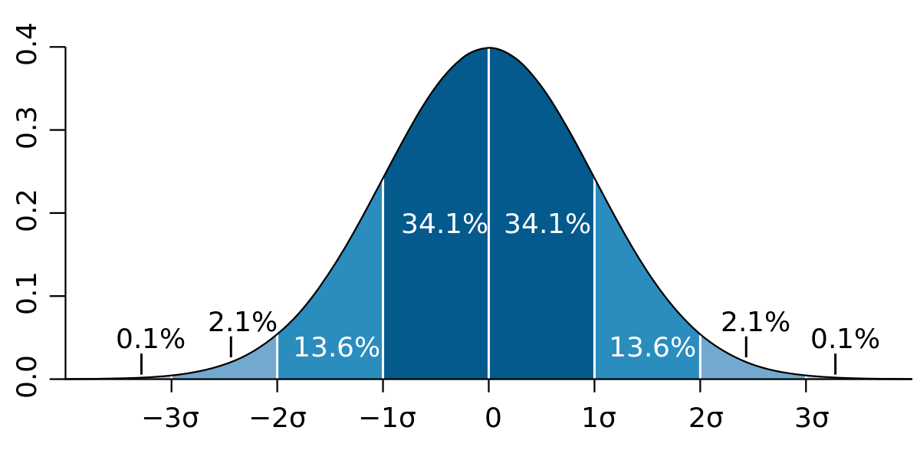
BOLLINGER BANDS
Purely statistical
Buy when price is bottom 5% of expected
Sell when price is top 5% of expected

Slide 5
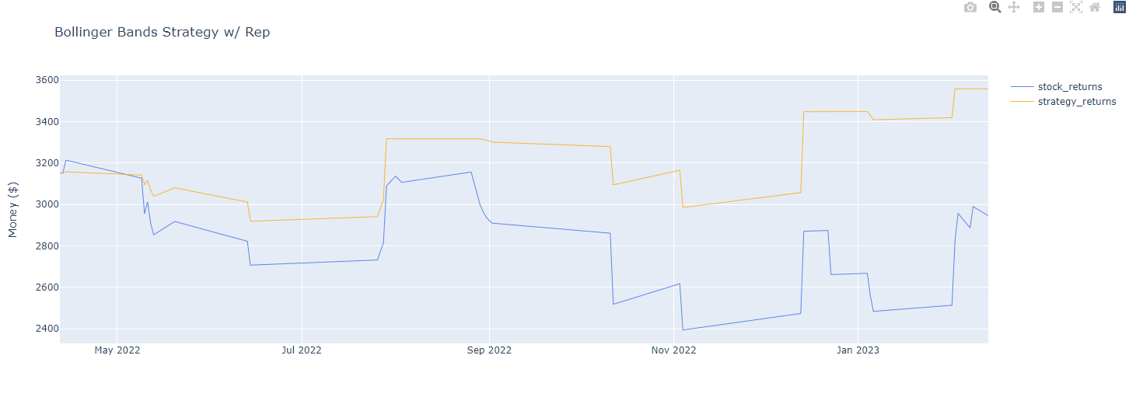
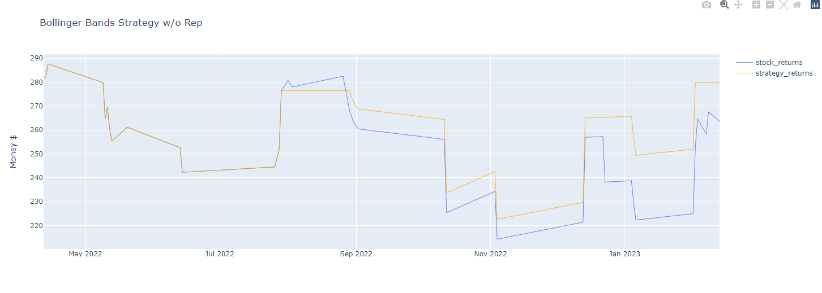
BOLLINGER BANDS - SUCCESS
Repeated purchases: $406.45
Requires $3151.82
Single purchase: $-2.26
Requires $282.06
Graph
Purchases

Slide 6
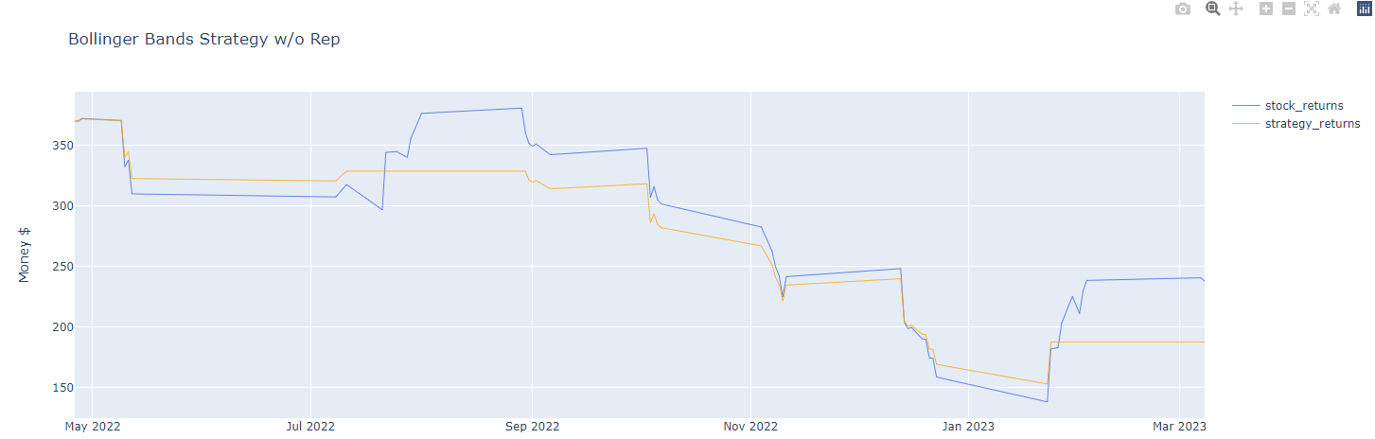
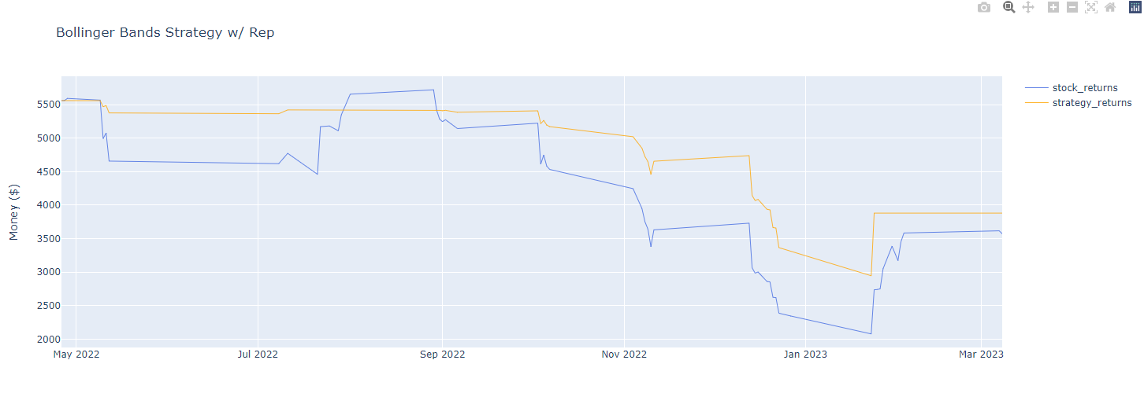
BOLLINGER BANDS - FAILURE
Repeated purchases: -$1686.37
$-2050.37 + $364.0 (2 stocks)
Requires $5561.91
Single purchase: $-370.16
$-370.16 + $182.0 (1 stock)
Requires $370.16
Graph
Purchases

Slide 7
TECHNICAL INDICATORS
Simple Moving Average (SMA)
Smoothes data with average
Average True Range (ATR)
Volatility based on range and changes
Average Directional Index (ADX)
Strength of trend and trend direction
Stochastic Oscillators
Momentum, identifies oversold/overbought
Relative Strength Index (RSI)
Momentum, speed of price change
Moving Average Converge Divergence (MACD)
Convergence of EMAs
Rate of Change (RC)
Self explanatory

Slide 8
OTHER FACTORS
News
Quarterly financial reports
Market volatility as a whole

Slide 9

PRICE PREDICTION
SIMPLE LSTM, COMPLEX LSTM

Slide 10
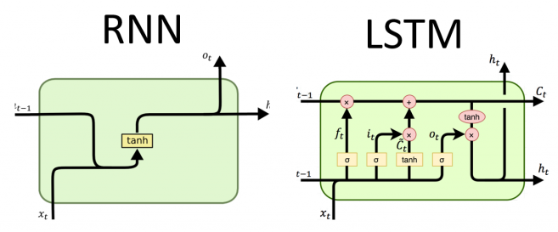
LONG SHORT-TERM MEMORY (LSTM) NETWORKS

Slide 11
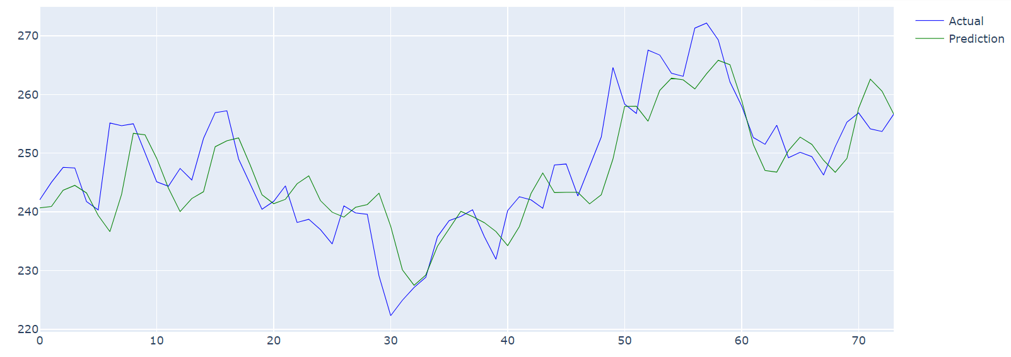
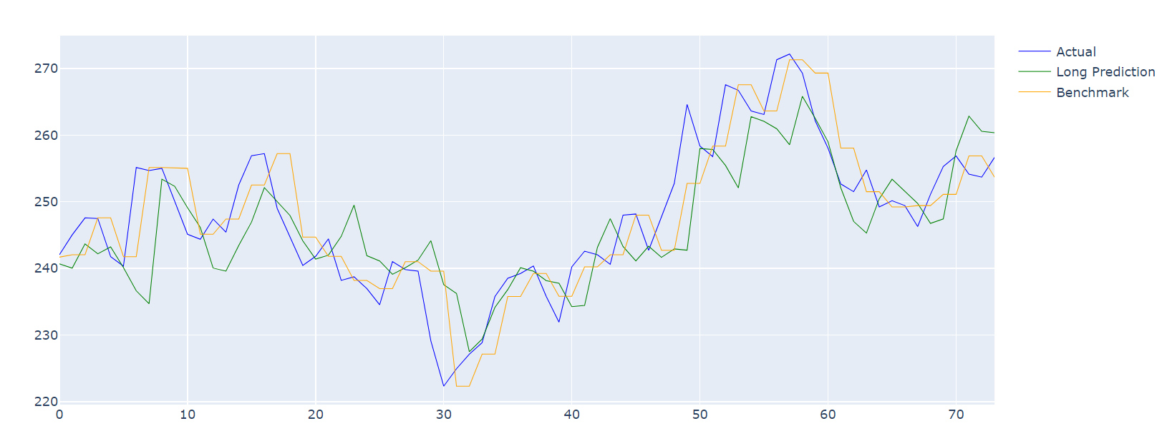
SIMPLE LSTM
Microsoft, 3 years
Root Mean Squared Error (RMSE):
Next Day: 5.98
Long Prediction: 7.26
Benchmark RMSEs
4.76
5.49
Results: Earned $16.20
Requires $240.45

Slide 12
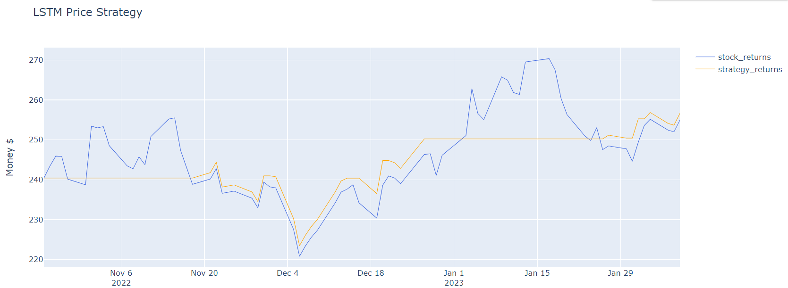
SIMPLE LSTM – CONCLUSION

Slide 13
COMPLEX LSTM
Parameters | RMSE
All (92) | 9.69
Closing Only | 6.16
Best 10 (optimal) | 7.29
Custom Set | 9.15
Custom Set 2 | 12.02
Parameter Importance
Variating parameter values
Pruning to try to improve

Slide 14
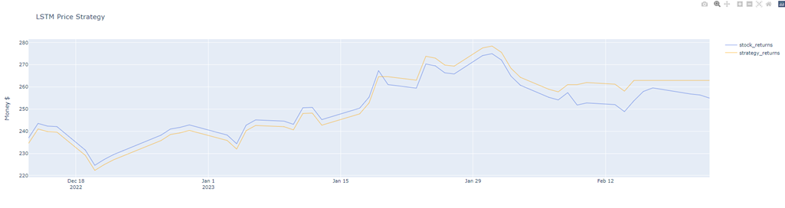
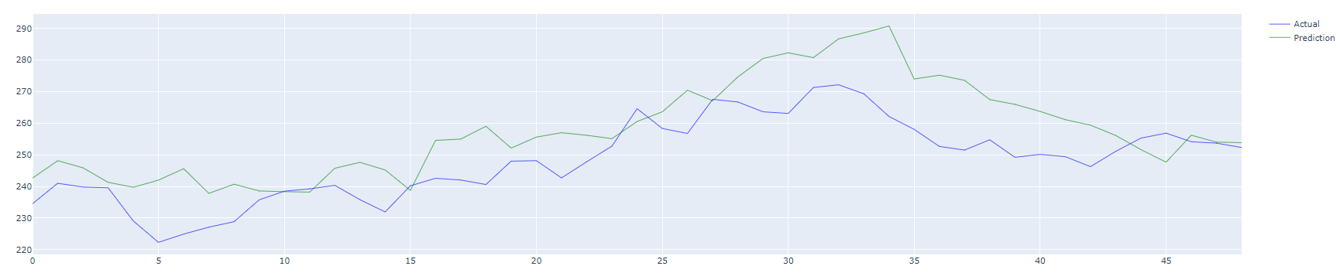
COMPLEX LSTM - GRAPHS

Slide 15
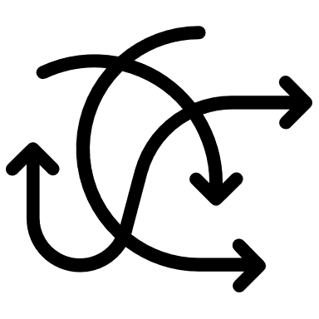
DIRECTION PREDICTION
LSTM % CHANGE, LSTM DIRECTION, SVM DIRECTION

Slide 16
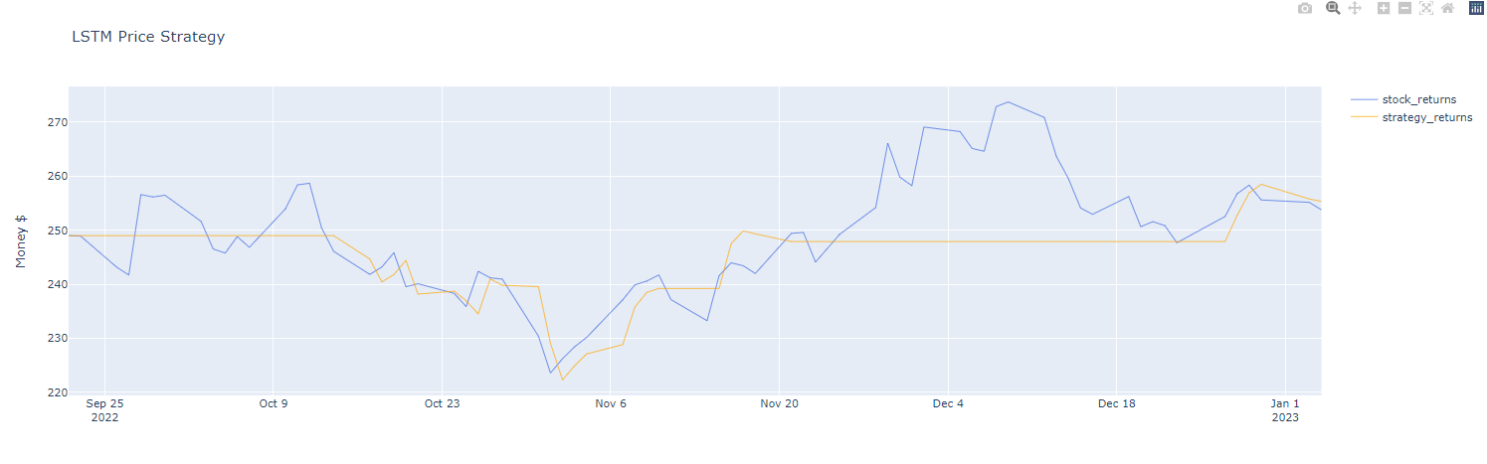
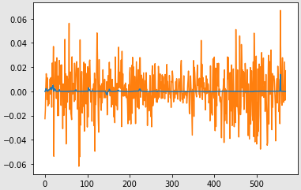
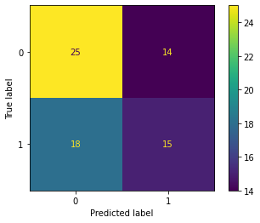
LSTM % CHANGE
Earned $4.95
Requires $249.01
55.6%

Slide 17
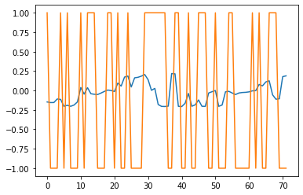
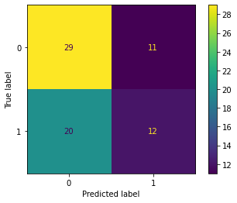
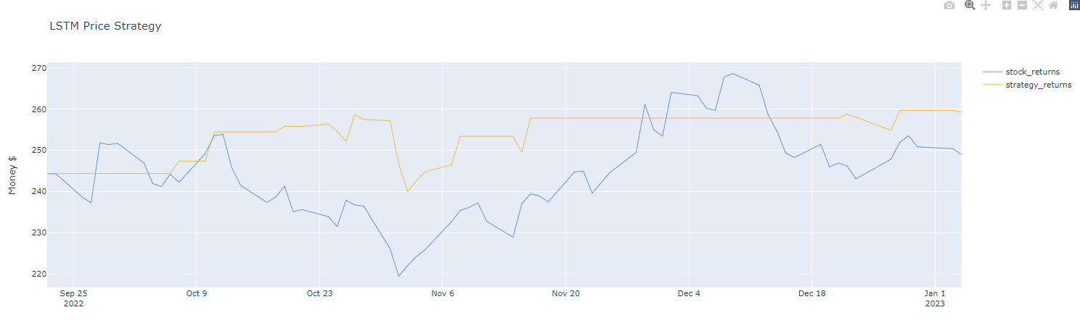
LSTM DIRECTION
$13.52
Requires $244.37
56.9%

Slide 18
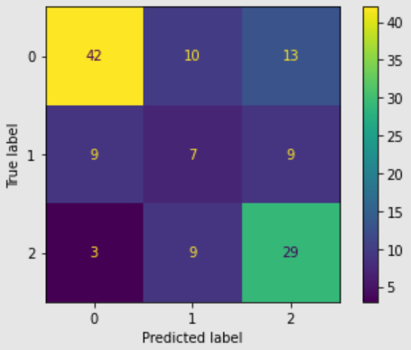
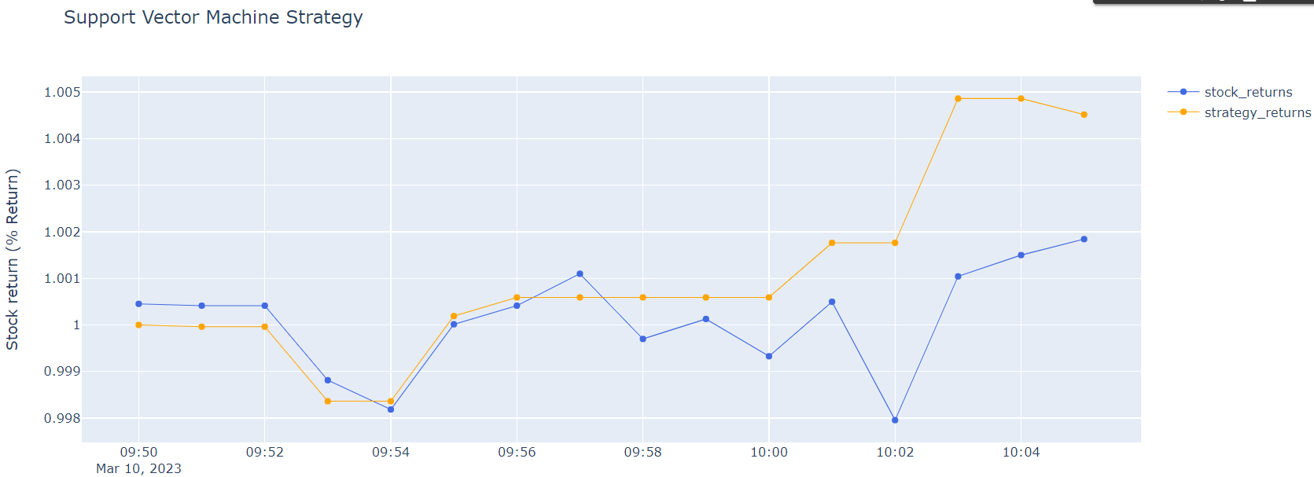
SVM DIRECTION
59.5% accuracy

Slide 19

FURTHER EXPANSION

Slide 20
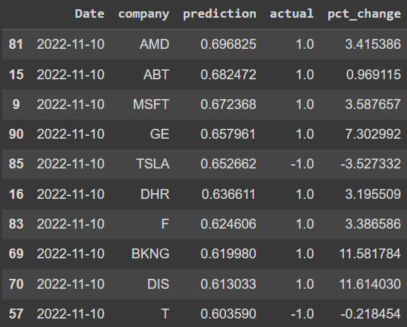
STOCK PICKER
Clustering
Better models
Applicable to multiple stocks
More data
Clusters

Slide 21
FUTURE PLANS
MORE TUNING/ADJUSTMENTS
Incorporating other factors
TRYING OTHER MODELS
Transformers (sequential)
XGBoost (direction)

Slide 22

THANK YOU

