Slide 1
Covid19 Map
潘建琿(0716103) 洪德輝(0716106) 郭志龍(0716336)

Slide 2
Dataset
https://opendata.ecdc.europa.eu/covid19/casedistribution/csv
The downloaded dataset don’t have .csv ext but don’t worry, read_csv can process it.
Current dataset:
2020 week 1 - 2020 week 52(according to the dataset)

Slide 3
Library Used
ggplot2
To plot the graph
dplyr - provide basic function for data manipulation
scales
For scaling the number for plotting
maps
To get the world map
animation
To compile multiple plot into GIF file.

Slide 4
Work distribution
潘建琿(0716103):
Search and Find dataset
Search and Find library
Plotting the graph
Animate the graph
洪德輝(0716106):
Search and Find Dataset
Check dataset
Match Corona dataset with World Map Countries data
郭志龍(0716336):
Filter data used
Search and Find Library
Plotting the graph
Animate the graph

Slide 5
Work explanation
Find a good Covid-19 dataset
Find libraries to do plotting and animation
Check and Match dataset
Filter Dataset to do plotting
Plot each week Graph
Put each week graph plotting into list
Animate the plotting list using “animation” library

Slide 6
Problem encounter
Matching the country name
World map country name is different with our dataset country name
Solution: manually check the country name with NA weekly cases
Plotting world map have some blank part due to the join of corona dataset and world map data.
Solution: plot the corona infected distribution on top of the world map plot.

Slide 7
Problem encounter (Cont.)
Choosing the suitable color for the map
Solution: white → yellow → red → brown

Slide 8
Code Demonstrations
The result(.gif) is attached on the submitted files

Slide 9
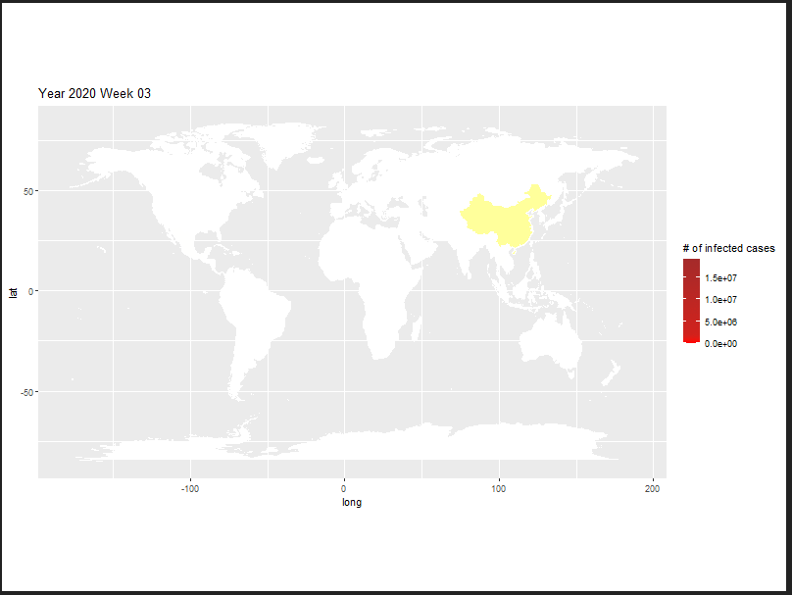
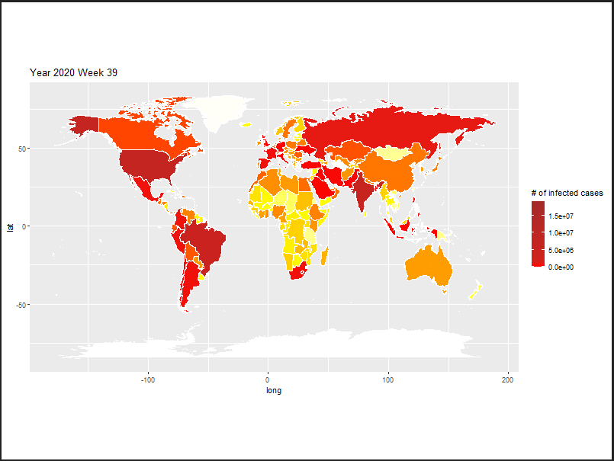
Result Analysis
Using the animation plotting we can see the growing case of COVID-19
Based on the animation it can be seen the Virus is highly infectious and the number of infected growing rapidly.

Slide 10
Github Repository
https://github.com/LiawiFelix/R_FinalProject

Slide 11
Thank You

Slide 12
Q&A
可以用中文

