Slide 1

Speech enhancement by Wiener Filtering using All-Pole Modelling
Laurent Colbois, Lionel Desarzens
COM-415 Audio and Acoustic Signal Processing course
EPFL 2018-2019

Slide 2
Menu of the day
Algorithm
Wiener Filtering
Noise Power Spectral Distribution (PSD) estimation
Speech PSD estimation : all-pole model
Voice Activity Detector
Results
Evaluation metrics
Sentence and word denoising
Conclusion

Slide 3
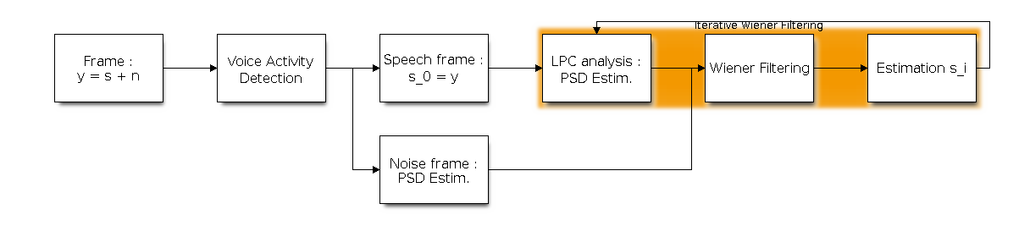
Algorithm
Block diagram :

Slide 4
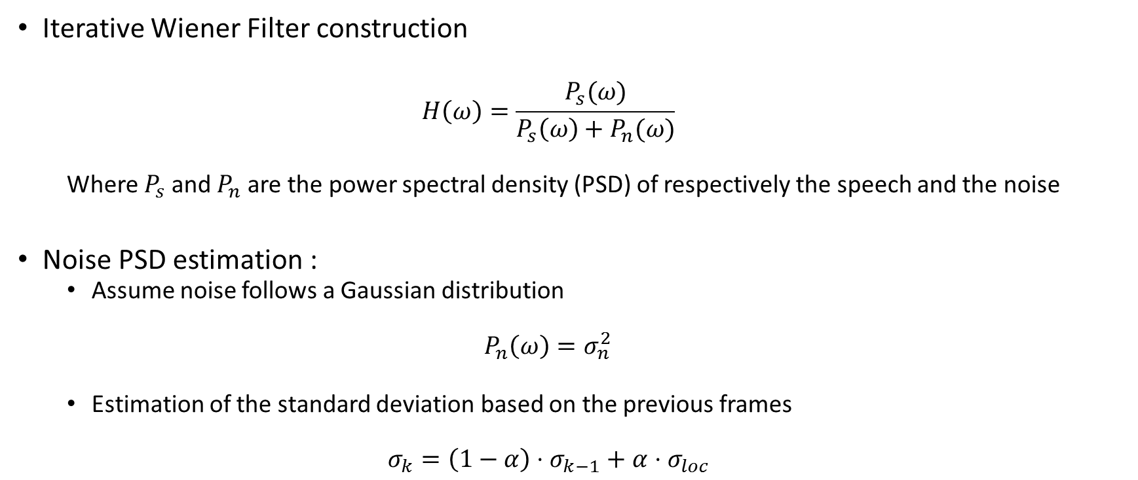
Algorithm (2)
Iterative Wiener Filter construction
$$H\left(ω\right)=\frac{P_{s}(ω)}{P_{s}\left(ω\right)+P_{n}(ω)}$$
Where $P_{s}$ and $P_{n}$ are the power spectral density (PSD) of respectively the speech and the noise
Noise PSD estimation :
Assume noise follows a Gaussian distribution
$$P_{n}\left(ω\right)=σ_{n}^{2}$$
Estimation of the standard deviation based on the previous frames
$$σ_{k}=\left(1−α\right)⋅σ_{k−1}+α⋅σ_{loc}$$

Slide 5
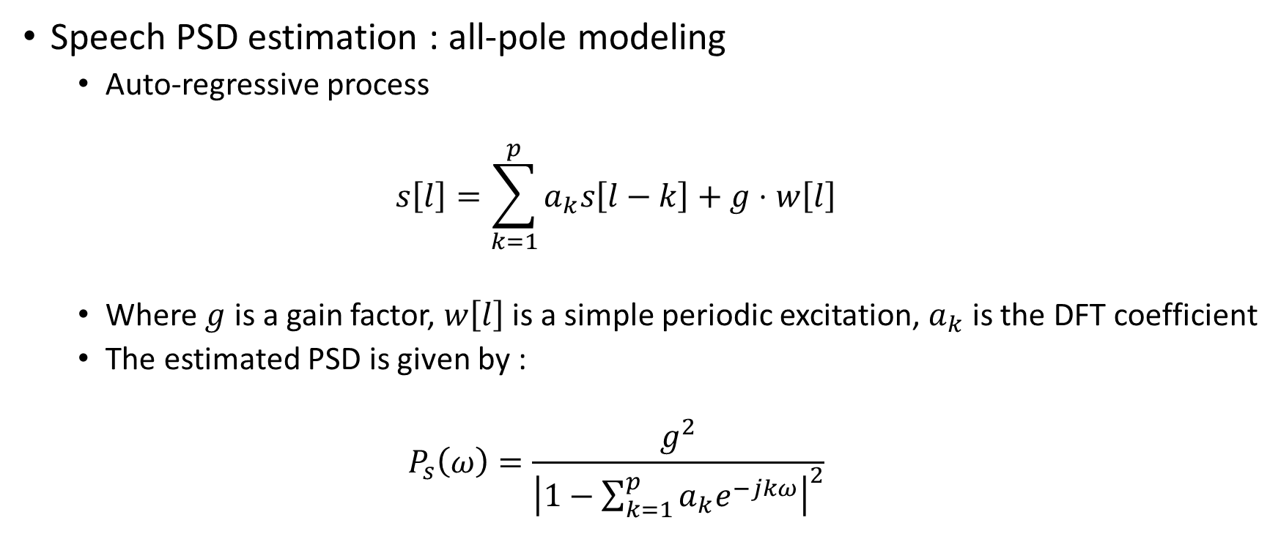
Algorithm (3)
Speech PSD estimation : all-pole modeling
Auto-regressive process
$$s\left[l\right]=\sum_{k=1}^{p}{a_{k}s\left[l−k\right]+g⋅w\left[l\right]}$$
Where $g$ is a gain factor, $w\left[l\right]$ is a simple periodic excitation, $a_{k}$ is the DFT coefficient
The estimated PSD is given by :
$$P_{s}\left(ω\right)=\frac{g^{2}}{{\left|1−\sum_{k=1}^{p}{a_{k}e^{−jkω}}\right|}^{2}}$$

Slide 6
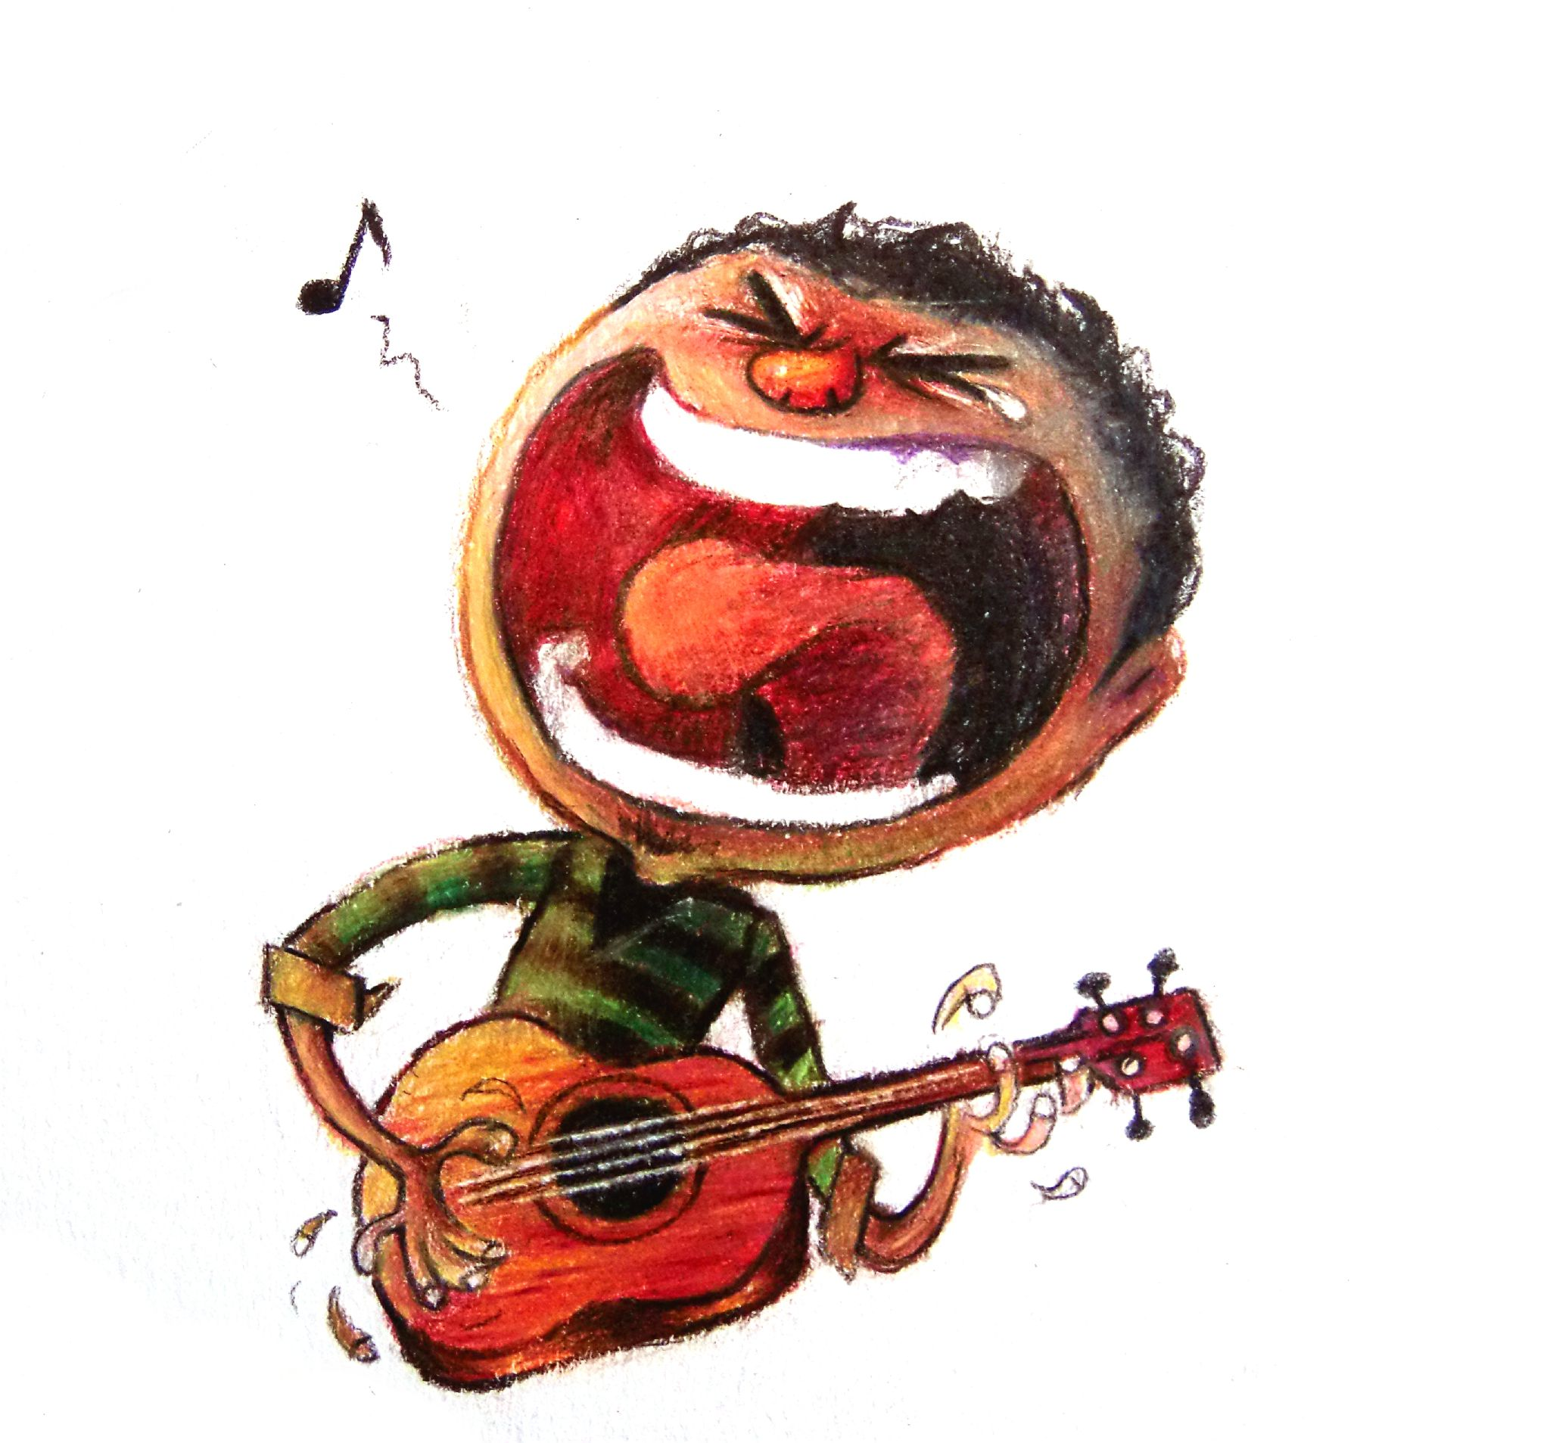

Musical interlude
Original speech sample
Synthesized speech sample
Noisy speech sample
Denoised sample

Slide 7
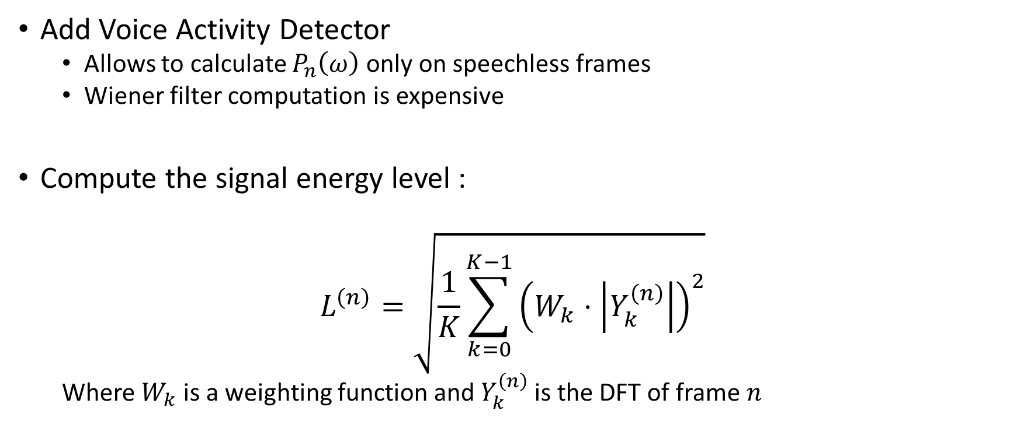
Improving the algorithm ?
Add Voice Activity Detector
Allows to calculate $P_{n}\left(ω\right)$ only on speechless frames
Wiener filter computation is expensive
Compute the signal energy level :
$$L^{\left(n\right)}=\sqrt{\frac{1}{K}\sum_{k=0}^{K−1}{{\left(W_{k}⋅\left|Y_{k}^{\left(n\right)}\right|\right)}^{2}}}$$
Where $W_{k}$ is a weighting function and $Y_{k}^{\left(n\right)}$ is the DFT of frame $n$

Slide 8
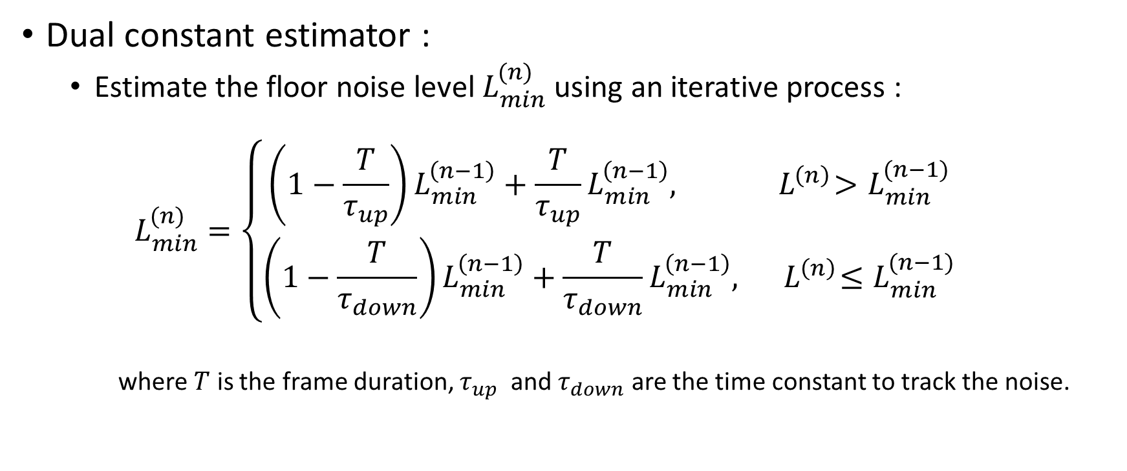
Improving the algorithm (2)
Dual constant estimator :
Estimate the floor noise level $L_{min}^{(n)}$ using an iterative process :
$$L_{min}^{(n)}=\left\{\begin{aligned}\left(1−\frac{T}{τ_{up}}\right)L_{min}^{\left(n−1\right)}+\frac{T}{τ_{up}}L_{min}^{\left(n−1\right)},{ L}^{\left(n\right)}>L_{min}^{(n−1)} \\ &\left(1−\frac{T}{τ_{down}}\right)L_{min}^{\left(n−1\right)}+\frac{T}{τ_{down}}L_{min}^{\left(n−1\right)},{ L}^{\left(n\right)}≤L_{min}^{(n−1)}\end{aligned}\right.$$
where $T$ is the frame duration, $τ_{up}$ and $τ_{down}$ are the time constant to track the noise.

Slide 9

Improving the algorithm (3)
Final decision :
$$V^{\left(n\right)}=\left\{\begin{aligned}0, if\frac{L^{\left(n\right)}}{L_{min}^{(n)}}>T_{down} \\ 1, if \frac{L^{\left(n\right)}}{L_{min}^{(n)}}>T_{down} \\ V^{\left(n−1\right)}, otherwise\end{aligned}\right.$$

Slide 10
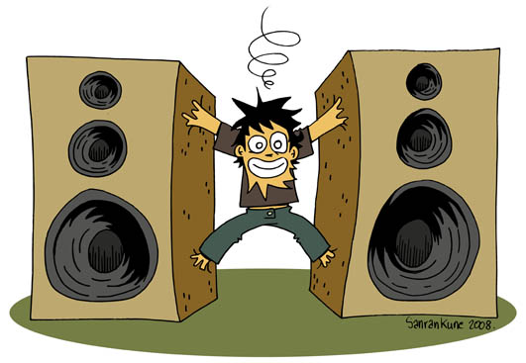
Musical interlude bis
Original speech sample
VAD on original signal
VAD on noisy signal
Denoised sample with VAD

Slide 11
Evaluation
A posteriori SNR
Build estimate of noise
Compute SNR of the denoised signal
Intelligibility
A network is asked to classify speech signals at various SNR ratios, and we compare its classification certainty for noisy speech and denoised speech

Slide 12
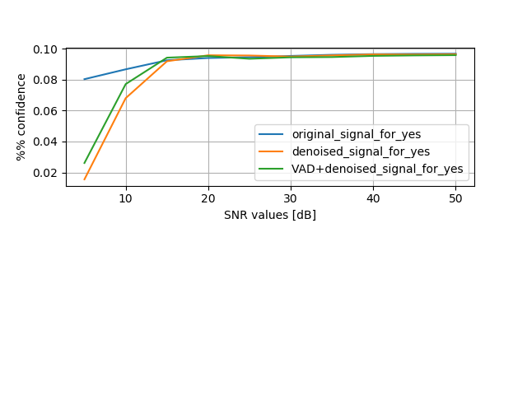
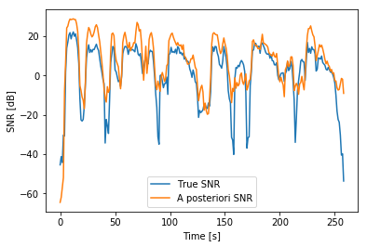
Final results

Slide 13
Conclusion
We have shown an algorithm used for speech denoising
Based on LPC modelling
The necessity of a VAD has been established
For low SNR, a statistical model could be developped
Lower computation time
We improved the a posteriori SNR for all the noisy speech samples
Can be improved by correctly tuning the parameters in the code

Slide 14

Questions ?

