Slide 1

Speech enhancement by Wiener filtering - Voice activity detection and all pole modelling of the vocal tract
Laurent Colbois, Lionel Desarzens
COM-415 Audio and Acoustic Signal Processing course
EPFL 2018-2019

Slide 2
Menu of the day
Algorithm
Wiener Filtering
Noise Power Spectral Distribution (PSD) estimation
Speech PSD estimation : all-pole model
Voice Activity Detector
Results
Evaluation metrics
Sentence and word denoising
Conclusion

Slide 3
Algorithm
Block diagram :

Slide 4
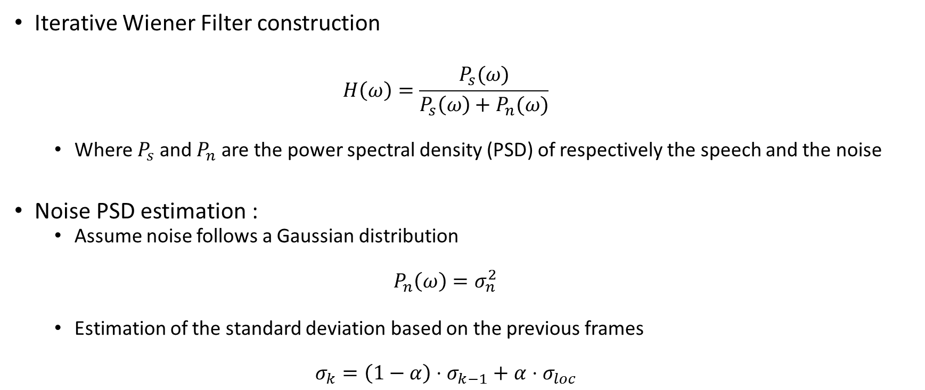
Algorithm (2)
Iterative Wiener Filter construction
$$H\left(ω\right)=\frac{P_{s}(ω)}{P_{s}\left(ω\right)+P_{n}(ω)}$$
Where $P_{s}$ and $P_{n}$ are the power spectral density (PSD) of respectively the speech and the noise
Noise PSD estimation :
Assume noise follows a Gaussian distribution
$$P_{n}\left(ω\right)=σ_{n}^{2}$$
Estimation of the standard deviation based on the previous frames
$$σ_{k}=\left(1−α\right)⋅σ_{k−1}+α⋅σ_{loc}$$

Slide 5
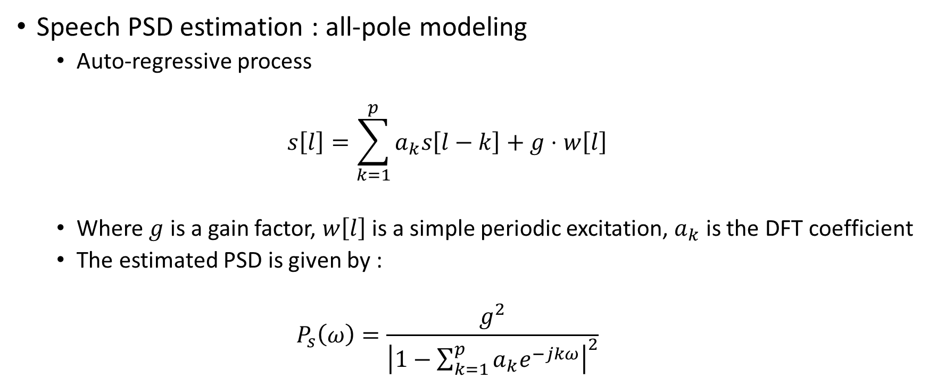
Algorithm (3)
Speech PSD estimation : all-pole modeling
Auto-regressive process
$$s\left[l\right]=\sum_{k=1}^{p}{a_{k}s\left[l−k\right]+g⋅w\left[l\right]}$$
Where $g$ is a gain factor, $w\left[l\right]$ is a simple periodic excitation, $a_{k}$ is the DFT coefficient
The estimated PSD is given by :
$$P_{s}\left(ω\right)=\frac{g^{2}}{{\left|1−\sum_{k=1}^{p}{a_{k}e^{−jkω}}\right|}^{2}}$$

Slide 6
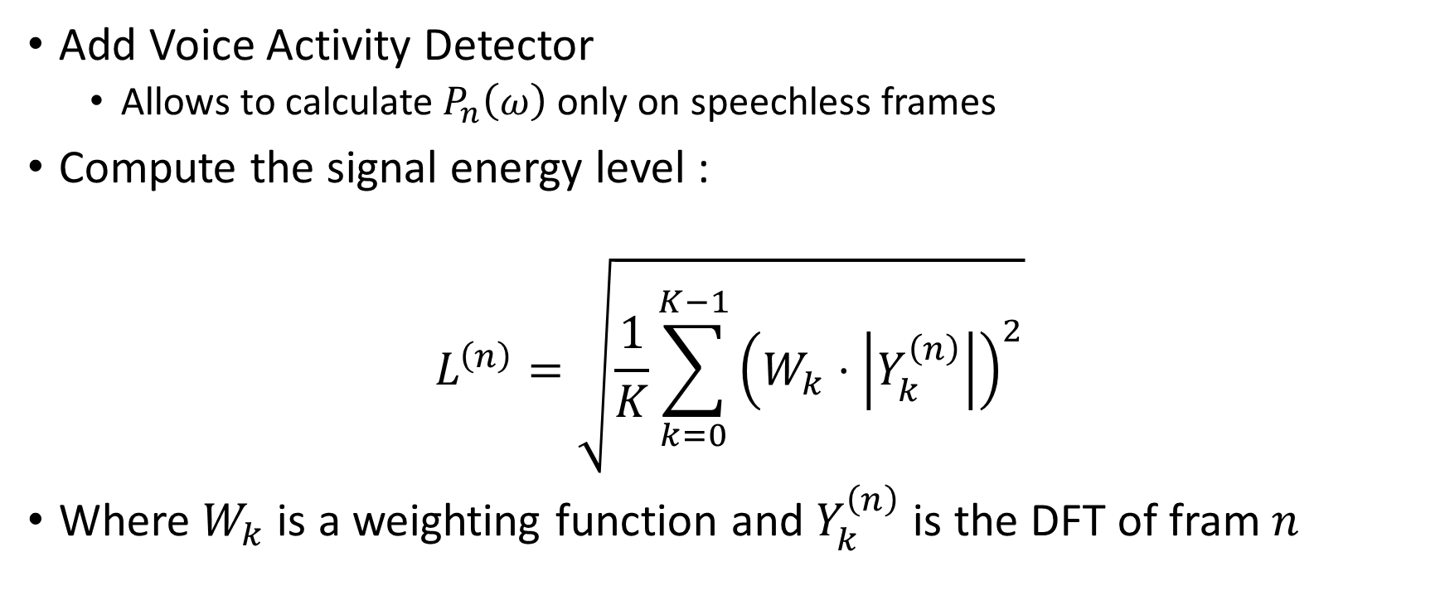
Improving the algorithm ?
Add Voice Activity Detector
Allows to calculate $P_{n}\left(ω\right)$ only on speechless frames
Compute the signal energy level :
$$L^{\left(n\right)}=\sqrt{\frac{1}{K}\sum_{k=0}^{K−1}{{\left(W_{k}⋅\left|Y_{k}^{\left(n\right)}\right|\right)}^{2}}}$$
Where $W_{k}$ is a weighting function and $Y_{k}^{\left(n\right)}$ is the DFT of fram $n$

Slide 7
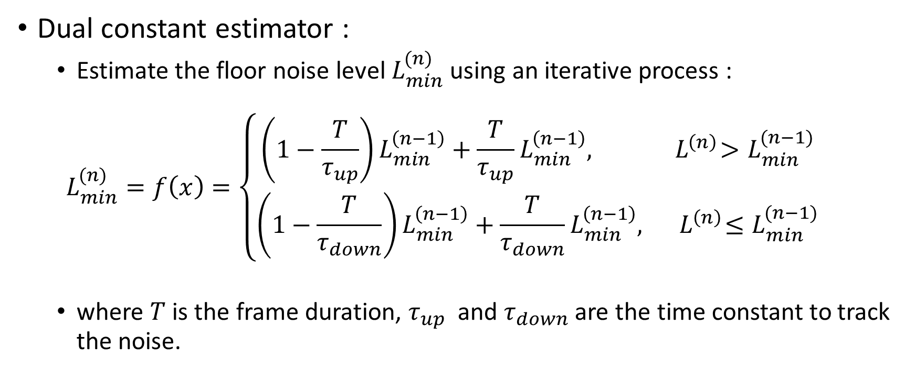
Improving the algorithm (2)
Dual constant estimator :
Estimate the floor noise level $L_{min}^{(n)}$ using an iterative process :
$$L_{min}^{(n)}=f\left(x\right)=\left\{\begin{aligned}\left(1−\frac{T}{τ_{up}}\right)L_{min}^{\left(n−1\right)}+\frac{T}{τ_{up}}L_{min}^{\left(n−1\right)},{ L}^{\left(n\right)}>L_{min}^{(n−1)} \\ &\left(1−\frac{T}{τ_{down}}\right)L_{min}^{\left(n−1\right)}+\frac{T}{τ_{down}}L_{min}^{\left(n−1\right)},{ L}^{\left(n\right)}≤L_{min}^{(n−1)}\end{aligned}\right.$$
where $T$ is the frame duration, $τ_{up}$ and $τ_{down}$ are the time constant to track the noise.

Slide 8

Improving the algorithm (3)
Final decision :
$$V^{\left(n\right)}=\left\{\begin{aligned}0, if\frac{L^{\left(n\right)}}{L_{min}^{(n)}}>T_{down} \\ 1, if \frac{L^{\left(n\right)}}{L_{min}^{(n)}}>T_{down} \\ V^{\left(n−1\right)}, otherwise\end{aligned}\right.$$

Slide 9

Evaluation
A posteriori SNR
Build estimate of noise
Compute SNR of the denoised signal
Intelligibility
A network is asked to classify speech signals at various SNR ratios, and we compare its classification certainty for noisy speech and denoised speech
Subjective evaluation
A few examples
Need your feedback about denoising process

Slide 10
Final results & Conclusion

