Slide 1

Speech enhancement by Wiener filtering - Voice activity detection and all pole modelling of the vocal tract
Laurent Colbois, Lionel Desarzens
COM-415 Audio and Acoustic Signal Processing course
EPFL 2018-2019

Slide 2
Menu of the day
Algorithm
Wiener Filtering
Noise Power Spectral Distribution (PSD) estimation
Speech PSD estimation : all-pole model
Voice Activity Detector
Results
Evaluation metrics
Sentence and word denoising
Conclusion

Slide 3
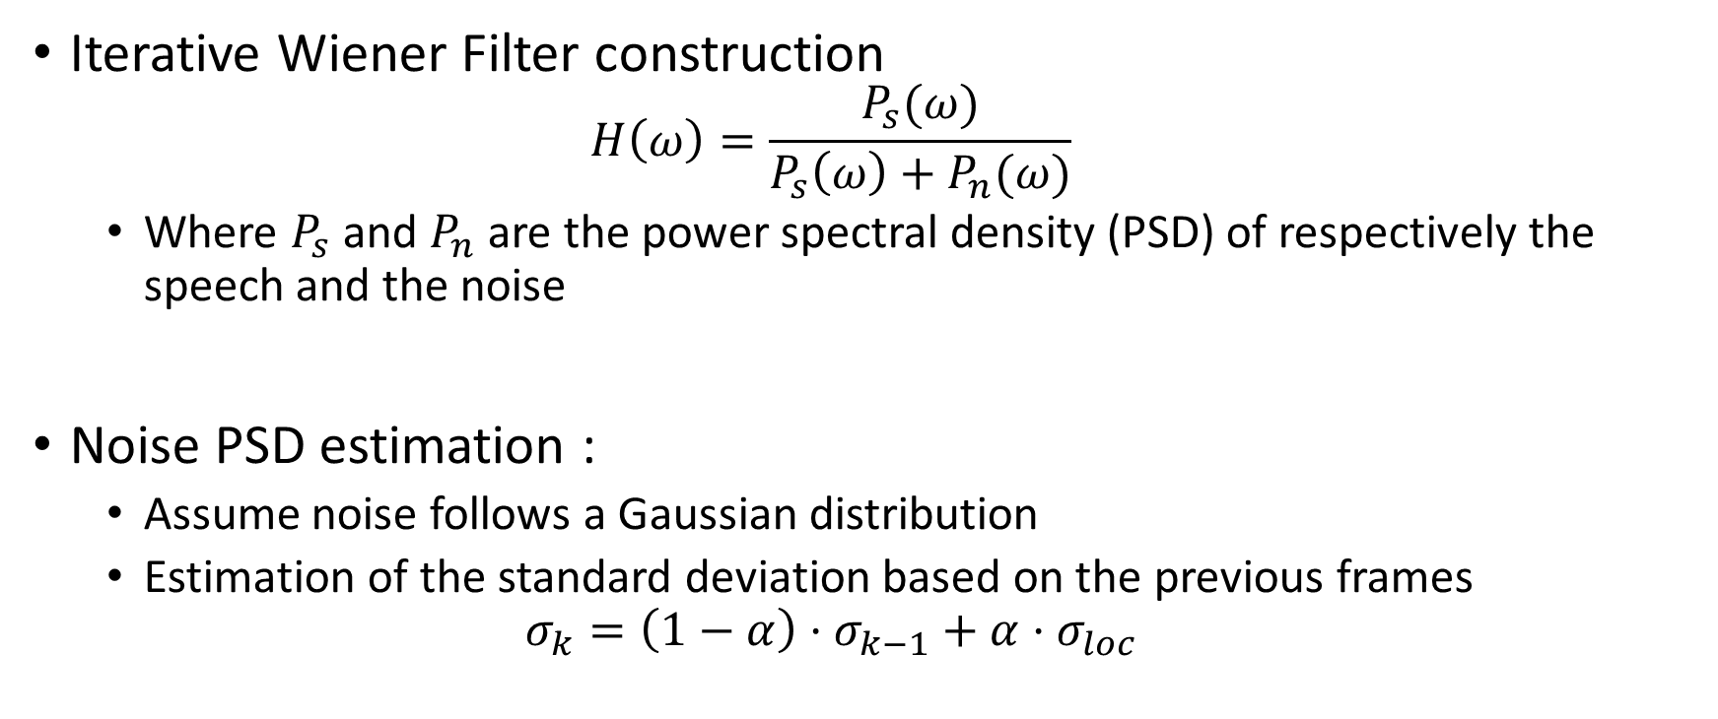
Algorithm
Iterative Wiener Filter construction
$$H\left(ω\right)=\frac{P_{s}(ω)}{P_{s}\left(ω\right)+P_{n}(ω)}$$
Where $P_{s}$ and $P_{n}$ are the power spectral density (PSD) of respectively the speech and the noise
Noise PSD estimation :
Assume noise follows a Gaussian distribution
Estimation of the standard deviation based on the previous frames
$$σ_{k}=\left(1−α\right)⋅σ_{k−1}+α⋅σ_{loc}$$

Slide 4
Algorithm (2)
Speech PSD estimation : all-pole modeling
Auto-regressive process

Slide 5
Improving the algorithm ?
Add Voice Activity Detector

Slide 6

Evaluation
A posteriori SNR
Build estimate of noise
Compute SNR of the denoised signal
Intelligibility
A network is asked to classify speech signals at various SNR ratios, and we compare its classification certainty for noisy speech and denoised speech
Subjective evaluation
A few examples
Need your feedback about denoising process

