Slide 1
Angular 2 Using VS2017 ASP.Net Core

Slide 2
Install VS 2017
https://www.visualstudio.com/zh-hant/downloads
Create an offline installer for Visual Studio 2017
vs_enterprise --layout C:\vs2017offlinetw --lang zh-TW
Enterprise:
NJVYC-BMHX2-G77MM-4XJMR-6Q8QF
Professional:
KBJFW-NXHK6-W4WJM-CRMQB-G3CDH

Slide 3
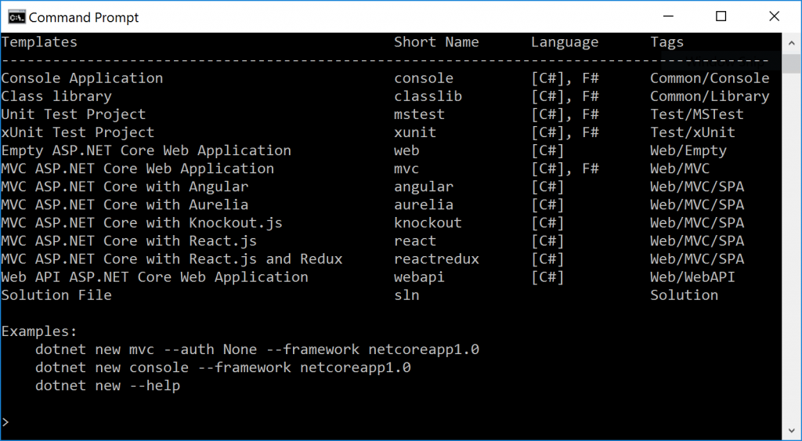
Installing the SPA Templates (SPA:Single Page Applications)
cmd➔node --version
cmd➔dotnet new --install Microsoft.AspNetCore.SpaTemplates::*

Slide 4
Create VS 2017 Project
Create an empty directory (mkdir angulartest)
cd to that directory(cd angulartest)
cmd➔dotnet new -l
cmd➔dotnet new angular
cmd➔dotnet restore
cmd➔npm install
set an environment variable to tell ASP.NET to run in development mode
cmd➔setx ASPNETCORE_ENVIRONMENT "Development“
and then restart your command prompt to make the change take effect
cmd➔start angulartest.csproj

Slide 5
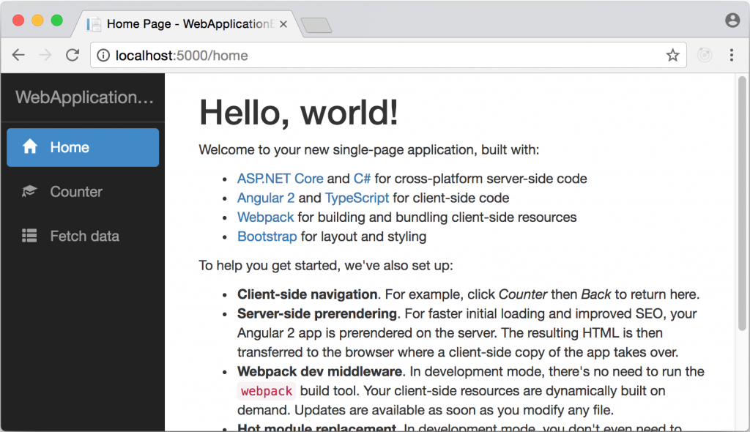
SAMPLE cODE

Slide 6
Reference
https://blogs.msdn.microsoft.com/webdev/2017/02/14/building-single-page-applications-on-asp-net-core-with-javascriptservices/
https://channel9.msdn.com/Events/Visual-Studio/Visual-Studio-2017-Launch/WEB-103

Slide 7
Clear Project
Delete the components
CounterComponent
FetchDataComponent
NavMenu
Update app.module.ts
Remove imports & declarations
Adjust Routes
Update AppComponent
Update HomeComponent

Slide 8
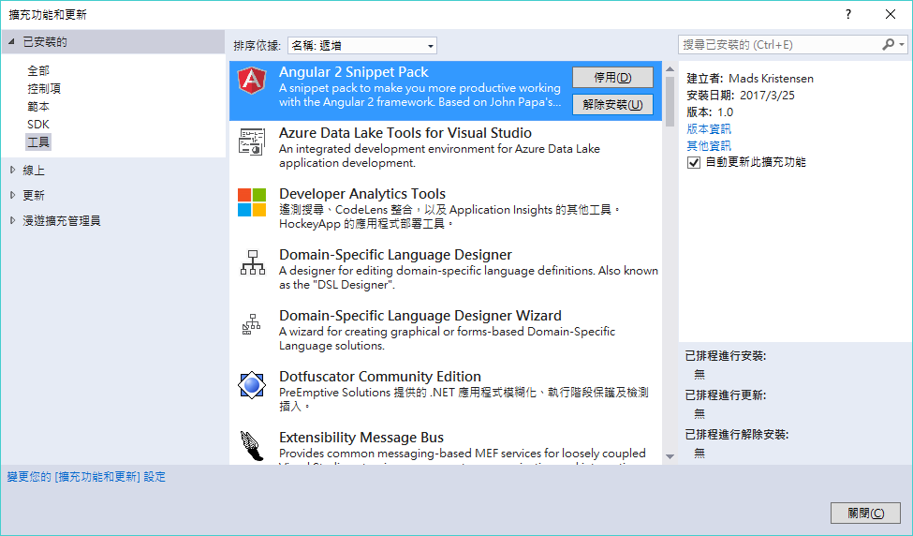
Install Angular 2 Snippet Pack

Slide 9
EF Core REF
https://docs.microsoft.com/en-us/aspnet/core/data/ef-mvc/intro
https://www.youtube.com/watch?v=4kgILKQuGjk
https://docs.microsoft.com/en-us/ef/core/index

Slide 10
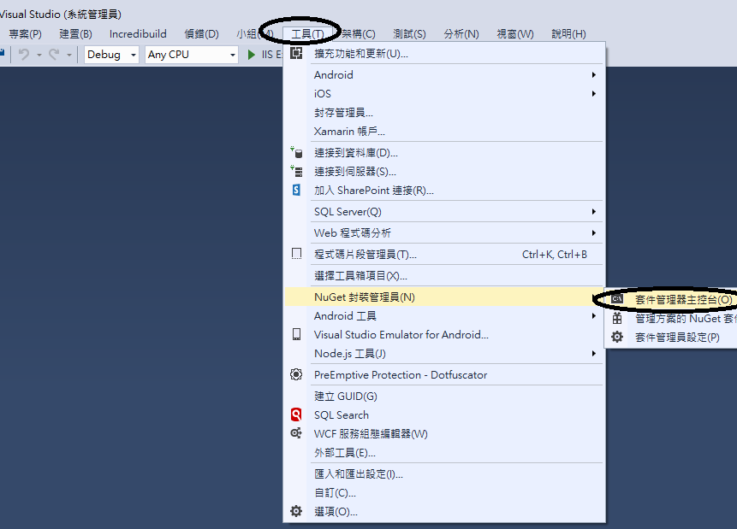
Install EF Core Package

Slide 11
Install EF Core Package
Install-Package Microsoft.EntityFrameworkCore.SqlServer
Install-Package Microsoft.EntityFrameworkCore.SqlServer.Design
Install-Package Microsoft.EntityFrameworkCore.Tools

Slide 12
Add ConnectionString
appsettings.json
{
"ConnectionStrings": {
"DefaultConnection": "Server=.\\sqlserver2012;Database=IRF;user id=sa;password=mssql;MultipleActiveResultSets=true;"
},
"Logging": {
"IncludeScopes": false,
"LogLevel": {
"Default": "Debug",
"System": "Information",
"Microsoft": "Information"
}
}
}

Slide 13
Add Table
using System;
using System.Collections.Generic;
using System.Linq;
using System.Threading.Tasks;
namespace angulartest.Models
{
public class SYSNO
{
public Guid ID { get; set; }
public string SYS_NO { get; set; }
public string SYS_NM { get; set; }
public string SYS_CLASS { get; set; }
public int SYS_SR { get; set; }
public string OWNER_USR_NO { get; set; }
public string OWNER_GRP_NO { get; set; }
public DateTime? ADD_DT { get; set; }
public string MDY_USR_NO { get; set; }
public DateTime? MDY_DT { get; set; }
public string IP_NM { get; set; }
public string CP_NM { get; set; }
}
}

Slide 14
Add DBContext
using System;
using System.Collections.Generic;
using System.Linq;
using System.Threading.Tasks;
using Microsoft.EntityFrameworkCore;
namespace angulartest.Models
{
public class ModelDbContext : DbContext
{
public ModelDbContext (DbContextOptions<ModelDbContext> options) : base(options)
{
}
public DbSet<SYSNO> SYSNO { get; set; }
}
}

Slide 15
Register Context as a service
Startup.cs
using Microsoft.EntityFrameworkCore;
public void ConfigureServices(IServiceCollection services)
{
// Add framework services.
services.AddDbContext<Models.ModelDbContext>(options =>
options.UseSqlServer(Configuration.GetConnectionString("DefaultConnection")));
services.AddMvc();
}

Slide 16
Entity Framework Core 1.0 : Reverse Engineering the Model
語法：
Scaffold-DbContext "Server=SERVERNAME;Database=DATABASENAME;user id=USERNAME;password=USERPASSWORD;" Microsoft.EntityFrameworkCore.SqlServer -OutputDir Models
dotnet ef dbcontext scaffold "Server=SERVERNAME;Database=DATABASENAME;user id=USERNAME;password=USERPASSWORD;" Microsoft.EntityFrameworkCore.&lt;wbr /&gt;SqlServer -o Models --context MyDBDataContext --verbose
參考：
https://jessedotnet.com/2016/05/30/entity-framework-core-rc2-reverse-engineering-the-db-database-first-development/
https://jessedotnet.com/2016/04/13/entity-framework-7-rc-modeling-and-connecting-to-sql-views/

Slide 17
Create API Controller
namespace angulartest.Controllers
{
[Route("api/SYS001")]
[Produces("application/json")]
public class SYS001Controller1 : Controller
{
private Models.IRFContext _context;
public SYS001Controller1(Models.IRFContext context)
{
_context = context;
}
[HttpGet]
[Route("Query")]
public IEnumerable<Models.SYSNO> GetQuery()
{
return _context.SYSNO;
}
}
}

Slide 18
Test API Controller

Slide 19
修正 Scaffold naming convention Startup.cs
using Microsoft.EntityFrameworkCore;
using Microsoft.EntityFrameworkCore.Scaffolding.Internal;
Startup.cs加下function
public void ConfigureDesignTimeServices(IServiceCollection services)
{
// override the defautlt naming service
services.AddSingleton<CandidateNamingService, CustomCandidateNamingService>();
}

Slide 20
ADD CustomCandidateNamingService Class
public class CustomCandidateNamingService : Microsoft.EntityFrameworkCore.Scaffolding.Internal.CandidateNamingService
{
public override string GenerateCandidateIdentifier(string original)
{
return original;
Console.WriteLine("Naming request: " + original);
// original will be the table name, column name, index name, etc.
// In this override, you are free to do whatever you want.
// the base class will return PascalCase
var pascalCaseify = base.GenerateCandidateIdentifier(original);
return pascalCaseify;
}
}

Slide 21
修正 camelCasing JSON Startup.cs
using Microsoft.EntityFrameworkCore.Scaffolding.Internal;
public void ConfigureServices(IServiceCollection services)
{
// Add framework services.
services.AddDbContext<Models.IRFContext>(options =>
options.UseSqlServer(Configuration.GetConnectionString("DefaultConnection")));
services.AddMvc().AddJsonOptions(opt =>
{
var resolver = opt.SerializerSettings.ContractResolver;
if (resolver != null)
{
var res = resolver as Newtonsoft.Json.Serialization.DefaultContractResolver;
res.NamingStrategy = null; // <<!-- this removes the camelcasing
}
});
}

Slide 22
HTML 5 & CSS JQUERY & BootStrap & RWD

Slide 23
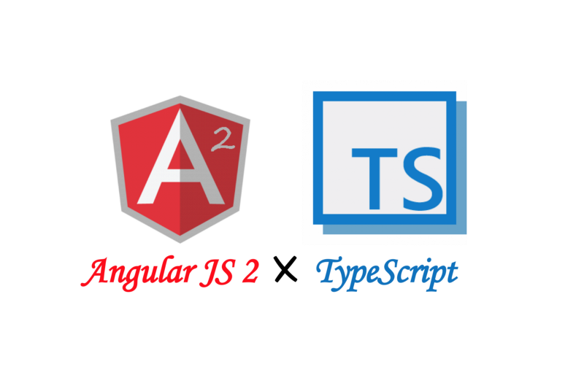

Angular JS 2 & TypeScript

Slide 24
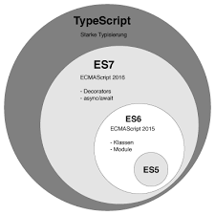
TypeSCRIPT

Slide 25
TypeScript

Slide 26
AngularJS 2
Module
Component
Template
Databinding
Directive
Service(Injection),provider
PipeLine
Dependency Injection
Router

Slide 29
Data binding
內嵌繫結 ( interpolation )
{{property}}
屬性繫結 ( Property Binding )
[property]='statement'
事件繫結 ( Event Binding )
(event)='someMethod($event)'
雙向繫結 ( Two-way Binding )
[(ngModel)]='property'

Slide 30
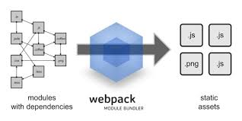

Slide 31
Simple CRUD

Slide 32
Debug
Using CHROME

Slide 33
Upgrade To 4.0
http://blog.kevinyang.net/2017/03/26/angular4-universal-aspnetcore/

Slide 34
Install PRIMENG
npm install @angular/common@next @angular/compiler@next @angular/compiler-cli@next @angular/core@next @angular/forms@next @angular/http@next @angular/platform-browser@next @angular/platform-browser-dynamic@next @angular/platform-server@next @angular/router@next @angular/animations@next --save
npm install @angular/common@latest @angular/compiler@latest @angular/compiler-cli@latest @angular/core@latest @angular/forms@latest @angular/http@latest @angular/platform-browser@latest @angular/platform-browser-dynamic@latest @angular/platform-server@latest @angular/router@latest @angular/animations@latest typescript@latest --save
npm install primeng --save
NPM install font-awesome --save
npm install -g webpack
移除 VIEWs\home\index.cshtml內容如下
asp-prerender-module="ClientApp/dist/main-server“
Modify webpack.config.vendor.js

Slide 35
entry: {
vendor: [
'@angular/common',
'@angular/compiler',
'@angular/core',
'@angular/http',
'@angular/platform-browser',
'@angular/platform-browser-dynamic',
'@angular/router',
'@angular/platform-server',
'angular2-universal',
'angular2-universal-polyfills',
'bootstrap',
'bootstrap/dist/css/bootstrap.css',
'es6-shim',
'es6-promise',
'event-source-polyfill',
'jquery',
'zone.js',
"primeng/resources/primeng.min.css",
"primeng/resources/themes/omega/theme.css",
"font-awesome/css/font-awesome.css"
]
},

Slide 36
webpack --config webpack.config.vendor.js

Slide 37
Publishing for Depolyment
dotnet publish -c Release

Slide 38
C:\Users\rex\Source\Repos\MERP2\node_modules\primeng\resources\images
npm install -g webpack
webpack --config webpack.config.vendor.js

