Slide 1
COMP2396B Tutorial 5
Answer

Slide 2
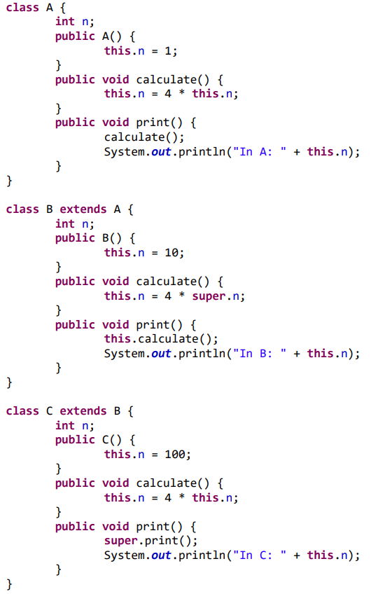
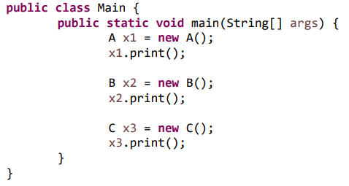
Question:
What is the output of the program?
It has no compile-time or run-time error.

Slide 3
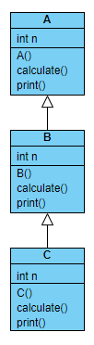

Slide 4
x1 – class A obj
A | n = 0
ints are initialized by 0

Slide 5
x1 – class A obj
A | n = 0

Slide 6
x1 – class A obj
A | n = 0 -> 1

Slide 7
x1 – class A obj
A | n = 0 -> 1

Slide 8
x1 – class A obj
A | n = 0 -> 1

Slide 9
x1 – class A obj
A | n = 0 -> 1

Slide 10
x1 – class A obj
A | n = 0 -> 1

Slide 11
1
x1 – class A obj
A | n = 0 -> 1 -> 4

Slide 12
4
x1 – class A obj
A | n = 0 -> 1 -> 4
In A: 4
Program output

Slide 13
x1 – class A obj
A | n = 0 -> 1 -> 4
x2 – class B obj
A | n = 0
B | n = 0
In A: 4
Program output

Slide 14
x1 – class A obj
A | n = 0 -> 1 -> 4
x2 – class B obj
A | n = 0
B | n = 0
In A: 4
Program output

Slide 15
x1 – class A obj
A | n = 0 -> 1 -> 4
x2 – class B obj
A | n = 0
B | n = 0
In A: 4
Program output

Slide 16
x1 – class A obj
A | n = 0 -> 1 -> 4
x2 – class B obj
A | n = 0 -> 1
B | n = 0
In A: 4
Program output

Slide 17
x1 – class A obj
A | n = 0 -> 1 -> 4
x2 – class B obj
A | n = 0 -> 1
B | n = 0 -> 10
In A: 4
Program output

Slide 18
x1 – class A obj
A | n = 0 -> 1 -> 4
x2 – class B obj
A | n = 0 -> 1
B | n = 0 -> 10
In A: 4
Program output

Slide 19
Which print() is called?
Ans:
The most specific version.
The calling obj is of class B. The print() in B is overriding the print() in A. The most specific version is the one in B.
x1 – class A obj
A | n = 0 -> 1 -> 4
x2 – class B obj
A | n = 0 -> 1
B | n = 0 -> 10
In A: 4
Program output

Slide 20
x1 – class A obj
A | n = 0 -> 1 -> 4
x2 – class B obj
A | n = 0 -> 1
B | n = 0 -> 10
In A: 4
Program output

Slide 21
x1 – class A obj
A | n = 0 -> 1 -> 4
x2 – class B obj
A | n = 0 -> 1
B | n = 0 -> 10
In A: 4
Program output

Slide 22
The calling obj is of class B. The most specific version of the calculate() is the one in B.
x1 – class A obj
A | n = 0 -> 1 -> 4
x2 – class B obj
A | n = 0 -> 1
B | n = 0 -> 10
In A: 4
Program output

Slide 23
x1 – class A obj
A | n = 0 -> 1 -> 4
x2 – class B obj
A | n = 0 -> 1
B | n = 0 -> 10
In A: 4
Program output

Slide 24
This statement is in the scope of B, super refer to the parent class, i.e., A. Therefore, super.n refer to the n in A, i.e., 1.
x1 – class A obj
A | n = 0 -> 1 -> 4
x2 – class B obj
A | n = 0 -> 1
B | n = 0 -> 10 -> 4
In A: 4
Program output

Slide 25
x1 – class A obj
A | n = 0 -> 1 -> 4
4
x2 – class B obj
A | n = 0 -> 1
B | n = 0 -> 10 -> 4
In A: 4
In B: 4
Program output

Slide 26
x1 – class A obj
A | n = 0 -> 1 -> 4
x3 – class C obj
A | n = 0
B | n = 0
C | n = 0
x2 – class B obj
A | n = 0 -> 1
B | n = 0 -> 10 -> 4
In A: 4
In B: 4
Program output

Slide 27
x1 – class A obj
A | n = 0 -> 1 -> 4
x3 – class C obj
A | n = 0
B | n = 0
C | n = 0
x2 – class B obj
A | n = 0 -> 1
B | n = 0 -> 10 -> 4
In A: 4
In B: 4
Program output

Slide 28
x1 – class A obj
A | n = 0 -> 1 -> 4
x3 – class C obj
A | n = 0
B | n = 0
C | n = 0
x2 – class B obj
A | n = 0 -> 1
B | n = 0 -> 10 -> 4
In A: 4
In B: 4
Program output

Slide 29
x1 – class A obj
A | n = 0 -> 1 -> 4
x3 – class C obj
A | n = 0
B | n = 0
C | n = 0
x2 – class B obj
A | n = 0 -> 1
B | n = 0 -> 10 -> 4
In A: 4
In B: 4
Program output

Slide 30
x1 – class A obj
A | n = 0 -> 1 -> 4
x3 – class C obj
A | n = 0 -> 1
B | n = 0
C | n = 0
x2 – class B obj
A | n = 0 -> 1
B | n = 0 -> 10 -> 4
In A: 4
In B: 4
Program output

Slide 31
x1 – class A obj
A | n = 0 -> 1 -> 4
x3 – class C obj
A | n = 0 -> 1
B | n = 0 -> 10
C | n = 0
x2 – class B obj
A | n = 0 -> 1
B | n = 0 -> 10 -> 4
In A: 4
In B: 4
Program output

Slide 32
x1 – class A obj
A | n = 0 -> 1 -> 4
x3 – class C obj
A | n = 0 -> 1
B | n = 0 -> 10
C | n = 0 -> 100
x2 – class B obj
A | n = 0 -> 1
B | n = 0 -> 10 -> 4
In A: 4
In B: 4
Program output

Slide 33
x1 – class A obj
A | n = 0 -> 1 -> 4
x3 – class C obj
A | n = 0 -> 1
B | n = 0 -> 10
C | n = 0 -> 100
x2 – class B obj
A | n = 0 -> 1
B | n = 0 -> 10 -> 4
In A: 4
In B: 4
Program output

Slide 34
The most specific version of print() is in class C
x1 – class A obj
A | n = 0 -> 1 -> 4
x3 – class C obj
A | n = 0 -> 1
B | n = 0 -> 10
C | n = 0 -> 100
x2 – class B obj
A | n = 0 -> 1
B | n = 0 -> 10 -> 4
In A: 4
In B: 4
Program output

Slide 35
x1 – class A obj
A | n = 0 -> 1 -> 4
x3 – class C obj
A | n = 0 -> 1
B | n = 0 -> 10
C | n = 0 -> 100
x2 – class B obj
A | n = 0 -> 1
B | n = 0 -> 10 -> 4
In A: 4
In B: 4
Program output

Slide 36
x1 – class A obj
A | n = 0 -> 1 -> 4
x3 – class C obj
A | n = 0 -> 1
B | n = 0 -> 10
C | n = 0 -> 100
x2 – class B obj
A | n = 0 -> 1
B | n = 0 -> 10 -> 4
In A: 4
In B: 4
Program output

Slide 37
x1 – class A obj
A | n = 0 -> 1 -> 4
x3 – class C obj
A | n = 0 -> 1
B | n = 0 -> 10
C | n = 0 -> 100
x2 – class B obj
A | n = 0 -> 1
B | n = 0 -> 10 -> 4
This statement is in the scope of C, super refer to the parent class, i.e., B. Therefore, super.print() refer to the print() in B.
In A: 4
In B: 4
Program output

Slide 38
x1 – class A obj
A | n = 0 -> 1 -> 4
x3 – class C obj
A | n = 0 -> 1
B | n = 0 -> 10
C | n = 0 -> 100
x2 – class B obj
A | n = 0 -> 1
B | n = 0 -> 10 -> 4
In A: 4
In B: 4
Program output

Slide 39
x1 – class A obj
A | n = 0 -> 1 -> 4
x3 – class C obj
A | n = 0 -> 1
B | n = 0 -> 10
C | n = 0 -> 100
x2 – class B obj
A | n = 0 -> 1
B | n = 0 -> 10 -> 4
In A: 4
In B: 4
Program output

Slide 40
Which calculate() to be called?
Ans:
The most specific version.
x1 – class A obj
A | n = 0 -> 1 -> 4
x3 – class C obj
A | n = 0 -> 1
B | n = 0 -> 10
C | n = 0 -> 100
x2 – class B obj
A | n = 0 -> 1
B | n = 0 -> 10 -> 4
In A: 4
In B: 4
Program output

Slide 41
x1 – class A obj
A | n = 0 -> 1 -> 4
x3 – class C obj
A | n = 0 -> 1
B | n = 0 -> 10
C | n = 0 -> 100
x2 – class B obj
A | n = 0 -> 1
B | n = 0 -> 10 -> 4
In A: 4
In B: 4
Program output

Slide 42
x1 – class A obj
A | n = 0 -> 1 -> 4
x3 – class C obj
A | n = 0 -> 1
B | n = 0 -> 10
C | n = 0 -> 100 -> 400
x2 – class B obj
A | n = 0 -> 1
B | n = 0 -> 10 -> 4
100
In A: 4
In B: 4
Program output

Slide 43
x1 – class A obj
A | n = 0 -> 1 -> 4
x3 – class C obj
A | n = 0 -> 1
B | n = 0 -> 10
C | n = 0 -> 100 -> 400
10
x2 – class B obj
A | n = 0 -> 1
B | n = 0 -> 10 -> 4
In A: 4
In B: 4
In B: 10
Program output

Slide 44
x1 – class A obj
A | n = 0 -> 1 -> 4
x3 – class C obj
A | n = 0 -> 1
B | n = 0 -> 10
C | n = 0 -> 100 -> 400
x2 – class B obj
A | n = 0 -> 1
B | n = 0 -> 10 -> 4
400
In A: 4
In B: 4
In B: 10
In C: 400
Program output

Slide 45
x1 – class A obj
A | n = 0 -> 1 -> 4
x3 – class C obj
A | n = 0 -> 1
B | n = 0 -> 10
C | n = 0 -> 100 -> 400
x2 – class B obj
A | n = 0 -> 1
B | n = 0 -> 10 -> 4
In A: 4
In B: 4
In B: 10
In C: 400
Program output
Done! 👍

