Slide 1

Tutorial 2 Building simple database applications
COMP3278 Introduction to
Database Management Systems
School of Computing & Data Science, The University of Hong Kong
Acknowledgement: Dr. Chui Chun Kit, Dr. Reynold Cheng, Dr. Ping Luo

Slide 2
Outcome based learning (OBL)
Outcome 1. Information Modeling
Able to understand the modeling of real life information in a database system.
Outcome 2. Query Languages
Able to understand and use the languages designed for data access.
Outcome 3. System Design
Able to understand the design of an efficient and reliable database system.
Outcome 4. Application Development
Able to implement a practical application on a real database

Slide 3



In this tutorial…
To build a simple web-based database application
To understand the role of
Web server
Database server
Application programming server (Server-side programming language)

Slide 4



Dynamic web page request process
HTTP request (e.g. http://www.facebook.com/)
E.g. facebook news feed page
The web server receives the request of browsing the newsfeed page.
Client (web browser)
Web server

Slide 5
Dynamic web page request process
HTTP request (e.g. http://www.facebook.com/)
E.g. facebook news feed page
Execute server-side programme,
Generate a web page for that
particular request.
Application server
Client (web browser)
Web server
The web server then transmits the data to the application server.
In the application server, it executes the newsfeed page (written in PHP, Perl, …etc).

Slide 6

Dynamic web page request process
HTTP request (e.g. http://www.facebook.com/)
E.g. facebook news feed page
Execute server-side programme,
Generate a web page for that
particular request.
Application server
SQL
Client (web browser)
Web server
The application server retrieves the information w.r.t. the client from database (e.g. my friend list, their news …etc)
Database system

Slide 7
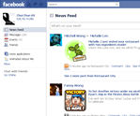
Dynamic web page request process
HTTP request (e.g. http://www.facebook.com/)
E.g. facebook news feed page
Execute server-side programme,
Generate a web page for that
particular request.
Application server
SQL
Client (web browser)
Web server
The generated web page
E.g. my personal facebook news feed
The newsfeed PHP program generates the web page, and ask the web server to send the generate page (HTML page) back to the client.
Database system
The generated web page
E.g. my personal facebook news feed

Slide 8
Dynamic web page request process
HTTP request (e.g. http://www.facebook.com/)
E.g. facebook news feed page
Execute server-side programme,
Generate a web page for that
particular request.
Application server
SQL
Client (web browser)
Web server
The generated web page
E.g. my personal facebook news feed
Database system
The generated web page
E.g. my personal facebook news feed
The client, web server and database are not necessary to be hosted on the same server (computer)

Slide 9
Using the CS Servers
Acknowledgement: Dr. Chui Chun Kit, Dr. Reynold Cheng, Dr. Ping Luo

Slide 10

CS servers
We can use the Web Server, PHP Application Server and Database Server provided by the CS department.
The MySQL GUI interface (phpMyAdmin)
is located at: http://i.cs.hku.hk/phpmyadmin/
Uploading file form your computer to the CS web server
Connect to CS VPN if you are not inside the CS network.
Copy your PHP/HTML files in the public_html folder (e.g. HelloWorld.php),
Then you can view it using this link: (http://i.cs.hku.hk/~yourCSID/HelloWorld.php)
https://intranet.cs.hku.hk/csintranet/contents/technical/howto/ft.jsp

Slide 11
Application 1
Slides prepared by - Dr. Chui Chun Kit (http://www.cs.hku.hk/~ckchui) for students in COMP3278
For other uses, please email : ckchui@cs.hku.hk

Slide 12
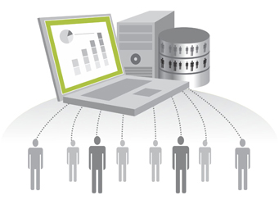
Application 1
Suppose that you are going to develop an employee information retrieval system.
You are going to use a database to maintain the employee information.
For each employee, we record his/her employee_ID (unique), name, and address.

Slide 13
Application 1
Step 1. Information modeling.
Step 2. Reduction to database table.
Employee (employee_ID, name, address)
Foreign : none.
employee_ID
Employee
name
address

Slide 14

Application 1
Step 3. Build the database table.
Create a table called “employee”, with 3 columns, “employee_id”, “name” and “address”.
Make “employee_id” a primary key.
Try to enter some records in the table.
We can use the Database GUI phpmyadmin to create the tables ☺

Slide 15
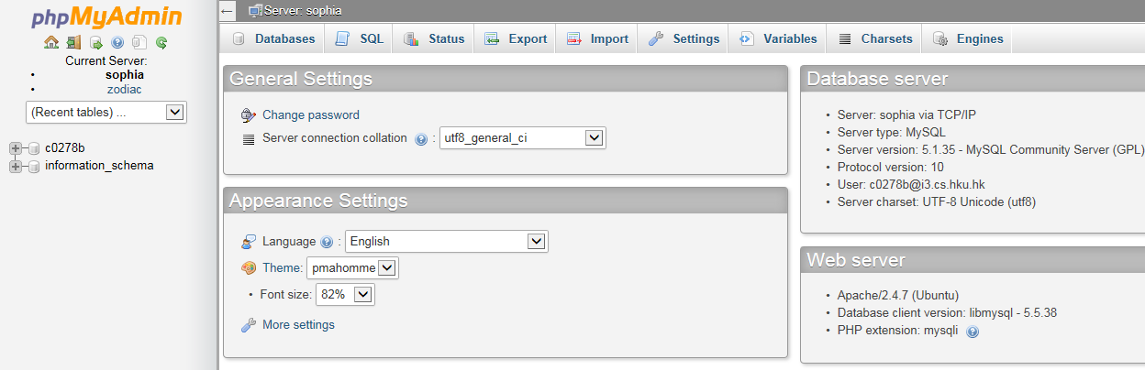
Application 1
Access the MySQL database through the graphical user interface called phpMyAdmin:
http://i.cs.hku.hk/phpmyadmin/
Login to the database using your MySQL account.
A database named with your CSID is created for you, please click on it:

Slide 16
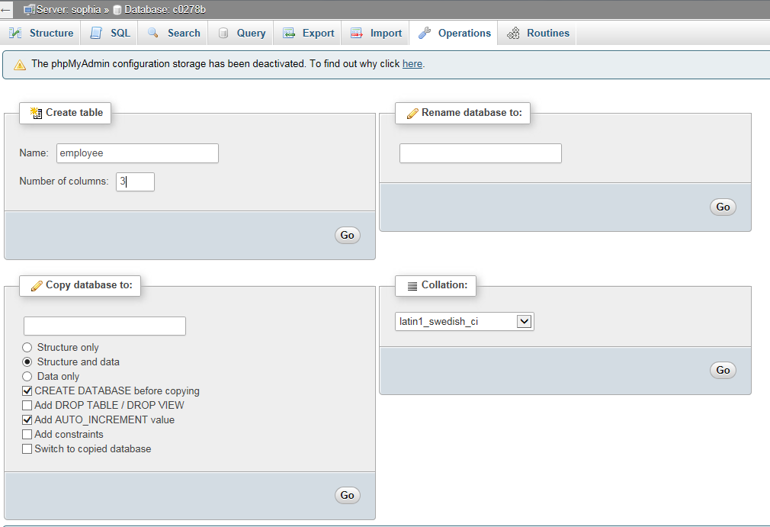
Application 1
Create a table “employee” in the database.
Let’s create a table called “employee”.
Since the table contains 3 columns, we enter “3” in the “number of fields”.

Slide 17
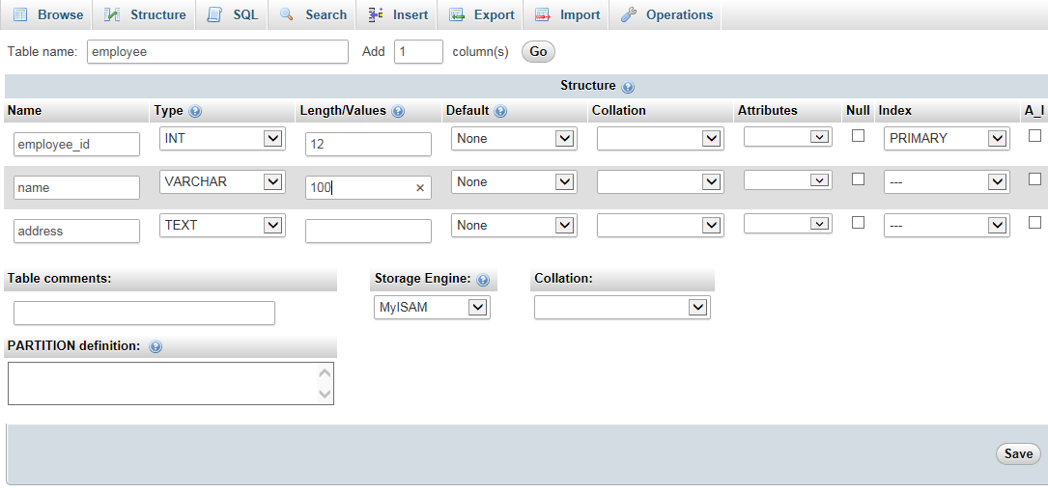
Application 1
Specify the columns in the employee table.
For each column, we need to specify some detail, like the data type, and the size of the data record.
Select this pull down menu to make the employee_id as a primary key

Slide 18
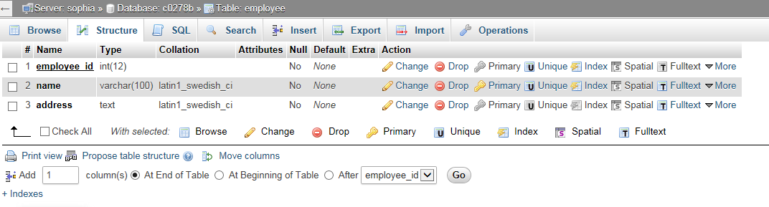
Press this button to open the form for inserting record into the employee table.

Slide 19
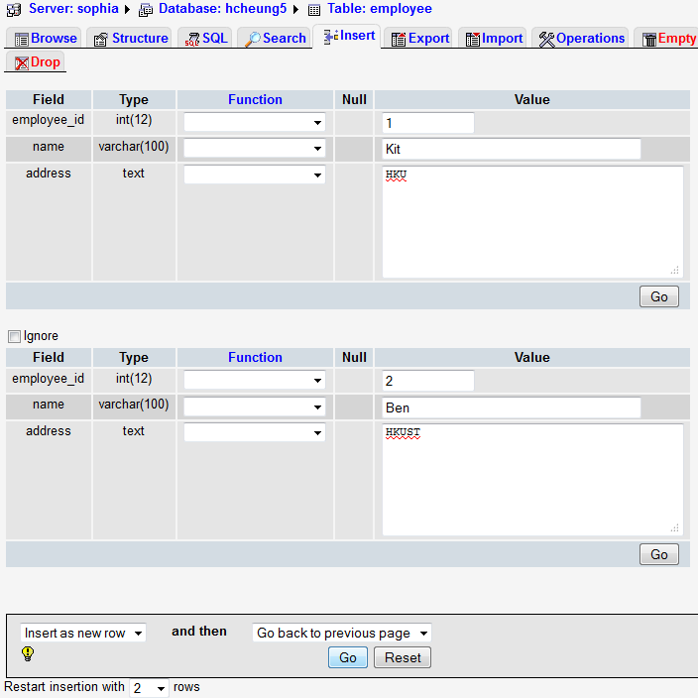
After filling in the records, press “go” to insert the record to the employee table.

Slide 20
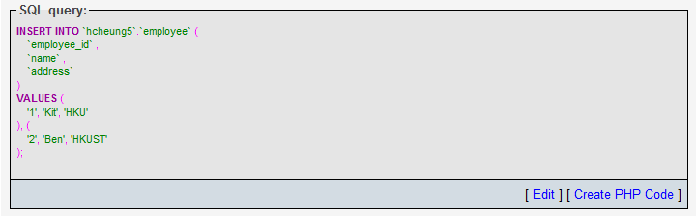
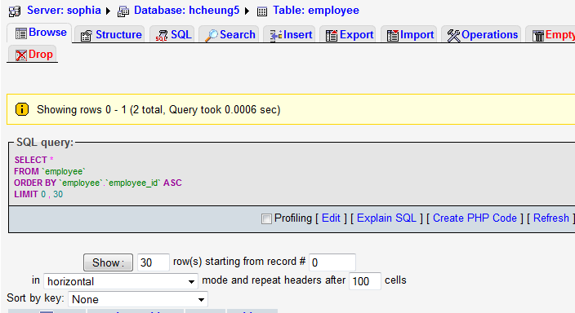
In fact, phpmyadmin just generate a database SQL query and ask MySQL database to execute the query to insert the record to the database.
Click the browse button, we can see the list of records in the employee table.

Slide 21
Application 1
Step 4. Develop applications on top of the database.
In this step we can use the PHP server side programming language to access the database.
Other programming language can also be used, e.g., JAVA, C, JSP, ASP …etc
To access the database, we need the following steps:
Step 1. Connect to the database server.
Step 2. Select the database.
Step 3. Prepare the query.
Step 4. Execute the query and obtain the result (if any) returned by the database.

Slide 22

Application 1
Put query.php in the web server (W:/public_html/)
HTTP request (e.g. http://i.cs.hku.hk/~yourCSID/query.php)
Execute query.php located in the web server root.
Generate a web page containing the retrieved information
Application server
...
SQL
Client (web browser)
Web server
Result
The generated web page containing
employee information
...
Database system
The generated web page containing
employee information

Slide 23
Application 1
<?php
$host = “sophia";
$username=“yourCSID";
$password=“yourDataBasePassword";
$database="yourCSID";
$connection = mysqli_connect($host,$username,$password);
mysqli_select_db($connection, $database) or die( "Unable to select database: ".mysqli_error($connection));
$query = "SELECT * FROM employee;";
$result = mysqli_query($connection, $query) or die( "Unable to execute query: ".mysqli_error($connection));
while($row = mysqli_fetch_array($result, MYSQLI_ASSOC))
{
echo "Employee ID: ". $row['employee_id'] ." <br> ";
echo "Name: " .$row['name'] ." <br>";
echo "Address: " .$row['address'] ."<br><br>";
}
mysqli_close($connection);
?>

Slide 24
Application 1
<?php indicates the start of php code.
<?php
$host = “sophia";
$username=“yourCSID";
$password=“yourDataBasePassword";
$database="yourCSID";
$connection = mysqli_connect($host,$username,$password);
mysqli_select_db($connection, $database) or die( "Unable to select database: ".mysqli_error($connection));
$query = "SELECT * FROM employee;";
$result = mysqli_query($connection, $query) or die( "Unable to execute query: ".mysqli_error($connection));
while($row = mysqli_fetch_array($result, MYSQLI_ASSOC))
{
echo "Employee ID: ". $row['employee_id'] ." <br> ";
echo "Name: " .$row['name'] ." <br>";
echo "Address: " .$row['address'] ."<br><br>";
}
mysqli_close($connection);
?>

Slide 25
Application 1
Variable in php starts with “$”, so $host is a variable.
The value of $host is a text “sophia”.
It is because the database server is located in a machine called “sophia” in the CS department.
<?php
$host = “sophia";
$username=“yourCSID";
$password=“yourDataBasePassword";
$database="yourCSID";
$connection = mysqli_connect($host,$username,$password);
mysqli_select_db($connection, $database) or die( "Unable to select database: ".mysqli_error($connection));
$query = "SELECT * FROM employee;";
$result = mysqli_query($connection, $query) or die( "Unable to execute query: ".mysqli_error($connection));
while($row = mysqli_fetch_array($result, MYSQLI_ASSOC))
{
echo "Employee ID: ". $row['employee_id'] ." <br> ";
echo "Name: " .$row['name'] ." <br>";
echo "Address: " .$row['address'] ."<br><br>";
}
mysqli_close($connection);
?>

Slide 26
Application 1
<?php
$host = “sophia";
$username=“yourCSID";
$password=“yourDataBasePassword";
$database="yourCSID";
$connection = mysqli_connect($host,$username,$password);
mysqli_select_db($connection, $database) or die( "Unable to select database: ".mysqli_error($connection));
$query = "SELECT * FROM employee;";
$result = mysqli_query($connection, $query) or die( "Unable to execute query: ".mysqli_error($connection));
while($row = mysqli_fetch_array($result, MYSQLI_ASSOC))
{
echo "Employee ID: ". $row['employee_id'] ." <br> ";
echo "Name: " .$row['name'] ." <br>";
echo "Address: " .$row['address'] ."<br><br>";
}
mysqli_close($connection);
?>
1. Connect to the database server.

Slide 27
Application 1
2. Select the database in the database server because a database server can host more than one databases.
<?php
$host = “sophia";
$username=“yourCSID";
$password=“yourDataBasePassword";
$database="yourCSID";
$connection = mysqli_connect($host,$username,$password);
mysqli_select_db($connection, $database) or die( "Unable to select database: ".mysqli_error($connection));
$query = "SELECT * FROM employee;";
$result = mysqli_query($connection, $query) or die( "Unable to execute query: ".mysqli_error($connection));
while($row = mysqli_fetch_array($result, MYSQLI_ASSOC))
{
echo "Employee ID: ". $row['employee_id'] ." <br> ";
echo "Name: " .$row['name'] ." <br>";
echo "Address: " .$row['address'] ."<br><br>";
}
mysqli_close($connection);
?>

Slide 28
Application 1
3. Prepare the query.
We use the variable $query to store the SQL statement. We will learn more different SQL constructs in Chapter 3.
In this example, the statement means :
Select all records from the employee table.
<?php
$host = “sophia";
$username=“yourCSID";
$password=“yourDataBasePassword";
$database="yourCSID";
$connection = mysqli_connect($host,$username,$password);
mysqli_select_db($connection, $database) or die( "Unable to select database: ".mysqli_error($connection));
$query = "SELECT * FROM employee;";
$result = mysqli_query($connection, $query) or die( "Unable to execute query: ".mysqli_error($connection));
while($row = mysqli_fetch_array($result, MYSQLI_ASSOC))
{
echo "Employee ID: ". $row['employee_id'] ." <br> ";
echo "Name: " .$row['name'] ." <br>";
echo "Address: " .$row['address'] ."<br><br>";
}
mysqli_close($connection);
?>

Slide 29
Application 1
<?php
$host = “sophia";
$username=“yourCSID";
$password=“yourDataBasePassword";
$database="yourCSID";
$connection = mysqli_connect($host,$username,$password);
mysqli_select_db($connection, $database) or die( "Unable to select database: ".mysqli_error($connection));
$query = "SELECT * FROM employee;";
$result = mysqli_query($connection, $query) or die( "Unable to execute query: ".mysqli_error($connection));
while($row = mysqli_fetch_array($result, MYSQLI_ASSOC))
{
echo "Employee ID: ". $row['employee_id'] ." <br> ";
echo "Name: " .$row['name'] ." <br>";
echo "Address: " .$row['address'] ."<br><br>";
}
mysqli_close($connection);
?>
4. Execute the statement.
After the statement is executed, the result is in the variable $result.

Slide 30
Application 1
<?php
$host = “sophia";
$username=“yourCSID";
$password=“yourDataBasePassword";
$database="yourCSID";
$connection = mysqli_connect($host,$username,$password);
mysqli_select_db($connection, $database) or die( "Unable to select database: ".mysqli_error($connection));
$query = "SELECT * FROM employee;";
$result = mysqli_query($connection, $query) or die( "Unable to execute query: ".mysqli_error($connection));
while($row = mysqli_fetch_array($result, MYSQLI_ASSOC))
{
echo "Employee ID: ". $row['employee_id'] ." <br> ";
echo "Name: " .$row['name'] ." <br>";
echo "Address: " .$row['address'] ."<br><br>";
}
mysqli_close($connection);
?>
We now echo the result and generate the web page.
This example code is VERY USEFUL! It simply prints out the records one by one.

Slide 31
Application 1
<?php
$host = “sophia";
$username=“yourCSID";
$password=“yourDataBasePassword";
$database="yourCSID";
$connection = mysqli_connect($host,$username,$password);
mysqli_select_db($connection, $database) or die( "Unable to select database: ".mysqli_error($connection));
$query = "SELECT * FROM employee;";
$result = mysqli_query($connection, $query) or die( "Unable to execute query: ".mysqli_error($connection));
while($row = mysqli_fetch_array($result, MYSQLI_ASSOC))
{
echo "Employee ID: ". $row['employee_id'] ." <br> ";
echo "Name: " .$row['name'] ." <br>";
echo "Address: " .$row['address'] ."<br><br>";
}
mysqli_close($connection);
?>
Finally, we close the database connection.

Slide 32
Application 1
Now, please browse the PHP generated web page through the following URL:
Note that you cannot access the source code in query.php in the browser.
It is because the browser only receives the web page “generated” by the query.php (i.e., the echo commands), but not the codes in query.php.
http://i.cs.hku.hk/~yourCSID/query.php

Slide 33
Take home exercise
Acknowledgement: Dr. Chui Chun Kit, Dr. Reynold Cheng, Dr. Ping Luo

Slide 34

Application 2
You are going to develop a catalog system in a library.
The library stores the book info as well as the
author info in the database.
For each book, we record its book_id (unique) and book_name.
For each author, we record his/her author_id (unique) and author_name.
A book is written by one or more authors.
We only keep the information of the authors who have written some books.
The catalog system simply retrieves
query1.php – The complete list of books. For each book, displays only its book_id and book_name.
query2.php – The complete list of all authors. For each author, displays only his/her author_id and author_name.
(Challenging question, learn this technique in Chapter 3 ☺) query3.php – The names of the book(s) written by an author with author_id equals to 1.

Slide 35
Application 2
Book
writes
Author
book_id
author_id
author_name
book_name
Book (book_id, book_name)
Foreign key: none
Author (author_id, author_name)
Foreign key: none
Writes (book_id, author_id)
Foreign key : {book_id referencing Book ; author_id referencing Author}

Slide 36
Application 2
Some sample records
Book
(1,”Introduction to programming”)
(2,”Introduction to database management systems”)
(3,”Introduction to JAVA programming”)
Author
(1,” Walter Savitch”)
(2, “Dennis M”)
Writes
(1,1)
(2,1)
(1,2)
(3,2)

Slide 37
END ☺
COMP3278 Introduction to
Database Management Systems
Department of Computer Science, The University of Hong Kong
Acknowledgement: Dr. Chui Chun Kit, Dr. Reynold Cheng, Dr. Ping Luo

