Slide 1
Lab 2 : Explanatory Modeling
Impact of Weather Factors on Giant Pumpkin and Competitive Cucurbit Production
Lab 2 Team 1:
Eric Ellestad
Patricia Gallagher
Kisha Kim
Sean Koval
Fall 2021

Slide 2
Overview & Research Question
Research Question
What impact do temperature and precipitation have on the weight of giant pumpkins and other cucurbits grown in the United States that were entered into official GPC competitions between the years 2013 - 2021?
Notes:
PATRICIA
For our research paper, our questions was: What impact do temperature and precipitation have on the weight of giant pumpkins and other cucurbits grown in the United States that were entered into official GPC (Great Pumpkin Commonwealth) competitions between the years 2013 - 2021? (For background, cucurbits encompass the gourd family, including squash, pumpkins, tomatoes, and watermelon.) The competitive cucurbits scene has grown largely, now being a worldwide phenomenon. Overtime, growers have developed unique seed genetics and specialized growing techniques to improve the size of their cucurbits. Our research focuses on how factors outside of grower control, namely weather patterns affects cucurbit growth. Our research is from the perspective of a grower with our product being cucurbits and our goal being to understand how weather impacts cucurbits growth so we can alter our growing practices to produce larger cucurbits.

Slide 3
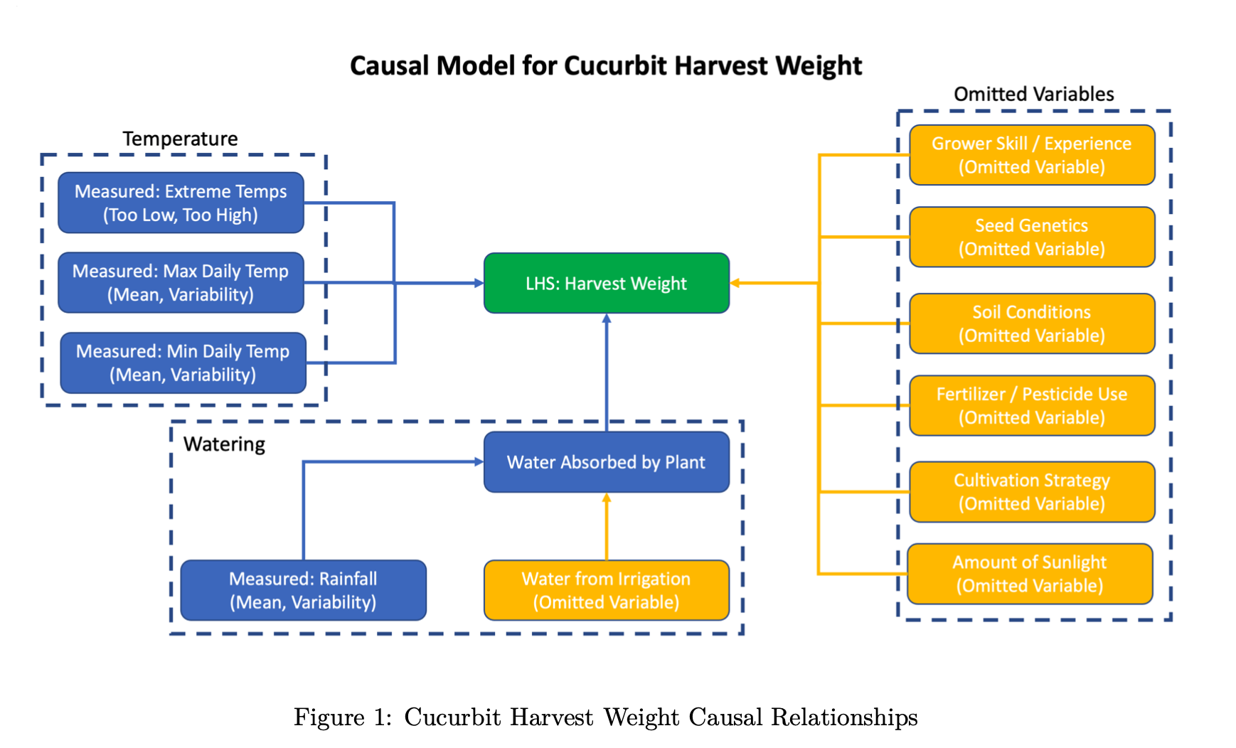
Causal Relationships

Slide 4
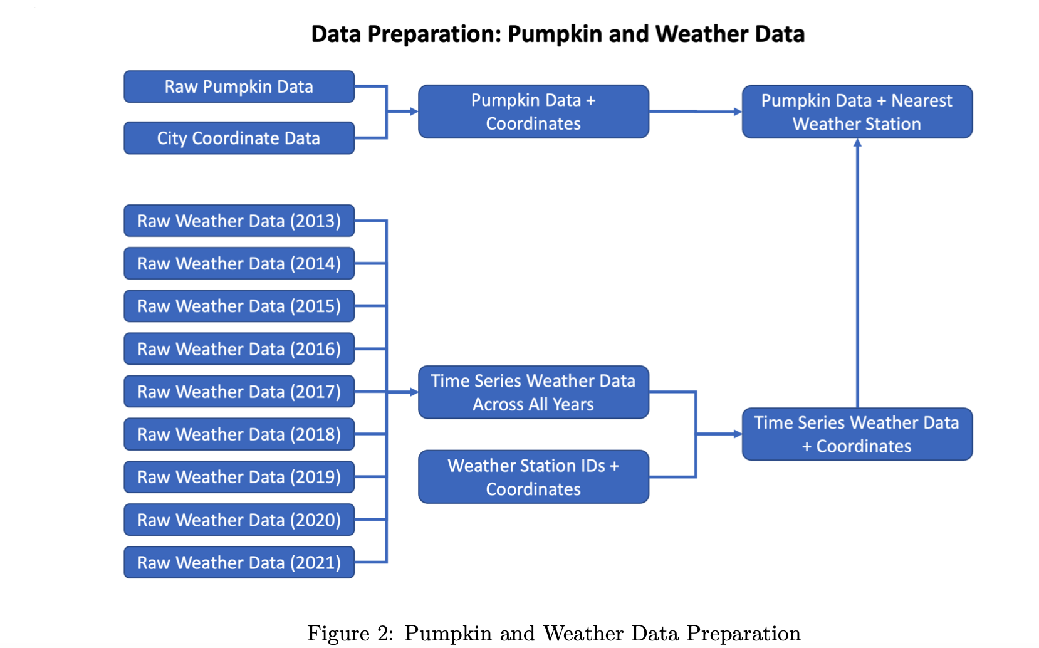
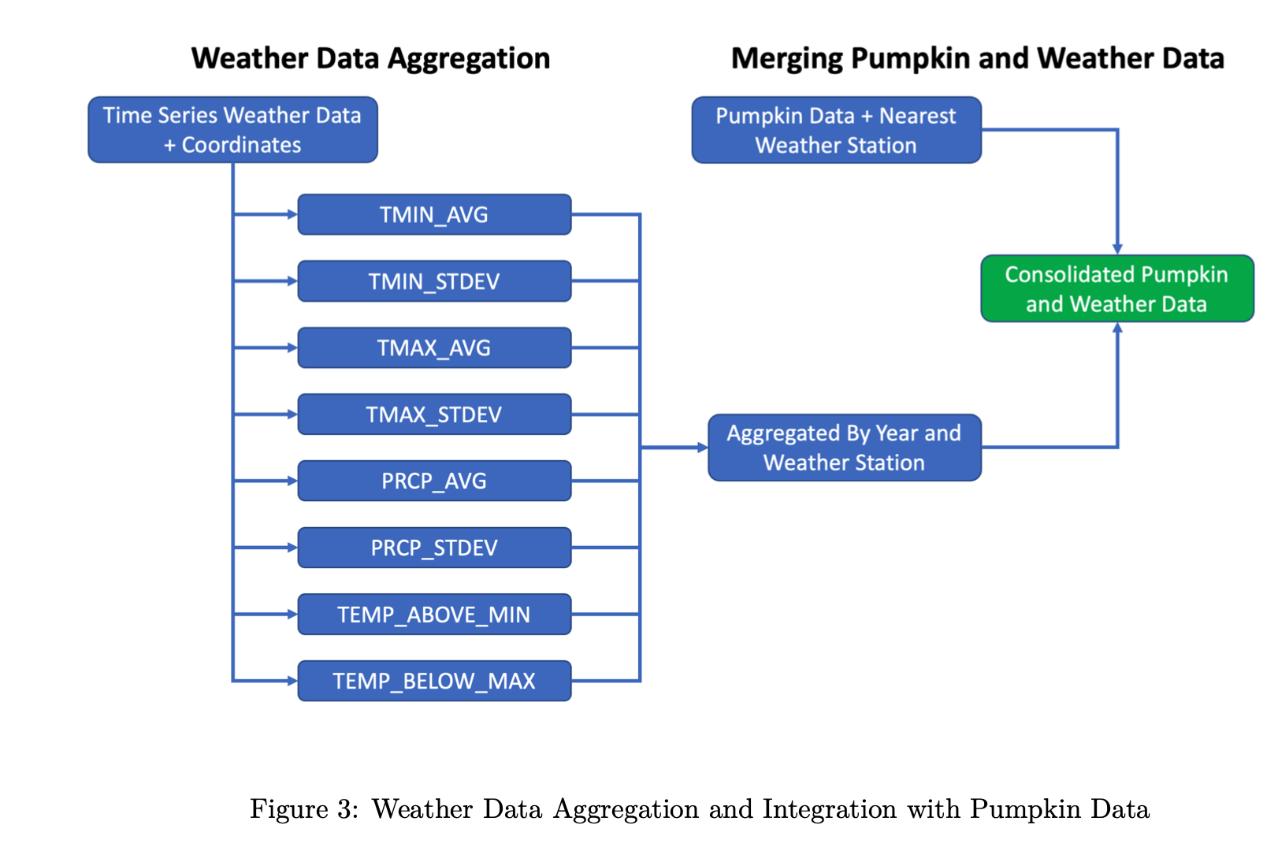
Data & Data Cleansing
Data Sets & Key Variables
Giant Pumpkins: dataset from the official GPC (Great Pumpkin Commonwealth) site
Below are few key variables utilized in the research:
Outcome Variable: Weight of the pumpkin
Predictor of Interest: Weather (avg precipitation, avg templaterature, temp and precipitation standard deviation, number of day below and above optimal temperature range)
Covariates: pumpkin type, year
Our final data set had over 11,000 observations

Slide 5
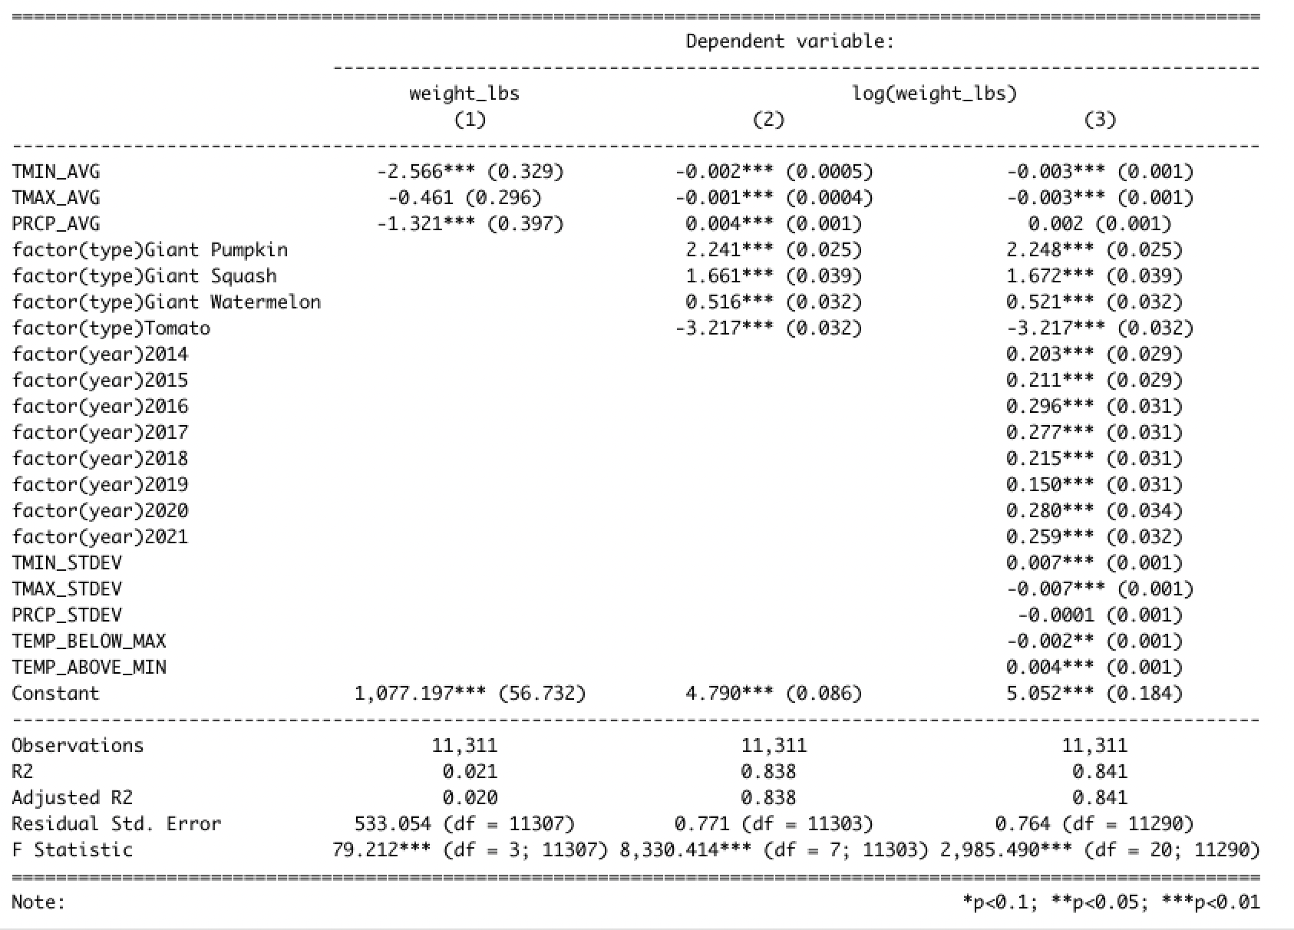
Modeling, Analysis, and Results

Slide 6
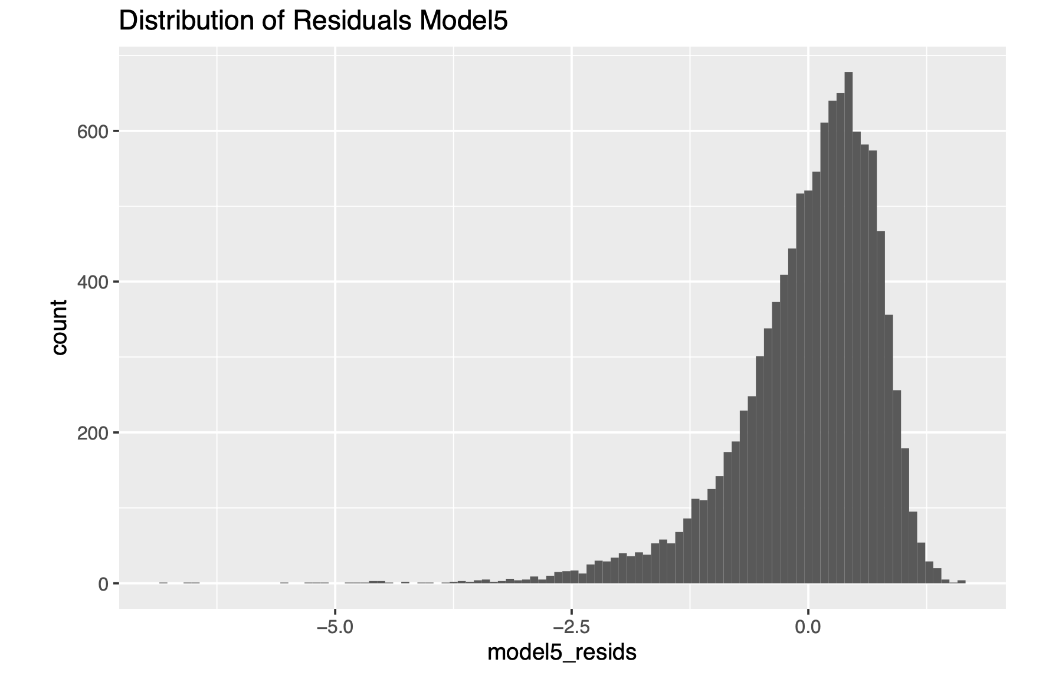
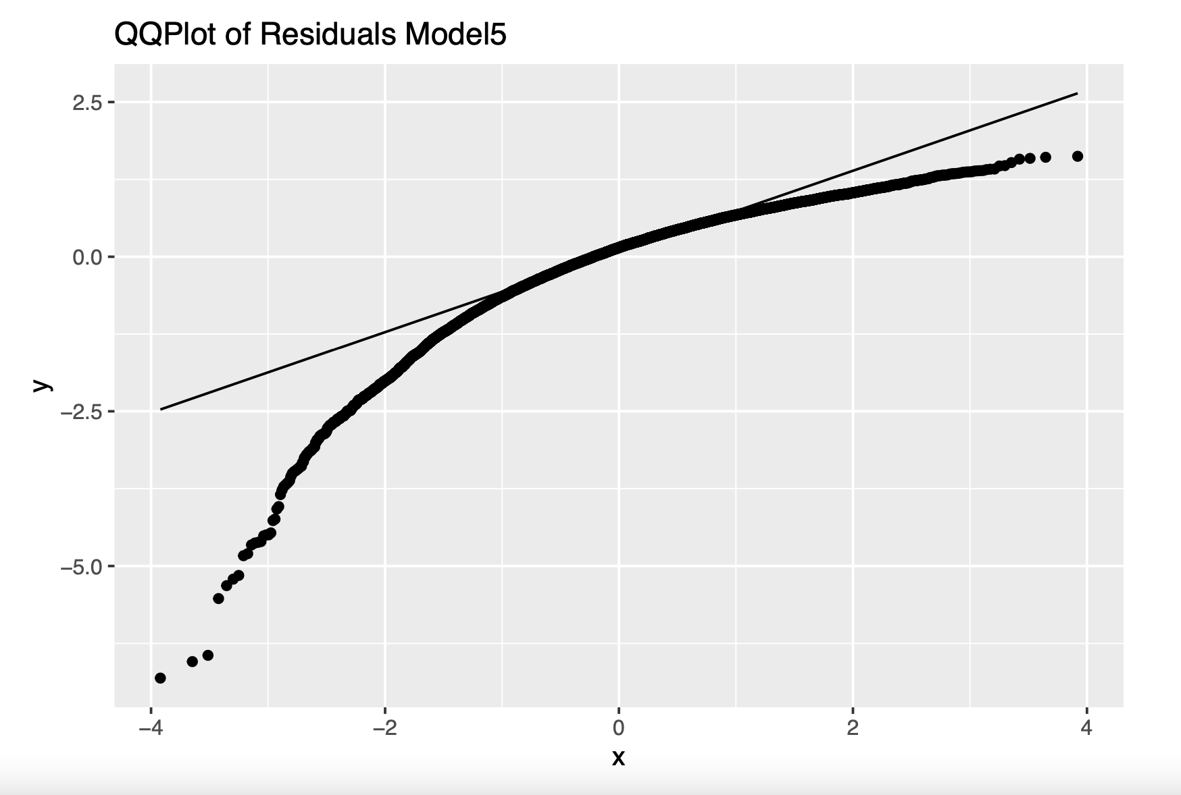
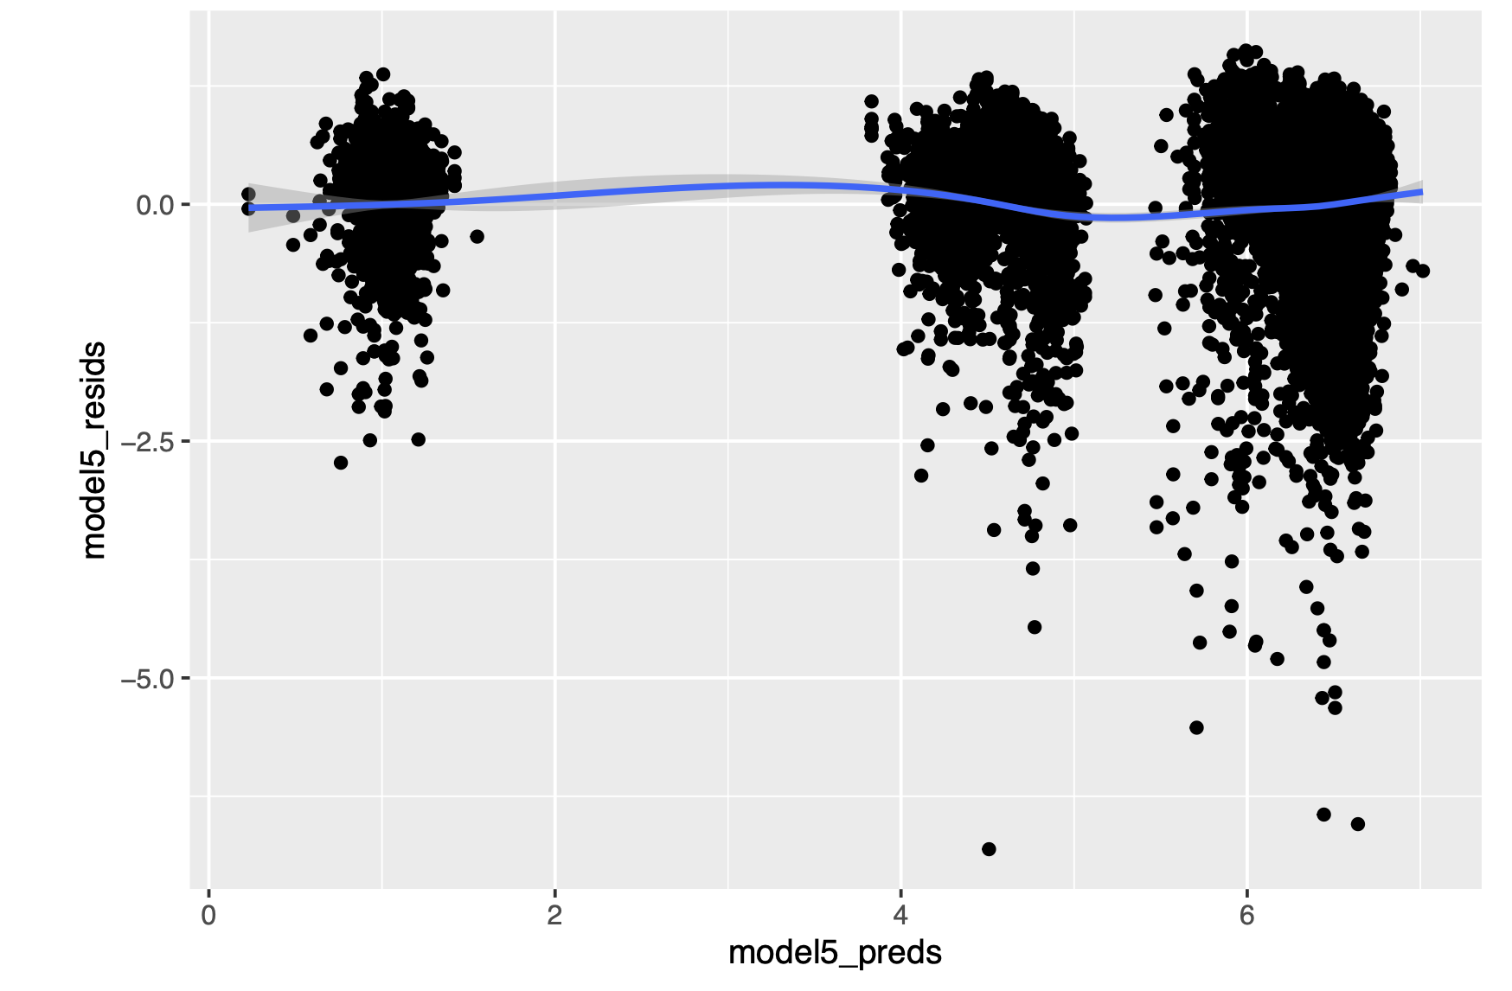

Slide 7
Structural Limitations
Missing data
Pumpkin
Weather
Access to data
Irrigation variable
Sunshine variable
Grower operations
Omitted variable bias
Negative bias in model
Relationship with PRCP variable

Slide 8
Conclusion
Weather is statistically significant, but not practically significant
No suggestions
Other external factors that may have impacted the cucurbit weight were not included in our research, namely the specific growing methods individual growers used.
Further research needs to be done

