Slide 1

Chest X-Ray Images:
Normal vs. Pneumonia

Slide 2
Outline
Introduction
Data
Method
Model
Result

Slide 3
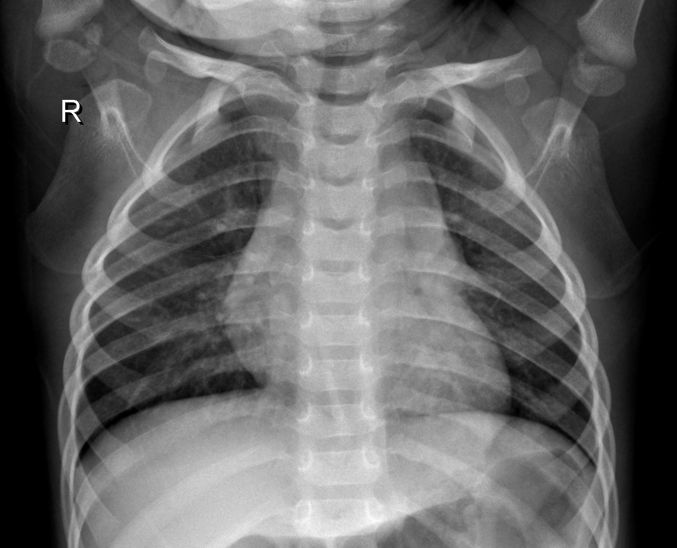
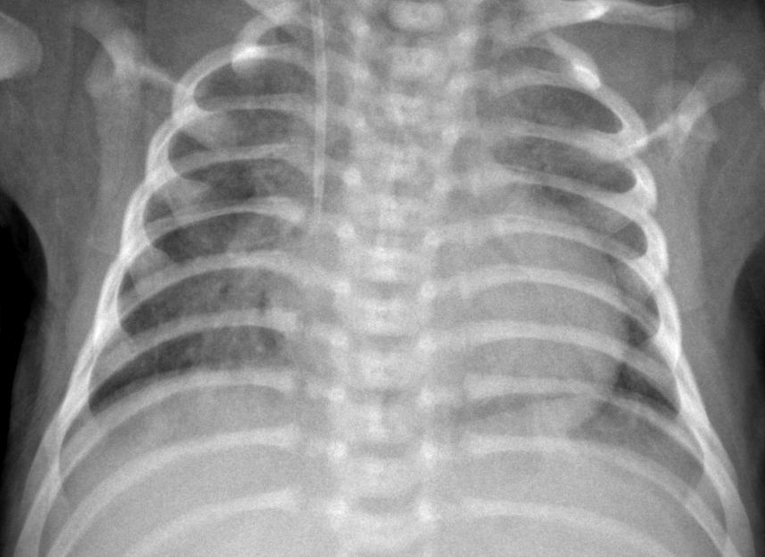
Introduction
Goal: Detect Pneumonia through Chest X-ray Images
Which one has Pneumonia?

Slide 4


Data
Original
Processed
Train Set: 5216 images
$$\frac{3}{4}$$
Train Set: 3911 images
Validation Set: 16 images
$$\frac{1}{4}$$
Validation Set: 1321 images
Test Set: 624 images
Test Set: 624 images

Slide 5
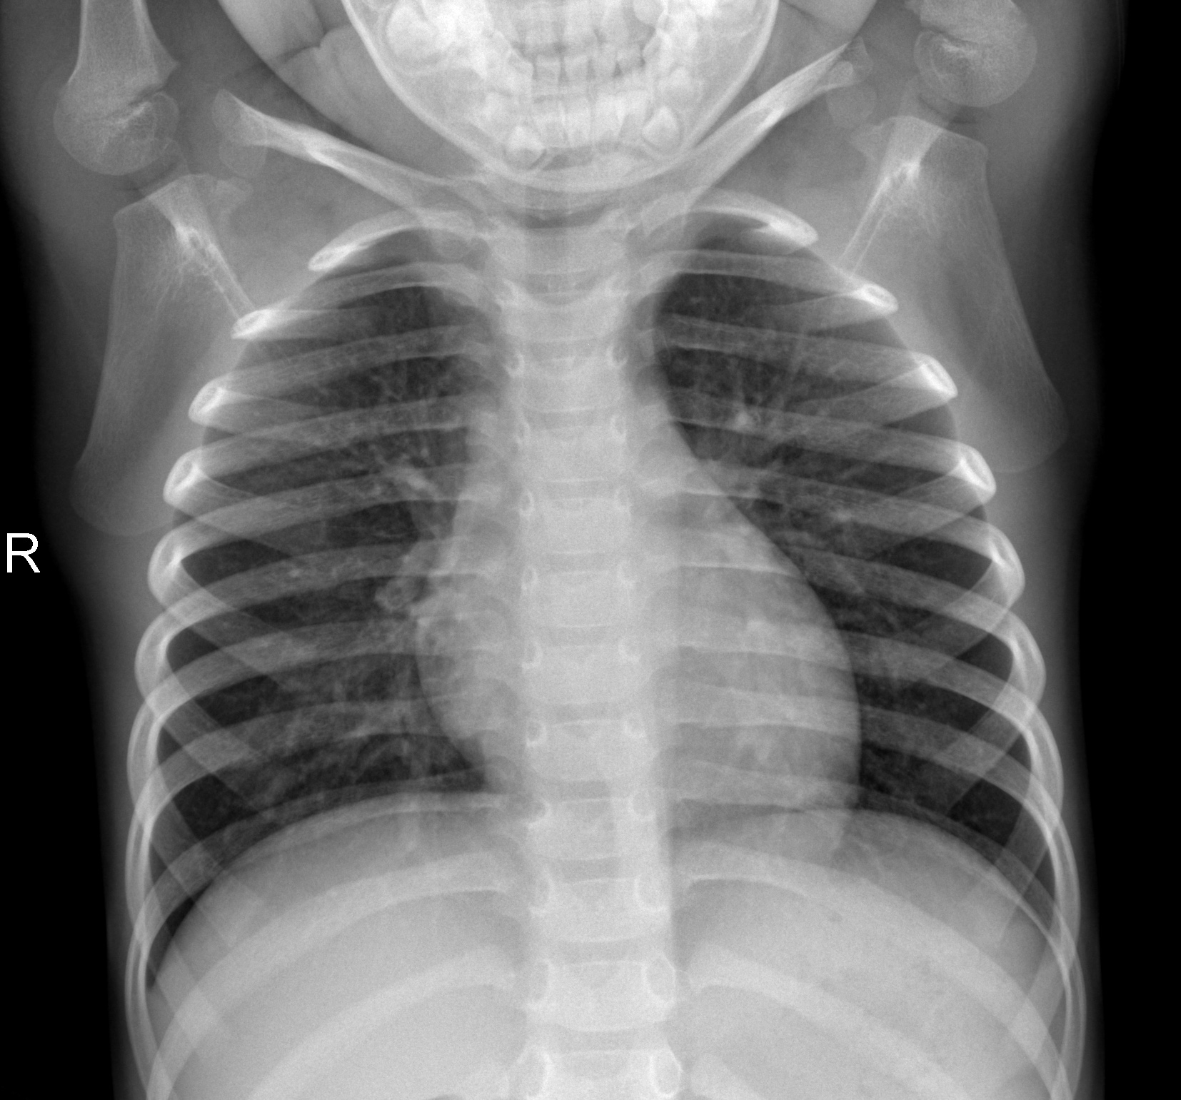
Data
[[44, 46, 46, 49, …, 0, 0, 0],
[44, 47, 47, 50, …, 0, 0, 0],
[46, 50, 50, 52, …, 0, 0, 0],
[46, 50, 51, 53, …, 0, 0, 0],
………
[ 0, 0, 0, 0, …, 0, 0, 0],
[ 0, 0, 0, 0, …, 0, 0, 0],
[ 0, 0, 0, 0, …, 0, 0, 0],
[ 0, 0, 0, 0, …, 0, 0, 0]]
Image convert into array

Slide 6
Method:
Convolutional Neural Network

Slide 7
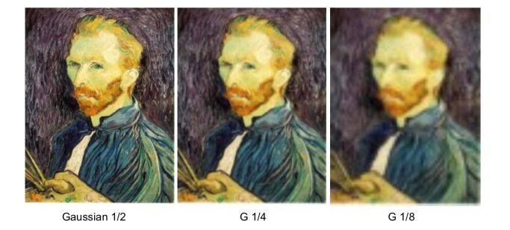
Properties of Images
Some patterns are much smaller than the whole image.
Same patterns appear in different regions.
Subsampling the pixels will not change the objects
圖片來源:
https://maelfabien.github.io/computervision/cv_3/#

Slide 8
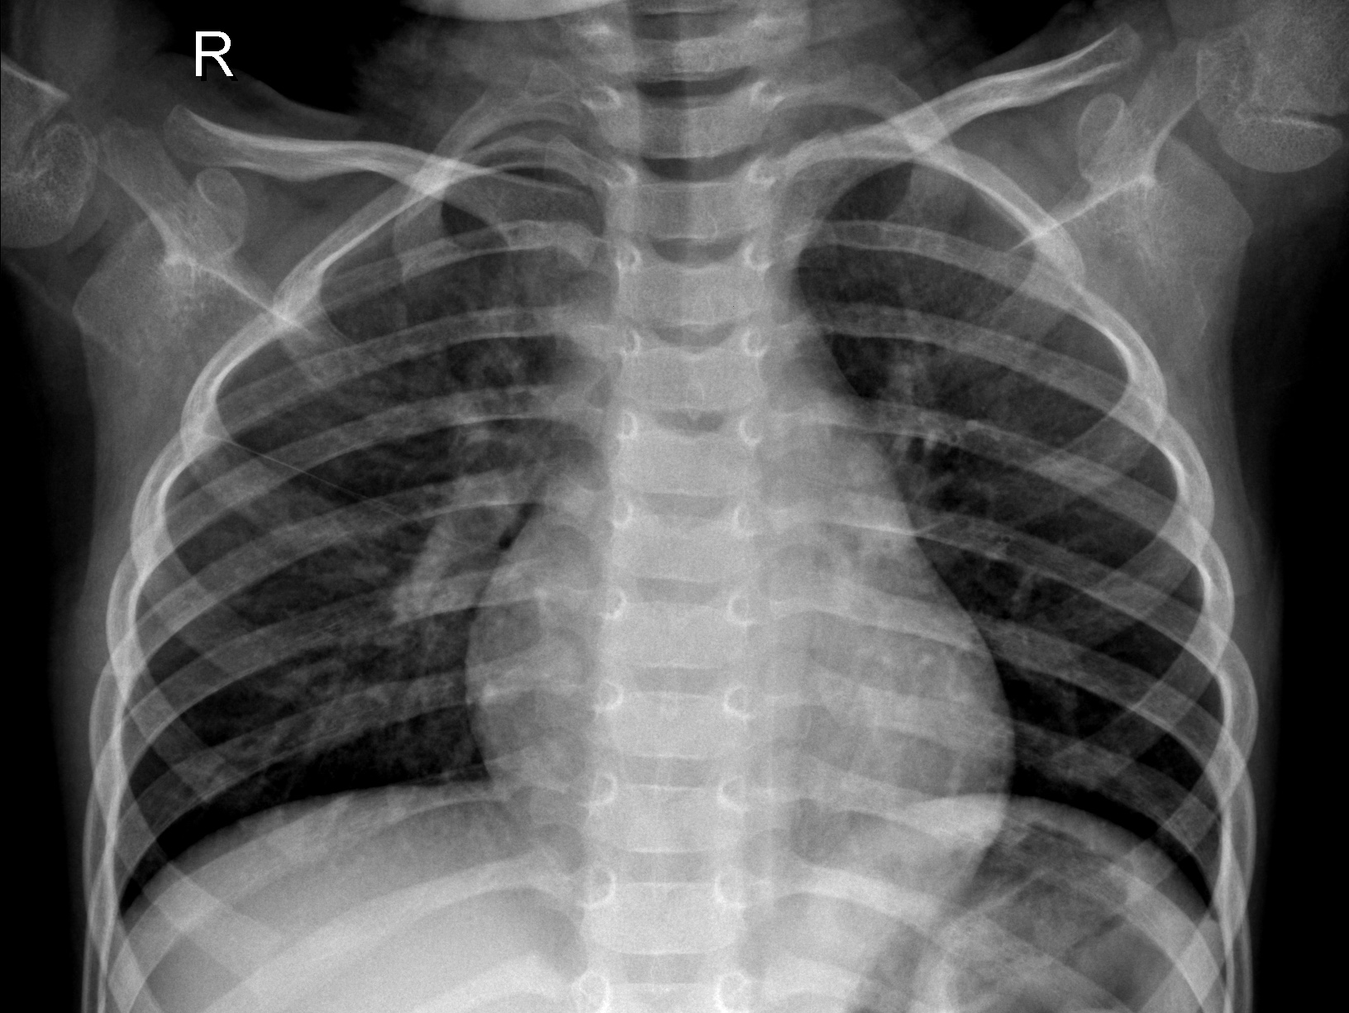
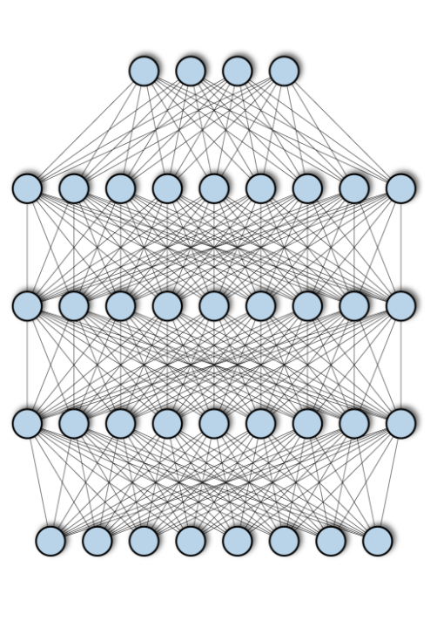
Normal, Pneumonia
Convolution
Max Pooling
Fully Connected Network
Can Repeat Many Times
Convolution
Max Pooling
Flatten

Slide 9
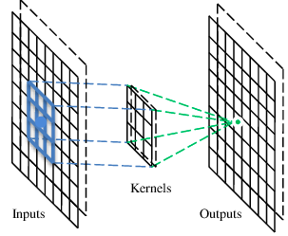
CNN - Convolution
(Filters)
圖片來源：
https://www.cs.bgu.ac.il/~dip182/wiki.files/Deep-Learning-2017-Lecture5CNN.pdf

Slide 10
CNN - Convolution
1 | 0 | 0 | 0 | 0 | 1
0 | 1 | 0 | 0 | 1 | 0
0 | 0 | 1 | 1 | 0 | 0
1 | 0 | 0 | 0 | 1 | 0
0 | 1 | 0 | 0 | 1 | 0
0 | 0 | 1 | 0 | 1 | 0
1 | -1 | -1
-1 | 1 | -1
-1 | -1 | 1
Filter 1
-1 | 1 | -1
-1 | 1 | -1
-1 | 1 | -1
Filter 2
6 x 6 image
…

Slide 11
CNN - Convolution
1 | -1 | -1
-1 | 1 | -1
-1 | -1 | 1
Filter 1
Stride = 1
1 | 0 | 0 | 0 | 0 | 1
0 | 1 | 0 | 0 | 1 | 0
0 | 0 | 1 | 1 | 0 | 0
1 | 0 | 0 | 0 | 1 | 0
0 | 1 | 0 | 0 | 1 | 0
0 | 0 | 1 | 0 | 1 | 0
Dot
Product
3
-1
6 x 6 image

Slide 12
CNN - Convolution
1 | -1 | -1
-1 | 1 | -1
-1 | -1 | 1
Filter 1
Stride = 1
1 | 0 | 0 | 0 | 0 | 1
0 | 1 | 0 | 0 | 1 | 0
0 | 0 | 1 | 1 | 0 | 0
1 | 0 | 0 | 0 | 1 | 0
0 | 1 | 0 | 0 | 1 | 0
0 | 0 | 1 | 0 | 1 | 0
Dot
Product
3
-1
-3
-1
-3
1
0
-3
-3
-3
0
1
3
-2
-2
-1
6 x 6 image
4 x 4 matrix

Slide 13
CNN - Convolution
1 | -1 | -1
-1 | 1 | -1
-1 | -1 | 1
Filter 1
Stride = 1
1 | 0 | 0 | 0 | 0 | 1
0 | 1 | 0 | 0 | 1 | 0
0 | 0 | 1 | 1 | 0 | 0
1 | 0 | 0 | 0 | 1 | 0
0 | 1 | 0 | 0 | 1 | 0
0 | 0 | 1 | 0 | 1 | 0
Dot
Product
3
-1
-3
-1
-3
1
0
-3
-3
-3
0
1
3
-2
-2
-1
6 x 6 image
4 x 4 matrix

Slide 14
CNN - Convolution
-1 | 1 | -1
-1 | 1 | -1
-1 | 1 | -1
Filter 2
Stride = 1
1 | 0 | 0 | 0 | 0 | 1
0 | 1 | 0 | 0 | 1 | 0
0 | 0 | 1 | 1 | 0 | 0
1 | 0 | 0 | 0 | 1 | 0
0 | 1 | 0 | 0 | 1 | 0
0 | 0 | 1 | 0 | 1 | 0
Dot
Product
3
-1
-3
-1
-1
-1
-1
-1
-3
1
0
-3
-1
-1
-2
1
-3
-3
0
1
-1
-1
-2
1
3
-2
-2
-1
-1
0
-4
3
6 x 6 image
Feature Map

Slide 15
CNN – Max Pooling
3
-1
-3
-1
3
-1
-3
-1
3
-3
1
0
-3
-3
1
0
-3
0
3
0
-3
-3
0
1
-3
-3
0
1
1
3
1
3
-2
-2
-1
3
-2
-2
-1
3

Slide 16
CNN – Max Pooling
3
-1
-3
-1
-3
1
0
-3
3
0
3
-1
-3
-1
-3
-3
0
1
3
1
-1
-1
-1
-1
-3
1
0
-3
3
-2
-2
-1
3
0
-1
-1
-2
1
-1
1
-3
-3
0
1
3
1
-1
-1
-2
1
0
3
3
-2
-2
-1
-1
-1
-1
-1
-1
0
-4
3
-1
-1
-2
1
-1
1
-1
-1
-2
1
0
3
-1
0
-4
3

Slide 17

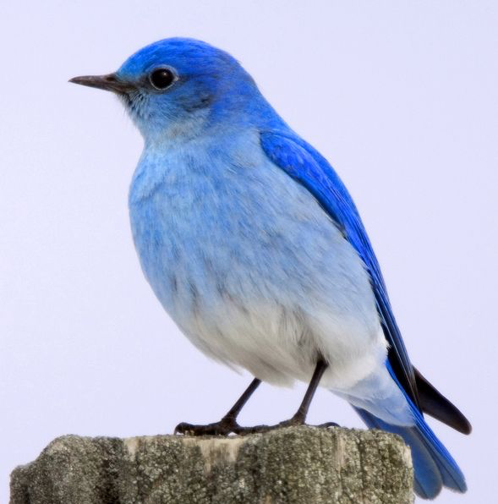
Convolutional Neural Network
Translation Invariant
圖片來源：
https://whitecherry2019.com/archives/2204
https://huaban.com/pins/3231075895/

Slide 18
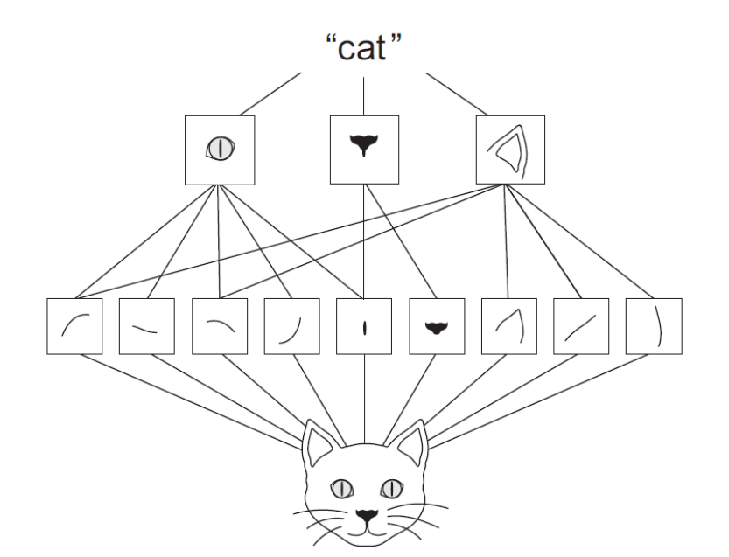
Convolutional Neural Network
Spatial Hierarchies of Patterns
圖片來源：
http://www.esl.ait.ac.th/courses/AT74.06/class9-1%20-%20CNN.pdf

Slide 19
Normal, Pneumonia
Convolution
Max Pooling
Fully Connected Network
Can Repeat Many Times
Convolution
Max Pooling
Flatten

Slide 20
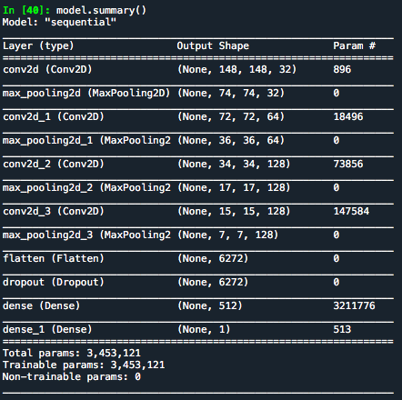
Model
Convolution
Max Pooling
Convolution
Max Pooling
Convolution
Max Pooling
Convolution
Max Pooling
Flatten
Dropout

Slide 21
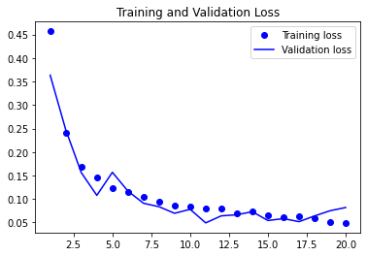
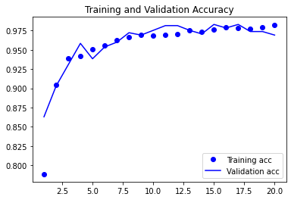
Model

Slide 22
Result
Test Loss: 2.58
Test Accuracy: 0.79
Problem:
Validation Loss (< 0.1) << Test Loss
Validation Accuracy (> 0.97) >> Test Accuracy

