Slide 1

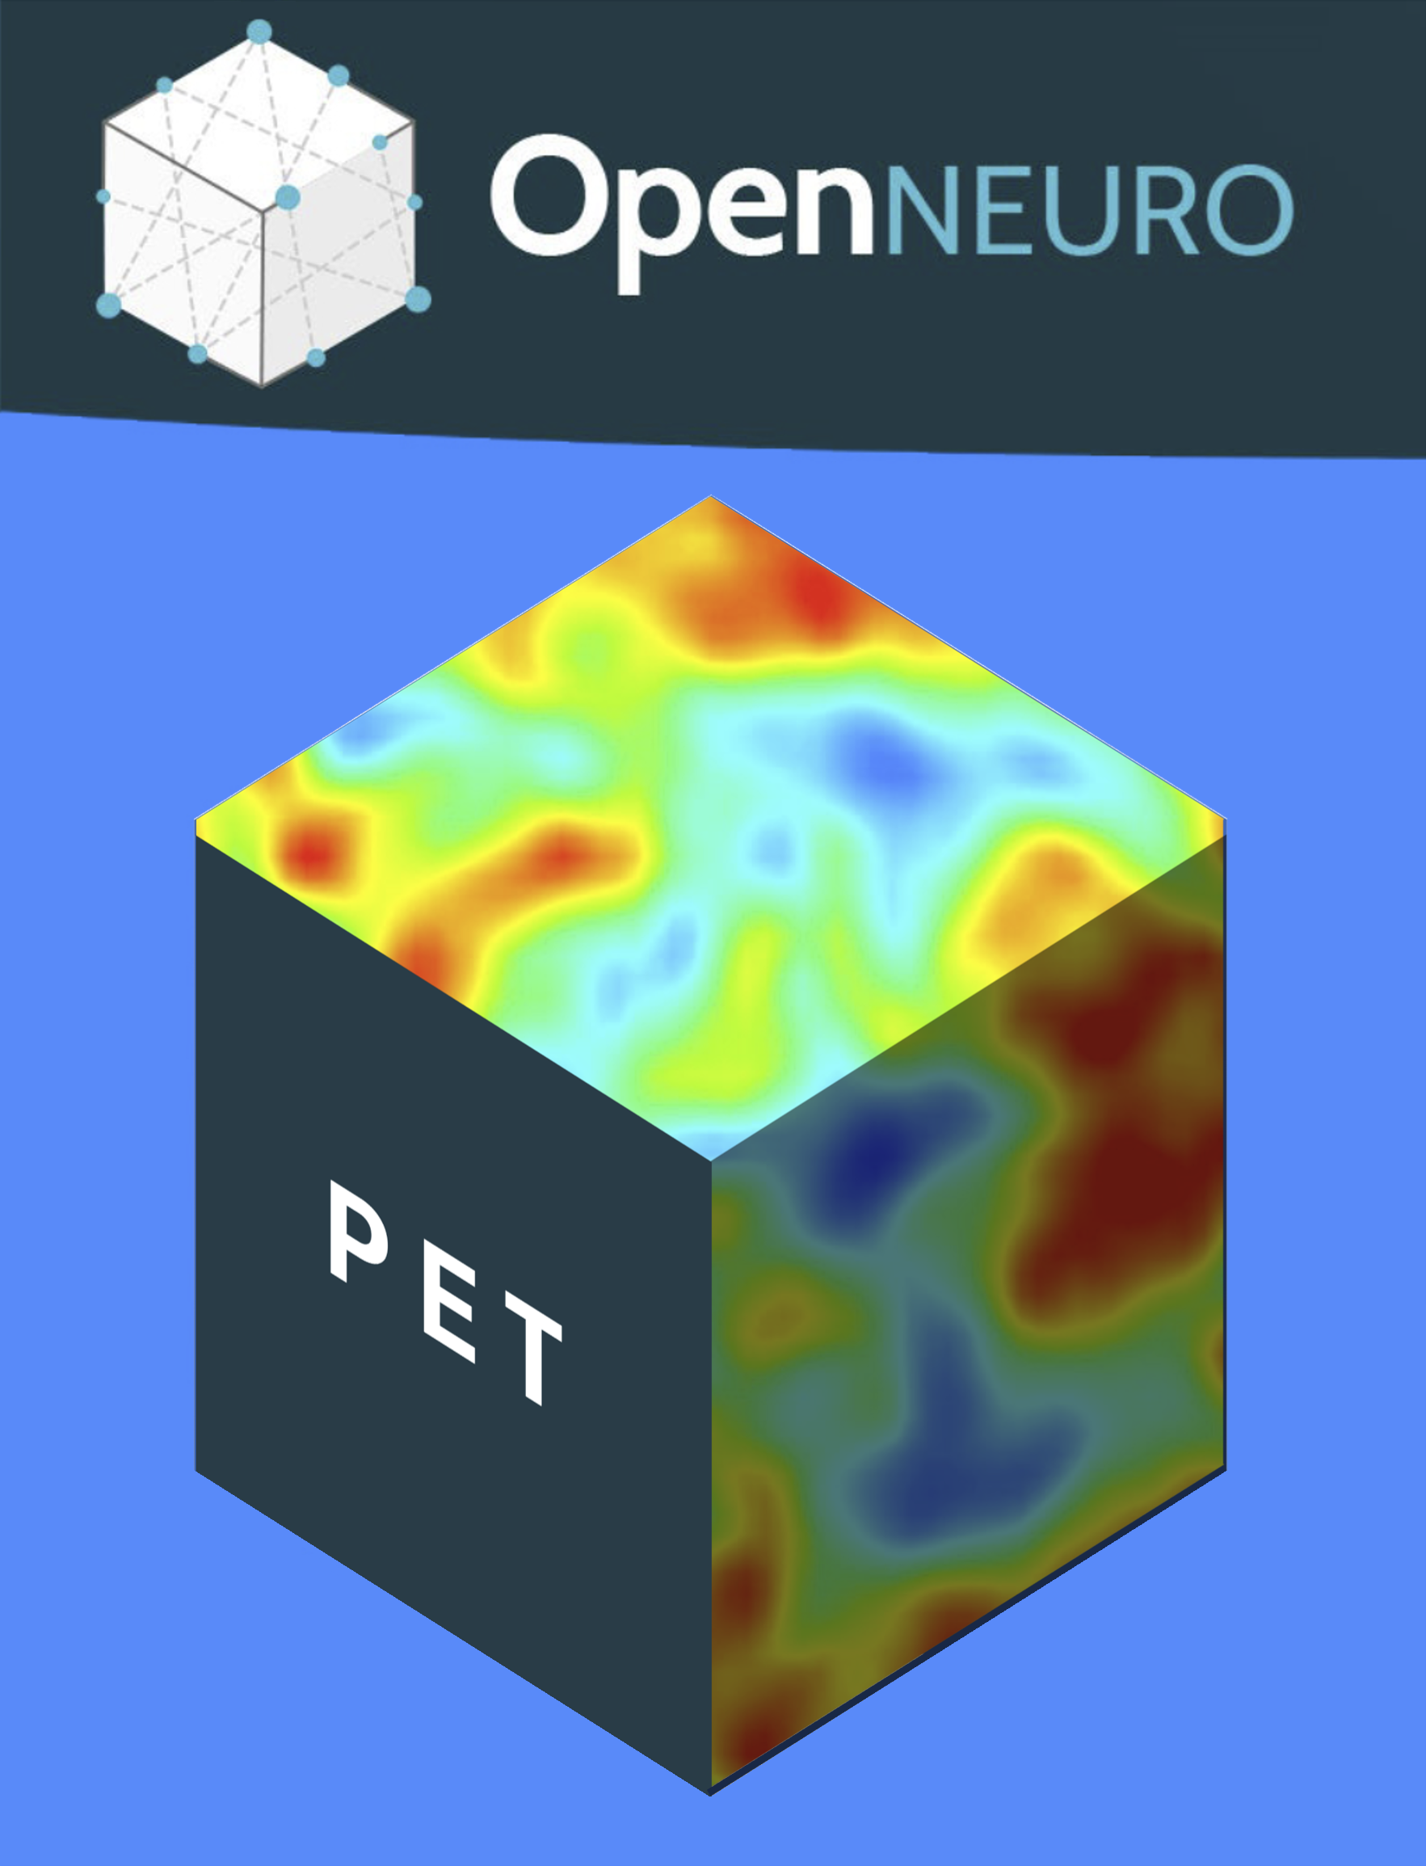
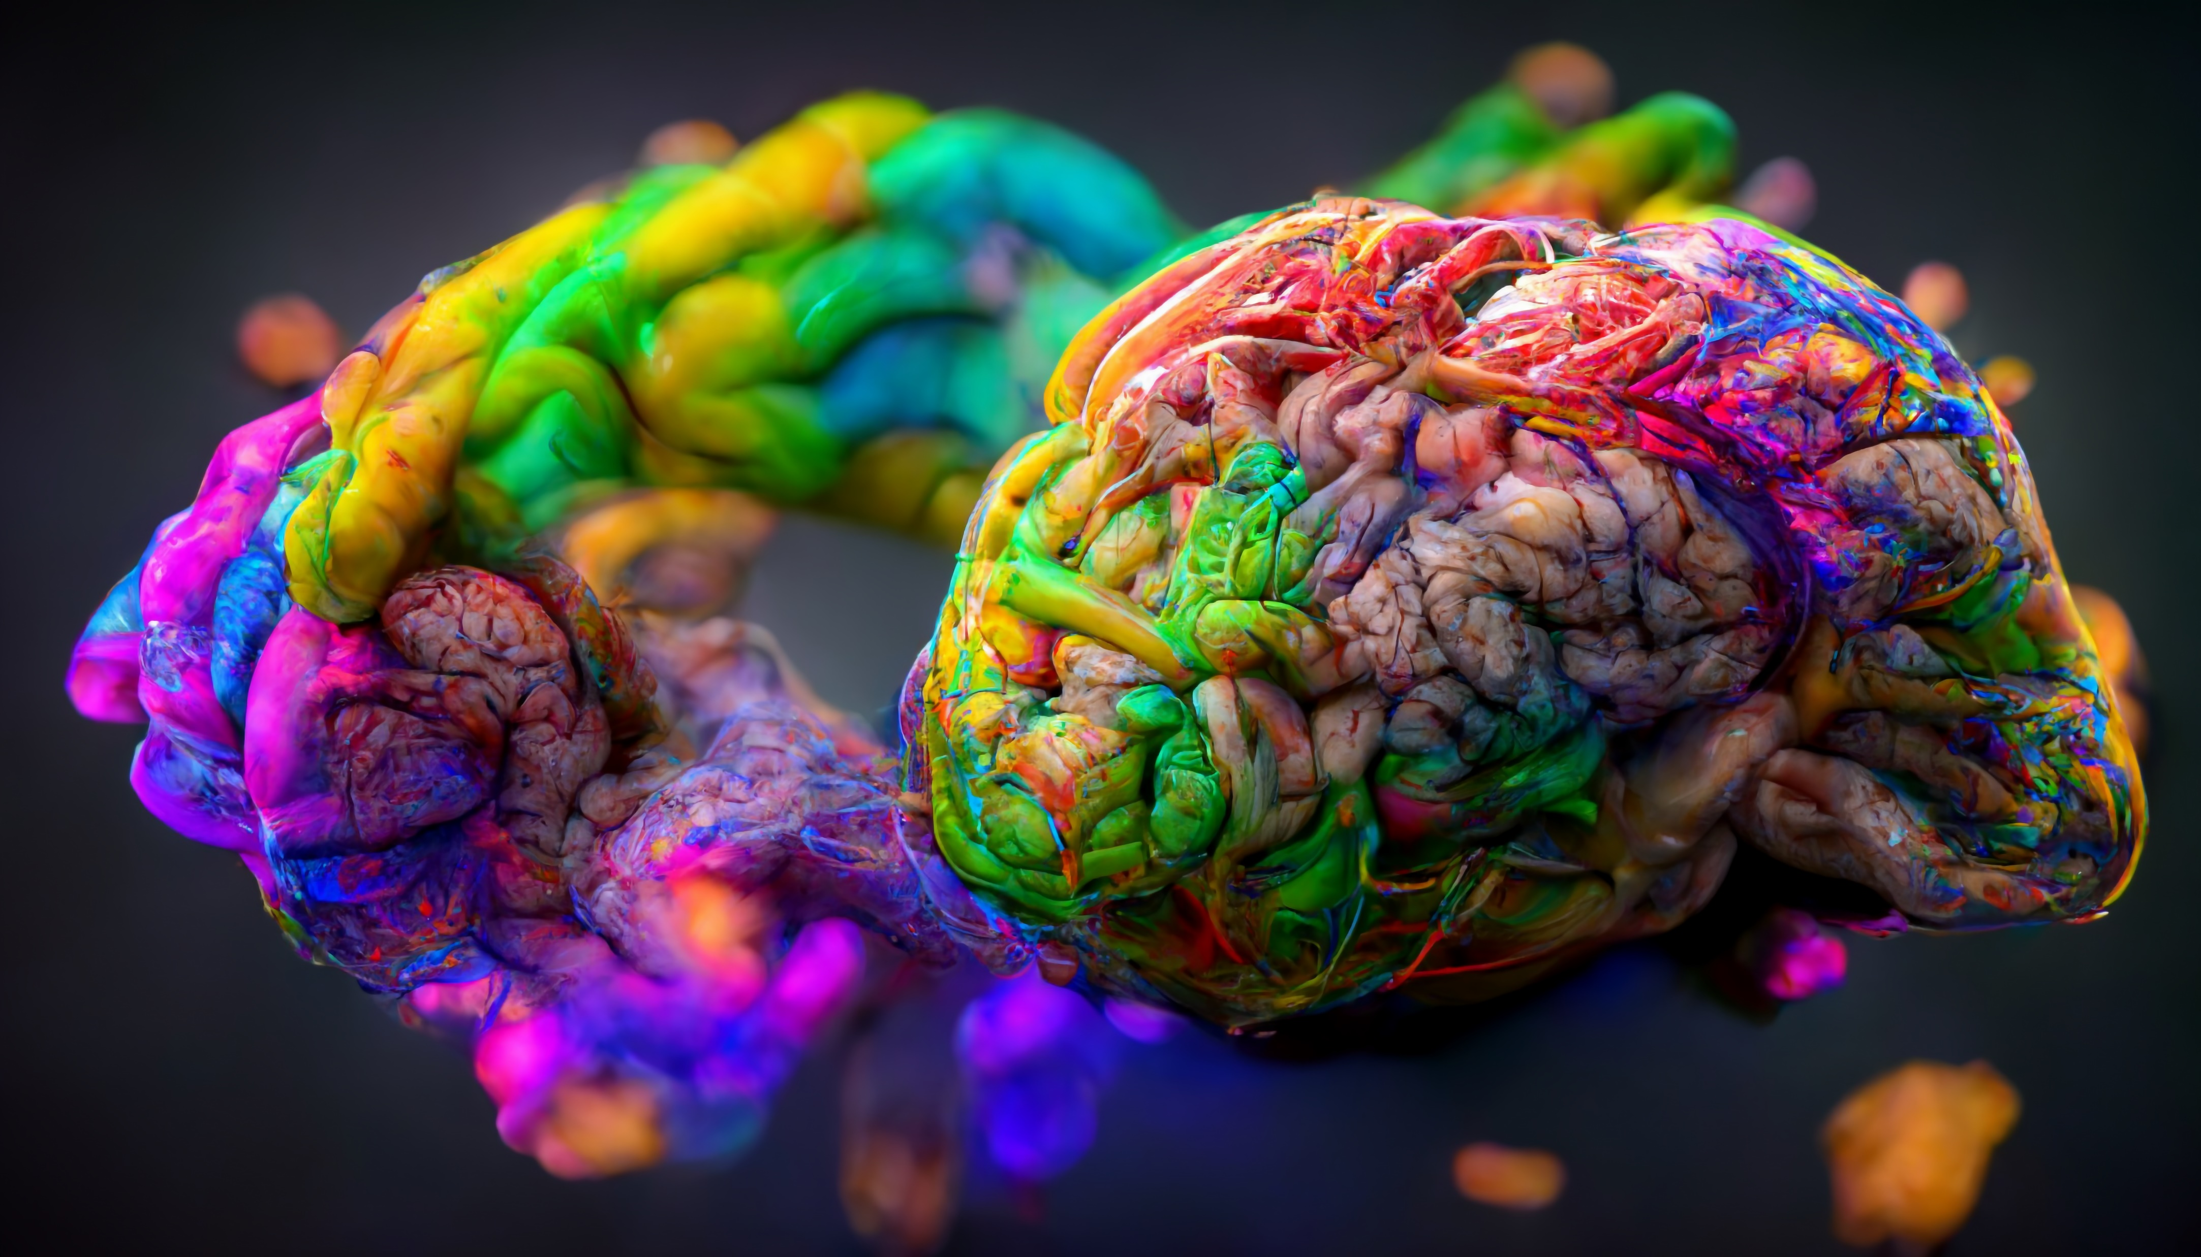
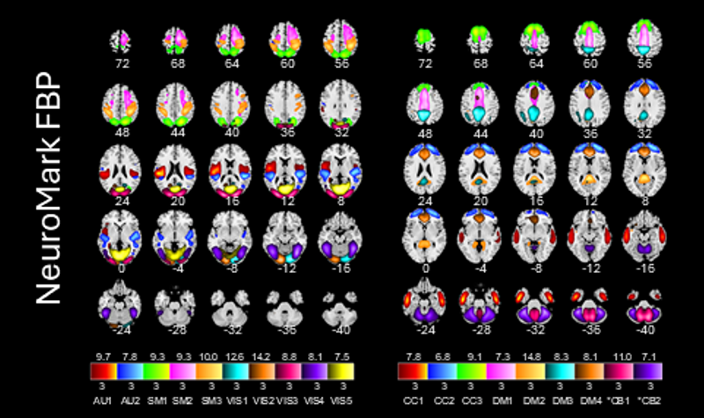
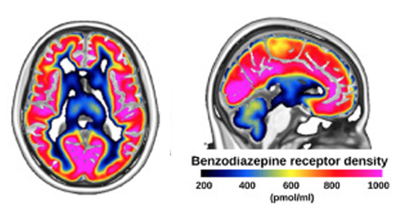
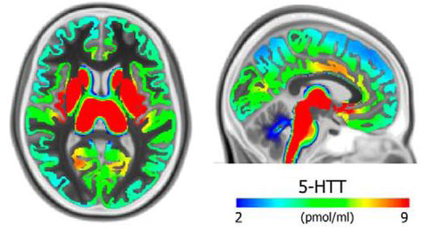


Open Neuro PET : opening PET data workflows
https://openneuropet.github.io/
Cyril Pernet¹ , Anthony Galassi², Martin Norgaard^{2,3}, Granville J. Matheson^{4,5}, Paul Wighton⁶, Adam G. Thomas², Gabriel Gonzalez-Escamilla⁷, Cyrus Eierud⁸, Murat Bilgel⁹, Eric Ceballos¹⁰, Claus Svarer¹, Chris Rorden¹¹, Vince Calhun⁸, Douglas Greeve⁶, Russel Poldrack¹², Melanie Ganz^{1,3}, Robert B. Innis² & Gitte M. Knudsen¹
¹ Neurobiology Research Unit, Copenhagen, Denmark ² NIH, Bethesda, USA ³ Dpt of Computer Science, University of Copenhagen ⁴ Dpt of Clinical Neuroscience, Karolinska Institutet, Stockholm, Sweden ⁵ Mailman school of Public Health, Columbia University, NY, USA ⁶ Martinos Centre, MGH, USA ⁷ University Medical Center of the Johannes Gutenberg University Mainz, Germany ⁸ TReNDS Center, Georgia State University, Atlanta, USA ⁹ National Institute on Aging Intramural Research Program, Baltimore, USA ¹⁰ McGill University, Canada ¹¹ Dpt of Psychology, University of South Carolina, USA ¹² Dpt of Psychology, Stanford University, USA.
Background: Reproducibility is a cornerstone of science, and one factor contributing to improving reproducibility is openness, from raw data to publication. OpenNeuroPET is a project primarily driven by NIMH (Prof Innis) and the NRU (Prof Knudsen), assembling a team of experts in PET analyses and data science, providing a set of tools and solutions to take brain PET at the forefront of open neuroimaging.
Data Standard
BIDS specification (raw and derivatives)
PET2BIDS (conversion tool) https://github.com/openneuropet/PET2BIDS
Reporting and publication
https://bids.neuroimaging.io
Data Sharing
Openly with OpenNeuro
Publicly with PublicNeuro
(open meta but controlled access)
https://publicneuro.eu
https://openneuro.org
Data Worklfows
PETPrep+PETSurfer
PETPrep+PETICA
Bloodstream + kinfitR
GIFT ICA Toolbox for PET
with dedicated PET templates
Molecular Atlasing
Build and share atlases
Funding

