Slide 1

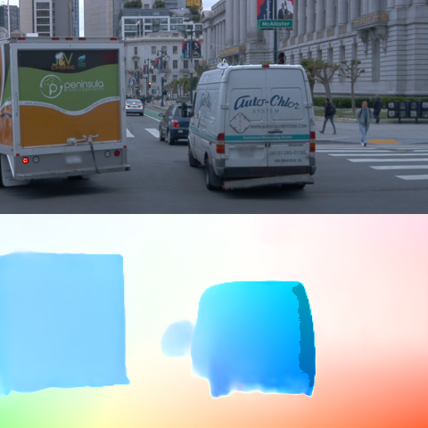
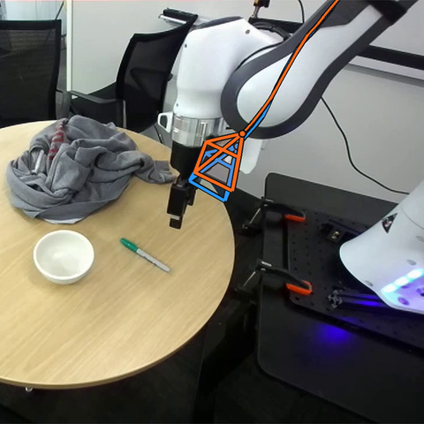
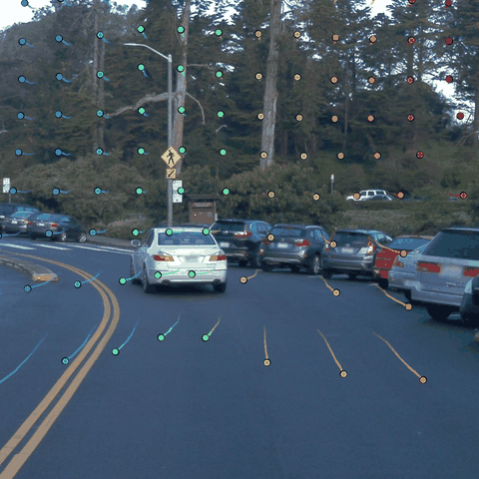

Image 1
IDM
Latent attention
Image 2
Inverse dynamics
Flow Head
Camera Pose Head
2D Tracking Head
3D Tracking Head
(Δx, Δy) per pixel
(R, t) per frame
(x, y, vis) per point
(X, Y, Z, vis) per point

Slide 2
Image 1
IDM
Latent attention
Image 2
Inverse dynamics
Flow Head
Camera Pose Head
2D Tracking Head
3D Tracking Head
(Δx, Δy) per pixel
(R, t) per frame
(x, y, vis) per point
(X, Y, Z, vis) per point

Slide 3
Image 1
IDM
Latent attention
Image 2
Inverse dynamics
Flow Head
Camera Pose Head
2D Tracking Head
3D Tracking Head
(Δx, Δy) per pixel
(R, t) per frame
(x, y, vis) per point
(X, Y, Z, vis) per point

Slide 4
Image 1
IDM
Latent attention
Image 2
Inverse dynamics
Flow Head
Camera Pose Head
2D Tracking Head
3D Tracking Head
(Δx, Δy) per pixel
(R, t) per frame
(x, y, vis) per point
(X, Y, Z, vis) per point

Slide 5
Image 1
IDM
Latent attention
Image 2
Inverse dynamics
Flow Head
Camera Pose Head
2D Tracking Head
3D Tracking Head
(Δx, Δy) per pixel
(R, t) per frame
(x, y, vis) per point
(X, Y, Z, vis) per point

