Slide 1
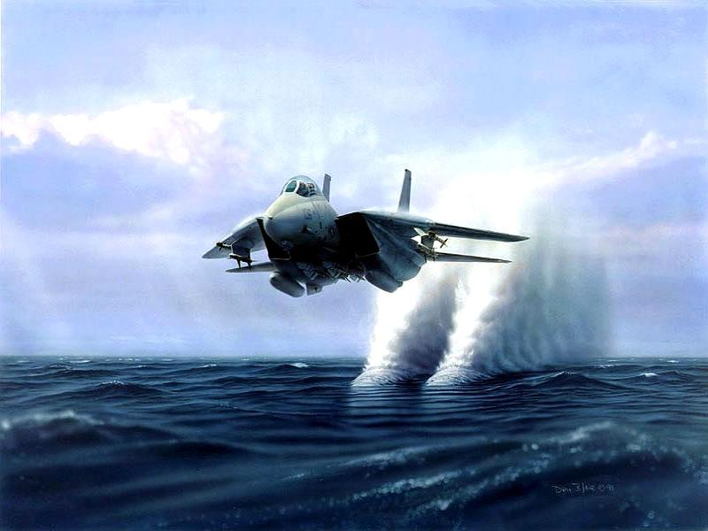
Minimum Cost Flow
Lecture 5: Jan 25

Slide 2
Problems Recap
Stable matchings
Bipartite matchings
Minimum spanning trees
General matchings
Maximum flows
Shortest paths
Minimum Cost Flows
Linear programming

Slide 3
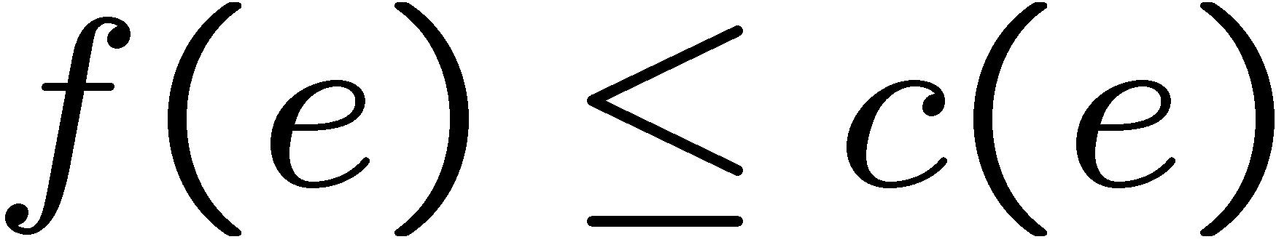
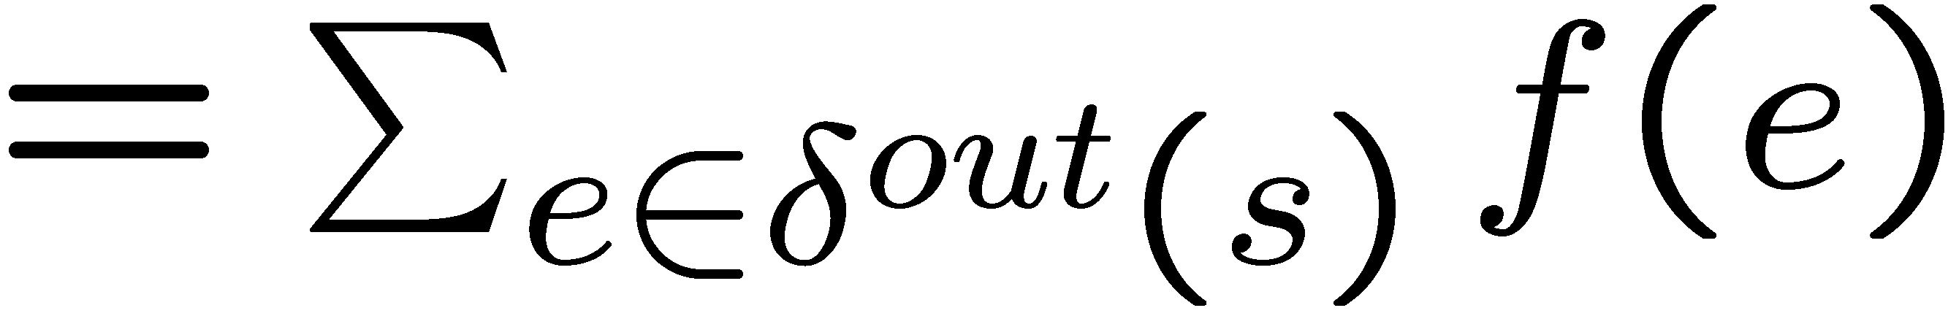
Flows
An s-t flow is a function f on the edges which satisfies:
(capacity constraint)
(conservation of flows)
Value of the flow

Slide 4
Minimum Cost Flows
Goal: Build a cheap network to satisfy the flow requirement.
Input:
A directed graph G
A source vertex s
A sink vertex t
A capacity function c on the edges, i.e. c:E->R
A cost function w on the edges, i.e. w:E->R
A flow requirement k (optional)
Output: a maximum s-t flow f which minimizes Σf(e) w(e)

Slide 5
Special cases
Shortest path: find a shortest path between s and t
A minimum cost flow with k = 1
Maximum flow: find a maximum flow between s and t
Every edge in the original graph has cost 0.
Disjoint paths: connect s and t by k paths with min # of edges
Every edge in the original graph has cost 1 and capacity 1.

Slide 6
Stuctures Recap
M-augmenting paths
Bipartite matchings
Residual graph
augmenting paths
Maximum flows
Shortest paths
???
Minimum Cost Flows

Slide 7
Residual Graph
f(e) = 2
c(e) = 10
c(e) = 8
c(e) = 2

Slide 8
Maximum Flow Algorithm
A larger flow because:
Flow conservations
More flow out from s
No directed path from s to t ⇨
The current flow achieves the capacity of an s-t cut

Slide 9
Minimum Cost Flow Algorithm?
Two parameters: value and cost of the flow
What is the augmenting stucture?
Try to use residual graphs

Slide 10
Residual Graph
f(e) = 2
f(e) = 2
c(e) = 10
c(e) = 10, w(e)
c(e) = 8
c(e) = 8, w(e)
c(e) = 2
c(e) = 2, -w(e)
Max Flow
Min-cost Flow

Slide 11
What is the augmenting structure?
Matchings
M-augmenting paths
Idea: Imagine a bigger matching and consider the union.
Maximum flows
Directed paths in residual graphs
Idea: Keep flow conservations and increase the flow from s.

Slide 12
What is the augmenting structure?
Minimum cost flows
Strategy: start with a maximum flow and improve the cost?
Try: Imagine a cheaper flow.
What would happen in the residual graphs?

Slide 13
Finding the augmenting structure
Residual flow f ⁻¹
An s-t flow f of value k with total cost W
s
t
s
t
An s-t flow f * of value k with total cost W *
s
t
s
t
Idea: Consider the union

Slide 14
Cycle decompositions
In the union of f ⁻¹ ∪ f*, every vertex has indegree = outdegree.
Eulerian digraphs
Every Eulerian graph can be decomposed into directed cycles.
Since W > W*, we have W* - W < 0.
Therefore, there is a negative cost directed cycle.

Slide 15
Negative cycles
If we have a cheaper flow, then there exists a negative cycle.
Suppose we have a negative cycle.
By sending a flow along the cycle,
flow conservations are kept in every vertex,
and so the value of the flow is the same.
And the cost decreases!
Key: A flow has minimum cost ⬄
there is no negative cycle in the residual graph!

Slide 16
Minimum Cost Flow Algorithm
A cheaper flow because:
Flow conservations
Negative cost
No negative cost directed cycle ⇨
The current flow is of minimum cost.

Slide 17
Complexity
Assume edge capacity between -C to C, cost between 1 to W
At most O(mCW) iterations
Finding a negative cycle in O(mn) time (Bellman-Ford)
Total running time O(nm²CW)

Slide 18
Successive Shortest Path Algorithm
Minimum cost flows
Strategy 1: start with a maximum flow and improve the cost.
Strategy 2: keep flow cost minimum and increase the flow value.
Algorithm
Start with an empty flow
Always find an augmenting path with minimum cost.
Complexity: O(n²C) · shortest path algorithm

Slide 19
Speeding Up
Maximum Flow:
shortest augmenting path O(n²m)
capacity scaling O(nm + n² log(C))
Minimum Cost Flow:
min mean-length cycle O(n²m³ log(n))
capacity scaling O((m log(n))(m + n log(n))

Slide 20
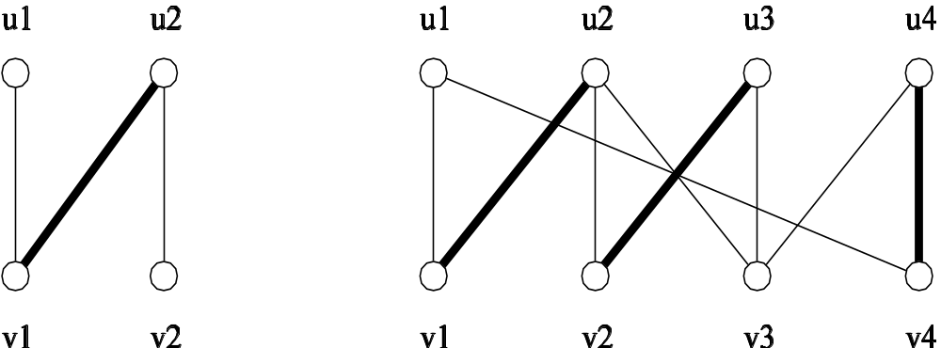
Weighted Bipartite Matchings
Goal: Find a matching with maximum total weight
Reduce to min-cost flow by adding a source and a sink.

Slide 21
The Transportation Problem
Input:
p plants, each has supply s(i)
q warehouses, each has demand t(j)
cost of shipping from plant i to warehouse j is d(i,j)
Goal: Find a cheapest shipping plan to satisfy all the demands.

Slide 22
Optimal Delivery
1
2
3
4
n
a car with capacity p going from station 1 to n.
delivery request from station i to station j is r(i,j), each unit gains c(i,j) dollars.
Goal: Find a delivery plan to maximize the profit.

